Slide 1

Creating New Resource Types to Improve Discoverability
Mark Baggett Systems Development Librarian, Univ. of Tennessee
Mike Rogers IT Administrator, Univ. of Tennessee
ELUNA 2014 – Montreal, Quebec, CA

Slide 2
Overview
Primo and U.T.
Why did we undertake this work?
Methodology & implementation
Modified resource types
  Aleph items
  Digital collections
Outcomes & next steps

Slide 3

Primo and UT
Implementation - 2009
Primarily used “out of box” settings
Departmental upheaval left us without a Primo administrator
Disliked by librarians because it wasn’t configured to suit our needs
Continued running Aleph Web OPAC

Slide 4

Why did we undertake this work?
2013: “Make Primo Better”
Steve Smith,
Dean of Libraries
Sincere desire to improve discovery interface
Anticipation that Web OPAC would eventually go away with new system
Discovery & Access Working Group (DAWG)

Slide 5
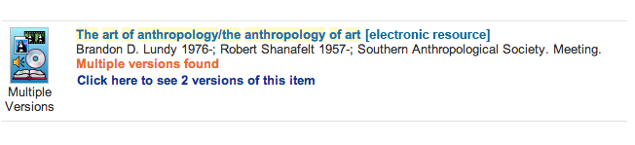
Catalyst for Improving Resource Types: FRBR and GMD confusion
Users confused by GMD information, esp. in FRBR sets
  FRBR set below contains an E-Book and a print book
Remove GMD from Title display to reduce user confusion
Convey version using resource type

Slide 6
Methodology & implementation
Worked on sandbox, modified normalization rules, mapping tables, & code tables for Aleph pipes & Digital Collections
Tested each new rule with an individual record
Once all rules were in place, performed full re-publishing on sandbox (harvest, pipe, re-index)
Reviewed results
When all looked good, copied the NRs to production, then performed full re-publishing

Slide 7
Primo’s basic MARC mapping to resource type
LDR pos.6 Code Format of work
a + pos.7=a,c,d,m BK Book
t BK Book
b + pos.7=b,i,s SE Continuing Resource
c,d MU Music
e,f MP Map
g,k,o,r VM Visual Material
i,j AM Audio Material
m CF Computer File
p MX Mixed materials
Primo Technical Guide, pg. 330-331

Slide 8








UT’s original resource types
Book
Video
Audio
Map
Score
Journal
Image
Other
Default gray-scale icons

Slide 9

How did we decide on which new resource types to add?
Asked the DAWG committee for ideas
Consulted Aleph material types
Created others as they seemed fit (i.e. Thesis, E-Thesis, Online Document)

Slide 10


















Modified resource types: Aleph
*with new icons color = existing color = newly added
Book
Video
Audio
Map
Score
Journal
Image
Other
Thesis
Microform
E-Book
E-Thesis
Research Dataset
Online Document
Streaming Video
DVD
VHS
Streaming Audio
Audio CD
Cassette or LP

Slide 11
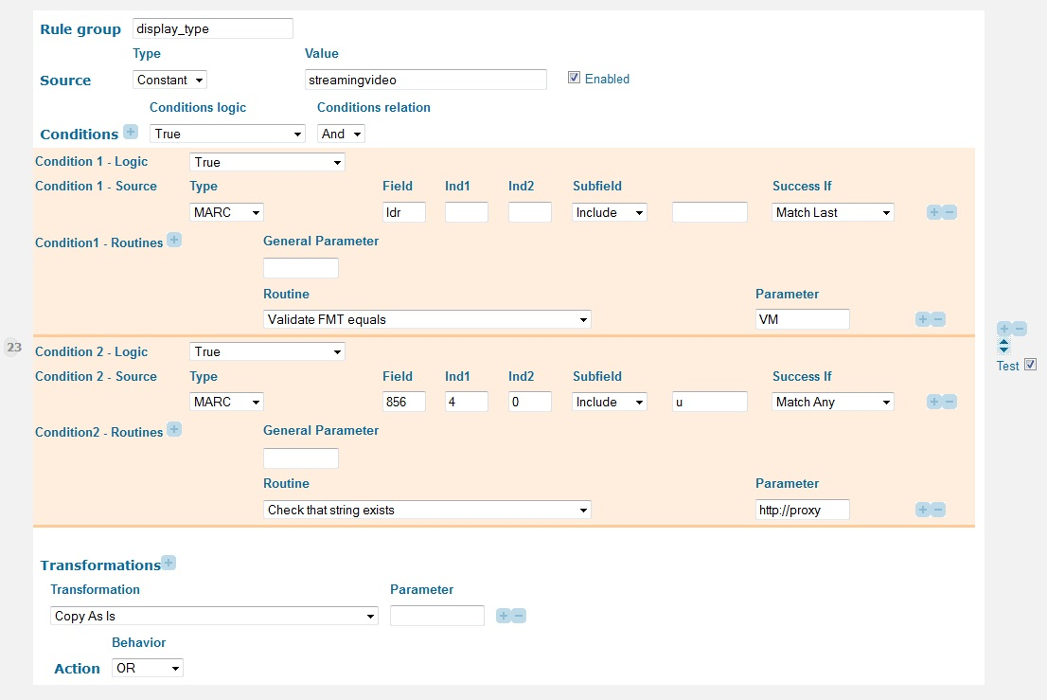
Example of a new rule: streaming video

Slide 12
“Cascading” effect of normalization rule mapping
Many records could theoretically map to two or more rules
Had to order NRs accordingly for correct mapping
“Catch all” rules:
  Book
  Cassette or LP (Audio catch-all)
  Video
  Other

Slide 13
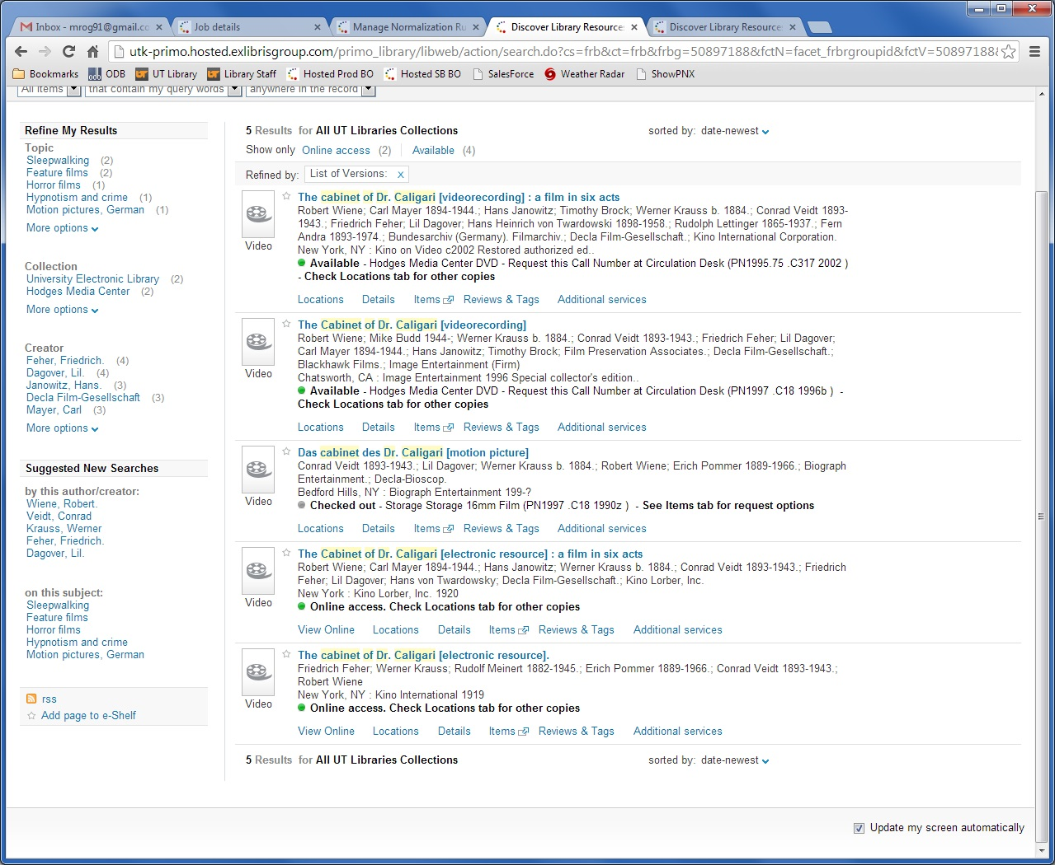
Old resource types: search = cabinet of dr. caligari

Slide 14
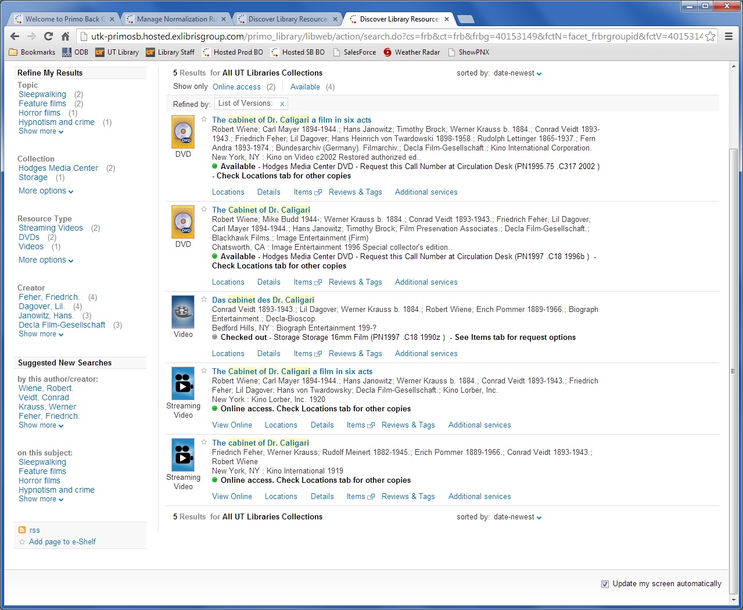
Modified resource types: search = cabinet of dr. caligari

Slide 15
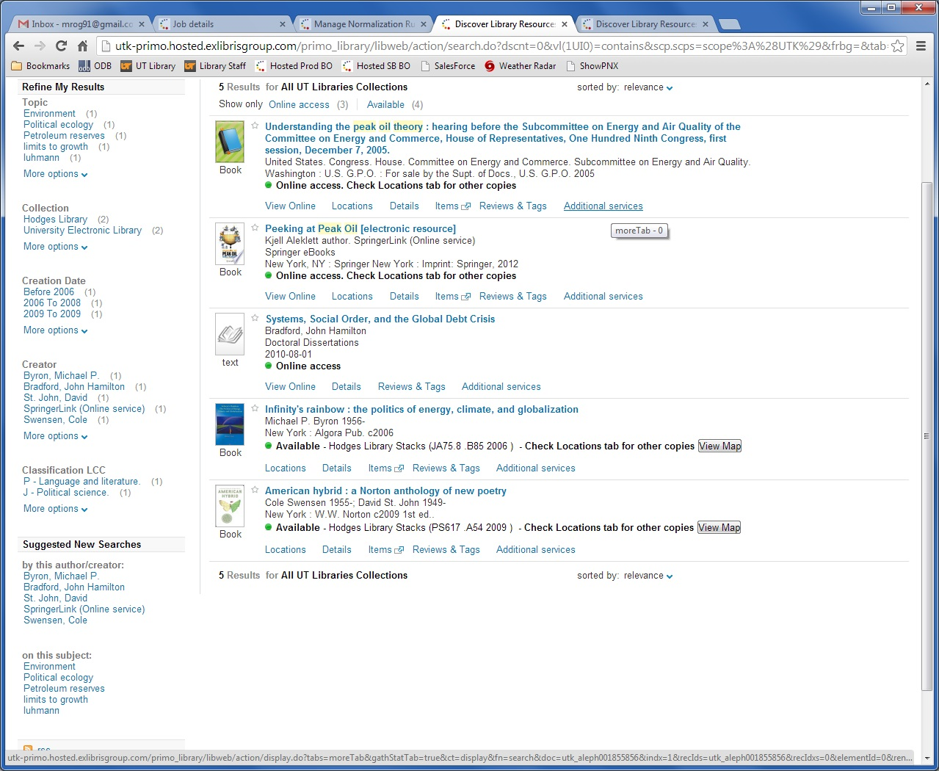
Old resource types: search = peak oil theory

Slide 16
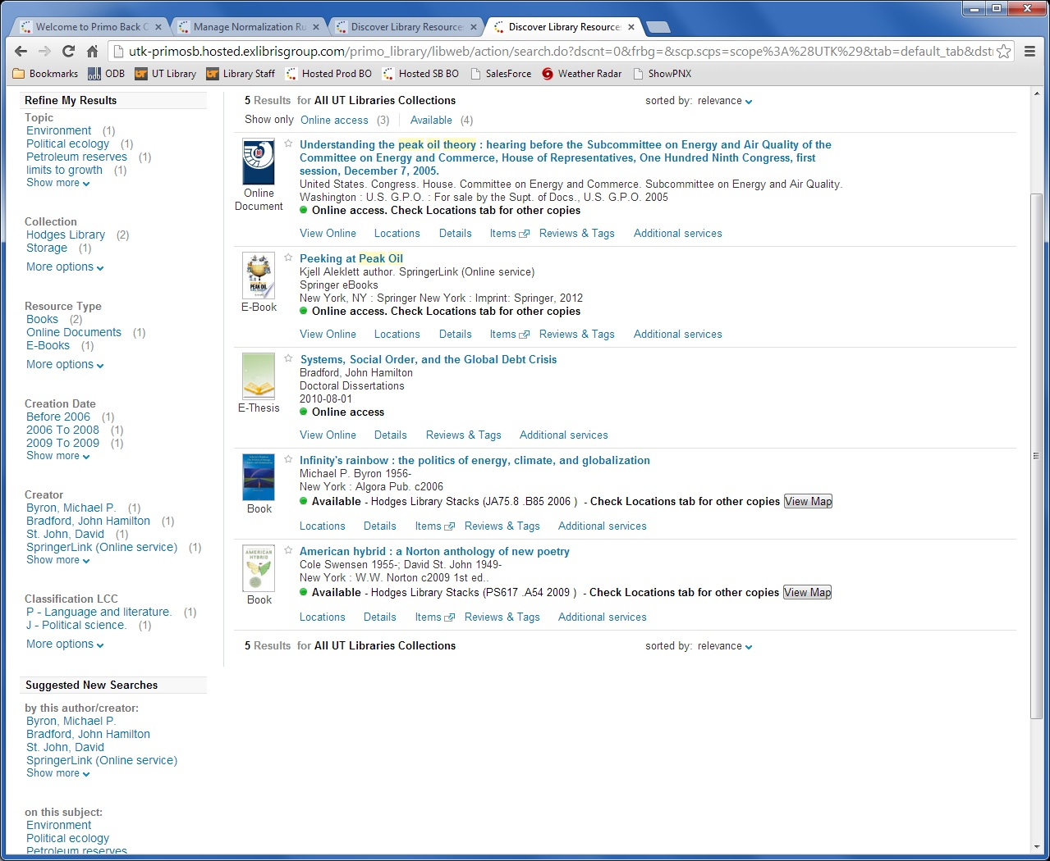
Modified resource types: search = peak oil theory

Slide 17
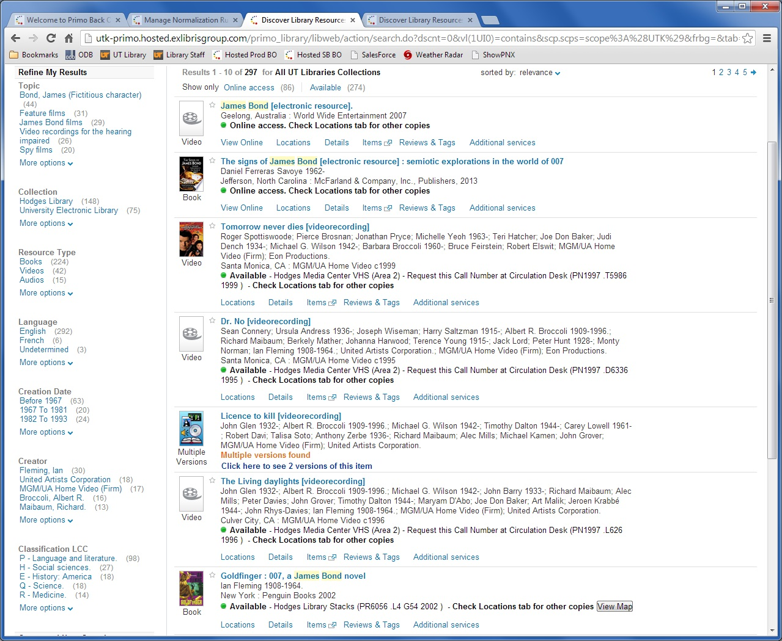
Old resource types: search = james bond

Slide 18
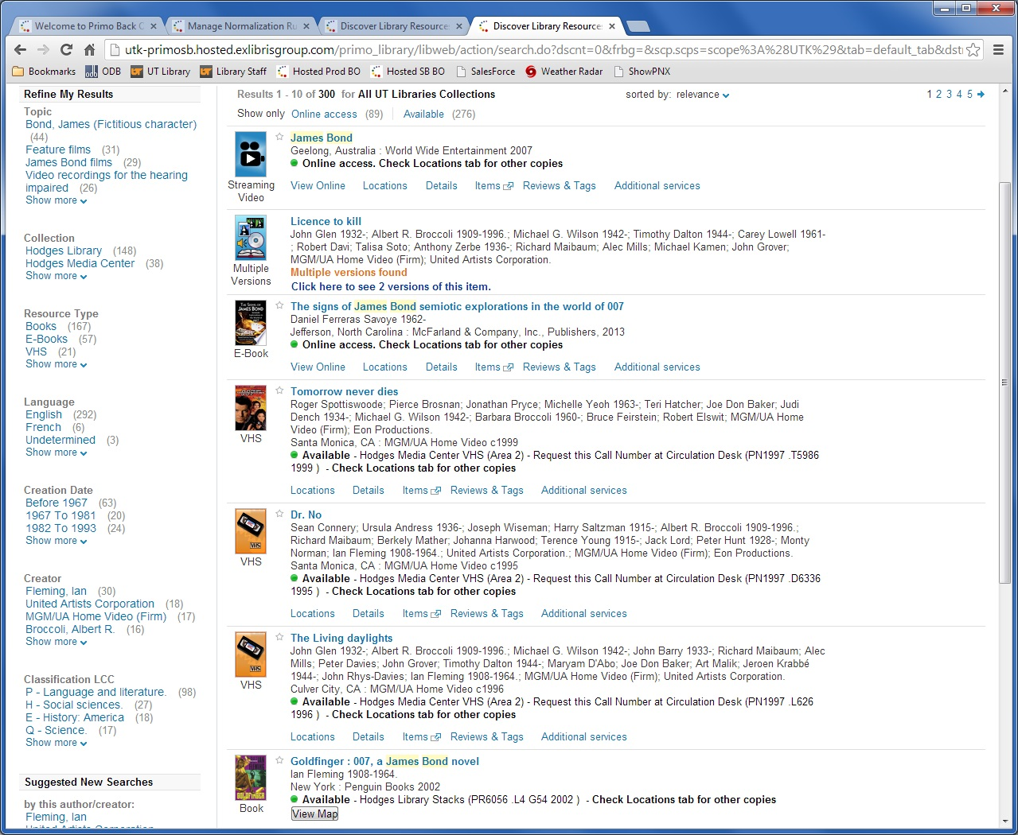
Modified resource types: search = james bond

Slide 19


Trivia Time!
What Major League Baseball team had the best win-loss record just prior to the 1994 baseball strike?

Slide 20









Modified resource types:
Digital Collections color = existing color = newly added
Image
Map
Journal
Score
Text
E-Thesis
E-Book
Article
Streaming Audio
Streaming Video
University Archives
Student Publication
Finding Aid
Manuscript
Playbill
Online Document
Digital Collection

Slide 21
How did we decide on which new resource types to add?
Consulted with Instruction and Humanities Librarians as well as the University Archivist
Reviewed existing resource types and the digital collections they represented.

Slide 22
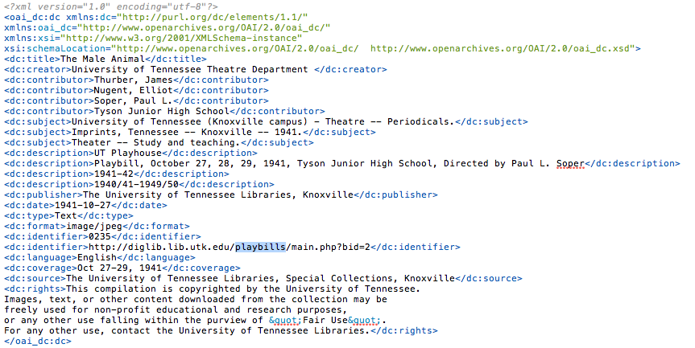
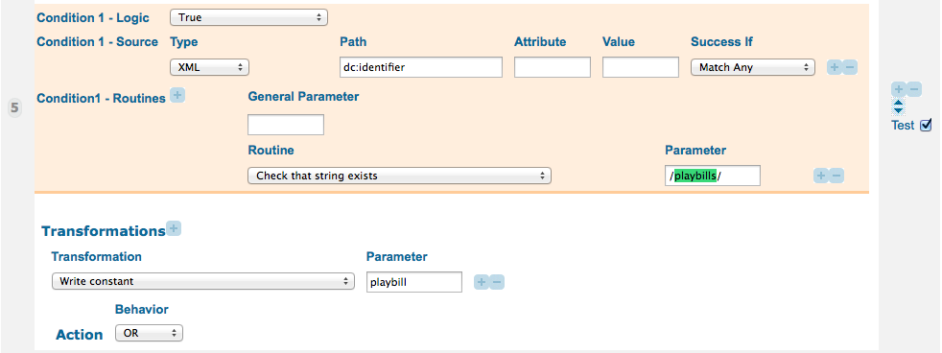
Working with cascading normalization rules

Slide 23
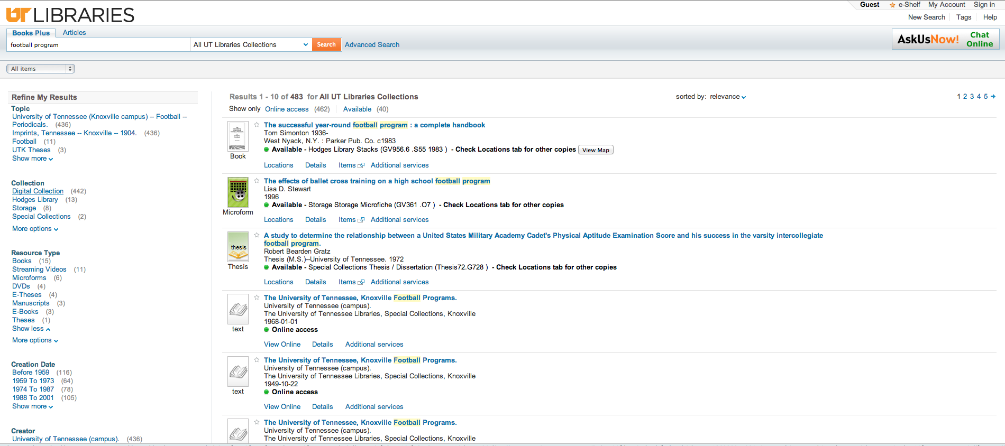
Old resource types: search = football program

Slide 24
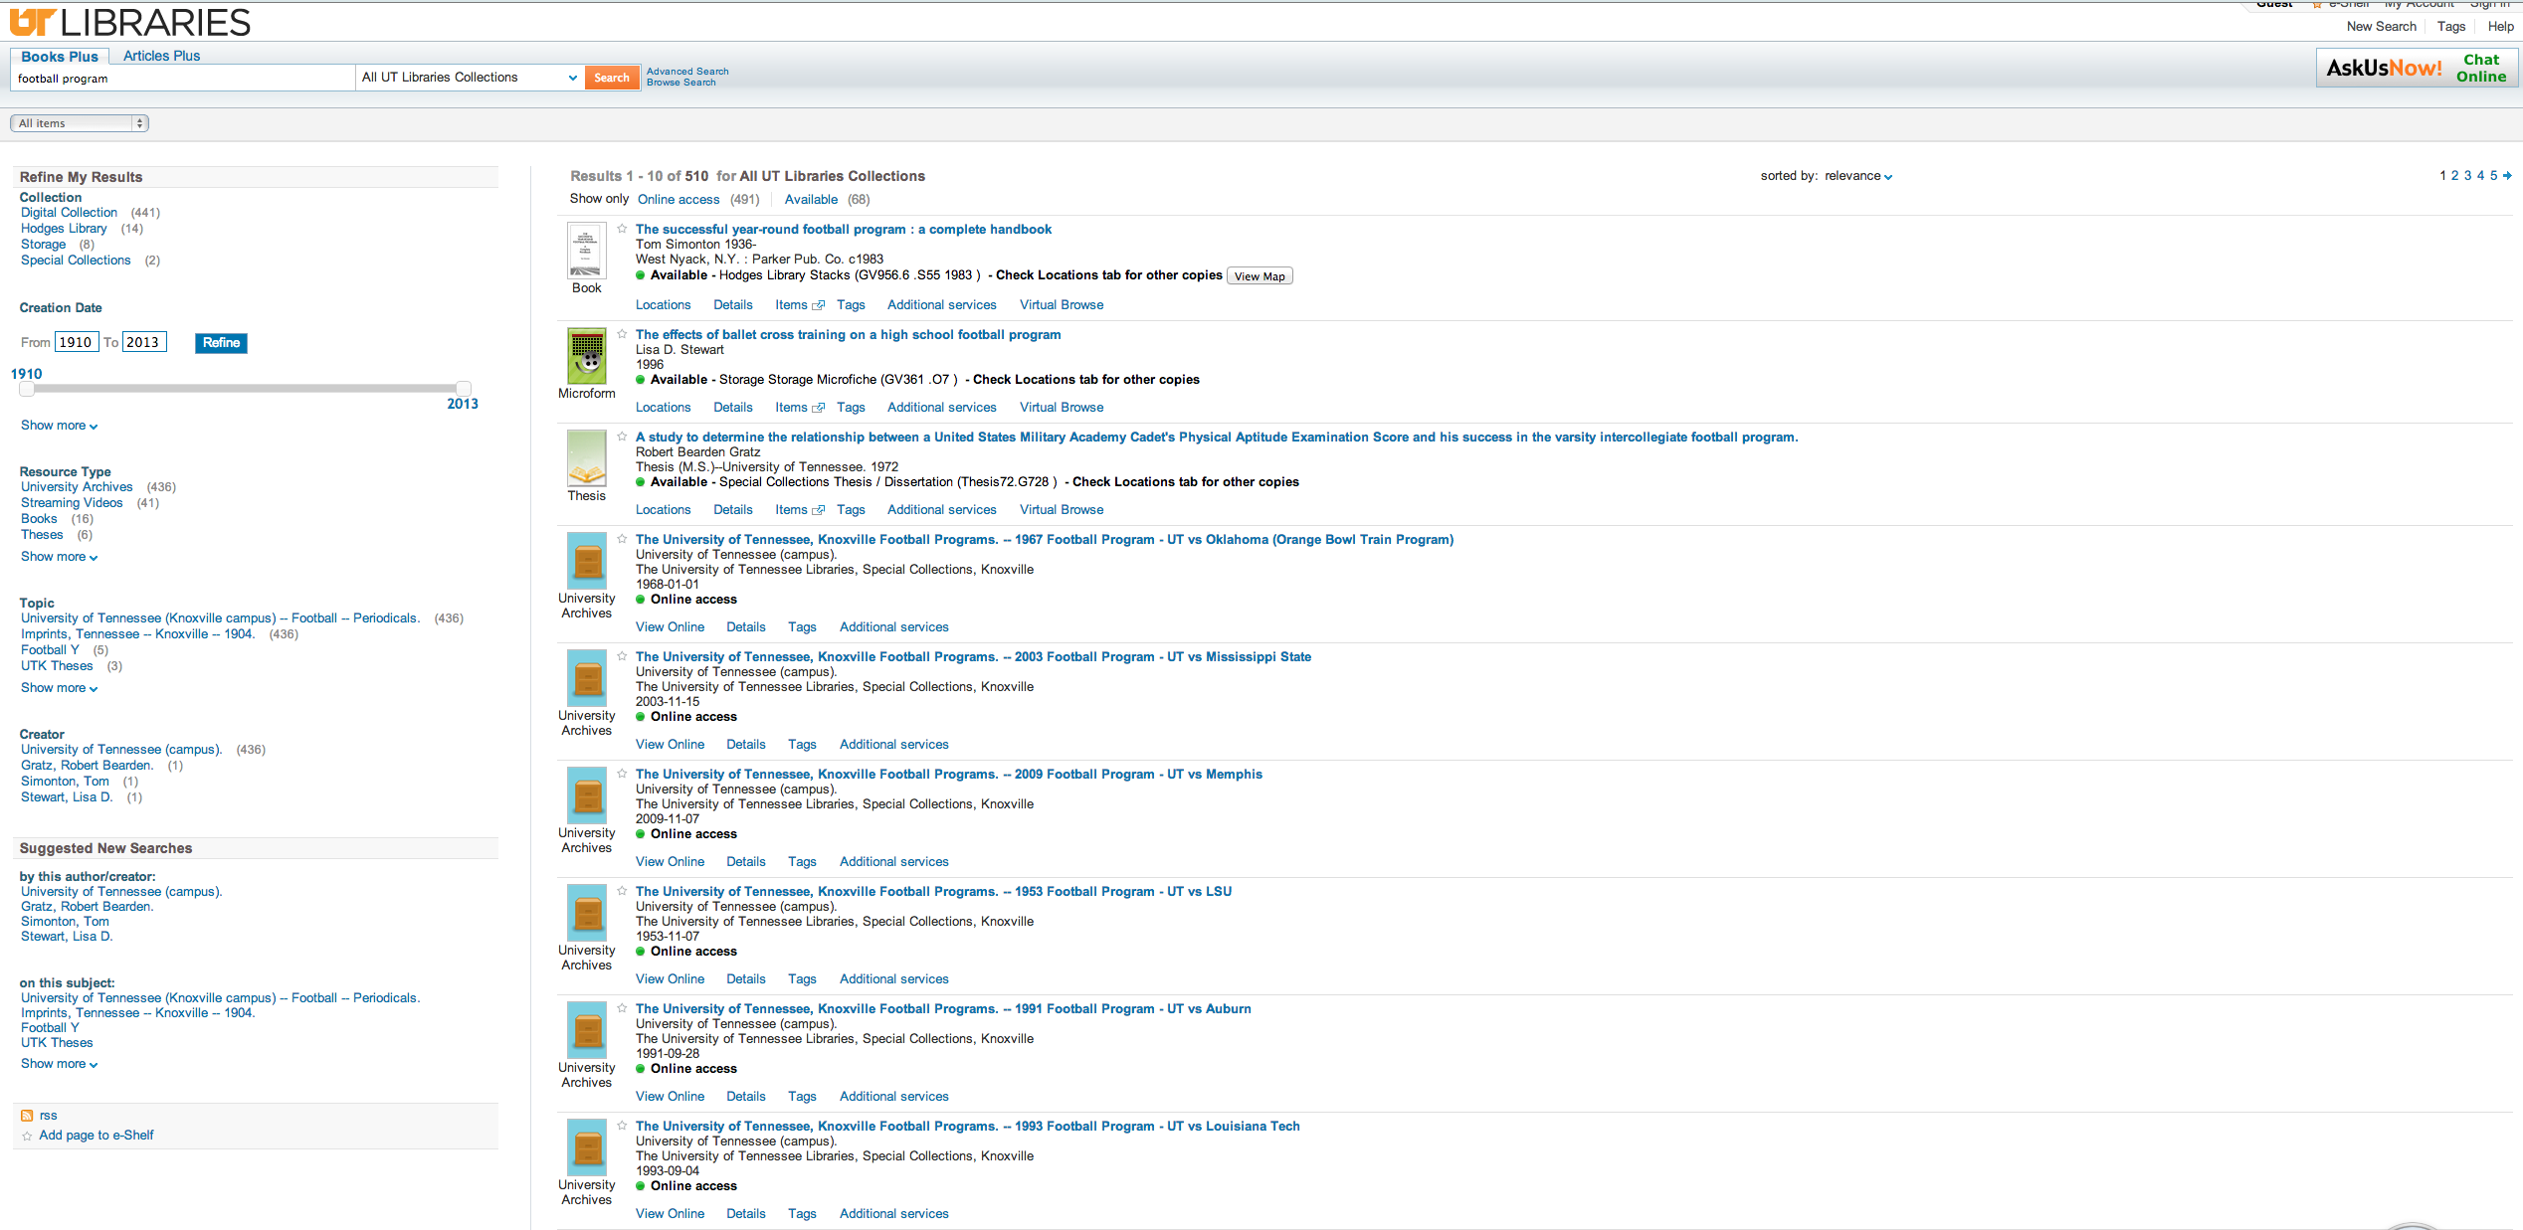
Modified resource types: search = football program

Slide 25
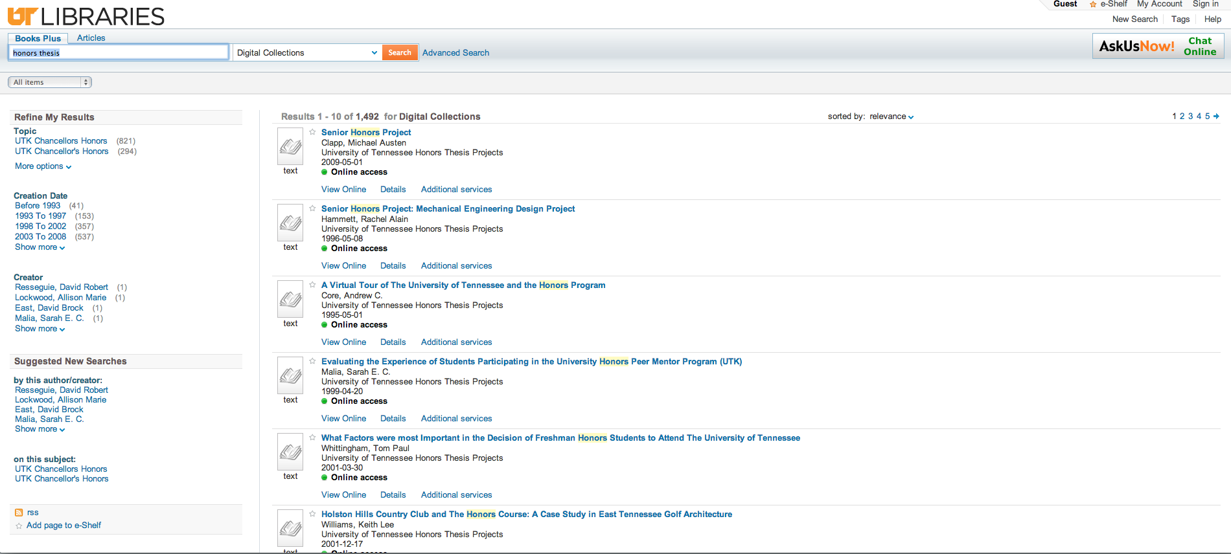
Old resource types: search = honors thesis

Slide 26
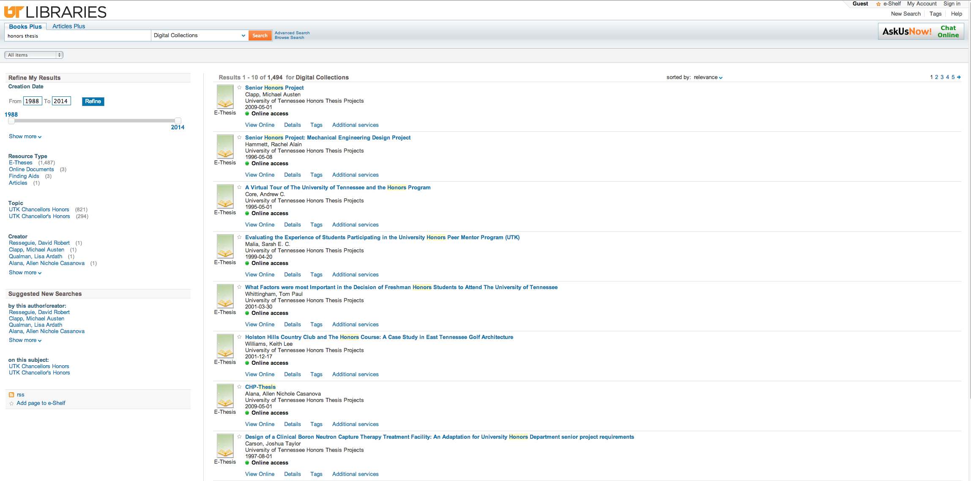
Modified resource types: search = honors thesis

Slide 27
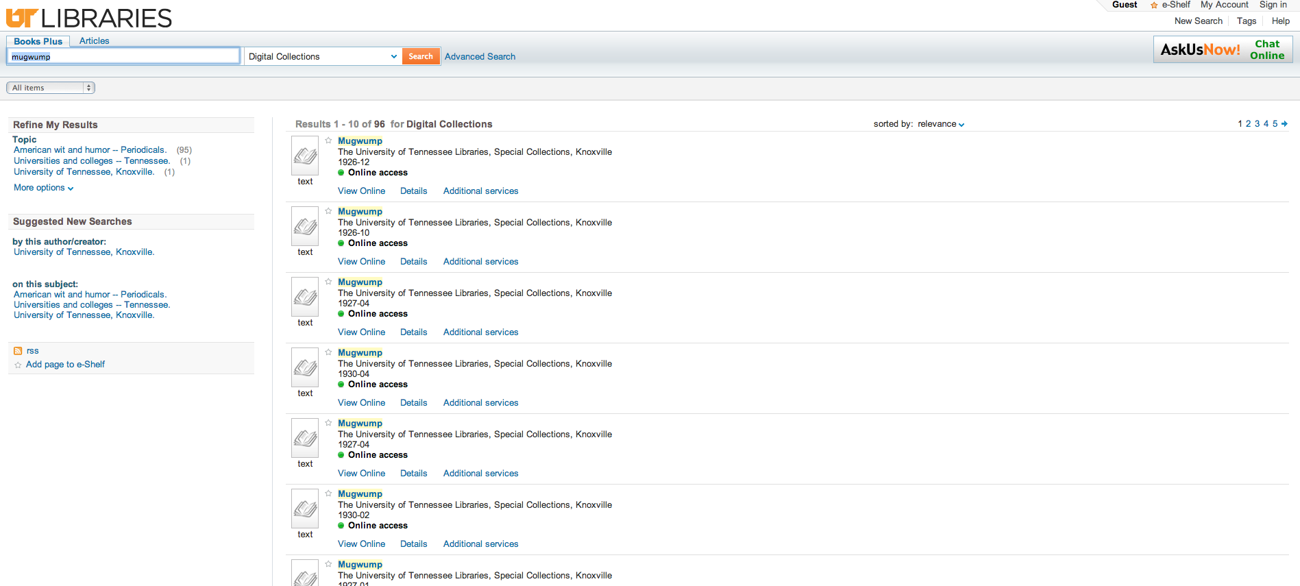
Old resource types: search = mugwump

Slide 28
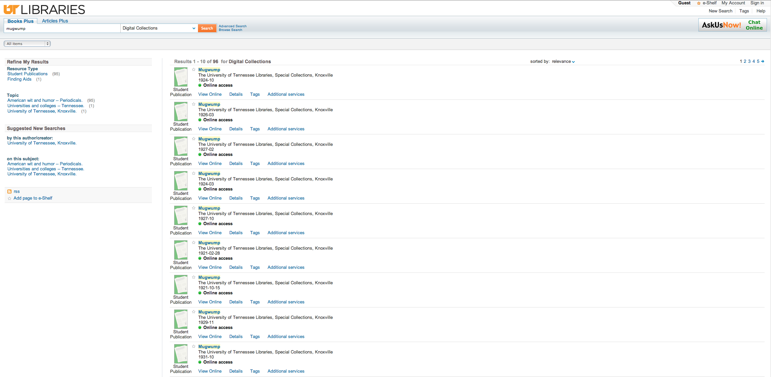
Modified resource types: search = mugwump

Slide 29
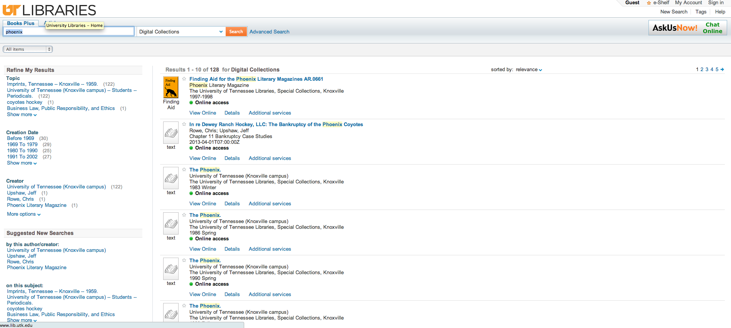
Old resource types: search = phoenix

Slide 30
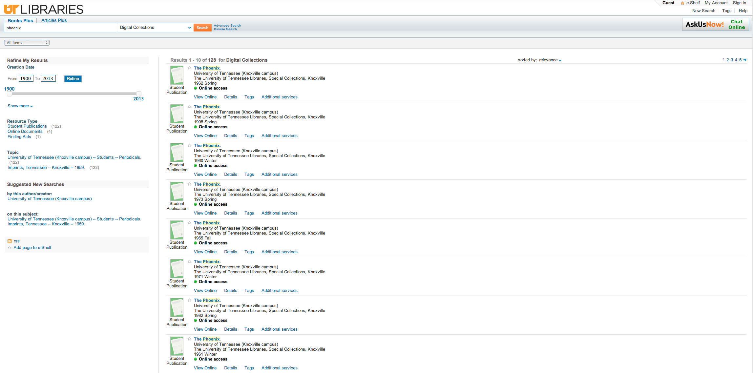
Modified resource types: search = phoenix

Slide 31
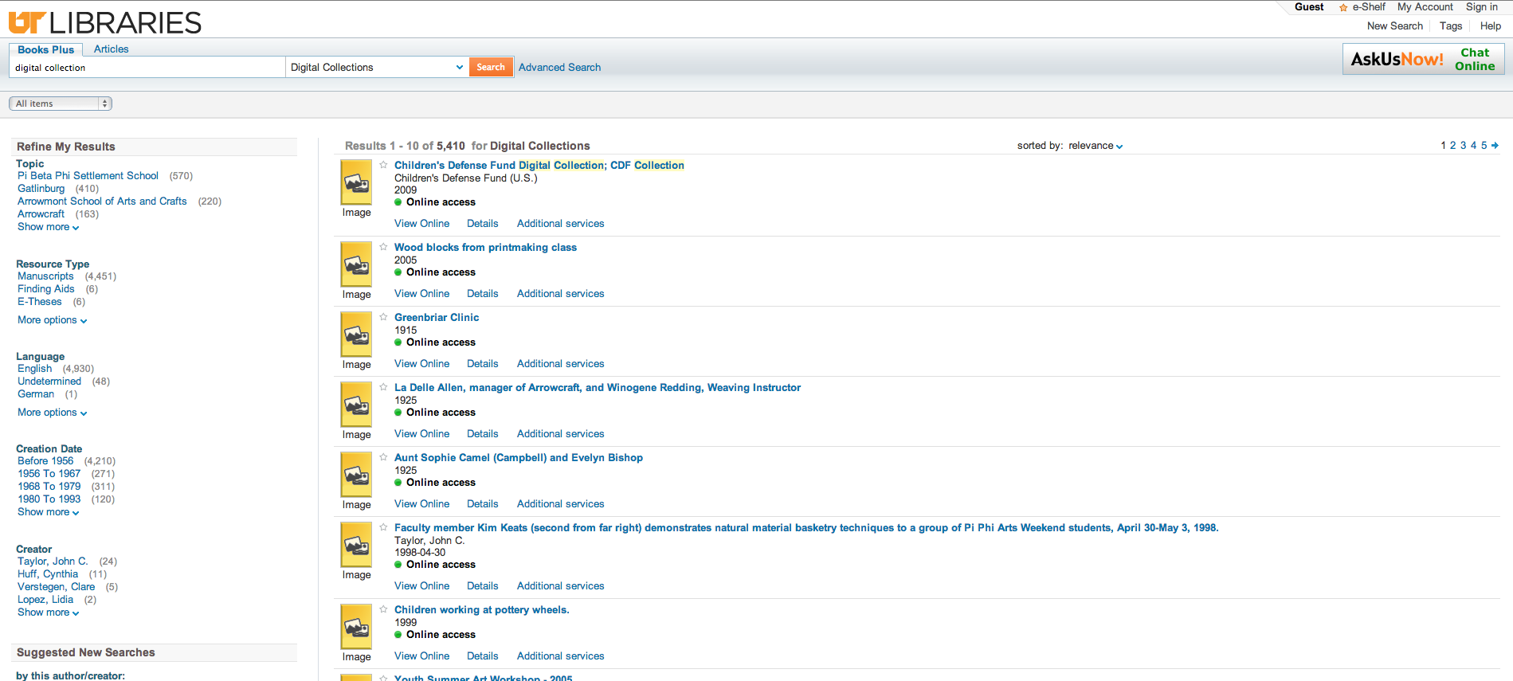
Old resource types: search = digital collection

Slide 32
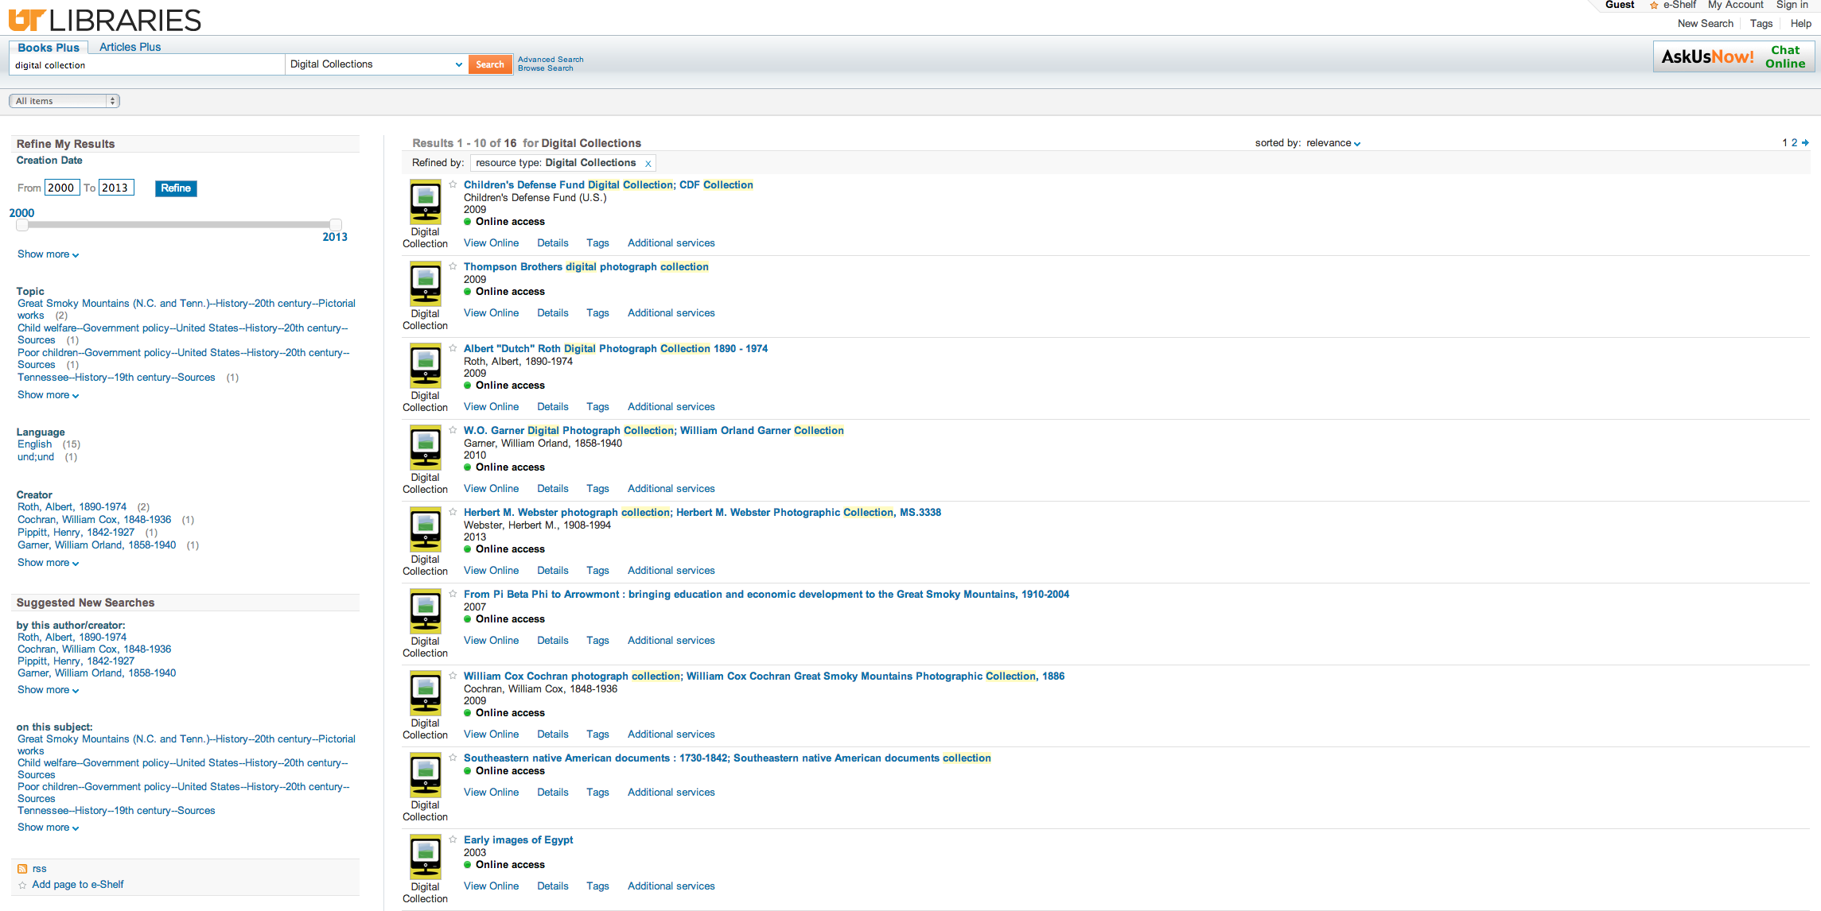
Modified resource types: search = digital collection

Slide 33
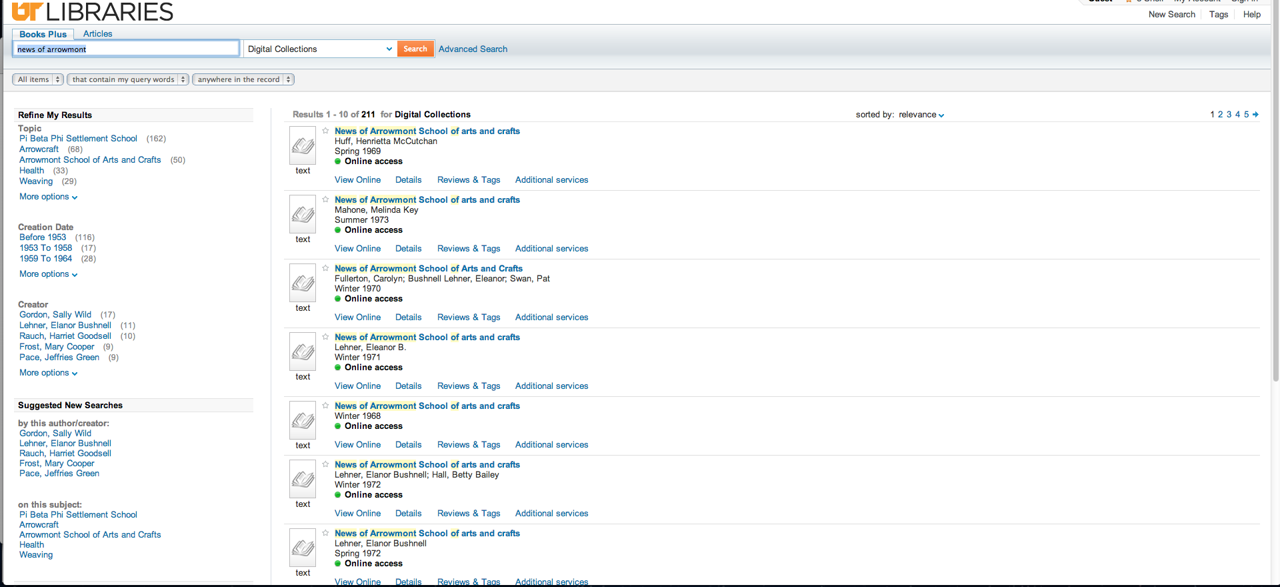
Old resource types: search = news of arrowmont

Slide 34
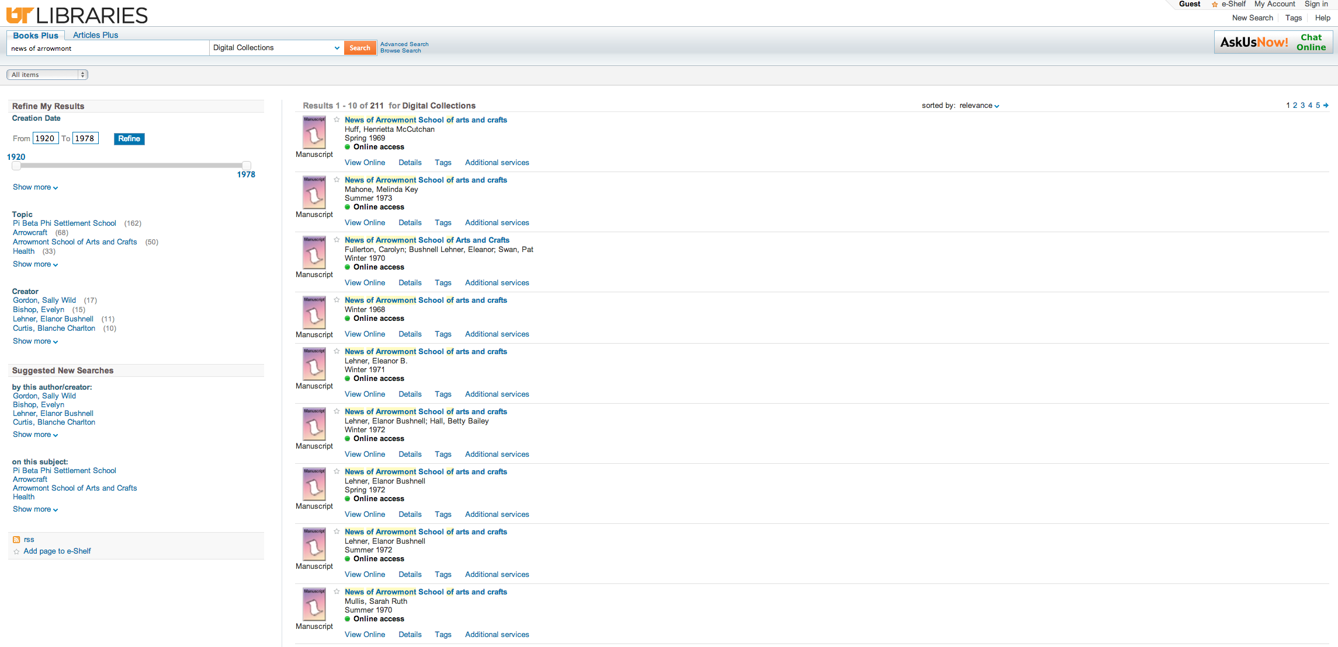
Modified resource types: search = news of arrowmont

Slide 35
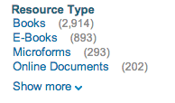
Mapping & code tables
Mapping tables
  facet_pfilter_values
  facet_rtype_values
  pre-filter
  format_mean
Code tables
  Basic media type
  Advanced media type
  Icon code
  Facet resource type

Slide 36
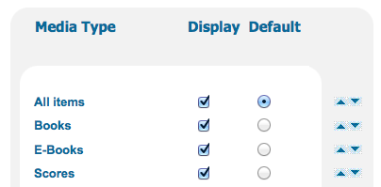
Front-end
Images & CSS
  ..\tomcat\search\webapps\primo_library#libweb\
Views

Slide 37
Outcomes:
Positive feedback from Librarians and Staff
Increase in usage of Resource Types facet according to BIRT reporting tool

Slide 38
Next Steps:
Consider “blended” resource types for pre-search filter and Advanced Search
Consider integration of Primo Central resource types – how to reconcile?
Unified design of icons
Any new resource types to add…?

Slide 39
Appendix I: How to create a test record from Aleph for Normalization Rule Changes
1) using publish-06 in Aleph, create a tar file for the record you wish to test in Primo. You can enter the exact system number in the "From Document" and "To Document" fields of publish-06. Alternately, you can create an input file with a system number in $alephe_scratch and use that file as the Input File in publish-06. In both cases you will need to enter a "Path" directory on your Aleph server to retrieve the record. Note that the actual path will also include the publishing set directory followed by the tar directory (e.g. ./LIVESET/tar).
2) Log into an Aleph SSH session and navigate to the Path directory. Drill down into <publishing_set>/tar directory.
3) Locate the *tar.gz file that you just published and untar it with this command: tar -zxvf filename
4) You should then have an *.XML file. If desired, rename this file to something that will make more sense as a Primo NR test file, leaving the .XML extension (e.g. "Book_ISBN_test.XML")
5) Copy this file from the Aleph server to your hard drive.
6) Log into Primo using an SSH FTP client and navigate to this directory:
exlibris/primo/p4_1/ng/primo/home/profile/publish/demo_data/normalization_test/marc
Note - 'marc' is the directory for test records from your ILS. There are other directory options for working with OAI records.
7) Copy the .XML file from your hard drive into the ./marc directory.
8) In the Back Office, go into Normalization Rules to the rule you are testing, then click the drop-down option for the records to test. You should then see your record listed.

Slide 40

Thank you!
Any questions?
mbagget1@utk.edu
mikerogers@utk.edu

