Slide 1
Secure Exit, or, Shortening That Line to Leave the Library
Hank Sway, Systems Librarian
ELUNA Annual Meeting | May 2, 2014 | Montréal, QC, CA

Slide 2
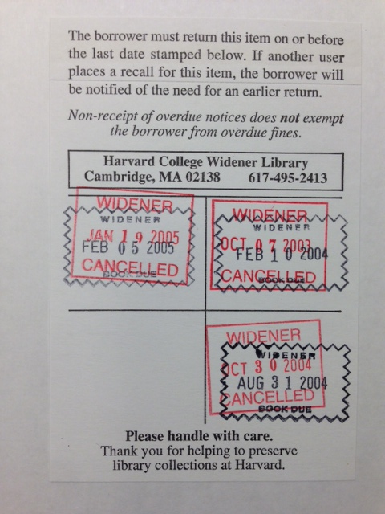
A brief introduction to the Harvard Library
73 libraries, ~16 million items
“Special collections” in the open stacks
Varying security procedures across libraries, including, perhaps:
  ID swipe to enter
  Security guards
  Tattletape, magnetic gates
  Bag checks upon exit
Units performing bag checks:
  Check each item for a future-dated, non-cancelled date stamp
  Performed at several major circulating units, including Widener

Slide 3
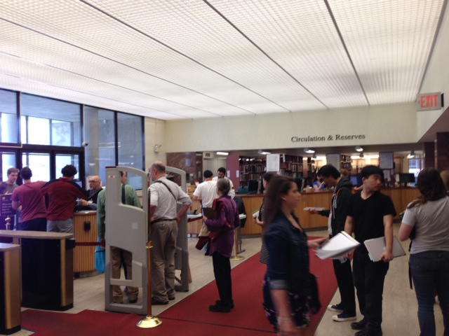
The problem – lines!

Slide 4
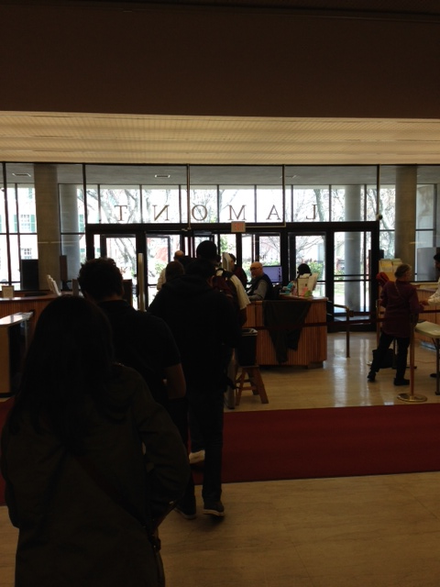
More on lines
Several minute wait during peak times not uncommon
Many patron complaints, particularly from those not carrying bags or books
Lamont added a second guard desk to speed up exit process

Slide 5
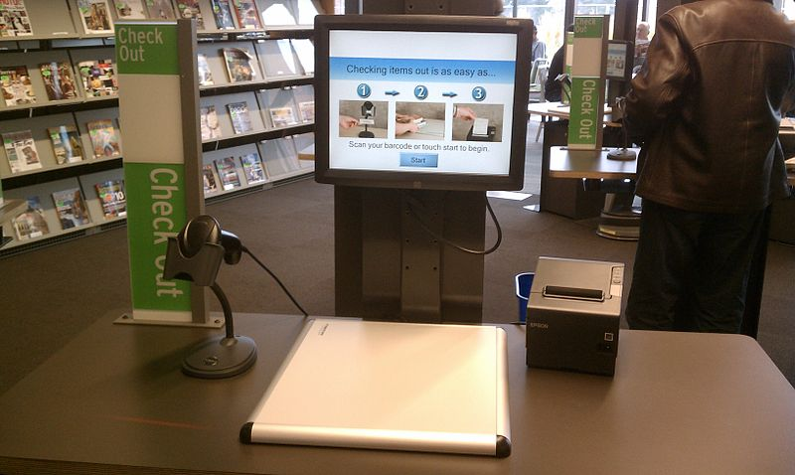
Enter, the self-checkout machine
With self-check, items leaving the library will no longer reliably have date stamps!
Receipts available, but unreliable
What to do?!
Image: http://commons.wikimedia.org/wiki/File:Self_checkout_in_library.jpg

Slide 6

Enter, Secure Exit
A web application that allows guards to scan an item barcode to determine if it is permitted to leave the library.
Improves:
  User experience
  Staff workflows
  Collection security

Slide 7

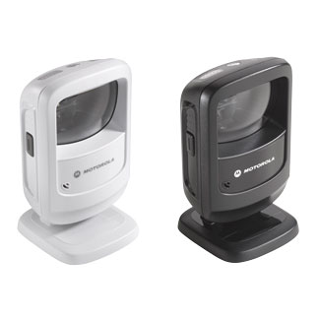
Equipment
Motorola DS9208 Scanner
DoubleSight 7" Smart USB LCD Monitor

Slide 8
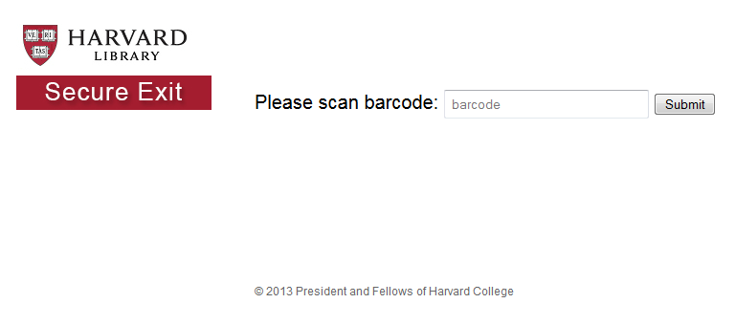
What does it do?
Queries the Aleph X-Server to determine:
  Is the item checked out?
  Is the item on loan to a permitted patron status?
  Is the item of a permitted item status?
  Is the item overdue?

Slide 9
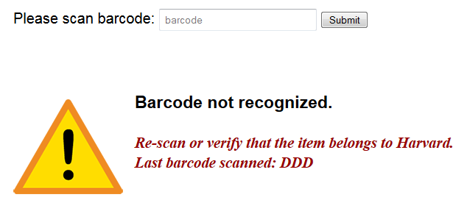
Error checking

Slide 10
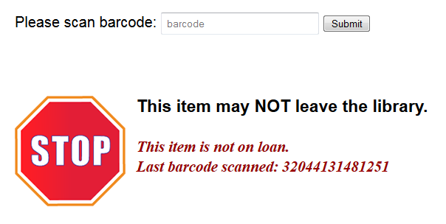
Is the item checked out?

Slide 11
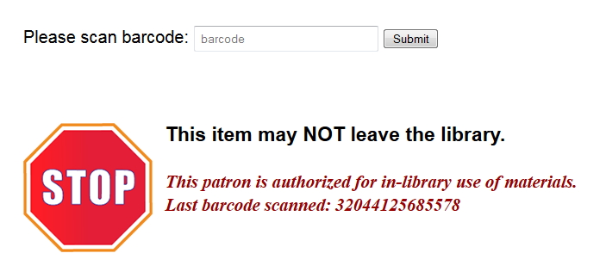
Is the item on loan to a permitted patron status?

Slide 12
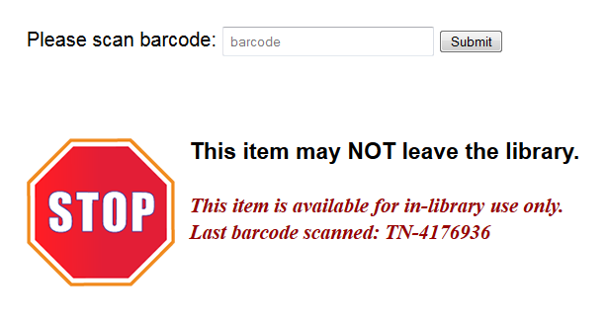
Is the item of a permitted item status?

Slide 13

Is the item overdue?

Slide 14
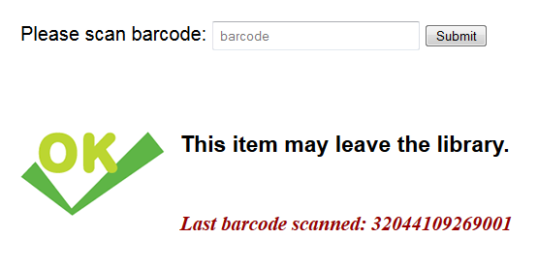
Or if all the criteria are met…
*accompanied by a subtle beep*

Slide 15
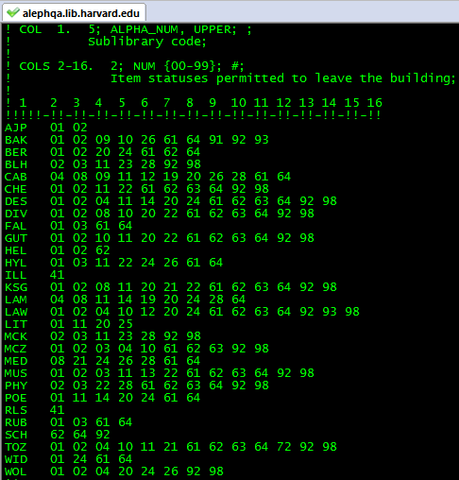
How does it work?
When webpage is loaded, perl script stores an array of configuration settings:
  Permitted patron statuses
  Permitted item statuses (vary by sublibrary)
  Error messages
  X-Server username and password

Slide 16
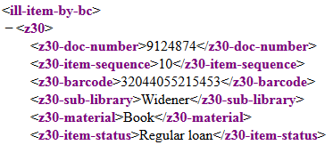
X-Server – ill-item-by-bc
Javascript onsubmit or onclick event:
  Constructs a URL with the scanned barcode and sends an XMLHttpRequest, e.g.:
  http://lms01.harvard.edu/X?op=ill-item-by-bc&barcode=32044055215453 &library=hvd50&user_name=SECXT&user_password=xxxxxxxxx
Returned XML is parsed:
  If no z30 information is returned, present “invalid barcode” message
  If <z30-sub-library> matches a configuration file of “unchecked” sublibraries, present “ok” message
  If z30 information is returned, grab <z30-doc-number> and <z30-item-sequence> for use in next step

Slide 17
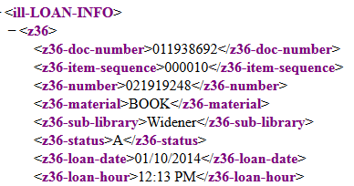
X-Server – ill-loan-info
Javascript constructs another URL & XMLHttpRequest using the <z30-doc-number> and <z30-item-sequence> returned in the last call, e.g.:
  http://lms01.harvard.edu/X?op=ill-loan-info&doc_number=013596338&item_seq=000010 &library=hvd50&user_name=SECXT&user_password=xxxxxxxxx
Returned XML is parsed:
  If z36 data is not present, “not on loan”
  Check <z36-bor-status> for “invalid patron”
  Check <z30-sub-library> and <z36-item-status> for “invalid item”
  Check <z36-due-date> for “overdue”
If no errors, item is “ok”!

Slide 18
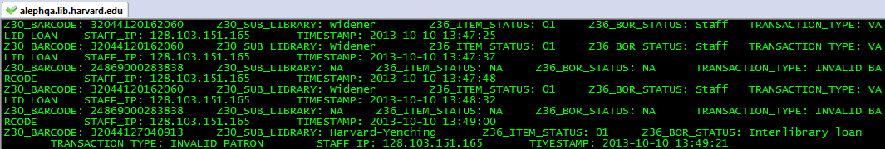
Transaction log
perl script called to log each transaction:
  Barcode, sublibrary, item status, patron status
  Transaction type: valid loan, invalid barcode, etc.
  IP address, timestamp
First 3 weeks of use: over 30,000 transactions!

Slide 19
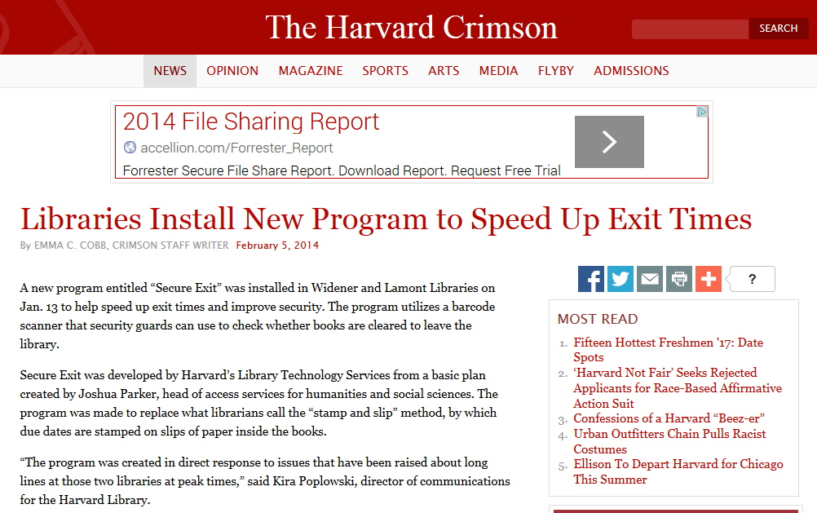
http://www.thecrimson.com/article/2014/2/5/libraries-install-new-program/

Slide 20
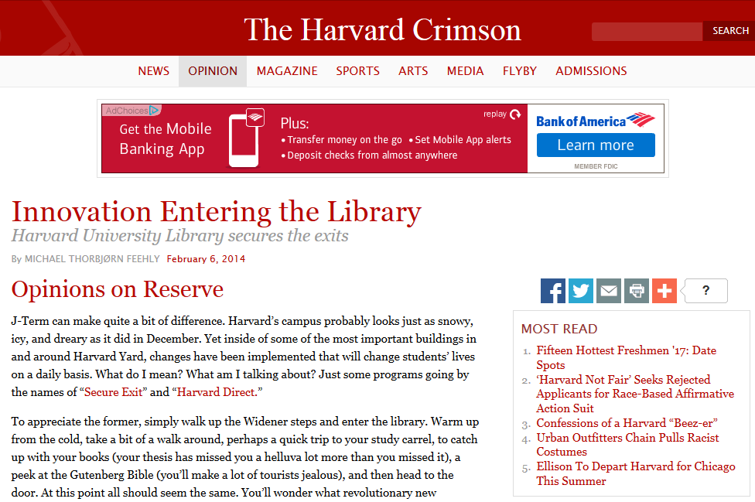
http://www.thecrimson.com/column/opinions-on-reserve/article/2014/2/6/harvard-library-innovation/
Notes:
Yet did I get mentioned in either of these pieces? No.

Slide 21

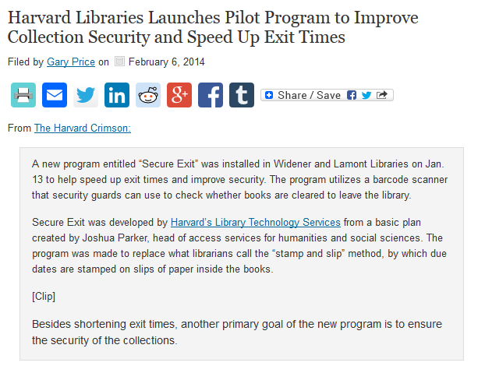
http://www.infodocket.com/2014/02/06/harvard-libraries-launches-pilot-program-to-improve-collection-security-and-speed-up-exit-times/

Slide 22
Thank you! Questions?
hank_sway@harvard.edu

