Slide 1

Implementing Rosetta :
“Migration” from DigiTool -
Discovery through Primo
Teresa Soleau – Digital Library Specialist – Getty Research Institute

Slide 2
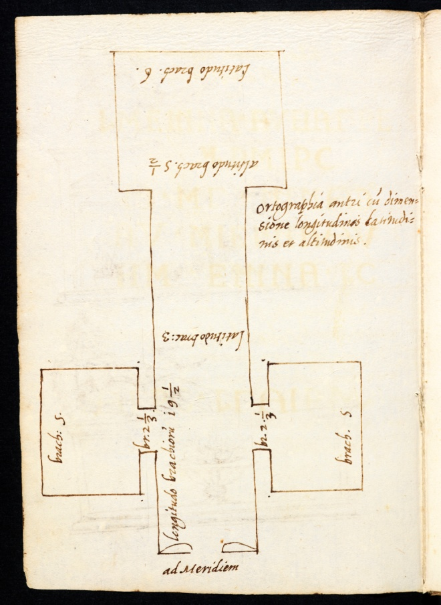
Outline
Overview of Collections & Infrastructure
The Project to Implement Rosetta
Added Value from Rosetta
Still to Explore

Slide 3
Overview of Collections & Infrastructure

Slide 4
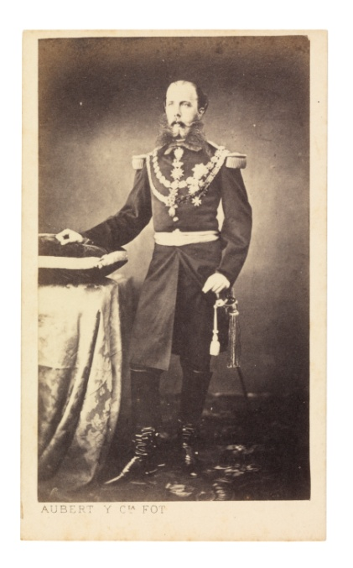
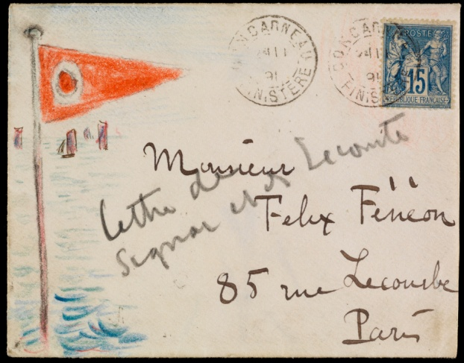
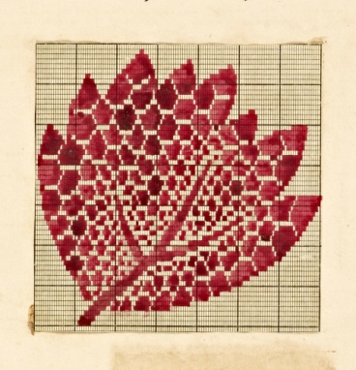
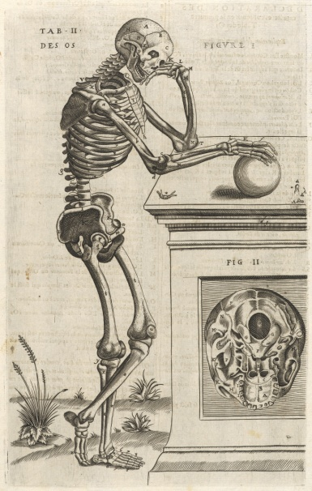
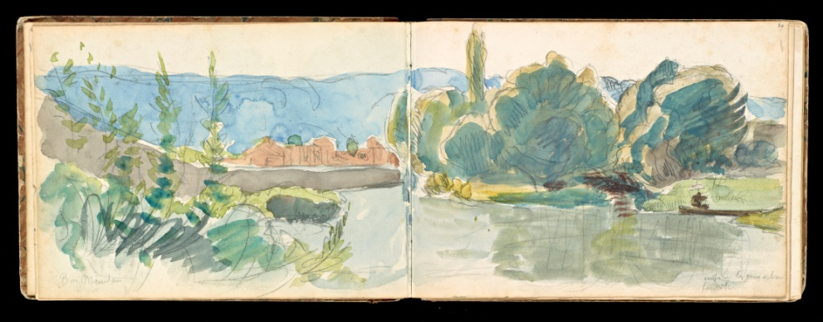
Size and formats
  454,000 files -17,000 complex digital objects - 40 TB in size
  NOTE: Bookscanning is a separate operation. We do not use Rosetta for preservation or access.
Notes:
454,000 files in about 17,000 complex digital objects (40 TB) – 200,000 files from dealer archive to be added soon.
Materials range from the 15th century to the present and include, photographs, manuscripts, archives, prints, drawings, business records and AV material.
Mostly images (tif & jpeg – 95%) but also video (mxf, mpg & mp4), audio (wav & mp3), pdfs and a smattering of born-digital business records in Word, Excel, and Powerpoint.
NOTE: Bookscanning is a separate operation. We do not use Rosetta for preservation or access.

Slide 5
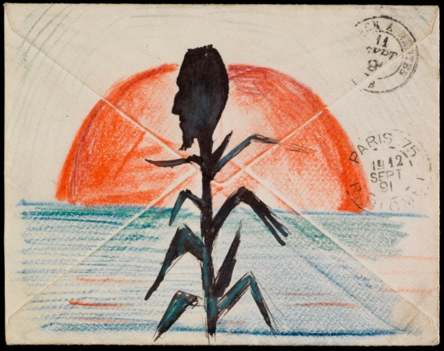
Descriptive Metadata
All items are cataloged before digitization.
  Sources:
    MARC catalog records (from Alma)
    EAD Finding Aids (from Archivist’s Toolkit)
    Legacy digital collections in STAR
    Databases acquired with collections (e.g. FileMaker)
  All descriptive metadata is mapped using XSL stylesheets to a locally defined set of Dublin Core elements (DC and dcterms).

Slide 6
Digital Object Creation
Dublin Core metadata
METS
Digital Object
(METS + files)
Hierarchy/structure
Filestreams
  Deposit at level of metadata

Slide 7
Intellectual Entity Structure
  IEs contain 2 to 3 representations:
    1.) Preservation master representation
      highest quality file we have, only accessible to staff
      image files contain color target
    2.) Modified master representation (if applicable)
      mezzanine level file, only accessible to staff
      examples:
        image file without target
        mpeg video ready for burning onto disc
    3.) Access representation (saved to permanent)
      web quality file, accessible to patrons
      not created by Rosetta

Slide 8
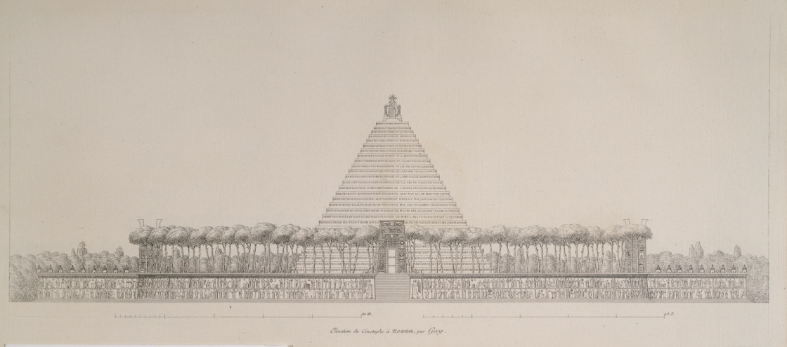
Consortial Structure
Consortium:
The Getty
GRI General & Special Collections
Trust Records
Institutions:
Why separate institutions?
User Management!!
Notes:
Note: It is possible to move IEs from one institution to another.

Slide 9
Discovery and Delivery
Descriptive metadata is published out of Rosetta into Primo.
Primo contains:
  Catalog records from Alma
  Digital Collections from Rosetta
  Article databases from PCI
  EAD Finding Aids from Archivist’s Toolkit
Access files are delivered to end-users
  some accessible on-site only due to rights restrictions
Some IEs in Rosetta are not published to Primo – only preserved.
Coming soon!

Slide 10
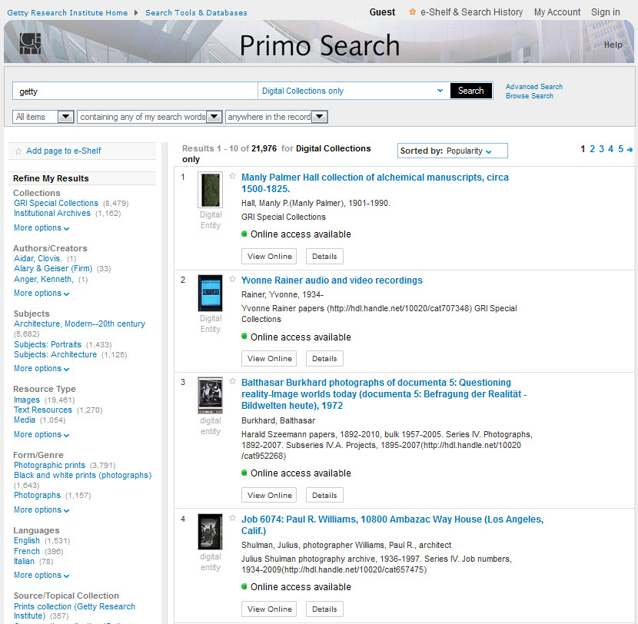
Discovery and Delivery

Slide 11
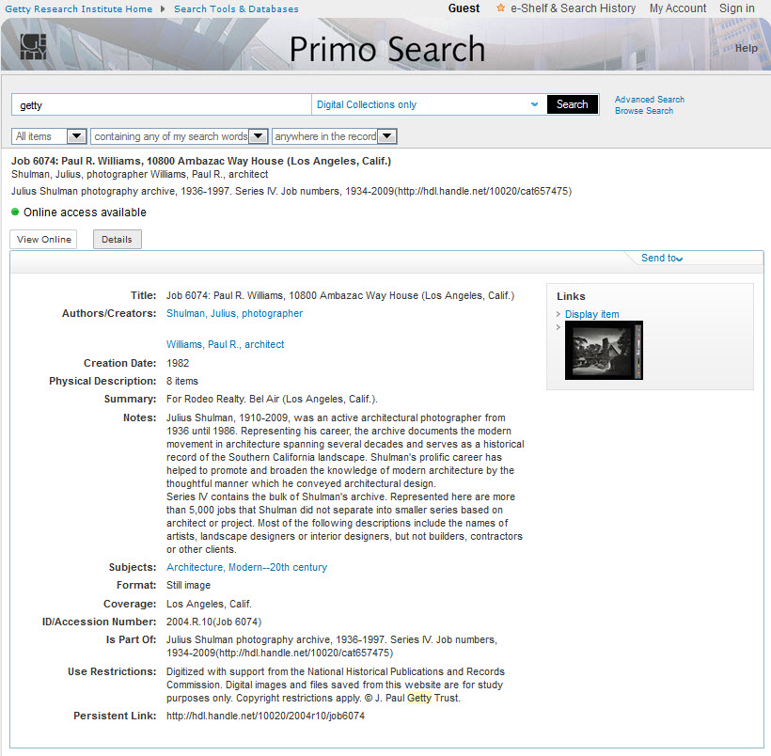
Discovery and Delivery

Slide 12
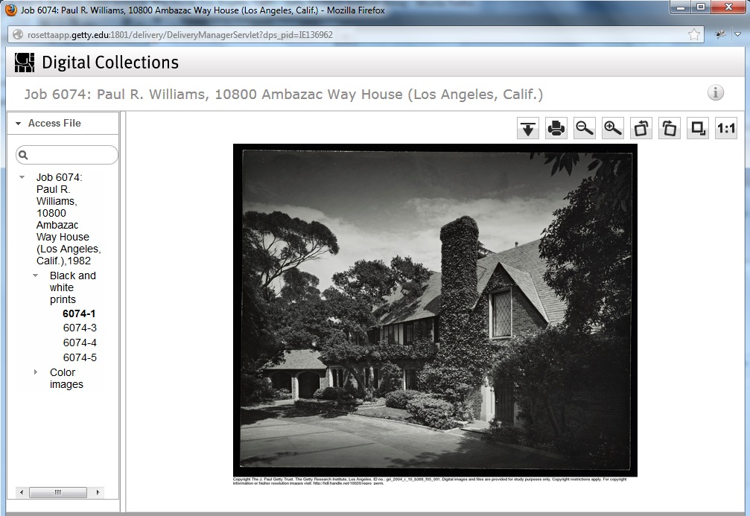
Discovery and Delivery

Slide 13
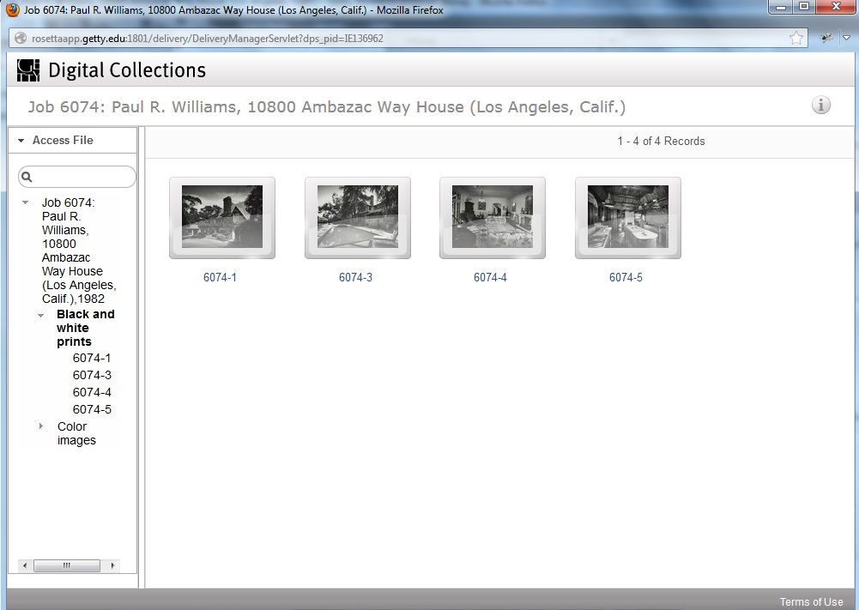
Discovery and Delivery

Slide 14
Staffing
Head of Digital Services (manages collections and book digitization as well as specialized imaging) |  | Metadata Librarian to map metadata from source systems into shot lists and DC records
Asset Creation | Deposit
AV Conservator for analog to digital conversions 2 Imaging Technicians to capture collection materials | Librarian to administer the repository and manage deposit 2 Library Assistants for preparing packages and depositing content
Note: Other staff from Information Systems, Institutional Archives and Special Collections Cataloging spend a portion of their time working on digital projects as needed
Ex Libris Users of North America Annual Conference
29 April 2014

Slide 15
The Project to Implement Rosetta

Slide 16
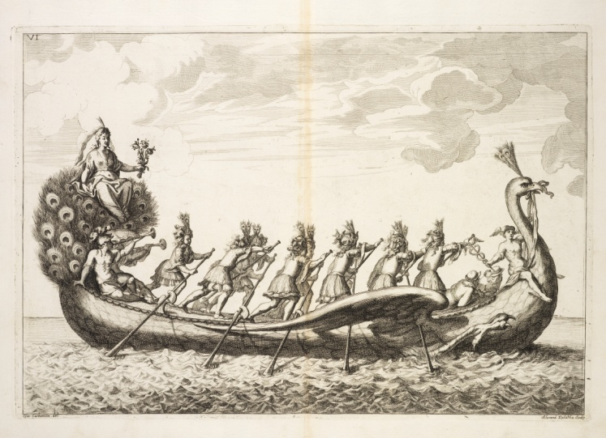
“Migration” Plan
Preservation master files not in DigiTool.
Populated Rosetta with locally saved METS and filestreams.
Wrote software to transform DigiTool METS into Rosetta METS

Slide 17
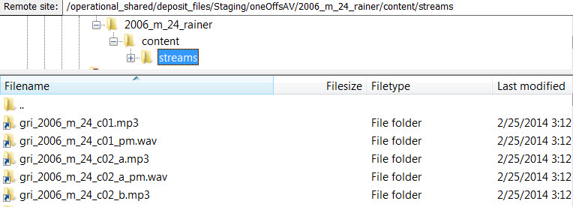
“Migration” Plan, cont.
Symbolic linking
Create SIP packages on the server
Moving wall – Rosetta filled as DigiTool emptied
Notes:
Used symbolic linking to deposit content into Rosetta without having to move all of the files.
Not using the SDK to deposit - we create SIP packages on the server.
As objects were added to Rosetta they were deleted from DigiTool so there was no interruption of access. Users could barely tell the difference because both DigiTool and Rosetta were in Primo and the viewer is only slightly different.
When we first started delivering content from Rosetta we turned off DigiTool front end to avoid confusion.

Slide 18
Implementation Timeline
On-site Training | November 2012
First items deposited | April 2013
Stopped loading content into DigiTool and started Rosetta active loading | July 2013
Switch to support | December 2013
Migration complete and DigiTool decommission | Expected July 2014

Slide 19
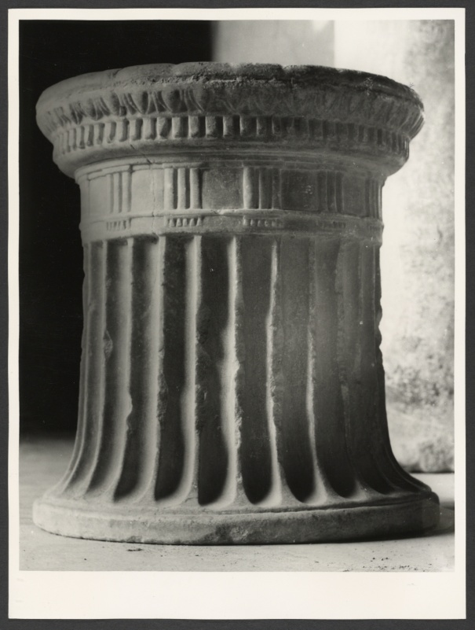
Storage & Backups
Oracle database
  SQL Backtrack – hot backup with tape (more for disaster recovery)
Filestreams
  All assets currently stored on spinning disk.
  COMING SOON! HSM (hierarchical storage management)
    some filestreams stay on spinning and some move to tape.

Slide 20
Pressure points during implementation
Testing options
  Different viewers for images vs. archives vs. AV content vs. PDF
    Settled on General IE Viewer
  Making derivatives in the system
    Decided not to use this
Steep learning curve – dependencies not always apparent
  Example: Delivery rules vs. Access Rights Policies

Slide 21
Lessons Learned
When implementing a Discovery System, expect stakeholder involvement.
Pre-process files! Technical Analyst Workbench difficult to work in.
System not very “talkative”. Sometimes unclear what the issue is.
Service Packs and Hot Fixes released often - needed to keep up!

Slide 22
Format Library Working Group
Ask questions about validation issues to email list
Quarterly calls
Request changes
to Global
Format Library
Notes:
Email list is a great place to ask questions about validation issues
Quarterly calls give you a sense of who is working in the system and where they are (versions, upcoming projects)
Opportunity to request changes to the Global Format Library – user driven; you need something changed and the group approves the change then it is done (and quickly!)

Slide 23
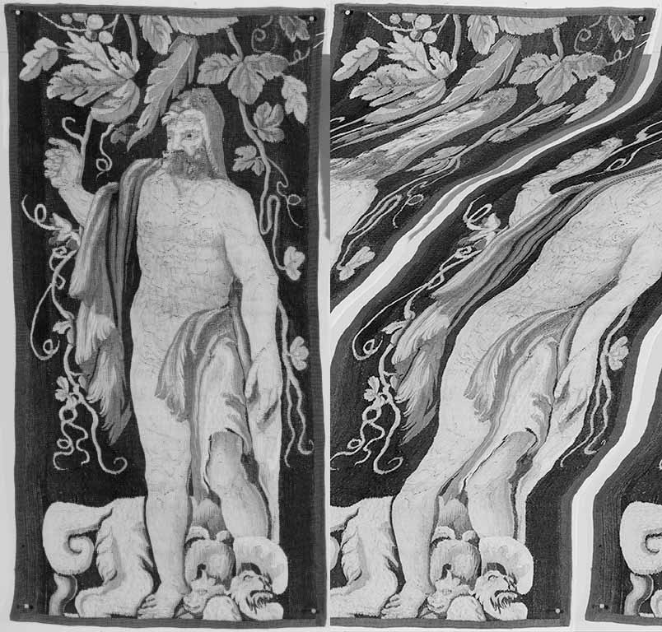
Validation Errors
Count mismatch for tag 36867; expecting 20; saw 11
Was: 1202201013
Change to: 2012:02:20 10:13:00
Invalid strip offset
  These files were actually corrupt

Slide 24
Validation Errors, cont.
Type mismatch for tag 700; expecting 1; saw 7
JHOVE 1.5 bug and it will be fixed with Rosetta version 4.0
Ignore until bug fixed and then reprocess
You can set up rules to remember your decisions next time a similar error is encountered.

Slide 25
Added Value from Rosetta

Slide 26
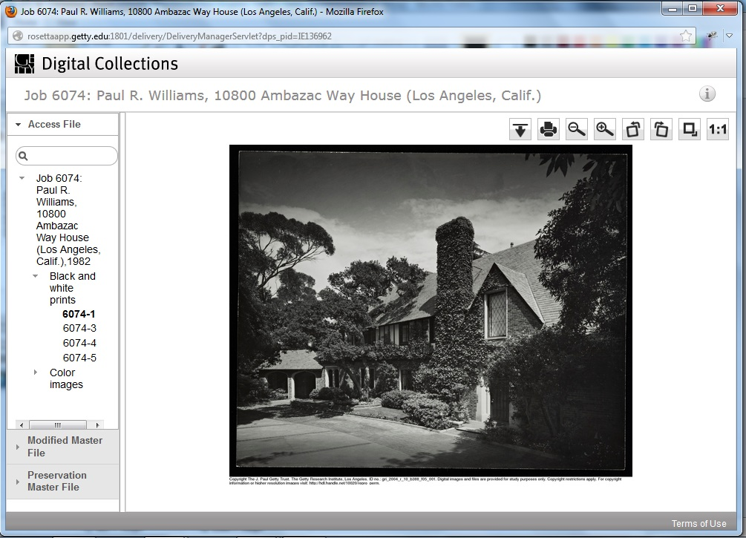
Staff Self Service
Notes:
The combination of Rosetta and Primo allows reference staff who fulfill image requests for publication to get their own files instead of having a staff member in our department retrieve them.
Each staff member has a Rosetta login (Viewer only). She logs into Rosetta in one tab and then searches Primo as normal. Since she is logged in, she is now able to see all representations in the Viewer and can download the higher quality file.

Slide 27
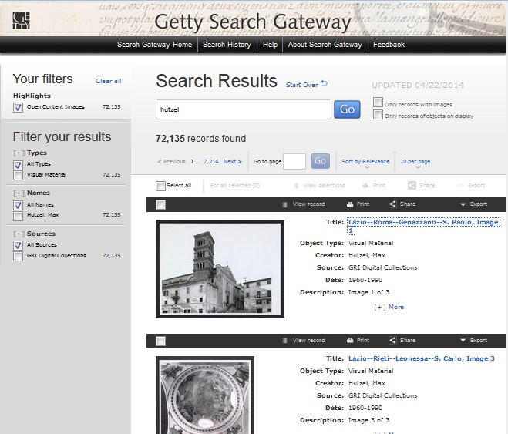
Open Content Program
http://search.getty.edu
Notes:
Couldn’t have done this when we had DigiTool because it didn’t allow users to download the files easily.

Slide 28
Easy to Use Web Services
Swapped out 73K jpegs with higher-res files using APIs.
Web Service updateRepresentation (using SOAP)
Documentation not great but our support lead did a WebEx with me and the process was easy to understand.
Notes:
We recently were asked to swap out our access files for a collection of IEs which contained about 74,000 jpegs. We needed to create higher-res jpegs that contained embedded metadata and replace the jpegs currently in the system.
We used the Web Service updateRepresentation to do that (using SOAP) and it worked very well.
Documentation not great but our support lead did a WebEx with me and the process was easy to understand.
Caveat: I have never worked with Web Services before so this means they are easy enough for a newbie, but I have no frame of reference!

Slide 29
Statistics and QC
Everything is indexed so very easy to pull out lists of content.
  How many access files do I have that are unrestricted vs. on-site only?
  How many files/IEs are in different rights category public domain vs. Getty owned vs. orphan vs. third party?
  Need a list of everything with certain dcterms:isPartOf?
Just search for it and click the export button to get a CSV file.
  You decide which data fields to export.
Notes:
Maybe change into a screenshot of search.

Slide 30
Still to Explore
Notes:
File Fixity
How frequently?
Different frequency on different assets?
More frequent for higher risk files? How do we define higher risk?
How will HSM impact the time it takes to do fixity checks?
Collections!
Primo is flat. Collections Viewer in Rosetta not yet fully developed.

Slide 31
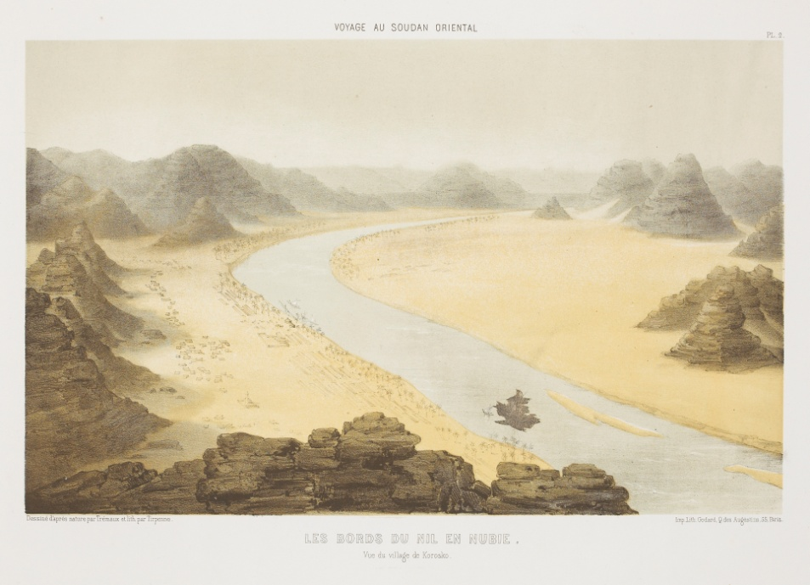
Still to Explore
File Fixity!
Collections!
Viewer Pre-Processors!
Custom Reporting!
Preservation Actions!
Born Digital!

Slide 32
All images used in this presentation courtesy of the
Getty’s Open Content Program http://www.getty.edu/about/opencontent.html

Slide 33
Questions & Comments tsoleau@getty.edu

