Slide 1


Customizing The SFX Interface:
An Open Discussion
ELUNA 2014
University of California/California Digital Library:
Alison Ray, Margery Tibbetts, Lena Zentall
Notes:
Image credit: http://www.designboom.com/wp-content/uploads/2013/07/massive-hordicultural-sculptures-in-montreal-designboom-20.png
About the images used in this presentation: Giant plant sculptures are from the 2013 MosaicCultures International in Montreal. http://www.mosaiculturesinternationales.ca/en/

Slide 2

Agenda
1. intro & overall findings
2. survey questions
3. discussion
4. wrap up/next steps
Notes:
Image credit: http://www.fascinatingpics.com/wp-content/uploads/2014/02/serd.jpg

Slide 3

1. Intro & Overall Findings
Notes:
Image credit: http://32u89a25ohko2x7o7q9usz2ccm.wpengine.netdna-cdn.com/wp-content/uploads/2013/11/belgique-mim2013-copyright-guy-boily.jpg

Slide 4
Who participated?
  52 institutions completed the survey
  29 institutions provided screenshots
Simplified vs. Advanced
  Most are using the simplified template (~60/40).
Aha moment
  We couldn’t tell at a glance whether a menu was using the simplified or advanced template.
Notes:
(show of hands) how many are using simplified?
(show of hands) how many are using advanced?

Slide 5
Big takeaway: Simple is good.
The simplified template is highly customizable and worth exploring.
A challenge: How do we (and Ex Libris) keep it refreshed over time?
Some limitations of the simplified template
Not WYSIWYG
You may need to edit in several places in the Admin interface to make one change.
Documentation is sometimes limited.
Notes:
We’ll talk about specific examples in the next few slides. Example of arrow icon (now more commonly known as a toggle for show more/less)

Slide 6
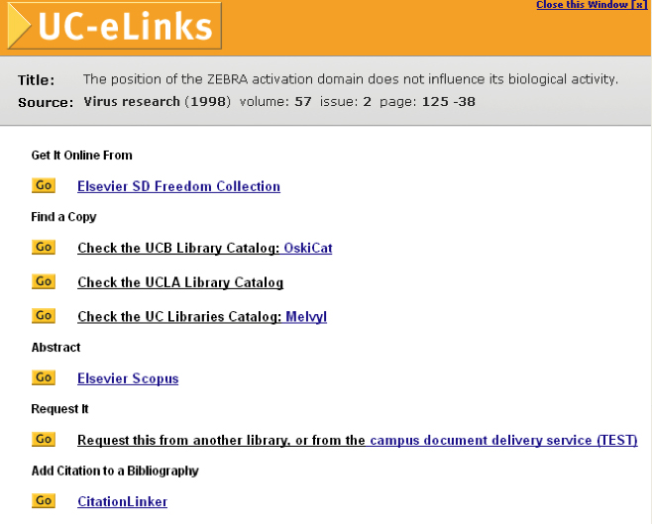
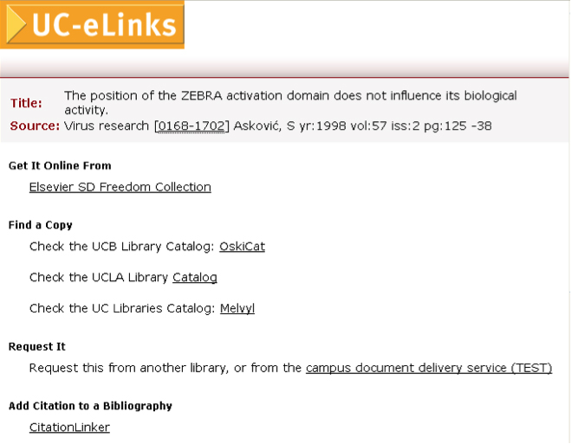
CDL advanced vs. simplified
advanced
simplified

Slide 7

some examples
Some examples
Notes:
http://www.cdn.mumbaihangout.org/7/dc7efda2304742791291068390153bc2.jpg

Slide 8
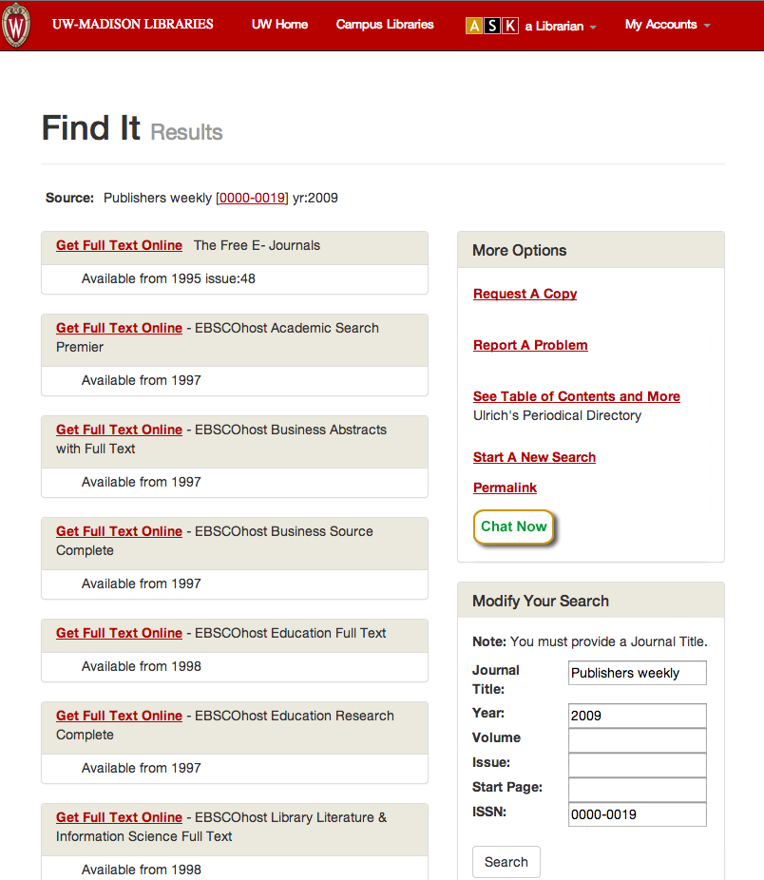
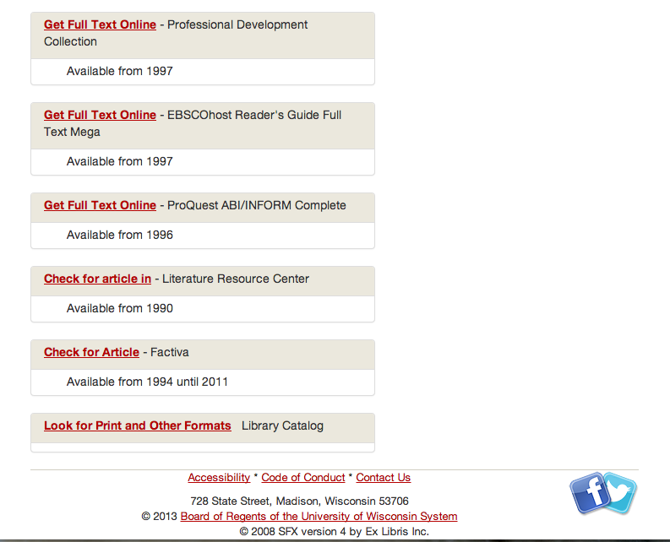
University of Wisconsin Madison
Top
Bottom
Citation linker window
Notes:
SFX menu advanced templates
Incorporates a ‘citation linker’ window

Slide 9
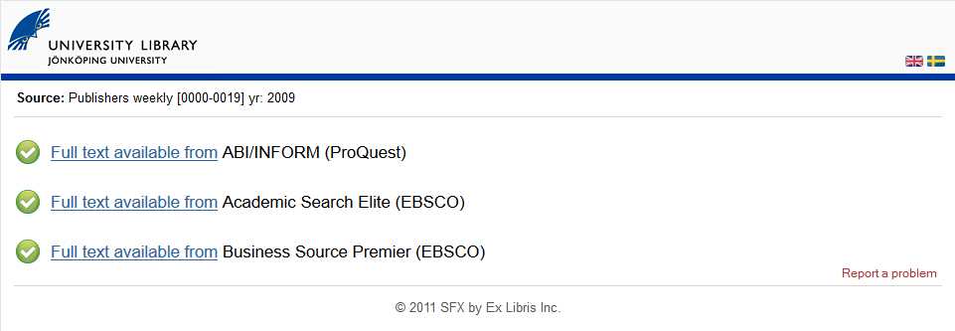
Jonkoping University
Graphic language indicator (flags)
Notes:
SFX menu advanced templates
Language switch using flags – not SFX pulldown menu

Slide 10
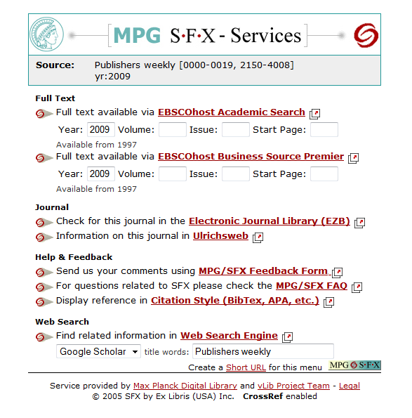
Max Planck Digital Library
Tiny URL generation for menu window
Notes:
SFX menu advanced templates
Tiny URL generation for menu window

Slide 11
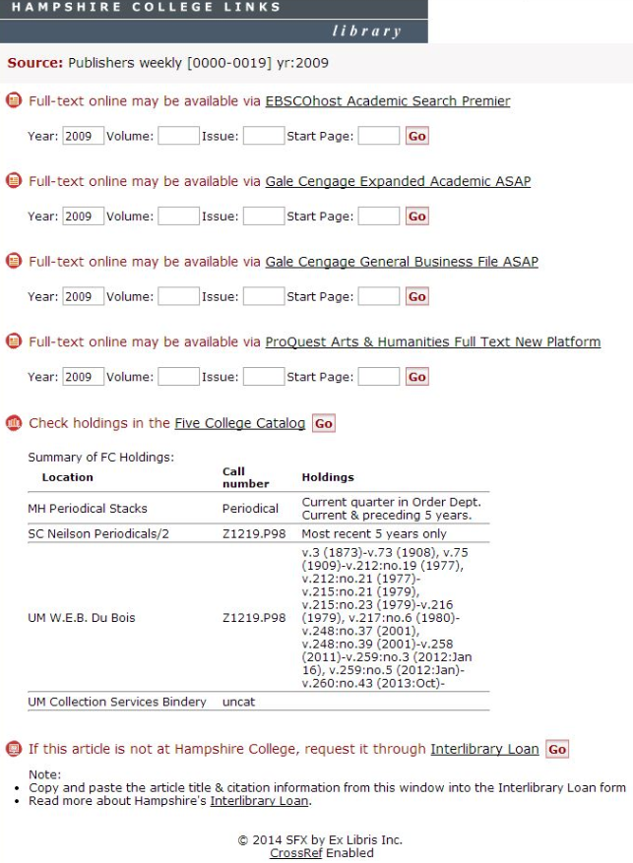
Hampshire College
Service-level icons
Link on target name
Fill-in boxes
Print holdings
Graphic language indicator (flags)
Using translation and display options to change wordings
Notes:
SFX menu simplified templates
Using service level icons
Hyperlink on target name
Included fill-in boxed
Print holdings
Using Translation & Display options to change wordings

Slide 12
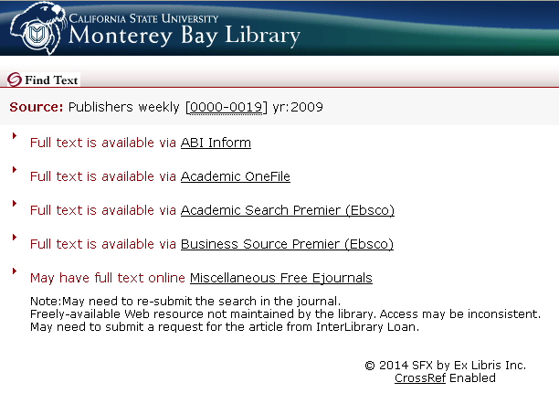
CSU Monterey Bay
Service-level icons
Notes:
SFX menu simplified templates
Using service level icons
Hyperlink on target name
Omitted GO button

Slide 13
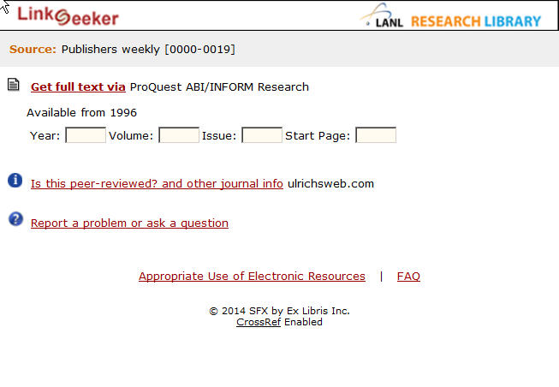
Los Alamos National Laboratory
Service-level icons
Link on service name
Notes:
SFX menu simplified templates
Using service level icons
Including fill-in boxes
Hyperlink – service name
Using Translation & Display options to change wordings

Slide 14
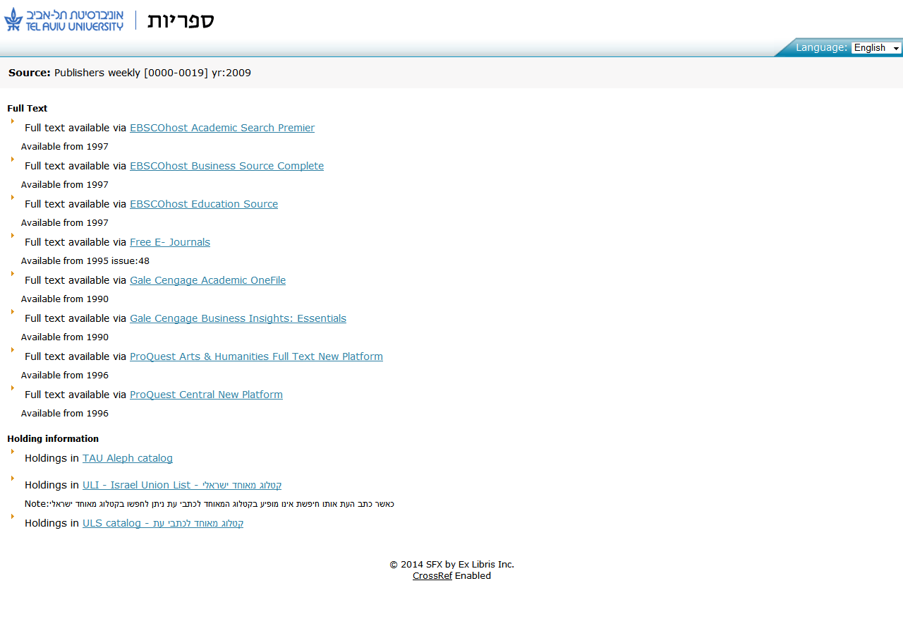
Tel Aviv University
language pulldown menu
Notes:
SFX menu simplified templates
SFX multiple language pull down
Using service level icons
Hyperlink – target name
Omitted GO button

Slide 15

2. Survey Questions
2. Survey Questions
Notes:
Image credit: https://photovide.com/sculptures-plants/

Slide 16
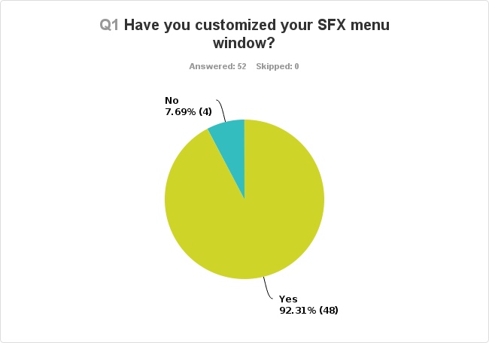

Slide 17
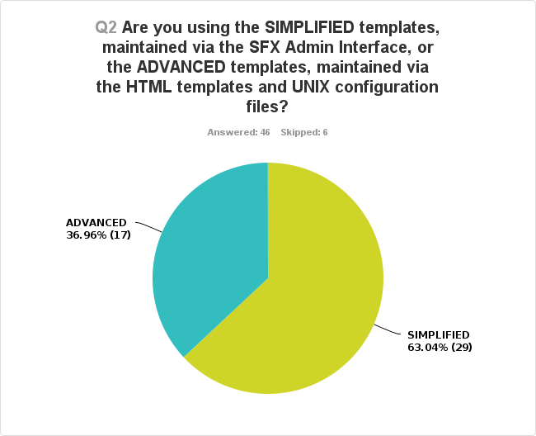
Notes:
Simplified template was introduced in March 2008 as part of SFX version 3 (not new with version 3 but during version 3). Prior to 2008, the only option for customizing your menu was to modify the SFX software.
Simplified templates were added to the SFX Admin interface. You still have to go into the software to make changes to the advanced templates – the underlying HTML was modified but not rewritten.

Slide 18
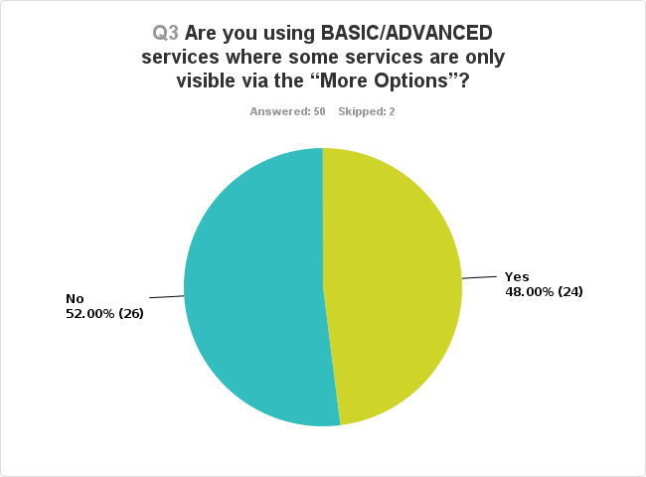

Slide 19
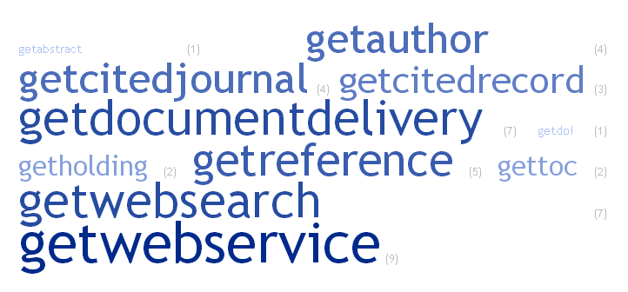
Q4: What services are in the advanced option “More options”?
Notes:
No surprises here. Nobody hides fulltext. It was somewhat surprising that people hid getholdings (but it may have been that they were hiding everything except getfulltext.)
getWebService 9
getDocumentDelivery 7
getWebSearch 7
getReference 5
getAuthor 4
getCitedJournal 4
getCitedRecord 3
getHolding 2
getTOC 2
getAbstract 1
getDOI 1

Slide 20
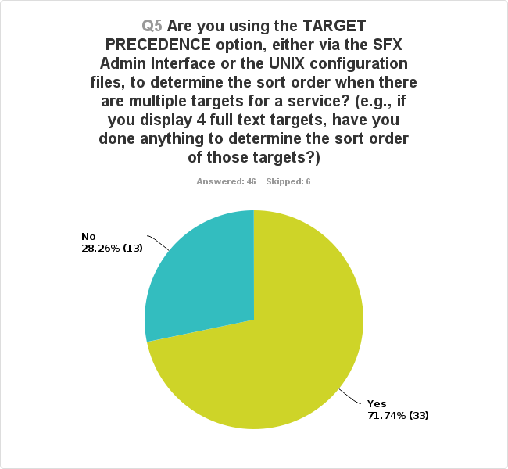
Notes:
One reason we put in these questions was to see if people were aware these advanced features existed (target precedence & display logic), and we discovered they are predominantly using them.
For example, we show 2 OPACS and we show the local OPAC above the union catalog.

Slide 21
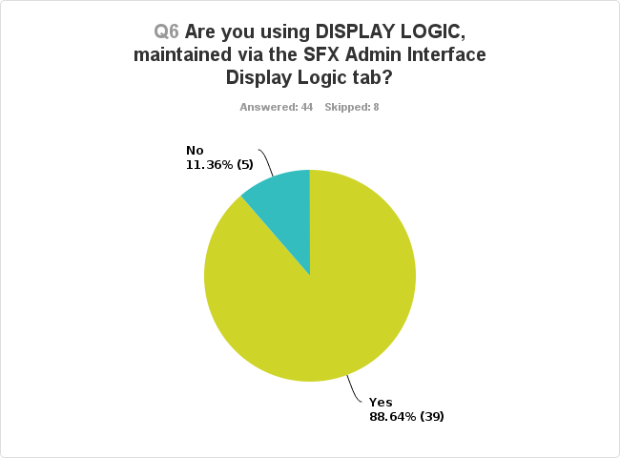
Notes:
Example: “if I have 55 EBSCO targets, I choose this EBSCO target to display”
And, you can also use this to choose NOT to display something – for example, if we have something from Elsevier ScienceDirect, we choose not to display Elsevier Freedom Collection.

Slide 22

Open Ended Questions
Notes:
Image credit: http://www.ilovetraveling.org/america/images/plant-sculptures-montreal-panda.jpg

Slide 23
Q7: How do you make your initial design decisions? How often do you revisit those decisions?
Triggers to change?
  New SFX version
  User feedback
  Review of usage statistics
  Availability of simplified template (introduced March 2008, SFX v.3)
  Ease of maintenance prompted move to simplified template
Barriers?
  Lack of staff expertise
  Lack of user feedback
  Don’t realize extent of SFX options
How often? (varied!)
  Never
  Every few years
  Once a year
  When there’s a trigger event

Slide 24
Q8a: What do you wish you could change?
“Able to turn on direct link for selected targets that we know are very reliable.”
Responsive design
Better way to maintain lists of targets and sources in Admin (i.e., direct linking, target precedence sorting.)
More granularity in display logic (i.e., a 3rd level)
More branding options in the simplified template
Better bilingual support
New window should open up matching the browser preferences set for size
Easier ability to support print holdings target from any OPAC.
Direct linking without banner (from Primo)

Slide 25
Q8b: What’s stopping you from making the change?
“The underlying HTML templates are quite out of date and difficult to work with e.g. deeply nested tables used to implement style details that should instead be externalized in CSS files.”
Old web encoding conventions: nested tables instead of CSS
Lack of usability studies
Lack of time and skills (institutional inertia)
Issues around related titles display (title history)

Slide 26
Q9: What comments do you hear about your SFX menu window design?
“Too complicated and I want to be redirected to the full text without an intermediate menu... ”
“Some feedback from users who do not initially recognize the links in SFX as links.”
We don’t get user feedback
Users prefer direct linking
“Confusing”

Slide 27
And our favorite…☺
"almost none, perhaps for lack of a feedback button.”

Slide 28
Q10: Other comments
"The most used resources are not at the top of the list. There are too many choices."
“We now use Bootstrap, which has made it more usable on mobile devices.”
“Librarians and colleagues are not always aware of what SFX is capable of, so the service is in my opinion underexploited.”
Notes:
First column: example of a target precedence issue from an institution using simplified.
One Solution: Better documentation for options in simplified template.
Bootstrap – if you’re using advanced, you can use other technologies. (interface is independent from backend.)
Underexploited: speaks to a lot of the barriers we mentioned – staffing, time, expertise, etc.

Slide 29
“We are grateful for the opportunity to customize our SFX menu. Many thanks to ExLibris for this flexibility.”

Slide 30

3. Discussion:
Tell Us About Your Experience.
3. Discussion:
Tell Us About Your Experience.
Notes:
Image credit: http://www.cdn.mumbaihangout.org/97/971bf00ac3156e13132434d452562dc6.jpg

Slide 31
Discussion Questions
If Ex Libris redesigned the SFX menu window to use responsive design and modern web encoding, would you move from the advanced template to simplified?
What’s the one thing any new design must have?
What are your compelling reasons for choosing the advanced template or the simplified template?
What would it take for you to move from advanced to the simplified template? What is missing now? Is it harder to move in one direction or the other? What breaks in the simplified template after software updates?
How much staffing is needed? Training?
Notes:
More questions:
have you found anything that breaks in the simplified template (ie, when Ex Libris makes software updates.)?
How much staffing is needed?

Slide 32

5. Wrap up/next steps
5. Wrap up/next steps
Notes:
SFX Product working group – working with SFX product manager
NERS enhancement request
Salesforce enhancement request
We will need to work with IGELU too!
Image credit: http://farm8.staticflickr.com/7386/9244825541_c6091b12fb_z.jpg

Slide 33

Thank you. Questions?
Notes:
Image credit: http://www.123inspiration.com/wp-content/uploads/2013/07/Mosa%C3%AFcultures-Internationales-Plant-Sculptures-8.jpg

Slide 34

Contact Us
Alison Ray alison.ray@ucop.edu
Information services
Margery Tibbetts margery.tibbetts@ucop.edu
Technical lead
Lena Zentall lena.zentall@ucop.edu
Service manager
California Digital Library
Our SFX team: CDL-SFX-TECH-L@ucop.edu
Notes:
Image credit: http://halshappenings.blogspot.com/2013/08/another-day-in-montreal.html
Phoenix

Slide 35

Advanced Template Examples
(by institution name)
Notes:
These screenshots are institutions using the advanced template for their SFX menu.
Image credit: http://img.designswan.com/2013/07/plantSculpture/6.jpg

Slide 36
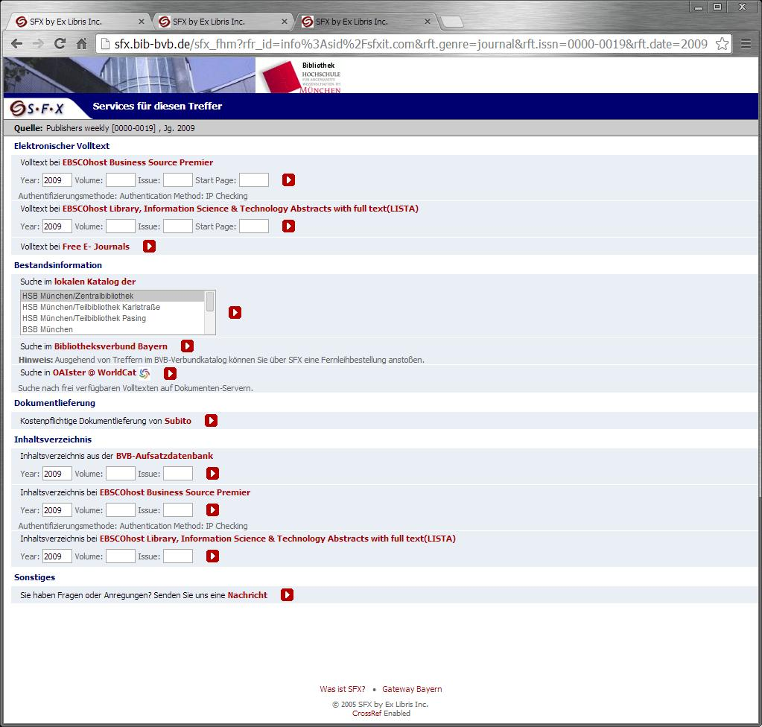
Hochschule Munchen (Bavarian State Library)
Notes:
SFX menu advanced templates

Slide 37
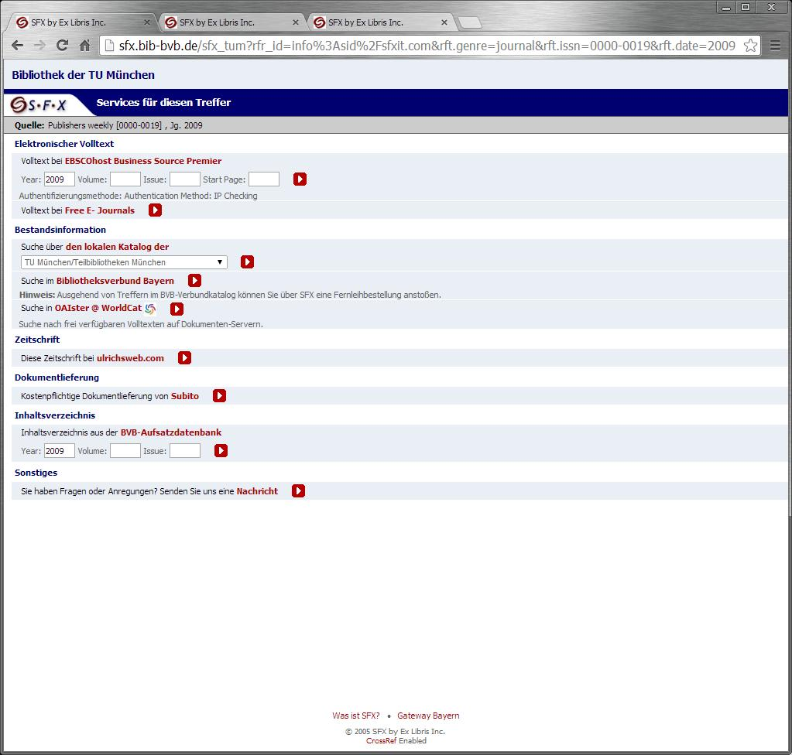
TU Munchen (Bavarian State Library)
Notes:
SFX menu advanced templates

Slide 38
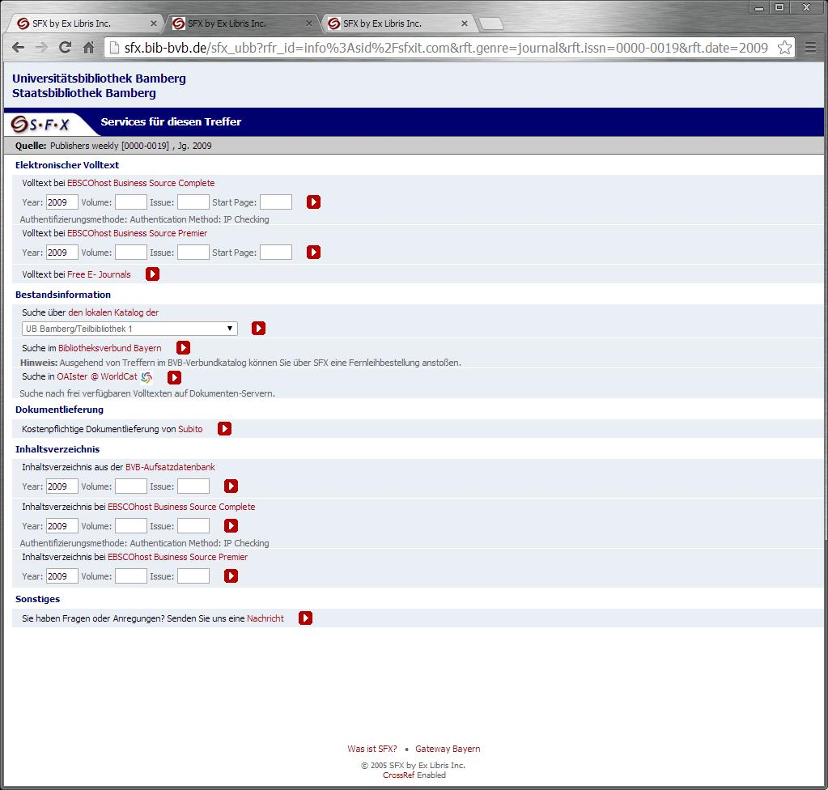
Bamberg (Bavarian State Library)
Notes:
SFX menu advanced templates

Slide 39
Jonkoping University
Notes:
SFX menu advanced templates
Language switch using flags – not SFX pulldown menu

Slide 40
Max Planck Digital Library
Notes:
SFX menu advanced templates
Tiny URL generation for menu window

Slide 41
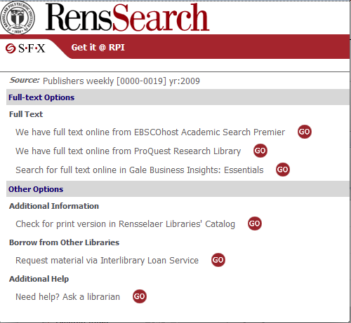
Rensselaer Polytechnic Institute (RPI)
Notes:
SFX menu advanced templates

Slide 42
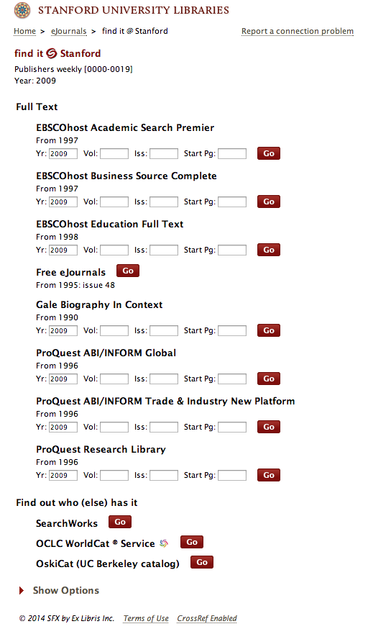
Stanford University
Notes:
SFX menu advanced templates

Slide 43
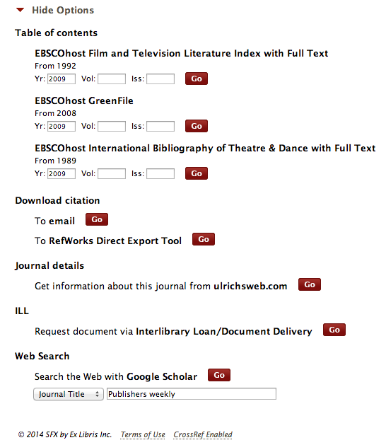
Stanford University
Notes:
SFX menu advanced templates
ADAVNACED options opened

Slide 44
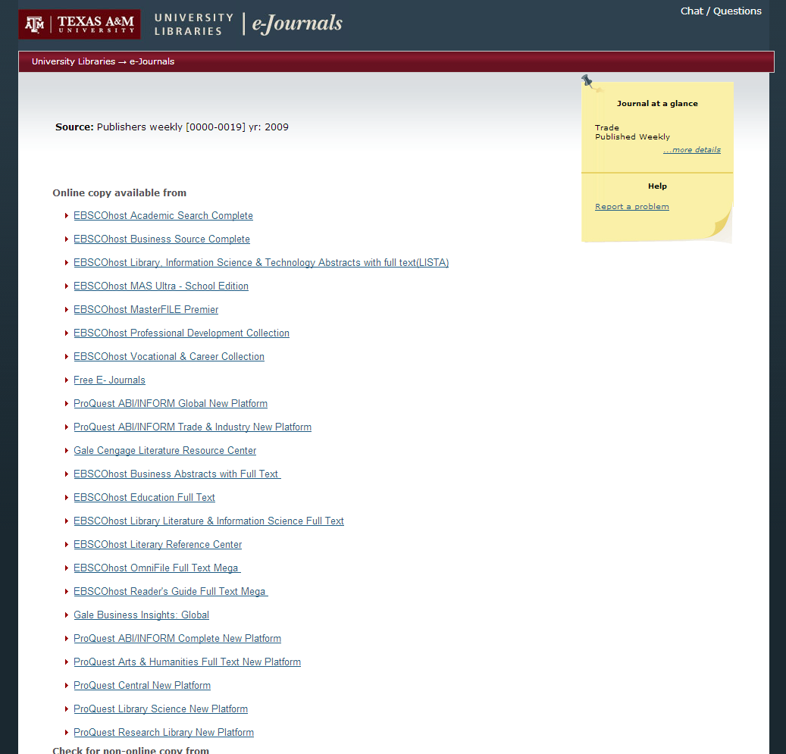
Texas A&M University
Notes:
SFX menu advanced templates

Slide 45
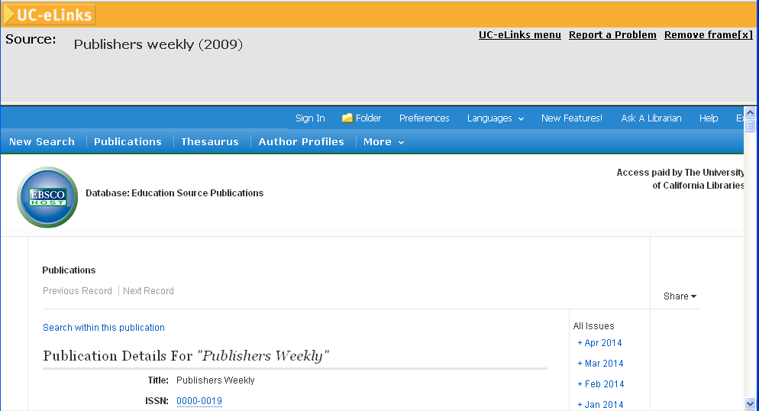
University of California
Notes:
SFX menu advanced templates
Direct link to EBSCO host
Direct link banner

Slide 46
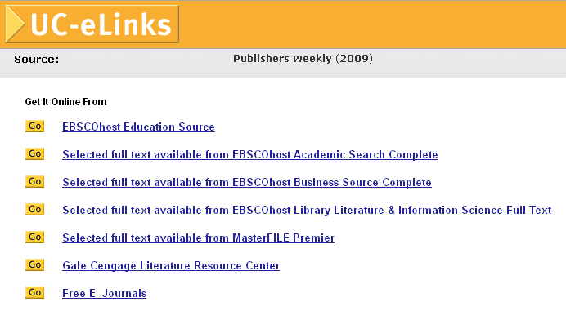
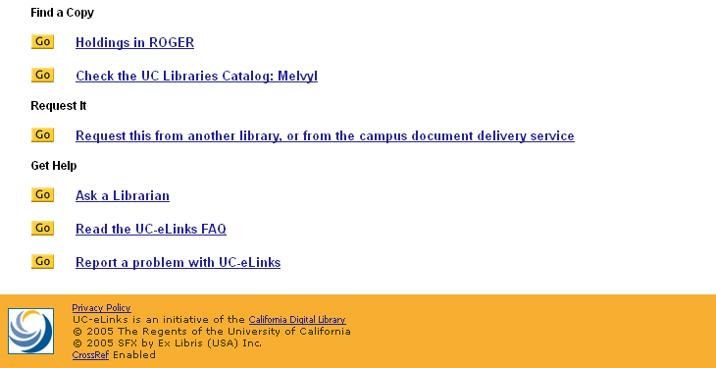
University of California
Notes:
SFX menu advanced templates

Slide 47
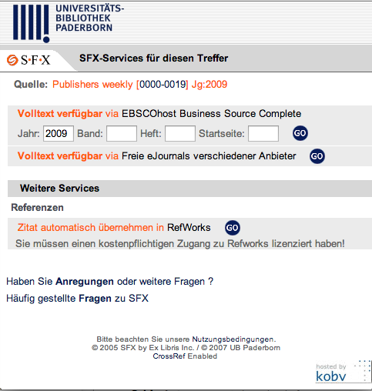
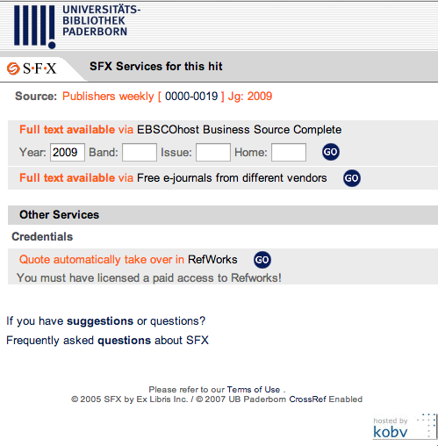
Universitats Bibliothek Paderborn
In German
In English
Notes:
SFX menu advanced templates

Slide 48
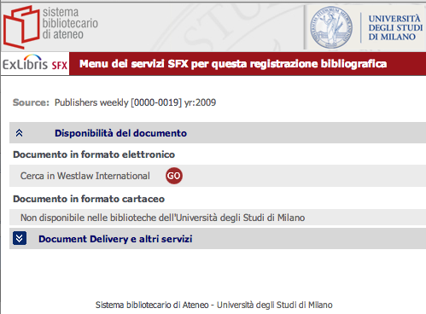
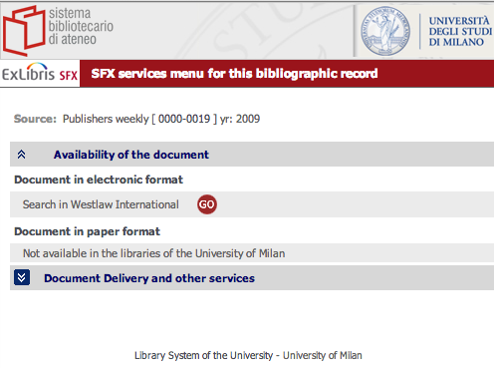
University of Milan
In Italian
In English
Notes:
SFX menu advanced templates
“Document delivery and other options “ - ADVANCED option label

Slide 49
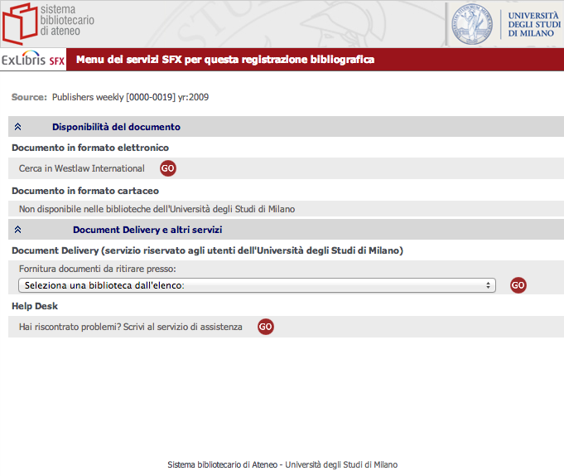
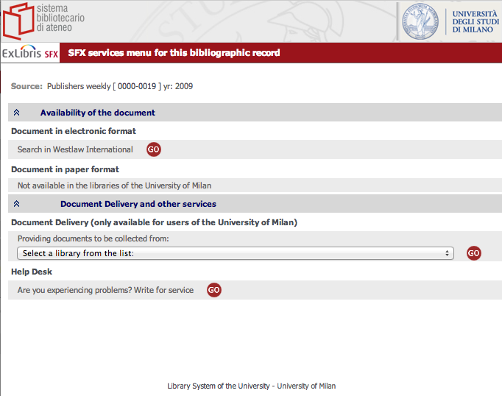
University of Milan
Italian –other services shown
English – other services shown
Notes:
SFX menu advanced templates
ADAVANCED options opened

Slide 50
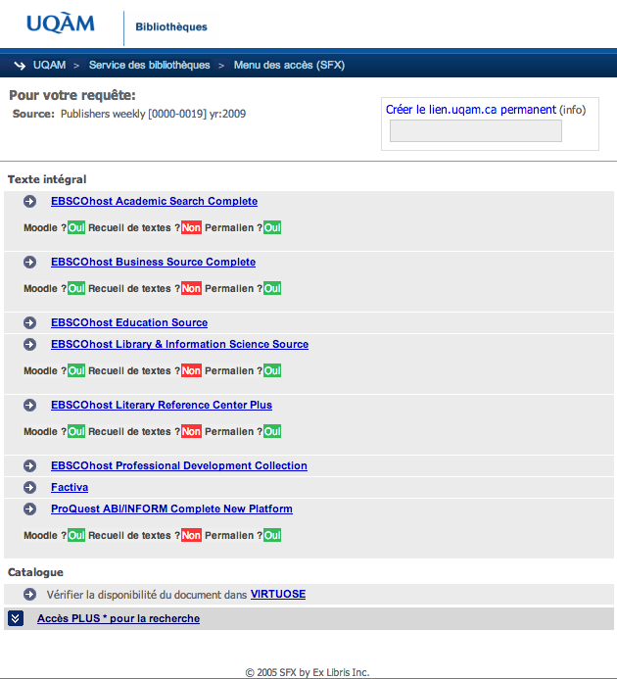
Université du Québec à Montréal
Notes:
SFX menu advanced templates
Incorporated basic license use terms for full text targets

Slide 51
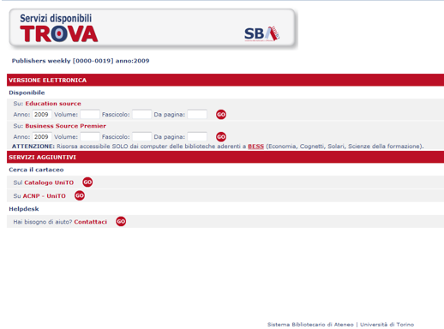
University of Turin
Notes:
SFX menu advanced templates

Slide 52
University of Wisconsin Madison
Top
Bottom
Notes:
SFX menu advanced templates
Incorporates a ‘citation linker’ window

Slide 53
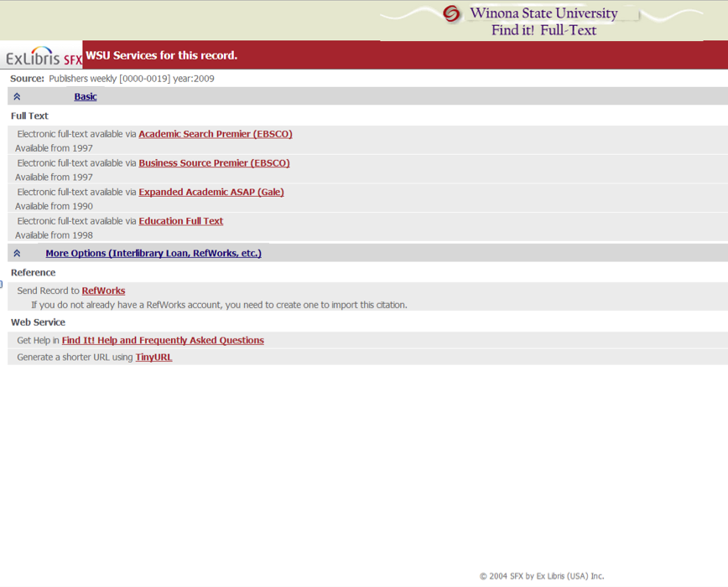
Winona State University
Notes:
SFX menu advanced templates

Slide 54

Simplified Template Examples
(by institution name)
Simplified Template Examples
(by institution name)
Notes:
These screenshots are institutions using the simplified template for their SFX menu.
Image credit: http://assets.inhabitat.com/wp-content/blogs.dir/1/files/2013/07/Mosaicultures-Internationales-de-Montreal-9.jpg

Slide 55
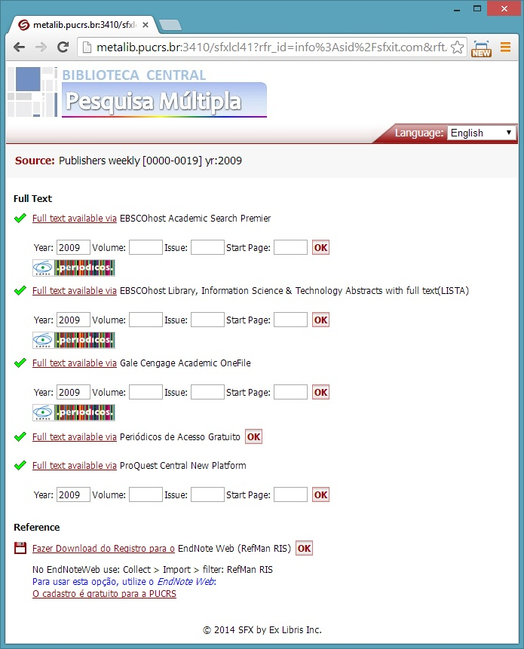
Biblioteca Central Pesquisa Multipla (55PUCRS)
Notes:
SFX menu simplified templates
SFX multiple language pulldown
Using service level icon
Hyperlink - service name
Includes fill-in boxes

Slide 56
CSU Monterey Bay
Notes:
SFX menu simplified templates
Using service level icons
Hyperlink on target name
Omitted GO button

Slide 57
Hampshire College
Notes:
SFX menu simplified templates
Using service level icons
Hyperlink on target name
Included fill-in boxed
Print holdings
Using Translation & Display options to change wordings

Slide 58
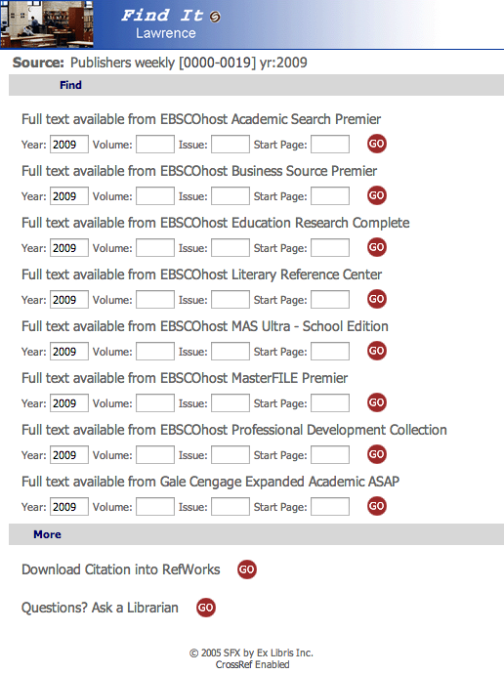
Lawrence University
Notes:
SFX menu simplified templates
GO button – no hyperlinks
Including fill-in boxed
Using Translation & Display options to change wordings

Slide 59
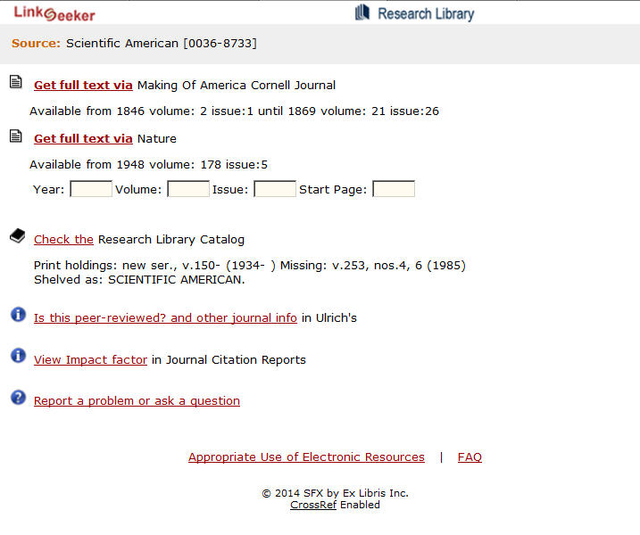
Los Alamos National Laboratory
Publishers weekly
Scientific American
Notes:
SFX menu simplified templates
Using service level icons
Including fill-in boxes
Hyperlink – service name
Using Translation & Display options to change wordings

Slide 60
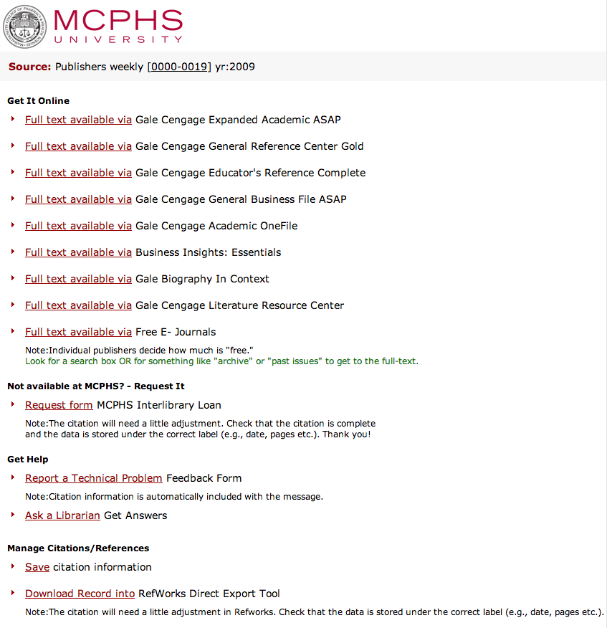
MCPHS University
Notes:
SFX menu simplified templates
Using default service level icons
hyperlink – service name
Omitted GO button

Slide 61
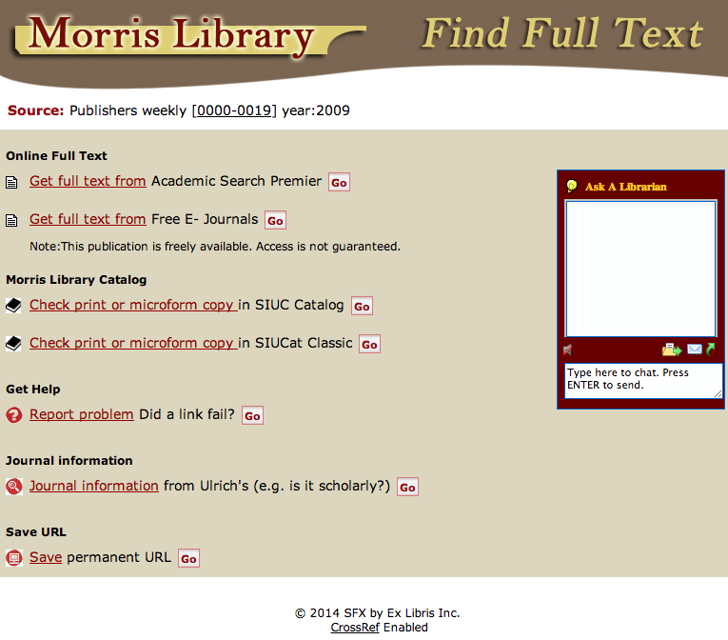
Morris Library
Notes:
SFX menu simplified templates
Using service level icons
Using Translation & Display options to change wordings
Ask a Librarian - CHAT window

Slide 62
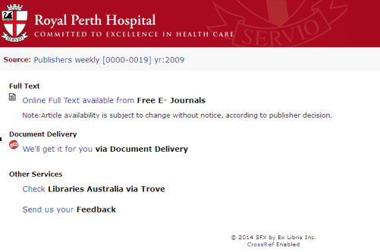
Royal Perth Hospital
Notes:
SFX menu simplified templates
Using service level icons
Hyperlink - target name
Omitted GO button
Using Translation & Display options to change wordings

Slide 63
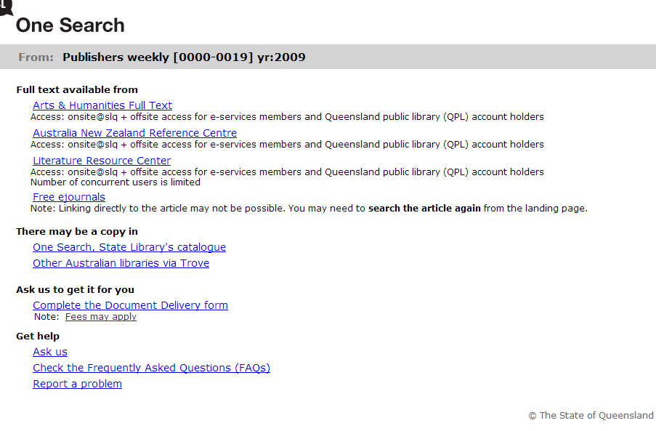
State Library of Queensland (Australia)
Notes:
SFX menu simplified templates
Hyperlink – target name
Omitted GO button
Access restrictions note
Using Translation & Display options to change wordings

Slide 64
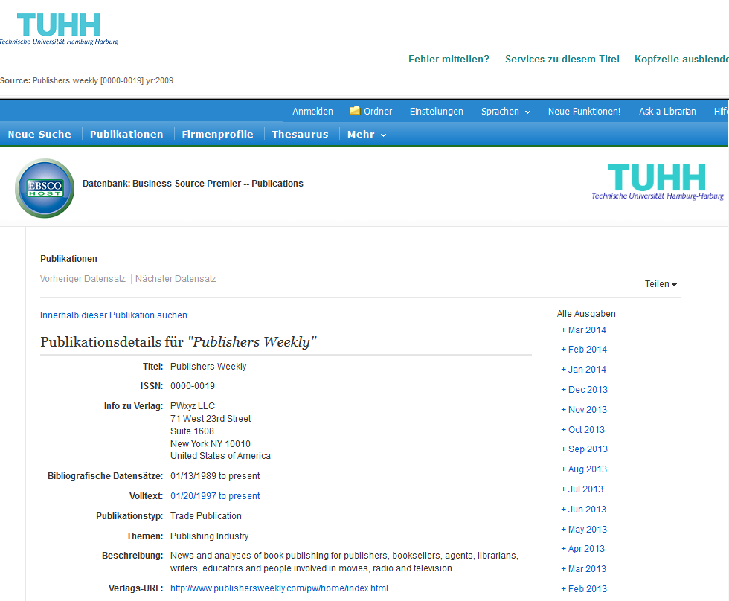
Technische Universitat Hamburg-Harburg
Notes:
SFX menu simplified templates
Direct link to EBSCO
Direct link in frame

Slide 65
Tel Aviv University
Notes:
SFX menu simplified templates
SFX multiple language pull down
Using service level icons
Hyperlink – target name
Omitted GO button

Slide 66
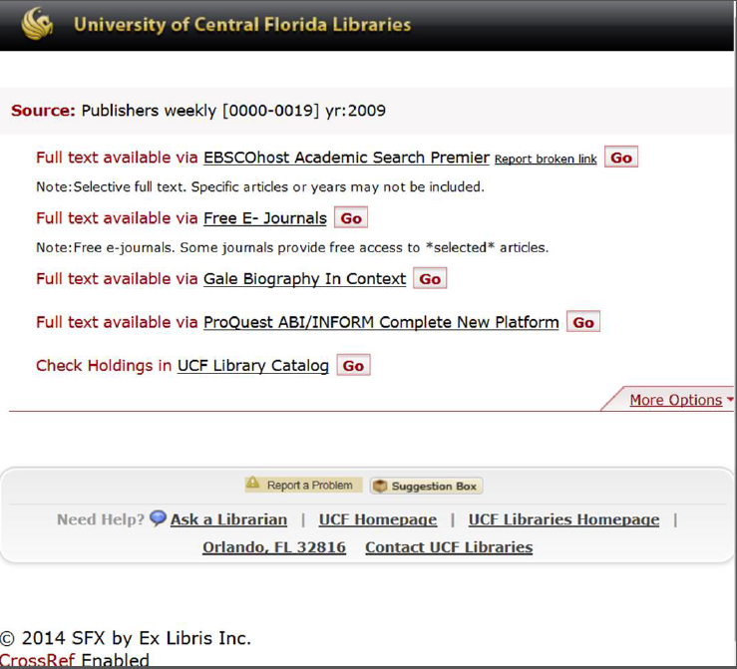
University of Central Florida
Notes:
SFX menu simplified templates
Hyperlink – target name
Footer

Slide 67
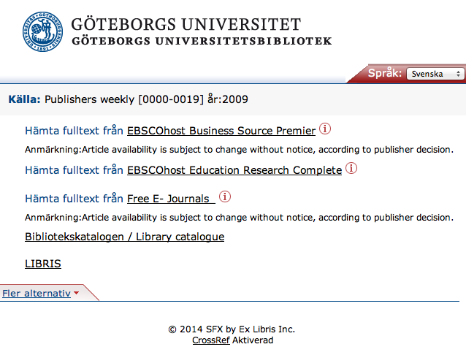
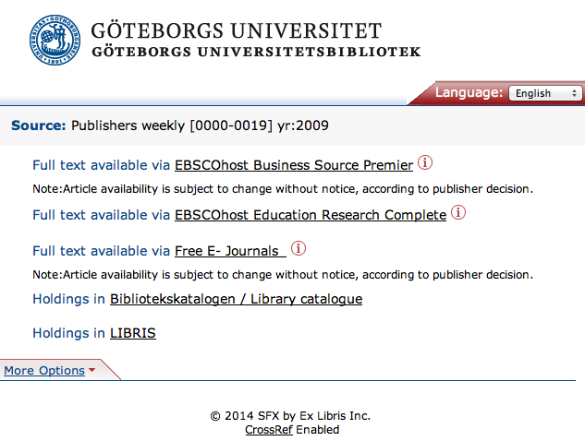
University of Gothenburg
In Swedish
In English
Notes:
SFX menu simplified templates
More information icon
Hyperlink – target name
Omitted GO button
Multiple language switch

Slide 68
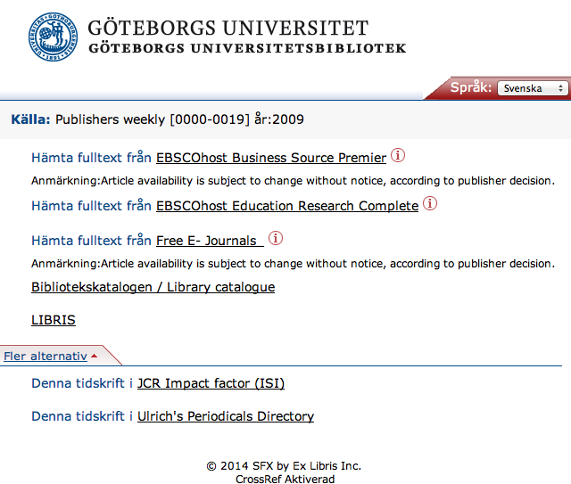
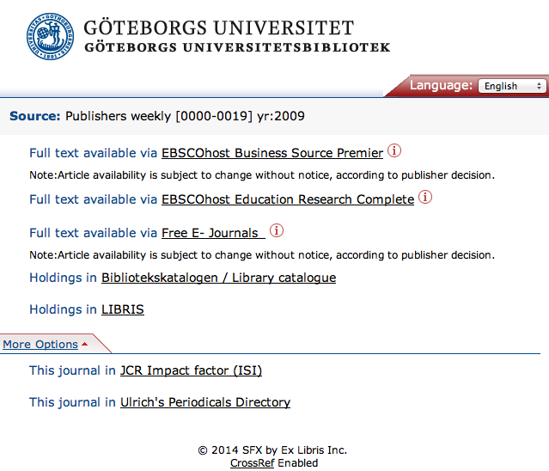
University of Gothenburg
Swedish – more options shown
English – more options shown
Notes:
SFX menu simplified templates
ADVANCED options expanded

Slide 69
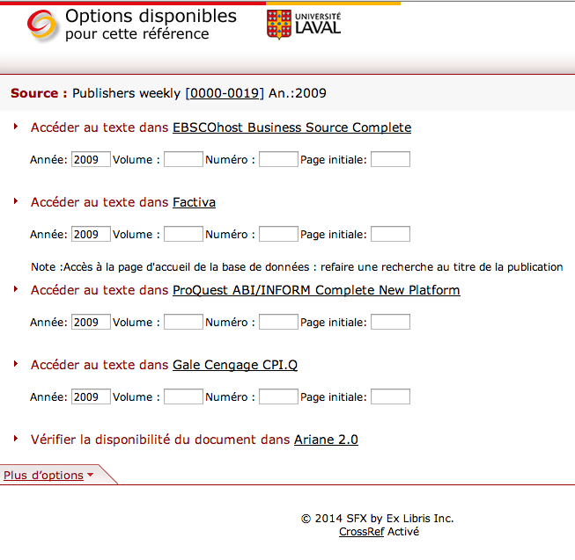
Universite Laval
Notes:
“be kind, he is 8 years old”
SFX menu simplified templates
Using default service level icon
Hyperlink – target name
Omitted GO button
Showing fill-in boxes
BASIC/ADVANCED options

Slide 70
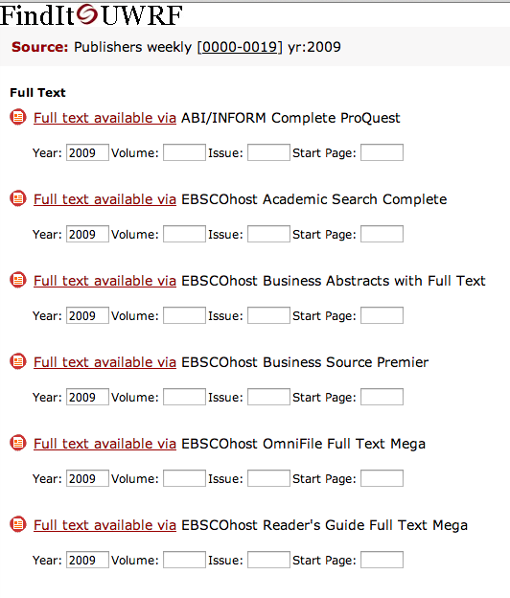

University of Wisconsin – River Falls
Top
Bottom
Notes:
SFX menu advanced templates
Using service level icons
Hyperlink – service name
Showing fill-in boxes
Omitted GO button

