Slide 1
Finding What You Know We Have
Known-Item Searching in a Discovery Environment
Jan Fransen
University of Minnesota – Twin Cities

Slide 2
Jeff Peterson
Jan Fransen
Janet Arth
Anne Beschnett /
Amy Clausen
Josh Bishoff
Jayne Blodgett
Sunshine Carter
Mark Engebretson
David Faust /
Malaika Grant
Stephen Hearn
Chris Koehler
Eric Larson
Darlene Morris
Arvid Nelson
Stacie Traill
MNCAT Discovery Implementation Group

Slide 3
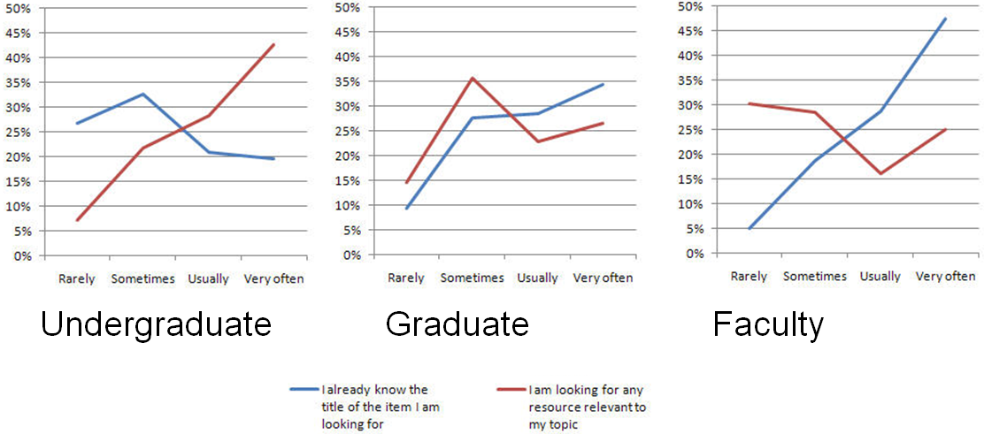
Why all the fuss?
Satisfaction surveys done by the U of M Libraries Primo Management Group in late 2009
Hessel, H., and J. Fransen. “Resource Discovery: Comparative Results on Two Catalog Interfaces.” Information Technology and Libraries 31, no. 2 (2012).

Slide 4
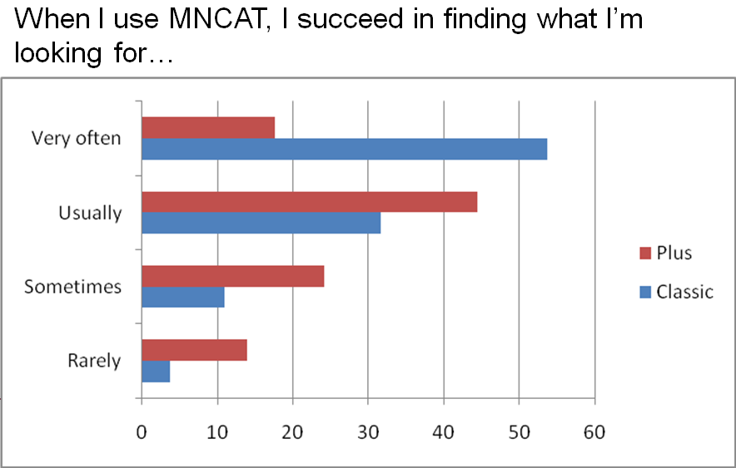
Satisfaction surveys done by the U of M Libraries Primo Management Group in late 2009
Hessel, H., and J. Fransen. “Resource Discovery: Comparative Results on Two Catalog Interfaces.” Information Technology and Libraries 31, no. 2 (2012).

Slide 5
But how often do they search for known items (really)?
55 percent of searches in University of Illinois at Urbana-Champaign’s log analysis
44 percent of searches in University of Michigan’s study
Schlembach, M. C., Mischo, W. H., & Bishoff, J. The Use of Transaction Logs to Model User Searching Behaviours.
Chapman, S., Desai, S., Hagedorn, K., Varnum, K., Mishra, S., & Piacentine, J. (2013). Manually Classifying User Search Queries on an Academic Library Web Site. Journal of Web Librarianship, 7(4), 401-421.

Slide 6
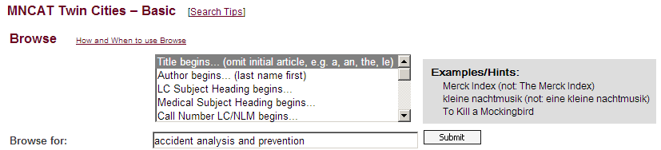
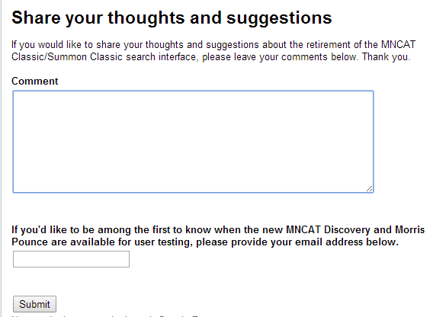
And then…

Slide 7
Please, PLEASE make the default search for whatever replaces MNCAT Classic be "Title begins" 95% of the searching I do is for known items that I know the title of. I hate having to go through multiple radio buttons and pull down menus just to do a simple title begins search!
I don't dislike change in general. I do dislike this change intensely. Known item searching is foundational to advanced research, and the replacement being provided is unsatisfactory.
Better to provide specific pointers on how to search most efficiently in the new MNCAT environment for a "known item."
I find MNCat Classic has much more accurate results when I search for a particular title or author. The new interface returns too many results to be useful, or sometimes none at all when I put the title in quotation marks.
I think the UMN Libraries need to keep in mind that some of your most frequent users know exactly what we need to find (we have a specific title or author), but we have very limited time for scrolling through lists of irrelevant results.
Comments collected from 5/8/13 to 12/26/13
Almost all comments were received in May and June.

Slide 8
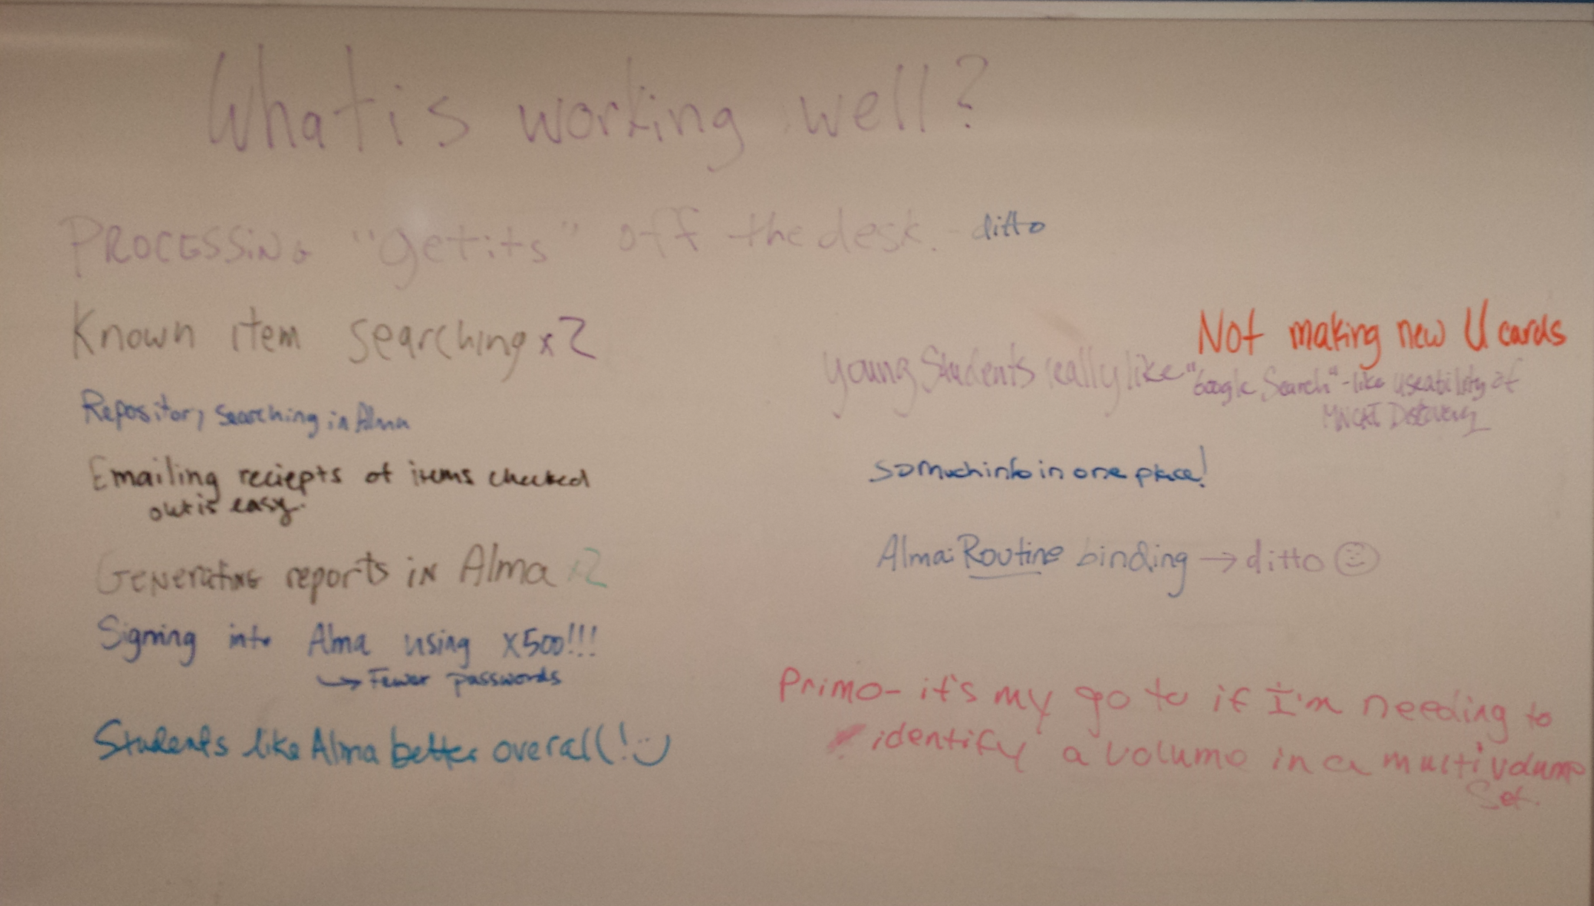
2/6/14 Library Staff Forum

Slide 9
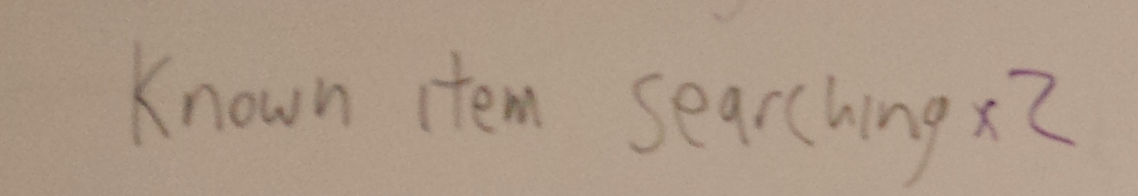

What is working well?

Slide 10
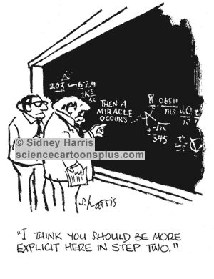
So how did we get there?

Slide 11
So how did we get there?
We knew Primo’s known item search success rates had improved (anecdotally)
  We needed to prove it
We knew the success rate wasn’t 100%
  It wasn’t in MNCAT Classic, either
  We needed people to know we were willing to work with them if they could give us examples

Slide 12
Proof
MNCAT Classic vs. Fall 2013 MNCAT
  (That’s Primo without Central)
Sample 1: 414 strings taken from actual Feb 2012 MNCAT Classic Title Browse searches
  37 journal searches, 377 all-Aleph searches
  Searched exactly as typed
MNCAT Classic: Basic screen, browse on title
MNCAT (Primo 3): Keyword search

Slide 13
What is success?
Considered found if result was in the first 10
If searching MNCAT and Did You Mean gave correct suggestion, considered found
Intent isn’t always obvious—there are some judgment calls

Slide 14
Results
Both worked equally well | 274 | 66%
MNCAT Classic found on first screen, MNCAT didn’t | 35 | 8%
MNCAT found on first screen, MNCAT Classic didn’t | 7 | 2%
Neither found on first screen | 98 | 24%

Slide 15
Where did Classic shine?
Partial words at the end of a long phrase (55%)
Subtitle or too much information included in search (17%)
Incorrect titles where the problem is AFTER the first words (7%)
Series titles or incorrect abbreviations (7%)
Annals of the American Academy of Political and Social Scien
Journal of hospitality and tourism technology
(Should be Journal of hospitality and tourism research)
phonetics and phonology 3

Slide 16
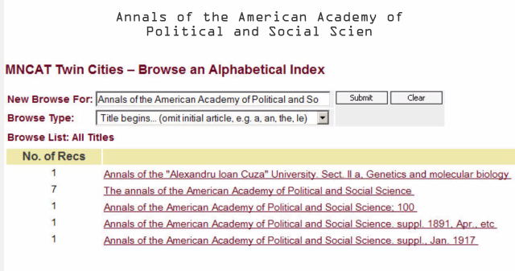
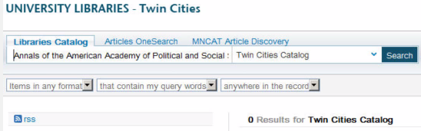

Slide 17
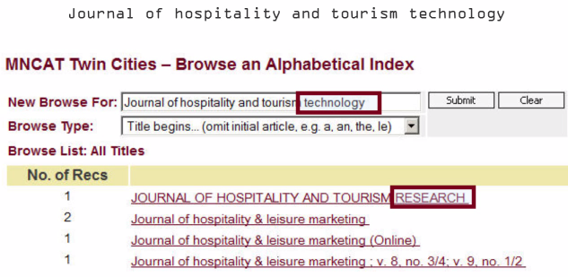

Slide 18
Where did MNCAT (Primo) shine?
Article included
Misspelling at the beginning of the phrase
  A Cross of Iron: Harry S. Truman and the Origins of the National Security State, 1945-1954
  The Clinical journal of pain
  The Harvard classics
  The lost Gospel of Judas Iscariot : a new look at betrayer and betrayed
europeen journal of archeology

Slide 19
Where else?
Didn’t look for cases where the MNCAT Classic Browse returned a matching result at the top, but clicking that item led you to many records
With MNCAT you can facet, so it would be better for that type of search
Examples
  Hamlet
  Criticism
  neurology
  New York Times

Slide 20
Tips for MNCAT Success
Get the title right
Spell it right
Don’t put in more than you need
If you don’t see what you expect, check for Did You Mean

Slide 21
And then we told people
Constant drum beat
  Just try it…
  And then tell us when you find something that doesn’t work
  “We can’t fix it if we don’t know it’s broken.”
YouTube Video!
  Focus on library staff, but available to anyone
  http://z.umn.edu/mncatbattle

Slide 22
“But I ALWAYS spell it right! And still…”
Sample 2: Random sample of MARC 245a fields from Aleph
  The most boring test you’ve ever seen
  So boring, we didn’t finish it
  If we own it and you spell it right, you’re almost always going to find it
We did identify a few instances of odd behavior and were able to fix records or tweak normalization rules

Slide 23
Adding Primo Central
December 26
  Aleph to Alma
  MNCAT + MNCAT Article Discovery = MNCAT Discovery
  Oh yeah, and moved to Primo 4.4.1
Phase 2 testing
  Same search set
  BUT corrected obvious spelling/typo

Slide 24
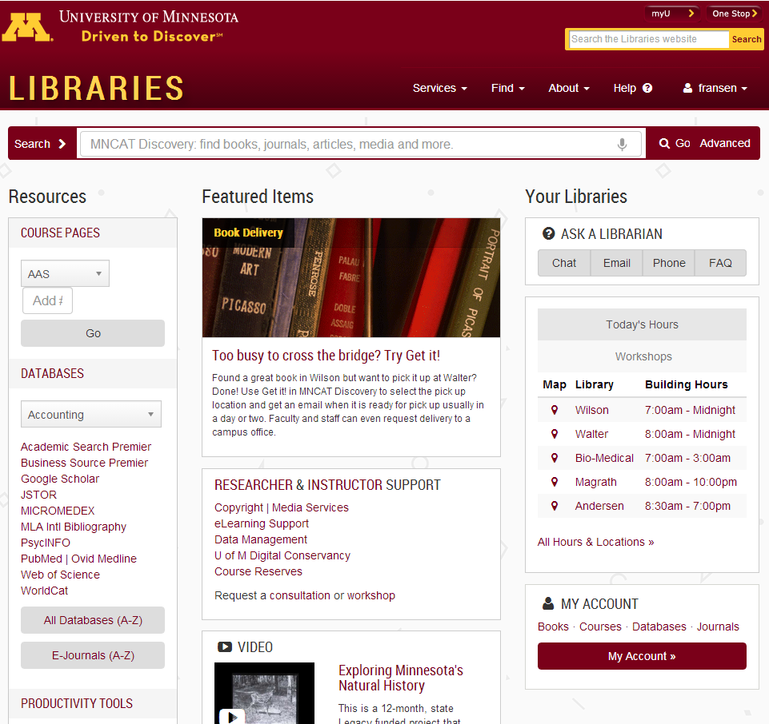

Slide 25
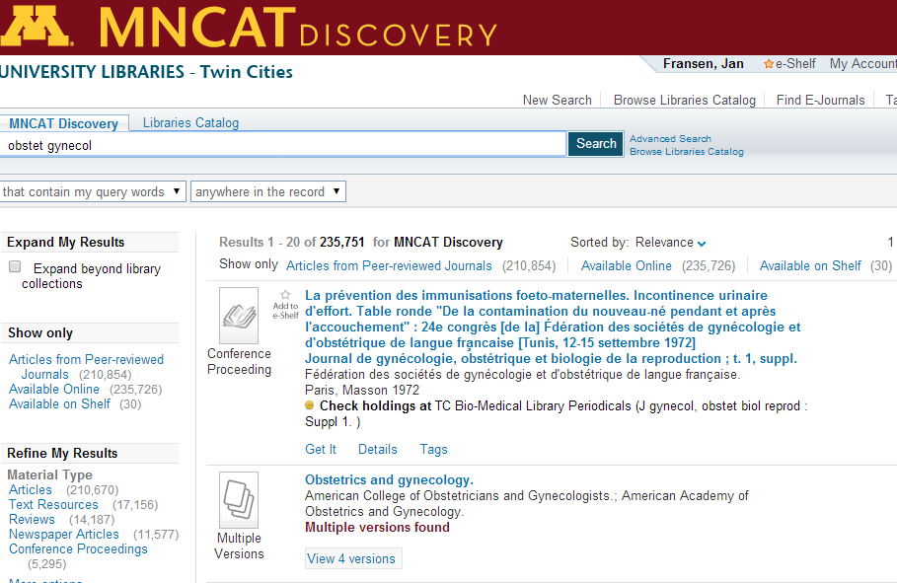

Slide 26
Results
Material Type | Found | Owned, but not found | Not owned
Journal | 89% | 5% | 6%
Book | 81% | 0 | 19%
Conference proceeding | 83% | 0 | 17%

Slide 27
Journals owned and not found
Search String | Notes
annals of the new york | Articles overwhelm. 2nd hit if I choose Libraries Catalog
j pharm sc | European Journal of Pharmaceutical Sciences is #2, and that's the only journal that shows up. Journal being sought is probably Journal of Pharmaceutical Science, and this abbreviation appears to be valid.
Journal of neuroimaging : official journal of the American Society of Neuroimaging. | First hit without the subtitle
Nw. U. L.. Rev. | Northwestern University Law Review (works unabbreviated); Discovery picks up individual articles from same
Obstet Gynecol | American Journal of Obstetrics and Gynecology, #2 (Valid abbreviation)
Popular Science 1946 | First hit without the year
SCI nursing : a publication of the American Association of Spinal Cord Injury N | Found with no subtitle
screen: the journal of the society for education in film | Found with no subtitle

Slide 28
More About Journals

Slide 29

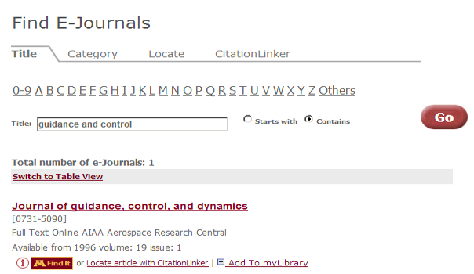

Slide 30
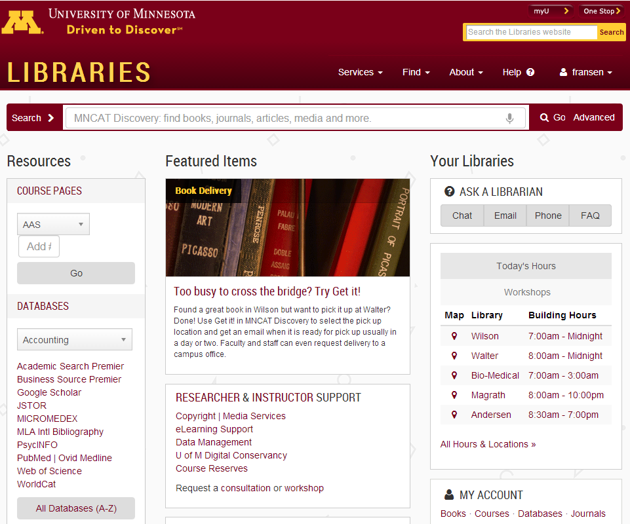

Slide 31
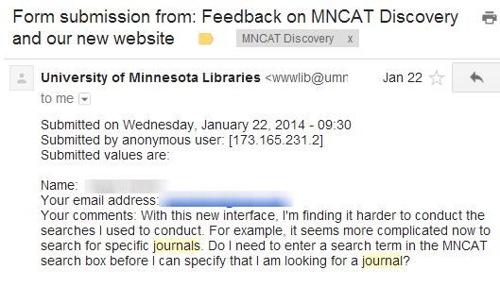

Slide 32
So what’s the problem?
MNCAT Discovery just doesn’t find journals by title reliably, or buries them under articles?
People don’t realize that they can just type the name in the Big Search Box?
People are systematically typing the names wrong?
People miss the functionality of the E-Journals list?

Slide 33
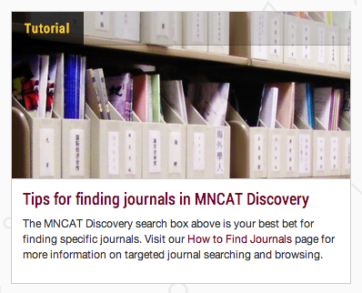
What did we do?

Slide 34
What should that link point to?
Find E-Journals (the A-Z list)
  Includes the word Journals!
  More tolerant of title variants than Title Starts With
  Better with abbreviations
Libraries Catalog Browse
  A little more like the SFX A-Z list
  More forgiving of errors late in search string
  Both print and online journals (BUT everything else in the catalog, too)
  Currently sorting by Date-Newest
  Several known bugs

Slide 35
Title | MNCAT Discovery | Browse (Popularity Sort) | Find E-Journals
The New England journal of medicine | 1 | 1 (without The) | 1
Nature | 1 | 1 | 1
Science | 1 | 4 | 1
Pediatrics | 1 | 1 | 1
Journal of the American Chemical Society | 1 | 1 | 1
JAMA | 4 | 1 | 1
Proceedings of the National Academy of Sciences |  | 1 | 3
PLoS ONE | 2 | 1 | 1
Annals of Internal Medicine | 1 | 1 | 1
Harvard business review | 1 | 1 | 1
The New York times | 6 | 1 | 5
Neurology | 1 | 2 | 1
Lancet | 1 | 1 | 1
Health affairs | 1 | 1 | 1
Chest | 1 | 1 | 1
Journal of personality and social psychology | 1 | 2 | 1
Journal of biological chemistry | 1 | 1 | 1
American journal of public health | 1 | 1 | 1
Journal of the American Veterinary Medical | 6 | 1 | 1
The American journal of psychiatry | 1 | 1 | 1
Circulation | 2 | 1 | 1
Archives of internal medicine | 1 | 1 | 1
Wall Street Journal | 1 | 1 (print) or 2 (online) | 1
The American journal of clinical nutrition | 1 | 1 (without The) | 1
BMJ. British medical journal | 1 | 1 | 1

Slide 36
Next Steps
This summer
  We’ll renormalize, and move to Primo 4.6
  Test the same set again to make sure we gained and didn’t lose in the Known Item game
Usability Lab
  Test discovery-to-delivery workflow
Ongoing
  Respond to specific problem queries
  Analyze what people are searching

Slide 37
Fun with Google Analytics

Slide 38

What ARE they searching?
How did they start their search?
Google Analytics on Libraries home page
January 21 – April 18, 2014

Slide 39
Most frequent search string?
Harvard Business Review (174)
JSTOR (173)
Nature (164)
Science (151)
PubMed (134)
Oxford English Dictionary (114)
Journals (102)
Web of Science (93)
Scientific American (90)
Pennsylvania Literary Review (86)

Slide 40
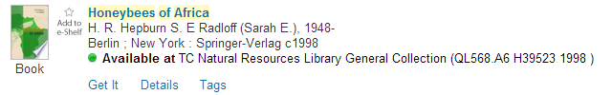
What about the first book?
66 searches

Slide 41
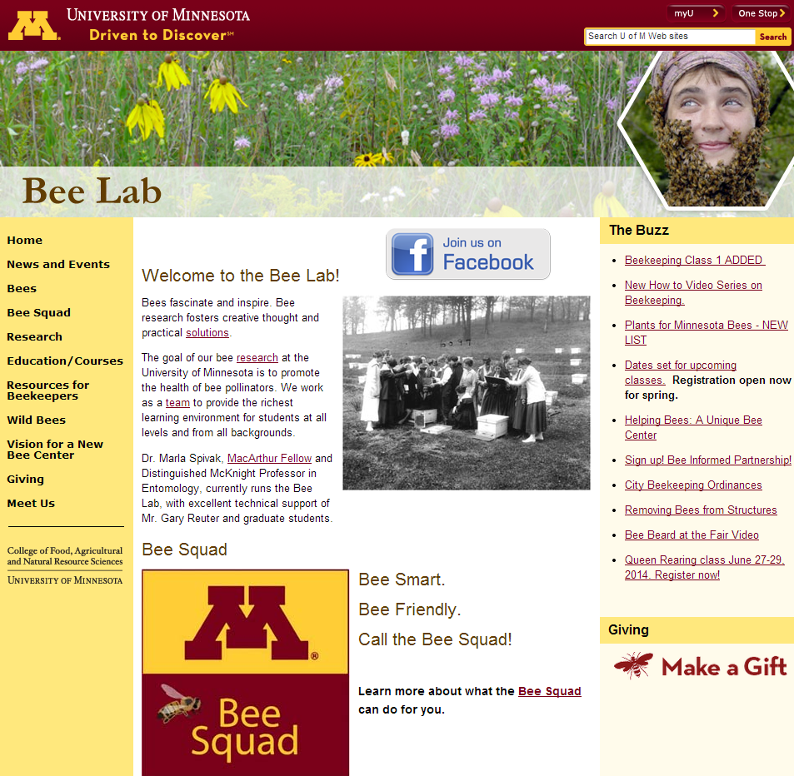

Slide 42
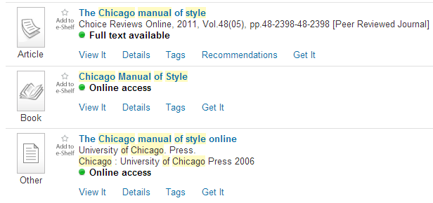
Next book?
50 searches
#26 on the list

Slide 43
Most unexpected top 20 result
rates of reaction of sodium borohydride with bicyclic ketones
78 times!

Slide 44
Number of times users searched for “hours”
Hours (3)
Spring break hours (1)

Slide 45
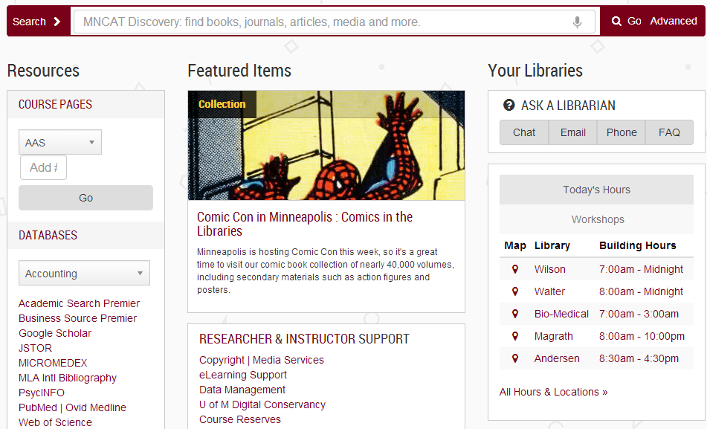

Slide 46
Number of words in a search string (average)
Average = 4.87
Minimum | 0
1st Quartile | 2
Median | 3
3rd Quartile | 6
Maximum | 504

Slide 47
504?!
\t Buy this book together with History of Syria, Including Lebanon and Palestine by Philip Hitti Origen’s construal of the Bible as a textual incarnation of the Word encourages an assimilationist interpretation of the Hebrew Scriptures as a proto-Christian gospel. Although in partial agreement with this thesis, this study suggests a non-assimilationist reading of Origen’s biblical exegesis. \t+\tA detailed history of Syria, Lebanon, and Palestine from the earliest times until the 20th century.\tSave $44.52 Total List Price: $296.82 Buy both books for only $252.29 Quantity: Customers who bought this book also bought: \tThe Jewish Neo-Aramaic Dialect of Urmi by Geoffrey Khan This volume presents a description of the Neo-Aramaic dialect that was spoken by the Jews of Urmi in north-western Iran but which is now virtually extinct. The material for the volume was gathered firsthand in fieldwork conducted with the last remaining speakers in Israel. The volume consists of a detailed grammatical description, a corpus of transcribed texts, including folktales, historical accounts and portrayals of customs, and an extensive glossary. Quantity: \tThe Archaeology of Cult in Middle Bronze Age Canaan by Jill Katz What was Canaanite religion like during the Middle Bronze Age, at the time of the of the biblical patriarchs? This volume presents a theoretical model for identifying ritual behavior in the archaeological record, providing a test case using the rich material culture and structures that have been unearthed at the biblical city of Gerar (Tel Haror, Israel). Quantity: \tDischronology and Dialogic in the Bible’s Primary Narrative by David Bergen This ground-breaking study offers a reassessment of Moses' book of the law from a narrative theory perspective. Concerned for the long-term viability of his people, Moses legislates a public reading of his document which is deposited next to the ark of the covenant as a national testament. Through the mechanics of narrative mediation, the narrator reveals to the reader of Deuteronomy the contents of Moses' enshrined publication. Deuteronomy's simulcast of Moses' book invites external readers to compare and evaluate their readings with story-world readers who access the same text within the Bible's Primary Narrative. Quantity: \tJacob of Sarug’s Homily on the Tower of Babel by Aaron Butts This edition of Mar Jacob of Sarug's (d. 521) homily on the Tower of Babel develops an extended word-play between “morduto” ‘rebellion’ and “marduto” ‘discipline.’ As is characteristic of Jacob, the characters, their personalities, and their motivations are developed far more than they are in the biblical narrative. The volume constitutes a fascicle of The Metrical Homilies of Mar Jacob of Sarug, which, when complete, will contain the original Syriac text of Jacob's surviving sermons, fully vocalized, alongside an annotated English translation. Quantity: \tInterpretation, Religion and Culture in Midrash and Beyond by Lieve Teugels The third issue of Proceedings of the Midrash session at the SBL Annual meeting published in this series. This volume contains papers on religion in midrash (2006) and modes of biblical interpretation in rabbinic, Syriac and Islamic traditions (2007). Quantity: \t previous | up | next The Spell of the Logos}

Slide 48
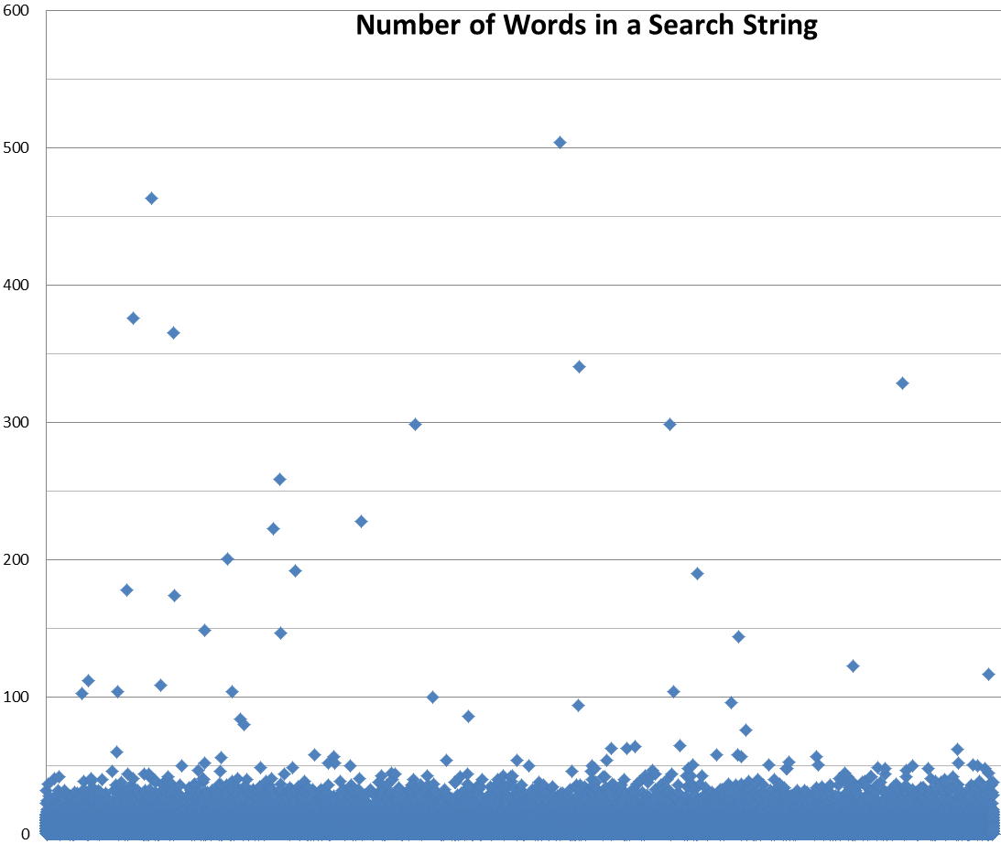

Slide 49
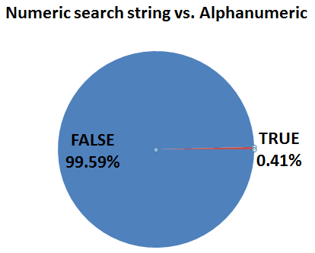
How often do people search by ISBN, ISSN, or another number?
Not very often
BUT that’s 550 searches

Slide 50
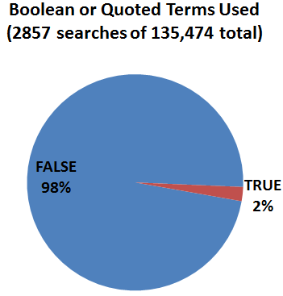
How often do they use Boolean operators or quotation marks?
A little more often

Slide 51
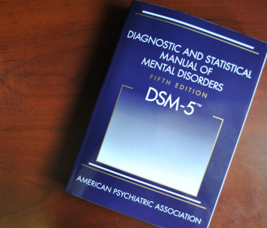
Just how many ways are there to search for DSM 5?
Search String | Search Count
DSM 5 | 29
DSM-5 | 23
dsm | 22
dsm v | 10
DSM-V | 4
DSM - 5 | 3
Dsm5 | 2
Diagnostic and statistical manual of mental disorders : DSM-5 | 1
Diagnostic and Statistical Manual of Mental Disorders: Dsm-5 | 1

Slide 52
Questions?
Jan Fransen
fransen@umn.edu

