Slide 1
Take the travail out of your work! Work orders explained
Siôn Romaine, University of Washington Libraries
Chelle Batchelor, University of Washington Libraries

Slide 2
Agenda
What are work orders
How work orders are configured
Types of processes
Deciding HOW to configure your work orders
Managing your queue
Demo
Q&A
Notes:
Sion; What we’ll cover today:
1. What are work orders & what you can use them for
2. How work orders are configured
3. The types of processes you might want to use a work order for
4. Things to consider when configuring your work orders
5. Where to manage your work orders
6. Demo

Slide 3
What are work orders?
A type of request (like patron holds or resource requests)
A way to track a physical inventory process
  Reserves, Branch Processing, Preservation
A way to indicate a series of steps in a workflow
Easily customizable
Notes:
Sion

Slide 4
Example Uses
Repair, At Bindery, other processes that take items out of circulation
Reserves processing department
Selector Review
Technical services workflows
Other?
Notes:
Chelle

Slide 5
Basic Work Order Workflow
Optionally, Item gets Requested
Item is placed into a Work Order Process Type and Work Order location
Optionally, Item is operated upon
Work Order is Completed and item is returned to its “home” location
Notes:
Chelle

Slide 6
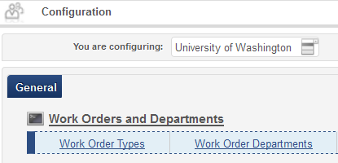
Configuration - Where
ADMINISTRATION
  General Configuration
  Configuration Menu
  Work Orders & Departments
Requires General System Administrator Role
Notes:
Sion; Note that to add a Work Order Type to a Circulation Desk, you only need the Fulfillment Administrator Role.

Slide 7
Configuration - How
Create a Work Order Type
  What are the statuses or steps in your process?
2a. Create a Work Order Department
  What department(s) will manage the work order?
  Which operators will manage the work order queue?
  May represent a library unit, a library desk, or both
  Separate from circulation desks & acquisitions units
  - OR -
  2b. Link Work Order Type to Circulation Desk*
  *From Fulfillment Configuration menu
Notes:
Sion: Step 1: Create a work order type. Think of the work order type as the overall name of the workflow you wish to manage or control. For example, you might have a work order for “repair” or one for “cataloging” or one for “gifts”.
Step 2: Create the Work Order Department. The Work Order Department is the unit that will manage and is served by the work order type. As part of the Work Order Department creation process, you can add the Work Order Operator role for that department to the users you choose.
Example of a Work Order Department might be “Preservation Department”, which might manage the “Binding” work order type, or “Main Circulation Desk”, which might manage a “Repair” work order type. Note that although the Work Order Department may represent a library unit, a library circulation desk or both, it is not linked to any circulation desk.
Should you wish to link a Circulation Desk to a work order type, you may do so by going to the Fulfillment Configuration Menu. Unlike Work Order Departments, it appears that a Circulation Desk may use multiple work order types.

Slide 8
Configuration – Work Order Types
Work order types may serve one or many departments or desks
But a Work Order Department may only use one work order type
Bothell Campus Repairs
Repairs
Tacoma Campus Repairs
Seattle Campus Repairs
Notes:
Chelle: A work order type may serve one or many department or desks. For example, at the University of Washington, the “Repairs” work order type could be used by the Bothell Campus Repairs Department, the Tacoma Campus Repairs Department, or the Seattle Campus Repairs Department.
However, a Work Order Department can only manage one work order type. The Seattle Campus Repairs Department, for example, cannot manage a “Repairs” work order type and a “Binding” work order type. You must set up two separate departments to manage different work order types, even if in reality you really only have one physical department that handles both work order types.

Slide 9
Things to consider
Will the process serve multiple departments?
What are the common steps?
  Will the item be retrieved from the shelf by circulation staff?
  Will the item be processed by more than one person within the work order department?
“In Transit”
Notes:
Chelle: Consider whether a single work type can serve multiple departments. At a large institution, it may be more efficient to have several departments share a work order type, if the processes are the same, than create many customized work order types for every unit.
Perils of “In Transit”

Slide 10
Decision-making
Consultation with staff who “own” the workflow
  In a large system, this will need to be cross-departmental
Consideration of other options
  Permanent locations
  Temporary moves
  Internal/departmental user accounts
  Use of personal user accounts
Notes:
Chelle

Slide 11
Scenarios
Reserve
Classroom use
Selector review
Notes:
Chelle
Work Order Decision Scenario 1
Reserve
-Our Reserves department is in a separate location from the Circ Desk
-Reserves staff were/are not ready to give up control (tracking items closely, following up on issues)
-Faculty were not ready to give up control (multiple loan periods)
-Staff were missing the “Reshelve to Reserve” note when they scan an item in, and were sending items to be reshelved in stacks.
-We set up a Reserve Work Order type and Work Order Department so items would go In Transit to Reserve for processing prior to shelving.
-This created extra steps once the item arrived in the Reserves department, since it needed to be scanned in to the department and scanned out.
-We’re now moving toward using the Temporary Move and Fulfillment Note and eliminating the Reserve Work Order
Classroom Use
Staff and faculty have the same fines & lost item fees as students
Staff need to take items to classrooms, but don’t want to check them out on their personal patron record
We considered using work orders for this purpose, and rejected the idea up until April 2014
It was going to be too labor intensive, and training intensive, to teach all the librarians who typically don’t do circulation how to scan items into a work order department and complete them
Now we can add this work order to our Circulation Desk, and easily move items in and out of the classroom use status with a single step

Slide 12
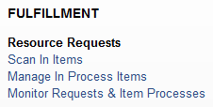
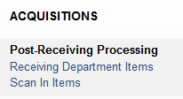
Managing your queue
FULFILLMENT
  Resource Requests
ACQUISITIONS
  Post Receiving Processing
Work order notes
Notes:
Sion: Depending on the roles, departments and desks assigned to you, you may choose to manage your queue from either Fulfillment or Acquisitions (or both).

Slide 13
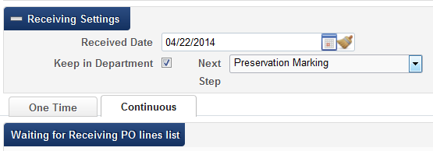
“Keep in Department” work order
Integrated into Alma Receiving Workbench
Allows materials to be placed in a Technical Services work order process at point of receipt
Serves all acquisitions / technical services units
Notes:
Sion: The “Keep in Department” or “Acquisition technical services” work order type is integrated into the Alma Receiving Workbench. It allows Receiving Operators to place items into a tech service work order process as part of the receiving process. This work order type serves all technical services units; if you have multiple acquisitions units, or if you have separate acquisitions and cataloging units, you’ll need to manage everything through a single department.

Slide 14
Acquisitions Demo
Scenario 1: Item is received in Acquisitions then sent to another technical services unit for further treatment
Scenario 2: Item is sent by unit to technical services for maintenance
Notes:
Sion

Slide 15
Fulfillment Demo
Scenario 1: circulation desk staff discover item needs repair; sends it to Repairs department using Work Order Request function
Scenario 2: Repairs department uses Work Order Request function; item appears on Pick From Shelf list
Scenario 3: Repairs department has items in hand, uses Scan In Items.
Notes:
Chelle

Slide 16
Questions
Chelle Batchelor – bchelle@uw.edu
Siôn Romaine – sromaine@uw.edu
Notes:
Chelle

