Slide 1


Creating Prompts in Analytics for Dashboards
Notes:
Introduce self.
Umanitoba. Work in Library Systems, general systems administrator. I “grew up” in the electornic rsources department of our library. We started out with an homegrown management system for Eresources, Access, moved that to Verde. I’ve worked in SFX from 2003 to 2014, we had Summon for about 3 years, then in 2012 we moved to Primo. In 2013 we migrated from Sirsi Dynex’s Symphony to Alma, going live in January of 2014. we’ve been on Alma now for just over 2 years.
This session will end up showing you how to create a dashboard by default, but basically we’re focusing on how to create a reusable prompt in Analytics. There are going to be step by step instructions in the slides, and all of this will be made available in the Document Repository on the ELUNA website after the conference. You can also email me for a copy. The accompanying hadn out wil also get on the doc respository.

Slide 2

Why Use Prompts in Analytics
Time Saving
  Creating reports
  For the User
Saved as objects; reusable in other dashboards
Image by Tsahi Levent-Levi https://flic.kr/p/cBFFBS
Notes:
From the Oracle website: A dashboard prompt is a specific kind of filter that, when created, saved and applied to a dashboard or dashboard pages can filter all of some of the analyses embedded in the dashboard or dashboard pages.
A Dashboard prompt is interactive and is always displayed on the dashboard page so the user can prompt for different values without havig to rerun the dashboard.
https://docs.oracle.com/cd/E23943_01/bi.1111/e10544/prompts.htm#BIEUG10761

Slide 3
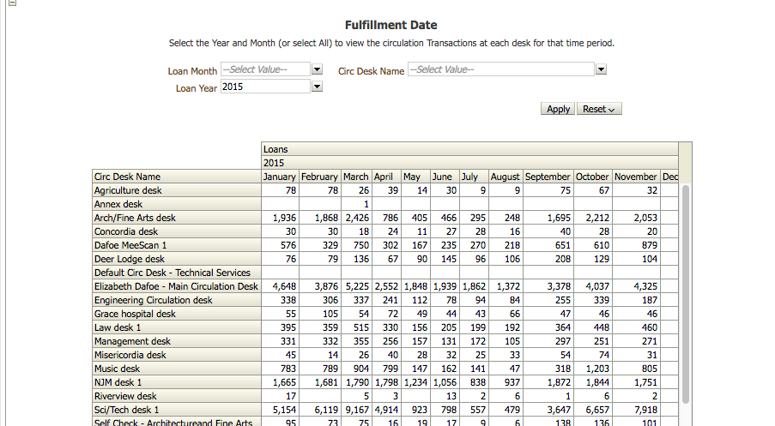
Examples
Notes:
Here, the arrow points to the prompt. The prompt applies to all reports on this page, so you only need to select the Circulation Desk once, and it will filter both the Loans and Returns reports on this page.

Slide 4
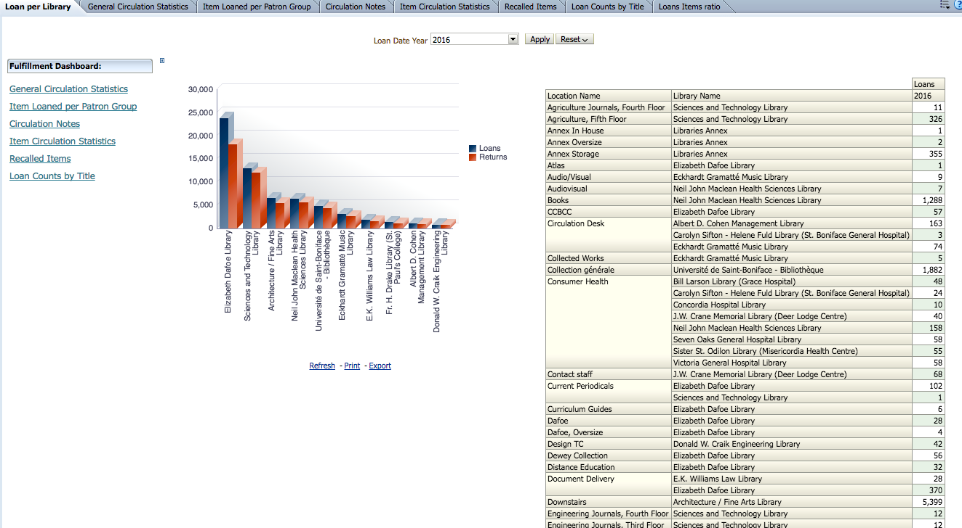
Examples
Notes:
Here is another example of a report with a promot. This is the out of the box fulfillment dashboard created by Ex L. The prompt you can apply is up at the top, the loan date year.
Once applied, it affects boththe graph and the table on the page, as well as the other tabs of information.

Slide 5
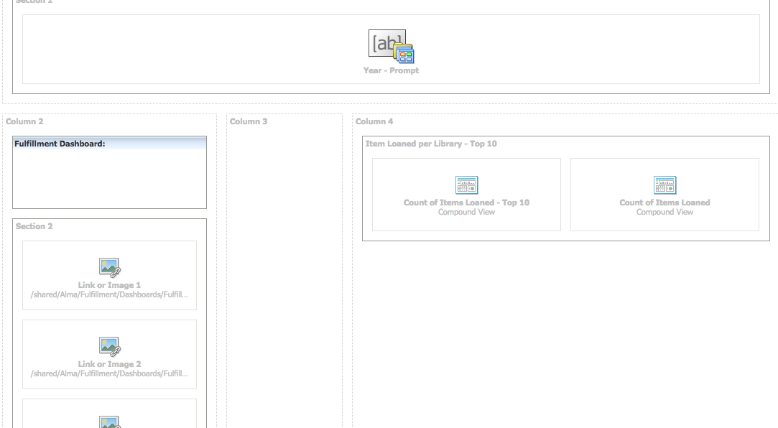
In Edit Mode
Notes:
Just to give you an idea of where the prompt is applied; here is a screen shot of this prompt from the Edit mode of this dashboard.

Slide 6
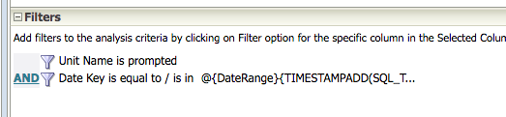
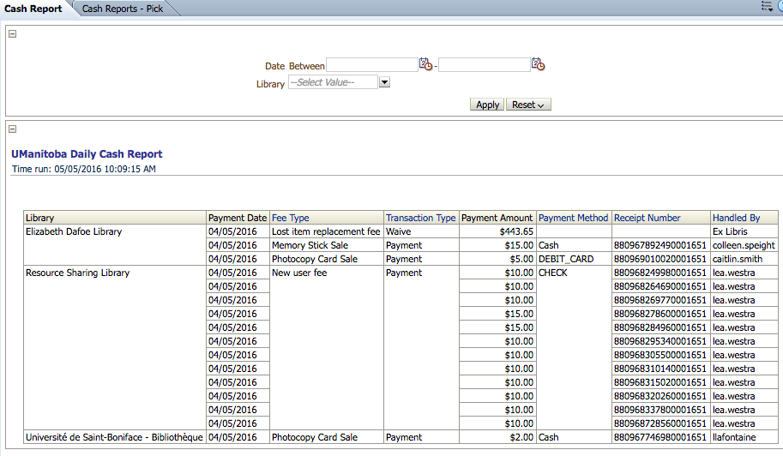
Examples
Shout out to:
Michael Johnson
UMinnesota Libraries
Data Systems & Services
Notes:
This is showing the settings for a variable date prompt. This prompt will default to yesterdays data, unless you enter a date in the prompt we create. I’m going to do a live demo of how to create a prompt from the next slide, then we will go step by step how to create this rpromt that you see here.
The context for this report is that at our University, we create a daily “cash report” that shows all the money collected at all the different Units for various fines or fees. It’s always based on Yesterday’s data.
We wanted to create on in Analytics because the staff didn’t like seeing all the information that came out of the Alma fines and fees report, and also, because we have had instances of staff members modifiying the cash reports in the past so the report matches the cash on hand, and not the cash on hand matching the report. I doubt this has happened in a very long time at our institution, but we did it this way.
This report will allow you to, without having to go to a different report, see yesterdays cash report, or see any range of dates you choose for your library. Some libraries don’t collect cash every day, so they can just use this to make a weekly report.
But, since I don’t want my staff to waste their time every day having to enter yesterdays date in the prompt, I had it default to always yesterdays Data.
I want to give a huge shout out right now to Michael Johnson at the U Minnesota Lbiraries for showing me how to do this. I started playing with it because someone on the List Serv asked how to create a prompt that would pass one date (of the same format) to many different dates, so you didn’t need to waste your time figuring this out. So, you have one prompt that will pass the same date to filters for Loan Date, Return Date, Renewal Date, etc, so you can run all these reports on one page and get the data.

Slide 7
How do you create prompts
https://na01.alma.exlibrisgroup.com/mng/login?institute=01UMB_INST&auth=local
Go to Design Analytics

Slide 8
How to Build a Variable Prompt
Variable Prompt: will pass a value to any field in your report
Filter uses SQL to show this month’s data, or the Month you choose
Why do this? Well, I want to see my loans by LOAN DATE, but my Returns by the date they were RETURNED.
Notes:
The Following instructions are going to go through how to build a Variable Prompt to get montly circulation statistics. I want a report that will default to the current month’s statistics, or change to any month I want to view.

Slide 9
Step by Step instructions
First need reports
  Have three already ready
    Loans etc
    Returns and Claimed Returned
    In House Use
Build a Dashboard
  It’s assumed here that this is already done

Slide 10
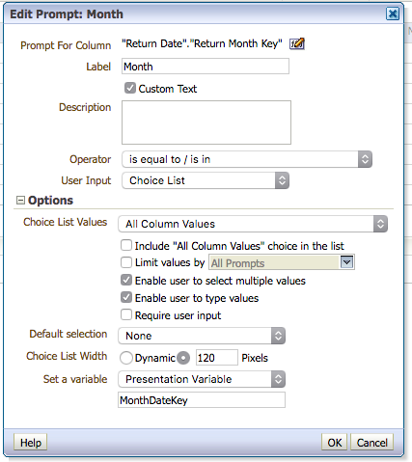
Create prompt
Important: Give Presentation Variable a name, no spaces
It does not matter which column you choose, as long as it is the same format as the things you want to filter for.

Slide 11
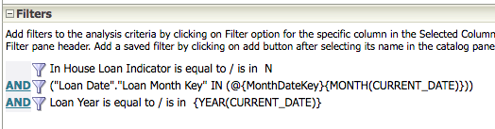
Filter in Report
Find your report, add filter

Slide 12
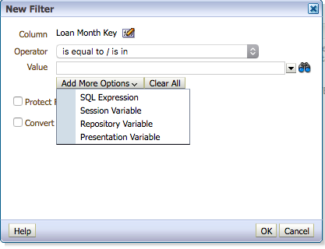
Filter in Report
When creating this, use the ADD MORE OPTIONS drop down
Choose SQL Expression

Slide 13
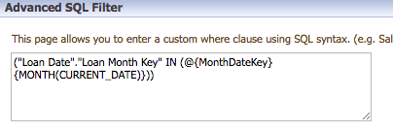
Filter in Report
Add
@{MonthDateKey}{MONTH(CURRENT_DATE)}
In plain language this says: Use the month key in the prompt, or use this month’s data.

Slide 14
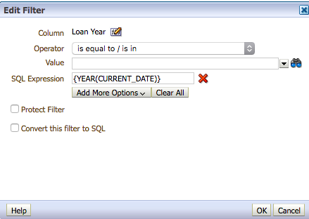
Filter in Report
Next, we want to pre-filter our report to only include the current year, otherwise will get back data from that month for EVERY year.
SQL Expression here is:
{YEAR(CURRENT_DATE)}

Slide 15
Filter in Report
Do the same thing for each Year Field in each of the three reports
Do the same for each of the Month Keys
  In Returns, it’s the Return Month Key, for the Loans it’s the Loan Month Key, and In House Use, the Return Month Key

Slide 16
Dashboard
The finishing touches
  Add the prompt to your dashboard, along with the reports
  Try it out!

Slide 17
Questions?
Allison.Erhardt@umanitoba.ca
THANK YOU

