Slide 1
User Research at the University of Rochester’s River Campus Libraries
Using an anthropological approach
to build a better catalog

Slide 2
The University of Rochester
Private university founded in 1850
Includes The College, Eastman School of Music, Warner School of Education, Simon School of Business and the Medical Center
4700 undergrads and 4000 grad students
Carnegie Level I research university

Slide 3


Slide 4
Making Assumptions
Nielsen Report of Teen Media Trends
June 2009
http://en-us.nielsen.com/etc/medialib/nielsen_dotcom/en_us/documents/pdf/white_papers_and_reports.Par.48571.File.dat/Nielsen_HowTeensUseMedia_June2009.pdf

Slide 5

True or False?
Teens are media multi-taskers
Notes:
False- 77% of the time they are consuming just one form of media-

Slide 6
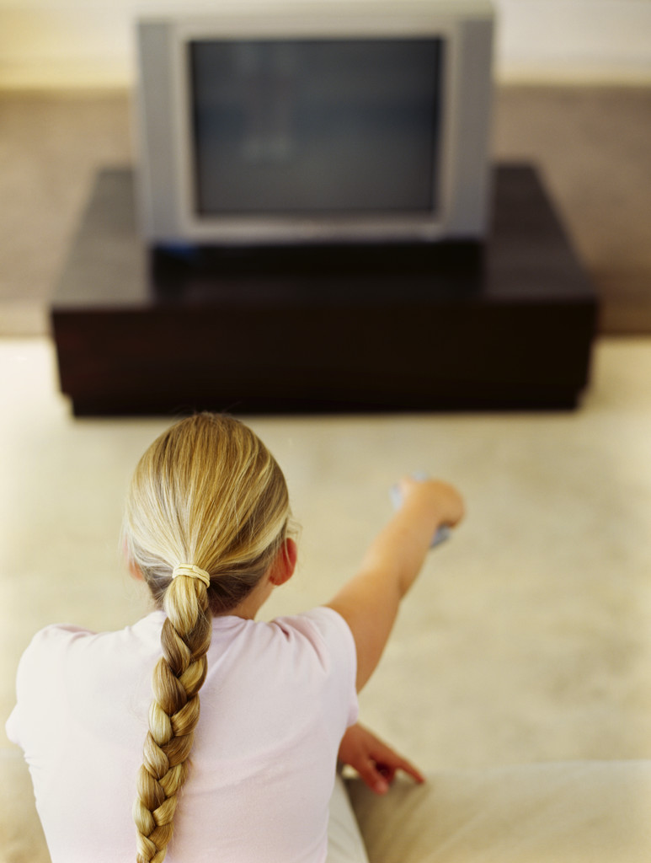
True or False?
Teens are watching less television now because they are on the Internet or gaming.
Notes:
False- in fact teens television viewing has increased by 6% over the last 5 years. According to the report, the average teen watches 104 hours, 24 minutes watching TV a month.

Slide 7
Who uses the Internet most?
18-24 year olds?
25-34?
35-44?
45-54?
55-64?
65+?
Notes:
Winner is 35-44 year olds- who spend an average of 42 hours 35 minutes online every month
45 year olds were next, followed by 55- 64 and then the 25-34 year olds,
The 65 plus spend more time online than teens!
So this is a good segueway to talking about our user research programs at the University of Rochester and how we’ve become an organization that relies on this kind of data when we commit our resources to the development or improvement of our web products and services.

Slide 8
User Research at RCL
Website Usability Group 2001- present
Faculty Work Practice Study (2003-2004)
Undergraduate Research Project (2004-2006)
Graduate Research Project (2006-2008)
XC User Research (2008- present)
Notes:
This is a list of user research projects we’ve undertaken here at Rochester. Each one of these projects involved a diversity of staff members from the River Campus Libraries, and we used the experience we learned in one project to inform the next. We started with a usability team.

Slide 9
Website Usability
What tasks do users come to our website to perform?
Can they perform those tasks successfully?
Notes:
The River Campus Libraries established a website usability team in 2001 to help develop a new web interface. Since then Usability has become an integral part of our website design program at U of R- a team of 6 librarians routinely test 6 or 8 web products/year.
Usability assumes users are not just browsing the web- they’re coming to your website to do work. We developed a set of tasks that users coming to our website should be able to do: find a book, find a journal by title, find a database, find the library’s hours, etc. and then we sit down with users and watch them perform those tasks. We use the “Think aloud protocol” which basically means we ask users “talk out loud” as they work through a list of tasks. “you scrolled up and down- tell me what you’re looking for” “what would you call that?” We test a minimum of 5 users, usually novice users- the prevailing assumption being those are the users that need the most help and if it is usable for beginners, usually undergraduates, it will be usable for faculty, graduate students, and staff.
You get an incredible return with very little investment in staff time and resources with a website usability program. It is relatively inexpensive, it is sustainable, and you have the added value of becoming more visible and accessible to your users. You can learn a lot…
So what do you learn about your OPAC? Which is why your users are coming to the library website- You find out (NEXT SLIDE)

Slide 10
Usability Findings on the OPAC
Users are not really sure what it is:
  When they do a search they’re not sure what exactly they’re searching- they’re just Googling
  The results aren’t obvious either- is it a book, a journal, a video, an article?
  Where is it, how can I find more like it?
  If I didn’t find anything can you help? What did I do wrong?
Notes:
Our website usability studies and all of yours, too, have uncovered many issues with OPACs, most of them the same issues no matter which flavor of ILS you subscribe to. Users are required to drop leading articles, users have to spell correctly, users have no idea what subject headings are, users can’t tell if it’s a DVD or a Journal, and what the heck is Boolean anyway! The problem wasn’t our usability team or our users- the problem was we kept uncovering issues for our OPAC- the most important part of our website- that we had limited control over.

Slide 11
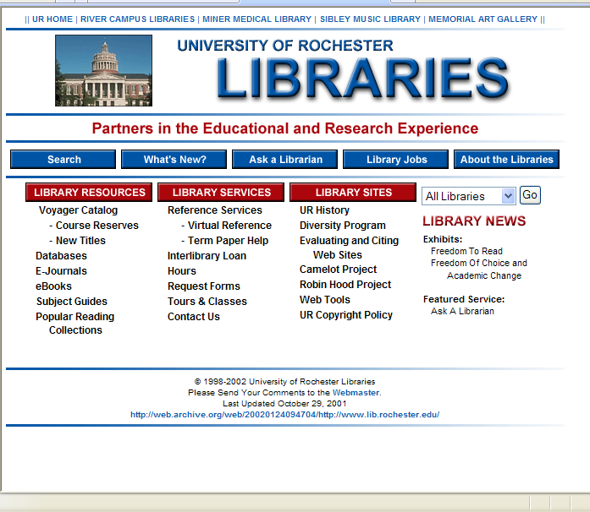
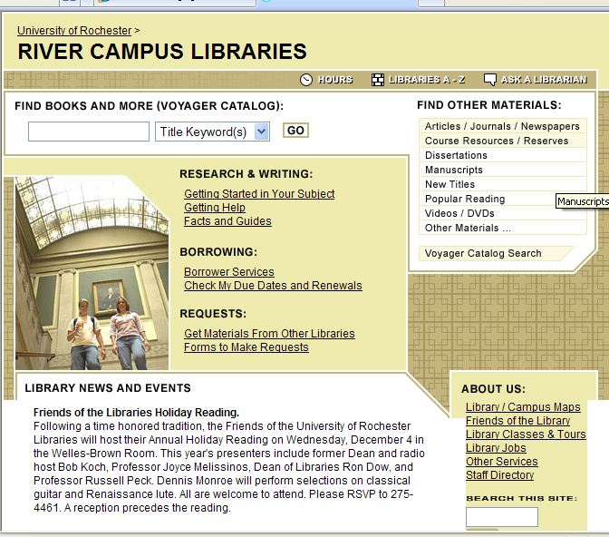
Our First “Usable” Website
January 2002
November 2002
Notes:
Our first big usability project focused on the catalog and we made a few really radical changes as a result-
First we added an OPAC search from the home page- our search logs showed that students were consistently typing book titles into our search site box on the home page- we’re a library, right? And its our homepage- must search the library.
So we added a google box to the homepage and made the default search title keyword- also based on usability results.

Slide 12
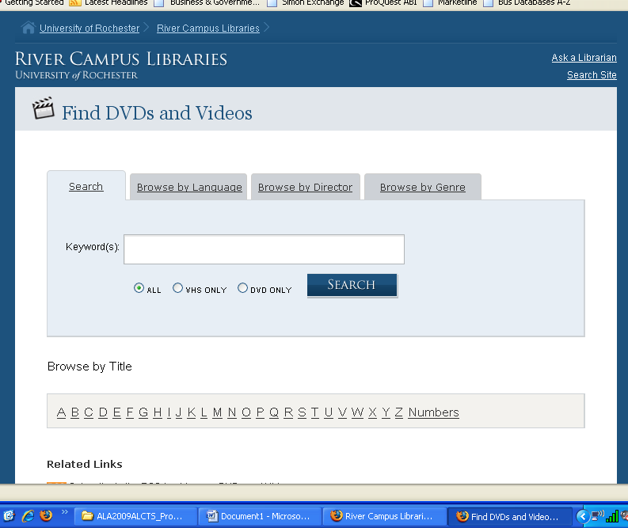
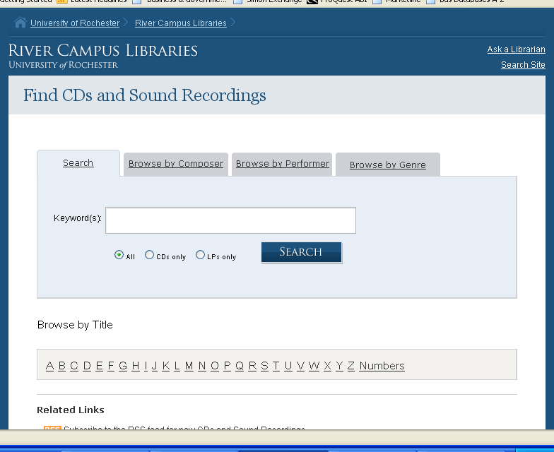
Notes:
We also developed our Find DVDs and Videos and Find CDs and Sound Recordings search systems. We leveraged the metadata in our catalog, and enriched some of the metada for the DVDs records to include Genre so that we could provide a custom search interface based on the material format.

Slide 13
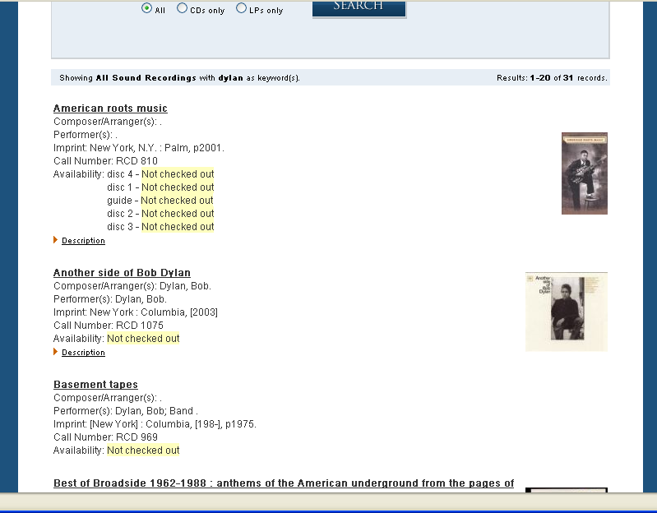
Notes:
This is the simplified results screen. We accomplish this by pulling the catalog data our of Voyager and into an sql database which is queried to provide the results. The circulation data is then pulled in from the voyager data at that point to provide up to the minute status. Jeff Suscynski, our programmer, created this system which is pretty cool and very popular.
The videos DVD search typically gets hit 800 times/day.

Slide 14
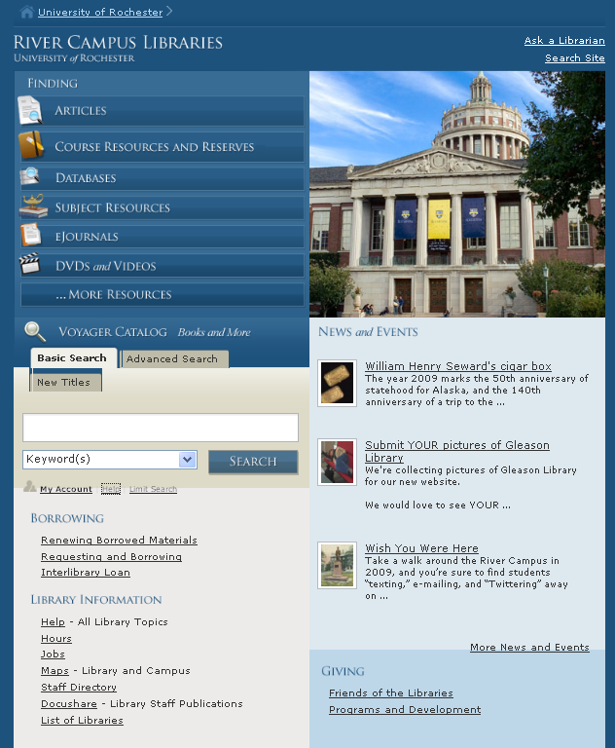
Notes:
Here is our current website- as you can see we’ve basically got the information chunked into three areas:
Finding
Borrowing
And Library Information
The Finding part is the most important part of website and the webpage is designed to draw the users eye to that area first.

Slide 15
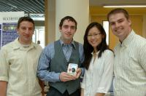


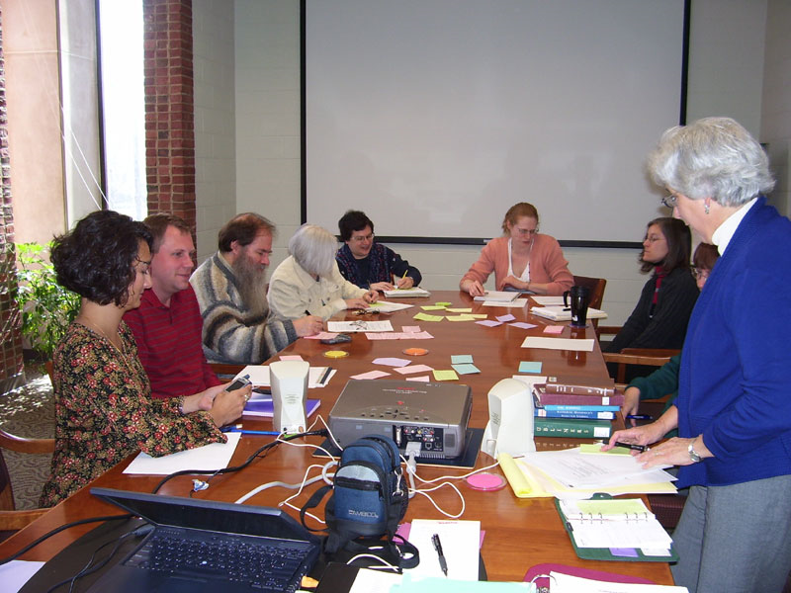

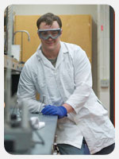
An anthropological approach
Notes:
And as a result of usability studies we started to change our thinking - this is where we had our AHA moment and decided we needed to know more about our users- we needed to know how they work- not how well they use the information we’ve already packaged to do their work- but how we could package it so it works FOR them. We needed to know WHAT WE DIDN”T KNOW ABOUT THEM. We needed to study them so they could participate in the design of these technologies- and we needed an anthropologist to lead the user research.
What if we approached each of our larger user groups as unique cultures? According to the Merriam Webster dictionary culture is defined as “the set of shared attitudes, values, goals, and practices that characterizes an institution or organization” – that seemed to fit-
If we wanted to learn about these unique academic cultures we would need an anthropologist- and Dr. Nancy Foster was exactly what we were looking for. She brought a wealth of experience in traditional field studies as well as recent experience in work practice studies to the library. In fact our entire organizational culture has changed as a result of our user studies.

Slide 16
Participatory Design
Collaborative approach to technology development
Involves collaboration among designers, developers and end users facilitated by social scientists
“work practice” studies
Notes:
“Participatory design” is an approach to technology design and development that we have followed for more than 5 years.
The approach derives from work done in Scandinavia in the 1970s to include worker input into the way computer technology was introduced into their workplaces. It has been further developed in the U.S. mainly in corporate settings.
The hallmark of this approach is providing workers and other end users with ways to provide their expertise to the project, often by documenting and analyzing the way they do their work - their “work practices” - and how they use existing technologies, how they work around technological problems, and how they would like to improve their work.
So how is it different from usability? Here is an example: for our first website redesign in 2002 the usability team did Mental Model testing on library websites- we asked our users to look at 3 different websites and perform a set of tasks. We determined the tasks- we didn’t ask users why they use our website or even if they used it- we just asked them to perform the tasks on 3 different library websites. As I mentioned before, it told us a lot about the usability of the sites, but nothing outside of what we asked.
For our current website redesign we approached the entire project differently. We asked users to tell us what those tasks are and what they should be – and then we designed around their tasks. So in Usability the tasks are already determined- the difference now is that users determine the tasks- not librarians and website designers.

Slide 17
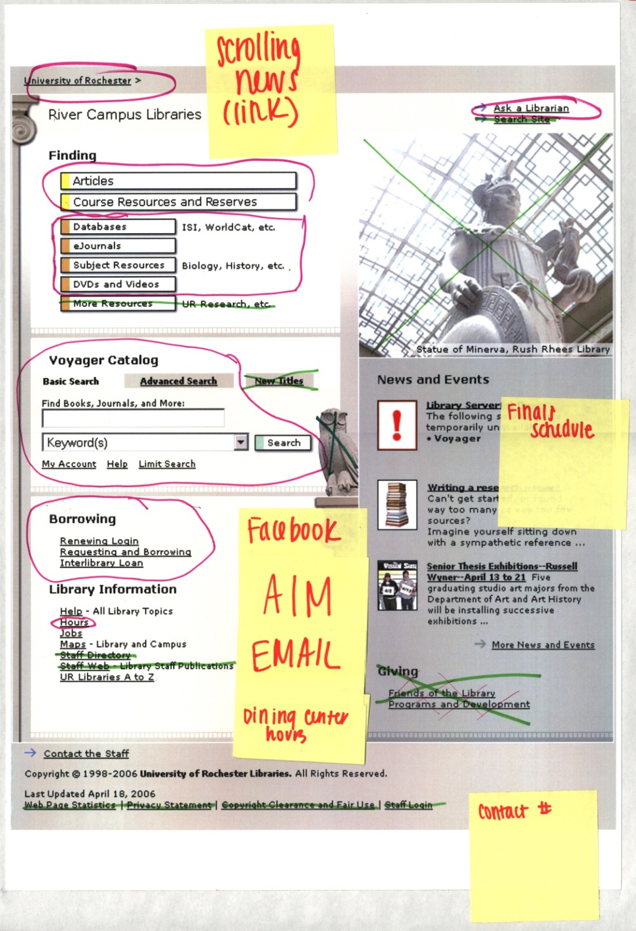
Notes:
This slide is an illustration of one of the products of our participatory design workshops for the libraries new website.
For one particular participatory design workshops we did this exercise in conjunction with a number of short exercises. We started with a short survey with just a few questions: Do you have a cell phone? When was the last time you visited the library in person? When was the last time you visited the library’s website? How many times/week do you use the library or the libraries resources?
This data allowed us to form a quick picture of the user- whether they were technologically savvy, whether they were stacks browsers or online browsers, etc.
Then we asked them to sit down at a computer and open a browser and show us the most important page in the library’s website to them, and which page was least valuable.
Then they did this exercise- which we call and x and o.
We asked students and faculty members to take this large printout of the current website and x out anything they don’t use- circle anything they do and use post it notes and markers to add features or additional content. This was a big departure for us- this is very different than asking a user to find a book or a journal article. It does generate a lot of data, and having a lead anthropologist was critical to making sense of most of it- but the value of having roughly 30% of the staff, both public and tech services, professional and para professional involved was priceless in terms of creating a culture of flexibility and change in the library.
This user was an undergrad- the facebook link was a prominent theme for undergrads.

Slide 18
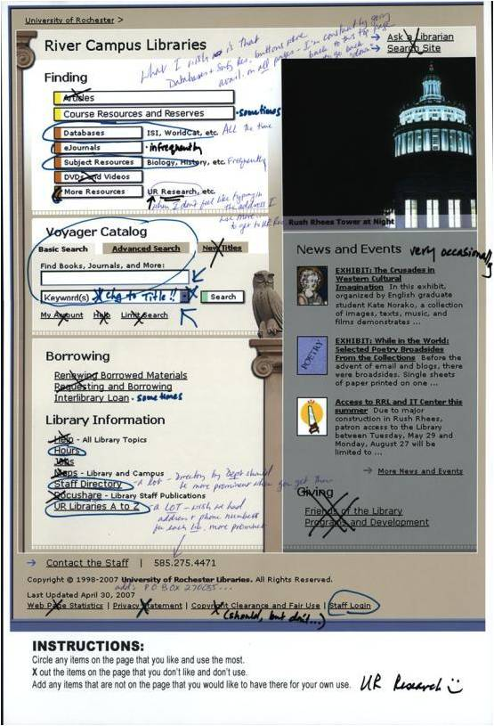
Notes:
Here is another example- note again that the catalog is circled- the whole thing, while even videos/dvds is xed out.
This user wants the default search to be title and that there would be a link to databases and subject resources on EVERY PAGE!

Slide 19
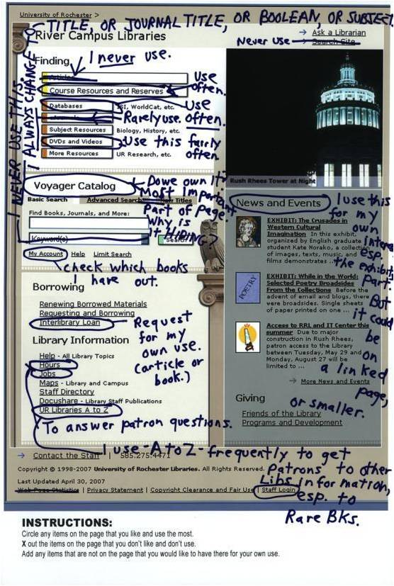
Notes:
Here is yet another- and they write next to Voyager “Most important part of the page. Why is it hiding?”
They also don’t like the default keyword…

Slide 20
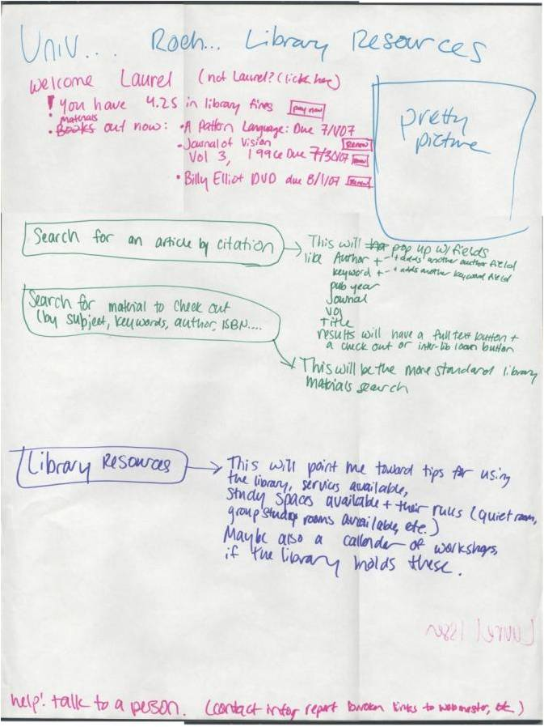
Notes:
Here is an example from the last exercise in the workshop- we ended by giving each participant a large sheet of paper and asked them to create the perfect website
I don’t know if you can see the top well- but it says “Welcome Laurel”
At this point in the exercise we saw almost every participant create a “custom” webpage- with their personal library data and just what they wanted to see.

Slide 21
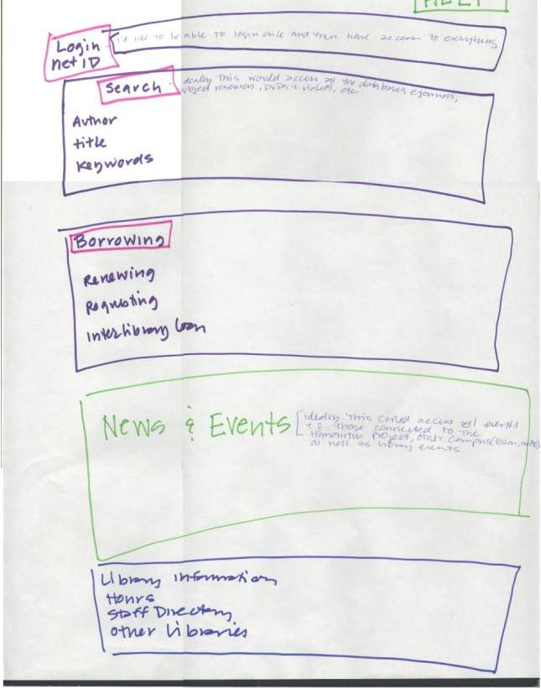
Notes:
Here is another- note they expect to login first to get their personalized resources.

Slide 22
Studying Faculty
2003 IMLS grant to study faculty
How do they do their work? How do they use gray literature?
Do they care about permanence? Metadata?
How can we design a digital repository that meets their needs?
Notes:
Our first foray into participatory design and work practice studies involved studying the faculty. This was a real eye opener. We went into the faculties offices and studios armed with video cameras ready to find out what their needs were in terms of their own research, the most important research in their fields, and how they discovered the “gray” literature? We wanted to know this information so we could improve on our implementation of D-Space, the open source digital repository application. We just weren’t finding it to be a good fit for faculty and we didn’t know why. We also wanted to know how they looked at their work so we could create more buy-in from other faculty.

Slide 23
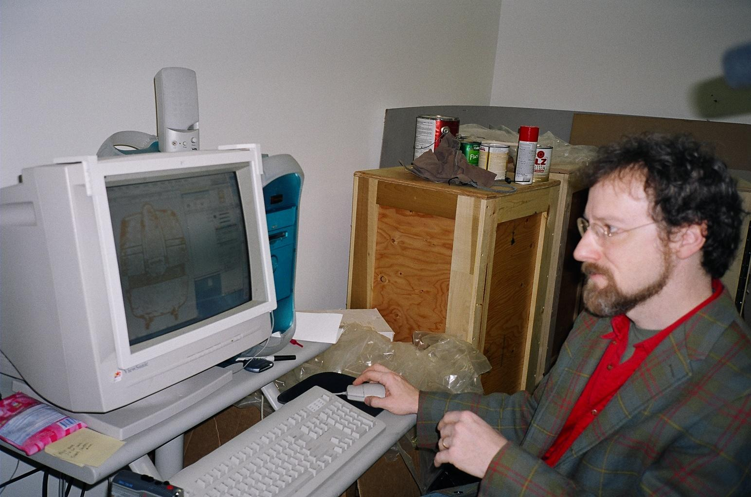
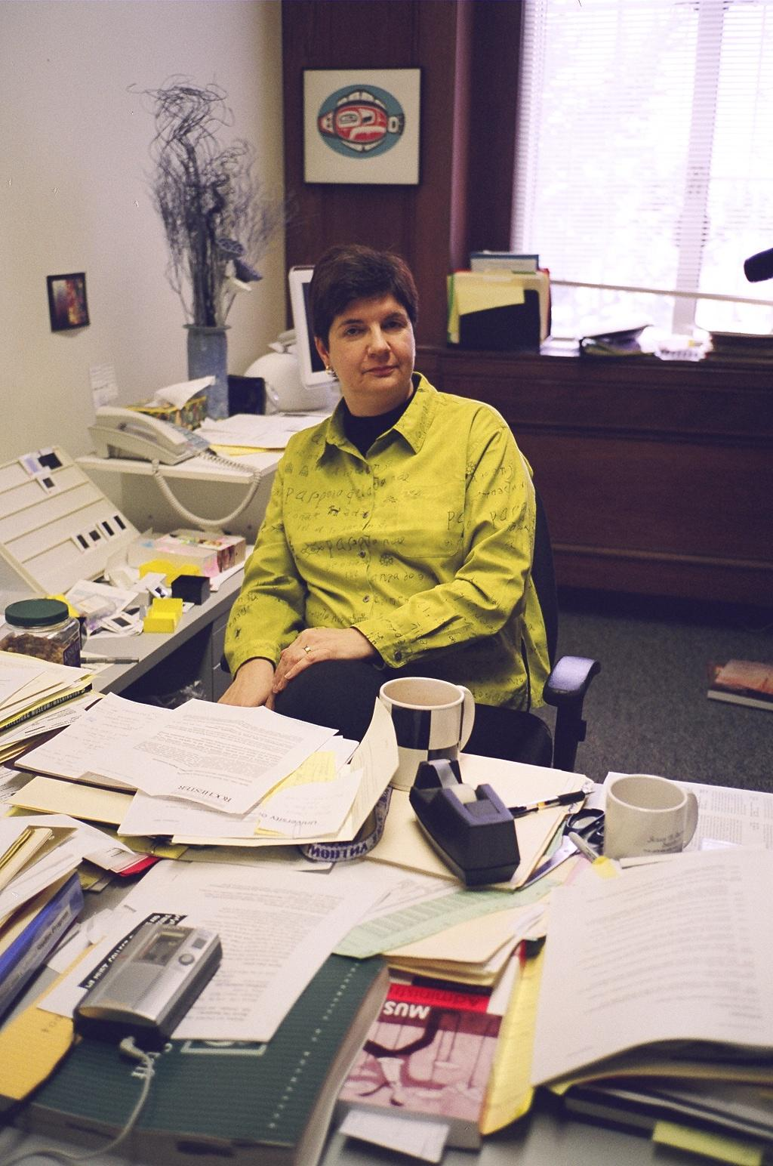
Notes:
These are several faculty members in their offices- all of the interviews were taped and the transcripts were coded – again- strict anthropological methods were used.
What we learned was that the faculty were focused primarily on themselves- their own research and maybe the research of a close group of cohort’s = this was true for scientists, social scientists, and humanities professors. They wanted a digital repository that featured them.

Slide 24
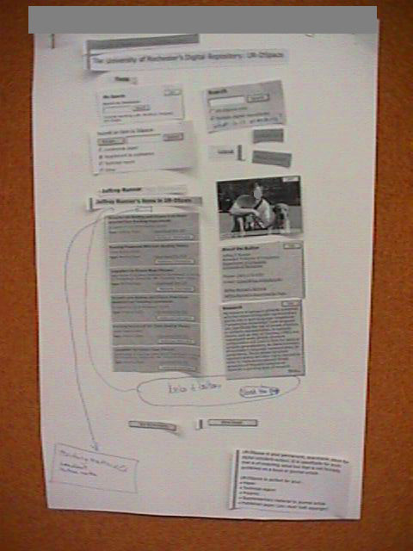
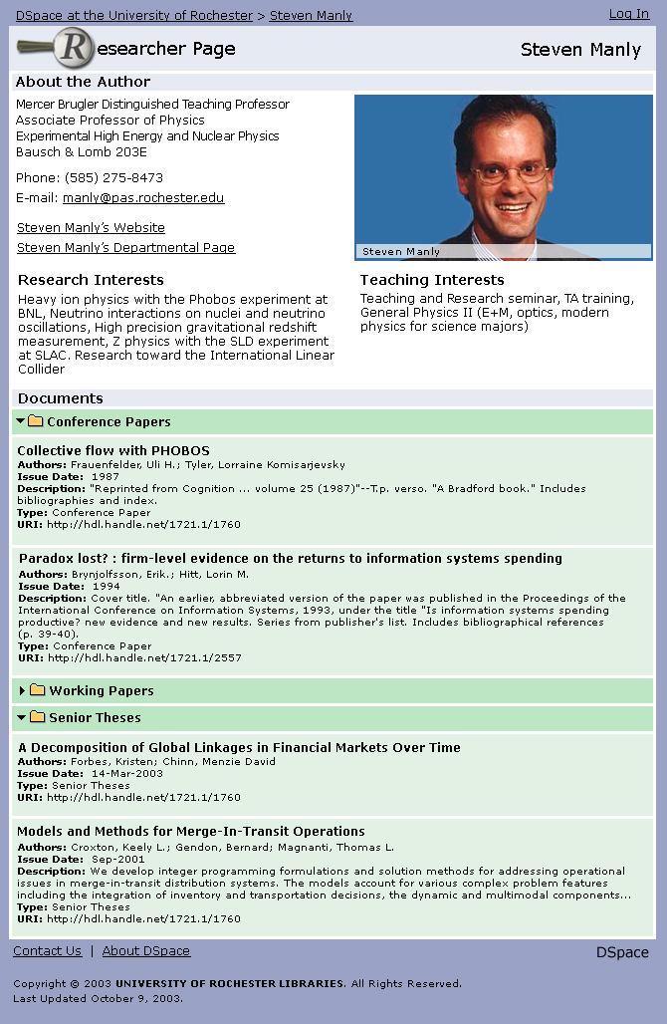
Participatory Design
⇒
Notes:
As a result of what we learned we decided we needed much more than the original D-Space code we were starting with, we developed researcher pages, which are used all over the world, and we also changed the way we promoted digital repositories to our faculty.
Here is another participatory design workshop- The faculty member “designed” his researcher page.

Slide 25
Studying Students
In 2004 embarked on the Undergraduate Research Project
What is their day like? What do they bring to class or the library?
What was their last research paper? How do they find resources?
How do they use information?
Notes:
Now we were ready to take on undergrads. Venturing into faculty offices was no longer any big deal- we talked to undergrads in the library, we went to the campus center, to the coffee shop, WE WENT INTO THE DORMS! We gave them cameras to take pictures of their possessions, they drew maps for us showing us where they went all day, they consumed Red Bull and ate countless cookies regaling us with tales of their latest research paper. We asked their professors “What are the hallmarks of a good research paper?” We asked students “What do you use our website for? What do you wish you could do on our website?” We studied students and published our research.

Slide 26
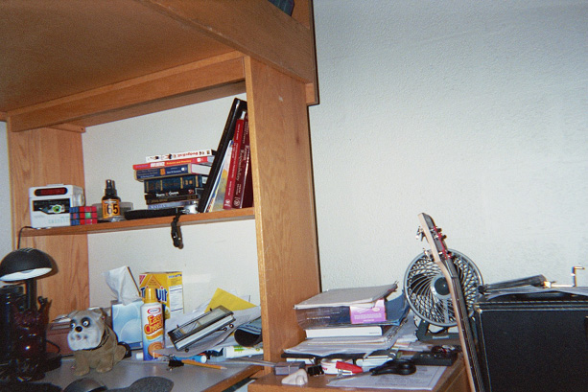
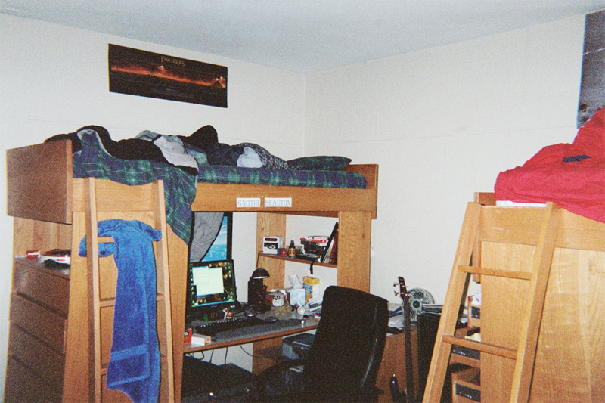
Notes:
Here is what their dorm rooms look like

Slide 27
Notes:
What they carry around in a typical day
This is a photo taken from a disposable camera we gave them with instructions of what to take pictures of-

Slide 28
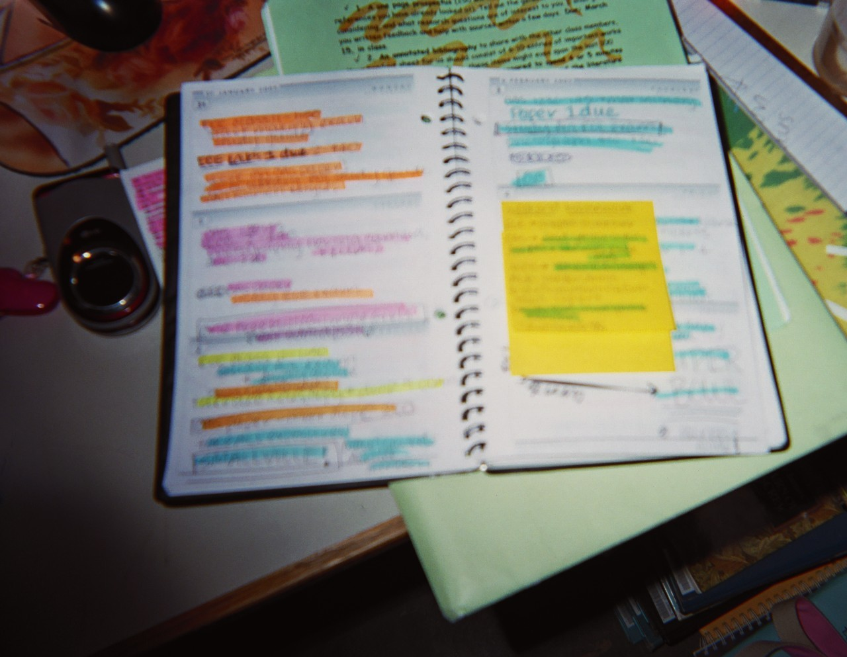
Notes:
Another picture – this is a great planner. I think the tasks are color coded. Very impressive for an undergrad
We made some changes based on our findings- we instituted night owl librarians during key weeks in the semester, we teamed up with the writing center to provide more support for writing assignments, and we made many small changes, like providing laptop locks, and more table space for all their things when redesigning space.
We had to put off any changes to our catalog, though-

Slide 29
Graduate Students
2006 IMLS Grant to study graduate students
How do they conduct research? What resources so they use? What are their writing practices?
How do they collaborate with other students and their adviser?
Notes:
The graduate student study used a mixture of both qualitative and quantitative research methods. The qualitative methods involved interviews and observations, all adhering to a strict protocol developed by the social scientist’s leading the project, Dr. Todd White and Dr. Nancy Foster. The quantitative research involved a survey of all graduate students and revealed a couple of surprising data points, including the fact that the average graduate student spends 7 hours/day on their computer.
7 hours a day!
Graduate students are a unique group- they’re learning to navigate faculty culture and bridging undergraduate culture. This was a very interesting study from that respect.

Slide 30
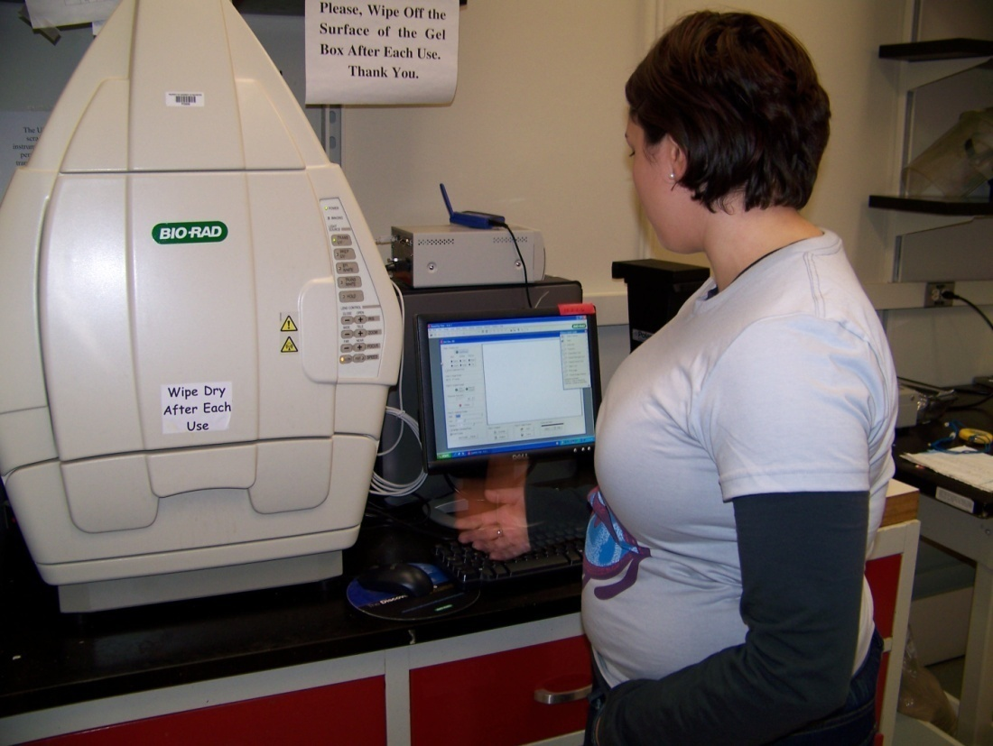
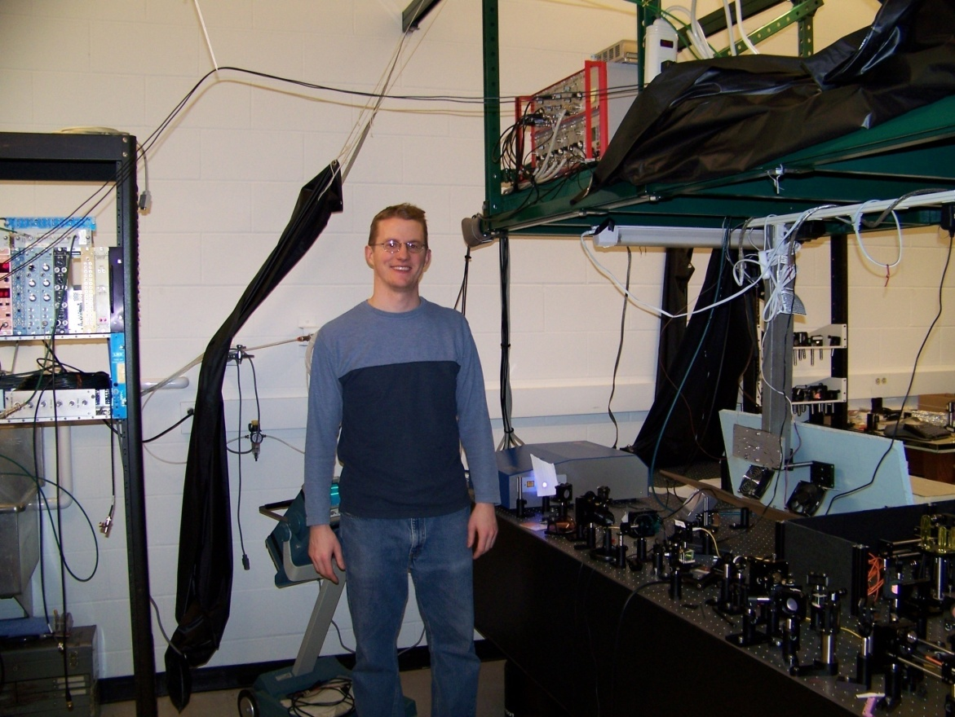
Notes:
Here is a typical workspace for a science grad

Slide 31
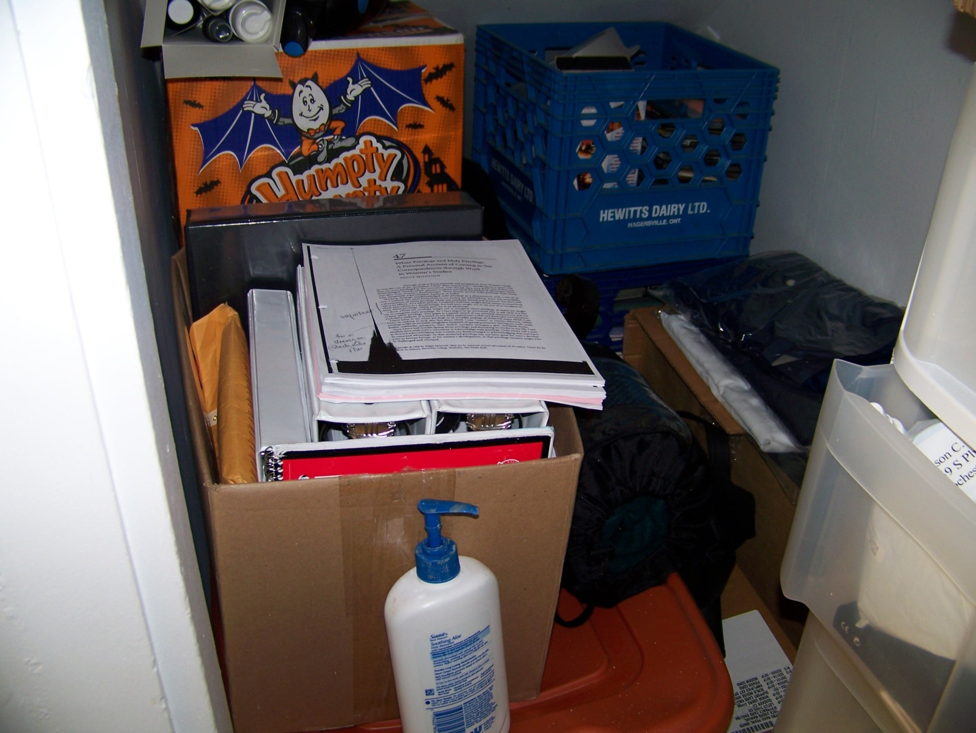
Notes:
And they collect a lot of research

Slide 32
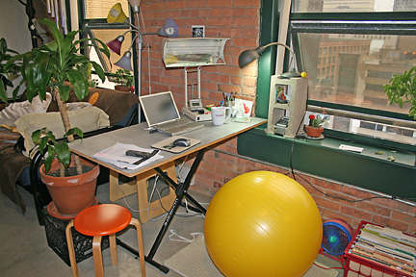
Notes:
They might be neater than undergrads

Slide 33
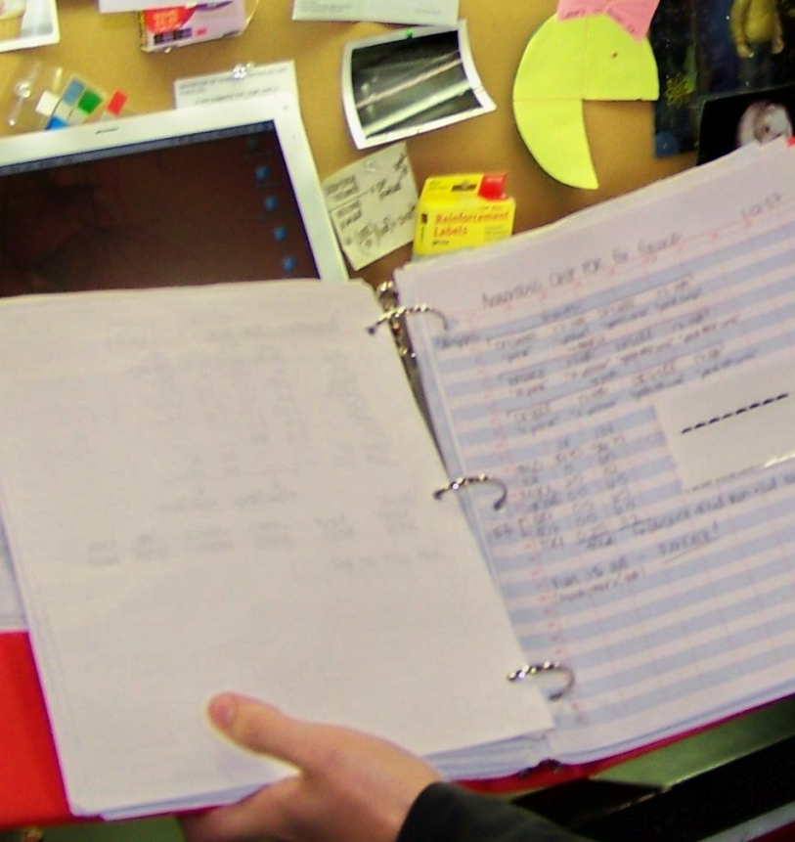
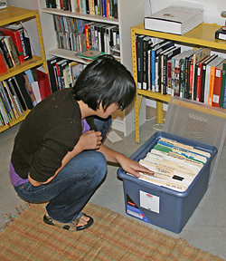
Notes:
But we continually heard about Lots of stuff- print and online
"I had to buy another book shelf.” (English)
"I have at least 1,000 [PDFs on this computer], if not more.” (Psychology)

Slide 34
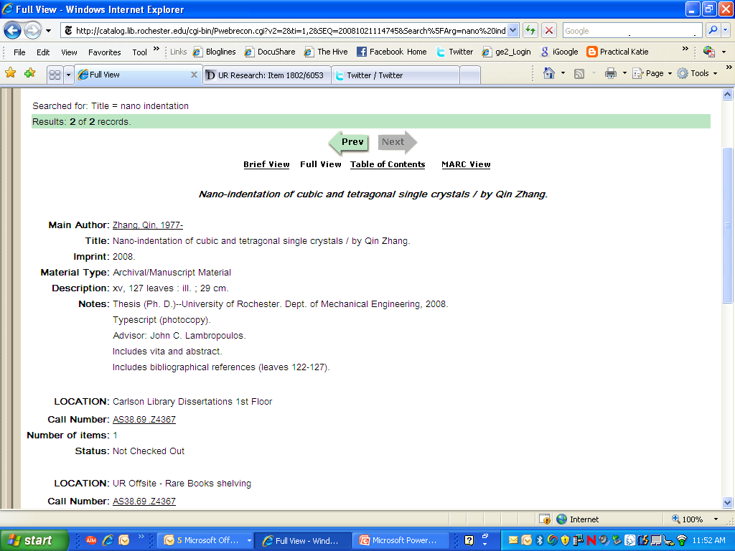
Notes:
And it did lead us to make an immediate change to the catalog- we added adviser to the catalog record for theses and dissertations based on our user research.
We also added lockers to our new graduate study space.

Slide 35
Summing it all up
Faculty
Graduate Students
Undergraduates
Notes:
So now we have a pretty good picture of our “cultures”

Slide 36
Our users want to know:
Is this electronic or print?
Can I get it now?
Is this relevant?
Can I get more like it?
How can I cite this?
What else has the author written?
Can I set up an alert for new publications?
Notes:
We concluded as a result of all of our studies that the catalog just didn’t meet the needs of our users- it presented way too many limitations for us to provide the kind of user experience that we wanted for our faculty and students. We needed another kind of catalog- an extensible catalog.

Slide 37
Extensible Catalog (XC)
Set of open-source tools
Facilitate resource discovery and metadata management
Funding from Andrew W. Mellon Foundation and from XC partner institutions
Software release: end of March 2009 (still being developed)
Governance: not-for-profit
Notes:
There are Lots of things about the eXtensible Catalog, or XC, that I can just touch on today:
First of all- the user research was conducted by a team of librarians from University of Rochester,
Cornell, Ohio State University, and Yale.
XC is a set of open source software tools to facilitate resource discovery and metadata management.
The XC project was conceived to create software to help libraries reveal their collections on the web (resource discovery) including an out of the box faceted user interface-
Think about a library’s entire web presence, not just the catalog search interface.- conceivably the tools in XC will allow users to search a number of resources from a single faceted inteface.
XCs toolkits are designed to bring library metadata into content management and library management systems by leverageing the existing investment in metadata, for example in our catalog, enhancing it, and delivering it.
XC provides the framework for collecting and aggregating metadata, enhancing it and delivering it.
Metadata management aspect: Leverage the existing investment in metadata.
Provide a framework for collecting and aggregating metadata, enhancing it, and delivering it

Slide 38
XC Interface Features
Availability of the item
Did you mean?
Authority control
Call number browse forward and backward
Ability to customize the fields in the results list
Book covers and book reviews
Notes:
The extensible catalog user research preliminary report was released last June and included a prioritized list of features and facets that will be implemented in the XC interface- features that will be made possible by utilizing the metadata toolkit developed by the xc project team.
The interface will be released in January and many of the toolkits are already available for download on the XC website.

Slide 39
Faceted Browsing
Publisher
Journal
Item length
Date of publication
Historical period
Keywords
Versions of the work
Notes:
These are the faceted browsing features: Also included in this list are paper vs. electronic , and the ability to limit to electronic resources.

Slide 40
More about XC
XC software overview (Webcast)
  http://www.screencast.com/users/eXensibleCatalog
  70 minutes, in 6 parts
XC metadata white paper and documentation
  http://www.extensiblecatalog.org/MetadataReports
eXtensible Catalog Project website
  www.eXtensibleCatalog.org
Notes:
To learn more about XC visit their website at this address.

Slide 41
More About User Research
Studying students : the Undergraduate Research Project at the University of Rochester. Nancy Fried Foster and Susan Gibbons, editors. http://docushare.lib.rochester.edu/docushare/dsweb/View/Collection-4436
Participatory Design of Websites with Web Design Workshops. Nancy Fried Foster, Alison Bersani and Nora Dimmock. http://journal.code4lib.org/articles/53
Understanding Faculty to Improve Content Recruitment for Institutional Repositories. Nancy Fried Foster and Susan Gibbons. http://www.dlib.org/dlib/january05/foster/01foster.html
Notes:
:

Slide 42
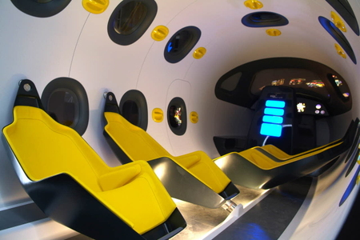
To be continued…
Notes:
In conclusion- At Rochester it makes sense for us to view our users as unique communities or cultures with their own sets of values, customs and needs. Having an anthropologist on staff has allowed us to study the way each of these groups, students, graduate students, and faculty, do their work so we can design thoughtful and effective tools to not only assist them, but to help them discover many of our resources and collections that they might otherwise never find. The Anthropological approach works for us- and we’ll continue to study our user communities on into the future because the pace of technological innovation demands it. Thank you very much.

