Slide 1
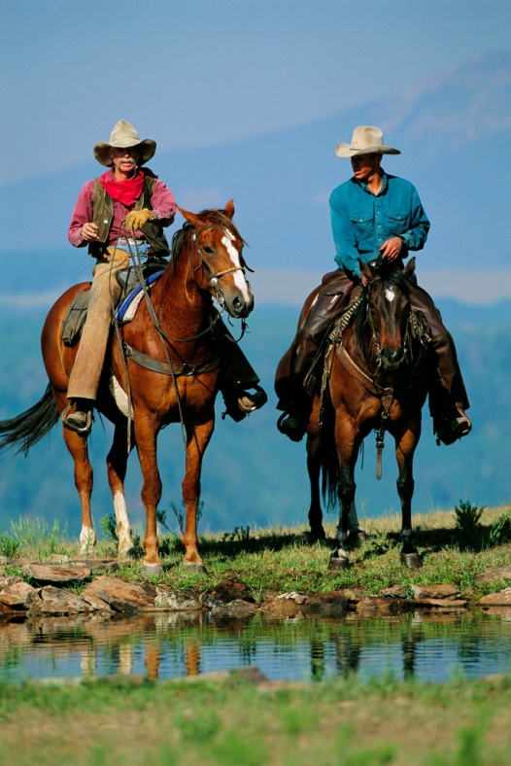



Scholarly Communications:
The Good, The Bad, and the Ugly
2009 Ex Libris Mid-Atlantic User Group (EMA) Meeting
November 5, 2009
Elizabeth Brown
Scholarly Communications Officer
Binghamton University Libraries

Slide 2
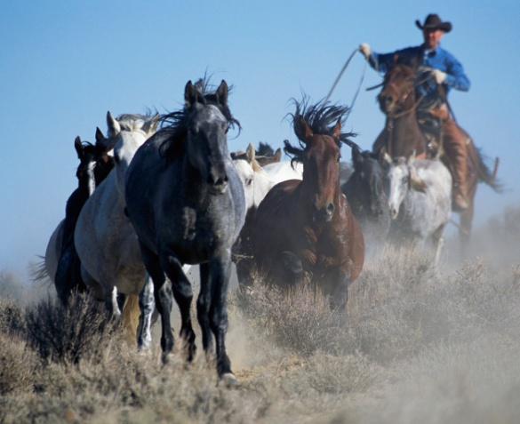
Scholarly Communications
What’s it all about?
Why should you care?
What does it mean?
The Good
The Bad
The Ugly

Slide 3
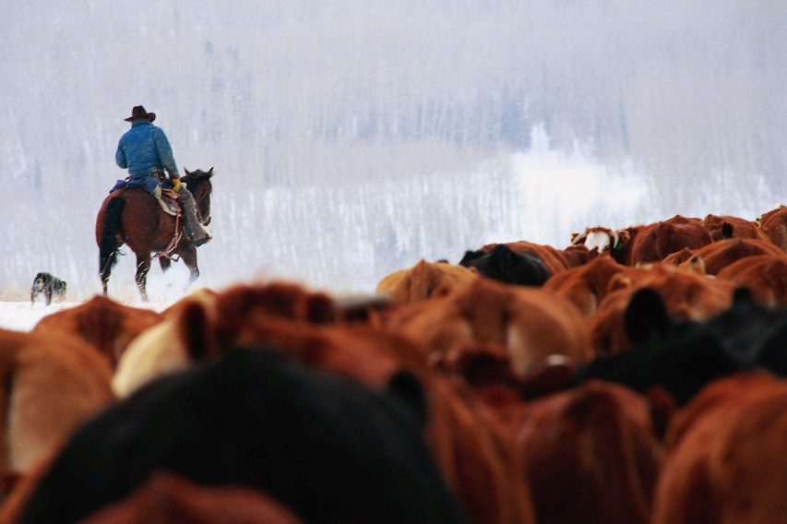
What’s it all about?

Slide 4
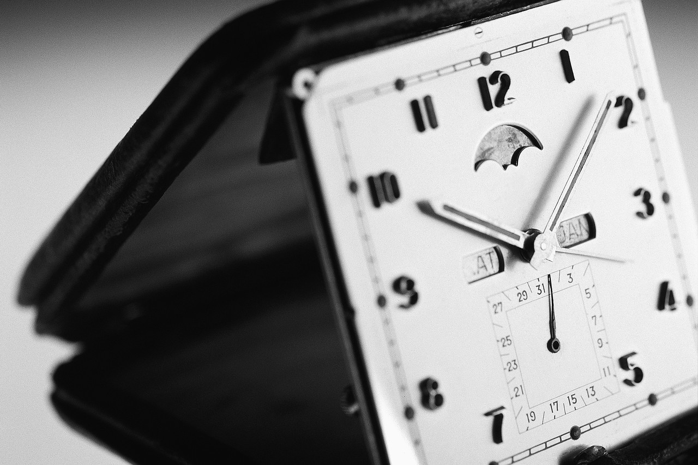
Some Background
First scholarly journal published 1665
Introduction of peer review 1675
ARPAnet (internet) created 1969
Creation of arXiv.org at Los Alamos 1991
Online scholarly electronic journals 1995
Electronic journal archives online 2000ish
Open Access movement begins 2002
NIH Public Access Policy 2008
Harvard U. Open Access mandate 2008
Google Book Search settlement terms 2008

Slide 5
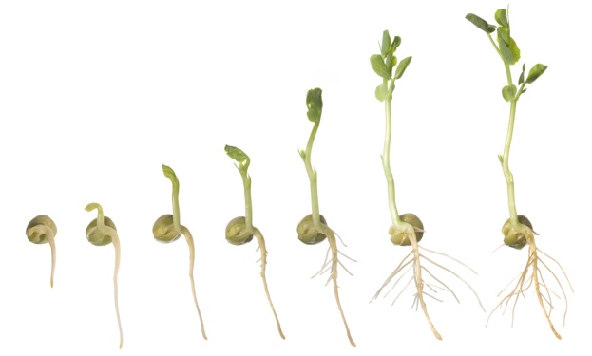
Scholarship has evolved
Manuscript text: handwritten, hand-lettered
Printed, typeset text
Electronic text adapted, converted from print
Electronic text “born digital”, converted to print
Electronic only text, embedded content

Slide 6
What’s causing change?
Academia:
1990’s serials crisis: rapid journal cost increases
Rise of interdisciplinary research
Changing channels of communication for researchers
Technology:
Growth of the internet
Low cost, rapid digitization of print materials
Open Source movement
Rise of Social Software, Web 2.0 tools

Slide 7
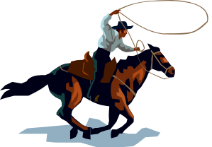
What’s driving change?
Copyright and intellectual property rights more important
Publicly funded research should be available to all
Authors should maintain rights to distribute and share their research
Creation of institutional repositories with local electronic collections
Permanent archives necessary for electronic materials

Slide 8
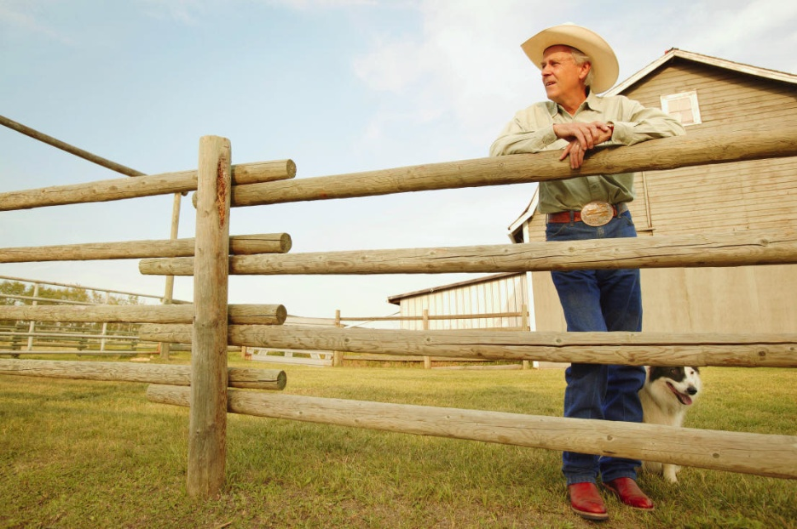
Why should you care?

Slide 9
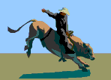
Lots of issues to consider
Publishing models are changing
Perceptions of ownership are changing
Everyone can access, modify and share information online
Researchers need to know how this affects research and publishing
Library policies, collections, and operations will be affected

Slide 10
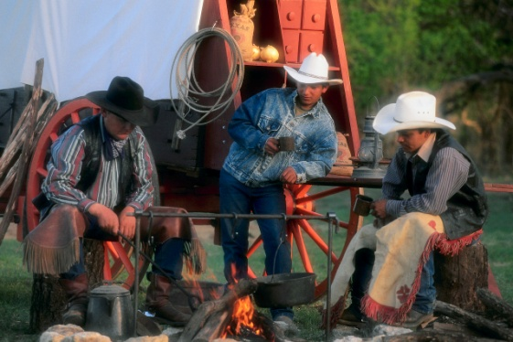
Who is affected?
Scientists and scholarly researchers
Policymakers / Lawmakers
Commercial and Society Publishers
Librarians
Archivists
Information Technology / Computer Programmers
Students and General Public

Slide 11
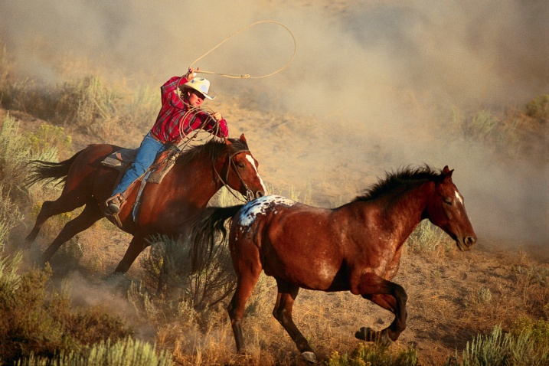
What does it mean?

Slide 12
Today
Quicker publication of research and publications
  Faster recognition
  Wider distribution among colleagues
  Long tail – info can be relevant long after creation
Lower journal costs for institution? (some debate)
Access to more materials than through subscriptions alone

Slide 13
Tomorrow
Preserve Institutional (and disciplinary) memories: data, ephemera, scholarship
Calculate the impact of scholarly output from authors and institutions
Alternative metrics for scholarship:
Preserve intellectual property rights through creative commons licenses and author addenda to copyright transfer forms

Slide 14
Subject Repositories
arXiv.org Physics, Mathematics
rePEc Economics
E-LIS Library & Information Science
Dlist Information Science
PhilSci Philosophy of Science
CogPrints Psychology
PubMedCentral Health, Nursing, Biology
Nature Preceedings Science

Slide 15
Repository Directories
ROAR Registry of Open Access Repositories
DOAJ Directory of Open Access Journals
Open DOAR Open Directory of Open Access Journals
Open J Gate Search platform: Open Access Journals
SHERPA/RoMEO Publisher Archiving, Copyright Policies
OAIster Union Catalog of Digital Collections

Slide 16
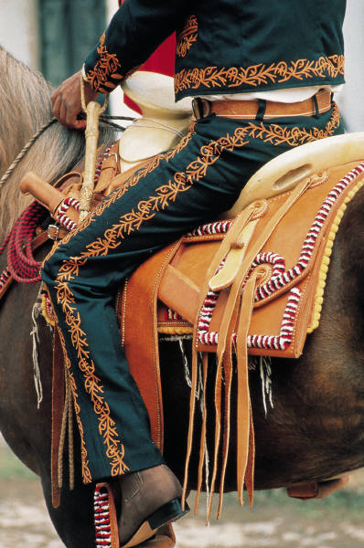
The Good

Slide 17








User Generated Content
Social Media
Shared, contributed tools and sites
  Amazon.com book reviews
  Wikipedia
  Social Tools:
Self Publishing:
Open Access
Online Collaboration between researchers

Slide 18
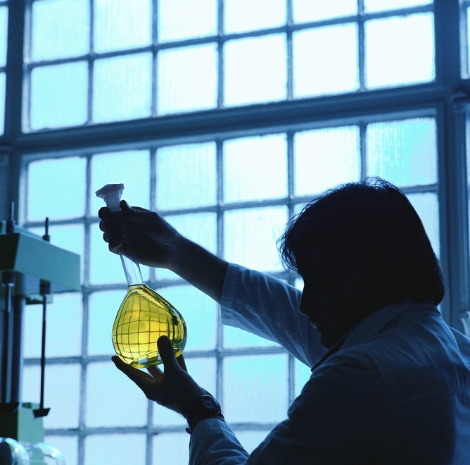
Online Collaboration in Chemistry

Slide 19
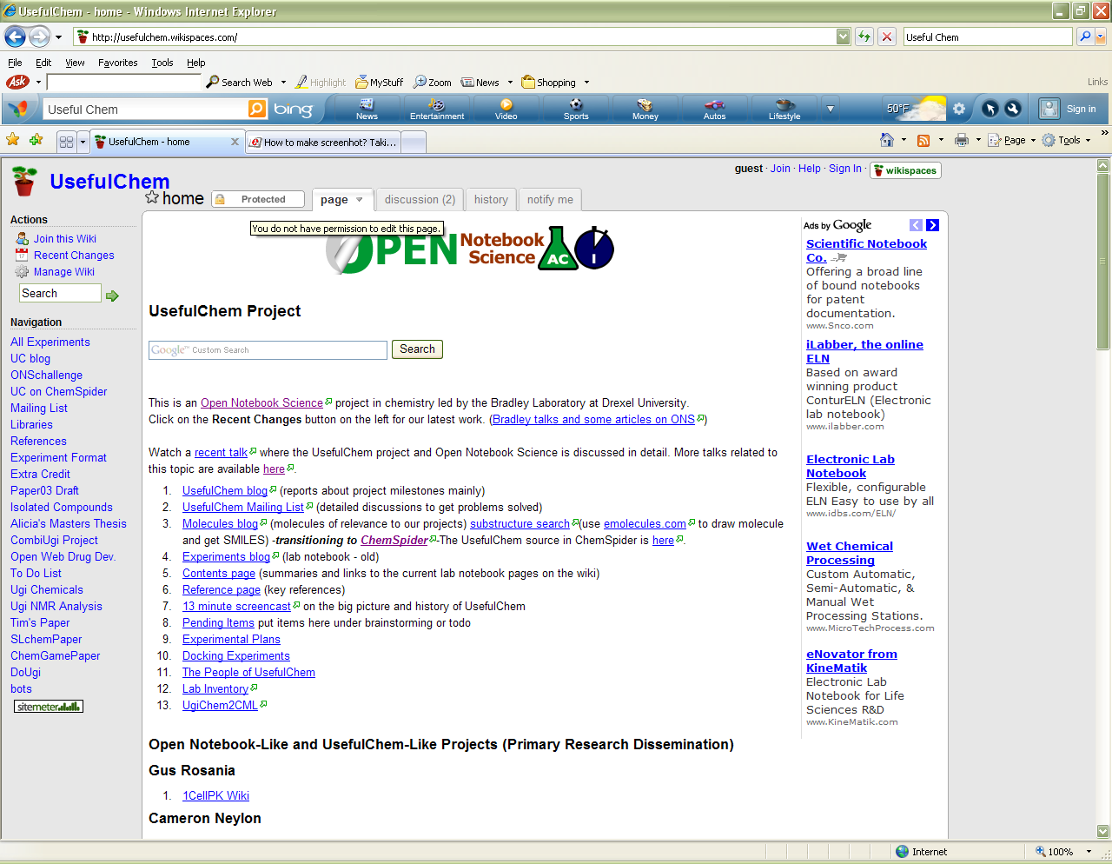
Useful Chem

Slide 20
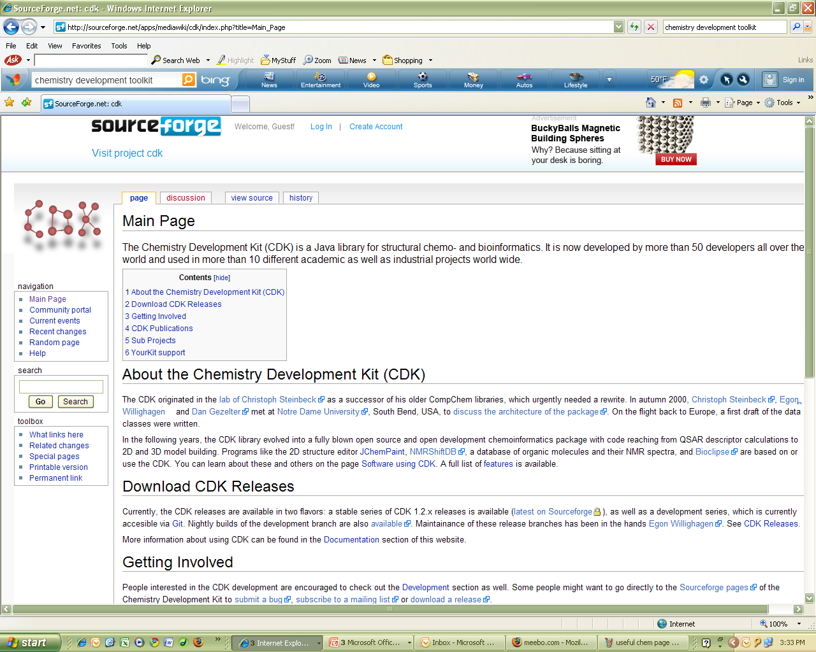
Chemistry Development Toolkit (CDT)

Slide 21
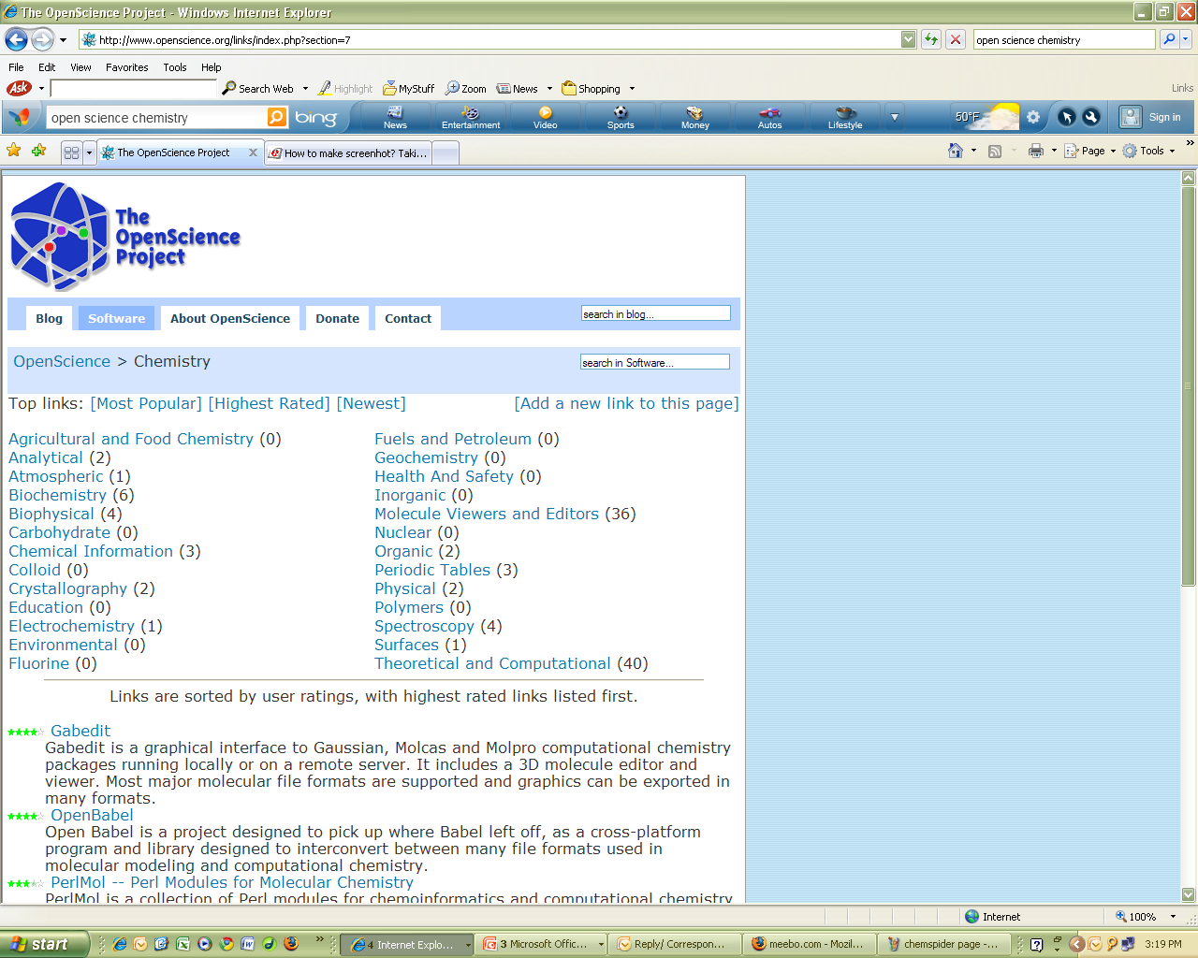
Open Science Project

Slide 22
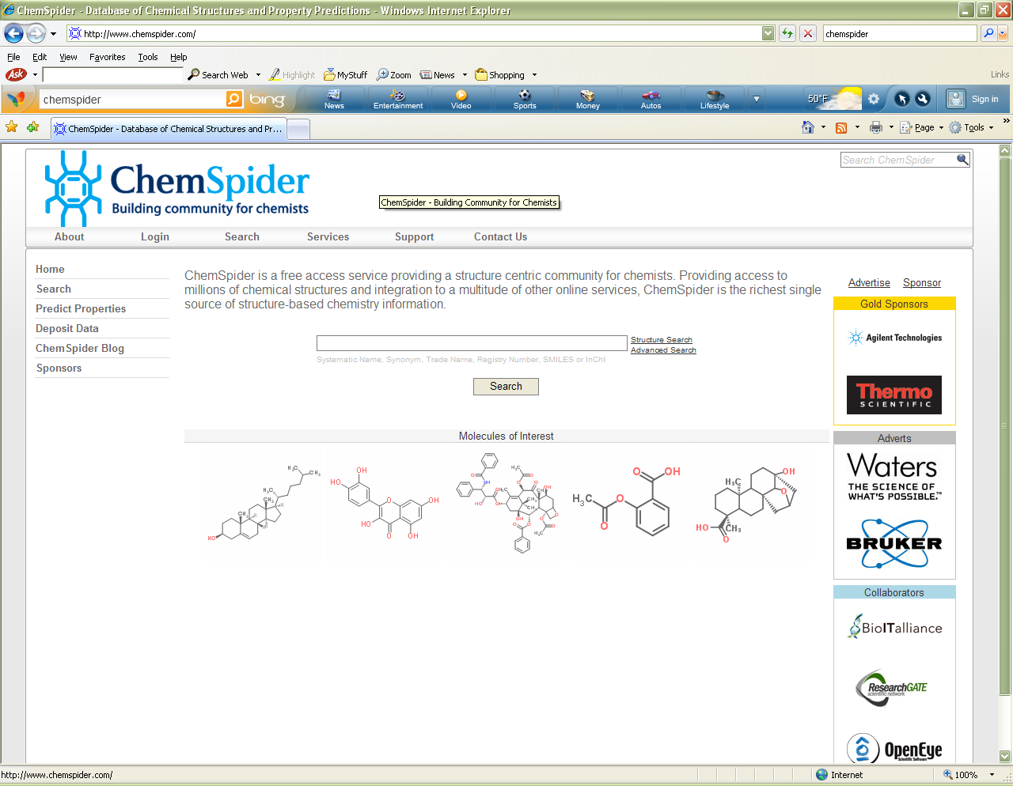
ChemSpider

Slide 23
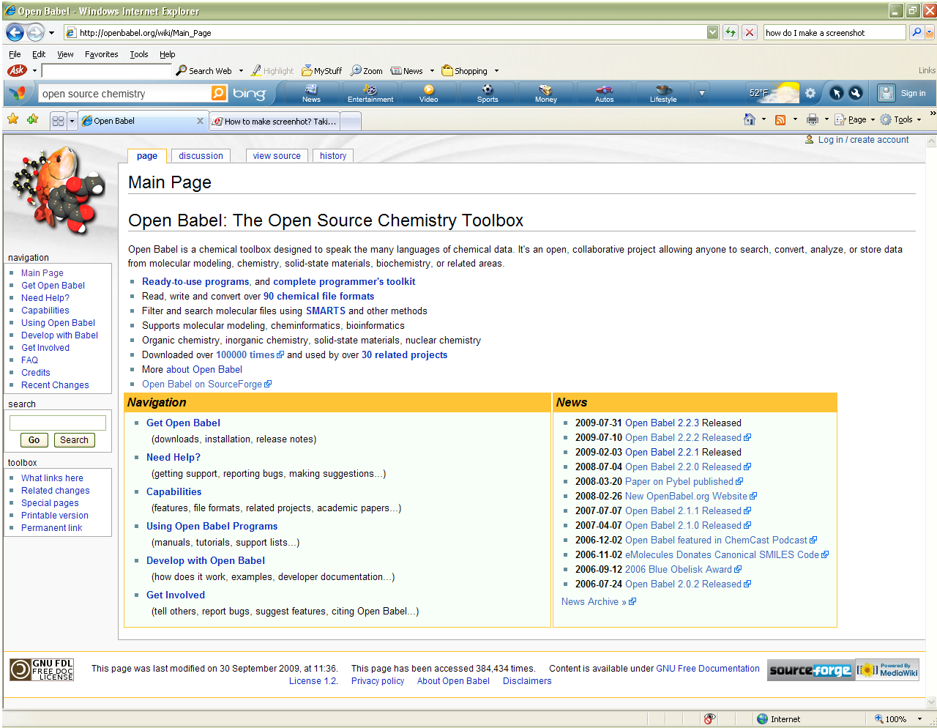
Open Babel

Slide 24
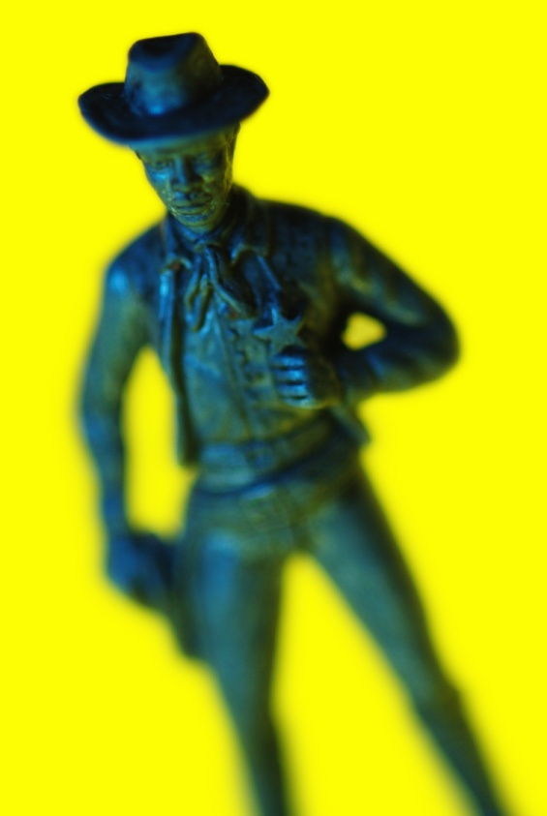
The Bad

Slide 25
Policies are Evolving
Non-uniform
  Open Access campus and publisher mandates
  Open Access terms and conditions
  Repository names and content
  Embargo periods vary
  Licensing terms and conditions

Slide 26
One size does not fit all
Copyright and fair use
  requires interpretation
  not interpreted consistently by all

Slide 27
Information is in silos
Repositories developed outside traditional publishing environment
Standards have been developed but not embedded into all platforms:
  OAI-PMH: Metadata Harvesting
  OAI-ORE: Object Reuse & Exchange

Slide 28
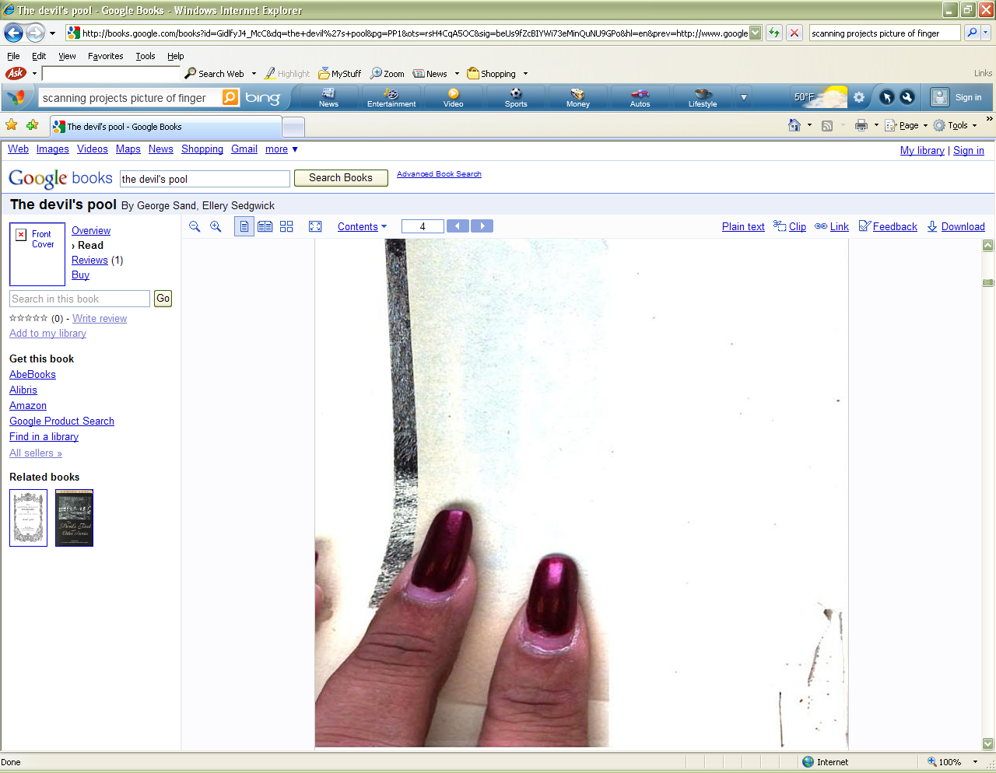
Scanning is messy

Slide 29
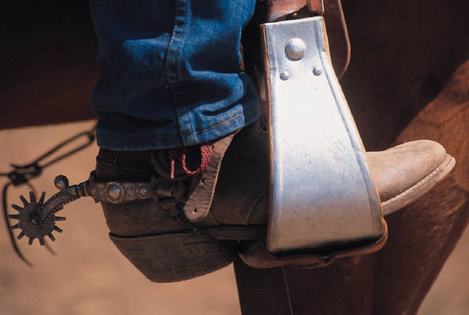
The Ugly

Slide 30
Who controls information?
Google Book Search (GBS) and Settlement
Federal Deposit Mandate Legislation:
  US Fair Copyright in Research Works Act: HR 6845, HR 801
Publisher responses to Open Access:
  Partnership for Research Integrity in Science and Medicine (PRISM)
Professional Societies: are they for profit or non-profit?

Slide 31
Who sets and enforces policies?
Researchers
Funding agencies
Institutions / Campuses/ Government
Libraries
Publishers
Web Search Engines

Slide 32
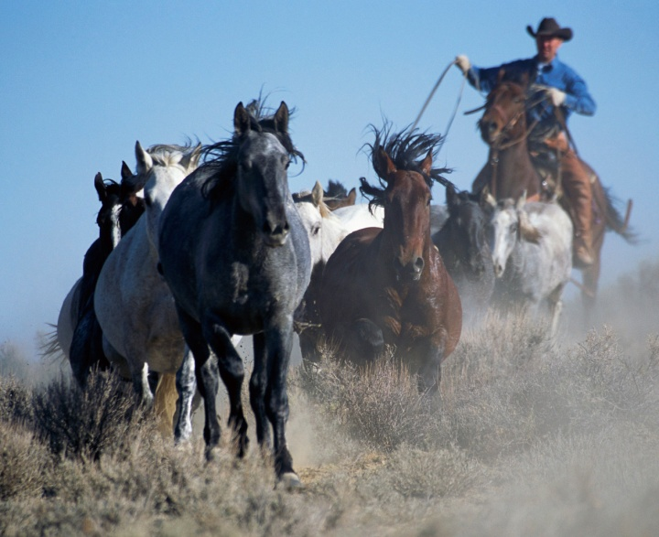
It’s a messy environment
Bibliographic control ≠ OPAC standards
Libraries may not be involved in process (GBS, NIH Public Access Policy)
Advocacy vs. zealotry: when does it cross the line?

Slide 33
More Information
  Google Book Search Settlement
    http://wo.ala.org/gbs/
    http://books.google.com/booksrightsholders/
Copyright and Fair Use tools
  Copyright slider: http://librarycopyright.net/digitalslider/
  Section 108 spinner: http://librarycopyright.net/108spinner/
Creative Commons licensing: http://creativecommons.org/
Open Access (BioMedCentral) http://www.biomedcentral.com/info/about/openaccess
Scholarly Publishing & Academic Resources Coalition (SPARC): http://www.arl.org/sparc/publications/index.shtml

Slide 34
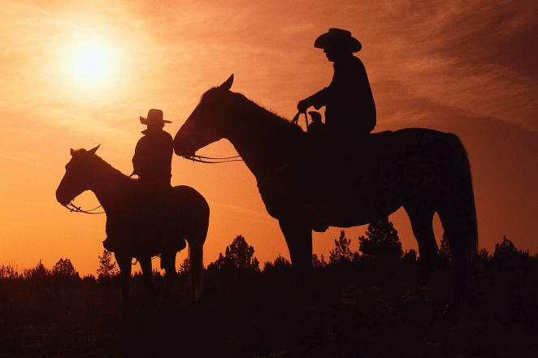

Thank You
Elizabeth Brown
Scholarly Communications and Library Grants Officer
Binghamton University Libraries
Scholarly Communications at Binghamton University
ebrown@binghamton.edu
(607) 777-4882
eabrown25
Presentation Link:
http://www.slideshare.net/ebrown/scholarly-communications-good-bad-ugly-11-3-09

