Slide 1
Advanced Analytics
Tips for reporting
Allison Erhardt ELUNA 2018
University of Manitoba Libraries Spokane, Washington

Slide 2
Bringing your reports beyond the basic
Tips for getting the most out of your report: ANALYTICS GIVES YOU WHAT YOU ASK.
Adding Custom formats and Messages
Font and Colour Changes
Adding Additional Text
Prompts Screen
  Order your months / days of week properly

Slide 3
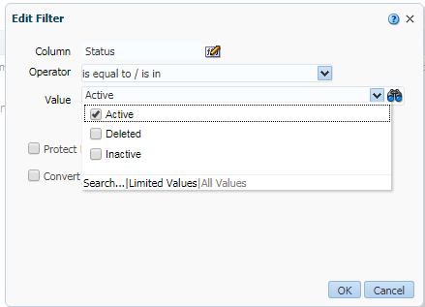
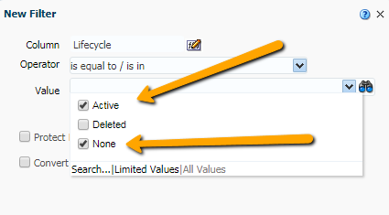
You Get What You Asked For….
So know what you asked…..
Ensure you become friends with:
  Users -> User Details -> Status
  Physical Items -> Physical Item Details -> Life Cycle
Filter your reports for either Active or Deleted Users, Lifecycle of Active AND None

Slide 4
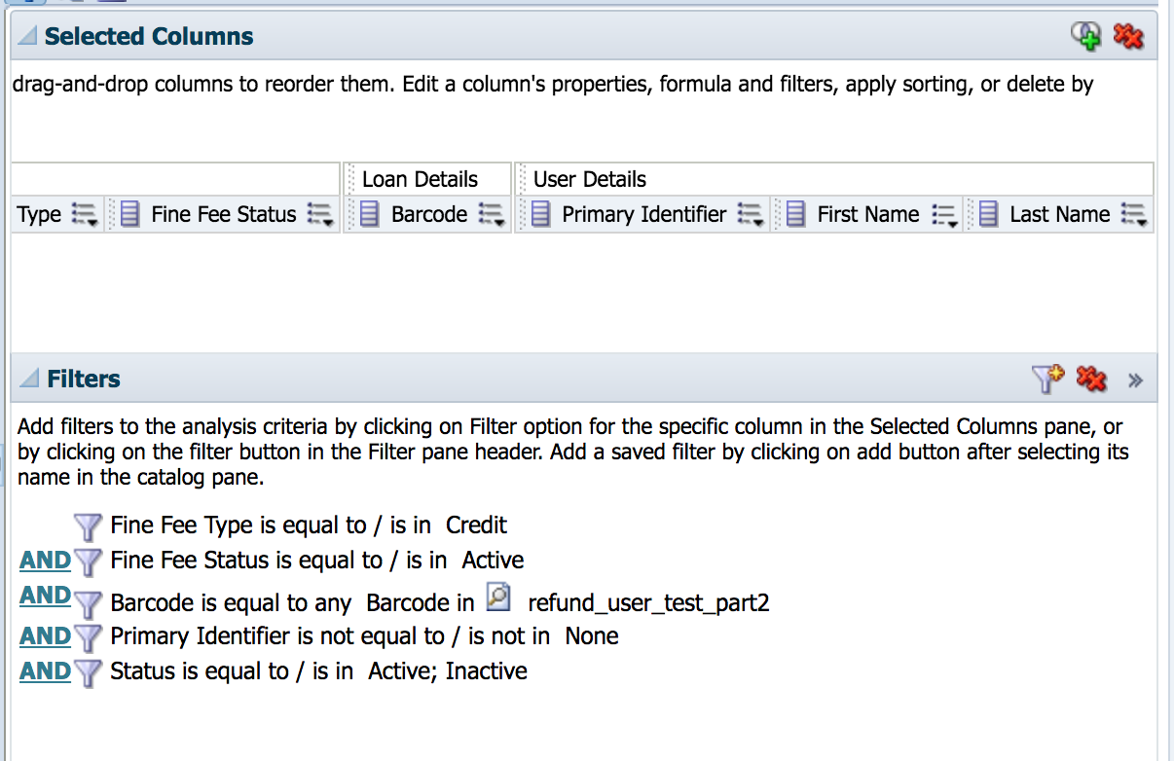
You Get What You Asked For….
You can add a filter then delete the attribute from your Selected Columns
  Usually no need to see the Lifecycle or User Status field in your report
Be careful when designing reports in Fulfillment
  Is your report based on Loan Date or Return Date?
  What is influencing your time frame?
  Are you looking for loans done at a specific location (by Circ Desk) or belonging to a Library (by Location)
Notes:
When you look at reports based on loan date or return date, you will be getting that number. If you pick a week long time frame of return dates, you will not be counting any loans which are overdue and still active, Only items that were returned on that day. This may through off your report.
What are you looking for in circ reports? The out of the box fulfilment dashboard by EX L is telling you how mny books from one library circulated. IN our previous system, we wanted to measure work done in a library. So, we wanted to know how many items were circulated by a desk. Not how many books that belong to that library were circulated. In some of our smaller libraries, their own stuff did not circulate, but they did a lot of renewals and loans of holds. And Returns.

Slide 5
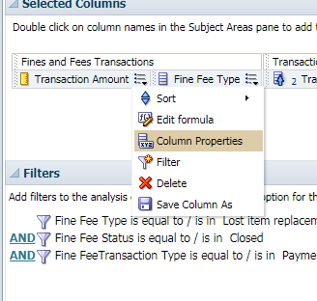
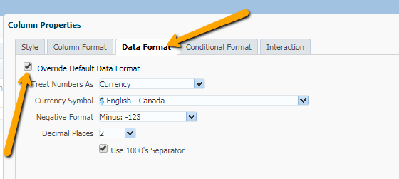
Custom Formats
Want to show Dollars as dollars?
Want to change the date format?
Changing formats to currency
Notes:
If you do not like the default display of data, check out the options in Column properties. Your first step is to click the Override default data format. Then you can change it. Not all options will be available, this list is limited to what OBI thinks it should be. You can’t change currency to written out words for example. But you can choose your currency symbol, how many decimals you want to see (and be careful! If you chose 0 decimals OBI will round the number! Sometimes it does not matter, but sometimes those pennies matter! Or nickles if you are from Canada.)

Slide 6
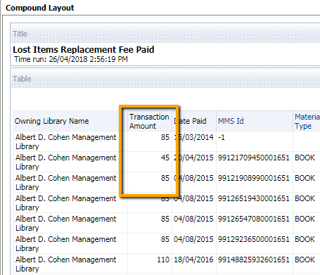
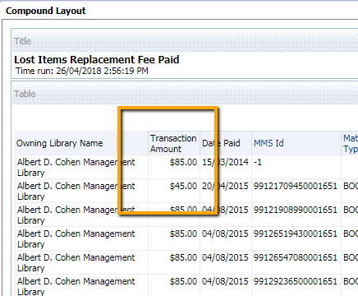
Custom Formats
From this…
To this!

Slide 7
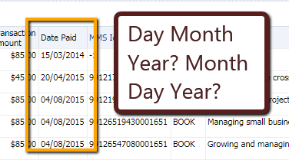
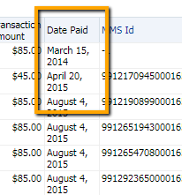
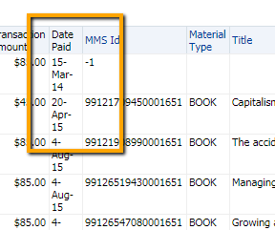
Custom Formats
From this….
To this!
Change the date format from short dates to long date, or another format!

Slide 8
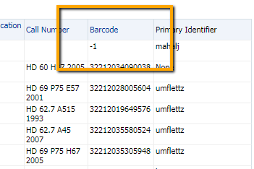
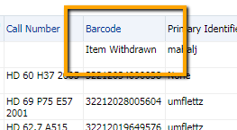
Custom Text to Avoid Confusion
Analytics will give funny info for some things
What does -1 even mean?

Slide 9
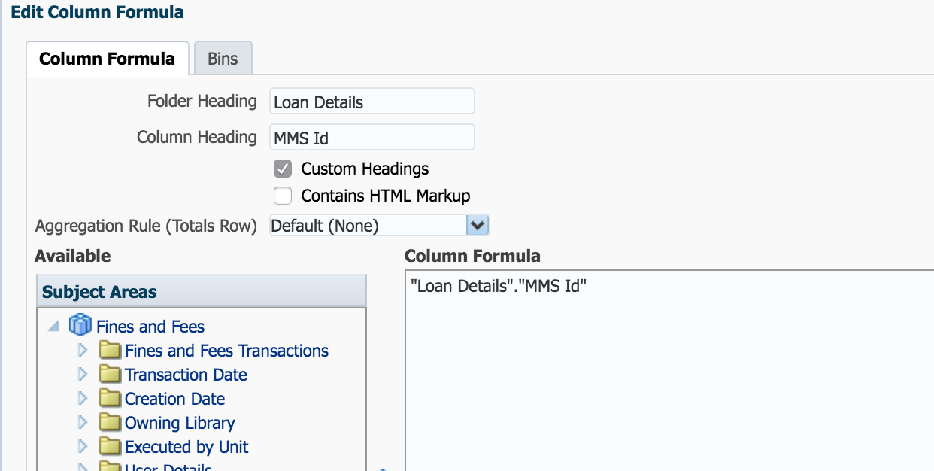
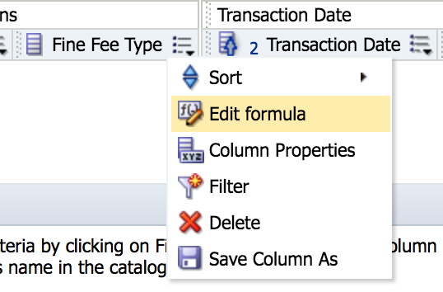

Custom Text to Avoid Confusion
Add some meaning!
Use REPLACE command in Edit Formula
Notes:
Open edit formula
Under column formula, change what is there to REPLACE(“attribute”.”Area”,’results you want to change’,’what you want it replaced with’)
Remember to use single quotes.

Slide 10
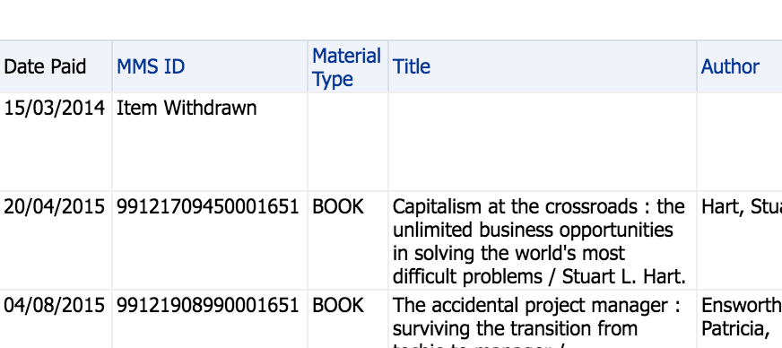
Custom Text to Avoid Confusion
Report is now more clear, makes more sense to the user of the information
Notes:
Thanks to Ex L support for this fix. I was trying to do this another way, and they showed me how!

Slide 11
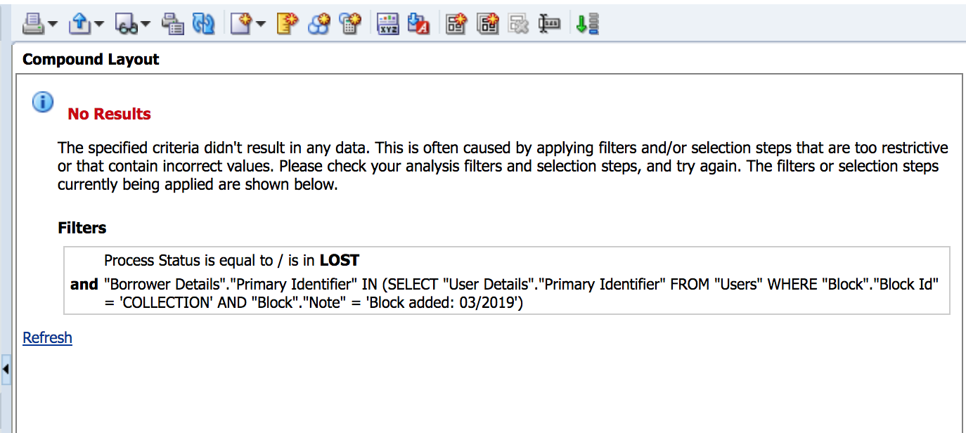
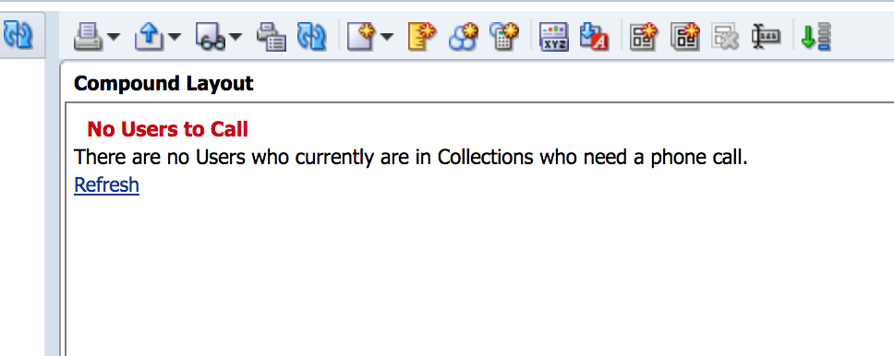
Custom Error Messages
From Confusing No Results Message
To clear

Slide 12
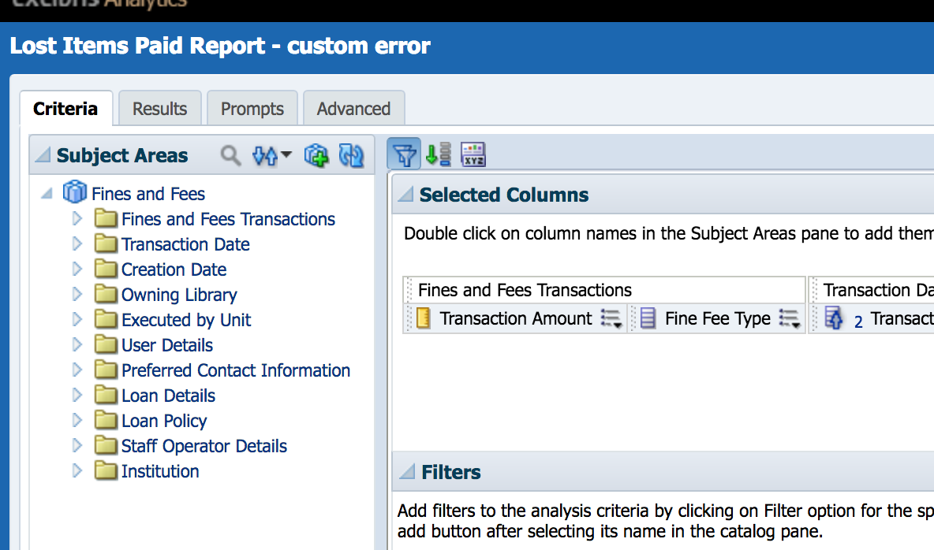
Custom Error Messages
Custom Error text
Notes:
To create a custom error message: click the XWZ button on the criteria tab.

Slide 13
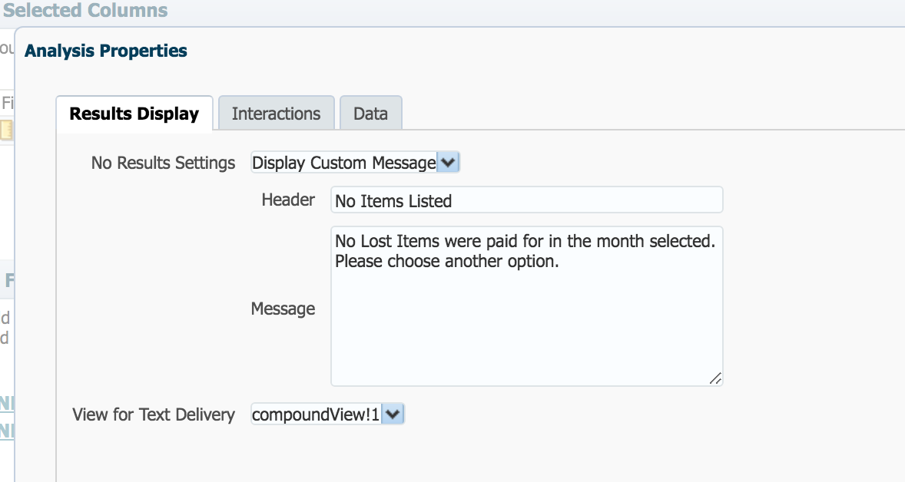
Custom Error Messages
Custom Error text
Notes:
To create a custom error message: click the XWZ button on the criteria tab.

Slide 14
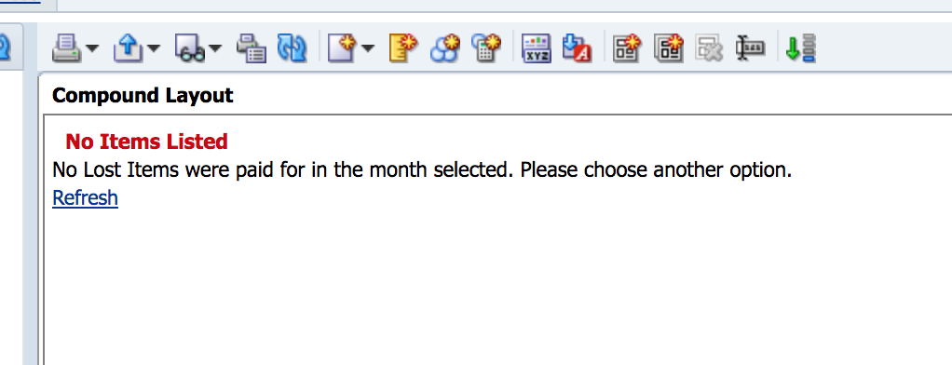
Custom Error Messages

Slide 15
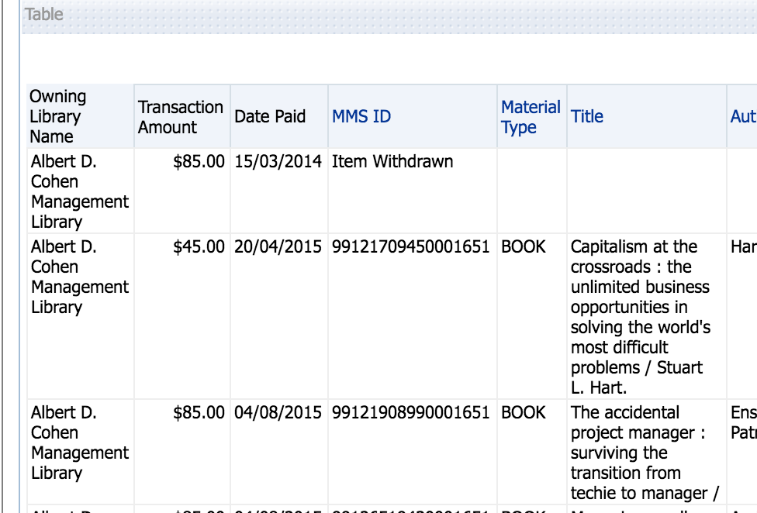
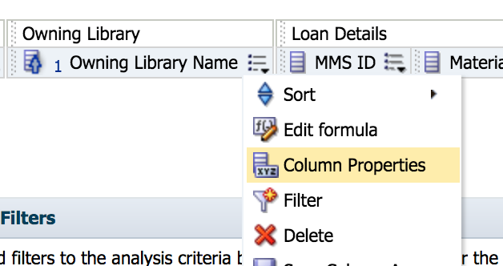
Font and Colour Changes
Make visual impact
Change Font, go to column properties
Notes:
Font or color changes can make a big impact.
It’s easy to do.
Just use the drop down menu of options nex to the column you will want to change. Use column properties.

Slide 16
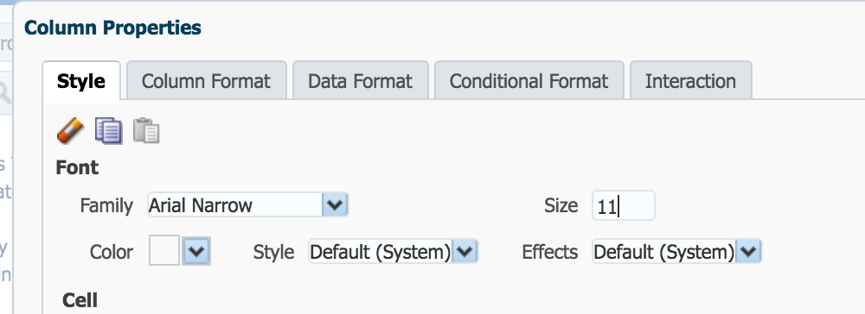
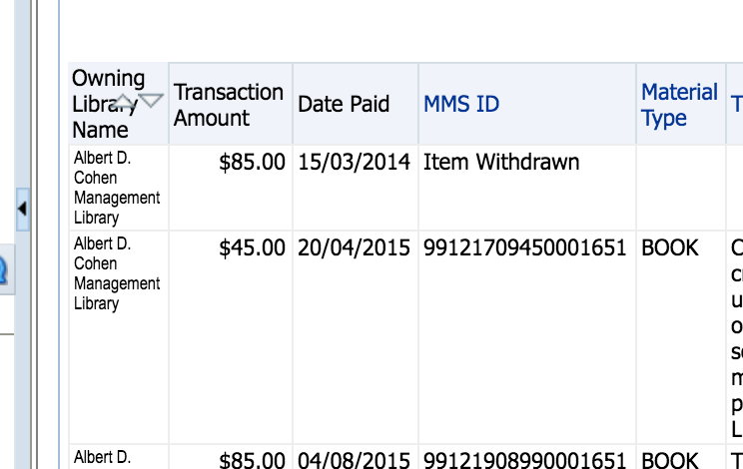
Font and Colour Changes
Make visual impact
Change Font, go to column properties
Notes:
Font or color changes can make a big impact.
It’s easy to do.
Just use the drop down menu of options nex to the column you will want to change. Use column properties.

Slide 17
Font and Colour Changes
Conditional Highlighting
Change Font, go to column properties
Make certain results stand out
We will use the Conditional Formatting tab to change this.
Notes:
Using conditional highlighting to draw the eye to something that is odd… here out default price of a lost item is $85. I want to make anything that isn’t $85 IN YOUR FACE.

Slide 18
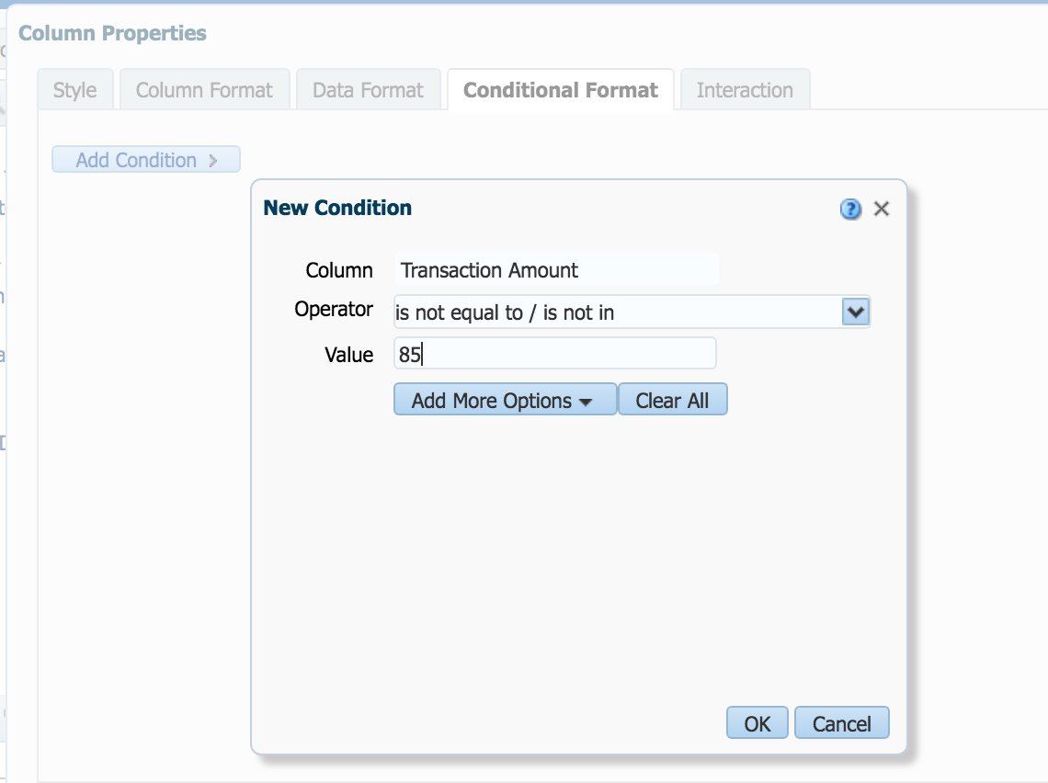
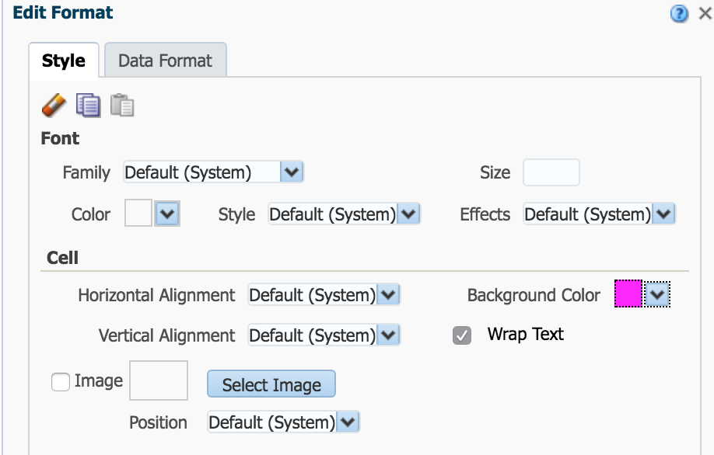
Font and Colour Changes
Conditional Highlighting
Add condition, then options if met
Notes:
Using conditional highlighting to draw the eye to something that is odd… here out default price of a lost item is $85. I want to make anything that isn’t $85 IN YOUR FACE.

Slide 19
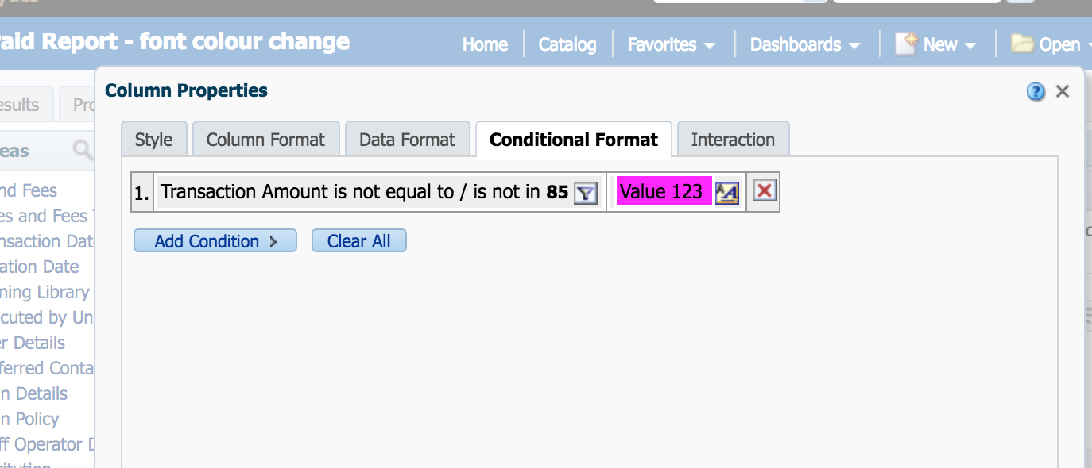
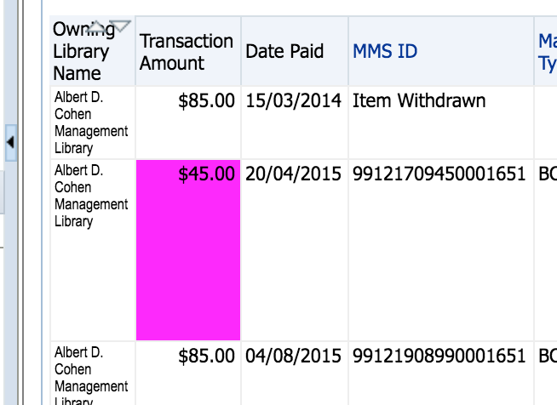
Font and Colour Changes
Conditional Highlighting
Add condition, then options if met
Notes:
Using conditional highlighting to draw the eye to something that is odd… here out default price of a lost item is $85. I want to make anything that isn’t $85 IN YOUR FACE.

Slide 20
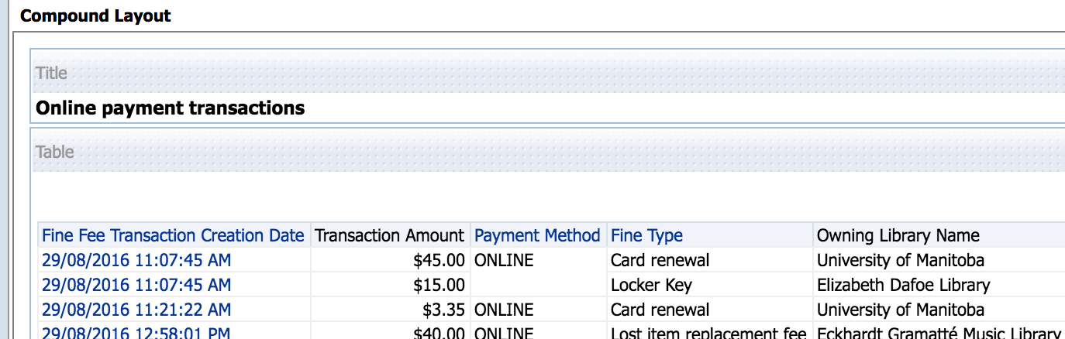
Adding Additional Text
There are some system messages available to be added to reports, such as what time and date a report was run.
No information about when this was run

Slide 21
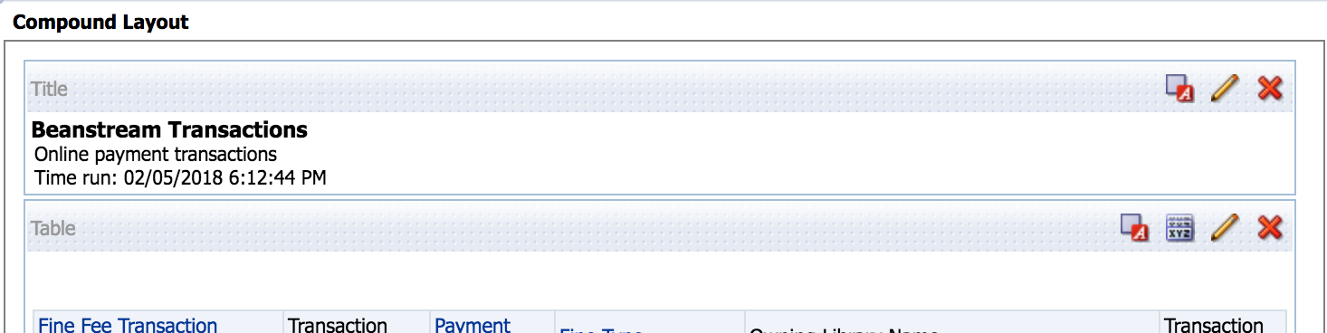
Adding Additional Text
To add some extra information, click the pencil on the Title box while viewing results.
Can add a logo, a different title and a subtitle. You can add the run time.

Slide 22
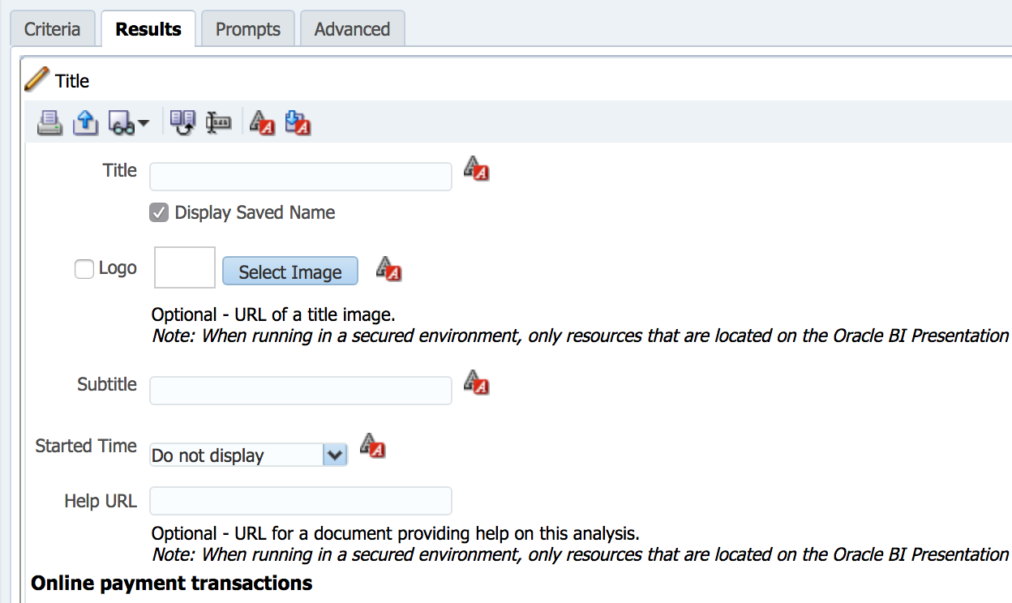
Adding Additional Text
Can add a logo, a different title and a subtitle. You can add the run time.

Slide 23
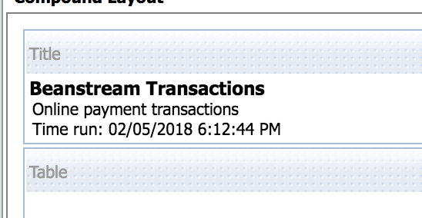
Adding Additional Text
This may keep reports you run daily from being confused

Slide 24
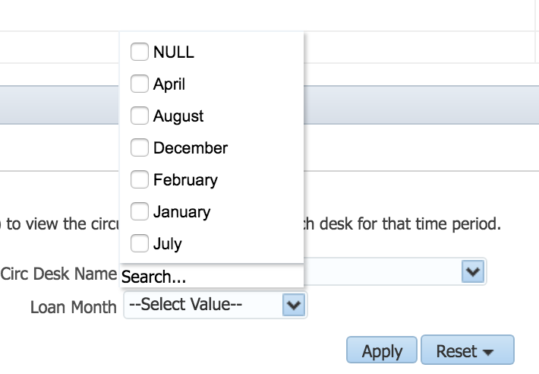
Prompts – Change order of options
    Want a specific order in your prompt?
This is not easy to understand, nor what we expect!

Slide 25
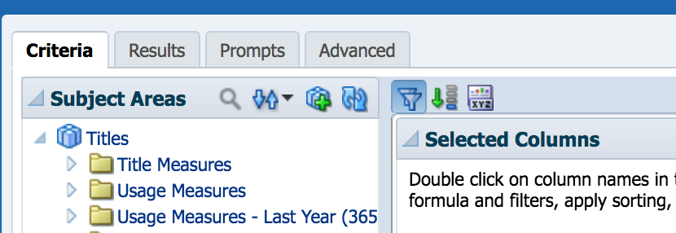
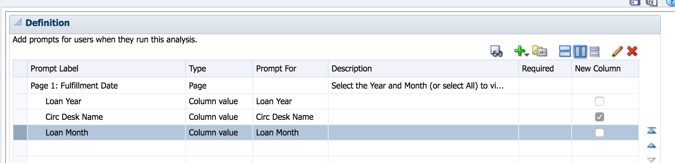
Prompts – Change order of options
1.
2.

Slide 26
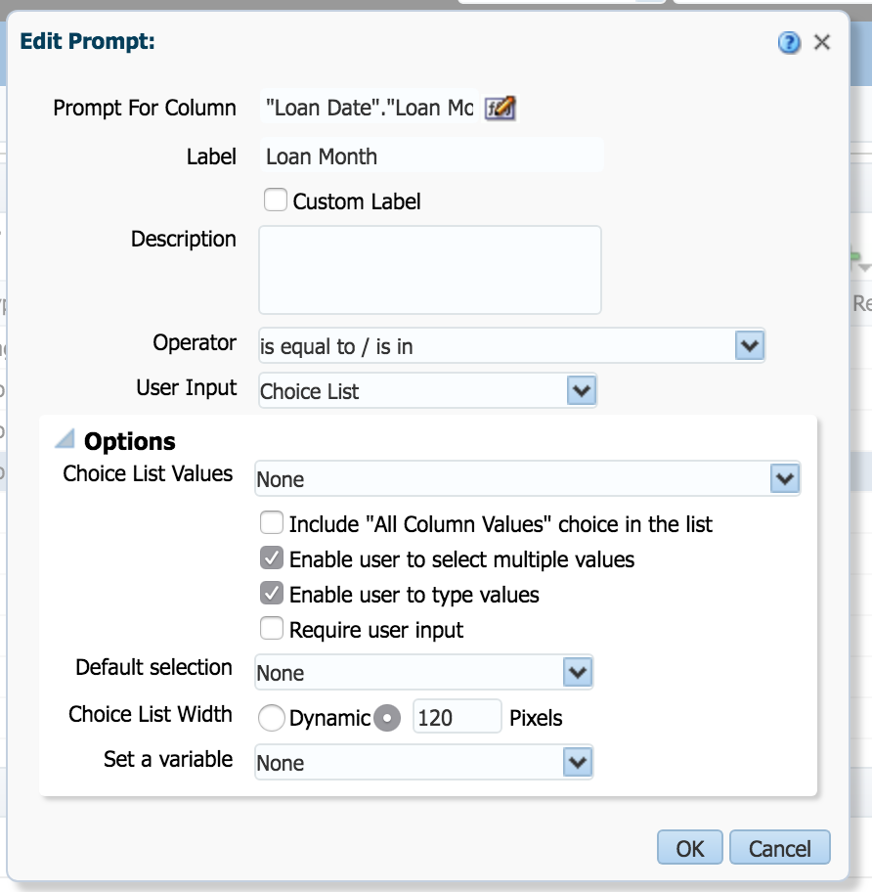
Prompts – Change order of options
3. Expand Options
4. Choice list values
use Specific
Column Values

Slide 27
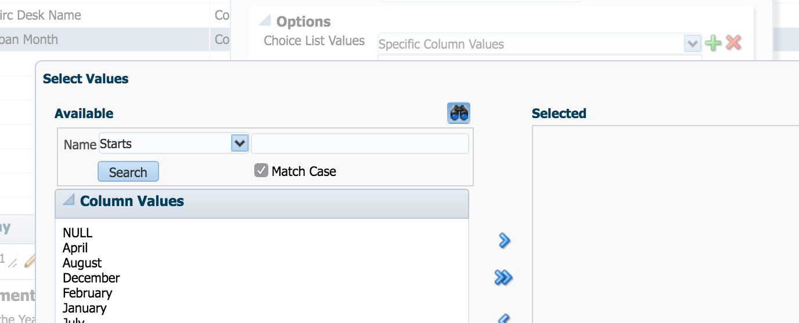
Prompts – Change order of options
5. Click Green Plus
6. Add to Selected in order
you wish to see them

Slide 28
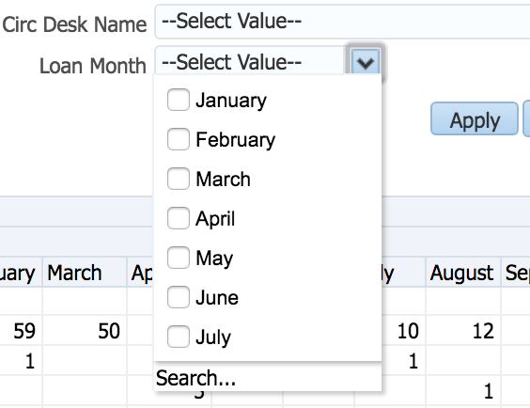
Prompts – Change order of options
Days of the Week, Months
are now ordered as you want

Slide 29
Questions?
Allison Erhardt
Library Systems Technologist
University of Manitoba Libraries
Allison.Erhardt@umanitoba.ca

