Slide 1
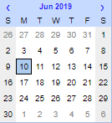
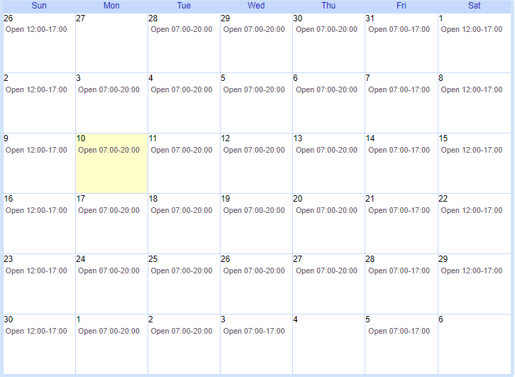
Calendars in alma – Seriously???
For eBUG 2019 Tari Keller University of Kentucky Libraries keller@uky.edu
New and
Improved!!!

Slide 2
Start here – Gather information
Institution’s academic or business calendars
  Standard events across institution – closed days, end of term dates
For individual library
  “Normal” business hours – open hours Sunday through Saturday during most of the year (like Fall and Spring semesters)
  Make list of exceptions to normal hours – like breaks, summer terms and holidays that have different open hours for each of the libraries

Slide 3
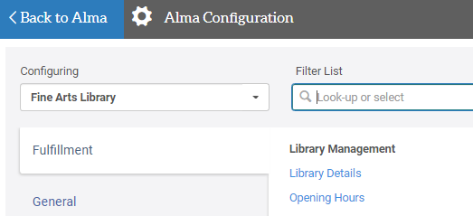

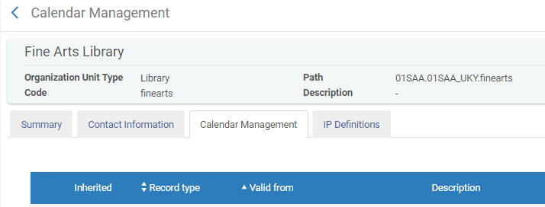
Be sure you are configuring the right calendar
Library you are configuring is here in Configuration
Or here in Alma
Click on Opening Hours in Library Management section or in Fulfillment>Advanced Tools
and Library appears here.

Slide 4
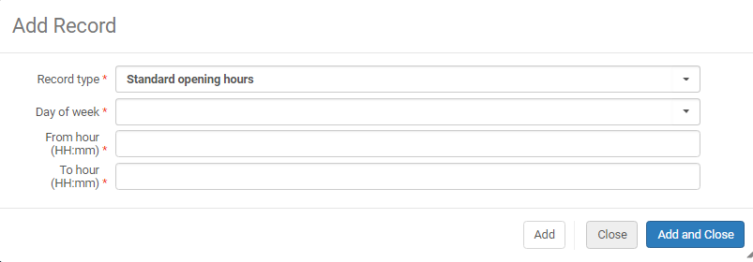
Add record – What you can do
RECORD TYPES
Standard opening hours
Exception
Event
DAY OF THE WEEK
Blank (Every Day)
Sunday
Monday
Tuesday
Wednesday
Thursday
Friday
Saturday
For Standard Opening Hours, enter the open hours range.
Notes:
For standard hours you enter the open hours.
If the library is normally closed on a particular day of the week – like Saturday or Sunday, you can skip setting that day or days up.
If they open for a special day, like you want the parents to be able to see the library on Commencement, you can add an exception OPENING the library for that day.

Slide 5
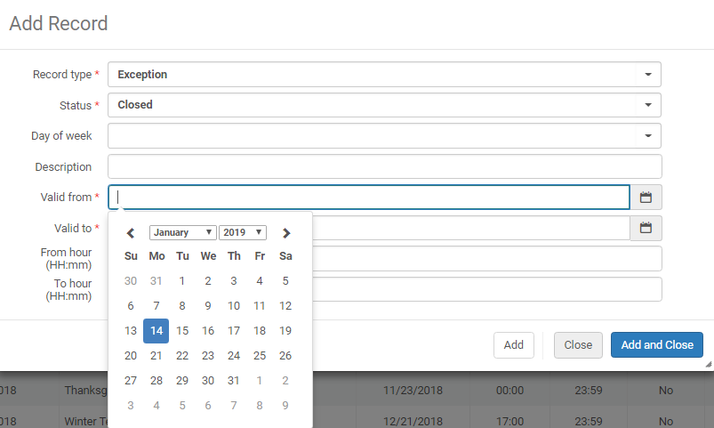
Add Record – Exception (You usually have to CLOSE the hours)
STATUS
Closed
Open
Type Description of exception here.
VALID FROM
VALID TO
Type date or
Click on Calendar icon and select date
Type hours here using 24 hour military time.
Notes:
If the change applies across a number of days, you can put in a date range. For Spring Break, most of our libraries close at 4:30 pm for Monday –Thursday of that week.
If you are shortening the hours or closing the library, put in the hours Valid from the new library closing hour for the Exception and Valid to the normal closing hour.

Slide 6
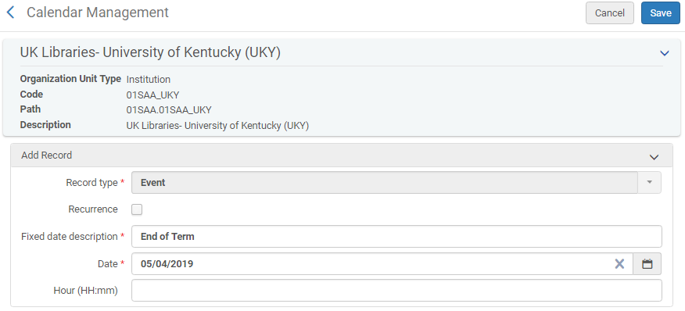
Add record – event
This is where the End of Term is defined on the Institution Calendar.
This could be used for other
events as well.

Slide 7
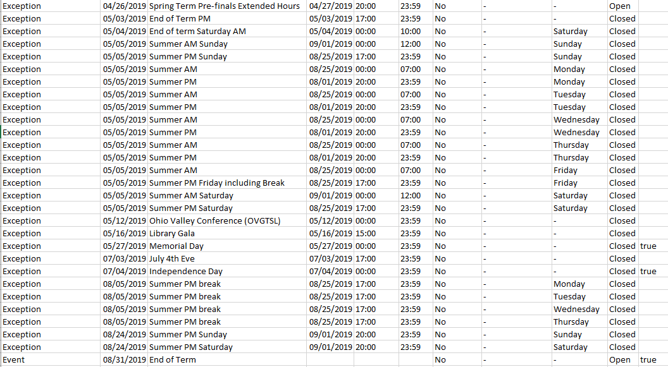
Some Young library Exceptions
When the library hours are shortened, the exceptions are “Closed”
When the hours are extended, the exceptions are “Open”.
Events do not have statuses.
This is the
Excel Export view.

Slide 8

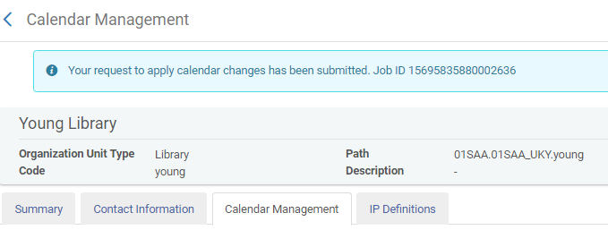
When you add, edit or remove a record a job MUST be submitted (Apply changes)
Timing can cause an error message at the top of the screen or information not updating (yet).
That job has to finish before the event or exception will appear on the calendar.
If you do anything with that calendar record before then, an error message may pop up.
A conflict with your institution calendar will also generate an error.

Slide 9
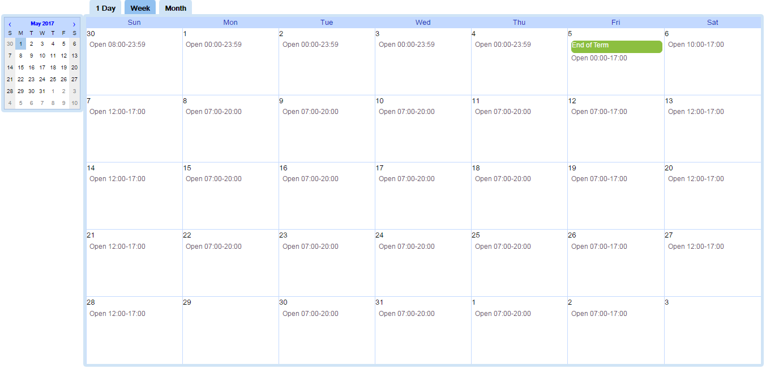
DO NOT Forget to
Apply your changes
Save your changes
Check the Full Calendar to be sure it all worked
You move from month to month using the arrows
on the small calendar,
BUT
you must select a day on the small calendar for that full month calendar to display!
If block is blank,
Library is closed
Last block in month is always blank

Slide 10
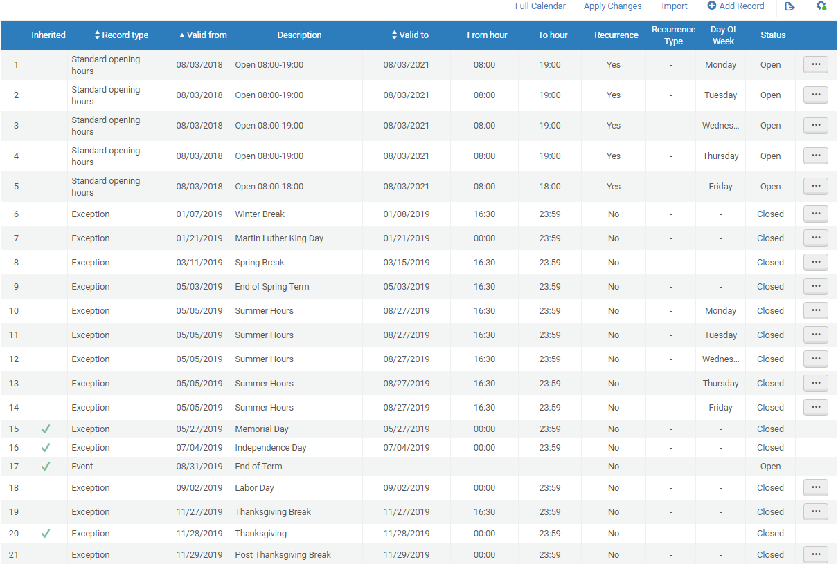
Regular hours -- Not open on Saturdays or Sundays, so no Standard Opening Hours records for Saturday and Sunday.
Library changes hours for breaks and Summer Session.
The institution exceptions should be in place before updating the other calendars. The exceptions are added into the library calendars automatically.
Green Check marks show which days were inherited from Institution’s Calendar.
Notes:
Fine Arts Library -- Regular hours -- Not open on Saturdays, so no Standard Opening Hours for Saturday.
Fine Arts changes hours mid Fall and Spring semesters to open on Saturdays.
The institution exceptions should be in place before updating the other calendars. The exceptions are added into the library calendars automatically.
Green Check marks show which days were added to the calendar from Institution’s Calendar.

Slide 11
Things to remember
All time fields are in 24 hour format.
For STANDARD OPENING HOURS, If library is closed on a particular day, there is no need for a record for it.
If closing hour is after midnight, must use 2 records. One should be normal opening time to 23:59. Second should be next day with open at 00:00 and To hour early morning closing time.
Example: Library is open 8:00 am to 2:00 am the next day.
Day of week: Monday From hour: 08:00 To hour: 23:59
Day of week: Tuesday From hour: 00:00 To hour: 02:00
Day of week: Tuesday From hour: 08:00 To hour: 23:59
Day of week: Wednesday From hour: 00:00 To hour: 02:00 and so on …
For EXCEPTIONS,
If exception is just a single day, both dates should match.
To close the shortened opening hours, always start with 00:00
To close the shortened closing hours, always end with 23:59
To close for a WHOLE day, use From hour 00:00 and To hour 23:59 on a single record
To extend the opening hours, Status is Open, From hour is normal closing time. To hour is extended to new closing time.
TIP: You can use date ranges to handle the early closures. Like the 5 days of Spring Break Week- in a single calendar record, use a date range for the week 03/11/19 to 03/15/19, that covers all 5 days that close at 4:30 (16:30—23:59).
Don’t forget to
Apply Changes,
Save your work,
and check the
Full Calendar!

Slide 12
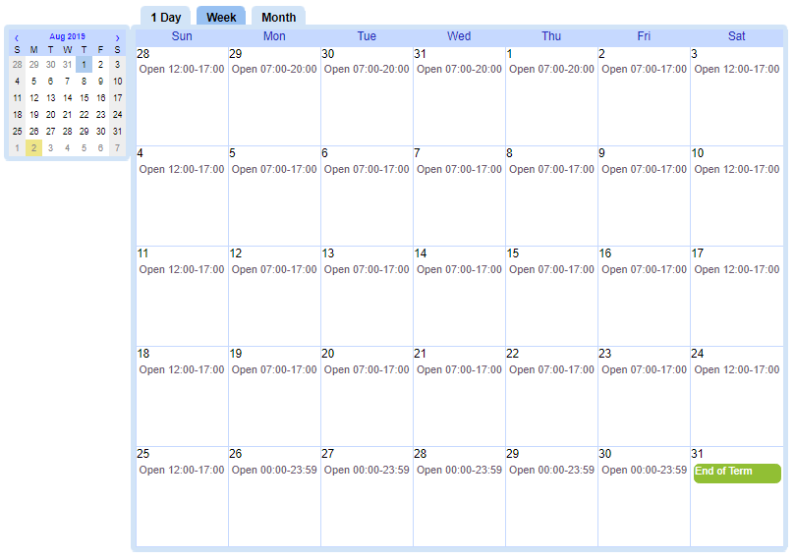
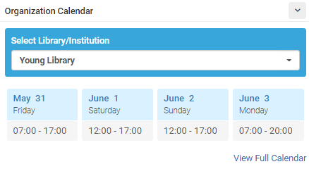
Calendar widget for Alma dashboard
Staff can add the Calendar Widget to their Dashboard and select their library to see open hours for the day, or view their Full Calendar.

