Slide 1
Before we begin
There may not be time for questions at the end of this presentation. We encourage you to email Ligia Gomez at lgomez@marcive.com directly with your questions and they will be answered and redistributed to today’s attendees.
The slides will also be shared on the MARCIVE website, so please sit back and relax instead of writing what you see on the screen.
www.marcive.com

Slide 2
MARCIVE & Temple University
MARCIVE knew that libraries were no longer interested in hosting their own authority file; and ExLibris offered an innovative solution with the shared authority file in the community zone. As library systems are changing to linked data and open environments, we were left with questions such as, “Is authority control relevant?”
We developed an ongoing subscription that would maintain the bibliographic records because we saw that there was still a gap. We needed a guinea pig, and are very grateful for Temple University’s partnership in testing out this product.
Holly Tomren, Head of Metadata Strategy and Digitization Services, Temple Univ.
Leanne Finnigan, Database Management Librarian, Temple Univ.
Ligia Gomez, Consultative Sales at MARCIVE

Slide 3


Outsourced Authority Control in Alma
Comparing Workflows and Results
Leanne Finnigan
Holly Tomren
ELUNA 2020

Slide 4

About Temple University Libraries
Libraries:
  Philadelphia, PA: Main campus, Health Sciences, Podiatry, Law, Special Collections Research Center, Charles L. Blockson Afro-American Collection, and remote storage facility
  Additional campuses: Ambler, PA; Harrisburg, PA; Tokyo, Japan; Rome, Italy
Total titles, including e-resources (FY20): 4,286,195
Total physical titles (FY20): 1,964,725
Total physical volumes (FY20): 2,874,066
NACO contributors; internal SACO training in progress

Slide 5
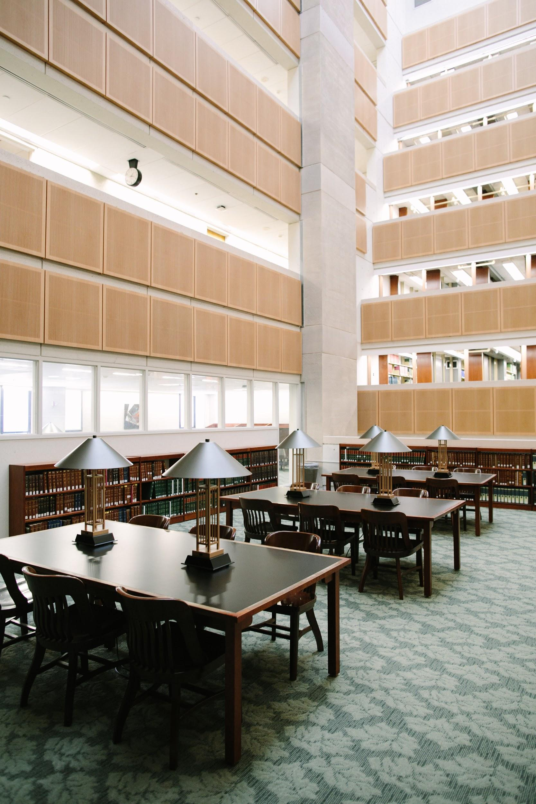

Timeline
1998 migration from GEAC to III Millennium
2017 migration from Millennium to Alma and Primo
2018 launched custom Blacklight discovery layer to replace Primo
2019 move from Paley Library to Charles Library

Slide 6
Authority Control Prior to Alma Migration
III Millennium ILS
Millennium used locally stored authority records to manage headings.
  Updated authority records would trigger updates to the headings in corresponding bibliographic records, based on 4XX string matching.
  Authority records with no matching headings in bibliographic records generated a Blind Headings report
  Bibliographic headings with no matching authority records generated additional reports, including new headings, near matches, etc.

Slide 7
Marcive Workflow, pre-Alma
Marcive services:
  Overnight Authorities, Standard Authority Notification, New Match Services
  Last Backfile was in 1998, corresponding to Temple main library’s migration from GEAC to III
Workflow:
  Send Marcive bibliographic records for new cataloging only, 2x/month, based on Millennium CAT DATE and BIB LOC fields
  Load back corrected bibs and corresponding authorities, using Millennium load profile
  Use Millennium Headings Reports to identify issues that need manual review - blind headings, etc.

Slide 8
Alma Migration 2017
Continued to use Marcive Overnight Authorities to send new cataloging, and re-load bibliographic records
  New import profile: 001 as match point, keep local fields and data upon merge (035, 9XX, etc.)
  New search strategy: had to replace Millennium CAT DATE with local processing field in Alma (997)
Cancelled Marcive Standard Authority Notification Service, as we no longer had a use case for returned authority records
Relied on Alma authority control rules for ongoing maintenance of headings:
  Default Link BIB Headings Rule
  Default Preferred Term Correction Rule

Slide 9
Alma Migration 2017
Alma Authority Control Task List
  In 2017, Authority Task List had few options to limit results, so the reports were overwhelming, and we did not have adequate staff time or resources to evaluate reports.
  One of the more useful reports was AUT record deleted - Unlinked BIB heading, which helped identify records that could not be handled automatically by Alma, including
    Split headings
    Formerly undifferentiated names
    Fictional names moving from LCSH to LCNAF (with change in tag from 650 to 600)
  Introduction of Authority Control Task List Filters and Facets in June-August 2018 Releases were a huge improvement, but we still didn’t have staff time to devote to this, or to figure out what we were missing, because we were preparing for a library move and implementation of our discovery layer...

Slide 10
Long Story Short...
50% of new cataloging is shelf ready, not reviewed by catalogers for authority control, so Overnight Authorities for new materials is still essential.
Alma authority control rules catch some headings updates, but not all, and we did not have resources to devote to working with the Authorities Task List (especially the backlog that accumulated before the June-August 2018 releases).
Locally managing authority controlled headings cleanup & maintenance for our backfile was at such a scale that we needed another solution, or it wasn’t going to get done.

Slide 11
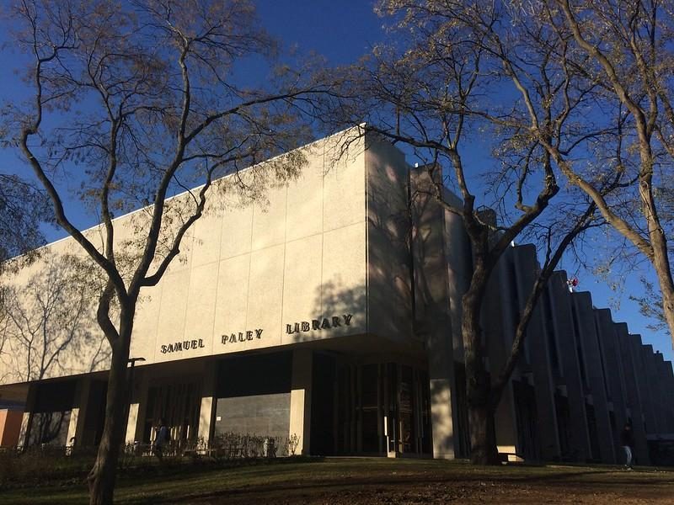
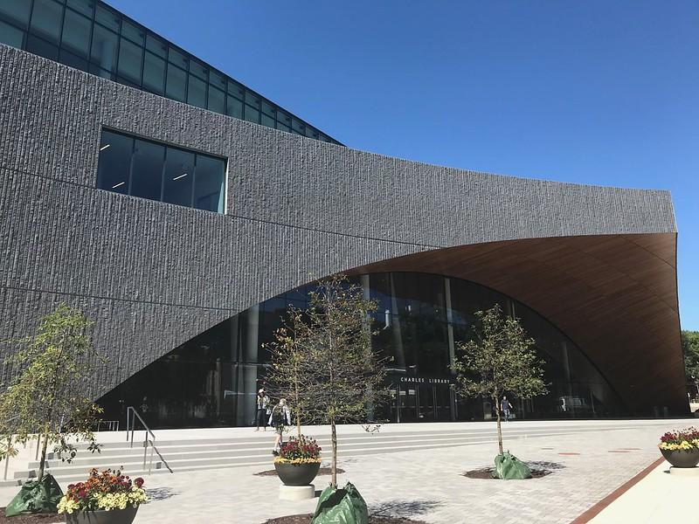
Move from Paley Library to Charles Library 2018

Slide 12
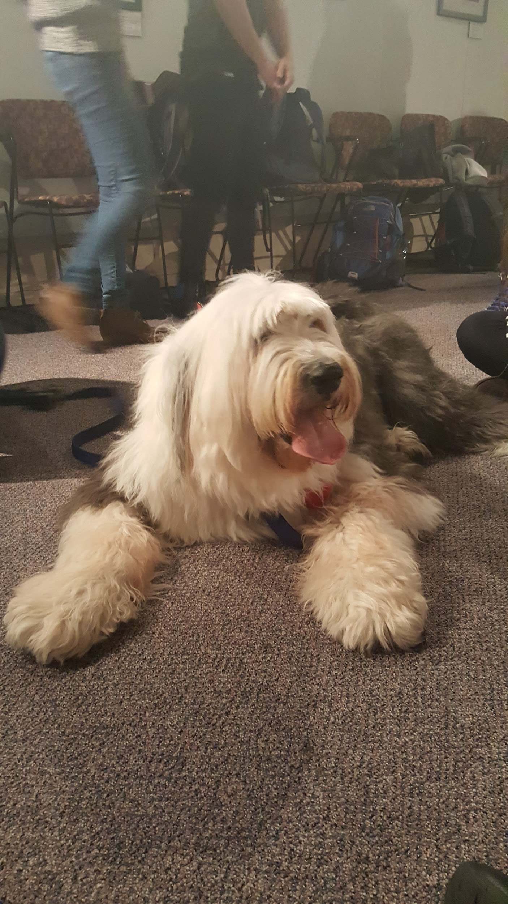
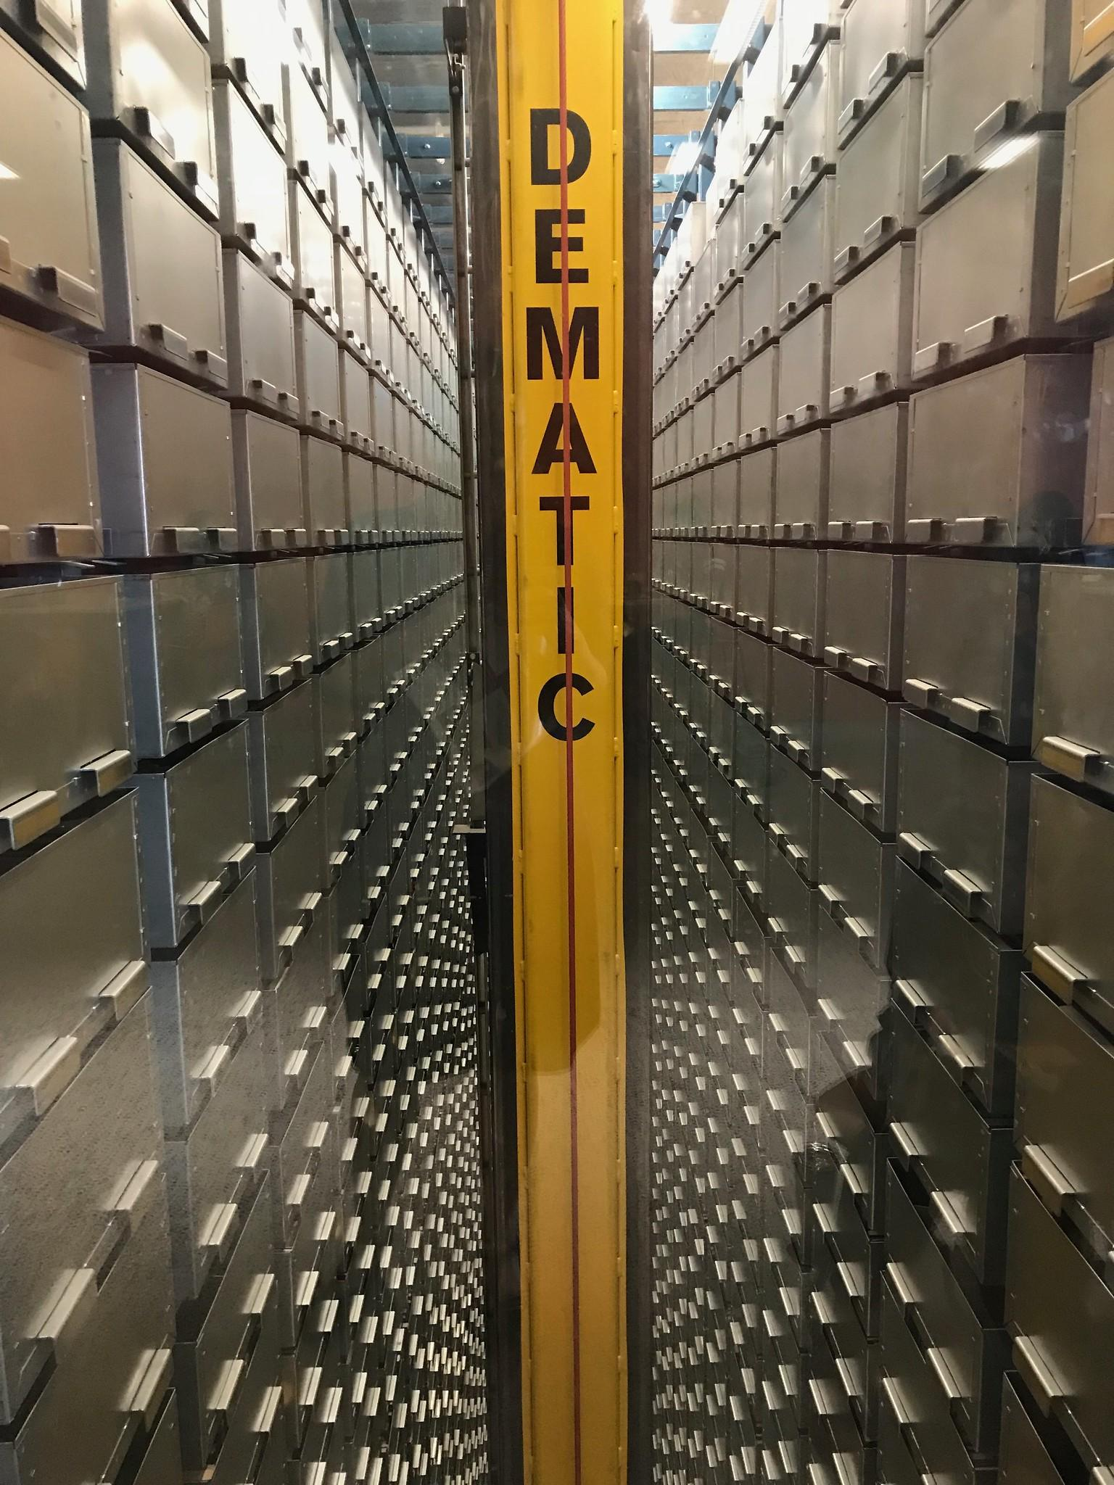
Automated Storage & Retrieval System (ASRS)
80% of circulating collection (1.2 million volumes) would now be inaccessible for browsing
Discovery is 100% dependent on availability and quality of metadata in the library catalog
To improve discovery in this new environment, we approached Marcive for
  One-time Backfile enrichment, including RDA and URIs
  One-time Table of Contents and Summary enrichment
Beyond new cataloging, still needed a way to continually update the backfile, within constraints of staff resources

Slide 13
Marcive Comprehensive Notifications Pilot
Marcive uses backfile + new records from Overnight Authorities, sends bibliographic record updates when headings have changed, rather than sending updated authority records as in the past.
We agreed to pilot for 1 year with quarterly notifications, in conjunction with our new backfile.

Slide 14

Drafting Our Profiles
Considerations
Largely centralized, but some distributed cataloging
Various rare book, archival, and manuscript description conventions
Various genre/form vocabularies and thesauri
Locally controlled terms
Theses
Whether record was “approved” by a cataloger

Slide 15
Drafting Our Profiles
Created a Confluence page to collect all relevant material, including:
Authority Control Profile, Pt. II: Guide (Marcive)
Previous TEU processing profile
Meeting/brainstorming notes and wishlists
Page was updated as the project progressed

Slide 16
Drafting Our Profiles
Separate profiles for regular and special collections
TEUM (“Traditional” cataloging)
  Backfile processing
  Ongoing CNS
  Overnight Authorities
  RDA enrichment
TEUS (“Special” cataloging)
  Backfile processing
  Overnight Authorities
  No RDA enrichment

Slide 17
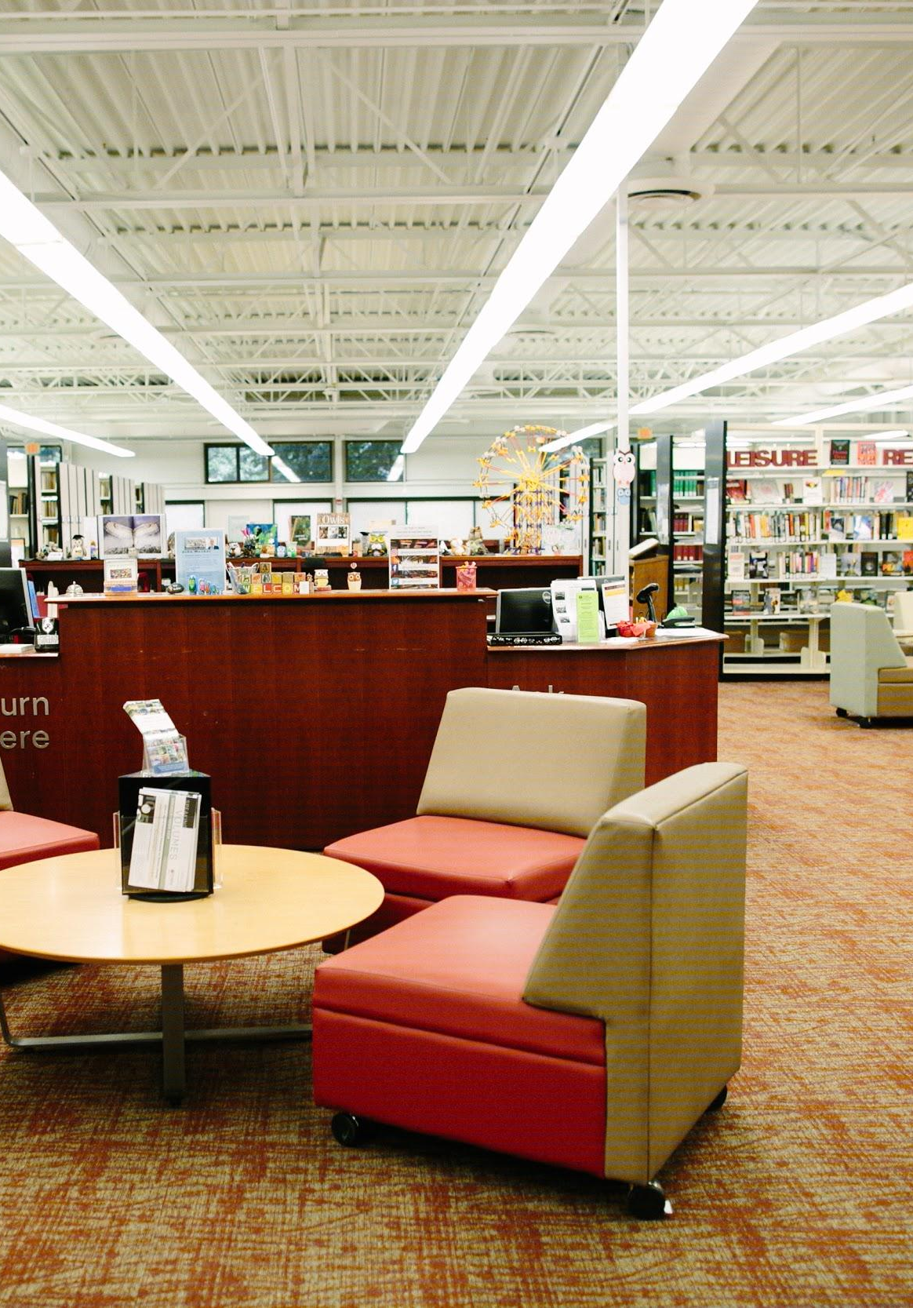
Backfile Criteria - TEUM
Unsuppressed titles
Brief level = 10 (has migrated Millennium CATDATE in 998$c or date in local processing field (997$a))
Specific locations
Stable, purchased electronic titles
Excluded:
  Incomplete records (certain records without 300 field, records without 008)
  Theses records
  Archival/manuscript and rare book records
  Records linked to Community Zone
  Records in TEUS backfile
Anticipated record count for TEUM backfile: 2,000,000

Slide 18
Backfile Criteria - TEUS
Unsuppressed titles
Brief level = 10 (has migrated Millennium CATDATE in 998$c or date in local processing field (997$a))
Rare book records (040$e has: bdrb, dcrb, dcrmb, dcrmc, dcrmg, dcrmm, dcrms)
Excluded:
  Incomplete records
  Theses
  Archival/manuscript records (040$e has: amremm, appm, dcrmmss, dacs)
Anticipated record count for backfile: 167,000

Slide 19
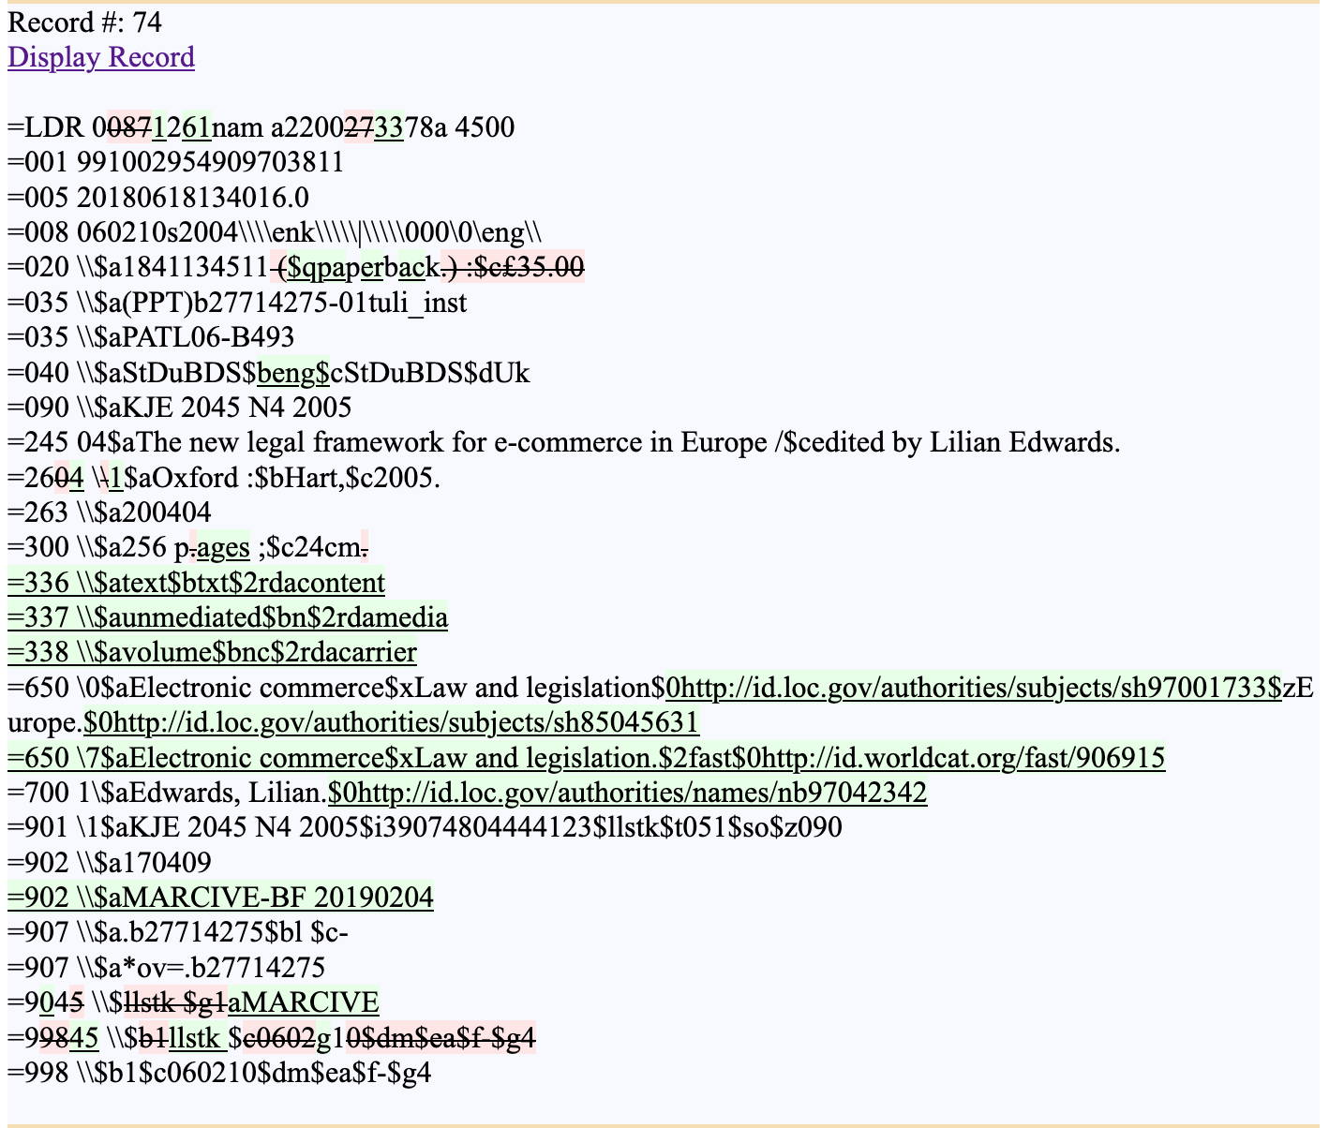
Reviewing Test Records & Finalizing Profiles
Tools used: MarcEdit & hypothes.is
Provided sample files that included “quirky” records for Marcive to process against our draft profiles
Resulting bibliographic files were processed using MarcEdit’s MARCCompare tool, which provides a visual rendering of the “before and after” of our test records
Those html files were put on a server so we could assess results collectively

Slide 20
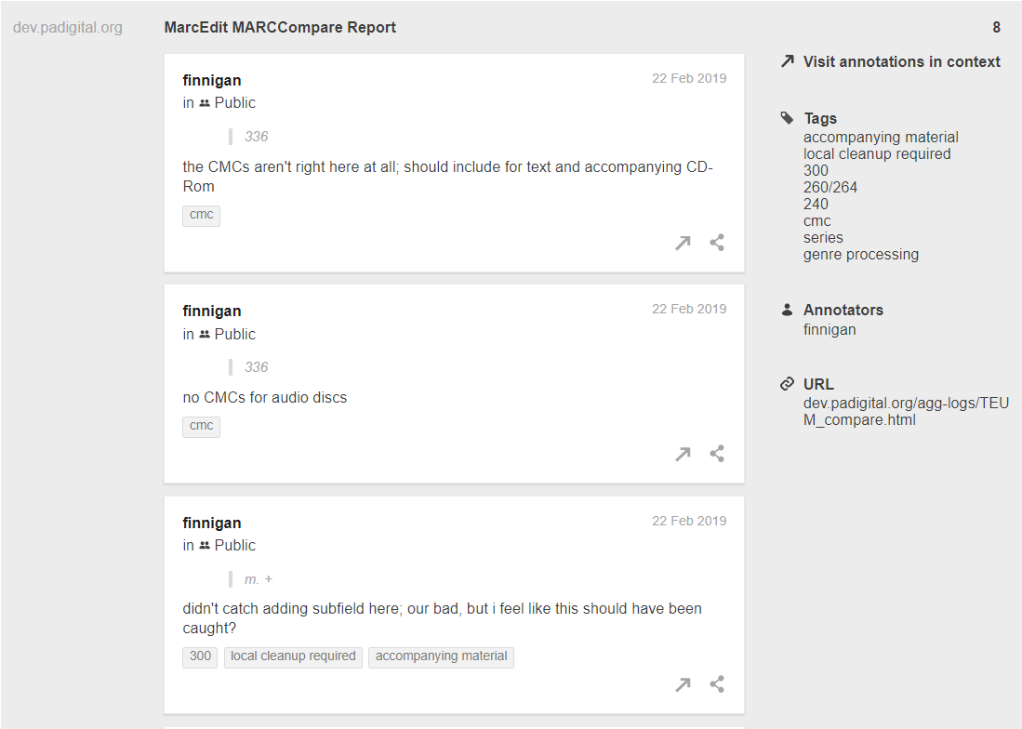
Reviewing Test Records & Finalizing Profiles
Once on a server, we used hypothes.is, a web annotation tool, to collectively review the records (think Google Doc comments but for web pages)
Instructions and assignments based on expertise were added to Confluence
Tagging annotations allowed us to organize our feedback and point to specific examples when we responded to Marcive
After we were satisfied with the profiles and processing, Marcive ran the backfiles

Slide 21
1st Quarter: Evaluate Records
First CNS yielded 200,000+ returned records
Evaluation process
  Added guide to processing reports to our Confluence project page
  Reviewed provided reports, especially:
    TEUXCHNG.TXT - Preprocessing changes report (updates to bibs based on our profiles before authority processing - generating RDA elements, fixing language codes, etc.)
    TEUXOBSO.TXT - Authorities processing report
    RELATED files - newly matched, updated, and deleted authority records

Slide 22
1st Quarter: Evaluate Records
Evaluation process (cont’d)
  Created Jira tickets with samples of particular types of changes in RELATED files
  Assigned to colleagues and asked them to compare the changes to what was in Alma
  Provide a short summary of their assessment answering the following:
    Were headings already updated locally in Alma due to its automated processing?
    Did Marcive pick the right heading? If not, please describe the error.
    If Alma did not update the heading and Marcive did, what are the characteristics of the headings that were missed? For example, note if a majority of qualified headings were updated by Marcive but not by Alma's automated processing.
    Did you find anything unexpected or weird that Alma and/or Marcive did?

Slide 23
1st Quarter: Evaluate Records
Where Marcive excelled:
  Updating headings where record has no 4XX to aid automated update
  Correct flip of fictitious characters
  Updating newly matched headings where new heading has qualifiers
  Updating headings for deleted undifferentiated authority records
Alma | Marcive
100 1 $aHulen, Bertram Dyer,$d1889- | 100 1 $aHulen, Bertram Dyer,$d1889-1949
650 0 $aRahl, Richard (Fictitious character) | 600 10 $aRahl, Richard$c(Fictitious character)
100 1 $aJohnson, Lynn | 100 1 $aJohnson, Lynn, $d 1953-
100 1 $aChickering, Edward Conner, $d 1875- | 100 1 $aChickering, Edward C.$q(Edward Conner),$d1875-1952

Slide 24
Establishing and Refining Workflow
Challenges
  Working around ongoing maintenance and cleanup
    Alma automated maintenance
    Post-move cleanup projects that resulted from the move to Charles Library
    Closure due to COVID-19: cleanup projects of existing metadata are ideal for telecommuting

Slide 25
Establishing and Refining Workflow
Challenges (cont’d)
  Alma server capacity and file size
    Each file is 120+ MB and contains 50,000 records
      Note: Marcive can reduce the number of records in a file, but we would prefer that Alma be able to handle files of this size (smaller files = more files to load!)
    Uploading and timeouts in Import Profile
      “It is suggested that you limit your file size to a maximum of 10MB” (Importing Records Using an Import Profile)
      “...try again, just on off hours of the Internet, e.g. early in the morning” (ExLibris customer support response to reported issues)
    Can’t do more than one Import Profile run at a time
    The longer it takes to load, the larger our synchronization gap; slows local editing
  During initial backfile, lots of validation errors and “deleted” records to sort through and correct (our fault, not Marcive’s!)

Slide 26
Establishing and Refining Workflow
Solutions - Working around ongoing maintenance
  Education and training
  Use 904 for processing stamp and tracking
  Merge profile - see “Temple University Marcive CNS” in Community folder
    only overlays fields under authority control (1XX, 240, 6XX, 7XX, 80X, 81X, 82X, 83X, 904)
when
merge
then
remove MARC."1"XX
add MARC."1"XX
end

Slide 27
Establishing and Refining Workflow
Solutions - Working around ongoing maintenance (cont’d)
  Use 904$x resend when editing, adding, and deleting a tag under authority control
    To “refresh” a record that Marcive has in our backfile
    Resend for Overnight Authorities
    Run Overnight Authorities immediately before CNS processing begins
  More to come!
    Track ongoing issues using a ticketing system

Slide 28
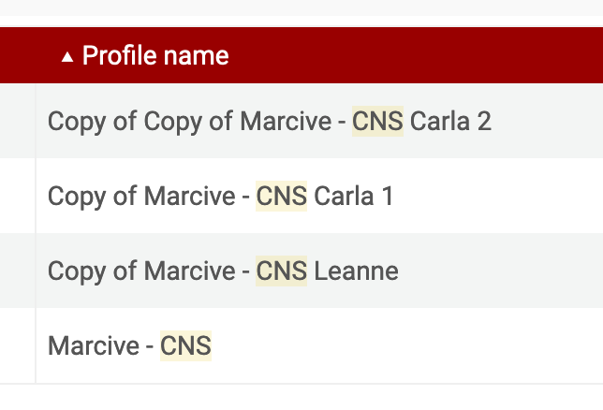
Establishing and Refining Workflow
Solutions - Alma server capacity and file size
  Used MarcEdit to split the files into smaller ones and placed on shared drive
  Made copies of Import Profile and “tag teamed” with colleague
  Used Safari and Firefox simultaneously
  Tracked loading with a spreadsheet

Slide 29
Benefits
Better than Alma at maintaining our access points
Supports our faceted discovery interface
  Cleans up 041 language codes
  Adds FAST headings
  Adds 655s based on $v subdivisions
  Adds 384 for musical key
  Adds LCDGT terms in 385 (age only)
  Adds Form of Work in 380 based on 047 value(s)
URIs open up possibility to maintain various vocabularies in house; won’t have to rely as heavily on string matching

Slide 30
Challenges
Marcive processing improvements/changes mean more records to load back in
  Changed order of subfields with URIs
  Changed process to generate FAST headings from LC
Ongoing Alma server capacity issues
  May look into using a local FTP server or OAI
Marcive reports
  Something easily plopped into a spreadsheet would have saved review time
Our database will always be a moving target; constant refining of workflow

Slide 31
Future Plans
Keep CNS service, but switch to semi-annual
Add CNS service for special collections, with an annual update
Plan for annual backfile refresh to address ongoing synchronization issues
  Capture updates we didn’t load during ongoing CNS
Hope to incorporate returned authority records into a newly developed Centralized Metadata Repository outside of Alma, which we will use to incorporate authority data into our local Blacklight discovery layer

Slide 32
Questions?
Ligia Gomez, lgomez@marcive.com
Leanne Finnigan, leanne.finnigan@temple.edu
Holly Tomren, holly.tomren@temple.edu

