Slide 1


Diving into the Wreck: Post-Migration Data Cleanup
at UNC Charlotte
Joseph Nicholson, Metadata Librarian
Shoko Tokoro, Electronic & Continuing Resources Librarian
August 19, 2020

Slide 2
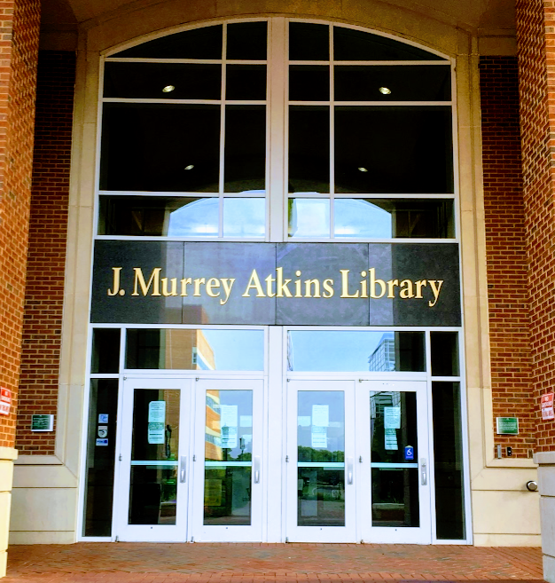
3.8 million volumes, including 1.2 million e-books
650+ databases
222,000 journals, the vast majority available electronically

Slide 3

Topics to Cover
Duplicate Fields
Local Bibliographic Data in Non-Standard Fields
Suppressing “May Be Available” holdings with 0 Items
Scrambled Copy Numbers
Diacritics & Special Characters Problems
Removing Non-LC Subject and Genre Access Points in Records
P2E
Disconnected Bound Withs and Analytics
Data Cleanup at UNCC: Complicating Factors

Slide 4
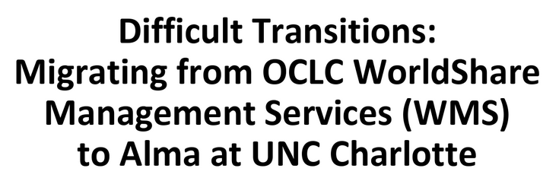


Preparing for the Dive
Sequel to ELUNA 2018 presentation
2018 presentation dealt with Atkins Library’s migration from WMS to Alma in 2017 and associated data messes
This presentation: a deep dive into our bibliographic and holdings data cleanup strategies, tools, successes, and failures since 2018
Prepare for extreme data detail

Slide 5

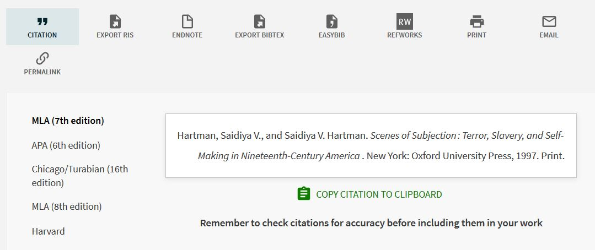
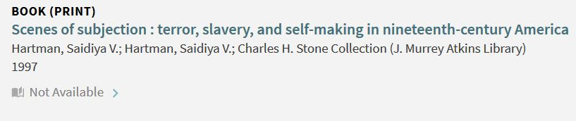
Duplicate Fields
Problem: duplicate fields for access points and note fields inserted in bibliographic data during migration to WMS in 2013
Creates confusing displays in both Primo bib data and Primo citation data

Slide 6

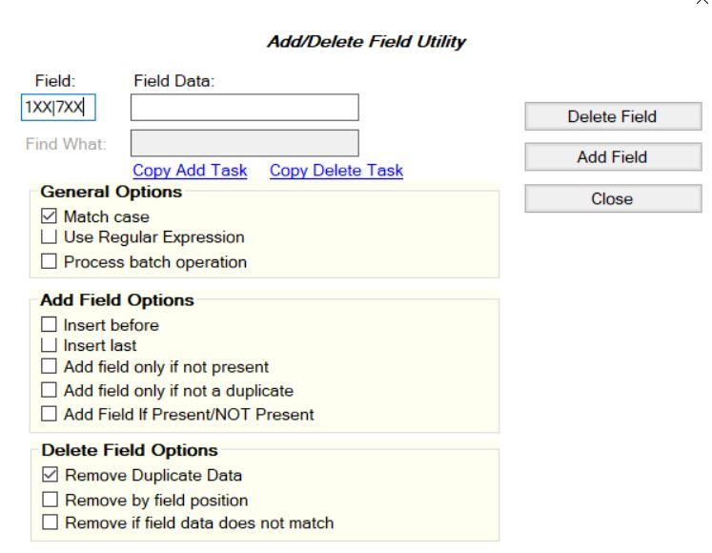
Duplicate Fields: Solution
Normalization process?
  No, because norm rules don’t allow matching on strings
MARCEdit
Process:
Export print records from Alma
Use Add/Delete Field Utility to remove duplicate fields
Extract changed records
Reimport and overlay changed records with import profile

Slide 7
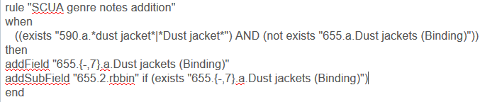

Normalization Rules vs. Other Data Editing Methods
Norm Rules
Relatively simple if-then conditions
Changing records based on specific values in them (vs. patterns)
MARCEdit and Others
Looking for data patterns with regular expressions
String matching
Various types of batch processing
Complex automated pre-programmed tasks

Slide 8


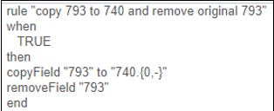
Local Bibliographic Data in Non-Standard Fields
Problem: Copy-specific information placed in non-standard MARC fields during migration to WMS in 2013
Solution: Normalization rules that move data back to standard fields
Other Local Bibliographic Data Fields
520 590
505 595
541 597
545 597

Slide 9
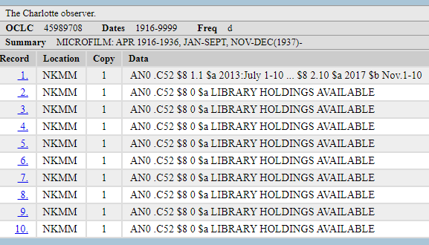
Suppressing “May be available” Holdings with 0 Item Records (1)
About 100 items per holding record
Multiple holdings were created during our earlier migration from Millennium to WMS

Slide 10

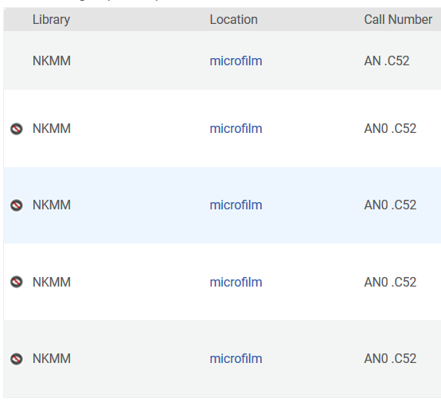
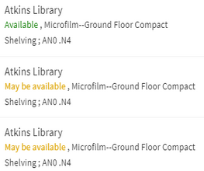
Suppressing “May be available” Holdings with 0 Item Records (2)
All item records were moved to one holdings record in Alma. The rest of the holdings record became empty.
The empty holdings with 0 items appear as “May be available” in Primo.

Slide 11
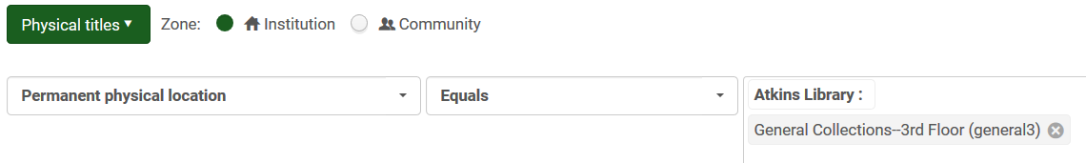
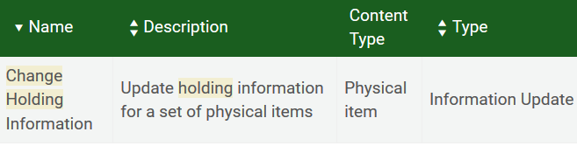
Suppressing “May be available” Holdings with 0 Item Records (3)
Process:
Search Physical Titles in a particular location and create a set
Search Physical Items in the same location
Export the list to extract barcodes and upload them using the csv file
Suppress all of the holdings records
Unsuppressing the holdings records to which item records with those barcodes are attached

Slide 12
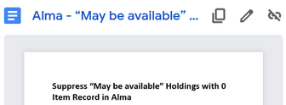
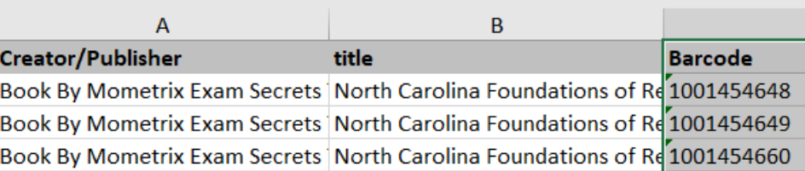
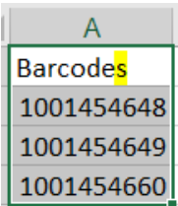
Suppressing “May be available” Holdings with 0 Item Records (4)
The procedure temporarily suppresses all records in a given location.
The header for the barcode has to be the plural form in a csv file, although it is the singular form in an Alma exported report.
.CSV
Exported Alma report

Slide 13
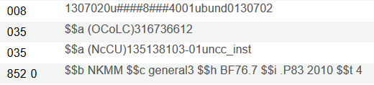
Scrambled Copy Numbers
Problem: In WMS, holdings data for multipart resources was sometimes scattered across multiple holdings records attached to a single bibliographic record. Each copy of a single-part resource in a given physical location had its own holdings record. In Alma, all of the items (copies) were attached to a single holdings record, regardless of whether the copy numbers matched.
Holdings record 22240454640004091

Slide 14
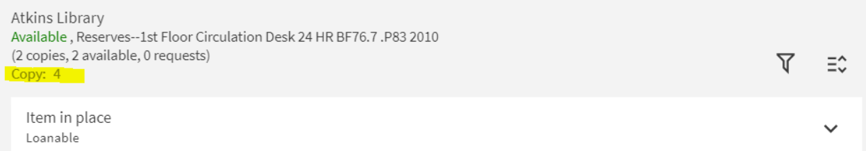
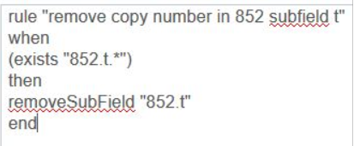
Copy Numbers Continued
Solution
  Stop using copy numbers altogether; barcode is now the identifier
  Remove copy numbers from subfield $t in 852 in holdings records
Primo Display

Slide 15

Normalization Process for Holdings Records
Create normalization rule
Create normalization process at Config - Resources - Cataloging - Metadata Configuration - MARC21 Holding
Add normalization process with rule
Create physical or all titles set with holdings records you want to change
Run Change Holding Information job on that set
In the job, check the box next to “correct the data using normalization rules” and select the normalization process from the dropdown

Slide 16
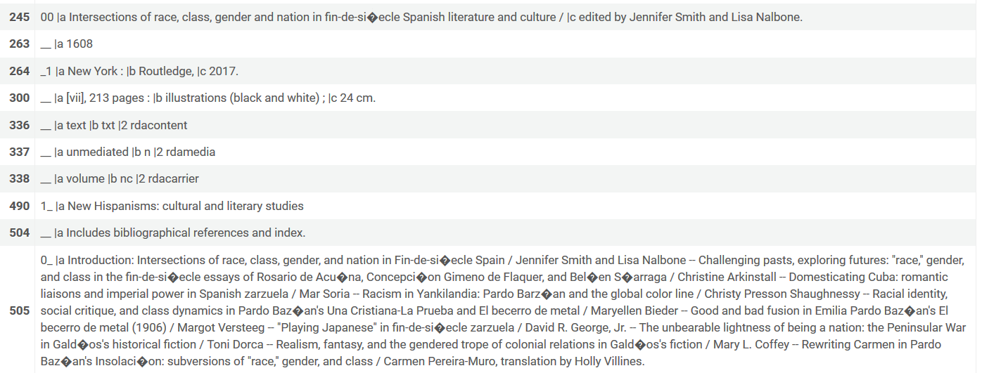

Diacritics & Special Characters Problems

Slide 17
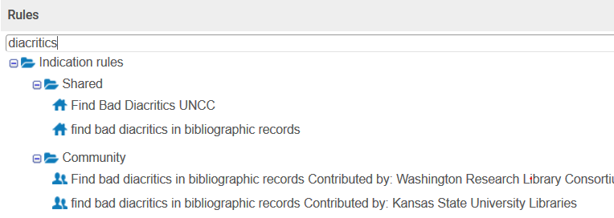
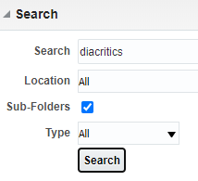
Identifying Diacritics & Special Characters Problems
Indication rule, Bad diacritics
  Contributed by Margaret Corby, Kansas State University
  All bibliographic records including from the CZ
Analytics reports
  Several reports available from other institutions
  Electronic portfolios / physical records

Slide 18

Correcting Diacritics & Special Characters Problems in Bibliographic Records
If there are few
Copy and paste correct characters to replace may work by making the characters in plain text
If there are many, correct them by
(1) Reimporting the records from OCLC and overlaying the records in Alma
(2) Using MarcEdit ([MARCEDIT-L] "converting" mnemonic file to UTF-8, Date: Fri, Aug 14, 2020)
(3) Using normalization rules in Alma

Slide 19
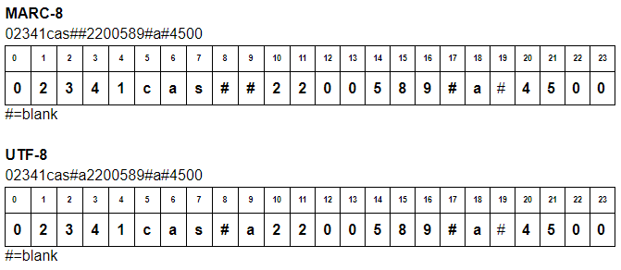
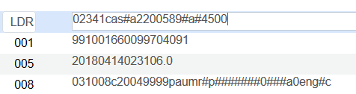
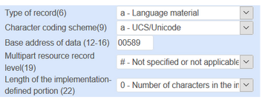
How to Prevent Diacritics & Special Characters Problems (1)

Slide 20
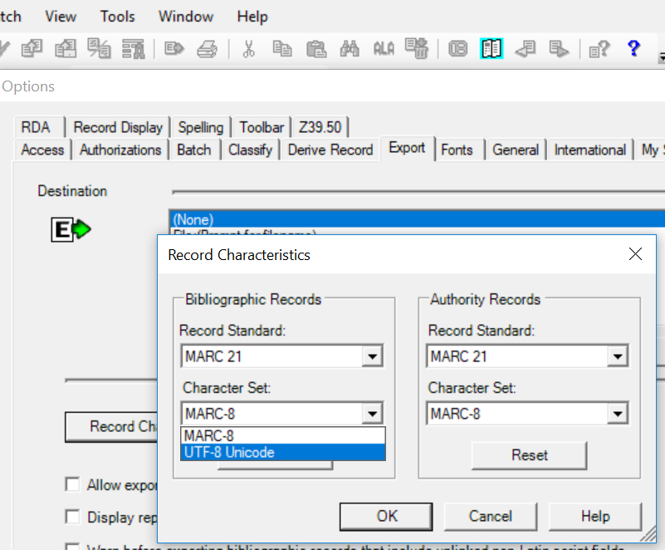
How to Prevent Diacritics & Special Characters Problems (2)
(1)
Connextion Client: Tools > Options > Export > Record Characteristics > UTF-8
UTF-8 Unicode export format is not available in the Connexion browser!

Slide 21
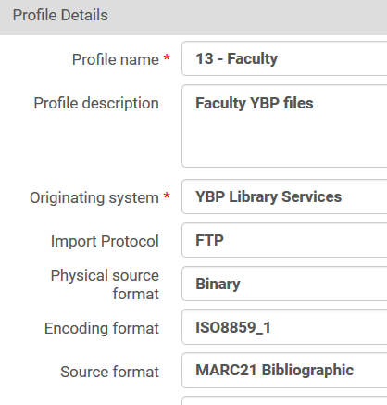
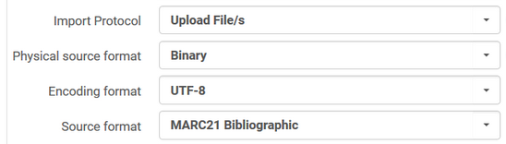
How to Prevent Diacritics & Special Characters Problems (3)
Confirm the source of records if it is MARC-8 or UTF-8. For ISO885901 records, use MARC-8 for the encoding format.

Slide 22
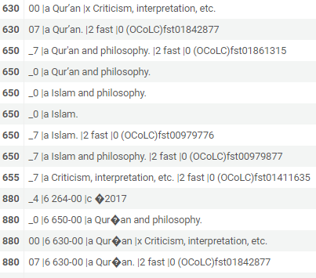
Bad Diacritics & Special Characters in 880
880 fields for “alternate graphic representation”–Linked / unlinked
Future plans:
Look into adjusting the alternate graphic representation configuration in the custom parameters
Strip the 880 fields out of the problematic records for resources in Latin scripts
Bad character from copyright symbol © in 264

Slide 23
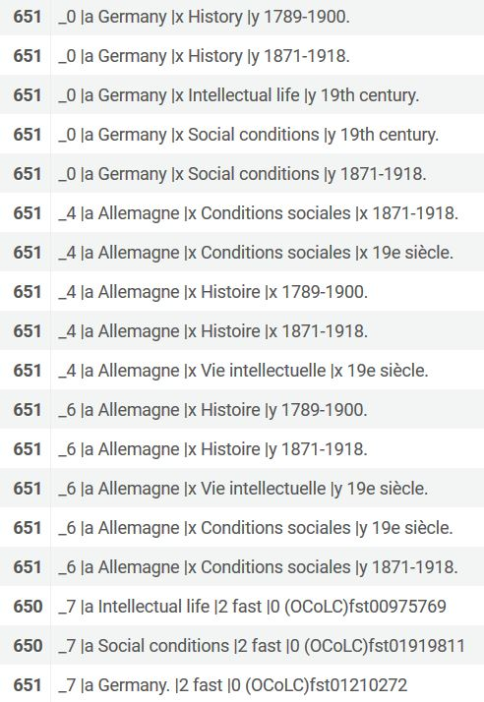
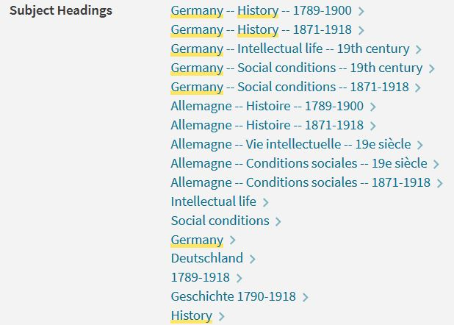
Non-LC Subject and Genre Access Points in Records
Problem: Thousands of records with non-LC subject access points entered Atkins’ stable of MARC records during its WMS period (2013-2017). After our migration to Alma, they remained, creating cluttered, unhelpful displays and search problems in Primo.
Alma
Primo

Slide 24
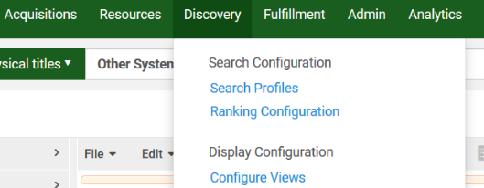
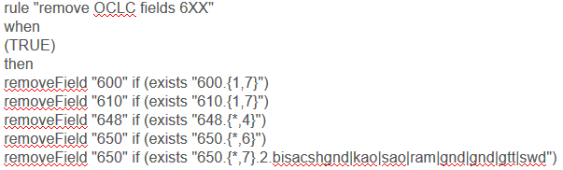
Removing Non-LC Subject and Genre Access Points in Records
Solutions
  Strip headings permanently out of bibliographic records with normalization rule?
  Retain unwanted subject and genre access points but suppress them from Primo?
or
?

Slide 25
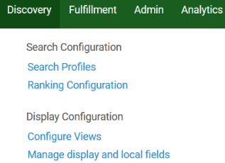

Removing Non-LC Subject and Genre Access Points in Records
Process:
Go to Discovery - Manage display and local fields
Choose “Add Field” and select new field from dropdown menu
Click ellipsis next to field and then on ellipsis beside “MARC21 normalization rule for display.”
Edit out-of-the-box norm rules; SAVE YOUR COPY.
On “Manage Display and Local Fields” screen, click “Apply Rules.”

Slide 26
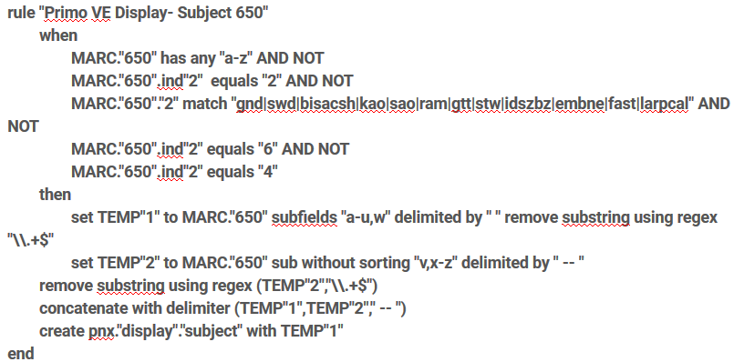
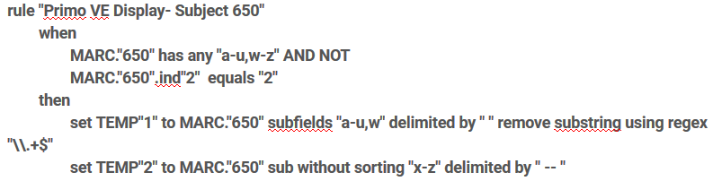
Removing Non-LC Subject and Genre Access Points in Records
Changed rule
Out-of-the-box rule for 650

Slide 27
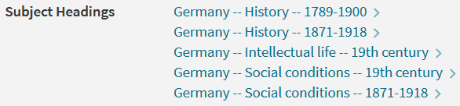
Removing Non-LC Subject and Genre Access Points in Records
After
Before

Slide 28
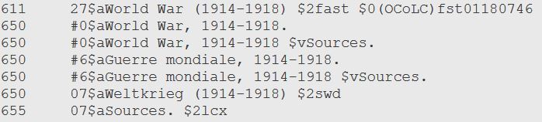
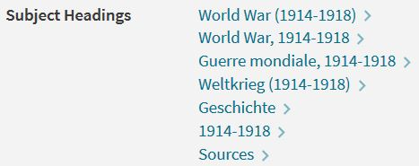
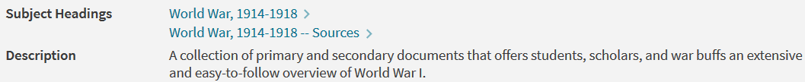
Related Issue: Mutilated Subject Heading Strings with Form Subheadings
After Primo VE Normalization Rule Fix:

Slide 29
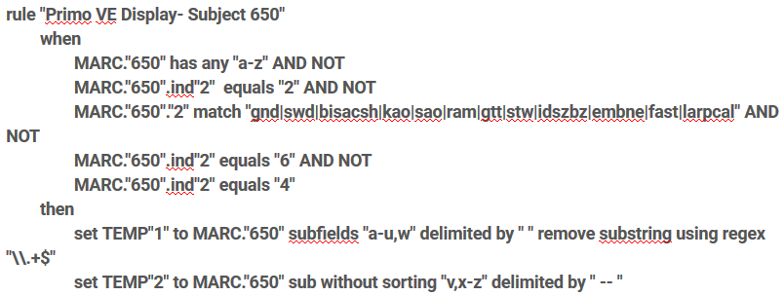
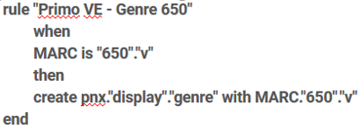
Related Issue: Mutilated Subject Heading Strings with Form Subheadings
Subjects Rule
Genre Rule
Rule after edits
Out-of-the-box rule

Slide 30

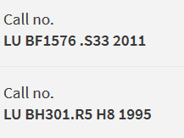
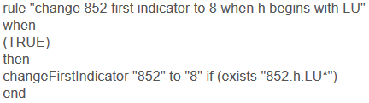
Local Call Numbers with Incorrect 852
1st Indicator Value
Problem: Numerous non-LC call numbers did not have correct 852 first indicator value in holdings record and thus were not appearing in “Other Call Number” search indexes in Primo
Solution: Normalization rule to correct values based on presence of certain values in 852 subfield h

Slide 31
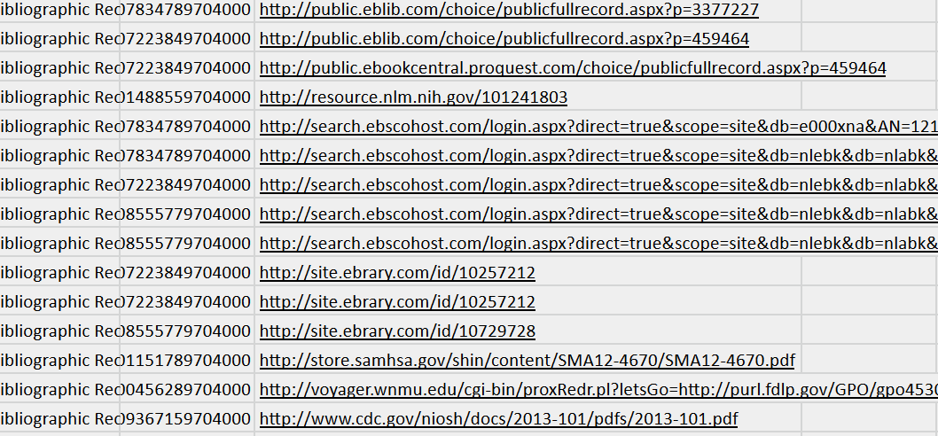

P2E - Cleanup (1)

Slide 32
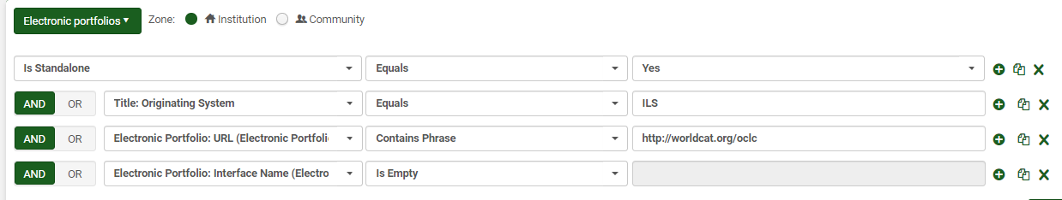
P2E - Cleanup (2)
HTTP Status URL Checker
URL Checker: https://httpstatus.io/
100 URLs per batch
Process:
Identify P2E records in Alma - Electronic portfolio advanced search & Is Standalone=Yes & Originating System = ILS
Create subsets using Facets or adding layers of search terms, such as Originating System, URL (Electronic Portfolio), and/or Interface Name (Electronic Portfolio), etc.
Allocated standalone portfolios into locally created collections

Slide 33
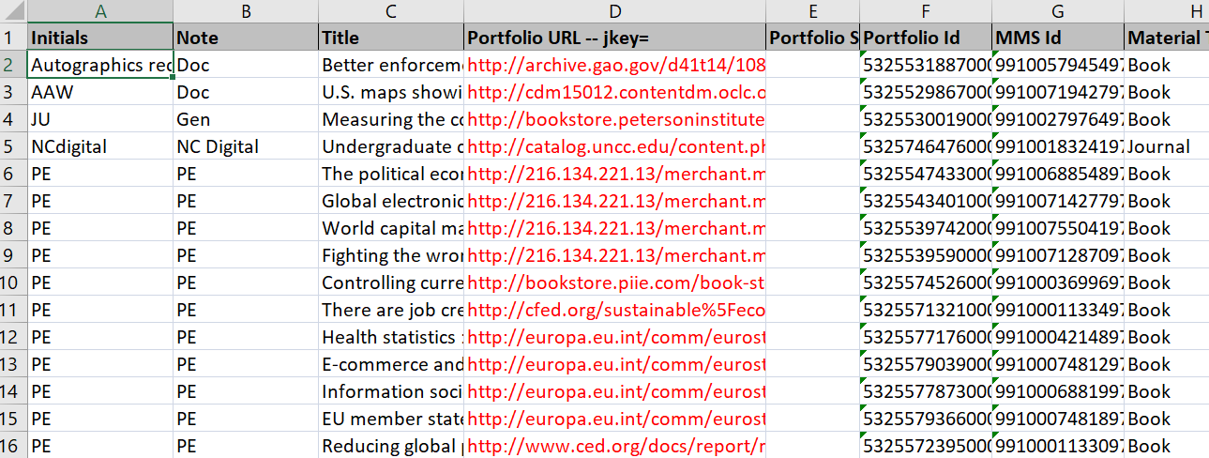

P2E - Cleanup (3)
Further identifying P2E records by Analytics
Bibliographic Details
Title, MMS ID, Material Type, Original Cataloging Agency, Originating System, Originating System ID
Portfolio
Portfolio Id, Material Type, Portfolio URL Information, Portfolio URL, Portfolio Static URL, Portfolio Proxy Enabled, Portfolio Proxy Selected, Portfolio Interface Name
Fields for the Filter
Lifecycle is equal to / is in In Repository and Electronic Collection Public Name is null

Slide 34
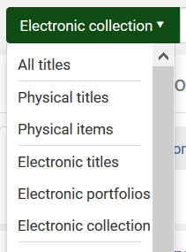
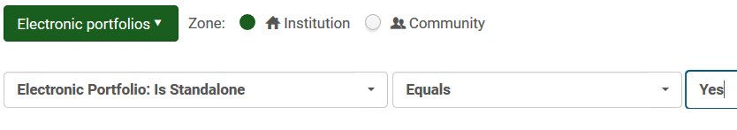

P2E - Standalone Portfolios Search
“Fewer clicks, less frustration!”

Slide 35
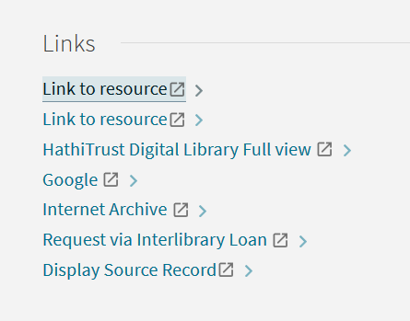
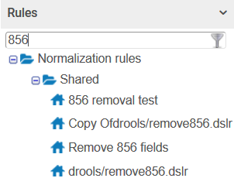
Links at the Bottom in Primo

Slide 36

Disconencted Bound Withs and Analytics
Problem: Bound withs were not linked in WMS other than by sharing the same barcode. During migration, only one bibliographic record in each bound with migrated with its item record intact, and that bib record is not always the parent record
Government Documents Bound Withs Example
First title in bound with (parent)
Last title in bound with (child) is only record that migrated with its item to Alma

Slide 37


Disconnected Bound Withs and Analytics
Fifth publication in bound with has item availability information in Primo
First publication in bound with has no item record and consequently no availability information in Primo

Slide 38


Bound Withs and Analytics
Solutions
  Manually connect the disconnected bound withs?
    Create 774 for child titles in bib record for parent, 501 “with” note in both parent and children records, 773 for parent title in bib record for children
    Disadvantages: extremely time-consuming
  Automated/scripting solution?
Adding requisite fields in bib links child record to parent in Primo

Slide 39

Data Cleanup at UNCC: Complicating Factors
Technical services downsizing in WMS has led to staff shortages
No systems librarian
Those doing technical services, cataloging, and metadata work are scattered across several different units
No unified administrative structure; lack of clarity about roles
Sporadic, inconsistent progress on data cleanup work

Slide 40
Image Credits
Slide 4: “Badge of scuba divers category of the Italian navy.” 2010. Photograph. Wikimedia Commons. https://commons.wikimedia.org/wiki/File:Badge_of_scuba_divers_category_of_the_Italian_Navy.svg. (accessed August 14, 2020)
Slide 5: Ibid.
Slide 6: “Discover scuba diving--St. Croix, U.S. Virgin Islands.” 2015. Photographs. Wikimedia Commons. https://commons.wikimedia.org/wiki/File:Discover_Scuba_Diving_--_St._Croix,_US_Virgin_Islands.jpg (accessed August 14, 2020)

Slide 41
Thank You!
Questions? Email to:
Joseph Nicholson (jnicho56@uncc.edu)
Shoko Tokoro (stokoro@uncc.edu)

