Slide 1
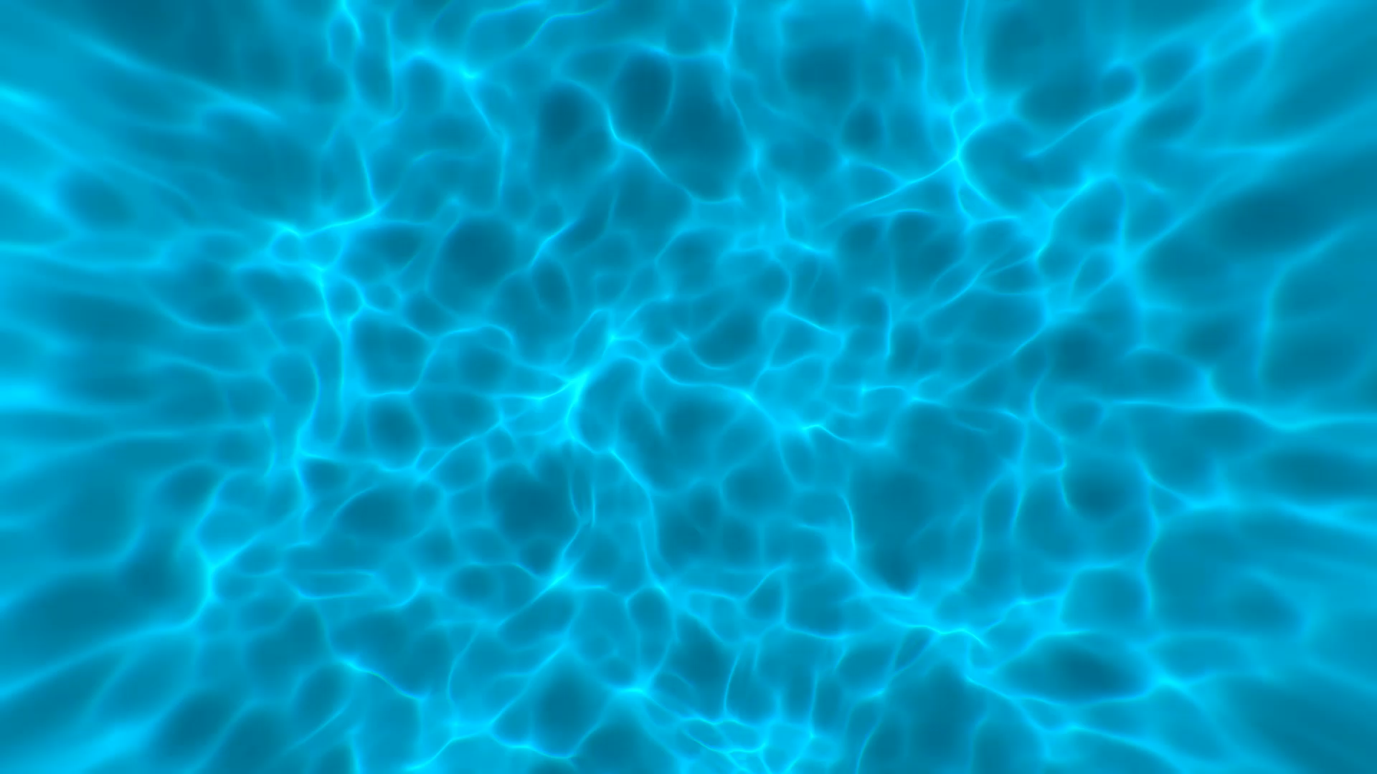
Digital Collection Data Across the Discovery Landscape
Greer Martin | Margaret Heller
August 12, 2020

Slide 2

Introduction
Digital collections everywhere

Slide 3
Digital Collections Don’t Live in One Place
Our reality
Digital Commons
Preservica
Omeka Classic
Omeka S
WordPress

Slide 4
Digital Collections Aren’t Discovered in One Place
Where discovery happens
Drupal/T4
Primo
LibGuides
External research portals

Slide 5
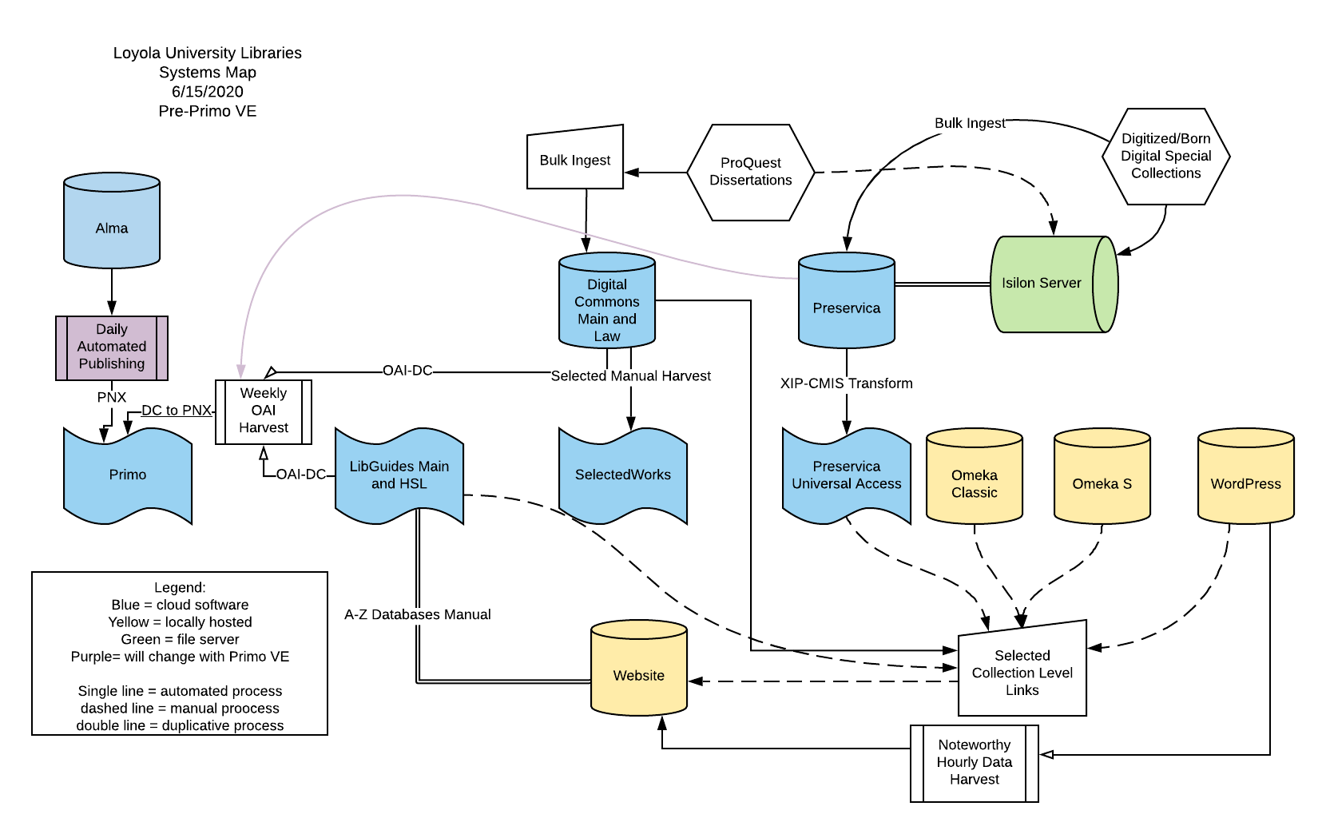

What this looks like in practice

Slide 6
The Primo Back Office Data Pipe Lifecycle
Data Source
Define Pipe
Pipe List
Scheduler
Search Scope List
Tabs Configuration
Scope Values
Resource Types
Renormalization
Delete
Harvest
Normalization Rules
Search
Labels and Facets
FRBR
Dedup
Display
Delivery

Slide 7
Primo VE External Data Sources
Data Import Profile
Normalization Rule Sets
Delivery
Additional customizations (tables)

Slide 8
A few notes on vocabulary
Primo Back Office
Primo VE
Data Sources
Normalization Rules Sets
Scope Values
Search Scopes
Tabs
Data Import Profiles
Normalization rules for External Data sources
Search Profiles
Search Profile Slots

Slide 9
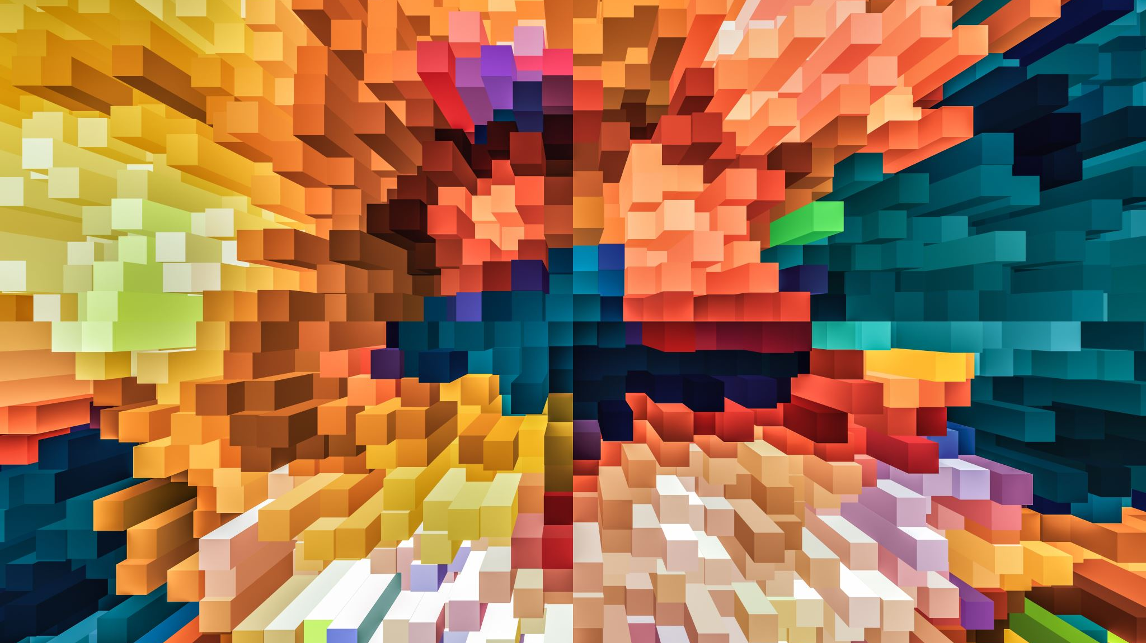
Harvest and Metadata
The building blocks of discovery

Slide 10
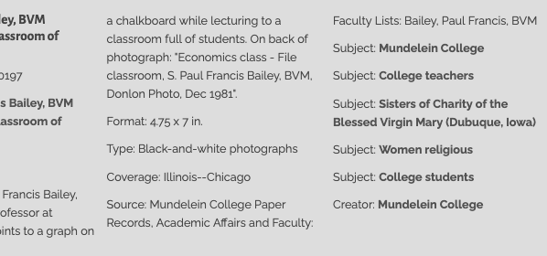
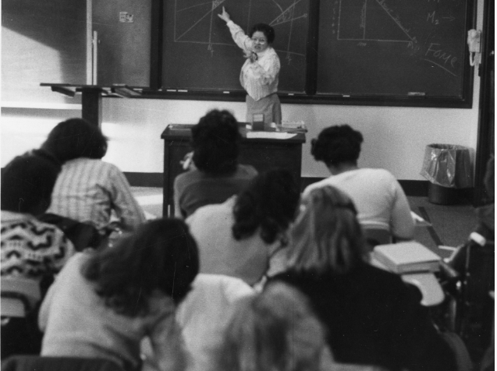
OAI-PMH
Springshare (LibGuides)
  No authentication required
  Simple Dublin Core
  Link out to resource
Digital Commons (IR)
  No authentication required
  Select designated set
  Link out to resource
Preservica (Digital collections platform)
  Requires authentication
  Richer Dublin Core
  Container XML elements
  Link out to item record, add thumbnail
  Mundelein College Photograph Collection, Women and Leadership Archives

Slide 11
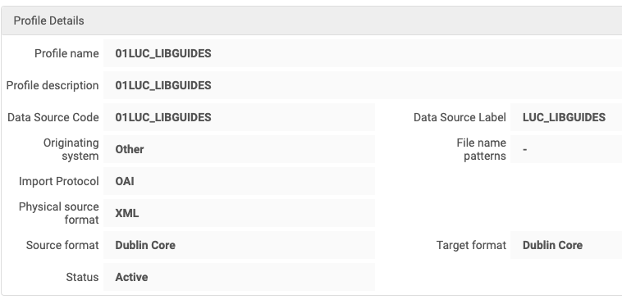
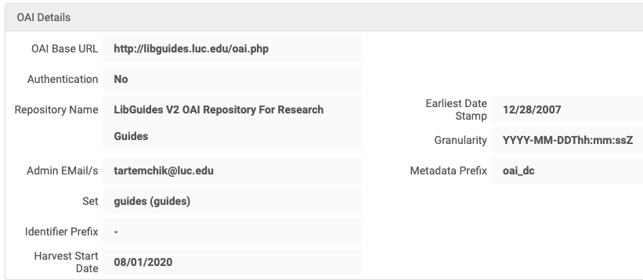
Configure Import Profile: LibGuides

Slide 12
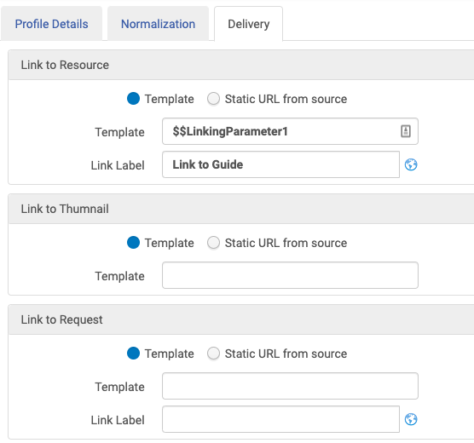
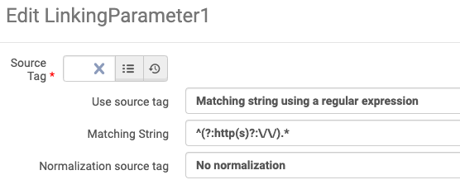
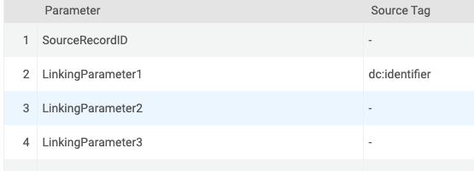
Link to Resource
<record>
…
<identifier>
oai:libguides.com:guides/49849
</identifier>
…
<oai_dc:dc>
<dc:title>Anthropology</dc:title>
<dc:identifier>
https://libguides.luc.edu/anthropology
</dc:identifier>
</oai_dc:dc>
...
</record>
dc:identifier

Slide 13
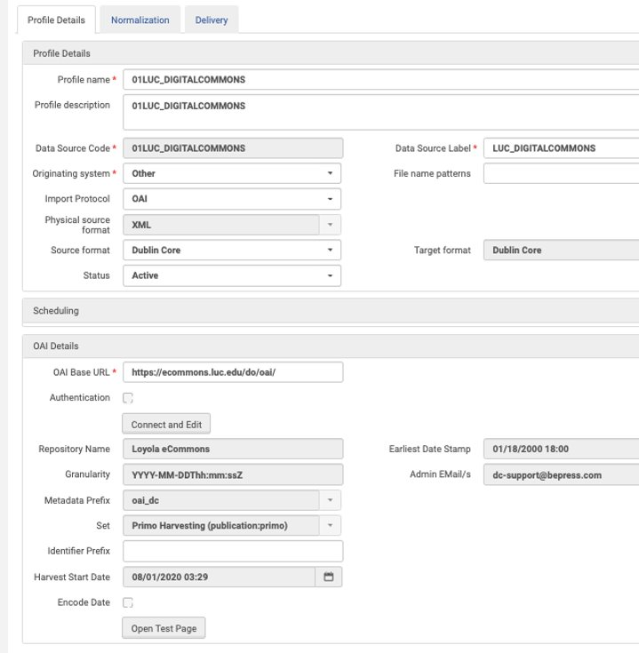
Configure Import Profile: Digital Commons

Slide 14
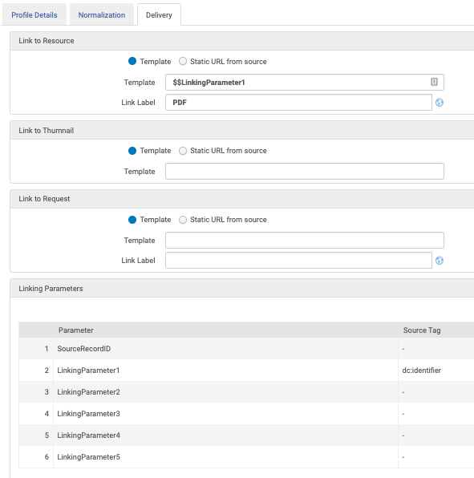
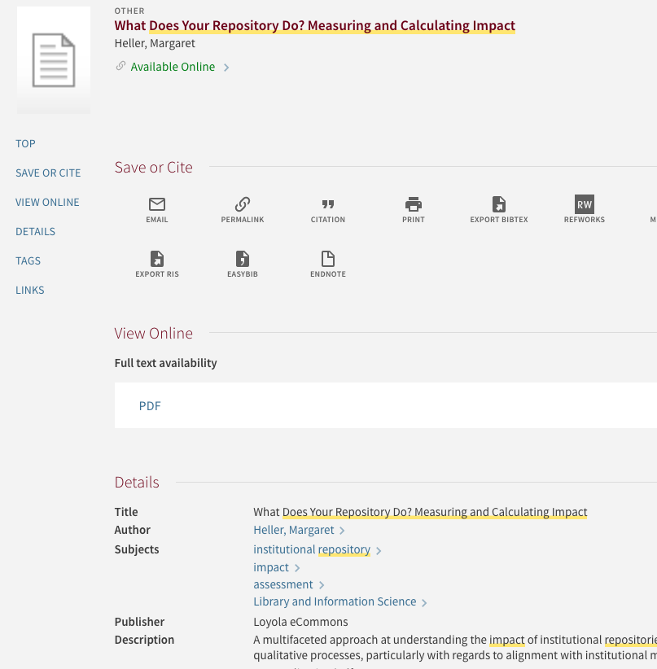

Slide 15
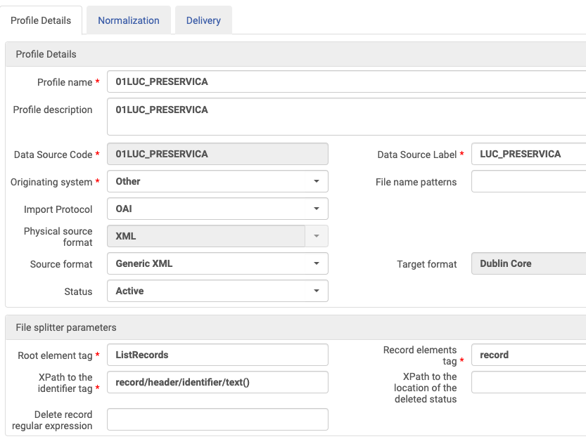
Preservica Import Profile Configuration
Has container XML elements
  Source format = Generic XML
  Add file splitter parameters

Slide 16
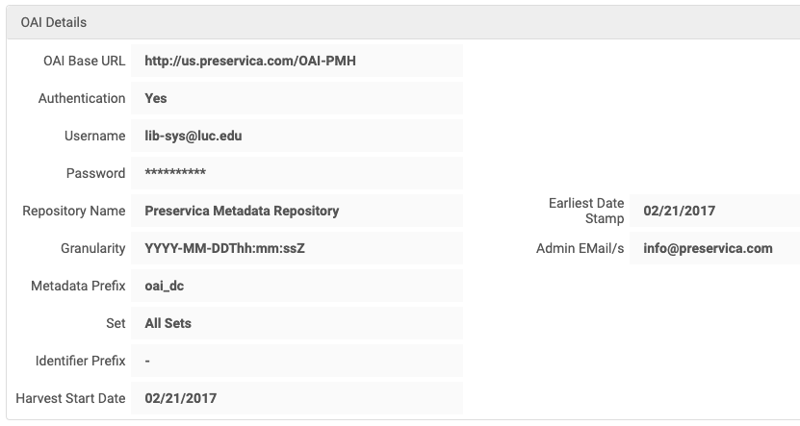
Preservica Import Profile Configuration
Requires authentication
  Add username and password

Slide 17
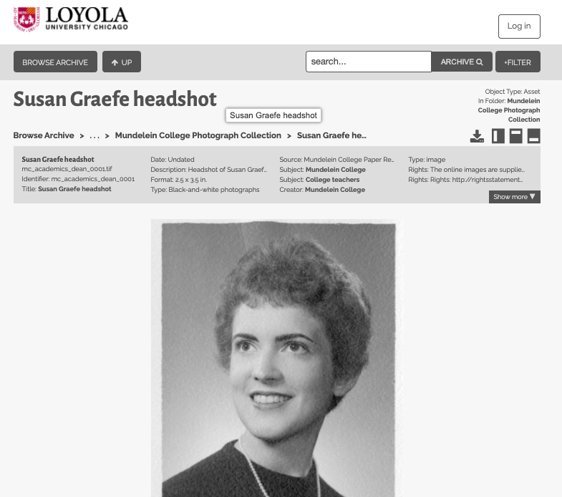
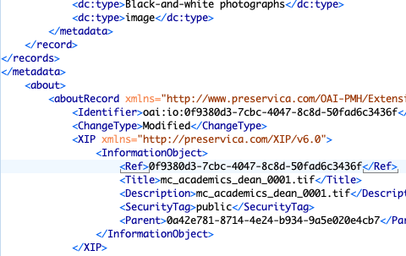
Link to Resource and Thumbnail
https://luc.access.preservica.com/uncategorized/IO_0f9380d3-7cbc-4047-8c8d-50fad6c3436f/

Slide 18
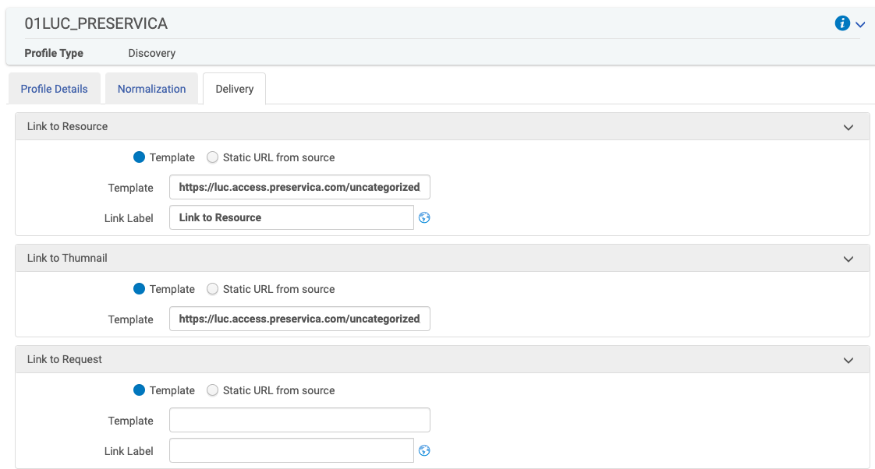
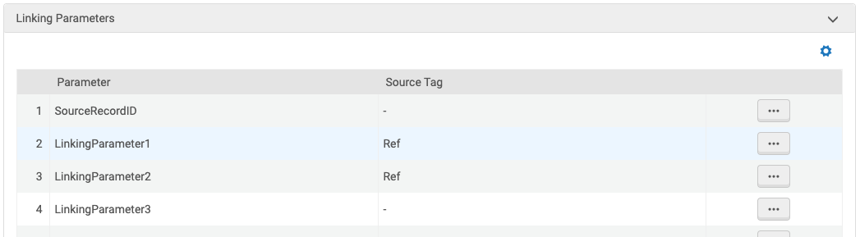
Link to Resource and Thumbnail
[URL]+$$LinkingParameter1
Link out to resource, add thumbnail
  Delivery tab: use templates if link won't be the same for every record
  Thumbnails: Will require configuration at source or external scripts
LinkingParameter1 = Ref

Slide 19

Normalization
Making it all fit together

Slide 20
The Primo Back Office Data Pipe Lifecycle: Normalization Opportunities
Data Source
Define Pipe
Pipe List
Scheduler
Search Scope List
Tabs Configuration
Scope Values
Resource Types
Renormalization
Delete
Harvest
Normalization Rules
Search
Labels and Facets
FRBR
Dedup
Display
Delivery

Slide 21
Primo VE External Data: Normalization Opportunities
Data Import Profile
Normalization Rule Sets
Delivery
Additional customizations (tables)

Slide 22
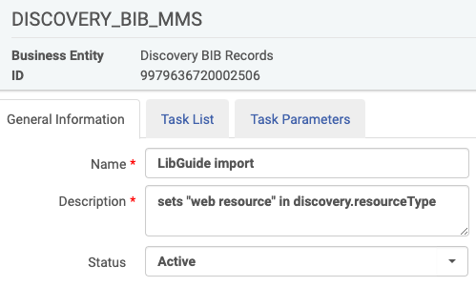
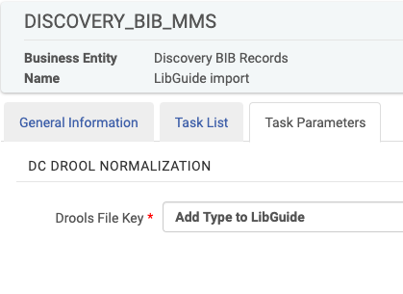
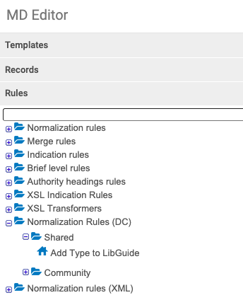
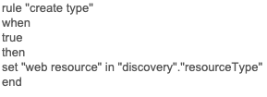
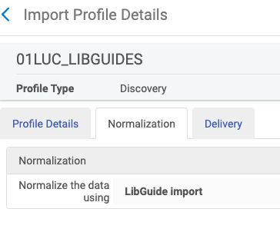
DROOLS
#2
Normalization process task
#1
Normalization rules for external data sources
#3
Discovery Import Profile: Normalization tab

Slide 23
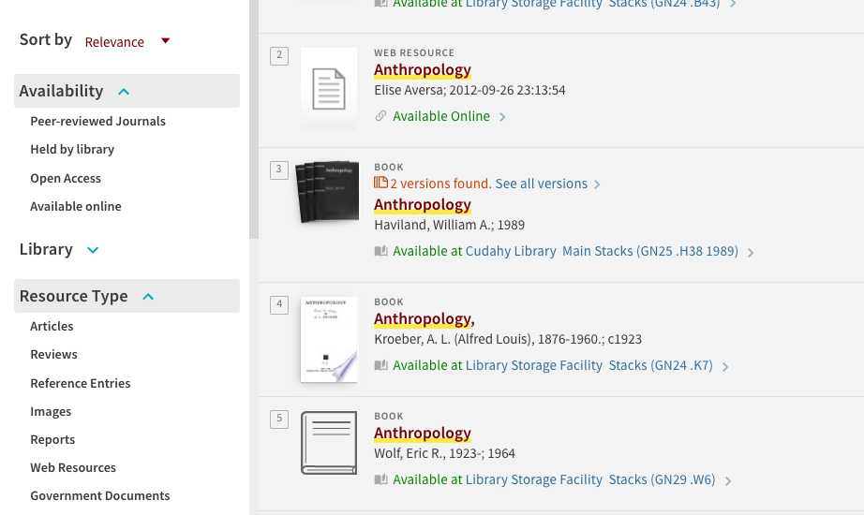

Slide 24
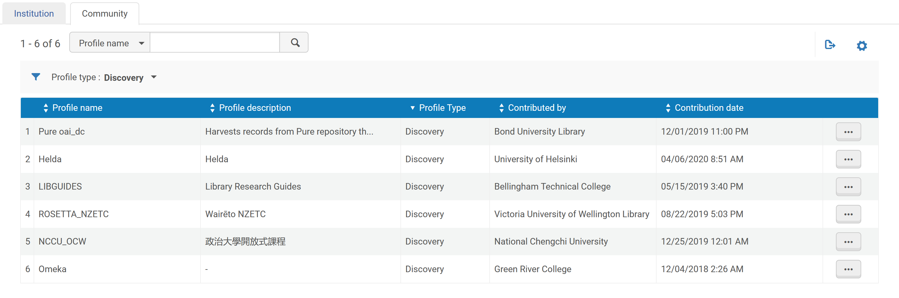
Harvesting and Metadata Tips
  Align external resource types with CDI resource types (website v. web resource)
  Determine if/when it's neccessary to clean metadata before import
  Use community normalization rules
  Community Import Profiles—we need more!

Slide 25

Changing Your Approach
Keeping up with new technology
Notes:
MH

Slide 26
Testing and iteration
Where is the safest place for the digital object, the easiest place to create metadata, and the most user friendly to discover the object?
What is the cost of migration?
What happens when technology improves?

Slide 27
Keeping up with Changes
Build in a digital collection review when you review/test release notes.
Stay active with ELUNA and other user communities.
Describe your problems, and work with vendors and users to improve cross-platform discovery.
Experiment with new tools—mostly when they serve a need, but sometimes just because.

Slide 28
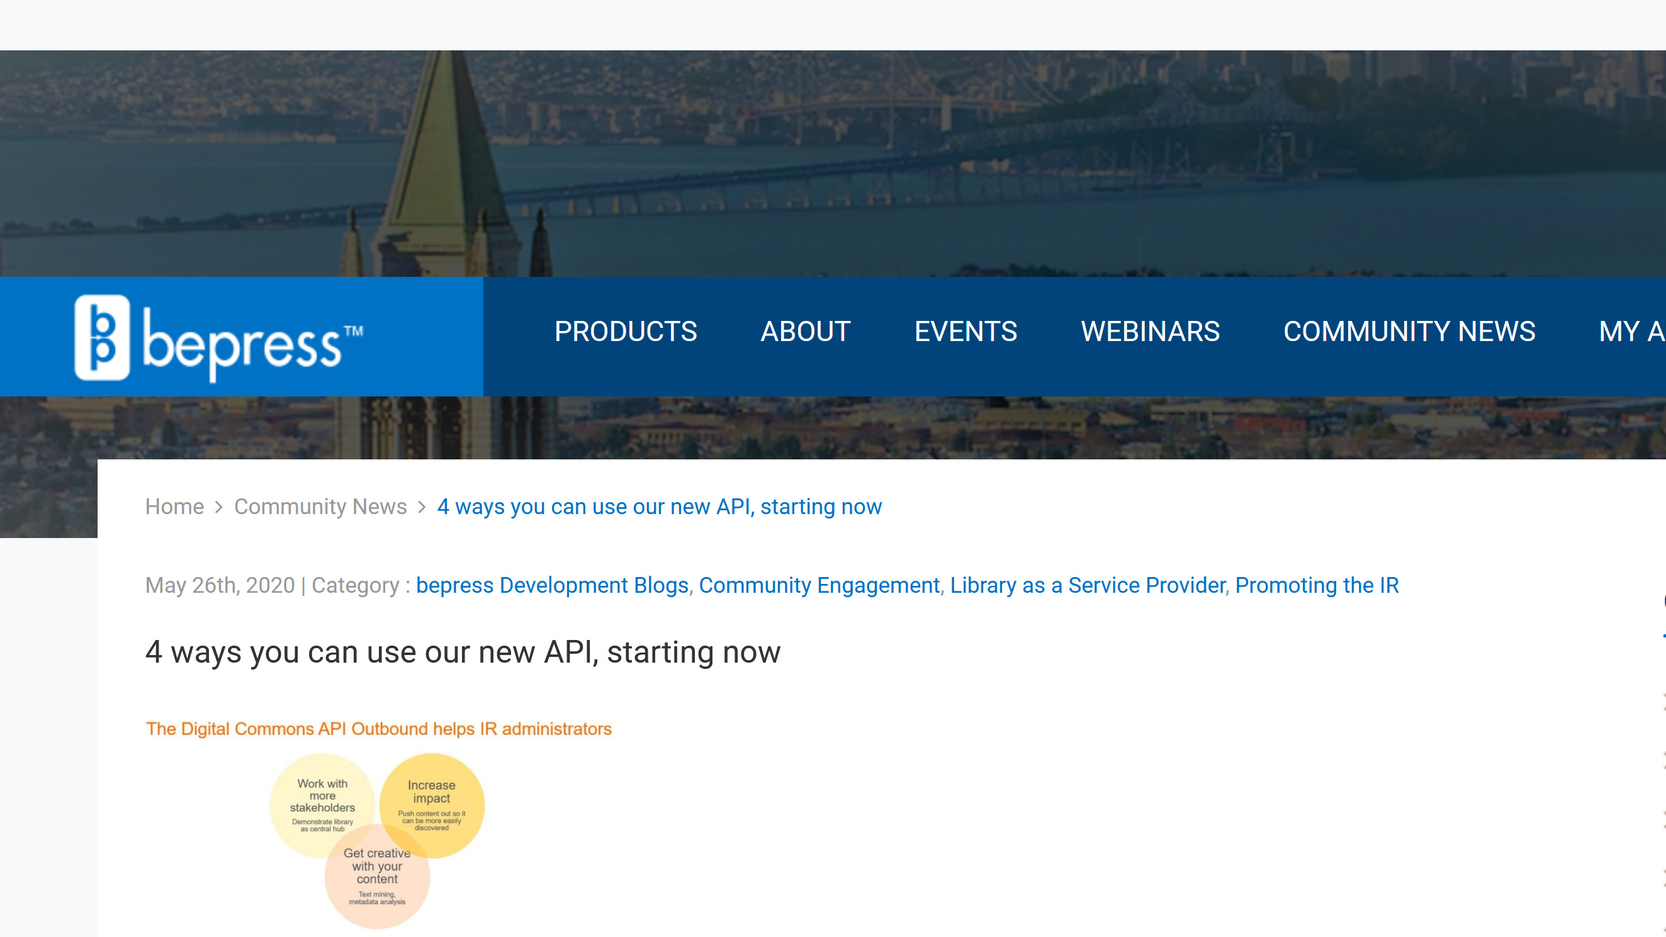
Should you change your approach with new tools?

Slide 29
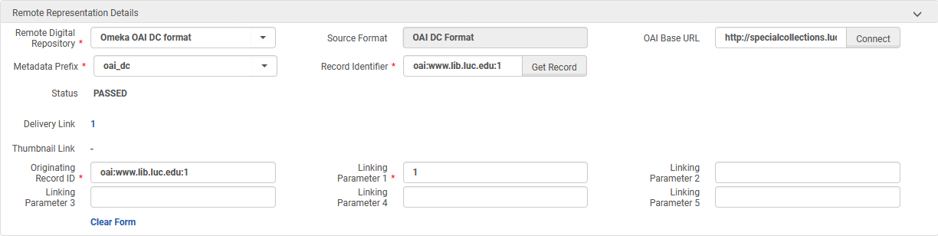
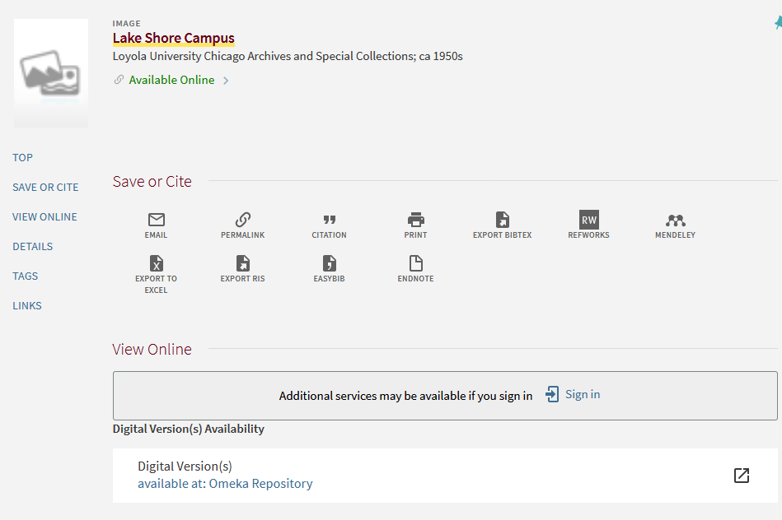
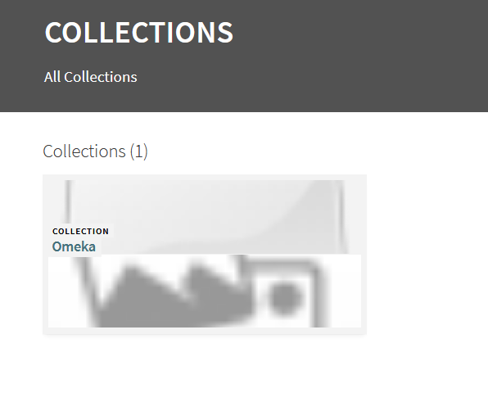
Alma Collections/Primo Collection Discovery

Slide 30

Conclusion
Migrations are part of digital collections

Slide 31
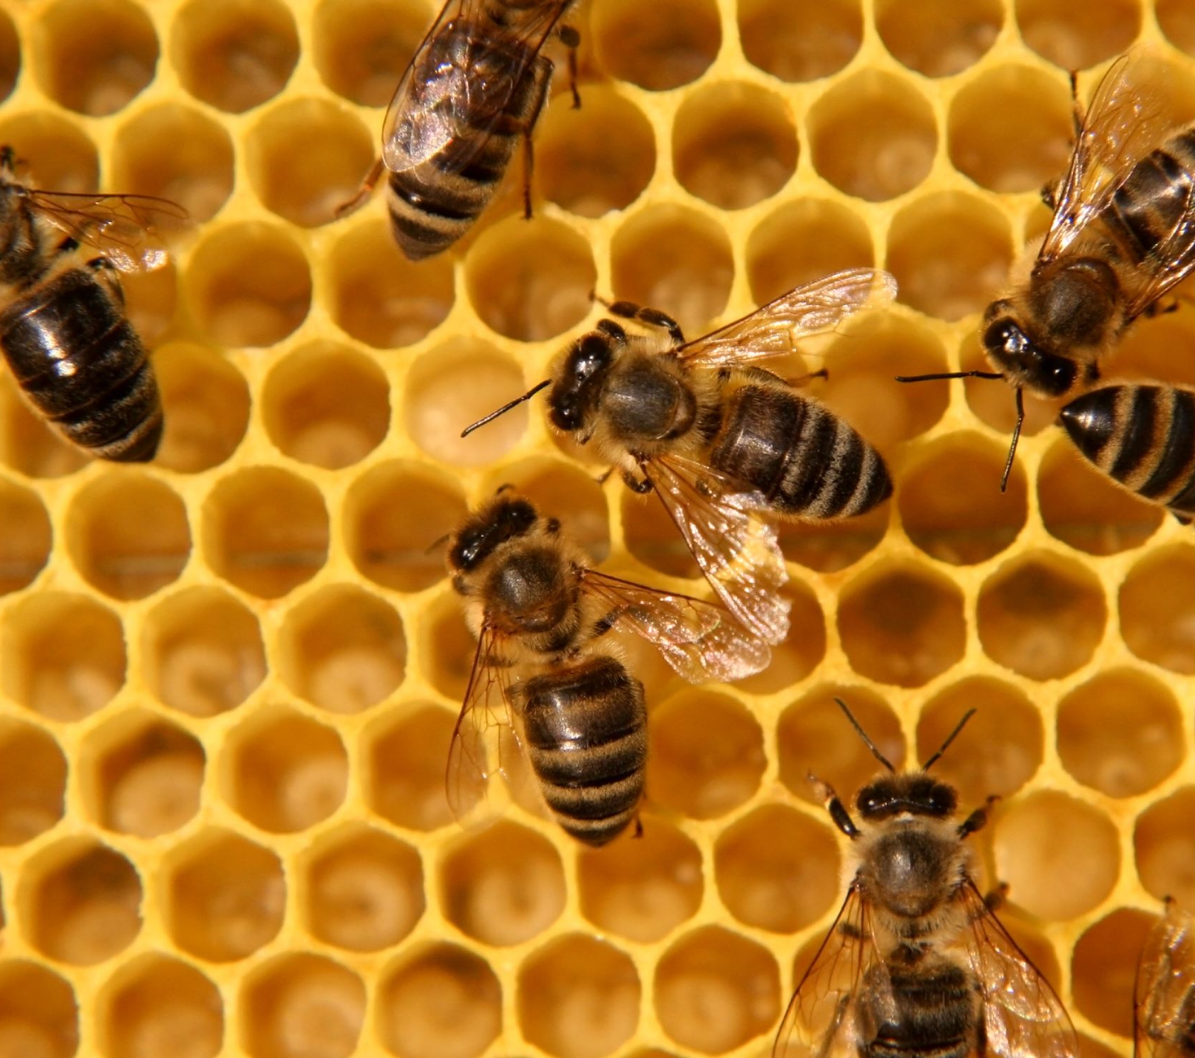
Questions
Contact us at:
Margaret Heller
  @margaret_heller
  mheller1@luc.edu
Greer Martin
  @greermartin_
  gmartin5@luc.edu

