Slide 1
Preserving Access to Your Digital Content Over Time
Presented by
Teresa Soleau, J. Paul Getty Trust
tsoleau@getty.edu
Dave Allen, State Library of Queensland
Dave.Allen@slq.qld.gov.au

Slide 2
Who are we?

Slide 3
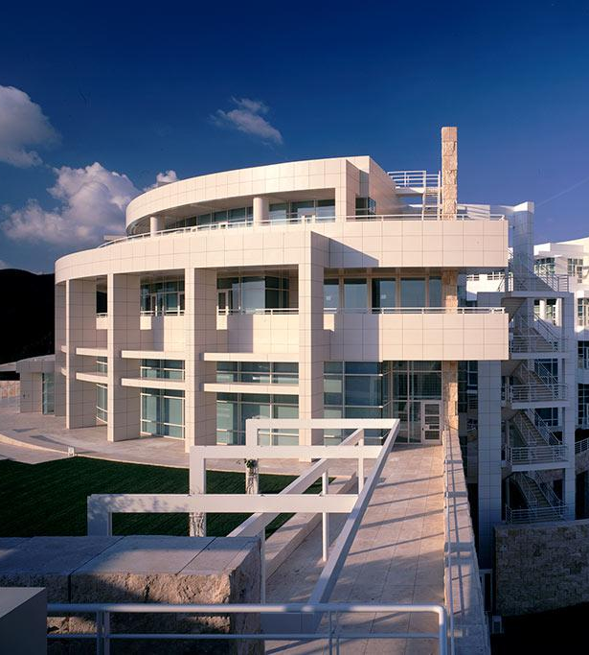

GRI Institutional Profile
Located in Los Angeles and one of 4 programs under the umbrella of the J. Paul Getty Trust
Dedicated to furthering knowledge and advancing understanding of the visual arts and their various histories
Research Library and Special Collections of rare materials and digital resources serve an international community of scholars and the interested public.
Preserving Access To Your Digital Content Over Time

Slide 4
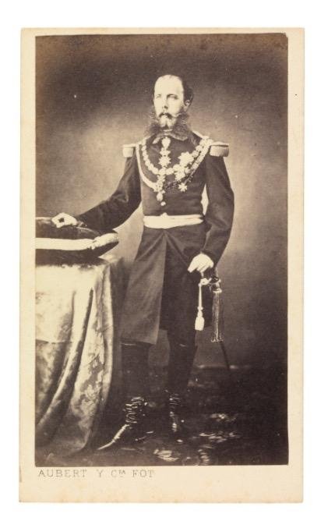
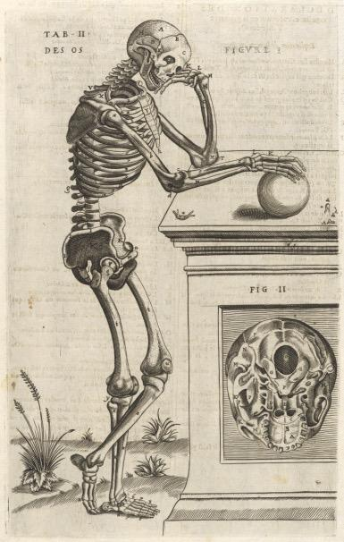
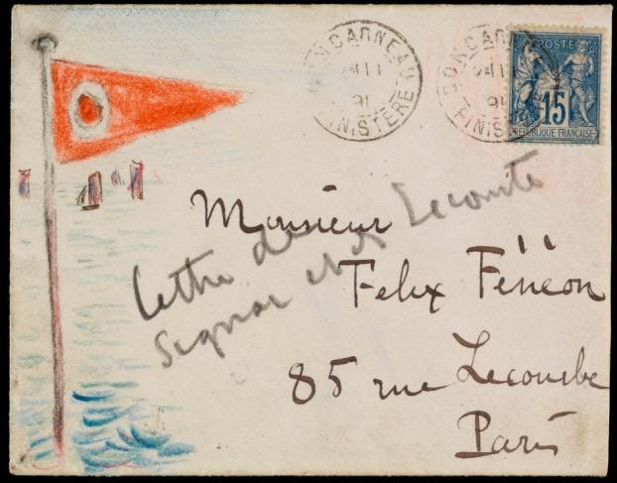
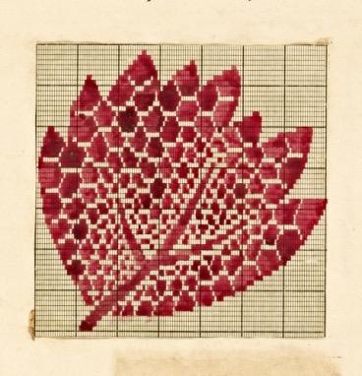
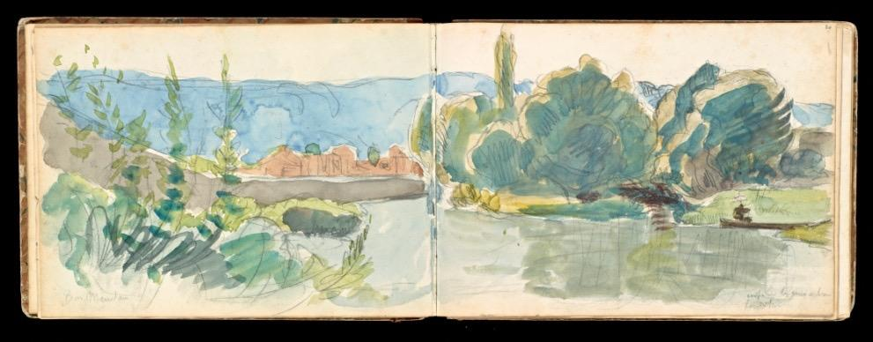

GRI Institutional Profile
over 4 million files - 54,000 complex digital objects - 425 TB in size
Note: Not including digitized books which are preserved at HathiTrust
Preserving Access To Your Digital Content Over Time

Slide 5
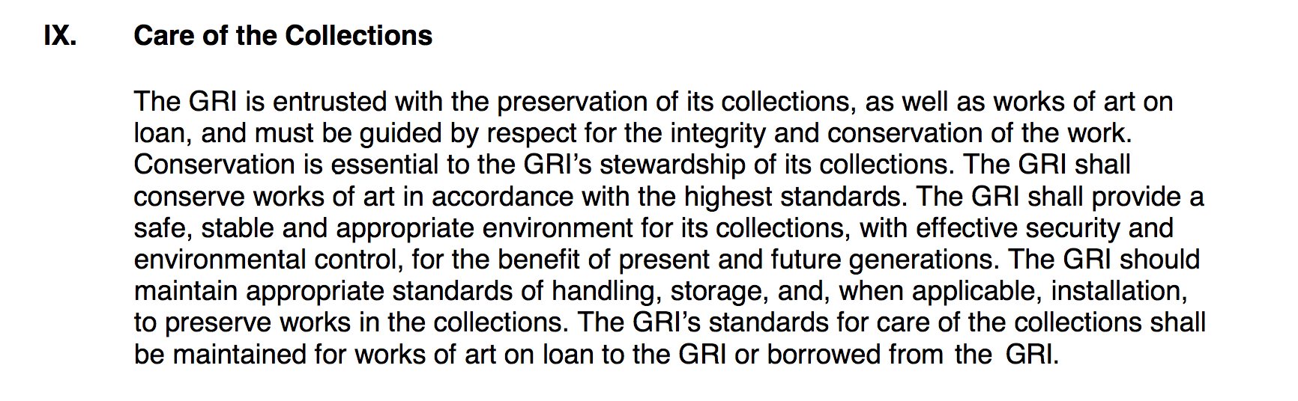
GRI Collection Policy
Preserving Access To Your Digital Content Over Time

Slide 6
State Library Queensland
Located in Queensland, Australia (the pointy bit)
We collect stuff -- lots of stuff
The stuff we collect include -- books, journals, magazines, newspapers, manuscripts, archives, maps, rare books, music, photographs, AV files and e-resources
We are a legal deposit library

Slide 7
State Library Queensland (cont’d)
Queensland Libraries Act 1988
1B(h) content relevant to Queensland should be collected, preserved, promoted and made accessible.
20(d) to control, maintain and manage the State library, to enhance, arrange and preserve the library, archival and other resources held by it and to exercise administrative control over access to the resources;
20(g) to collect, arrange, preserve and provide access to a comprehensive collection of library, archival and other resources relating to Queensland or produced by Queensland authors;

Slide 8
What’s the Problem?
Digital data (images, documents etc.) have value and create opportunities but…
Access depends on software, hardware and people…and…
Technology and people change, creating barriers to reuse therefore…
We need to actively manage data to protect and create opportunities.
Preserving Access To Your Digital Content Over Time

Slide 9
We do preservation because we want :
Transparency
  e.g. Data Protection, Freedom of Information …
Safety
  e.g. detection, disaster, recovery, audit …
Knowledge
  e.g. scientific value, access to heritage …
Wealth
  e.g. efficient business, management of IP …
Health
  e.g. research, safe innovation …
Environmental improvement
  e.g. evidence-based policy development …
Legal compliance
  e.g. Sarbanes-Oxley, Data Protection …
Regulatory compliance
  e.g. power generation, aviation ….
Legal protection
  e.g. scientific value, access to heritage …
Unanticipated exploitation
  e.g. petro-chemical, pharmaceuticals ….
Business continuity
  e.g. product recall, disaster recovery …
Business value
  e.g. the right information to the right people at the right time in a format they can use
Preserving Access To Your Digital Content Over Time

Slide 10
The Five Organizational Stages: The five stages of organizational response to digital preservation are:
Acknowledge: Understanding that digital preservation is a local concern;
Act: Initiating digital preservation projects;
Consolidate: Segueing from projects to programs;
Institutionalize: Incorporating the larger environment; and
Externalize: Embracing inter-institutional collaboration and dependency.
(From The Five Organizational Stages of Digital Preservation. Anne R. Kenney & Nancy Y. McGovern. "Digital Libraries: A Vision for the 21st Century..." 2003.)
Preserving Access To Your Digital Content Over Time

Slide 11
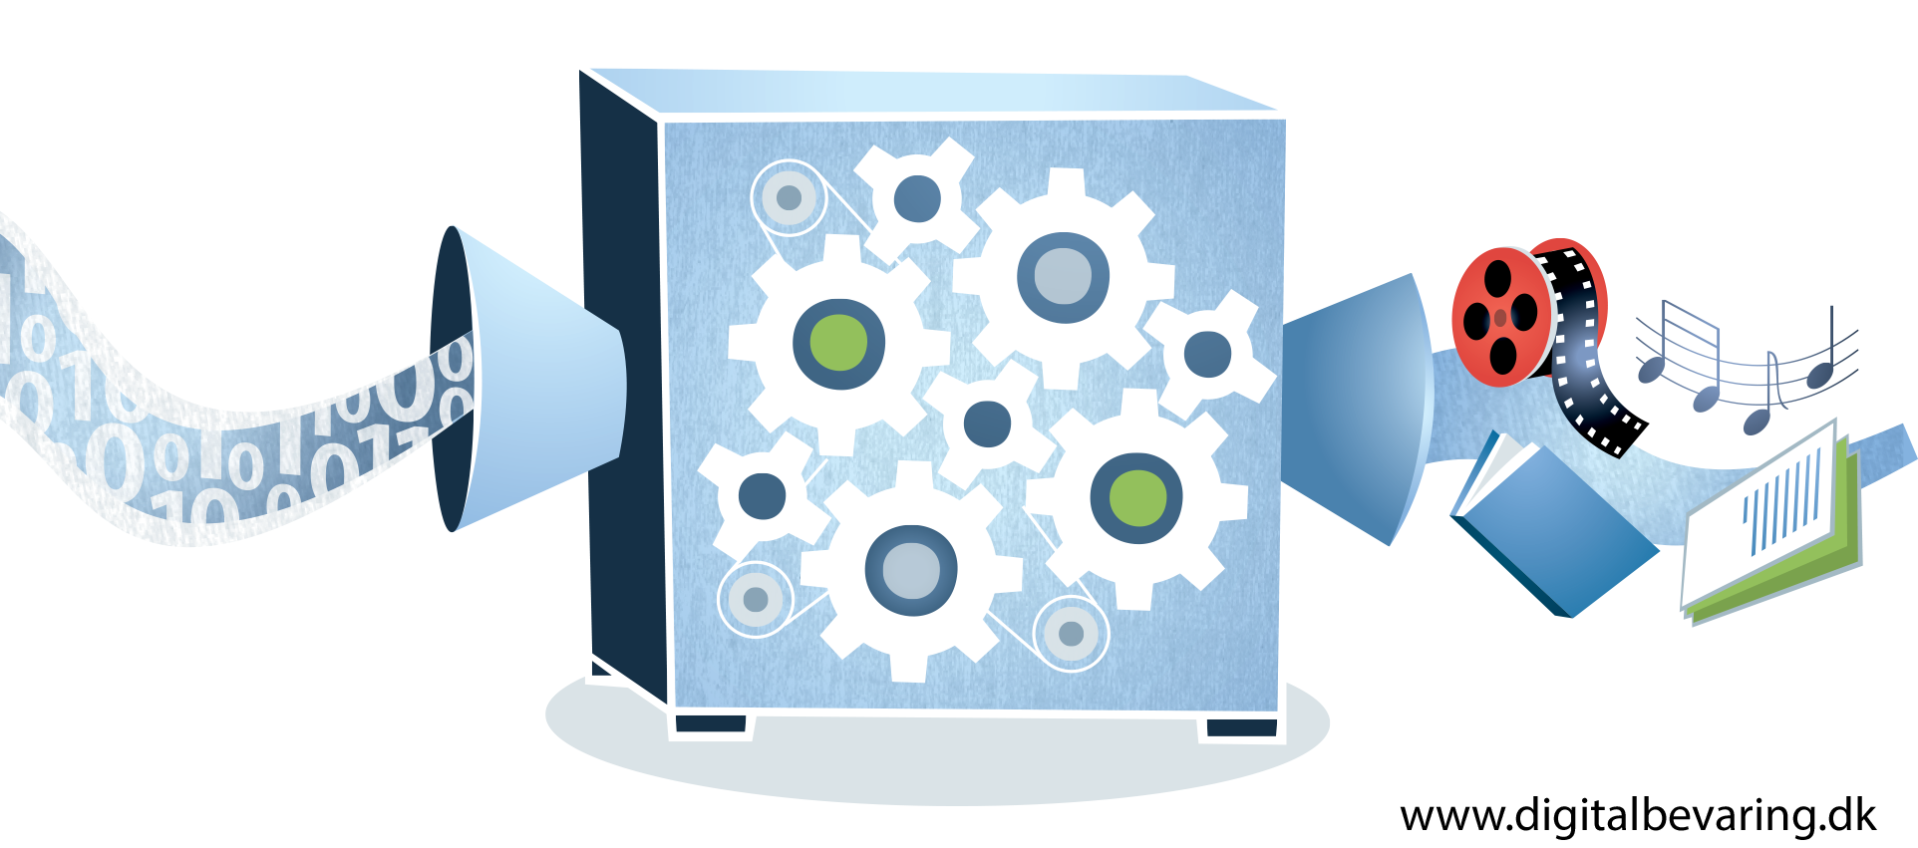
A Tale of Three Models
Three Legged Stool
DCC Life-Cycle Model
OAIS – Open Archival Information System
Preserving Access To Your Digital Content Over Time

Slide 12
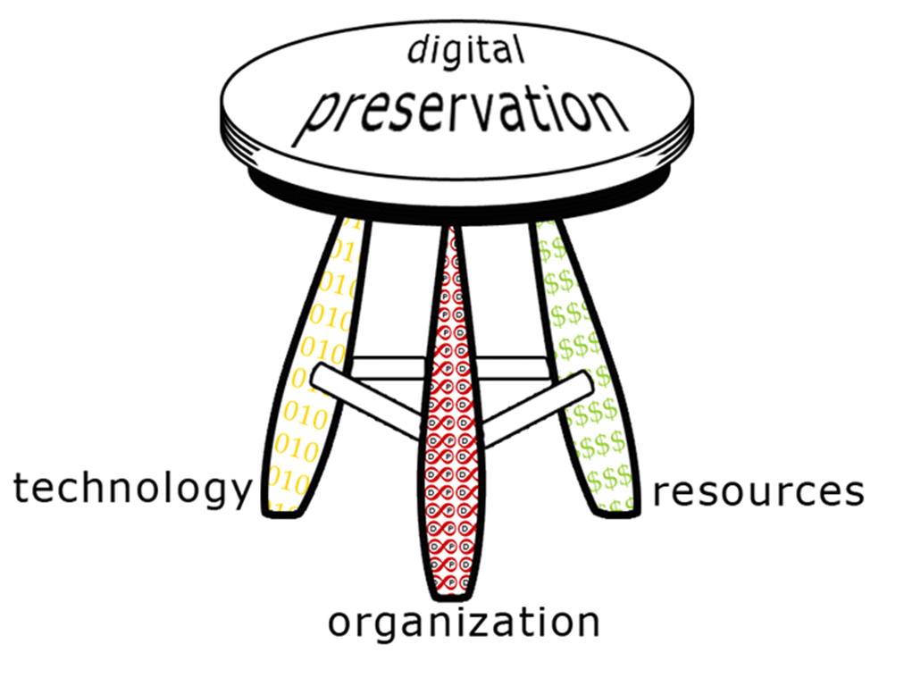
DP Models: Three Legged Stool
Organizational infrastructure
--the "what"
Technological infrastructure
--the "how"
Resources framework
--the “how much”
http://dpworkshop.org/dpm-eng/conclusion.html
Preserving Access To Your Digital Content Over Time

Slide 13
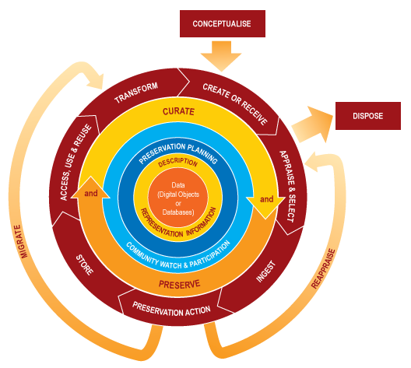
DP Models: DCC Lifecycle
https://www.dcc.ac.uk/guidance/curation-lifecycle-model
Preserving Access To Your Digital Content Over Time

Slide 14
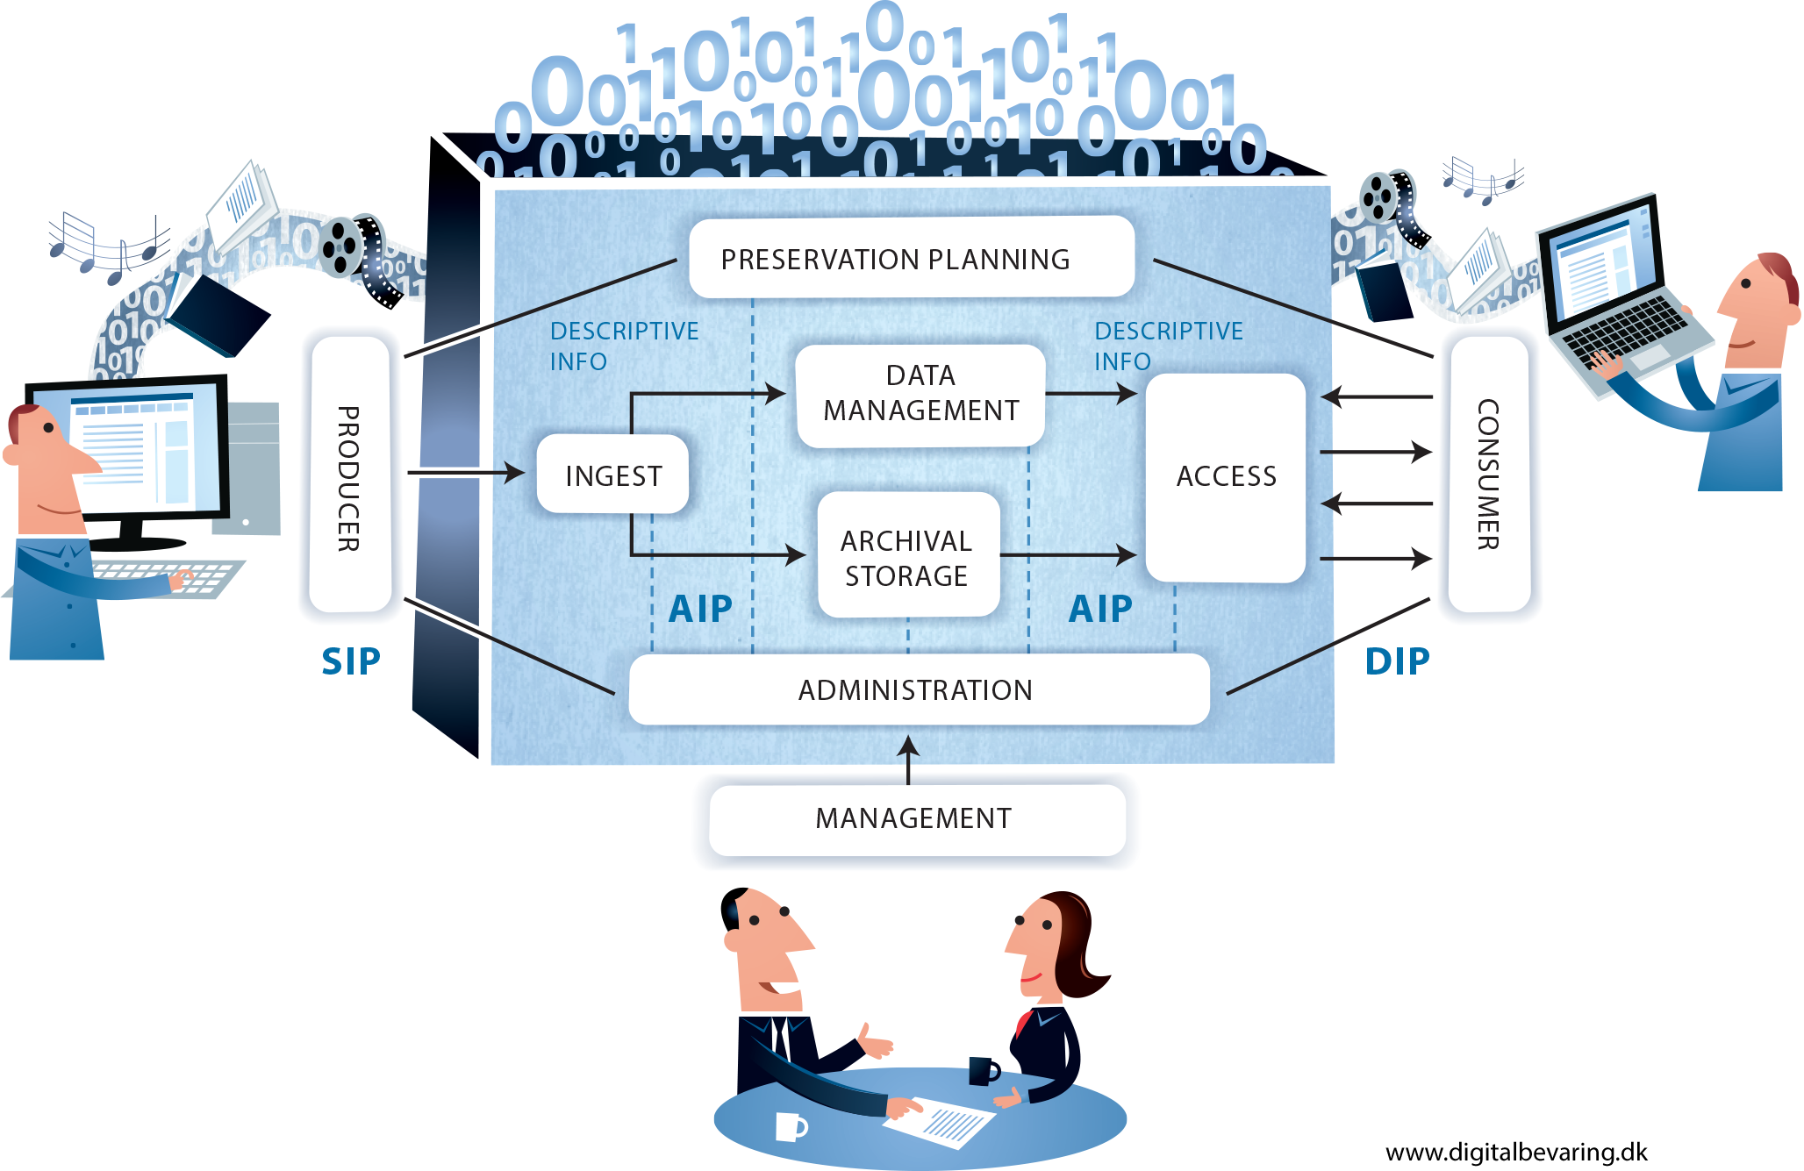
DP Models: OAIS
Preserving Access To Your Digital Content Over Time

Slide 15
Selection
What content will be preserved
Matching mission to content
Document selection decisions
Determine Selection Criteria
Selection is an ongoing process
Preserving Access To Your Digital Content Over Time

Slide 16
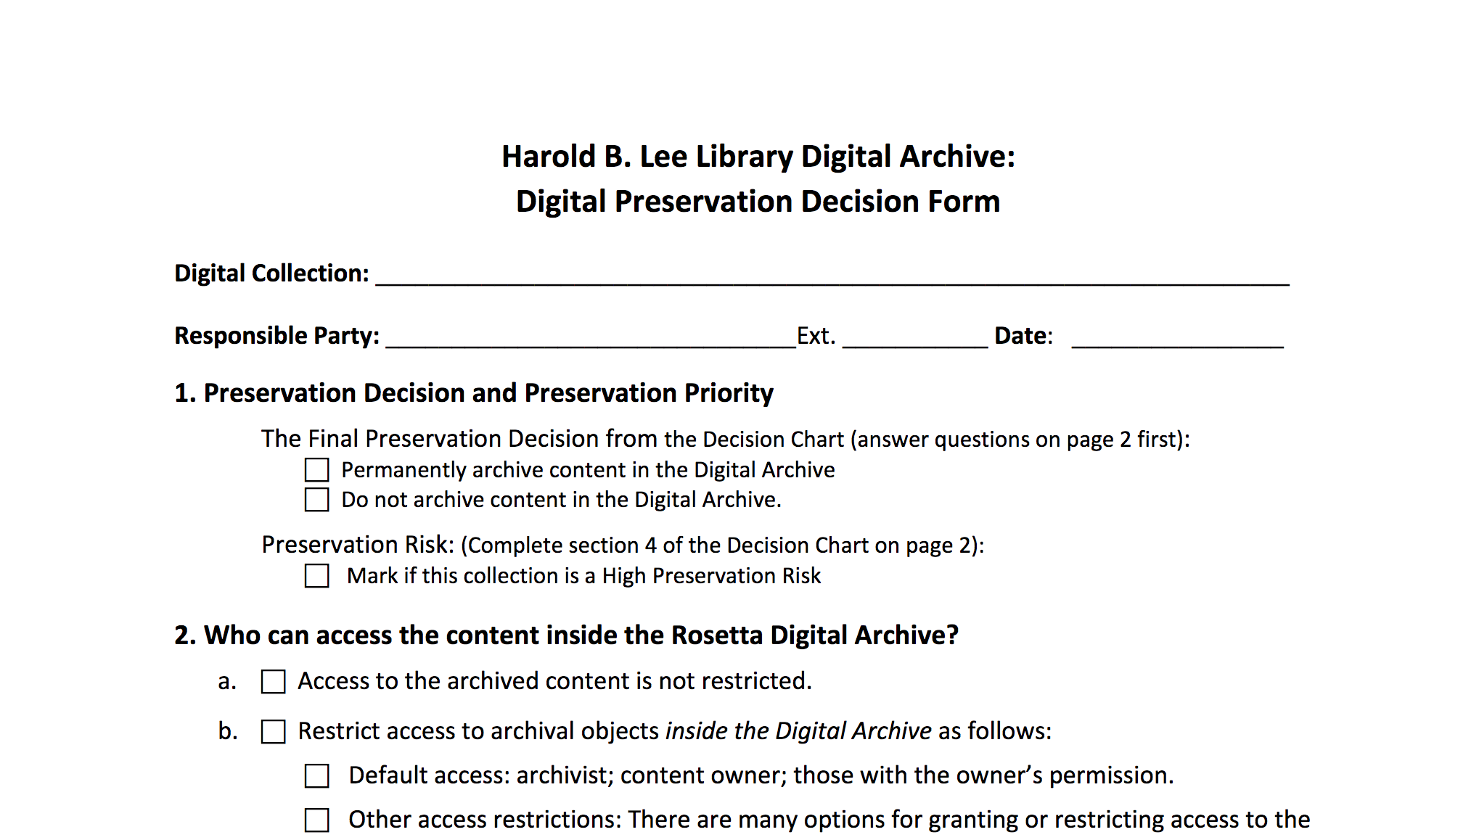
https://digitalpreservation.lib.byu.edu/wp-content/uploads/2016/01/Digital-Preservation-Decision-Chart-January-2016.pdf
Preserving Access To Your Digital Content Over Time

Slide 17
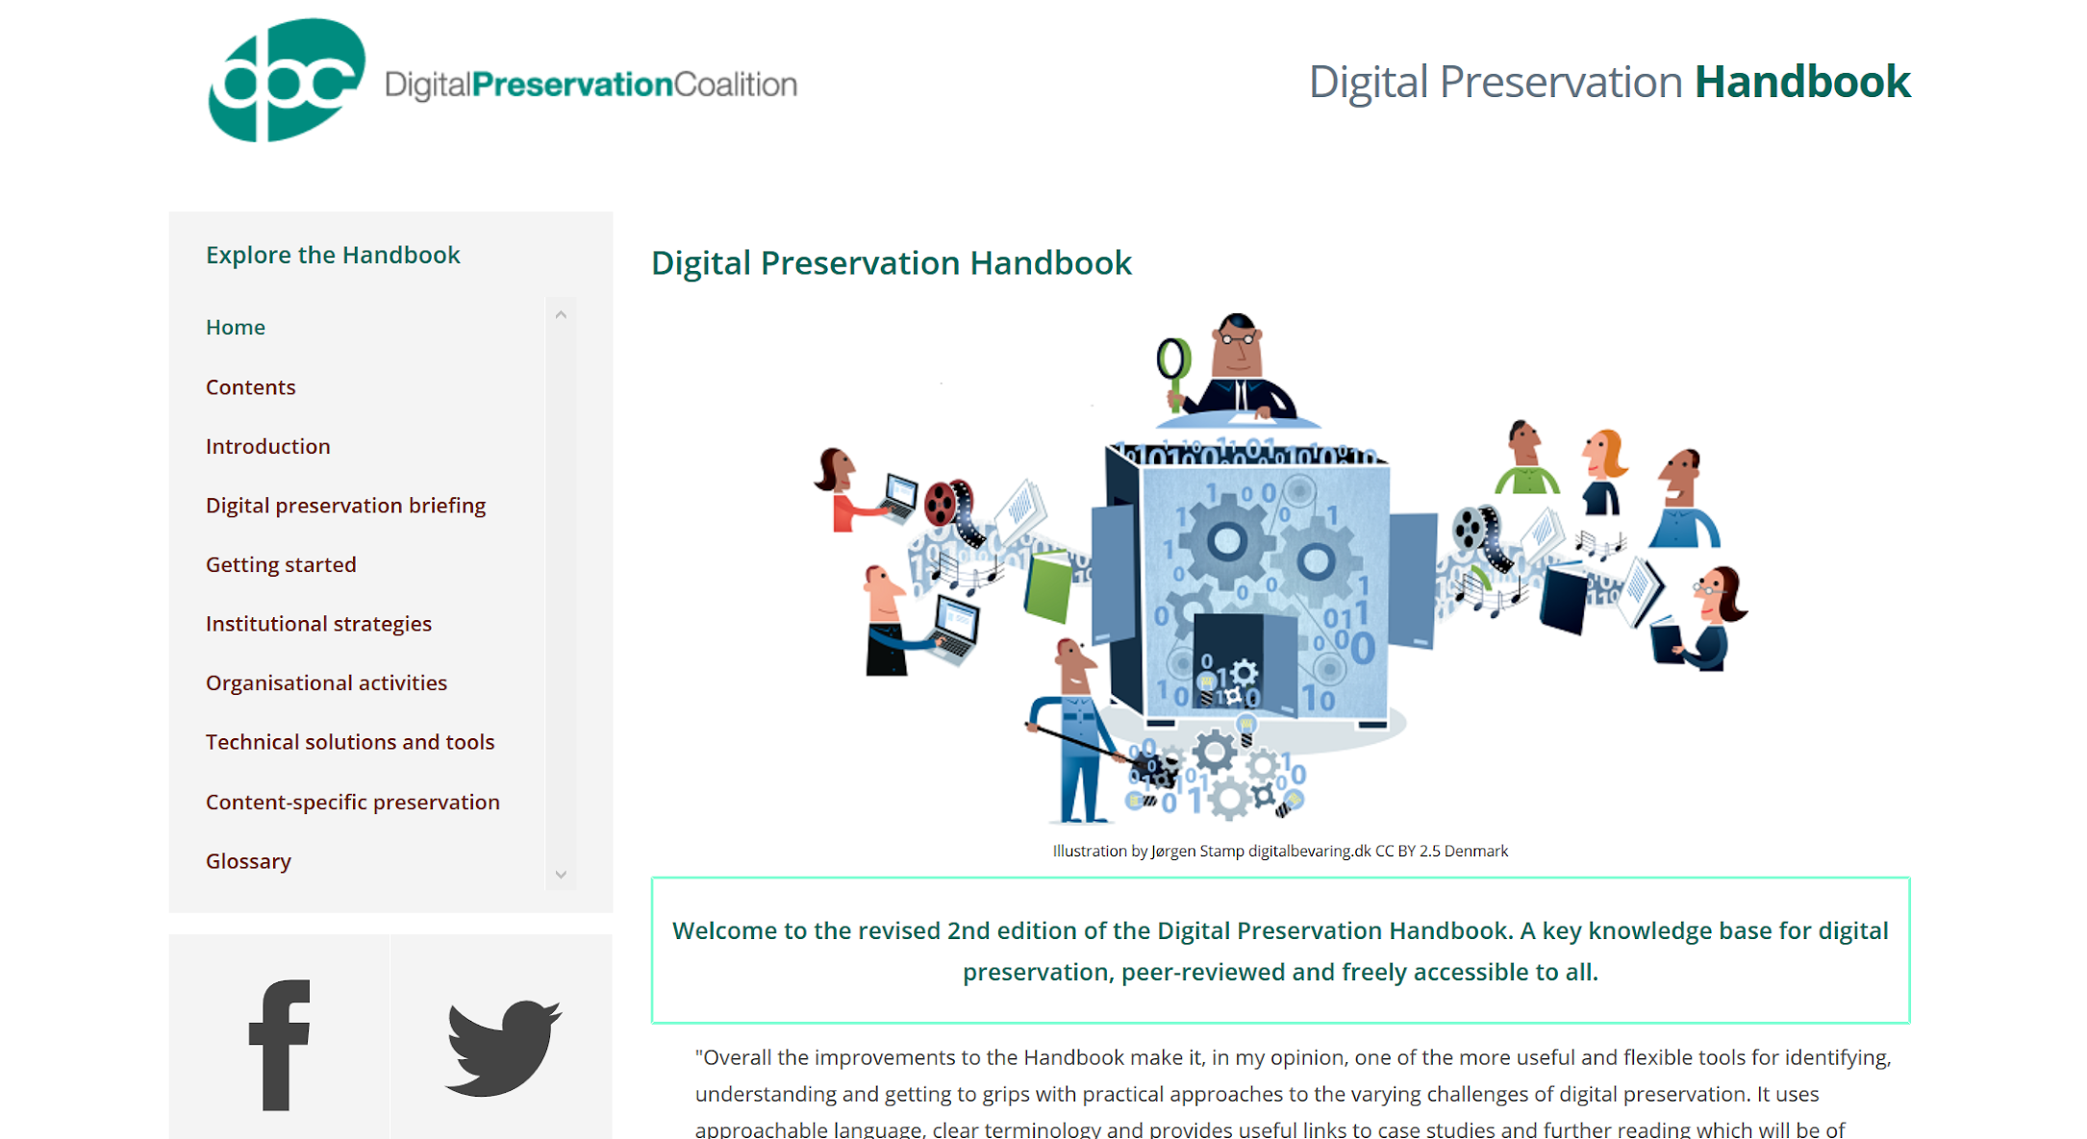
Digital Preservation Handbook
Preserving Access To Your Digital Content Over Time

Slide 18
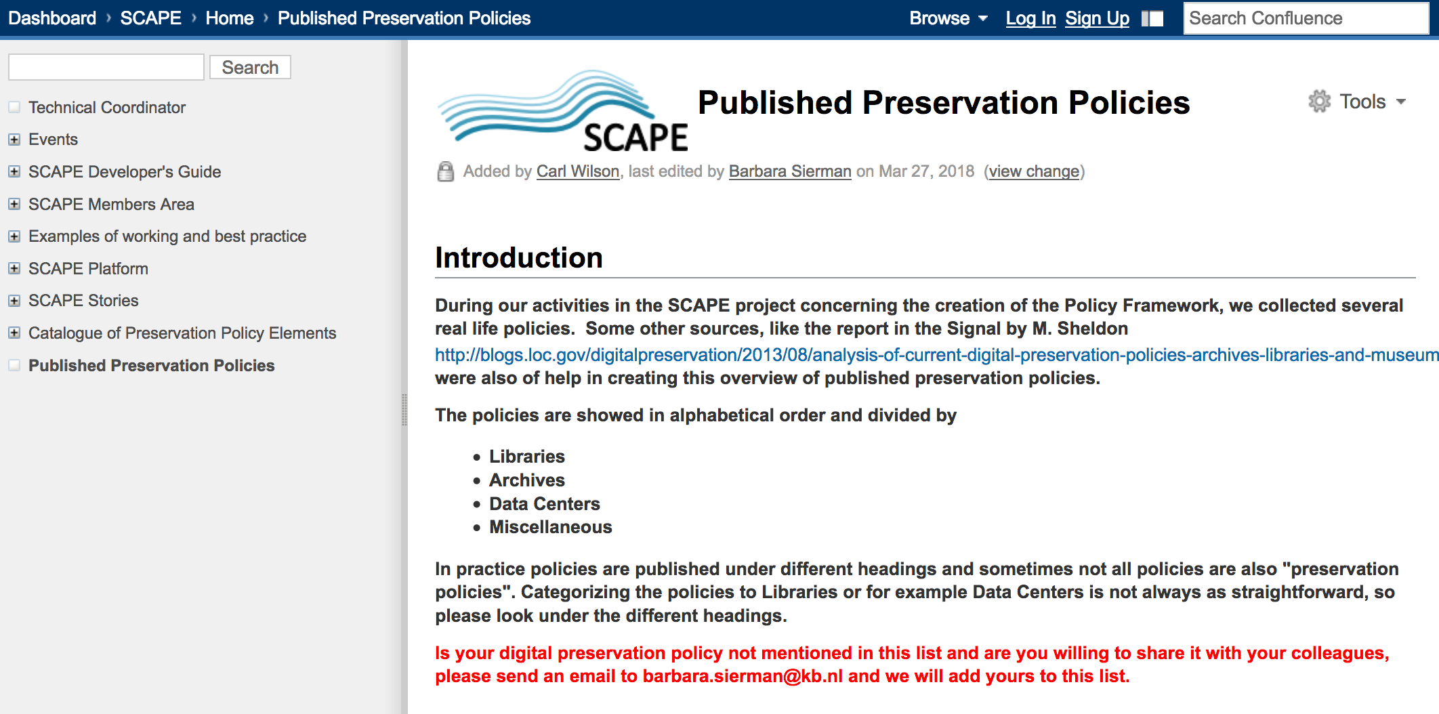
http://wiki.opf-labs.org/display/SP/Published+Preservation+Policies
Preserving Access To Your Digital Content Over Time

Slide 19
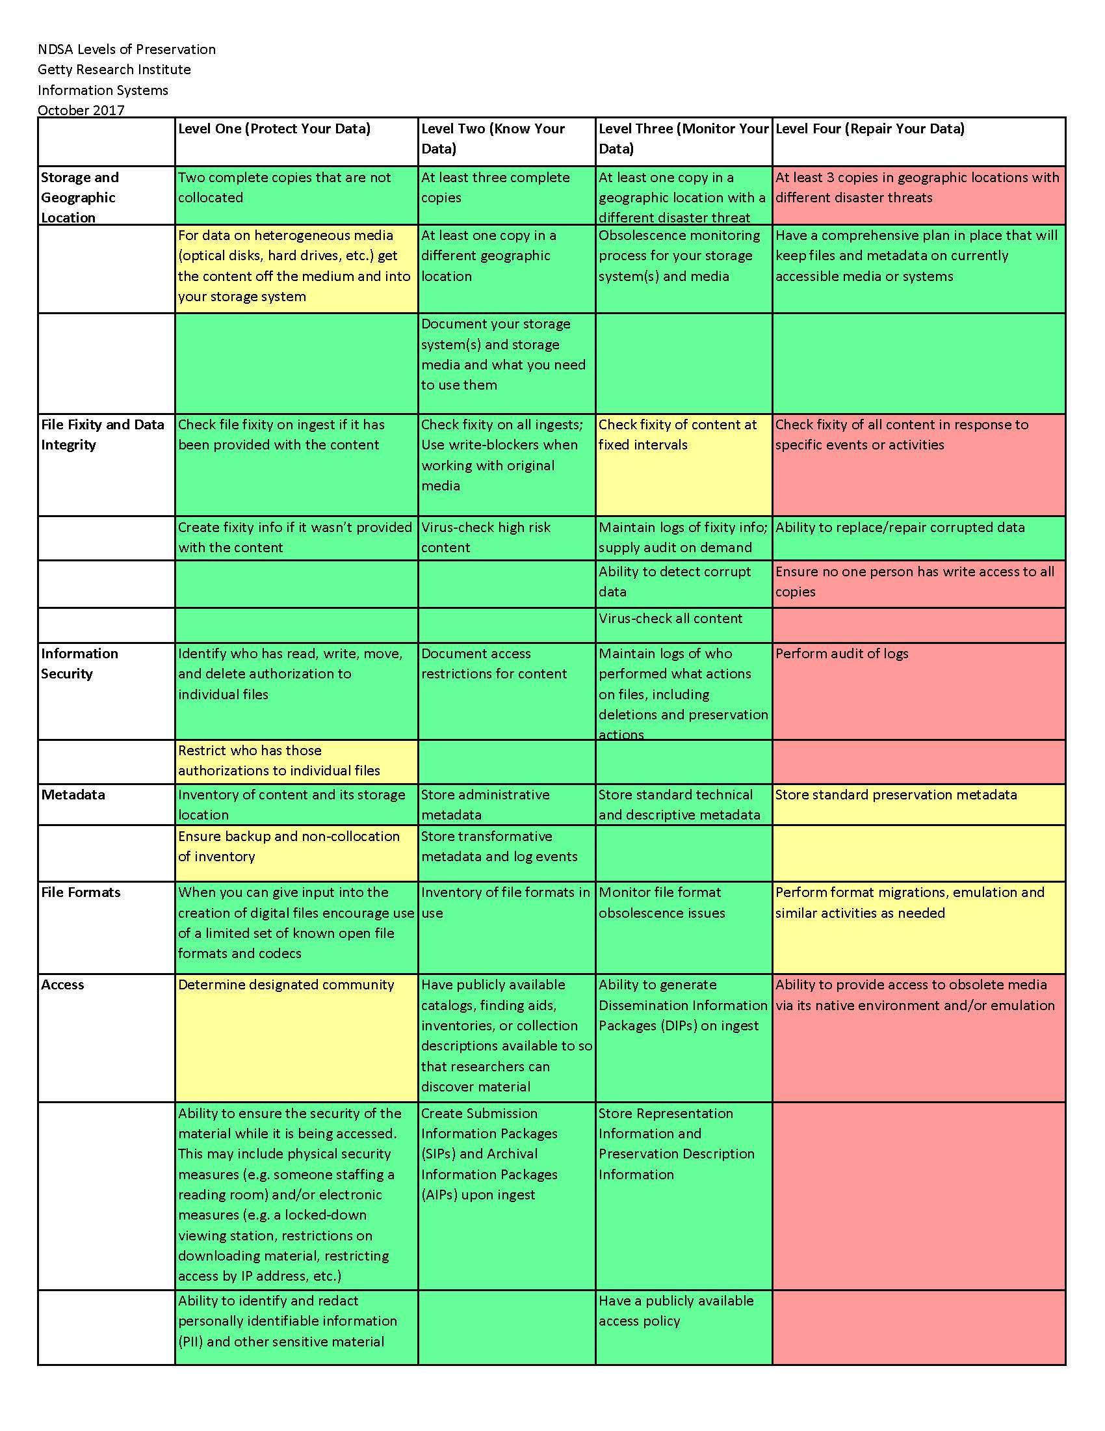
NDSA Levels of Preservation
http://ndsa.org/activities/levels-of-digital-preservation/
Preserving Access To Your Digital Content Over Time

Slide 20
Danger Alert – Some Boring Technical Stuff

Slide 21
Bit Rot
Not rotten fruit!
Can be defined also be defined as data rot
Occurs when one of the bits in a file gets flipped

Slide 22
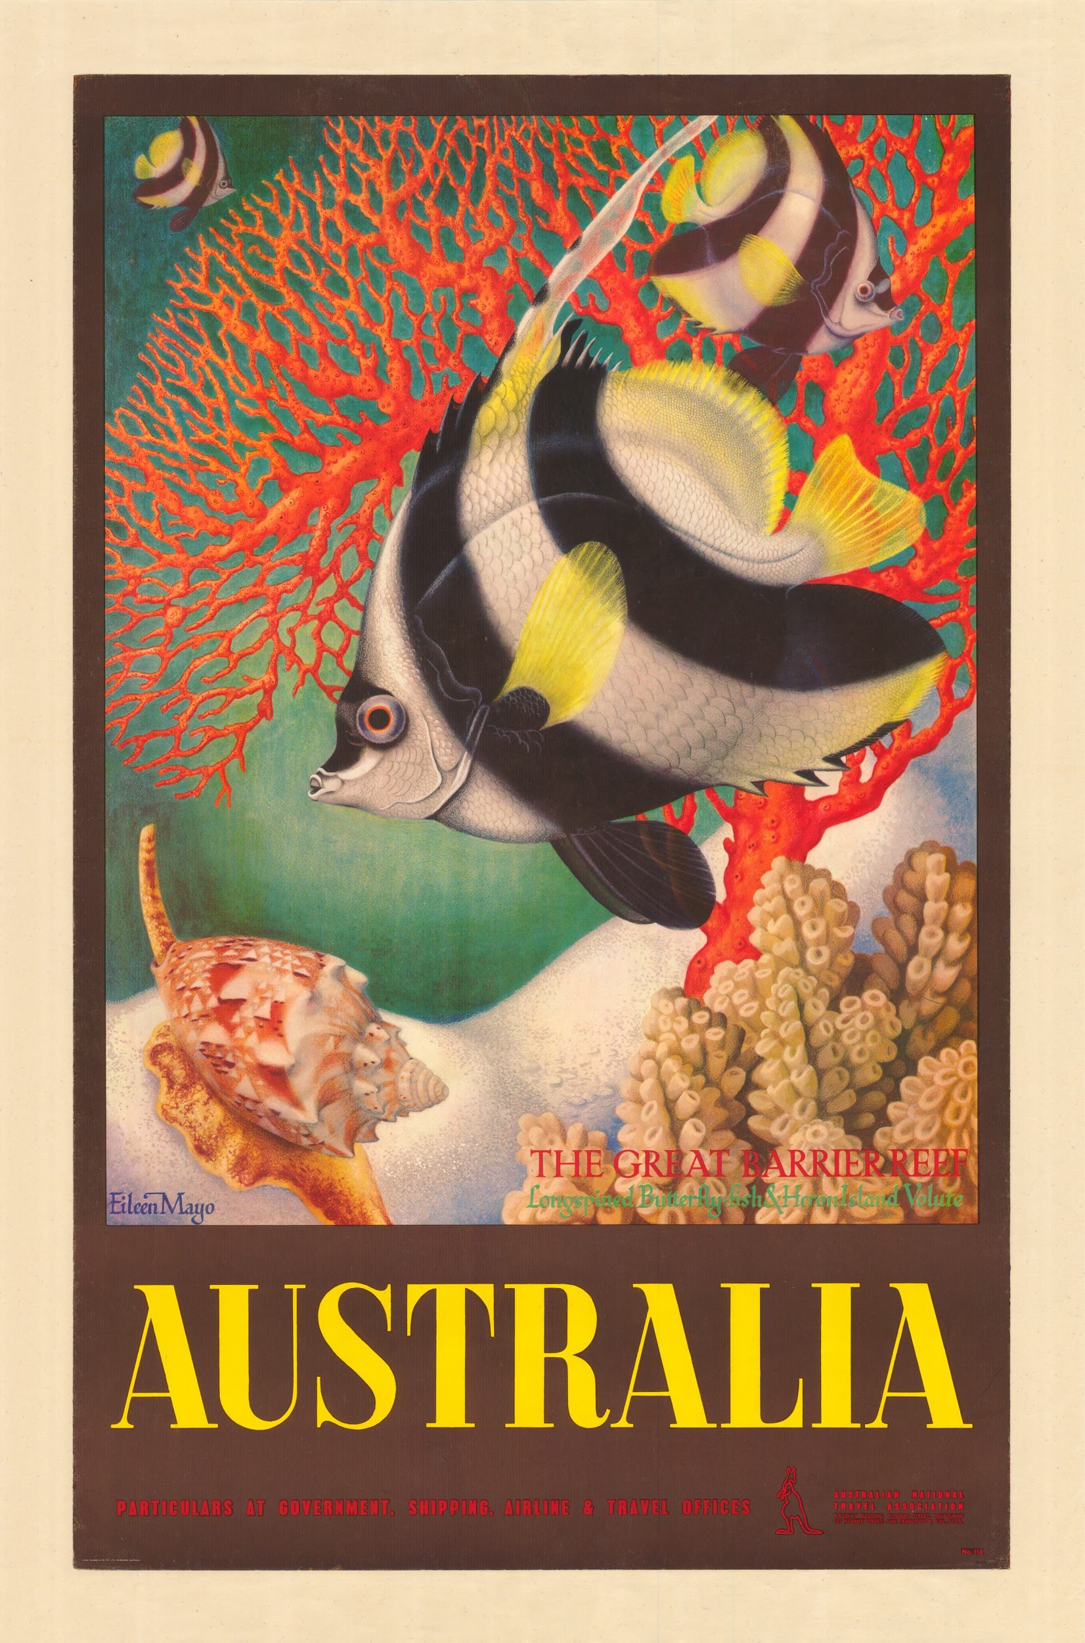
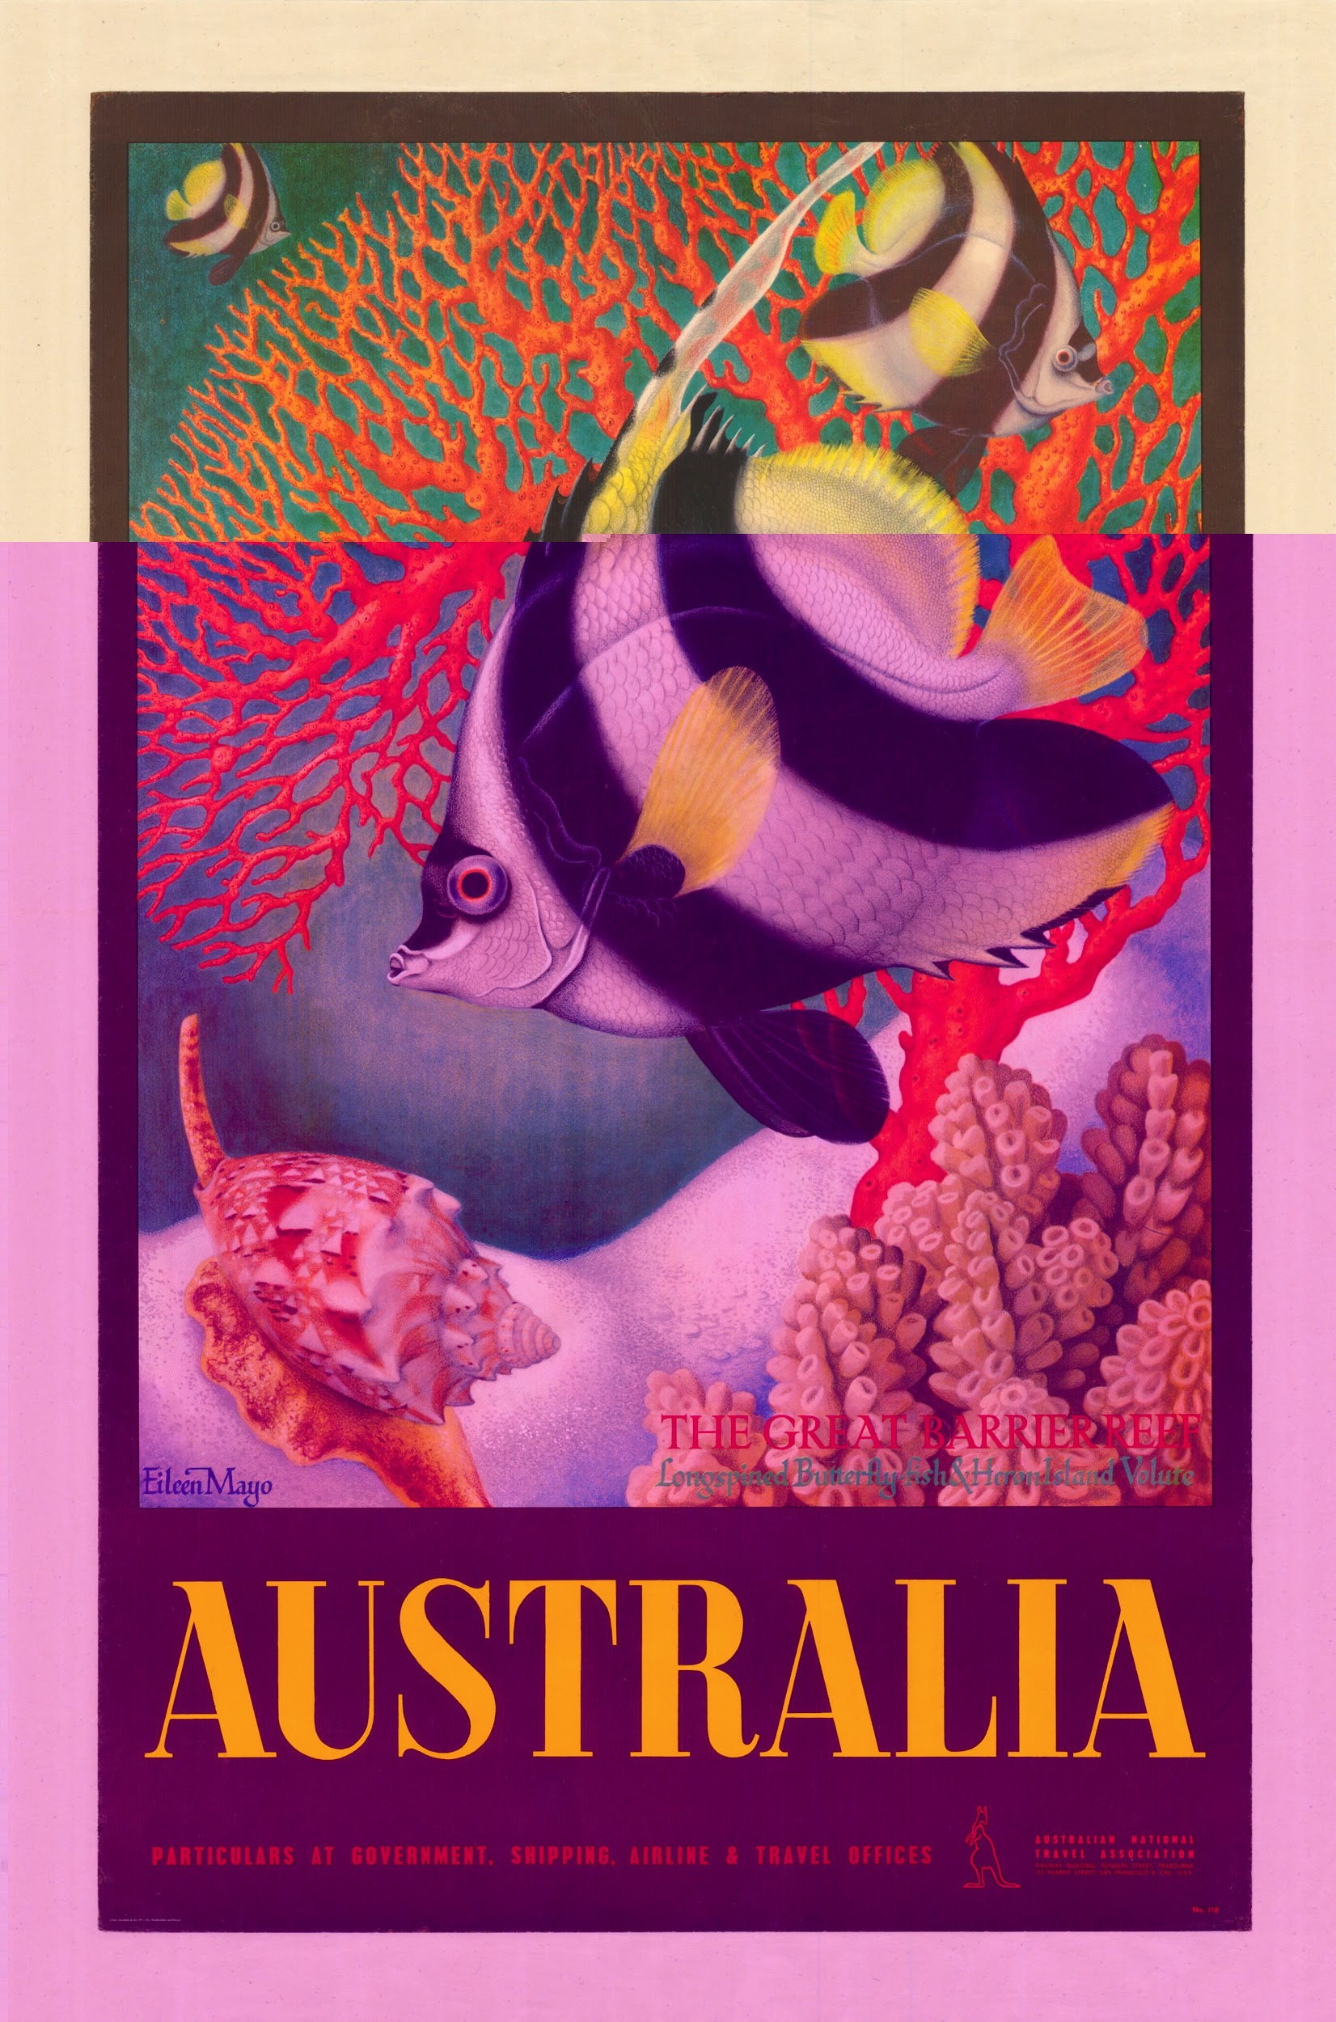
Examples of Bit Rot

Slide 23
Example of Bit Rot and Checksums
fc869521d624ae024602273cb5ad59bc fc506c31be9b4762109f60c77f12587

Slide 24
Bit Rot and uncompressed formats eg. TIF
595268dd31f2da7f565c767cafe31583 da80650b687525022b19871b1a185d41

Slide 25
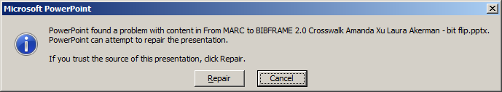
Bit Rot and PowerPoint file

Slide 26
Hi Dave,
I tried to open the floppy discs with our disc reader.
The files are there, but I just get spinning and this message – I can’t open because it keeps spinning.
Do I need special software to have file blocking?
Do I need to “disable the registry policy setting”?
I am dropping off all on your desk in a few minutes!
Can you extract the files and put them in the R drive in the Dianne Byrne folder?

Slide 27
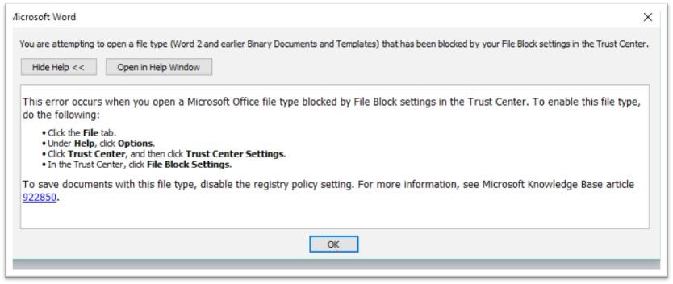

Slide 28
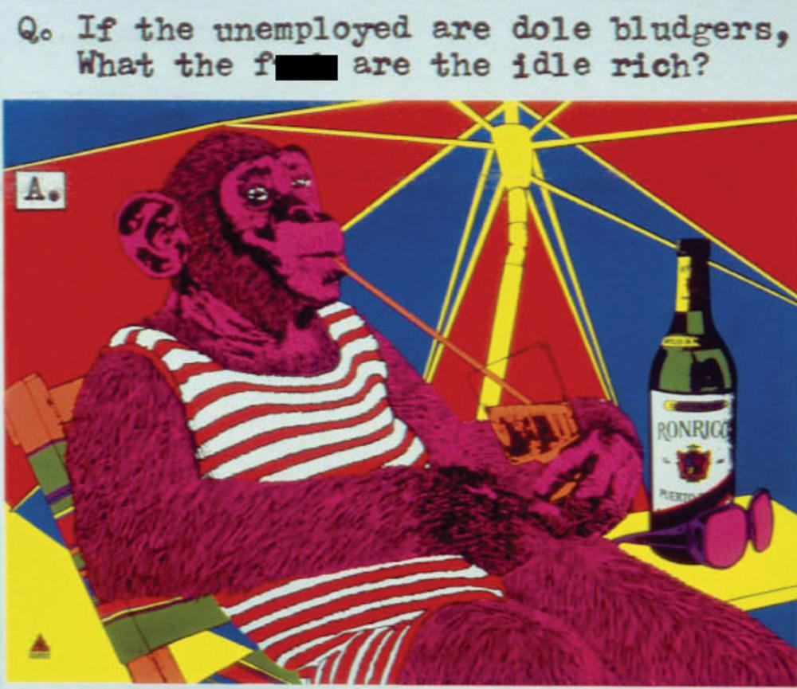
Authenticity - Which is the real one?

Slide 29
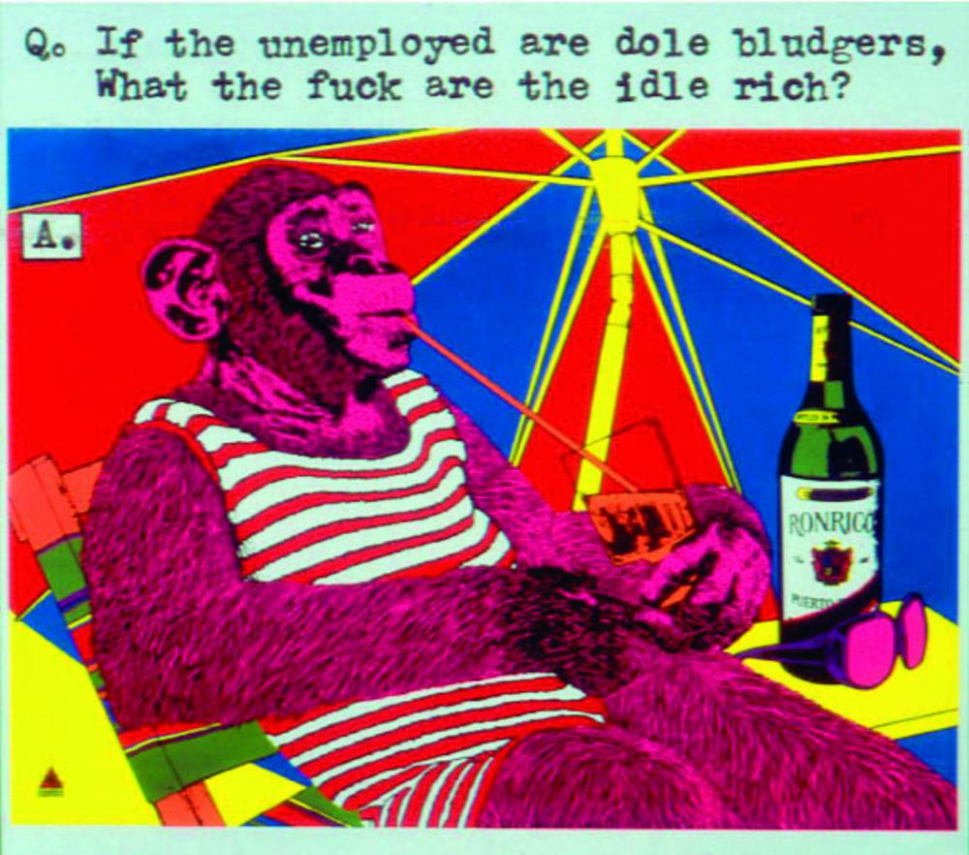
Authenticity - Which is the real one?

Slide 30
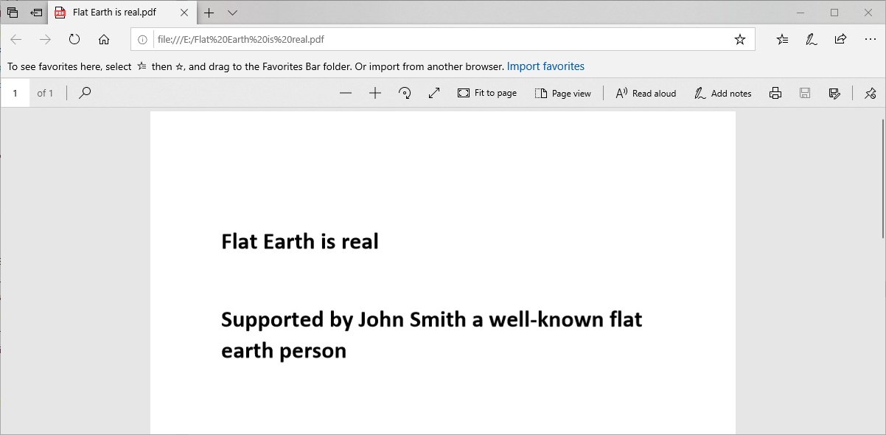
Authenticity - Which is the real one?

Slide 31
Authenticity - Which is the real one?
https://www.sejda.com/pdf-editor

Slide 32
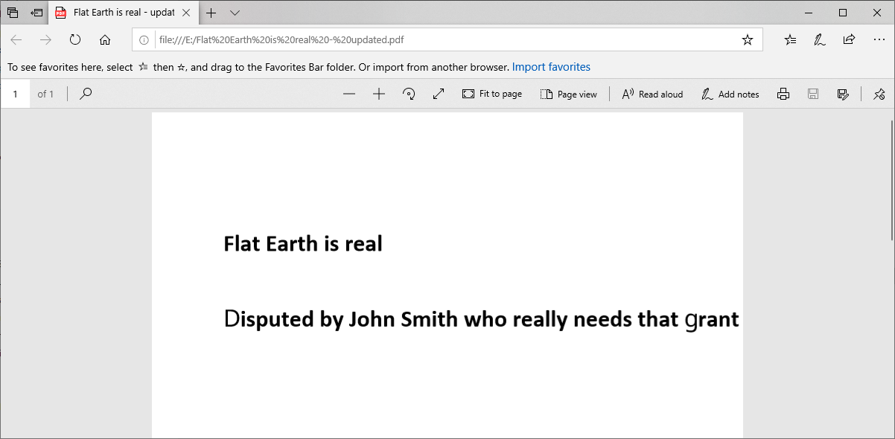
Authenticity - Which is the real one?

Slide 33
Format Obsolescence
I have a file with a ‘.doc’ so it must be a word document!
Well according to PRONOM Technical Registry it could be a one of 20 formats and this precludes someone naming a file ‘.doc’ instead of a ‘.txt’.

Slide 34
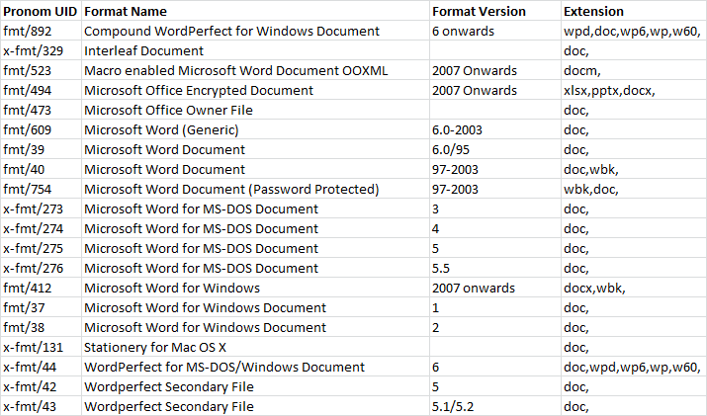
Format Obsolescence

Slide 35
Access
Long term access is one of the major reasons for Digital Preservation.
Examples of issues now
SLQ had a 1TB ‘.mov’ file -- we could hear the audio but no video
Issue related to the ‘ICOD’ codec -- popular on MACS but not available on PCs
SLQ had to create a modified master using the V210 codec

Slide 36
What is Rosetta
Digital Preservation System with Digital Asset Management
Workflow based solution/product
Scalable but On-site only at this stage
Collects Technical Metadata from digital files (significant properties)
Support PREMIS 2.2 (PREservation Metadata Implementation Strategies)
Use of METS (Metadata Encoding and Transmission Standard) as exit strategy
Interfaces with other repositories e.g. FigShare, ePrints
Plug-in framework

Slide 37
Rosetta Features
Preservation Validation Stack
checksum calculation/verification (4 diff types available)
file format identification (using DROID)
technical metadata extracted for many file types (using Jhove)
alerts for corrupt/non-standard files
virus check (we’re currently doing this outside the system)
risk assessment (specific to your institutional capabilities
Provenance events (audit trail)
Version control (can revert to earlier)
Preserving Access To Your Digital Content Over Time

Slide 38
Rosetta Features (cont.)
More than 10 viewers to choose from out of the box - and ability to plug in more
Robust access rights and retention period
Scale: No limit on size or number of files in a single object
Exit strategy clear - data stored as METS with absolute file paths
Preserving Access To Your Digital Content Over Time

Slide 39
Digital Preservation at the GRI
Preserving Access To Your Digital Content Over Time

Slide 40
Team & Collections
Team
Dig Pres & Lib Sys Mgr (.25)
Systems Librarian (.25)
Deposit team
  1 Team Lead
  3 Library Assistants
  2 Digital Archivists
Associated Staff:
Project planning/mgmt
Metadata creation
Rights
Central IT
Collections
Born-digital (20 TB)
  Institutional business rcrds
  Spec Collections materials
Digitized (ca. 405 TB)
  Photographs
  Prints
  Manuscripts/letters
  Audio/Video
  PDFs (e.g. press releases)
Preserving Access To Your Digital Content Over Time

Slide 41
Storage & Backups
Oracle database
SQL Backtrack – hot backup with tape (more for disaster recovery)
Filestreams - HSM (hierarchical storage management) with QStar
high-use filestreams stay on spinning media but most preservation-level files move to tape.
3 copies (on-site tape, off-site tape, Amazon S3 cloud)
Preserving Access To Your Digital Content Over Time

Slide 42
Preserving and providing access to born-digital files
Preserving Access To Your Digital Content Over Time

Slide 43
How Rosetta can help
Identify formats and extract metadata from the files so we know what we have
Checksums calculated outside the system can be checked at time of deposit
Non-standard (either invalid or malformed) files will be flagged in the system
Knowing what we have means we will be better able to manage preservation planning (derivative creation, file format migration, etc.)
Content will be stored in the Data Archiving solution (HSM) which provides more stability and security for files
Preserving Access To Your Digital Content Over Time

Slide 44
Limitations
Only tells us there is a problem with the file, can’t “fix” it for us
Cumbersome to provide access only to specific users (have to create a user account manually, link the account to the object and provide username/password)
Can’t do a full-text search of documents the way you can when the files are accessible directly from your computer
Making derivatives outside the system for heterogeneous collections is time-consuming and not sustainable
Not straightforward to add more files to an existing object
Preserving Access To Your Digital Content Over Time

Slide 45
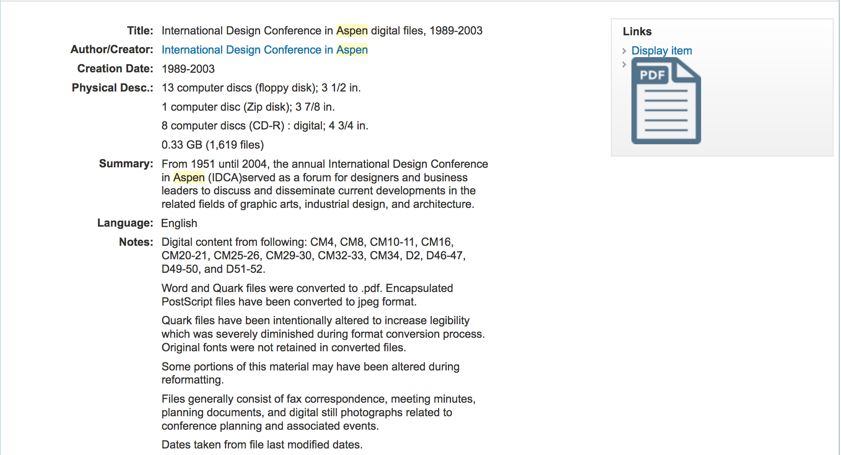
Example
Preserving Access To Your Digital Content Over Time

Slide 46
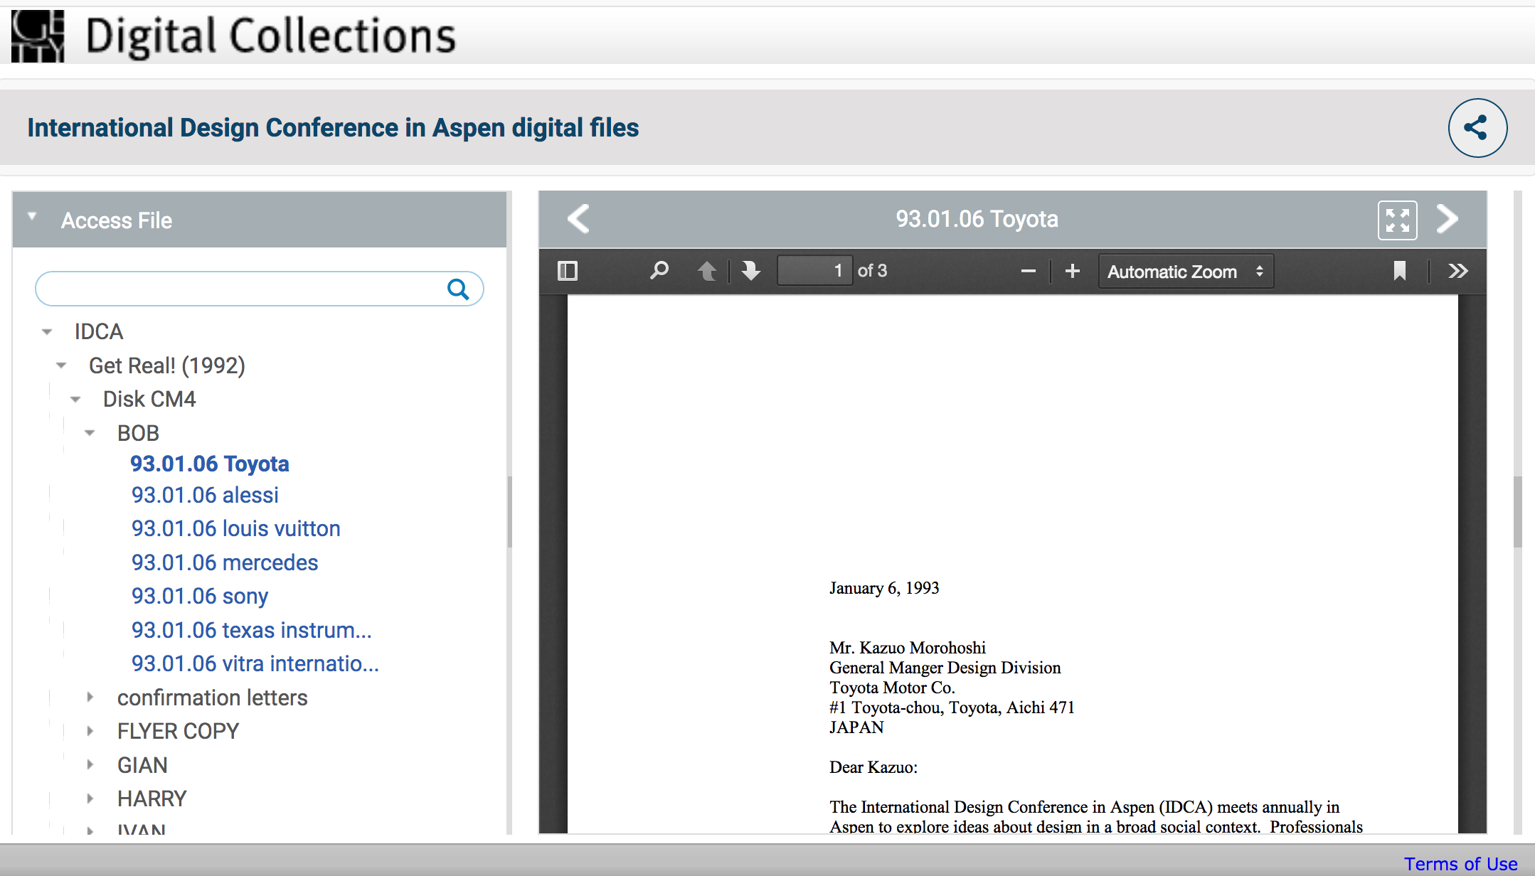
Preserving Access To Your Digital Content Over Time

Slide 47
How does SLQ use Rosetta
We have three categories of material
Turned Digital -- we have the analog original
Born Digital -- started life as digital
Digital Only -- we do not have the analog original
Heavy reliance on file naming conventions
Use in place storage (e.g. we have AV files that are > 1TB is size)

Slide 48
How does SLQ use Rosetta (cont’d)
Deposit into Rosetta either via staff (CSV ingest files) or in-house developed CSV generator
Replicate descriptive metadata Rosetta into Alma (DC to MARC)
Use Alma as single point of truth for descriptive metadata
Ensure assets going into Rosetta meet Digital Preservation requirements
Search in Primo -- deliver assets via Rosetta
Take advantage of rights control, embargo, check sums, format library

Slide 49
How does SLQ use Rosetta (cont’d)
Preservation Planning
Rosetta does carry out file fixity checks, virus checks, etc and records these actions
Rosetta will also alert you of issues such as ‘format at risk’, badly formed file header, Iocal viewer issues, etc
Rosetta does not do any format migration -- you carry out the format migration

Slide 50
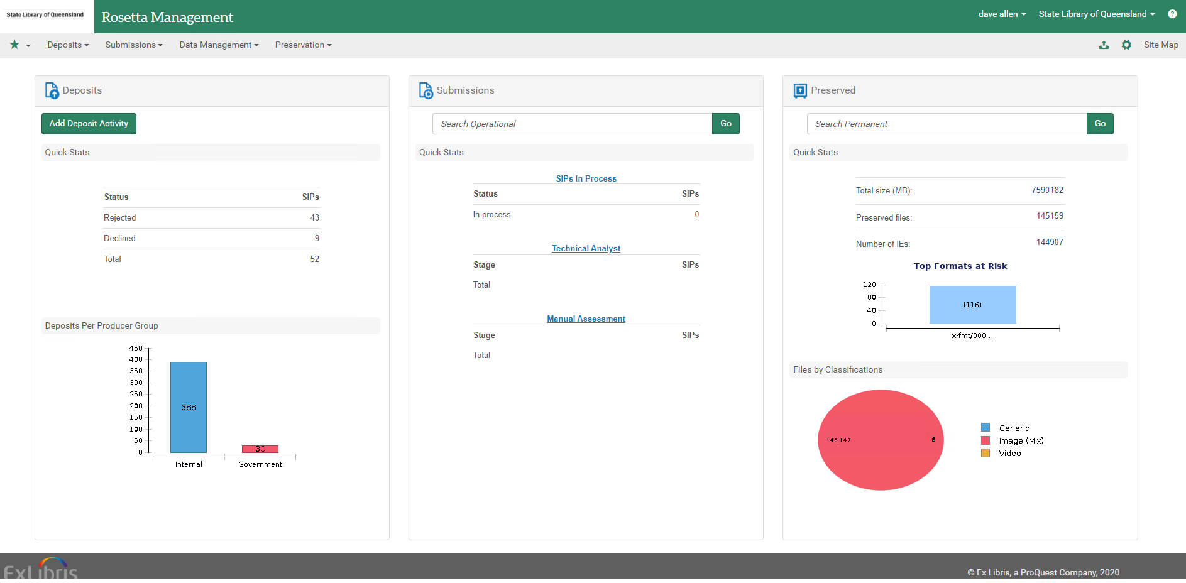
How does SLQ use Rosetta (cont’d)

Slide 51
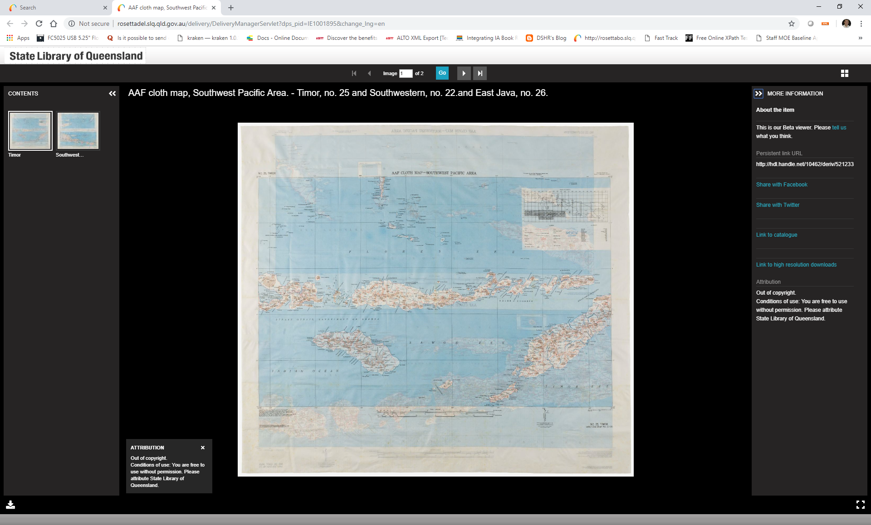
How does SLQ use Rosetta (cont’d)

Slide 52
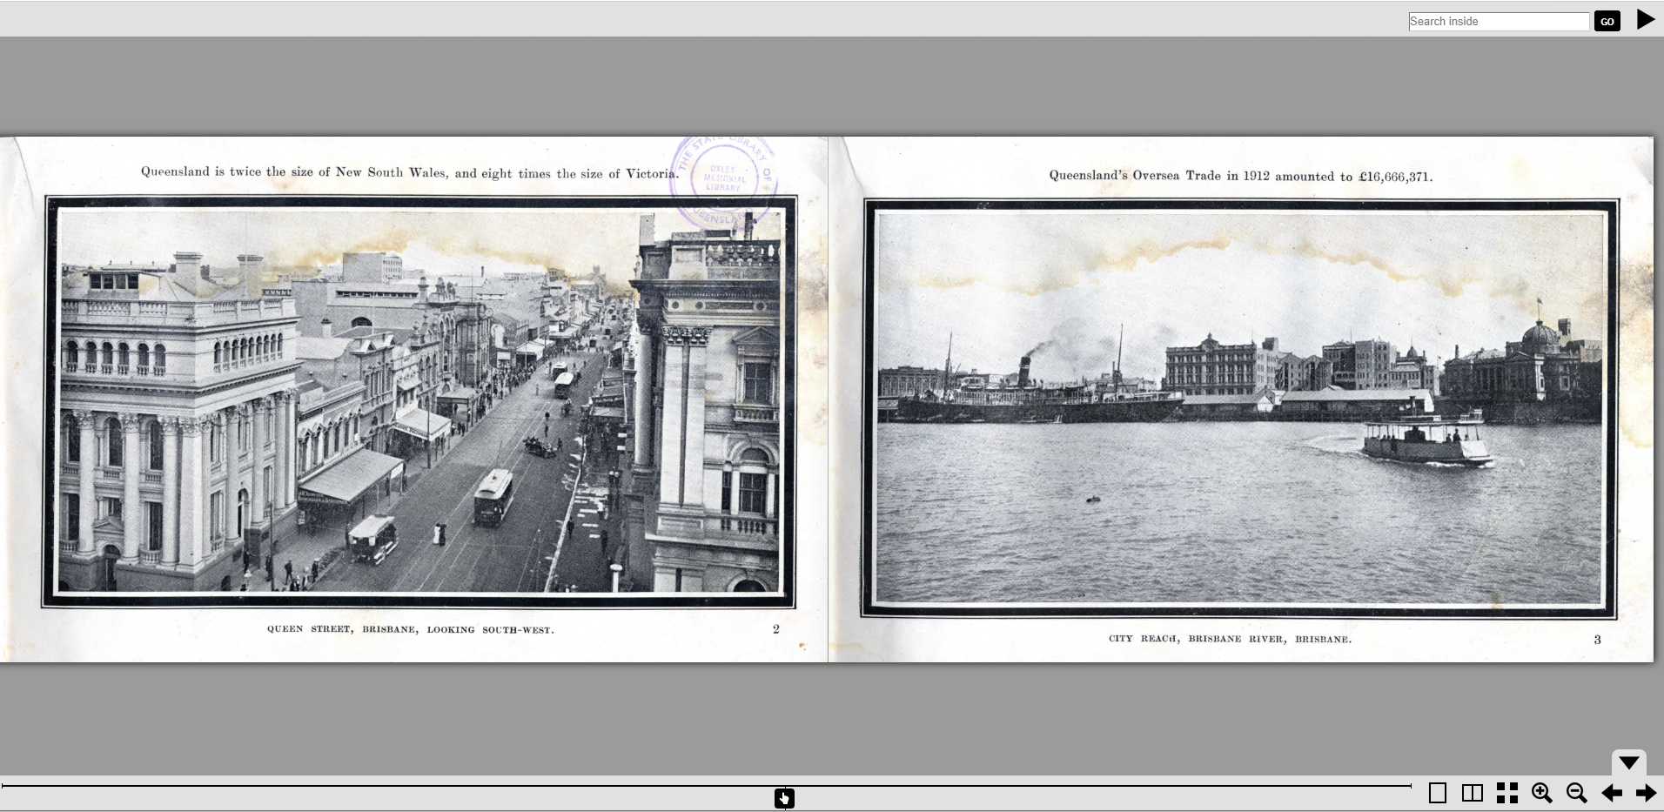
How does SLQ use Rosetta (cont’d)

Slide 53
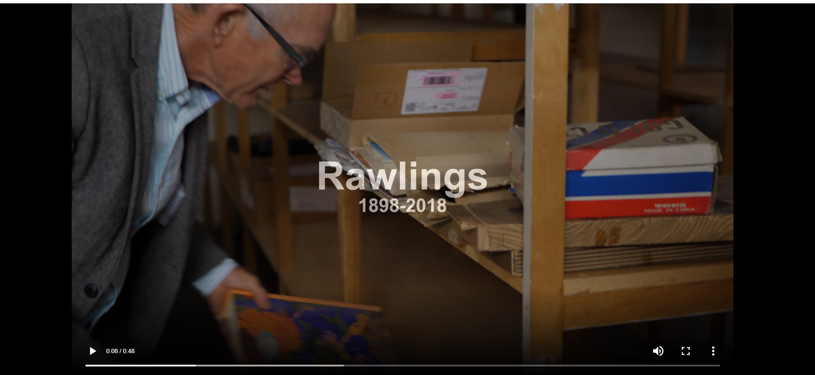
How does SLQ use Rosetta (cont’d)

Slide 54
Thank you.

Slide 55
Resources from the Digital Preservation Coalition
Tech Watch reports http://www.dpconline.org/publications/technology-watch-reports
Events http://www.dpconline.org/events
Novice to Know How Training https://www.dpconline.org/digipres/train-your-staff/n2kh-online-training
Digital Preservation Handbook https://www.dpconline.org/handbook
Business Case Toolkit http://wiki.dpconline.org/index.php?title=Digital_Preservation_Business_Case_Toolkit
Rapid Assessment Model (RAM) https://www.dpconline.org/digipres/dpc-ram
Preserving Access To Your Digital Content Over Time

Slide 56
Resources
Library of Congress - http://www.loc.gov/preservation/digital/
Recommended Formats Statement
Sustainability of Digital Formats
Tools and Open Source Software
PREMIS Data Dictionary http://www.loc.gov/standards/premis/
METS for wrapping data http://www.loc.gov/standards/mets/
NDSA (National Digital Stewardship Alliance)
2019 Storage Infrastructure Survey https://osf.io/uwsg7/
Preserving Access To Your Digital Content Over Time

Slide 57
Resources
Keeping Research Data Safe - Benefits Framework http://www.beagrie.com/krds.php
National Archives Policy Guidance https://www.nationalarchives.gov.uk/archives-sector/advice-and-guidance/managing-your-collection/preserving-digital-collections/
Open Preservation Foundation https://openpreservation.org/
Software Preservation Network https://www.softwarepreservationnetwork.org/
OSSArcFlow Guide to Documenting Born-Digital Archival Workflows
https://educopia.org/ossarcflow-guide/
Preserving Access To Your Digital Content Over Time

Slide 58
Resources: Registry services & characterisation
PRONOM and DROID - http://apps.nationalarchives.gov.uk/PRONOM/Default.aspx
JHOVE http://jhove.sourceforge.net/
Various Tools from SCAPE project http://www.scape-project.eu/tools
FITS http://fitstool.org
Preserving Access To Your Digital Content Over Time

