Slide 1



Auditing Usage Statistics or: What To Do When You Don’t Have Other Work
Sunshine
Carter
Grace
Lilyerd
Michael
Johnson

Slide 2
Project Overview/Rationale

Slide 3

University of Minnesota
21 libraries on 5 campuses: Crookston, Duluth, Morris, Twin Cities, Rochester
Share systems; but otherwise essentially autonomous
Systems in Use
  Alma: Single Institution / Multi-campus
  Primo/Primo Central: Multiple institutions/views
  Premium Sandbox for Alma & Primo
  bX
  Leganto
  EZProxy/Shibboleth

Slide 4

Twin Cities
Demographics @ Twin Cities
  30,500 FTE undergraduates
  14,500 FTE graduate/professional students
  18,000 faculty & staff
E-Resources @ Twin Cities
  100,000 e-serials (172,000 including free/OA)
  1.3 million e-books
  ~500 subject-specific databases
Notes:
ST

Slide 5
Our past usage collection practices
Collection: SUSHI, manual
Storage: UStat, shared drives
Presentation: Excel, websites
Personnel: student, e-resource, collection development & organizational data staff

Slide 6
The problem
Transitioned from UStat to Alma in H1 2017
Usage Data dashboard in Alma was painful
Began using Tableau to visualize usage data
Many questions……...
  Missing usage data?
  Or did we have zero use?
  Which vendor/platforms were missing?

Slide 7
The strategy: an internal audit
An audit would help answer questions:
  Are we collecting stats from all our vendors?
  How many vendors are COUNTER compliant?
  How much manual work is needed?
  Which vendors aren’t offering any stats?

Slide 8
Project Process

Slide 9

Data needs
Something to audit
  Password Safe
    Admin passwords
Tracking mechanisms
  Google Sheets
  Load Usage Data (Alma)
Notes:
-our process may not work for everyone
-the audit was something that developed as we started on it - methodology and terms grew out of working on it. That said, there are a few basic items that we need.
-we need a baseline of information to audit - we used our PWSafe entries because that was the most comprehensive list of everything we had admin passwords to. This also gave us the admin passwords. Just under 800 entries when we started, 818 now
-something to track and audit on (Google sheets; everyone had access)
-Load usage data page in Alma to guess at what was missing or wasn’t working; this had a lot of issues (especially for shared platforms and ‘no usage’) and lagged badly

Slide 10
The audit
Jumping into the deep end
Data dictionary
  Terms developed as we worked
  Standardized definitions
COUNTER 5 transition
  Used the audit as the base for transition
  Added fields (platform) and terms
Notes:
-issues with PWSafe as a base -lots of dupes entries, audit basically served as an audit of our admin database as well
-terms developed as we found the different issues for the audit
-ended up using the same spreadsheet for C5 transition, so terms were added there too

Slide 11
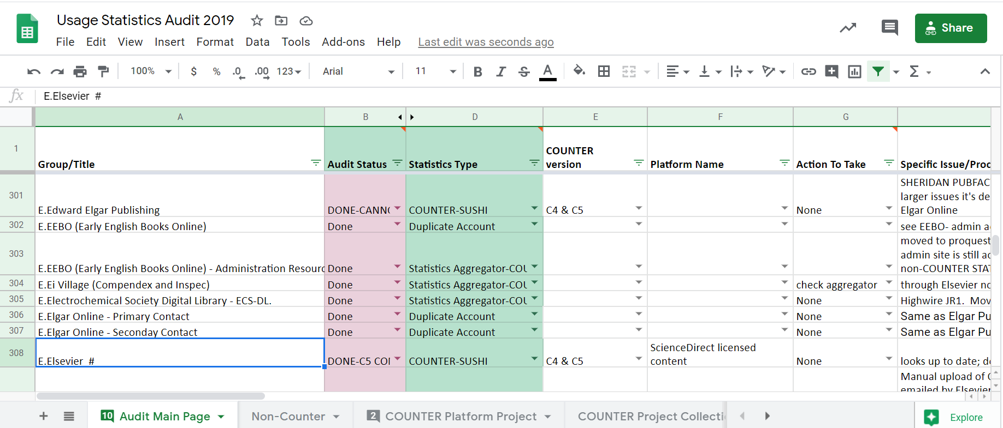
The spreadsheet
Notes:
-key categories: audit status, Statistics Types, COUNTER version, Platform name (later addition), Action, Process notes

Slide 12
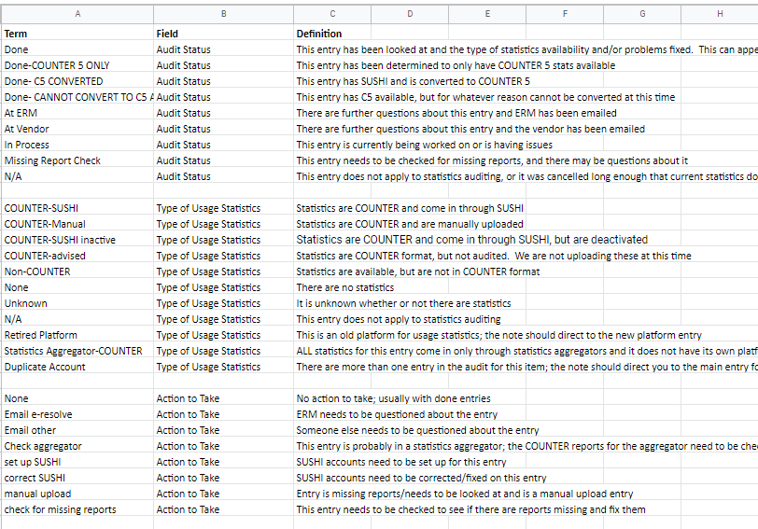
Data Dictionary
Notes:
-data dictionary

Slide 13
Analytics Need

Slide 14
Load Usage Data issues
Where are there gaps in our data?
What formats are provided by platforms?
Continuity through name changes

Slide 15
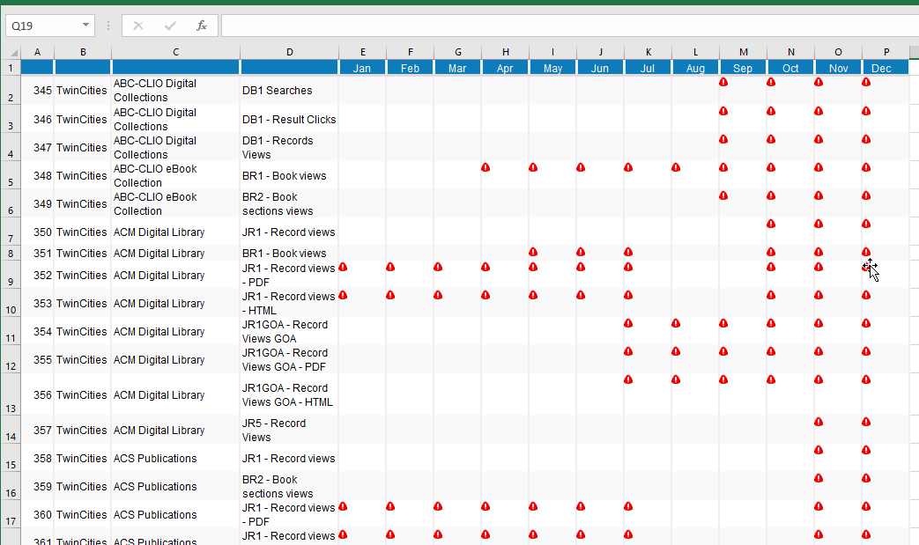
Monthly usage data (pre-July 2018)
Notes:
The monthly usage data screen within Alma does provide a quick view of where gaps might exist. However, it suffers from data overload. 275 platforms, 70+ COUNTER formats, 2 subscribers- even the Excel import has over 3000 rows… and that’s just for a single year. (~2017)
When we started this, there was no Excel import out of Alma. To make even a facsimile of this, I did a copy and paste into Excel, and manually converted the icons into data… very tedious

Slide 16
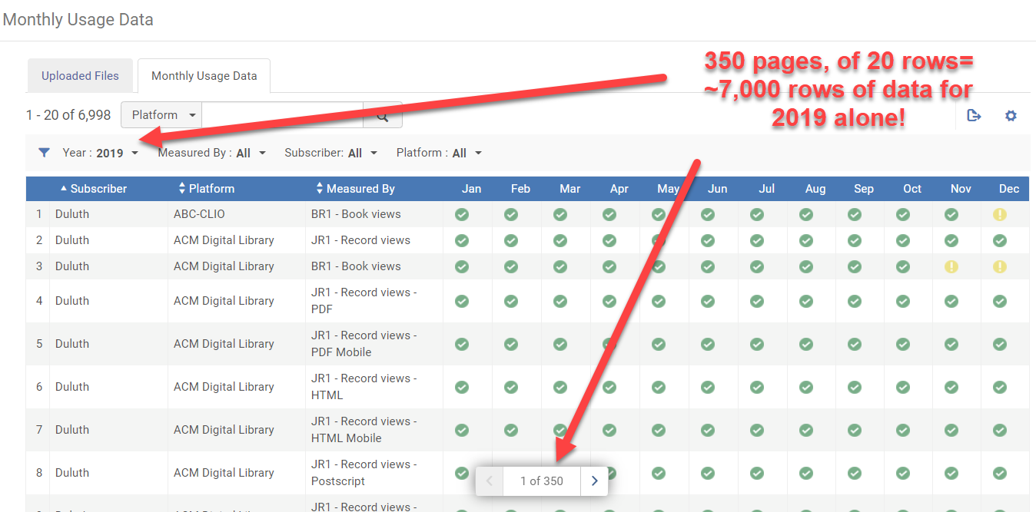
Monthly usage data (Alma, present)
Notes:
The monthly usage data screen within Alma does provide a quick view of where gaps might exist. However, it suffers from data overload. 275 platforms, 70+ COUNTER formats, 2 subscribers- even the Excel import has over 3000 rows… and that’s just for a single year. (~2017)
When we started this, there was no Excel import out of Alma. To make even a facsimile of this, I did a copy and paste into Excel, and manually converted the icons into data… very tedious

Slide 17
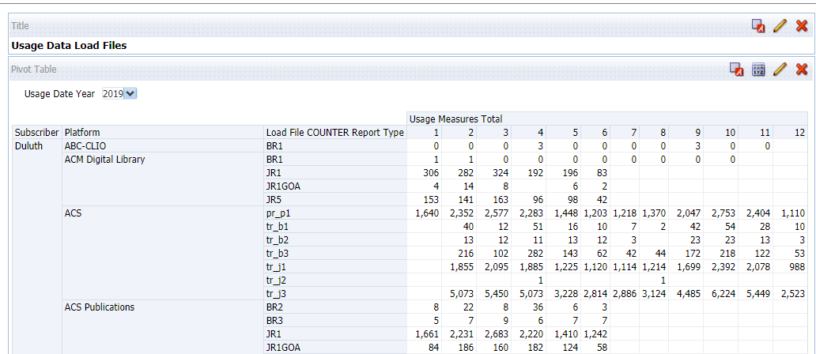
Replicating usage data in analytics via a report
xx
Zero usage
xx
xx
Gaps
xx
xx
xx
Notes:
Our first goal was to simply replicate the report displayed on the monthly data screen in Alma. Already, there are advantages. One- we can distinguish actual gaps (note- date for pre-alma)

Slide 18

Data enrichment
Vendor information
Upload Method
Load File information
COUNTER release
Regularly scheduled updates
Notes:
This was an improvement, but we still wanted something that provided more information, without requiring the time it takes to run a report in Analytics. This lead us to Tableau. If we were going to pull data into Tableau, what were other elements we could add that might be useful. (Some of this process was iterative along the way.)

Slide 19
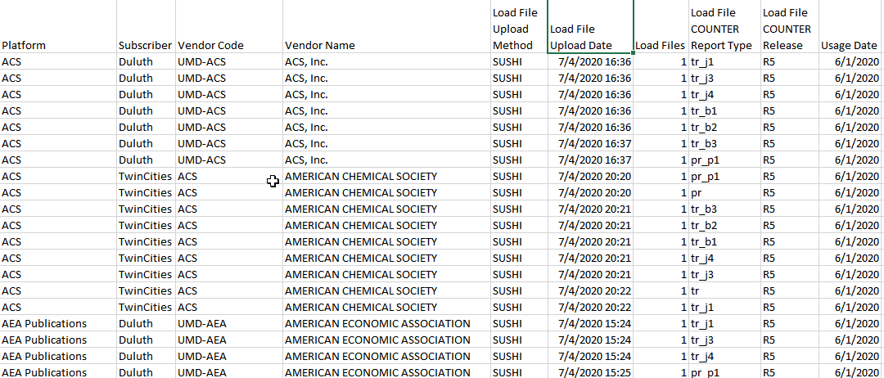
Tableau data feed
Notes:
Weekly updates, loaded through Python to our local tabshare folder for ingestion into Tableau. Incremental refresh based on Load File Upload Date.

Slide 20
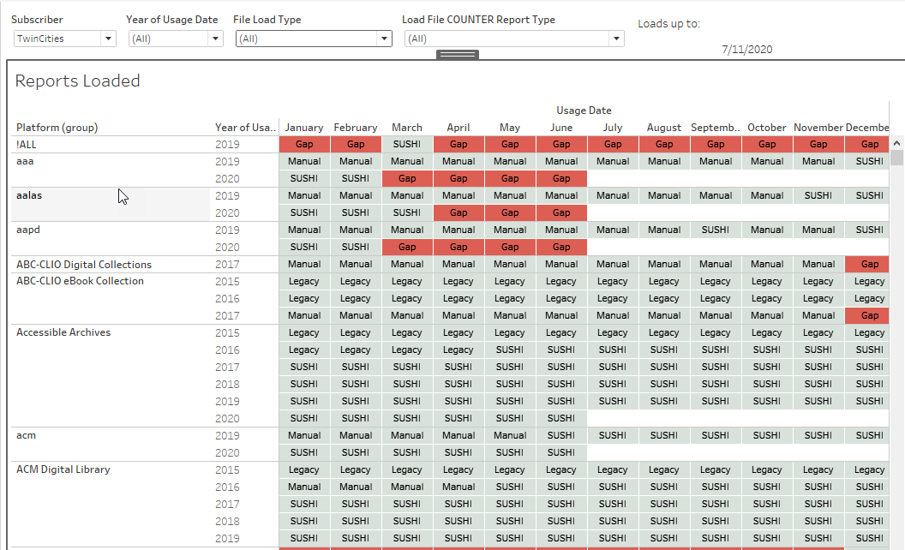
Missing data visualization in Tableau

Slide 21
Functionality
-Gaps highlighted -Quickly identify SUSHI and non-SUSHI vendors
-Quick filtering by Subscriber, Year, Report type
-Cross table of year/month
-Mouse-over a cell for specifics like Vendor info or which report types were loaded.
Notes:
Tooltip reference:<Sheet name="Vendor Code" maxwidth="300" maxheight="300" filter="<All Fields>"> Do I dare mention the ZN() function? Nah… too complex.

Slide 22
Using the Tool

Slide 23
Utilizing the analytics tool
Easier to understand what we had and were missing - no ”no usage” gap
Quicker loading time
Able to sort between C5 and C4 once the conversion started
Filter between Duluth and Twin Cities data
Vendor code of uploaded data - we could see which platforms were which vendors
Stopped using the Load Usage Screen entirely

Slide 24
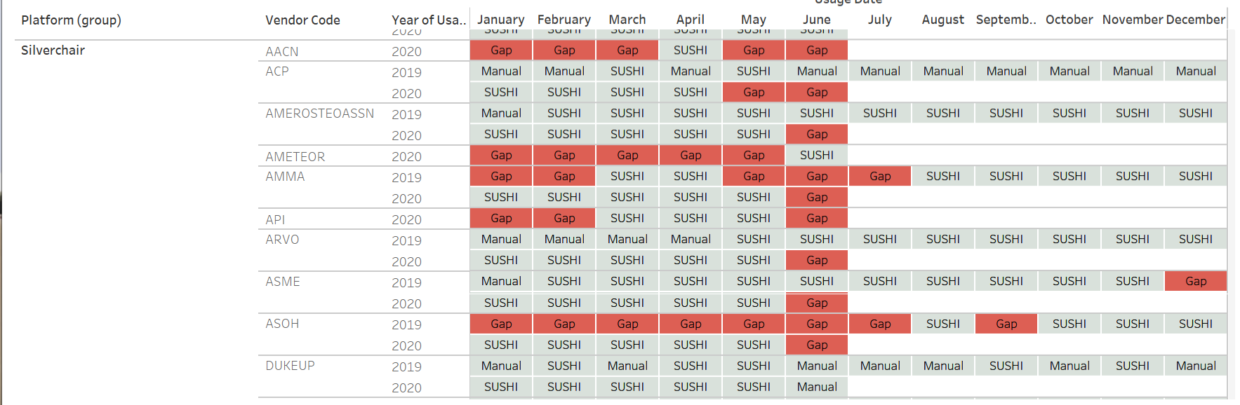
Analytics Tool - Silverchair Platform
Notes:
-this is where the analytics is REALLY useful - fixing and assessing vendors who all use the same platform

Slide 25
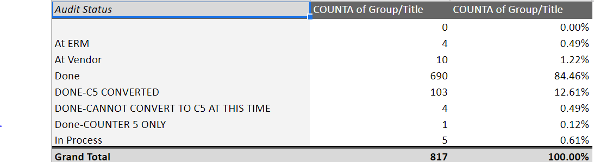
Audit results (to date)
Audit Status
*totals as of 8/19/2020
Notes:
-current status of the audit - about 96% done in some form

Slide 26
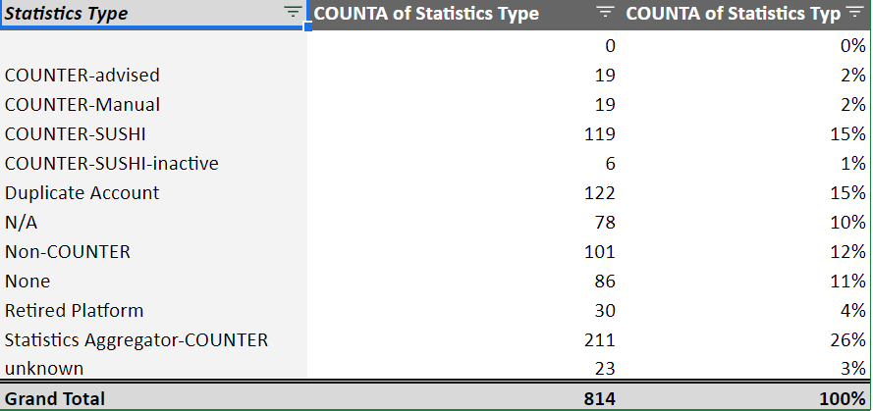
Audit results (to date)
Statistics Type
*totals as of 8/19/2020
Notes:
-about a quarter statistics aggregator
118 COUNTER-SUSHI accounts
-was able to convert some manual accounts over to SUSHI

Slide 27
Final thoughts

Slide 28
Was this worth it?
Collecting stats from 471 publishers/vendors.
  351 are COUNTER compliant
  Still working out issues with some vendors.
  124 require manual download (whether COUNTER compliant or not)
86 vendors are not providing any usage statistics
COUNTER R5:
  2019: 94% of usage collected
  2020: 85% of usage collected

Slide 29
The future
Better handle on our usage statistics gathering
Frequency of:
  collection manual statistics?
  monitoring SUSHI harvests
Audit benefits impending collection development decisions

Slide 30
Resources
Analytics
/shared/Community/Reports/Institutions/UMinnesota/
ELUNA Learns 2020/Usage Data Load Files
Tableau
https://z.umn.edu/UsageDataTableauFiles
Google Sheet
https://z.umn.edu/UsageStatisticsAudit

Slide 31
THANKS!
Any questions?
You can find us at:
Sunshine Carter - Collection Development, scarter@umn.edu
Grace Lilyerd - Acquisitions and Rapid Cataloging, gbutkows@umn.edu
Michael Johnson - Data Systems and Services, m-john1@umn.edu

