Slide 1


Change is the Only Constant for Libraries
Panel Discussion, August 26, 2020

Slide 2
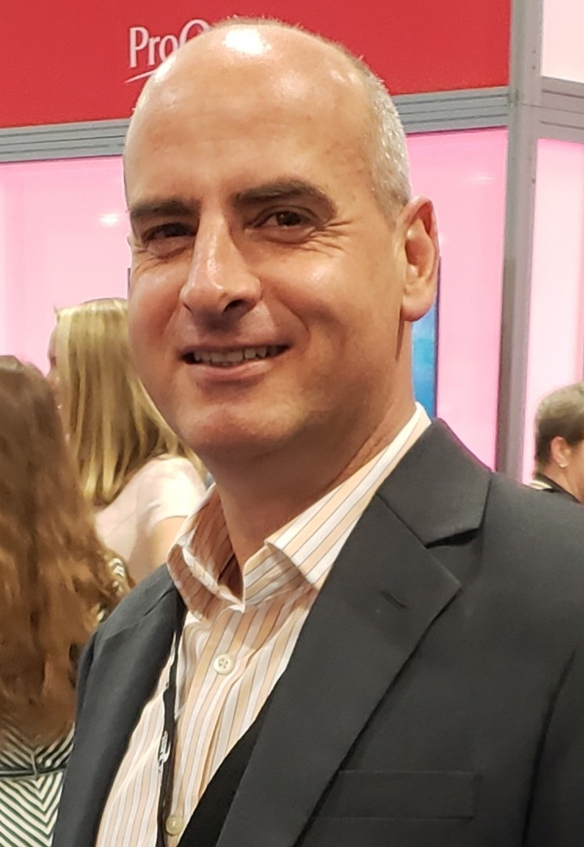
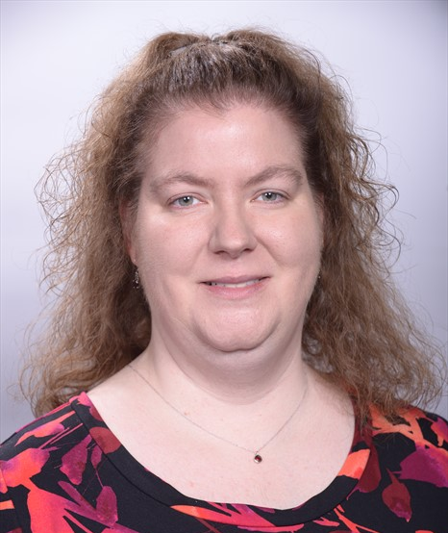

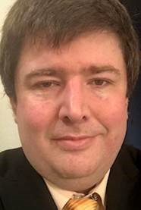
Panelists
  Jennifer King Matthews
  Collection Strategy Librarian
  Rowan University
  Yuval Kiselstein
  Senior Director, Product Management
  ProQuest
  Sarah Haight Sanabria
  Head, Collections and Technical Services
  Southern Methodist University Libraries
  Davin Pate
  Head of Acquisitions and E-Resources
  University of Texas at Dallas

Slide 3
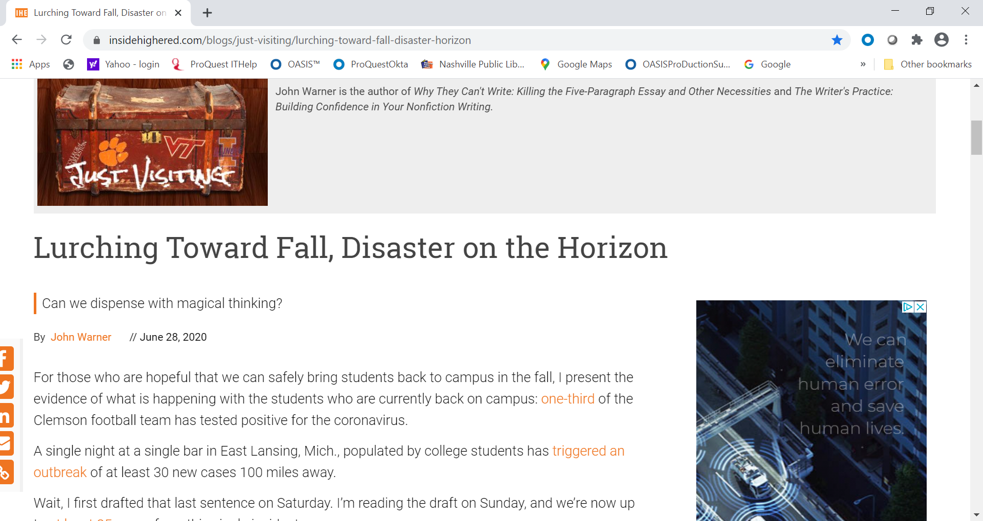
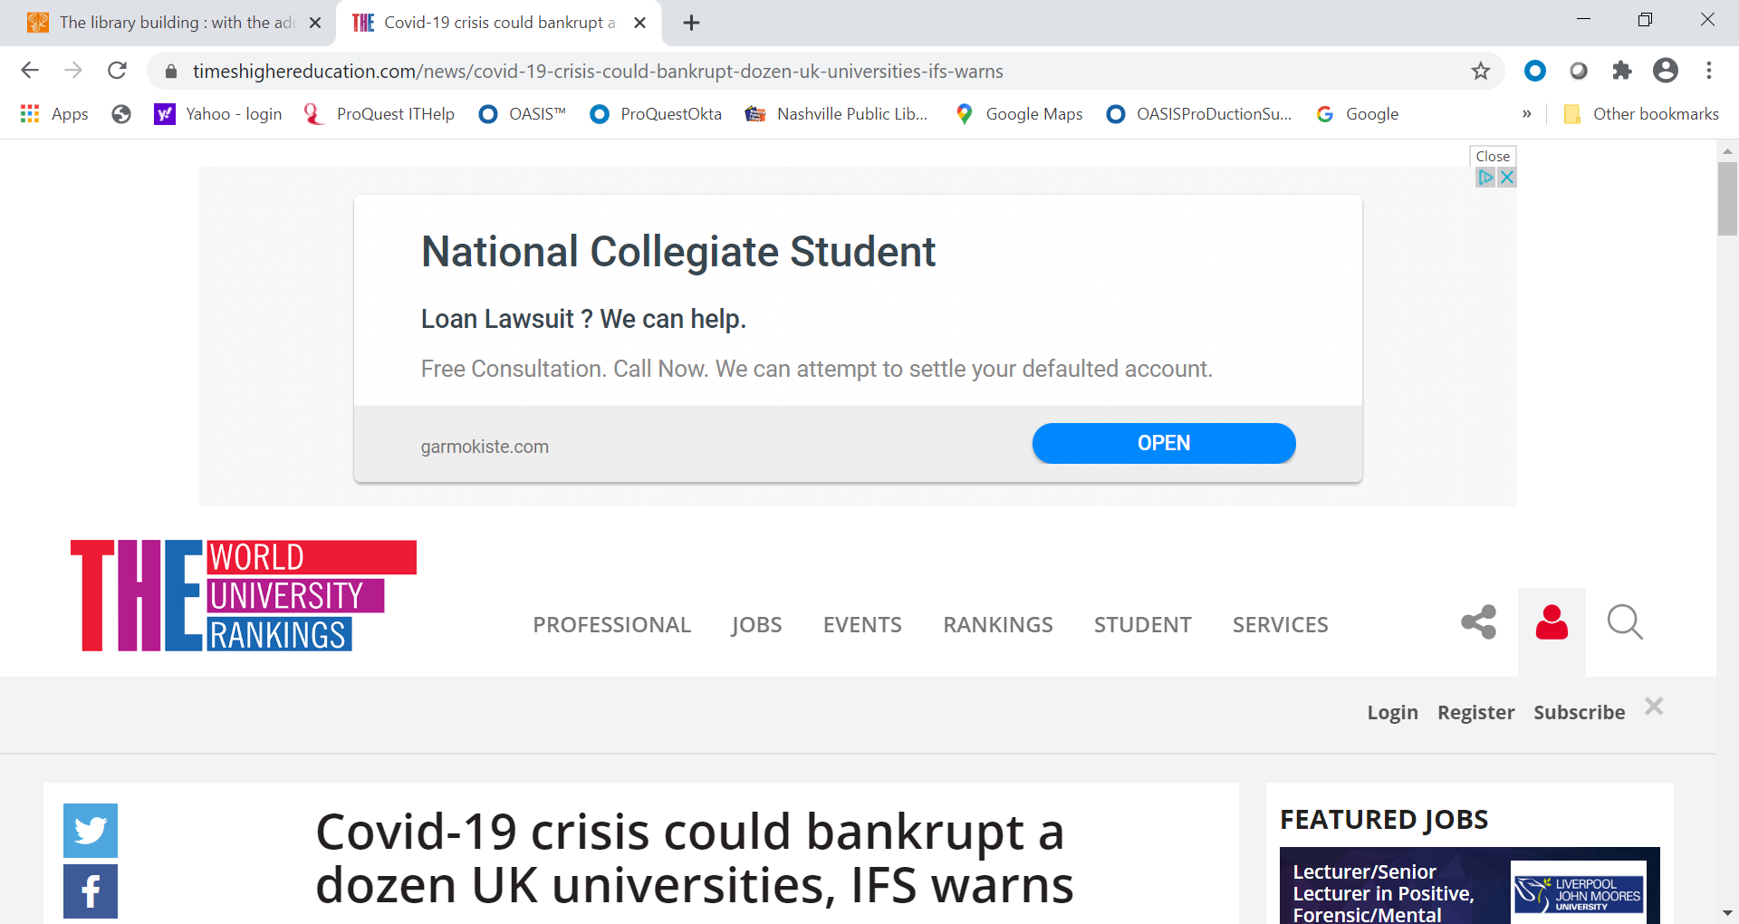
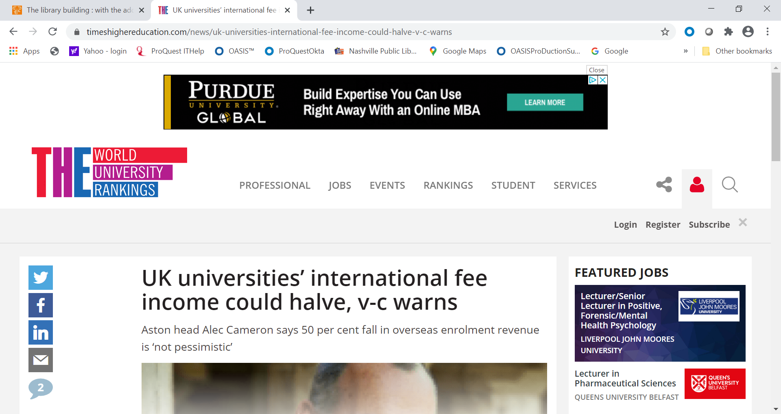
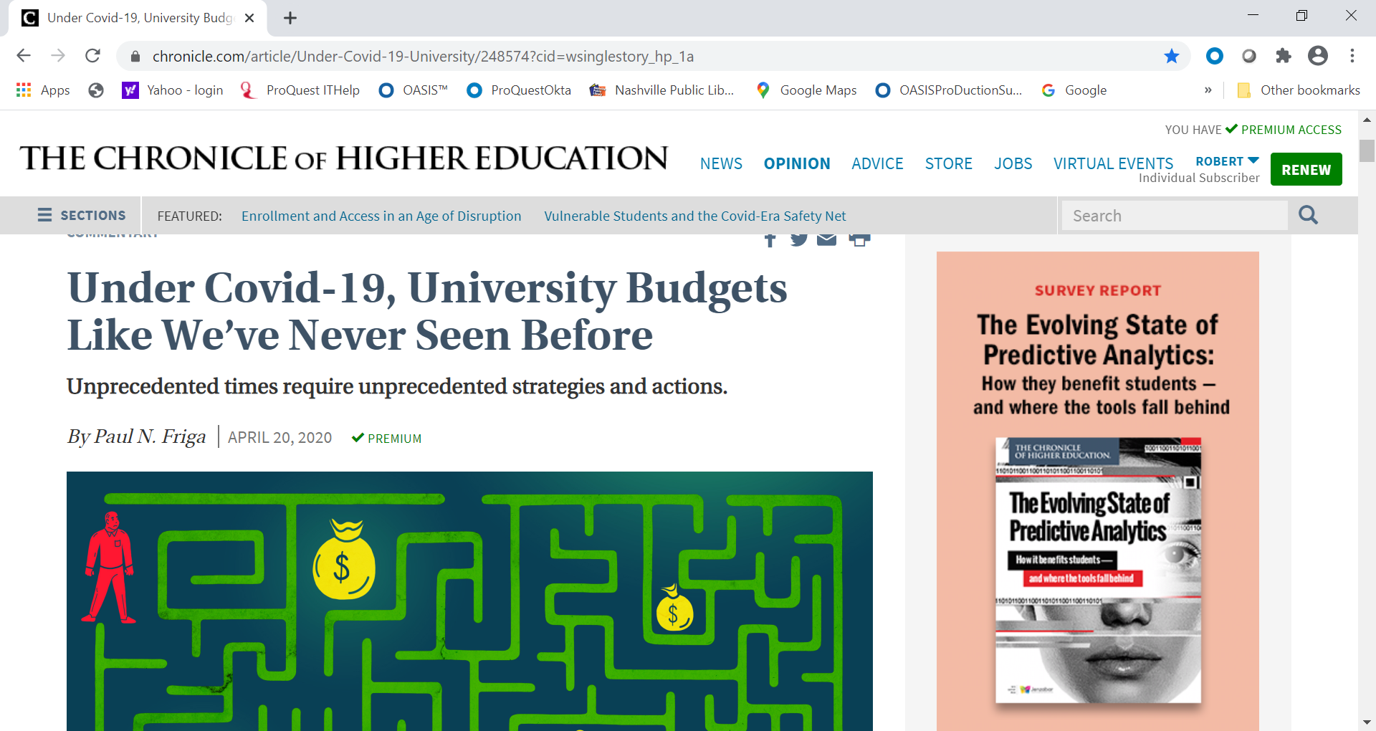
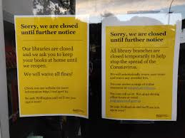
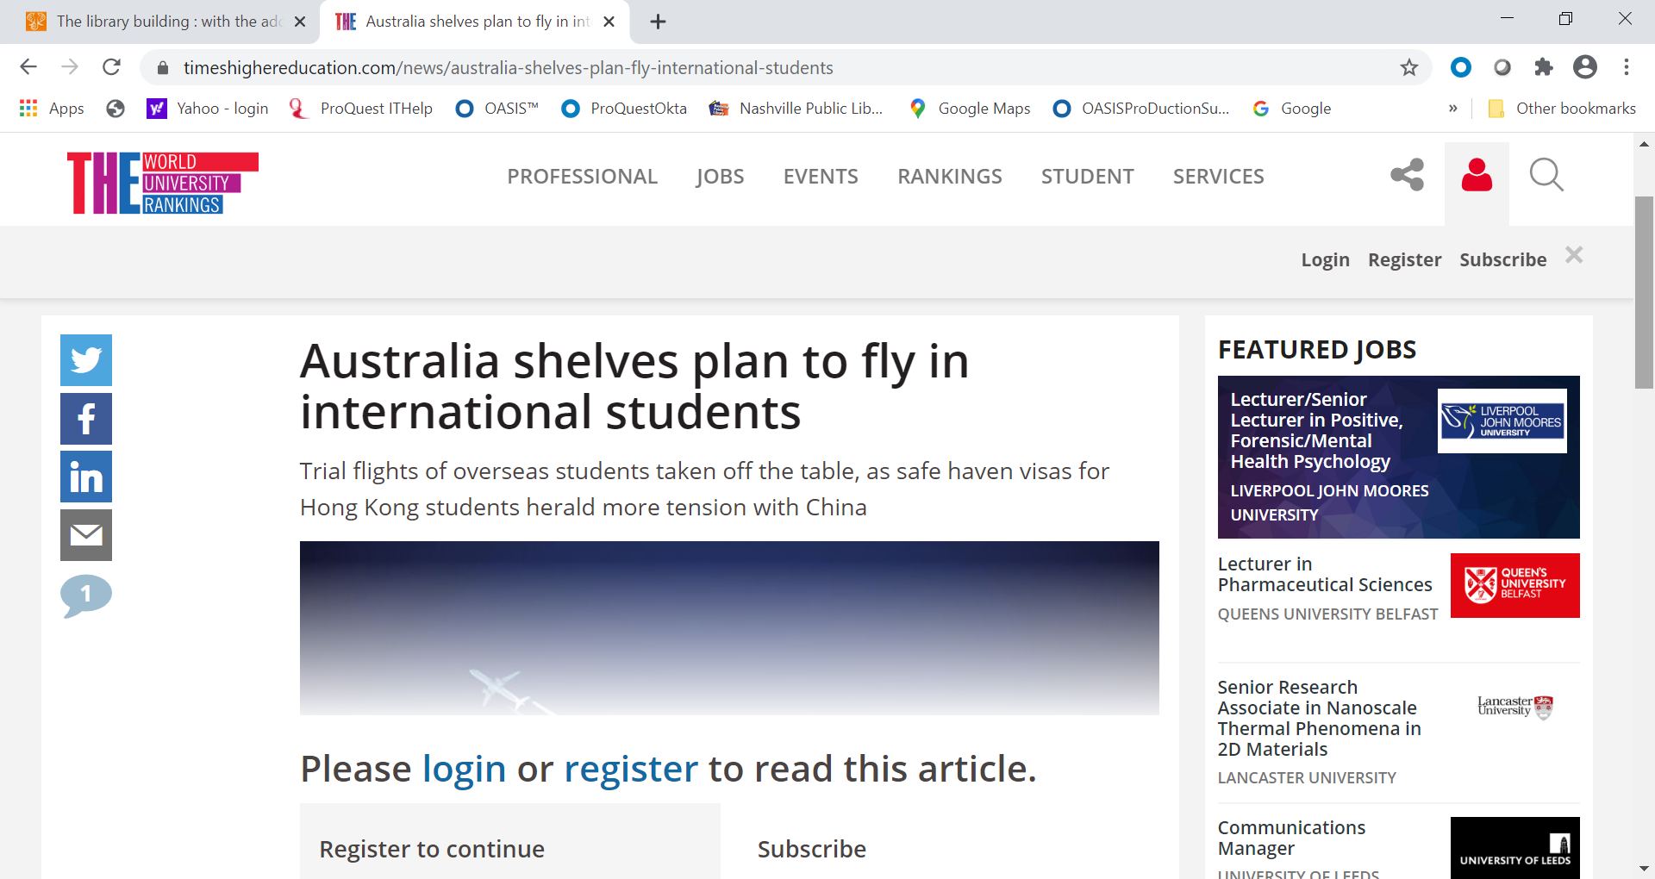
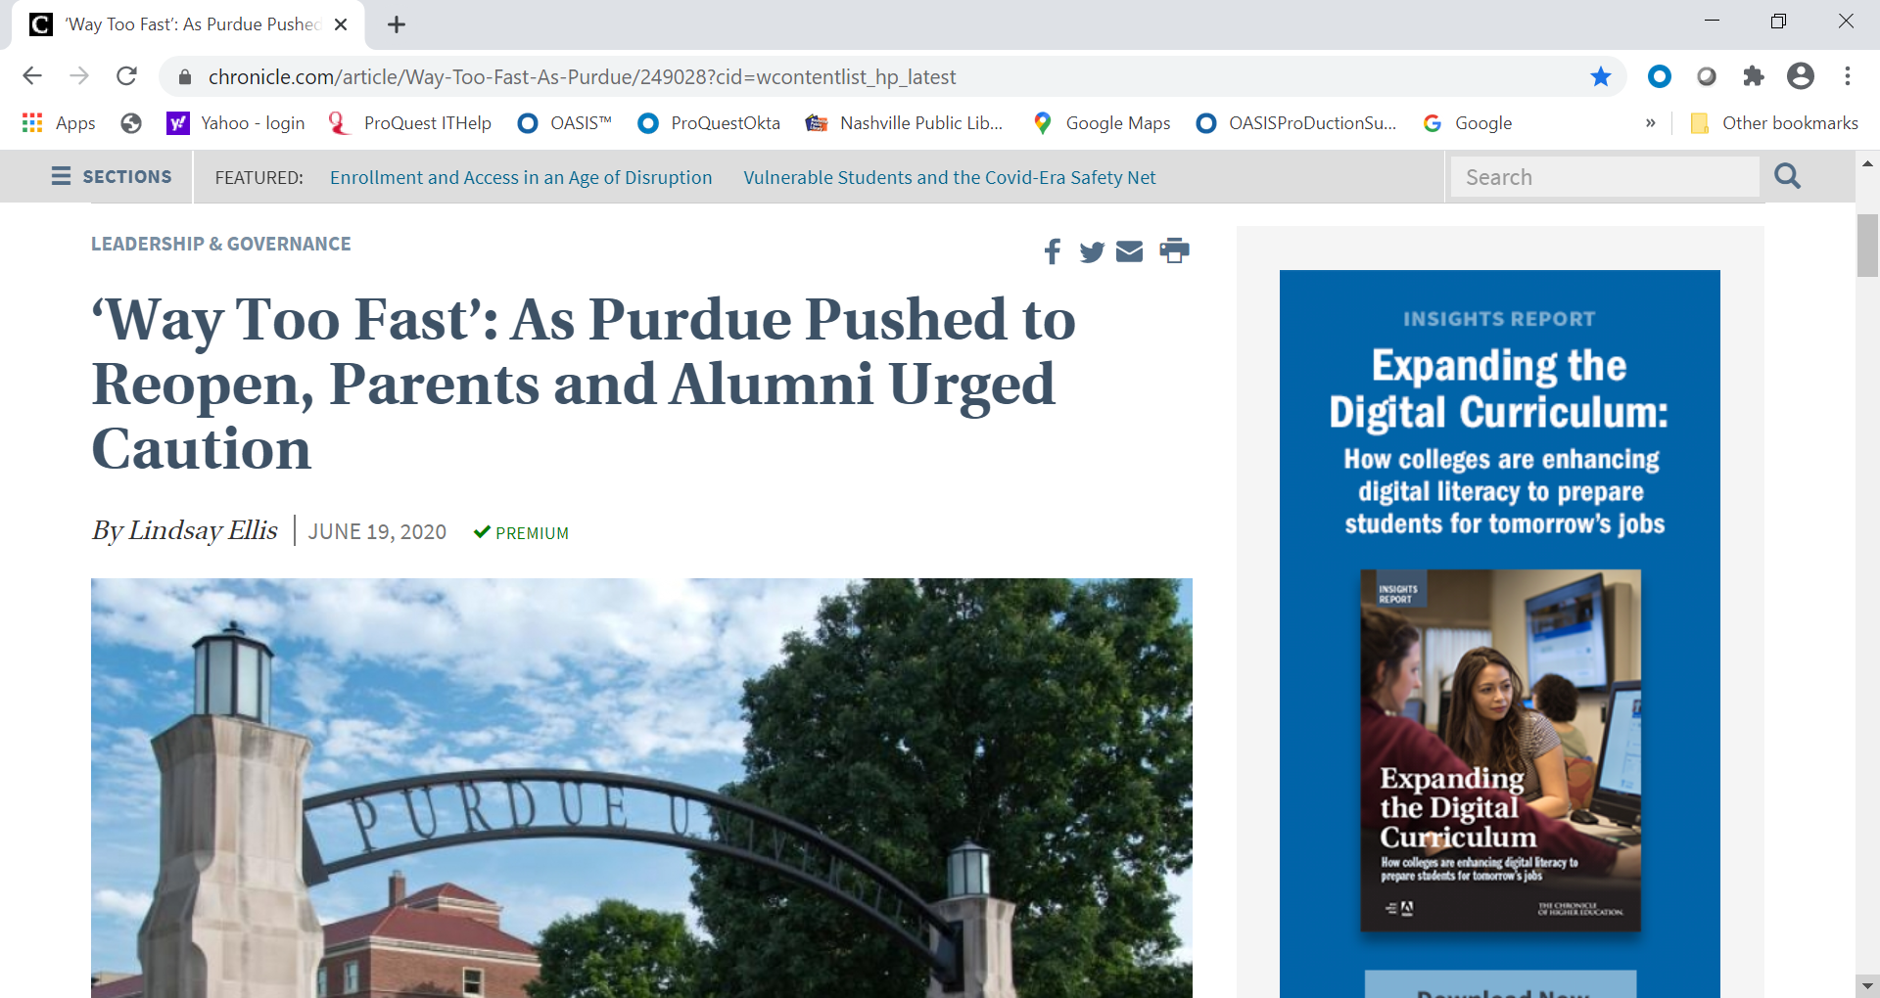
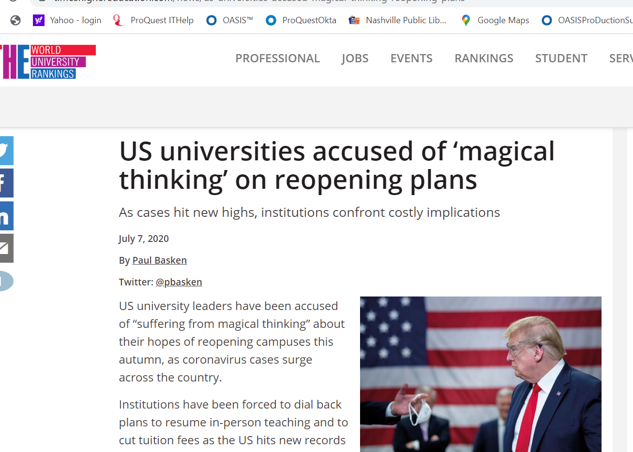
The Context for Our Conversation
Notes:
Here are some headlines from the higher ed trade press. They are not encouraging. Budgets will be under tremendous pressure, as the headline at bottom left points out. One question around the world, among many others, is over international students. If anything is certain, it’s that dealing with all the aspects of COVID-19 will be the predominant issue for libraries when the new year opens.

Slide 4
Topic: Changes in the selection & acquisition workflow
Have there been any changes in your selection and acquisition workflow? Will there be?
Has the library needed to find efficiencies? Where?

Slide 5
Topic: Changes in selection
In selection, will there be any change in the percent of purchases made because of a user request, vs. a purchase initiated by a selector?
What other ways has selection changed at your institution?

Slide 6
Topic: Changes in textbook policies
Has there been a change in the library’s attitude or policy toward acquiring textbooks or other books specifically meant for classroom use?
Has the library become more or less involved with faculty in textbook choices?

Slide 7
Topic: Changes in acquisition
Have there been changes in the methods used to acquire books: approval (scheduled purchase), firm order, DDA, EBA, STL, packages, subscriptions, special projects?
Was your library headed in this direction before COVID-19 hit?
What changes will remain when the library returns to normal operations?

Slide 8
Topic: Changes in ebook license preference
Have there been any change in ebook license preference?
What are those preferences?
Are these preferences temporary?

Slide 9
Topic: Changes in workplace
How did your teams adapt to work from home?
Did the work need to adapt the work or mostly the workers needed to reorient themselves?
What are the plans for the future?
What are the benefits and challenges?

