Slide 1
Rialto at Southern Methodist University
Heather Barrett
Head of Acquisitions
Fondren Library

Slide 2
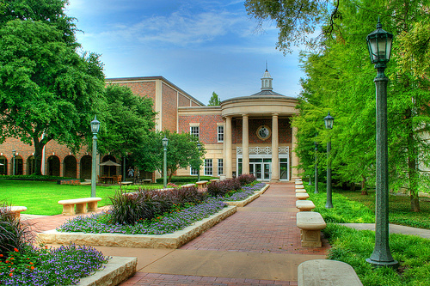
Background
Fondren Library, Southern Methodist University
  Main library for Southern Methodist University, a private university with FTE of approximately 10,000
  Centralized collections and technical services for several SMU libraries
  Collects across a wide array of subject areas

Slide 3
Background
Book acquisitions prior to Alma and Rialto
  LMS: Voyager
  Chief book vendor: GOBI
  Chief e-book provider: ProQuest Ebook Central (ordered via GOBI)
  Byzantine book budgets and fund structure

Slide 4
Background
Alma and Rialto
  December 2017: Went live with Alma
  August 2018: Invited to serve as development partner for “Next Generation Selection” (later named Rialto)
  January 2020: First library in the world to go live with Rialto
  New opportunities for acquisitions

Slide 5
Acquisitions & Rialto in 2020
GOBI is still chief vendor for print books, both firm orders and approvals, as well as e-book DDA
Rialto is now chief vendor for e-book firm orders (and occasional print orders)

Slide 6

Acquisitions & Rialto in 2020
Coronapocalypse!
Panels 1-2 from “On Fire” by KC Green - http://gunshowcomic.com/648

Slide 7
Acquisitions & Rialto in 2020

Slide 8
What’s next
Implementing recommendation feeds and scheduled purchases
Exploring Rialto Analytics

Slide 9
Thank you!
Heather Barrett
hbarrett@smu.edu
Q & A coming soon!

