Slide 1

Creating a Floating Collection in Alma
Ryan Buller- Access Services Librarian

Slide 2
Agenda
Setting the stage
Thinking through workflows
Decision making process
Deciding on workflows
Identifying the appropriate materials
Setting up in Alma
Problems encountered along the way
Considerations (what I would do/think about differently)

Slide 3
Setting the stage
The old system
Request from Library Administration
Identification of stakeholders

Slide 4
Thinking through Workflows
What questions did we need to ask ourselves regarding Alma configuration?
What questions did we need to ask ourselves regarding workflows?

Slide 5
Decision making process
How to set up in Alma
Need for room in stacks at Main Library
Identifying items to include in floating collection

Slide 6
Deciding on workflows
Set-up in Alma is important in determining workflows
Who would process change in item location?
How would items move through workflows in different departments?

Slide 7
Identifying the appropriate items in Alma
Used Alma Analytics
Difficult to structure query to cover so many different aspects
Decided to do a number of queries, each with only one component
  Made it easy to verify that the queries were pulling the correct items
Used a final query to bring together all of the different components to have a final list

Slide 8
Setting up in Alma
Updating item records to include the temporary location
Did not need to change any configuration
Needed to ensure that materials did not go in transit during the process

Slide 9
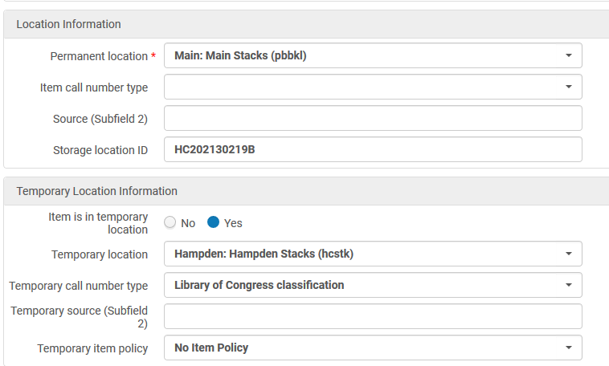
Example item record

Slide 10
Problems encountered
Items already in a temporary location
Double checking items after the job to put them in the temporary location
Ensuring new workflows are communicated to units outside of Department

Slide 11
Considerations (what I would do/think about differently)
Different ways in Alma to accomplish the same objective
Think through and identify potential roadblocks before thinking about potential ways to accomplish your objective
Was the desire to have as little change to Alma the right way to approach this?

Slide 12
Questions
Ryan.Buller@du.edu

