Slide 1
Establishing Withdrawal/Reinstatement Workflows Using Work Orders, Alma Analytics and More!
Carol Ou
Head, Discovery Services
University of Nevada Las Vegas
ELUNA Learns
September 3, 2020

Slide 2
Overview
Withdrawals (and certain relocations)
  Designing work orders to support
  Workflow in action
  How records look in Primo
  Issues and workarounds
Reinstatements
  Designing Alma Analytics report to support
  Workflow in action
  Issues and workarounds
Notes:
Abstract: UNLV University Libraries rebuilt our physical item withdrawal and reinstatement processes in 2018 to better use available Alma functionality. This presentation will describe how we use work orders, sets, jobs and Alma Analytics to manage withdrawal projects, and how we use Alma Analytics and the deleted repository to handle item reinstatements. Specific workflow decisions and configuration settings will be shared, as well as hiccups and lessons learned along the way! Some details of our processes may appear specific to our institution, but the intention is to present our processes in a way that allows other institutions to determine how they might develop similar workflows that are specific to their own institutions. Prior knowledge of work orders, Alma Analytics and the deleted repository will be helpful but not required.

Slide 3
Context
University of Nevada, Las Vegas
  Enrollment of 29k students.
  1 main library and 4 satellite/branch libraries
    Centralized cataloging and physical processing located in main library
  Migrated to Ex Libris Alma/Primo in December 2017.
    Most of the processes described in this presentation were built in 2018.
Notes:
Centralized cataloging and physical processing -- context for some workflow decisions.
Processes originally built in 2018, minor tweaks since then.

Slide 4
Withdrawals (and certain relocations)
Scenario:
  Provided with a spreadsheet of physical items that need to be withdrawn or relocated.
Preferences:
  Wanted to switch to mostly batch processes for withdrawal/relocation projects.
  Wanted items to look “off the shelf” while they are being processed for withdrawal or relocation.
Solution:
  Work orders!
Notes:
Understood work orders to be a way to route physical materials for internal processing and thought they might work here.

Slide 5
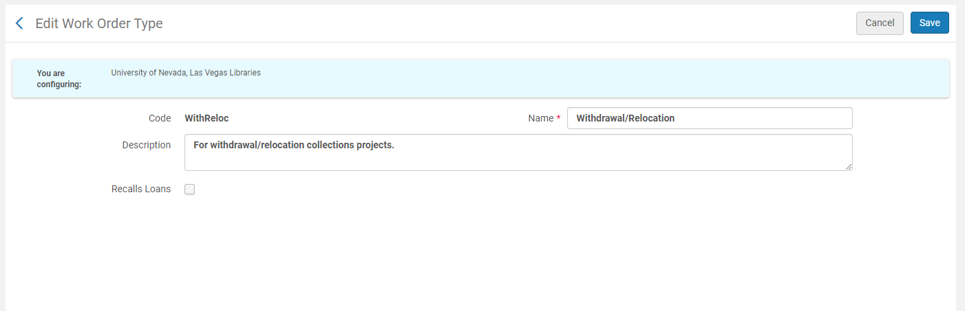
Work order configuration – work order type
Notes:
Set to not recall loans.

Slide 6
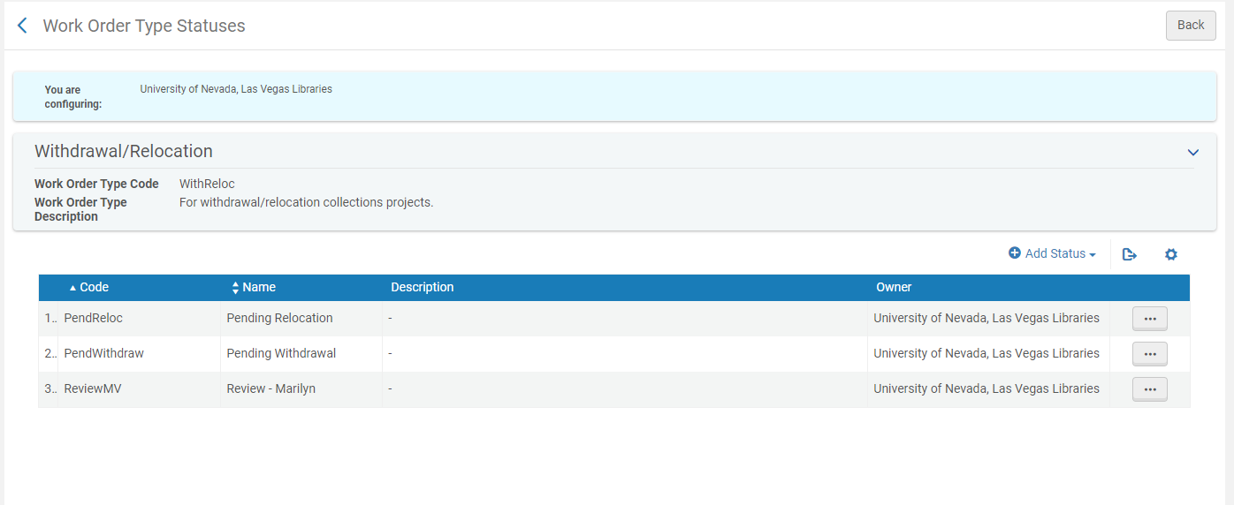
Work order configuration – work order type statuses

Slide 7
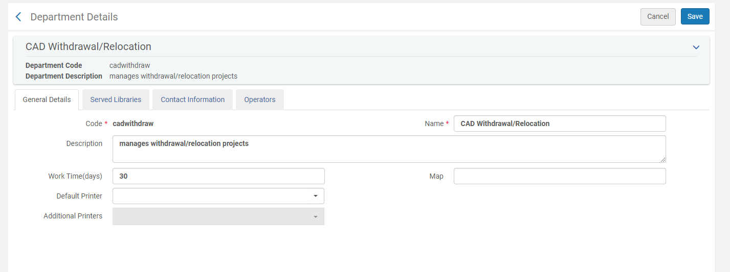
Work order configuration – work order department
Notes:
30 days in arbitrary, is what is used to calculate the date that appears in Primo and on the “Manage In Process Items” list. Nothing happens automatically when time is up.

Slide 8
UNLV-specific decisions
We withdraw items by deleting items and holdings. Bibs with no other holdings are retained but suppressed.
The majority of withdrawn items need to be counted for statistical purposes. To support stats collection, they get a standard note in the Internal Note 2.
  Example: WITHDRAWN ON 20181116 (Reference weeding project 2018/19)
  This note is similar to one we used in our previous system.
We chose the Internal Note 2 because it was the easiest note field for us to clear and reserve for this purpose after migration. Other institutions may use a different note field or not need to record this information at all.

Slide 9
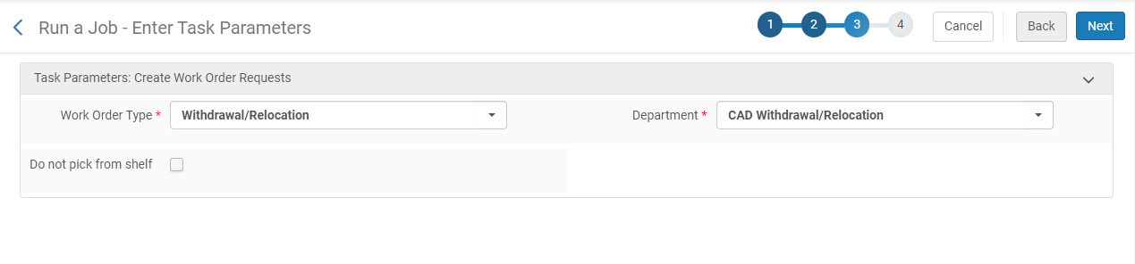
Workflow in action: placing requests
Spreadsheet includes barcodes. Use barcodes to create set of physical items.
  For larger projects, will split into smaller sets (e.g. 200 items per set.)
Review set to remove any items with a Missing process type.
Run “Create physical item work orders” job on set.
  Requests will be queued for any items on loan. Set not to recall.
Notes:
Don’t check “Do not pick from shelf” because we do want the items picked and placed in transit to our department.

Slide 10
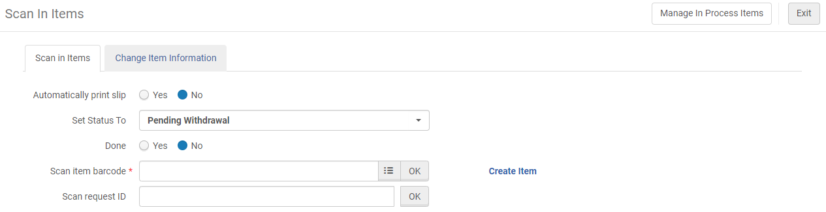
Workflow in action: scanning received items
Scan the items into the work order with the correct status when they arrive.
Complete any additional cataloging to support relocation, etc.
Export list of items “in process” to create set of item records to actually modify.
  Use button on “Manage In Process Items” screen, not job.
  Will not necessarily be identical to the list in Step #1!

Slide 11
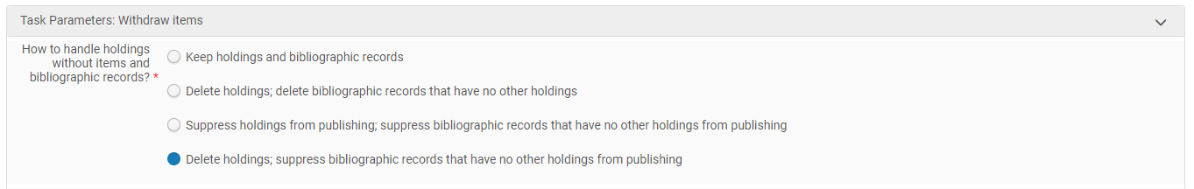
Workflow in action: batch updating items
Use spreadsheet exported in step #6 to create set of physical items to modify.
Create titles set based off of physical items set created in set #7.
Run jobs to supporting withdrawing or relocating items as appropriate.
  For withdrawals at UNLV that need to be counted, run “Change physical items job” to add standard Internal Note 2. Then run “Withdraw items” job, setting holdings to delete and suppressing bibliographic records with no other holdings.

Slide 12
Workflow in action: batch updating items (cont’d)
  For relocations, run “Change physical items job” to change Permanent Location.
  At UNLV, use titles set (created in step #8) and normalization rules to add standard notes to the bibs of items that are withdrawn or relocated.
Route physical items.
  For relocations, scan “Done” out of work order and route to new home.
  For withdrawals, route for physical disposition.
Review original set for outstanding items.
  Resolve Missing items (may directly withdraw or add notes to items for if they turn up.)
  Items that were checked out may continue to trickle in.

Slide 13
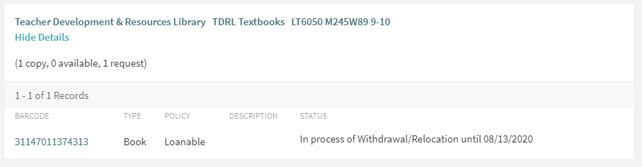
How records look in Primo

Slide 14
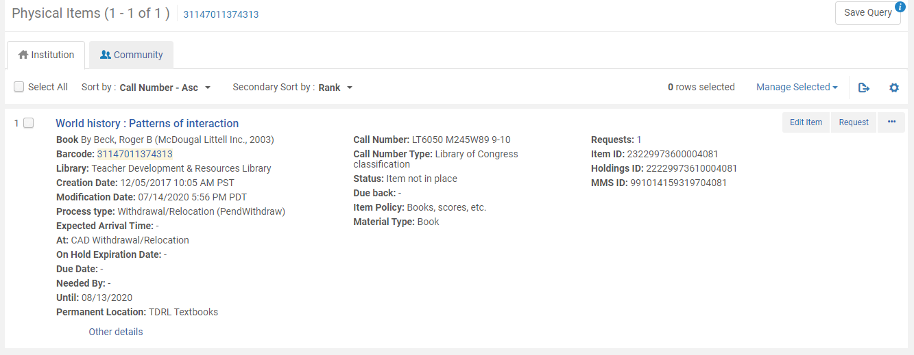
How records look in Alma repository search
Notes:
Can still see that the item is in the Withdrawal/Relocation work order even if don’t have access to the work order.

Slide 15
Additional scenarios
Items that are withdrawn because they are Missing or Lost and Paid
  We do not use the Withdrawal/Relocation work order for these items
    There is no physical item to request or scan!
    Also we want to leave the existing process type in place.
  Otherwise our withdrawal process is largely the same.
Items to be withdrawn that are in the Needs Repair work order
  Withdraw directly out of the Needs Repair work order instead of moving to the Withdrawal/Relocation work order.

Slide 16
Additional scenarios
Items to be withdrawn that are located in main library
  Do not place requests on all items. Instead, send students out with cart and spreadsheet.
  Retrieved items are scanned directly into Withdrawal/Relocation work order.
  Do place work order requests on items that are checked out.
Items to be relocated that do not need additional processing
  These are items that do not need to be routed through our centralized cataloging
  Do place work order requests on items that are checked out.

Slide 17
Issues and workarounds
Create Physical Item Work Orders job does not allow adding a note
  Can include a note when adding a work order manually, but not possible with batch job.
  Would be helpful with items that are returned to the library well after the rest of the project has been completed.
  Current workaround: Add work order manually with note when it is a small number of items. With larger projects, keep copies of spreadsheets to help identify which project the item belongs to. Have also experimented with notes added elsewhere in record via batch job.
Requests that are cancelled because the item is missing
  For work order requests, do not get an email notification.
  Current workaround: Sweep up any missing items at the end of the project. Use the original project spreadsheet to help identify these items.

Slide 18
Issues and workarounds
Items sent not the same as items requested
  Can scan any item into the work order; no alert if the item was not actually requested.
  Previous workaround: export “in process” items and compare against original spreadsheet using Excel functions.
  Emphasized the importance of only sending items that were requested. Reminder that Alma will not print a transit slip if item not requested. No longer encounter this issue.
Running the Create Physical Item Work Orders job requires the Fulfillment Administrator role
  An odd role to have to grant Cataloging staff.
  Submitted a support case to see if specific permission could be added to a role such as Cataloger Extended instead. Told not possible.
  Current workaround: Most of our withdrawal/relocation workflow has been delegated to other staff, but I still run the Create Physical Item Work Orders job.

Slide 19
Despite issues…
Items look correctly “off the shelf” in Alma and Primo.
Process is quicker and requires less manual editing.
Still able to do necessary reporting.

Slide 20
Reinstatements
Scenario:
  A physical item is found that does not have a record in Alma.
Preference:
  When reinstating, restore previously deleted item record if possible.
Problem:
  Deleted Repository does not allow searching by barcode.
Solution:
  A small Alma Analytics report.
Notes:
Cannot search for deleted items in a repository search, but can via an Analytics report!

Slide 21
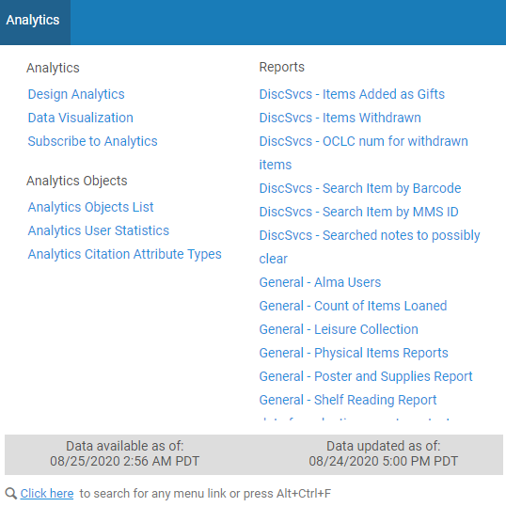
Alma Analytics report
– Search Item by Barcode
Prompts for barcode.
Returns physical item information that matches the barcode.
Configured as an Analytics Object so can access from the Analytics menu in Alma.

Slide 22
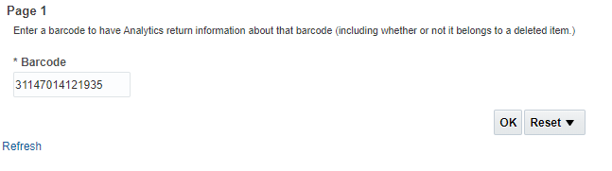
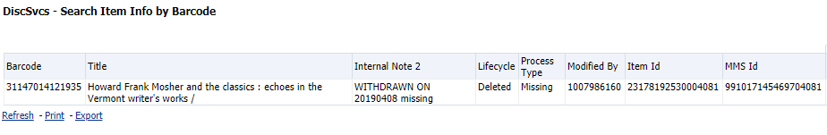
Workflow in action: analytics report
Report prompt:
Result:
Notes:
Generally speaking, we will reinstate items that were only withdrawn because they were missing.

Slide 23
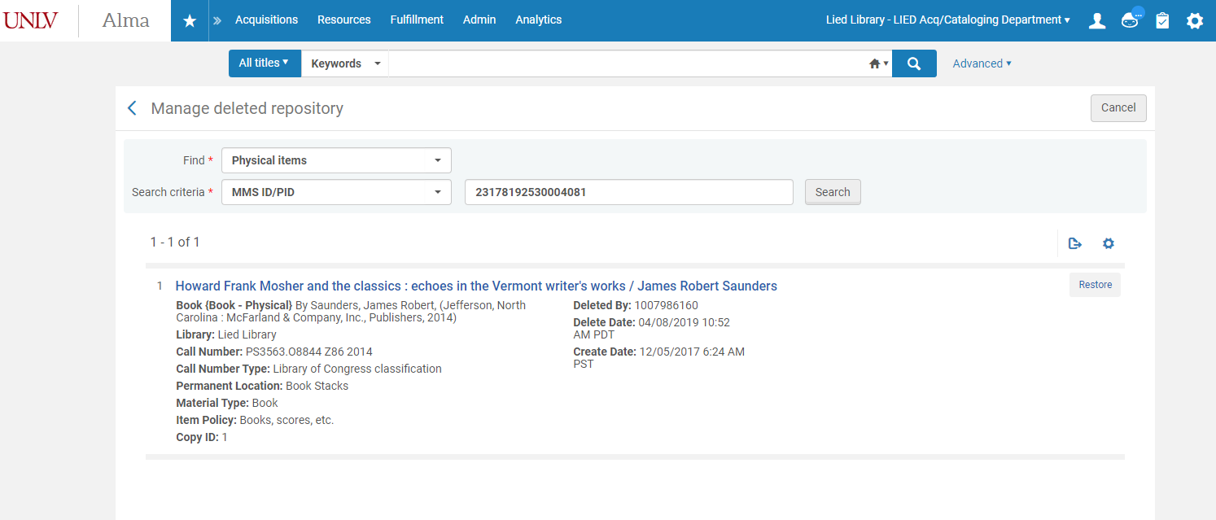
Workflow in action: use Item ID to search Deleted Repository

Slide 24
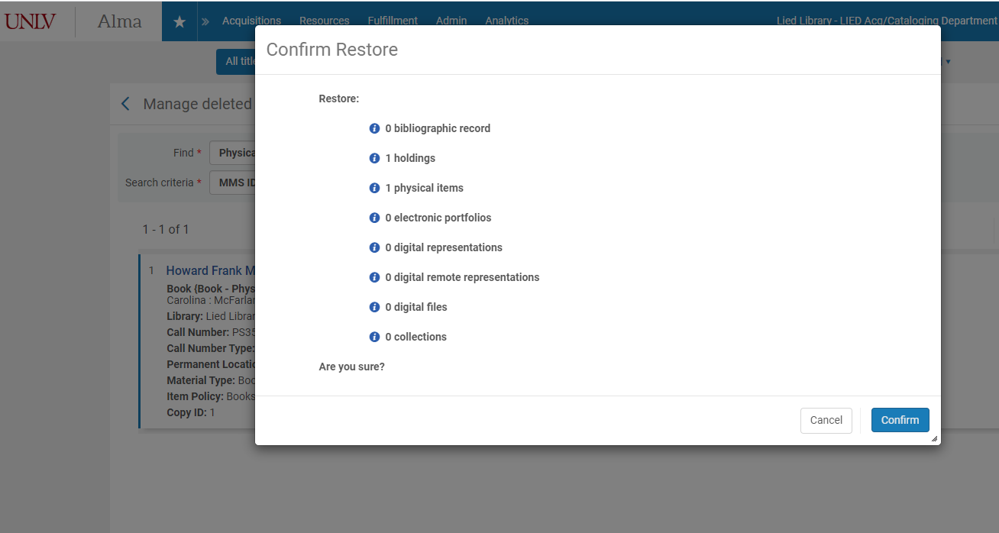
Workflow in action: restore item

Slide 25
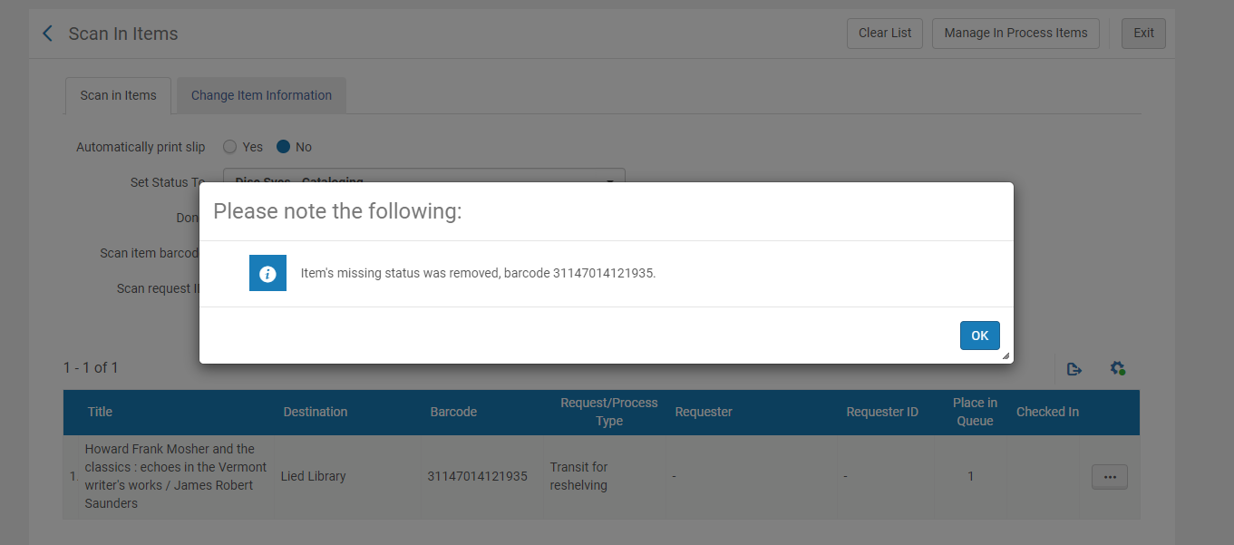
Workflow in action: additional edits
Clear withdrawal notes, add reinstate note, unsuppress bib if necessary.
Scan “Done” out of department to clear “Missing” process type and put in transit.
Notes:
In a way “Done” doesn’t do anything because it was never in the work order to begin with, but it’s a quick way to clear missing and make the item look in transit.

Slide 26
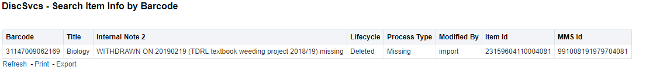
Issues and Solutions
Do not always want to reinstate. Need to know why item was withdrawn.
  Addressed this by adding Internal Note 2 to Analytics report.
  Internal Note 2 is where we add information about why the item was withdrawn.
  Example of an item that was intentionally withdrawn that we would not reinstate:

Slide 27
Issues and Solutions
Restored item record has original item creation date.
  Might skew statistics: Withdrawals reported annually, but this reinstatement will look like it was added in its original year and not re-added this year.
  Addressed via a note added to the Internal Note 1 (e.g. “Reinstated 2019/20”) and a specific report that looks for this note. The same style note we used in our previous system.
Item barcode illegible.
  Added a variant of the Analytics report that searches by MMS ID instead. Returns all deleted and in repository items associated with a bibliographic record. Look for possible matching item to reinstate and re-barcode.
Item deleted prior to Alma migration.
  Item does not exist in Analytics or the Deleted Repository.
  Reinstate by creating a new item record.

Slide 28
Lessons Learned
New workflows do not need to completely reinvent the process.
  Continued to use the same format withdrawal notes we used in the past. No compelling reason to use different notes.
General advice might not work in your circumstance.
  Had received advice to try to add statuses to existing work orders instead of creating new work order types. But for us, helpful to be able to tell the difference between items routed for “Acquisitions technical services” vs. “Needs repair” vs. “Withdrawal/relocation”.
New workflows do not need to address all exceptions
  Withdrawal/relocation work order still helpful to have, even if some withdrawals and relocations are conducted outside of this process.

Slide 29
Questions?

