Slide 1
Grima Meets COVID-19:
Staff Collaboration in Unexpected Times
Dajin Sun
Director of Metadata Services, Jean & Alexander Heard Libraries, Vanderbilt University
Jake Schaub
Music Cataloging Librarian, Wilson Music Library, Jean & Alexander Heard Libraries, Vanderbilt University
eBUG Annual Meeting
Monday, June 14, 2021

Slide 2
Project Overview
The Enumeration Project was launched library-wide in April 2020 to leverage the availability of a new library-wide workforce during the COVID-19 shutdown
Goal: Fix item call number problems in Alma that prevent users from finding individual issues of journals and/or monographic sets in Primo
Over one million records were targeted

Slide 3
Project Overview
Project Staffing
ca. 21 staff from across the system
5 additional catalogers
More staff joined later
Project Workflow
Frontline work with Grima
Problem-solving by catalogers

Slide 4
Background: The Problem
Vanderbilt Libraries migrated to Alma from Sirsi on July 23, 2018
Sirsi and Alma are structured differently
Crosswalking data between the two was affected by data quality and software structure
When encountering unclear or bad data, the Ex Libris migration algorithm often autogenerated new holdings records

Slide 5


Background: The Problem
Resultant problems:
Requisite volume-level data was not in the correct place in a given record, so:
  The public had difficulty identifying what we hold and how to request it if from off-site
  Alma would consider a 12-volume set as 12 copies of the same volume
“Pilfered” call numbers from individual volumes (e.g., DA176 .S72 v.6) sometimes applied to all volumes within a set
Items often attached to the wrong holdings records
EMPTY libraries or UNASSIGNED locations if data was ambiguous at migration

Slide 6
Background: The Problem
Resultant problems:
“Franken-records”: multiple holdings records merged into a confusing mess
Labels would not print correctly if there was a volume number
Lots of complaints

Slide 7
What Needs to be Done?
Discovery #1: Data being present in the Item Call Number field was one strong indicator that something had gone awry in migration (ca. 1.1 million items)
Discovery #2: Populating the Item Description field with volume-level information would clarify which volume was which for both the system and the public

Slide 8


Solution #1 (2019)
Solution: Transferring portions of one field to another in the item record.
Trained staff from various divisional libraries to address this issue on a case-by-case basis as complaints arose

Slide 9
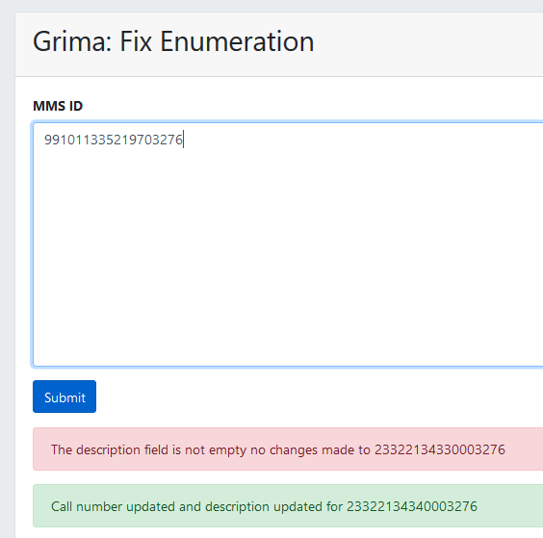
The Grima (partial automated solution)
API tool inspired by other tools used at the University of Kentucky called “Grima”
This one developed at Vanderbilt in coordination between Jake Schaub and Dale Poulter (LTDS)
Takes a bib record MMS ID as input
Compares an Item Call Number data with data in its associated holdings record
Applies an algorithm to transfer item-level data from one field to another for every item attached to a bib record
Operates according to very strict criteria to prevent collateral damage

Slide 10
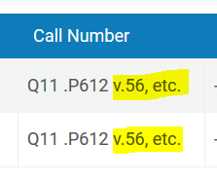
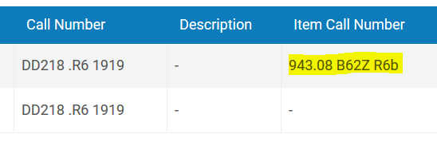
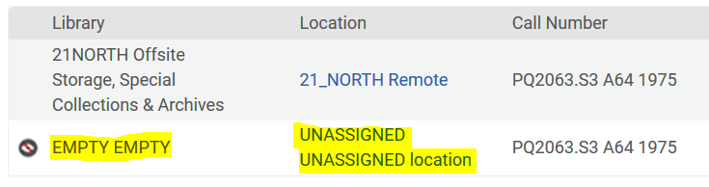
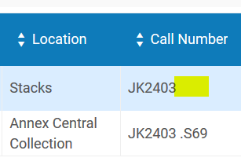
Why not a fully automated solution?
Too many unusual situations that require human eyes to untangle first
By a rough estimate, only ca. 50% of eligible records might be able to be “Grima’ed” without further changes.
Examples of problems the Grima cannot solve on its own.

Slide 11
User roles in Alma are restricted for many staff, so they can only apply limited changes to records (usually restricted to item-level changes)
2019 Mar. – “Tier 1” training (pre-Grima)
  Trained ca. 30 staff to do simple hand transfer of enumerations data on an as-needed basis, and when to hand problems up to cataloging
Who could work on this and when?

Slide 12
COVID lockdown – Mar. 2020
  Quickly developed a general plan and training materials
  Trained ca. 21 staff (mostly circulation and technical services staff) to work with the new Grima
    From Annex, Central, Biomedical, Peabody (Education), Science/Engineering, and Management libraries, and from Preservation and Technical Services
  5 main catalogers oversaw final cleanup
    From Music, Divinity, and Biomedical libraries, and the Central Technical Services Cataloging unit
Enter COVID-19

Slide 13
Workflow
  Alma Reports created for eligible records at various libraries and locations (updated daily)
  Managers distribute Excel lists of items to individual staff
  Staff examine record and run the Grima.
    If the Grima resolves all enumeration problems, life is good.
    If the Grima does not work on a record and/or any “red flags” are encountered, staff enter MMS ID with a short explanation in a separate Google spreadsheet organized by divisional library
      Red flags:
        Holdings records with 0 items attached
        Presence of an enumeration in a holdings root call number
        Anything else that looks strange
  Cataloging staff investigate each problem record and resolve any lingering issues
Enter COVID-19

Slide 14
Successes
Between Mar. 2020 and early 2021:
  800,000+ item records corrected
  User access improved
No staff were furloughed

Slide 15
Challenges
Training staff who had no background in anything like this, and may not know when to pass on records to a cataloger.
The Grima cannot handle SuDoc records due to the differences in spacing
Keeping track of workflow and the uniform entering of information in the various spreadsheets
Avoiding duplication of efforts/infringing on “turf”
Problem solving when there was no physical access to the collection

Slide 16
Moving forward
A handful of problematic records need examination of the physical item
Law Library and Special Collections were not involved originally but are joining the project right now

Slide 17
Questions?
dajin.sun@vanderbilt.edu
jake.schaub@vanderbilt.edu

