Slide 1
Vanderbilt’s Pick Up Program
Keegan Osinski
keegan.osinski@vanderbilt.edu

Slide 2
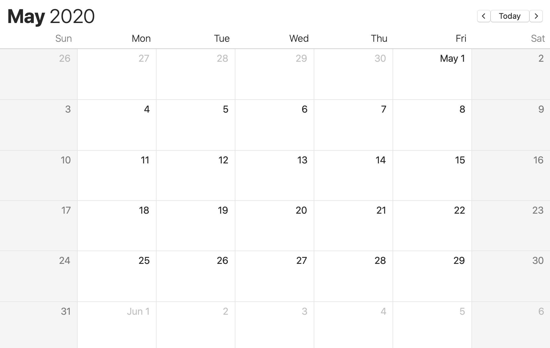

Slide 3
😅

Slide 4
😅
😱

Slide 5
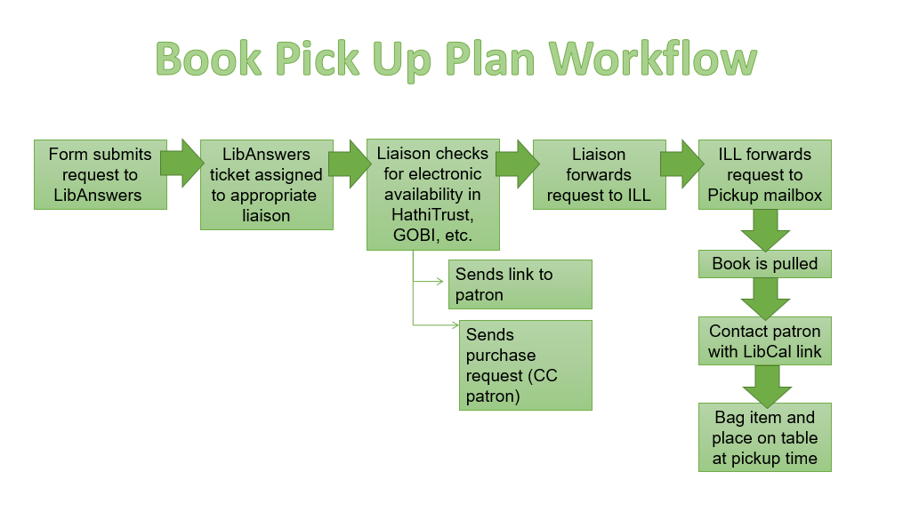

Slide 6
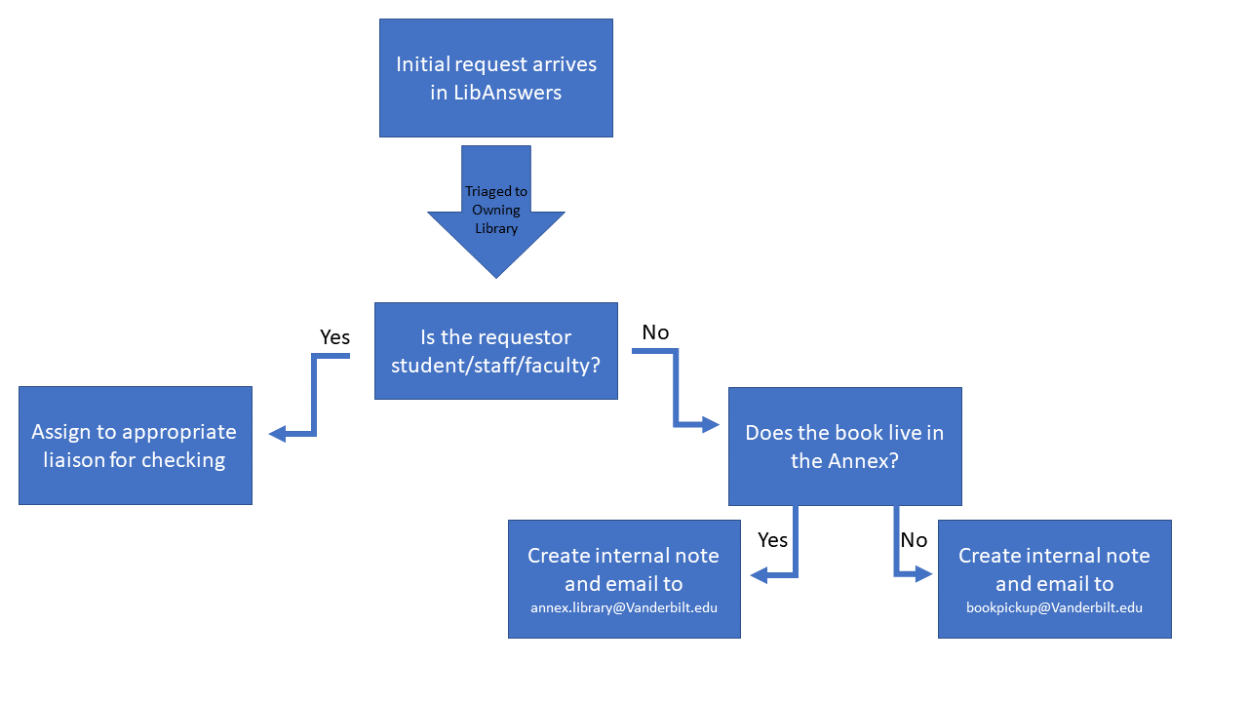

Slide 7
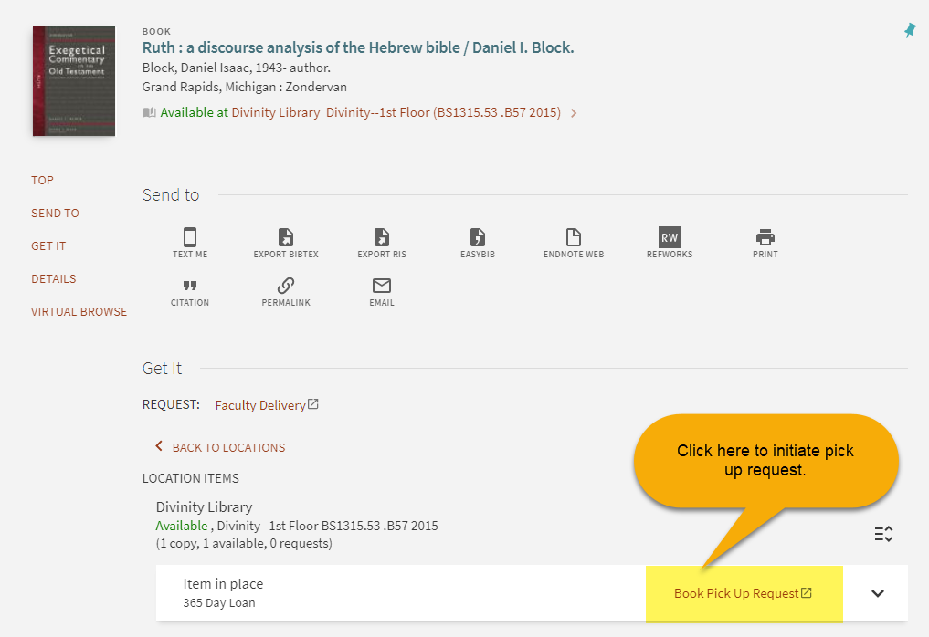

Slide 8
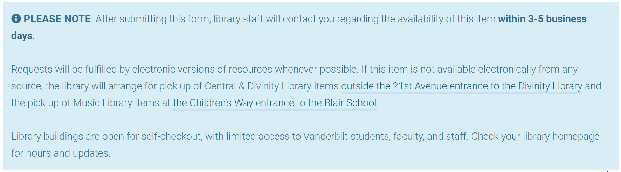

Slide 9
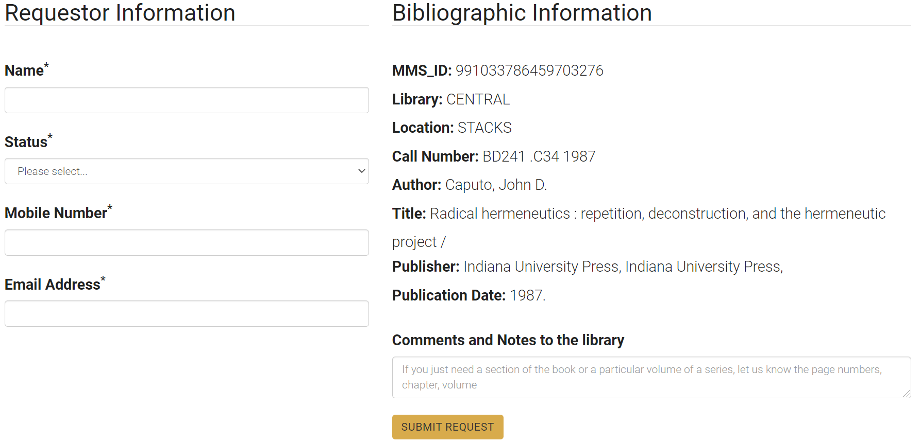

Slide 10
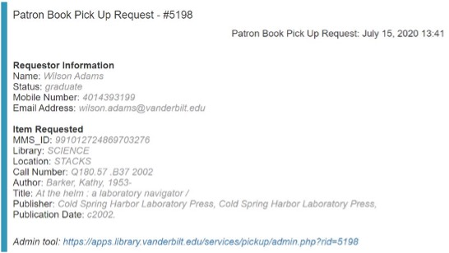

Slide 11
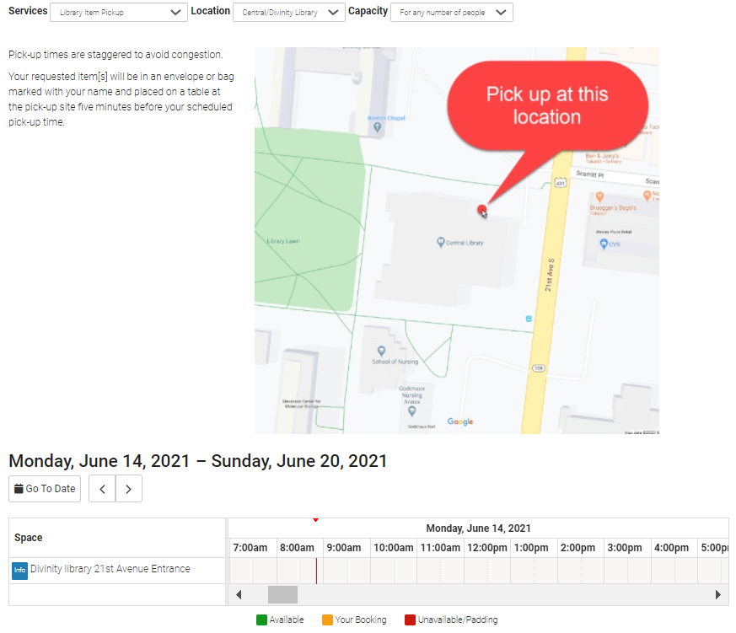

Slide 12
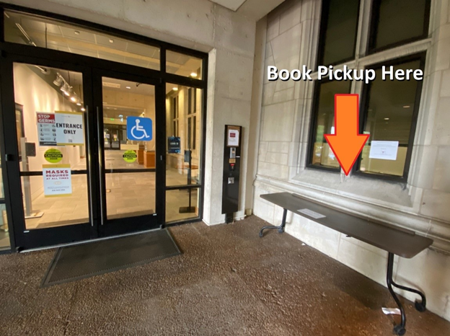

Slide 13


vs.

Slide 14


Slide 15
4321

