Slide 1
Provide an excellent patron experience: 81.1%

Slide 2
Provide an excellent patron experience: 81.1%

Slide 3
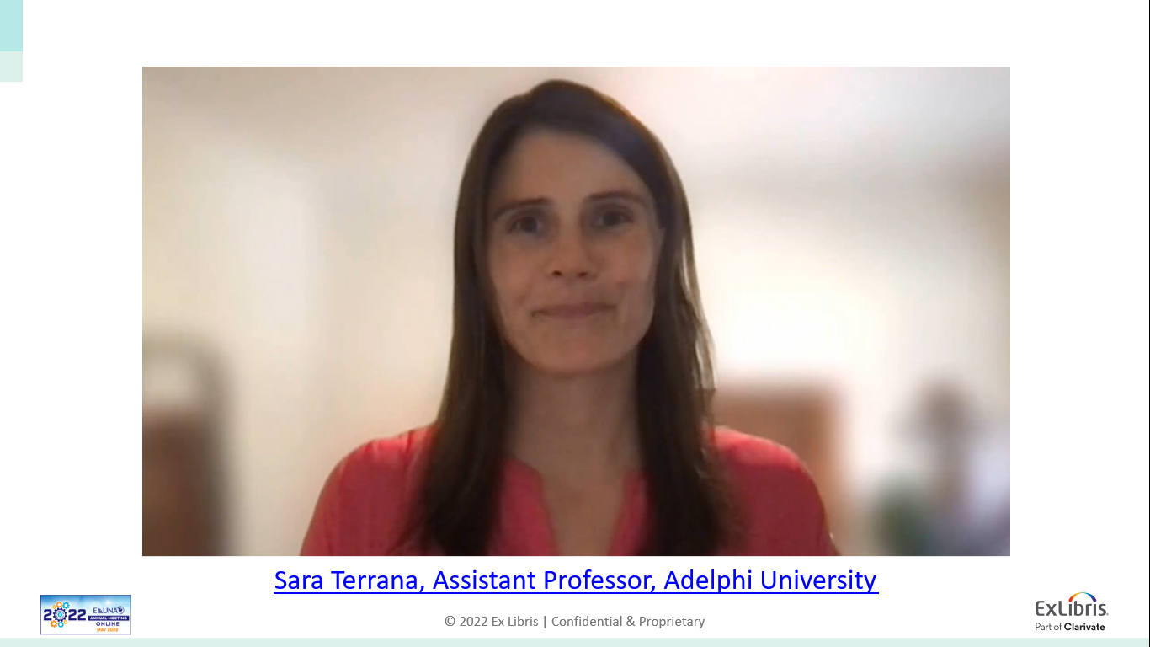

Slide 4
