Slide 1
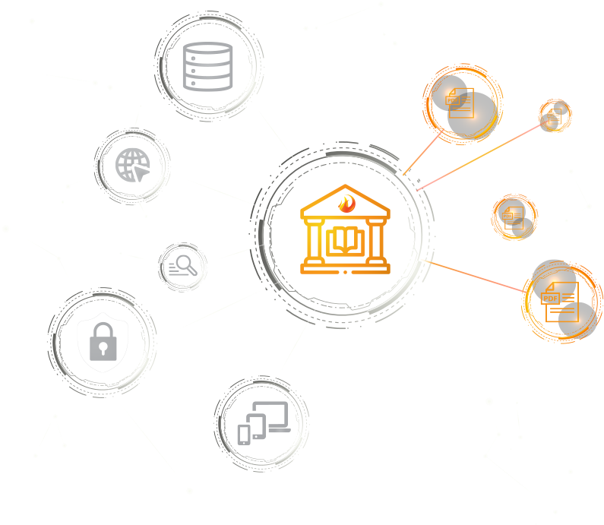
Third Iron:
eBug update!
Kendall Bartsch
CEO | Co-founder
Third Iron, LLC
kendall@thirdiron.com
Notes:
Times are changing

Slide 2






35 countries
1,500+ libraries

Slide 3




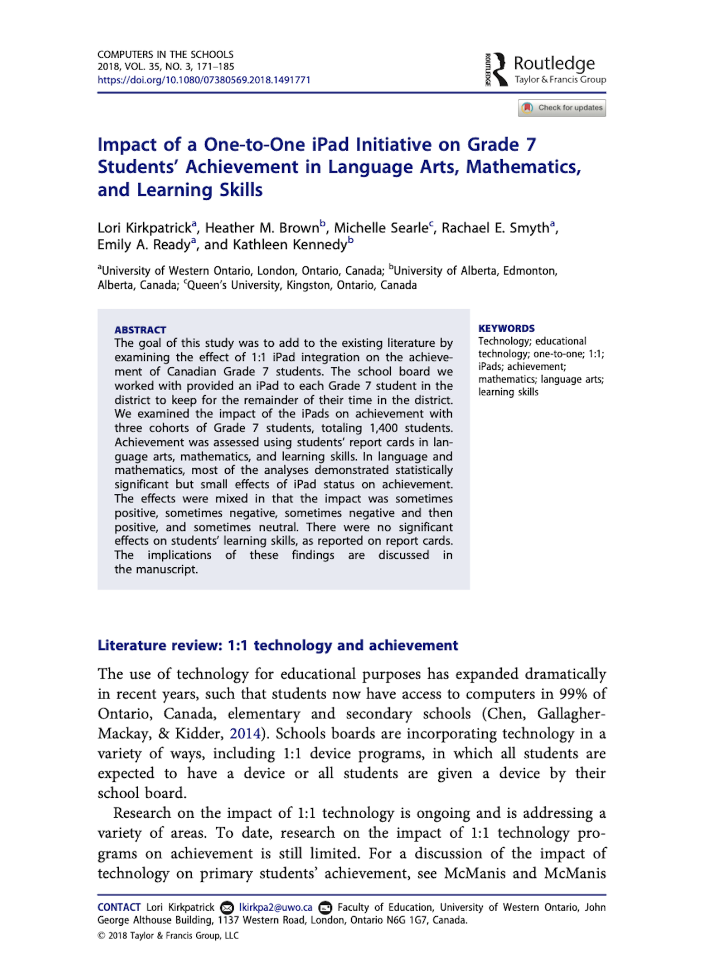








Discovery
services
Databases
LibKey
Full Text
Open Web
Searching
15 Million+ users ha e access to LibKey Services
15,000 articles are signposted per minute on average per day

Slide 4

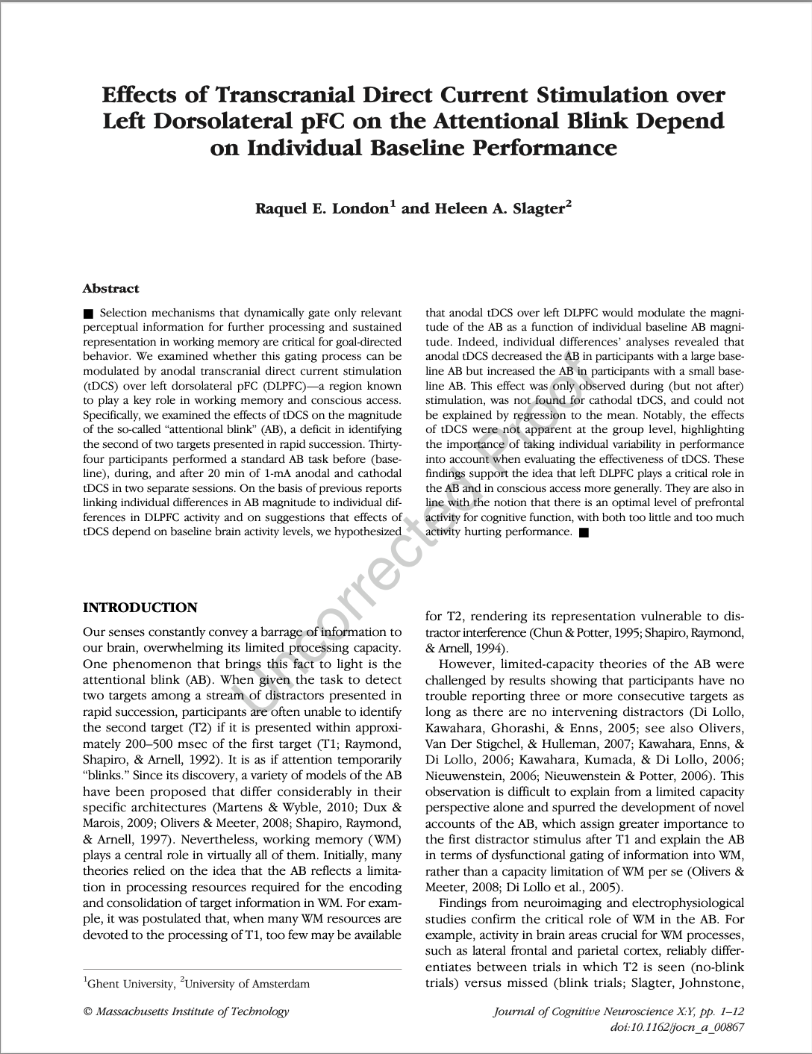






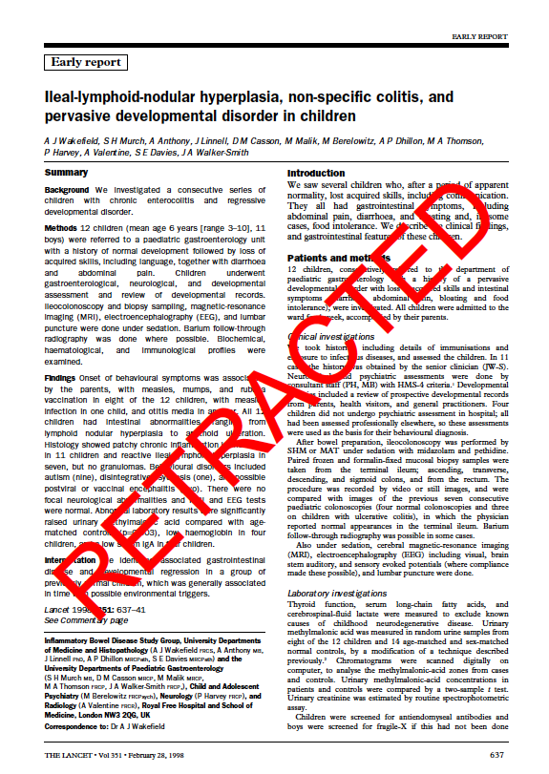

Article intelligence
Multiple Sources
Aggregator Availability
OA Status
Different Versions
Different Formats
Editorial Status
Problematic journals

Slide 5

Expanded editorial status
Use additional data sources to expand retracted article identification, signposting
Use additional data sources to add expression of concern identification, signposting
Cabells customers may integrate data to flag articles from problematic journals
Will be added to all LibKey services, including LibKey Nomad – no action required
Result: fully informing researcher of article editorial status wherever an article is found

Slide 6
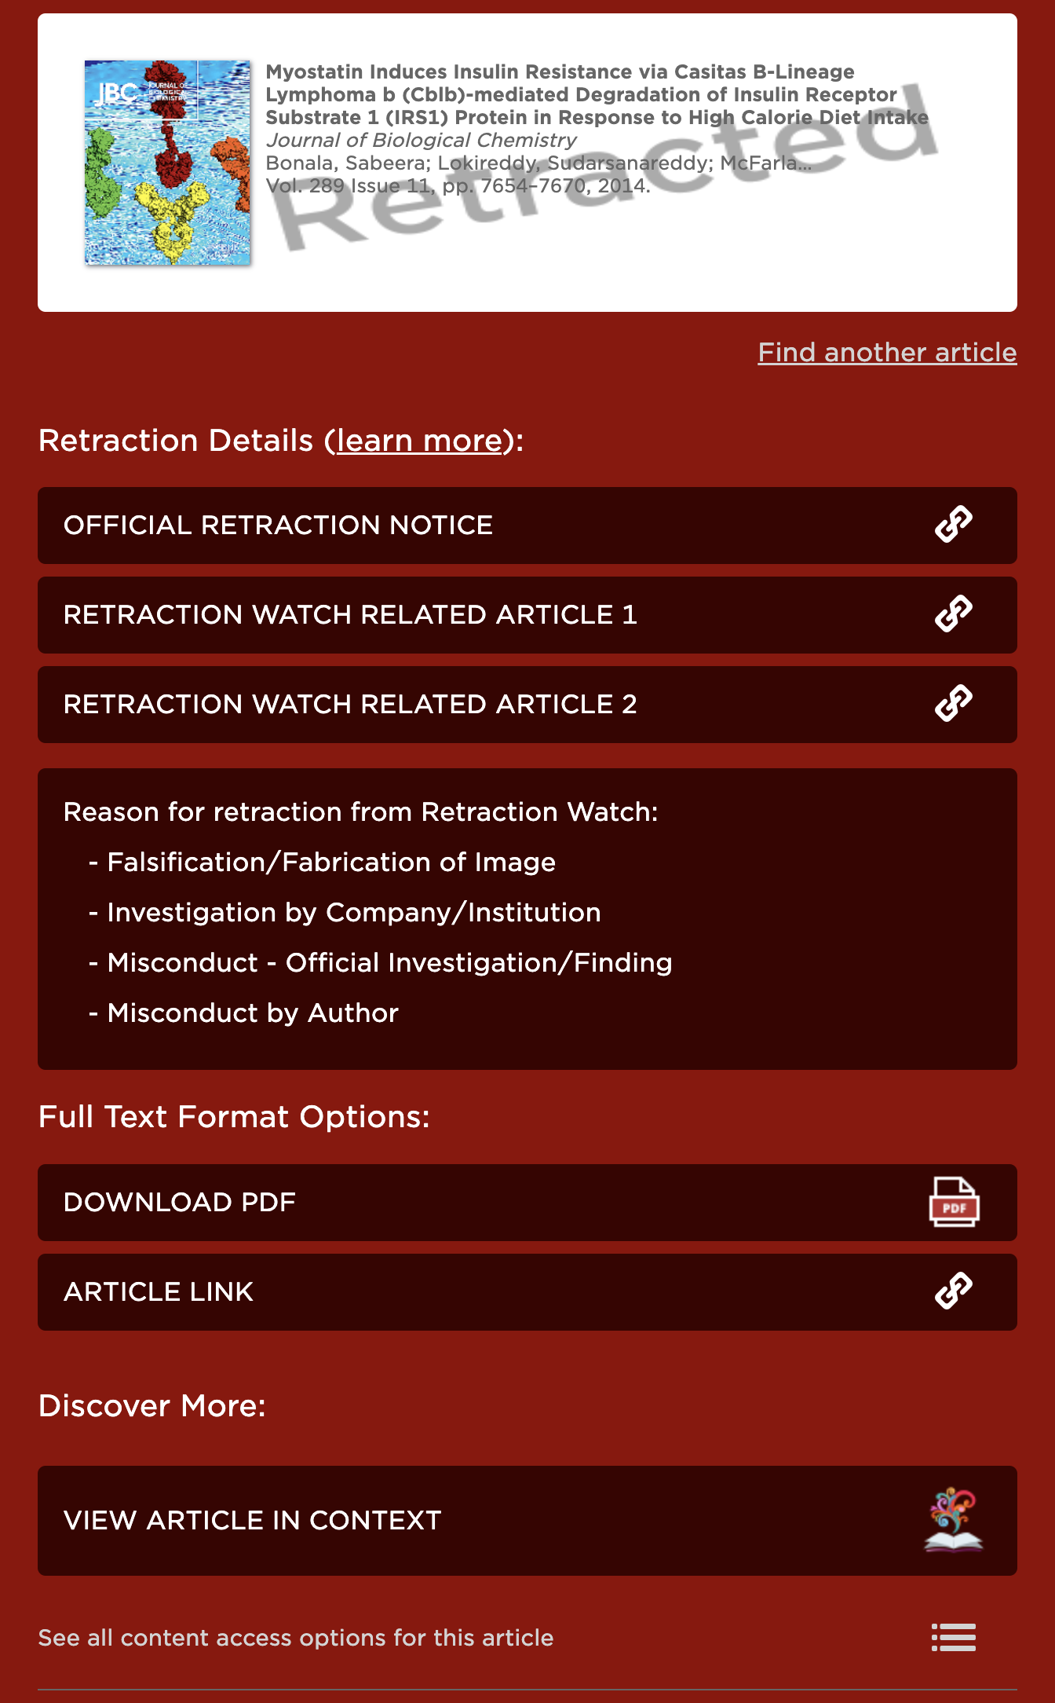

Current retraction notification

Slide 7
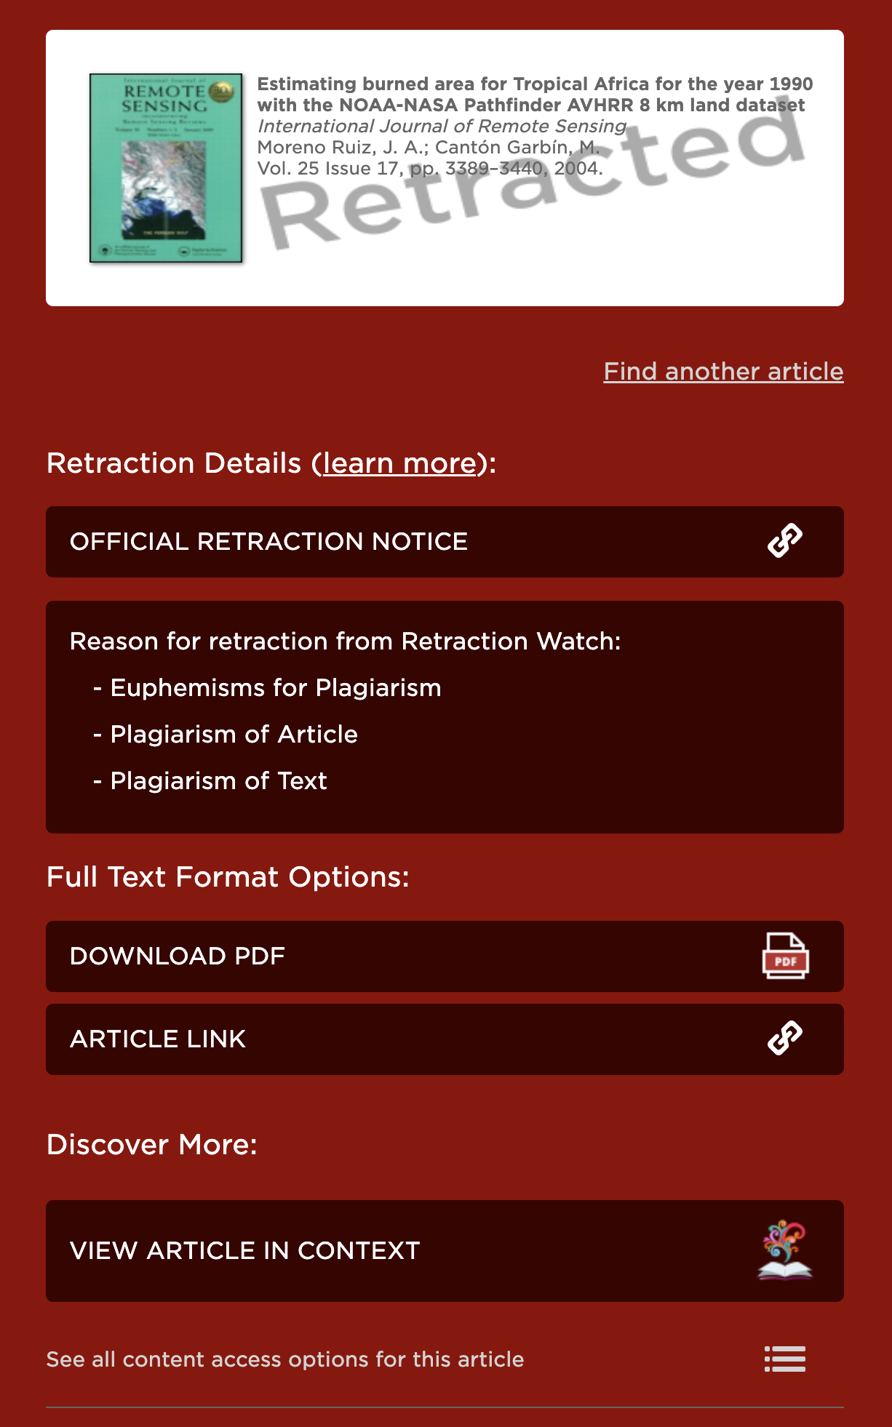

Current retraction notification

Slide 8

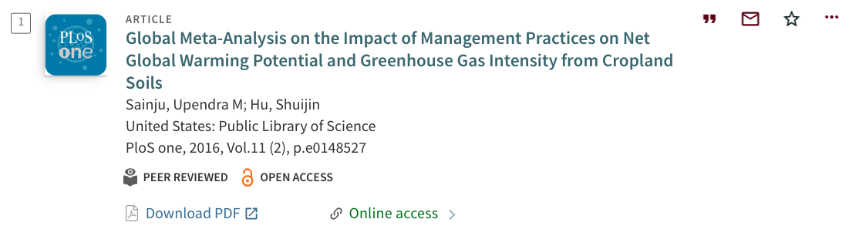
Expression of Concern Notification
Expression of concern

Slide 9
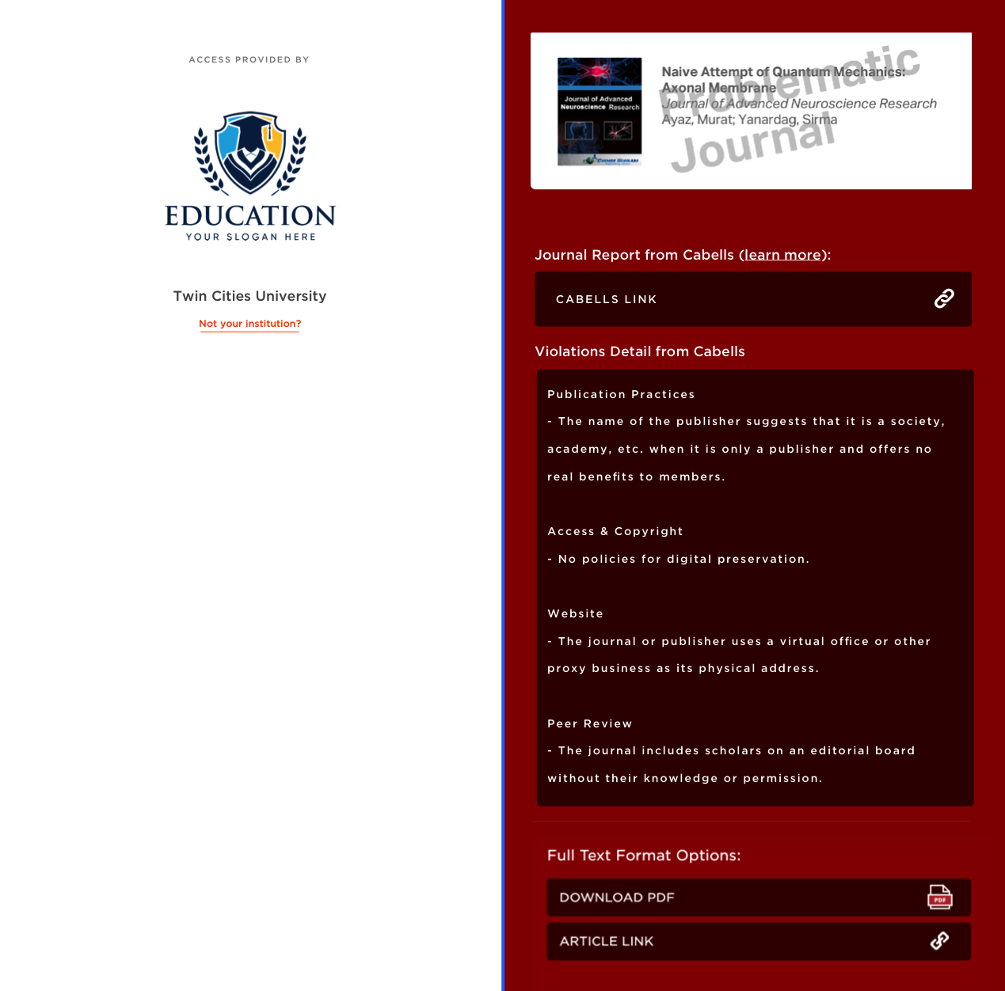
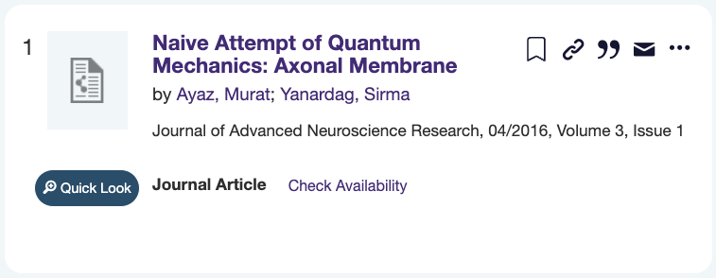


Cabells integration
Problematic journal

Slide 10



Cabells integration – LibKey Nomad
Will scan for known URL’s of problematic journals as well as DOI’s for Articles from those titles.

Slide 11


Expanded editorial status
Expanded Retraction Data
Problematic Journal Data from Cabells
+
=
Expression of Concern
Data
Available for Cabells customers (added upon request)
Expanded retracted article and expression of concern data added automatically (no action needed)

Slide 12
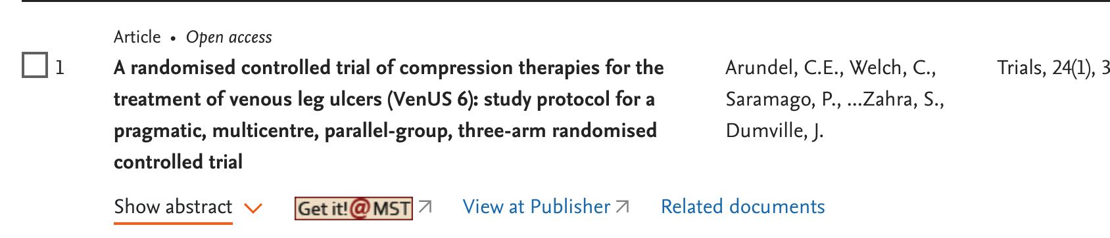


Interstitial with journal detail

Slide 13

Improving Open Access data
Dominance of the hybrid model: a subscription journal in which only some articles are Open Access

Slide 14


Hybrid Journals Indexed With No Full Text
Academic Search Complete
Journals Indexed with No Full Text/Embargo: 11,084
Titles identified as hybrid: 7,514 (68%)
PsycINFO
Journals Indexed with No Full Text: 2,289
Titles identified as hybrid: 1,913 (84%)

Slide 15



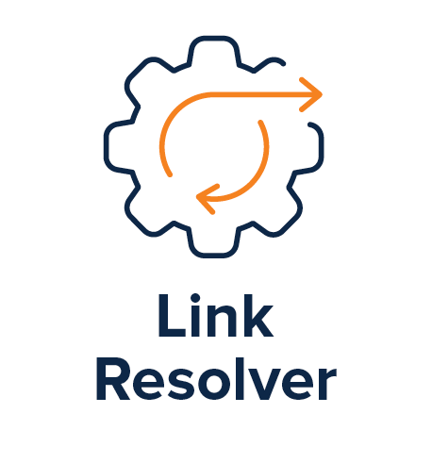
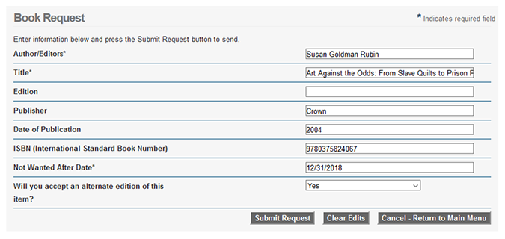




Hybrid journals
Interlibrary Loan
Unnecessary ILL requests
Delays in access
Frustrated users
Indexed In Databases
Results
OA Articles

Slide 16
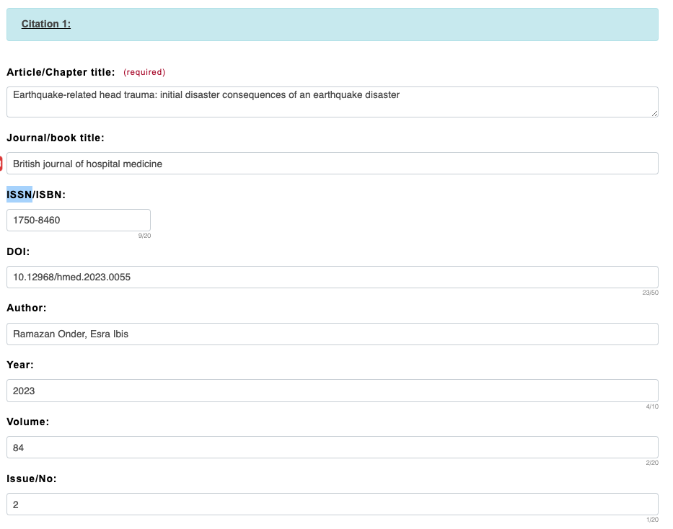
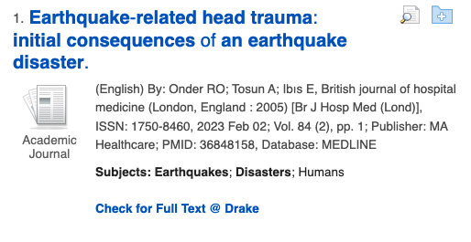
Current experience
Since the journal is not subscribed, the link resolver will point to ILL
Creates delay in access and unnecessary ILL requests

Slide 17

State of OA linking today
Different sources of Open Access information, using different methodologies
Varying abilities and speed in correcting errors
Results for linking
Missing Open Access articles
Incorrect links
Misidentifying articles as Open Access
Incomplete links to available formats
Unclear versioning
OA knowledge

Slide 18



Best OA data, most reliable links
Blending of Open Access data sources
Operational control
Stay current

Slide 19

Increase access with better OA data
Article request is first processed by LibKey
LibKey recognizes the article as OA
User gets immediately to full text
Article-level intelligence, AI-based source selection

Slide 20
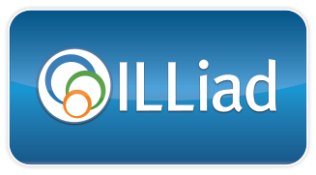
ILLiad-LibKey integration
Planned for Q2
LibKey to be available as a Decision Support Pipeline (DSP) addon, easy to activate in ILLiad
Provides automatic availability checking of library-subscribed and Open Access articles before the request is sent into your ILL desk
If article is available, the user automatically receives an email with a LibKey link providing direct access to the article
Prevents access delays and unnecessary ILL requests

Slide 21

ILLiad-LibKey integration
If not available, request sent for ILL fulfillment
DOI passed to LibKey
ILL request
Email sent automatically to requesting user with a LibKey link providing immediate access to the item
Automatic check for subscribed and Open Access articles prevents delays in access and minimizes unnecessary interlibrary loan requests!

Slide 22
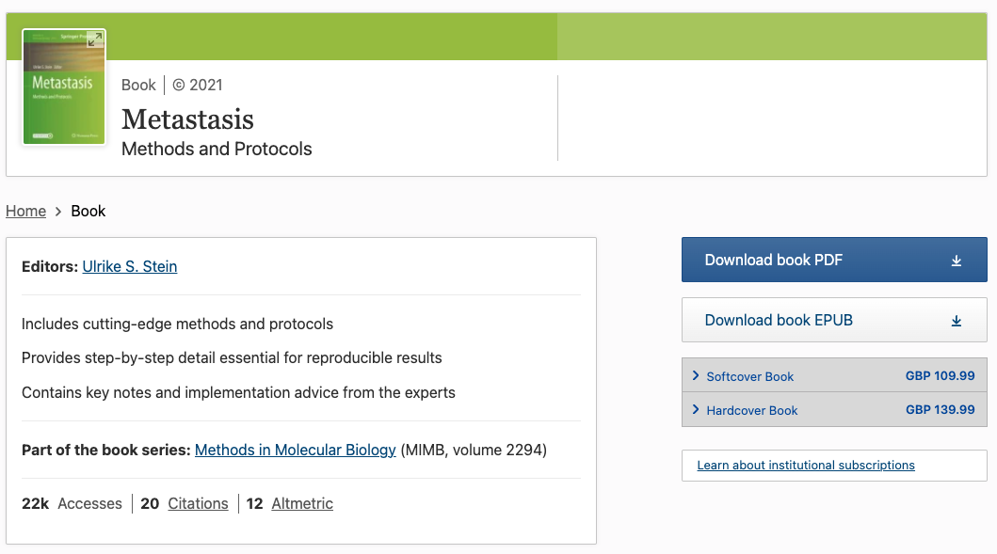
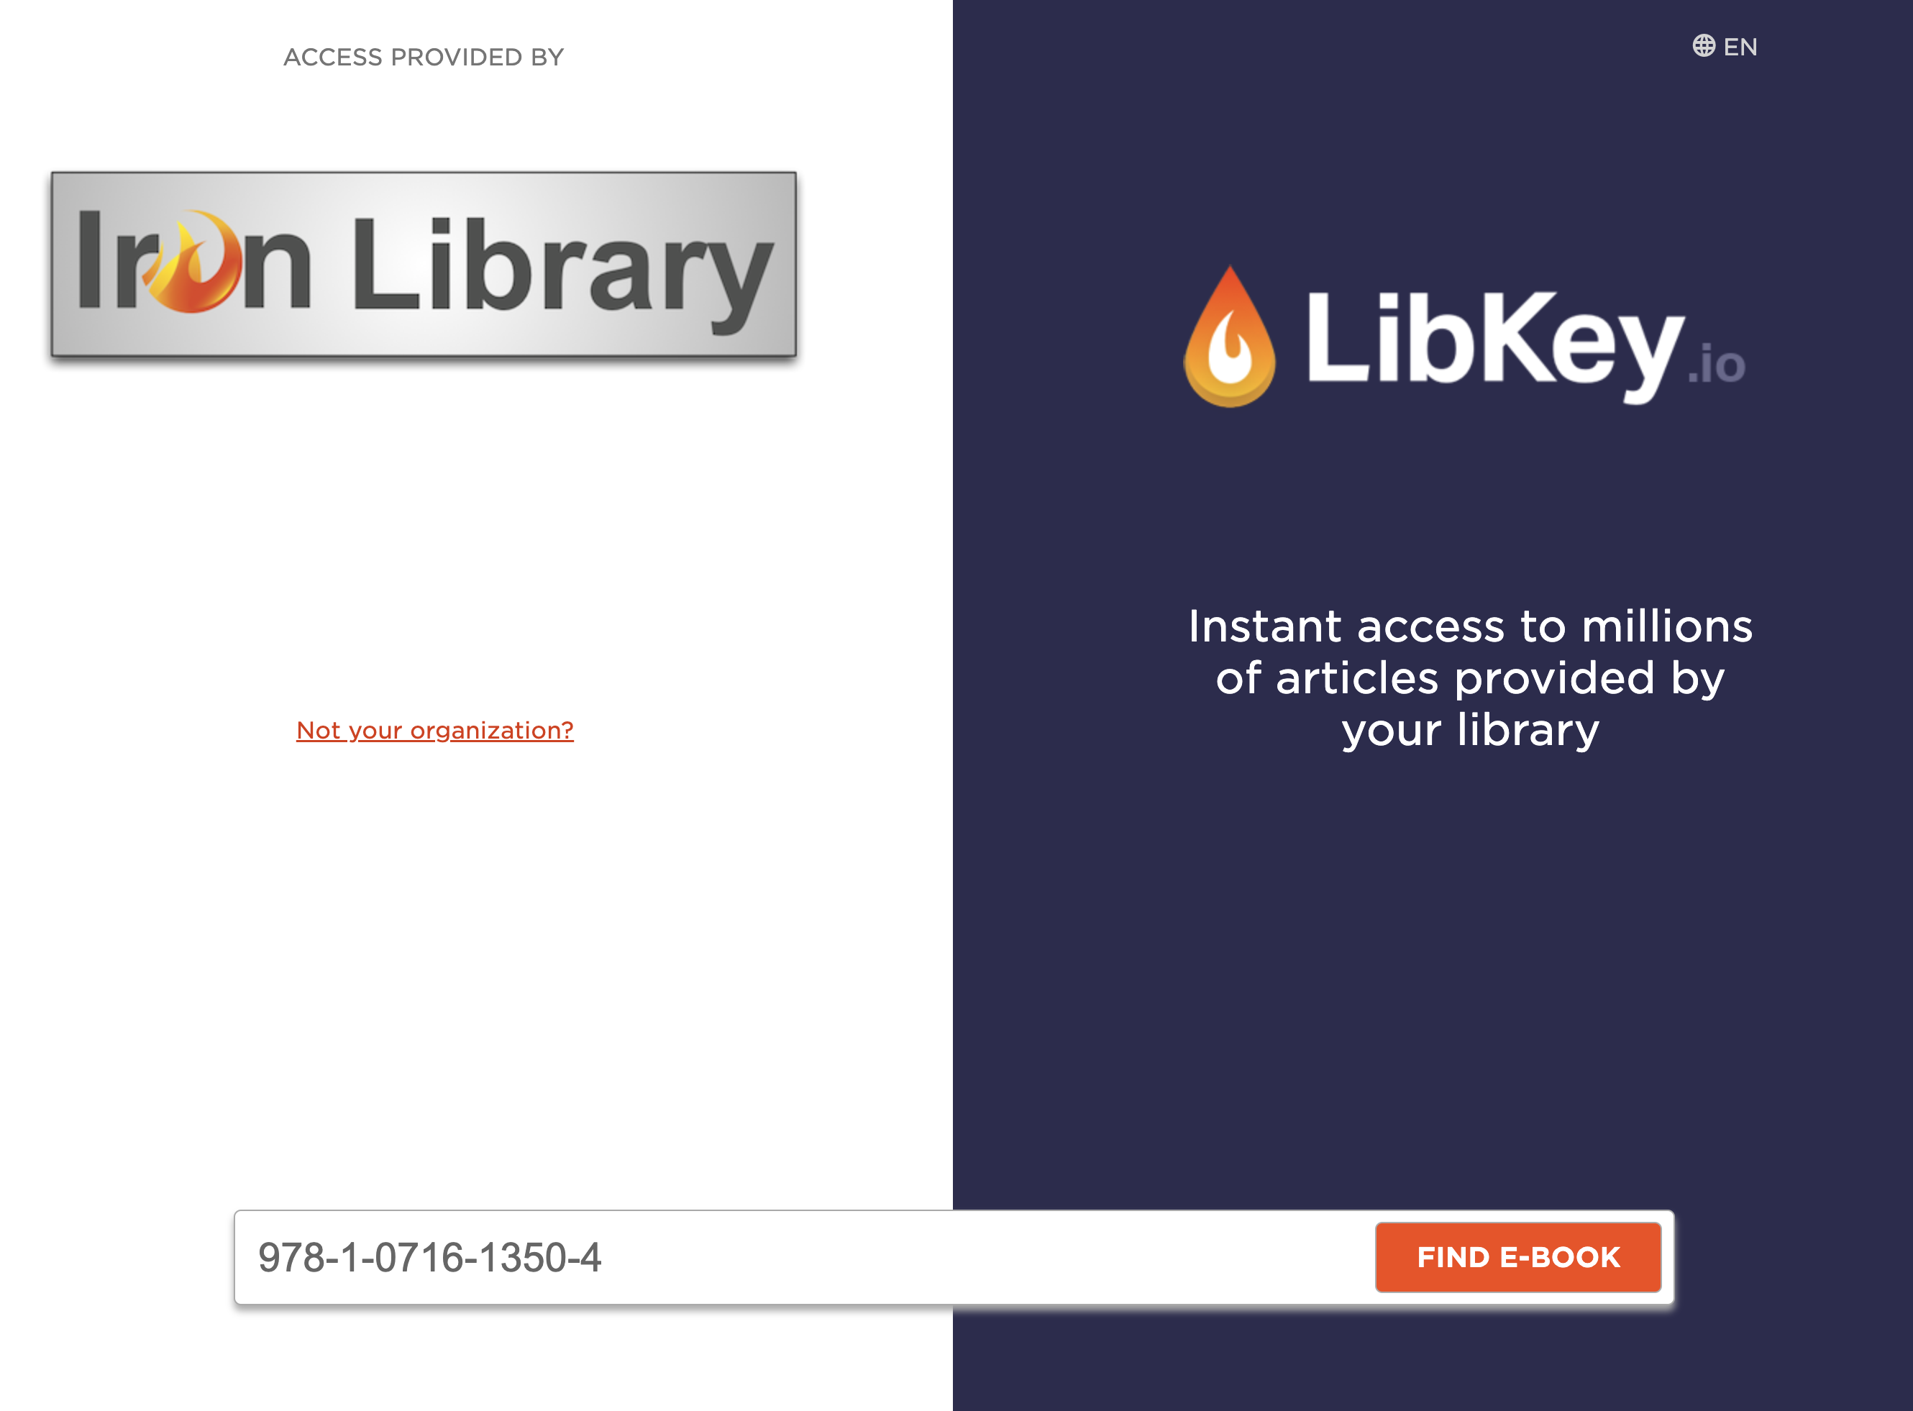
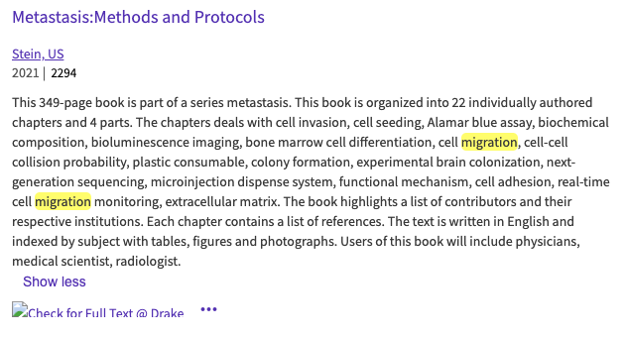
E-Book linking in databases via LibKey Link and .io
Later this year

Slide 23





LibKey Nomad ++ features
Domain intelligent messaging and custom linking
Bibliographic management integration
Customization and branding
LibChat integration
A webinar focused on all the forthcoming LibKey Nomad++ features in greater detail will be coming soon!

Slide 24
Thank you! Questions?
Kendall Bartsch
CEO | Co-founder
Third Iron, LLC
kendall@thirdiron.com

