Slide 1


Work Orders in Alma
Recapture, and some lessons learned

Slide 2

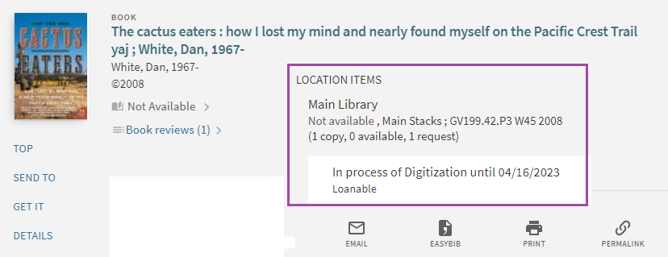
What is a Work Order?
Work Order is an internal library Request
The request is placed on a Physical Item
The item is “In Process” during the lifecycle of the Work Order
  It means that Primo shows the item as "not available”

Slide 3
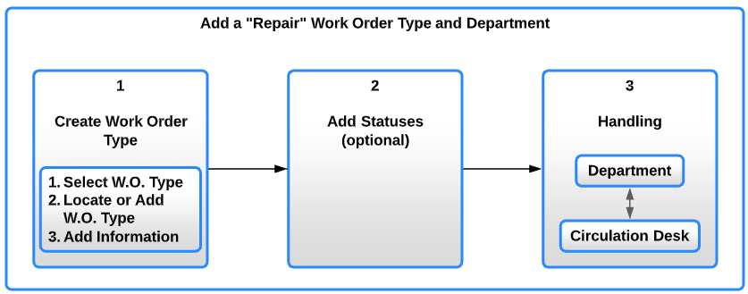
Configuration
Role required: General System Administrator
Configure three elements:
  Work Order Type
  Work Order Status (not mandatory)
  The handling Department (Institution/Library, work days, Operators)

Slide 4


Configuration – (1) Work Order Type
Define the purpose of the Work (restoration, binding, digitization, etc.)
Configure at the Institution or Library level
Create it in: Configuration > General > Work Orders and Departments > Work Order Types
  This is our “trail-head”

Slide 5
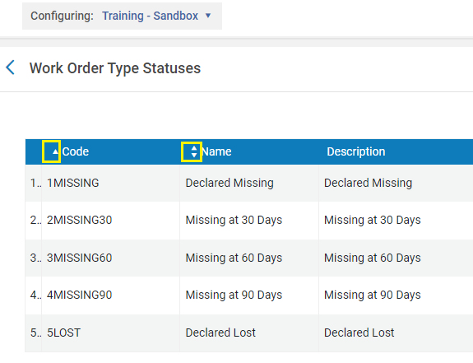
Configuration – (2) Work Order Statuses
Define the phases of the work
In: Configuration > General > Work Orders and Departments > Work Order Types > "Actions" > Manage Statuses
  Statuses are sorted by Code or Name
  Statuses are not mandatory

Slide 6
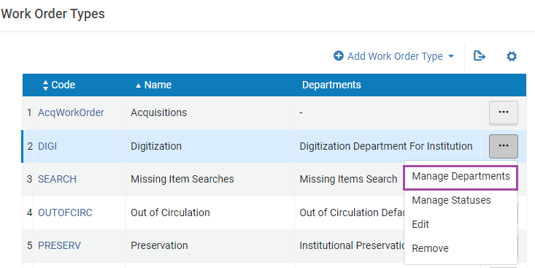
Configuration – (3) Work Order Department
Questions handled here:
  Where is the work done?
  Who are the Operators?
  How long will the item stay in Department?
Configuration > General > Work Orders and Departments > Work Order Types > Manage Departments

Slide 7
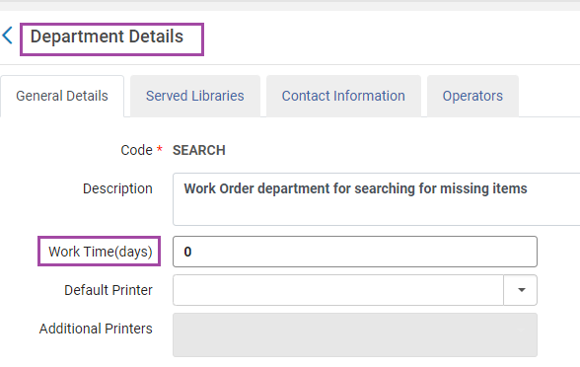
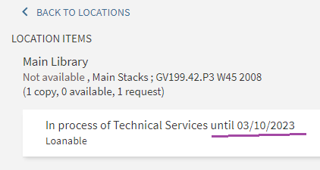
Configuration – (3) Work Order Department
General Details tab:
  Work Time (days): informational, how long is the item in Department?
    Value of 0 defaults to 7 days
    999999 will mean that there is no estimate
    “Blanket Solution”: Remove “until {1}” in: Configuration > Discovery > Display Configuration > Labels > ViewIt Labels > c.uresolver.getit2.item_list.status.WORK_ORDER_DEPARTMENT.with_expected_date

Slide 8
Statuses, creative ideas
Some find it useful to use one Work Order Type with multiple statuses (to avoid having to create multiple work order requests for one typical workflow)

Slide 9
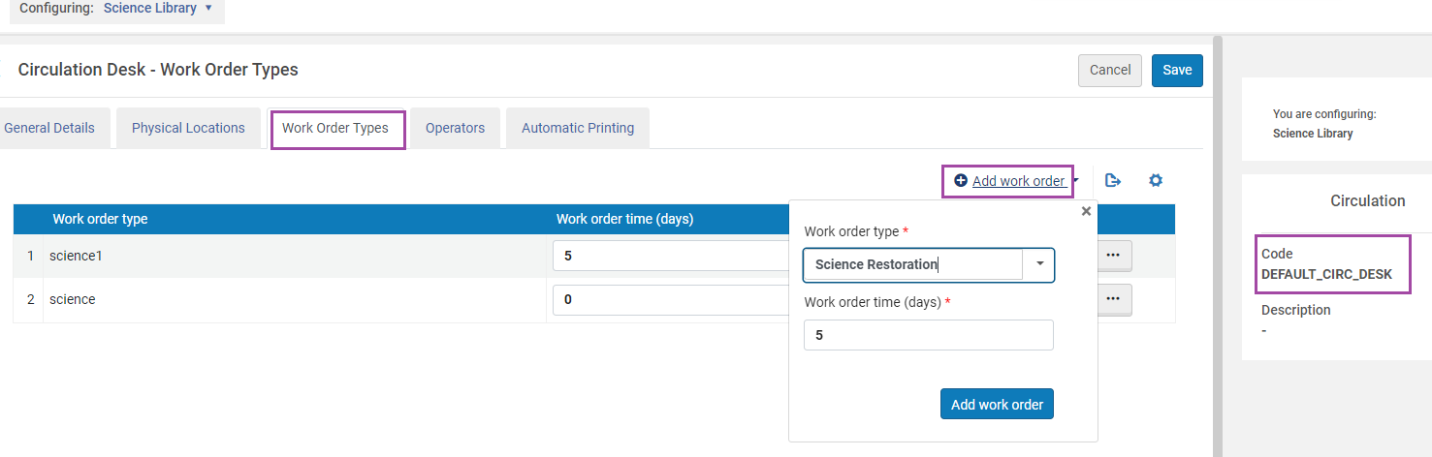
Decision: Institution or Library level?
Work Orders can be configured at the Library level. The Circulation Desk Operators can easily manage Items In Process
  Add the Work Order Type, Statuses – from the Circulation Desk Configuration

Slide 10

Creating Work Orders – Role, and where?
Create Work Order Requests – many Roles
Add Work Order – wherever we encounter a Physical Item

Slide 11
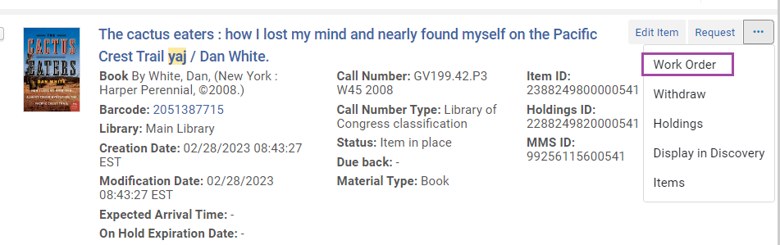
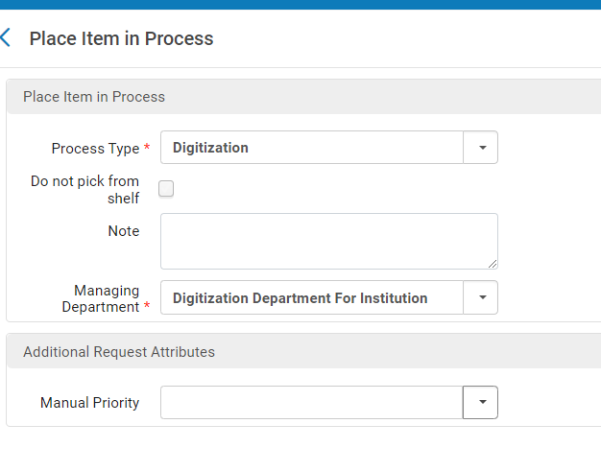
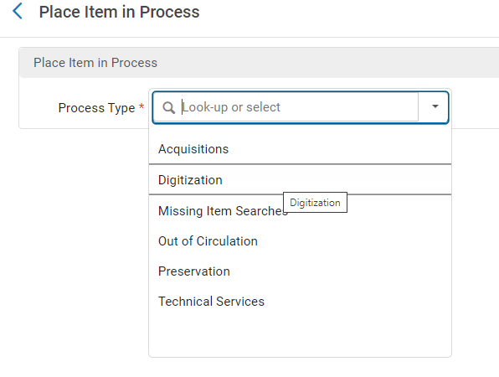
Creating Work Orders – Example (1)
From Physical Items Search > More Actions > “Work Order”
  Select the Process Type
  Decide if it needs to show in “Pick From Shelf”

Slide 12
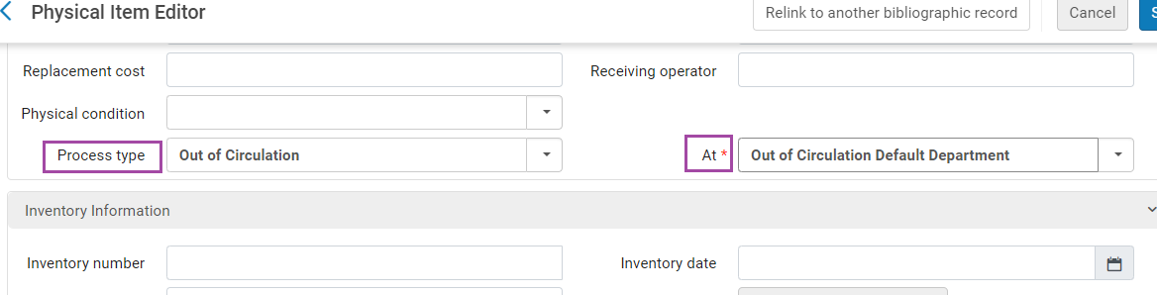

Creating Work Orders – Example (2)
Or, add Work Order from the “Item Editor”
  Again, choose the Process Type, and the Department
  Tip: only possible after the item was saved at least once

Slide 13
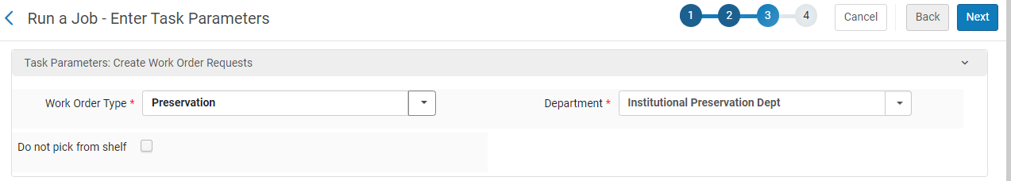
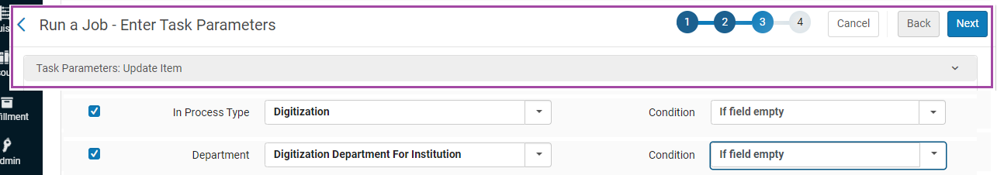
Creating Work Orders – via Jobs
To add Work Orders in bulk, create a Physical Items Set, and run either Job:
  Create Physical Item Work Orders
  Change Physical Items information

Slide 14
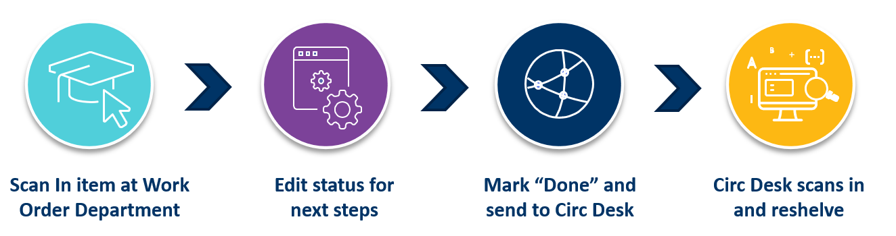
Processing Work Orders
Role: Work Order Operator
Scope of the Department

Slide 15
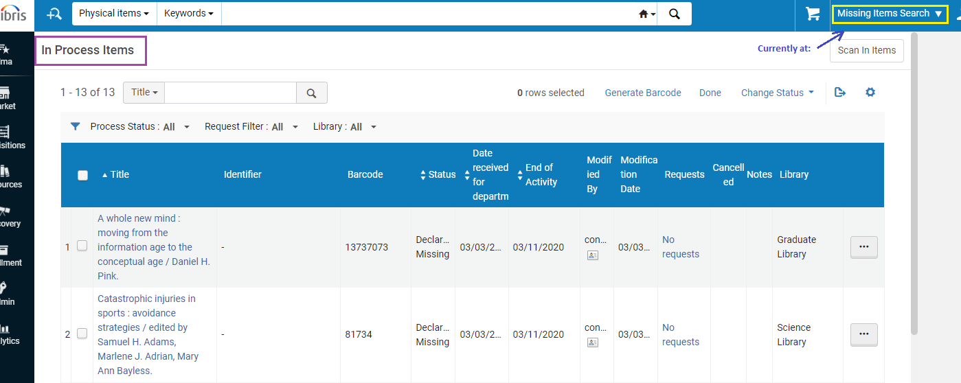
Processing Work Orders
Find the items from:
  Fulfillment > Monitor Requests & Item Processes
  Or, when In the Department > Manage In Process Items

Slide 16
Completing Work Orders
Change the Work Order Status to – Done
  In: Manage In Process Items > Select > Done
  Or, from: Scan In Items > as Done
  If a Work Order was created (request exists), use the Job: Cancel physical items requests
  If the item was edited and has no “Request” – edit the item and remove Process Type. For bulk change: Scan In at Circulation Desk

Slide 17
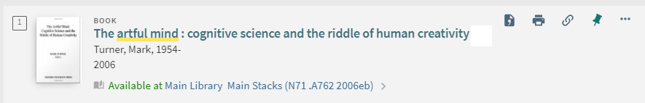
Completing Work Orders – Item Availability
Item may now be “In Transit” to the Circulation Desk
  Scan In at the Circulation Desk
  Or rely on “Reshelve without Transit Rules”
  When the work order department is managed by Circulation Desk and the item is marked “Done”, the item is available
  Editing the item will also move it to “available”

Slide 18

Automatically applied Work Order/Process Type

Slide 19
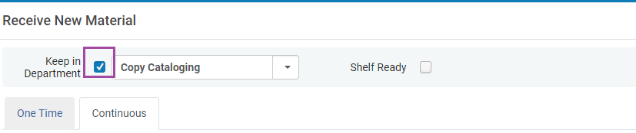
“Receiving > Keep in Department” and Work Orders
When Receiving ordered items, the “Keep in Department” flag will create an Acquisition Technical Services work order
  The Next Step options are the Statuses configured for the Acquisition Technical Services work order

Slide 20
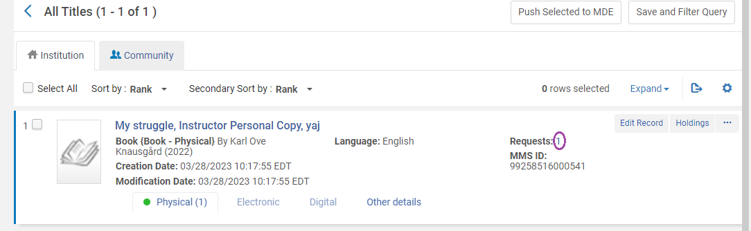
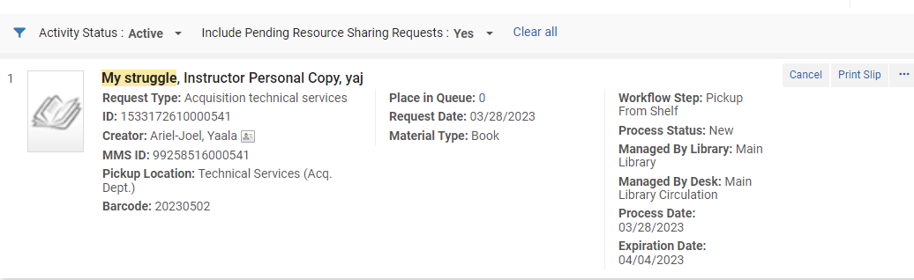
Quick Cataloging – Creates a Work Order
Resources > Add Physical Item
  This creates a request for Acquisition Technical Services, to be used for complete cataloging at a later time.

Slide 21
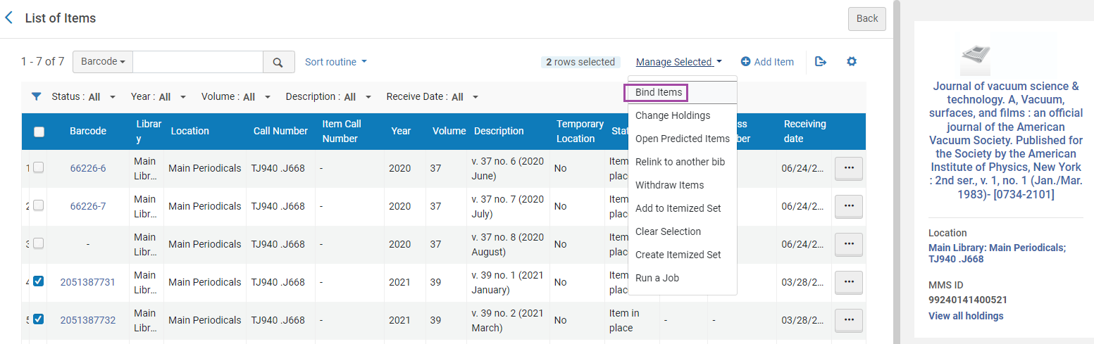
Binding items will create a Work Order
When Binding items, choose the Work Order Type
  The new bound item is In Process, handle it accordingly

Slide 22

Wrap up thoughts
How to delete the Work Order?
  Hint – make sure no Work Order Requests exist, and delete the Work Order Type
  Support has a tool to detect requests, if these are not found.

Slide 23
Documentation, Training, Apps
Online Help: Configuring Work Orders and Departments
Training Video
Knowledge Articles
Extended Training:
  Defining and managing work orders in Alma.pptx
  How to add an additional process type to Alma using the Work Order functionality.pptx
  Using an acquisition work order when receiving an ordered item.pptx
  The Scan-In app: How to activate and use the Bulk Scan In cloud app
  How to merge the Acquisition Department and Circulation Desk
  Failed to create Work Order, suggestions in this Knowledge Article

Slide 24
Yaala.ariel-joel@exlibrisgroup.com

