Slide 1

eBUG Annual Meeting
June 16, 2023
Jason Griffith
ELUNA Steering Committee

Slide 2
What is ELUNA?
Ex Libris Users of North America
  A not-for-profit advocacy and educational membership organization for libraries using Ex Libris products.
  Over 1,300 institutions across the US, Canada, Central America, and beyond
  Members include academic, public, government, corporate libraries and consortia
  Sister organization IGeLU (International Group of Ex Libris Users)

Slide 3
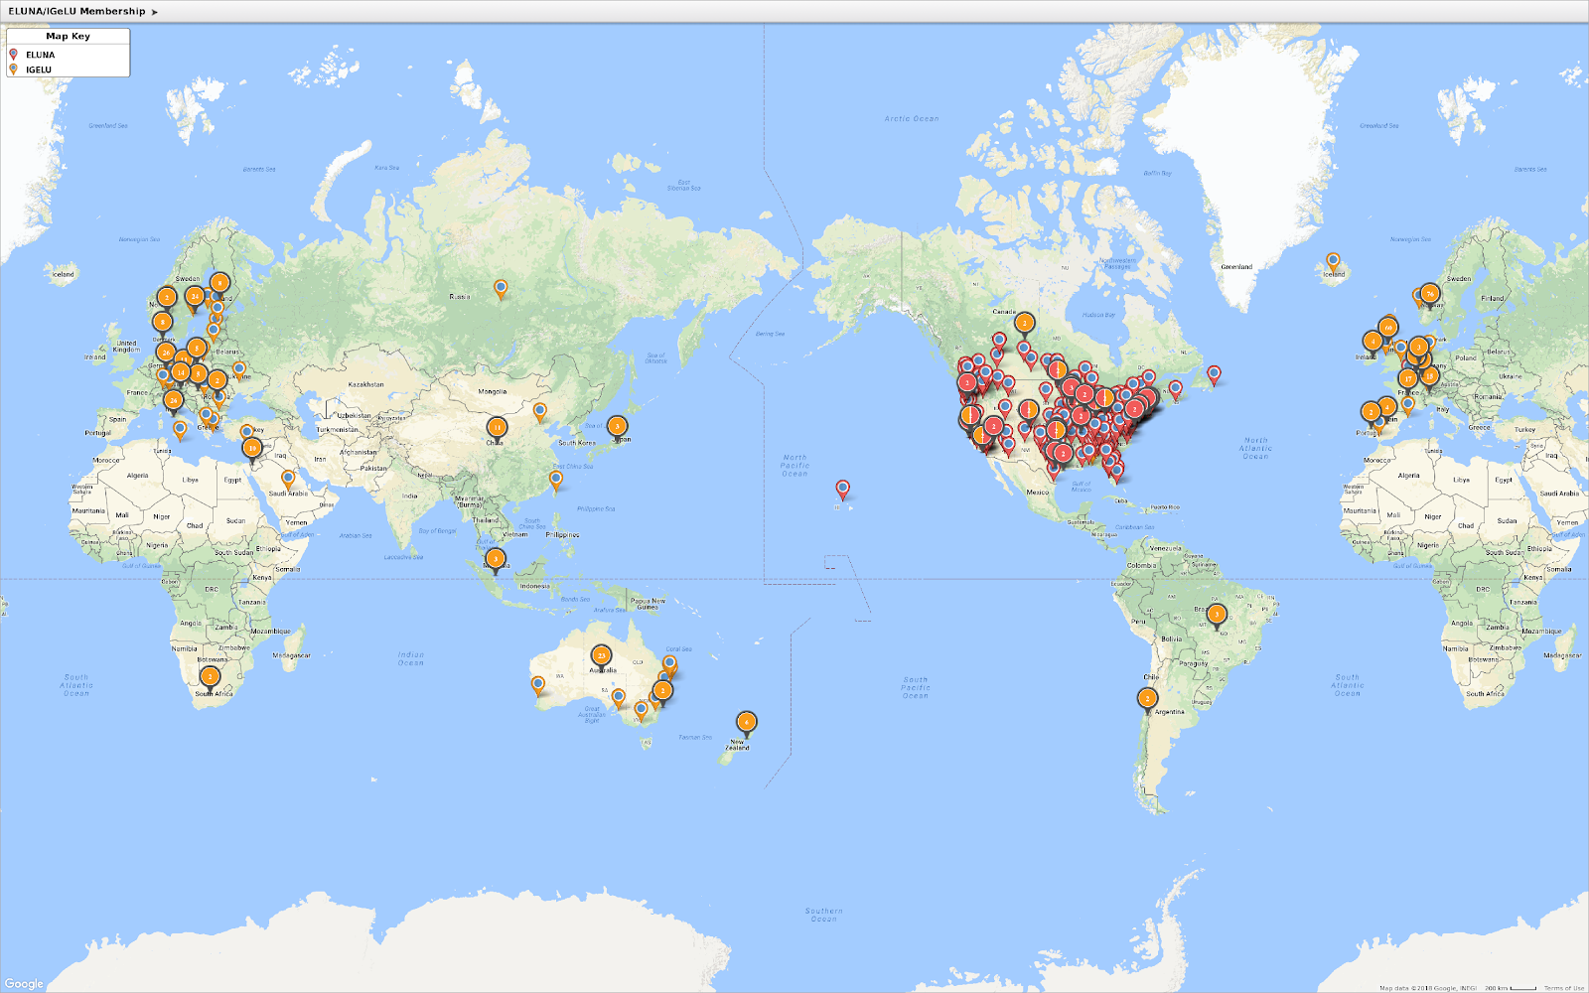

Slide 4
Benefits of ELUNA Membership
  Reduced registration for the ELUNA annual meeting
  Access to the meeting archives and other restricted information on the ELUNA website
  Eligibility for election to a leadership role on the Steering Committee or Product Working Groups
  Potential to be selected as part of a focus group, task force, or other working group established by ELUNA, or in conjunction with Ex Libris or IGeLU
  One vote per membership in all ELUNA supported elections or votes, including product enhancements (through NERS)

Slide 5
Membership Pricing
Membership Type | Annual Fee
Individual Institution | $280.00
Consortia (2-5 Members) | $425.00
Consortia (6-25 Members) | $495.00
Consortia (26-50 Members) | $565.00
Consortia (51+ Members) | $700.00

Slide 6

Save the Date – ELUNA 2023
Event Venue
Hilton Minneapolis
1001 S Marquette Ave
Minneapolis, MN 55403
Developers Day+: May 13-14, 2024
Ex Libris Knowledge Days: May 13-14, 2024

Slide 7
A little bit more about ELUNA…
User Organization Independent from Ex Libris
Volunteer-based
Different ways to get involved:
  Standing Groups
    Steering Committee
    Working Groups (WGs)
    Communities of Practice (CoPs)
    Regional User Groups (RUGs)
    Focus/Functional Groups
  Short-term groups
    Advisory Groups (Ags)
    Task Forces (TFs)

Slide 8
Steering Committee
    Central governing body
    Responsible for executive, financial, technological, and member operations
    Composed of chair, eight at-large members elected by user community, and Ex Officio members appointed by SC for specified period and purpose
    Elected for three-year, staggered terms
    Responsible for relationship between user community and Ex Libris

Slide 9
ELUNA Steering Committee Roles​
Chair – elected by SC
Deputy Chair – at-large member
Treasurer - Ex Officio
Secretary – at-large member
Conference Logistics Liaison – Ex Officio
RUG Liaison – at-large member
Sponsor Liaison – at-large member
Working Group Liaison – typically at-large
Technology Liaison – Ex Officio

Slide 10
2023 – 2024 ELUNA Steering Committee​
Allen Jones – Chair, The New School
John Greer (Ex Officio) -- Technology, University of Montana
Pascal Calarco – Rialto, Content Liaison, University of Windsor
Kristen Clark – University of Minnesota Twin Cities
Karen Glover– RUG Liaison, Georgia Tech
Jason Griffith – Rosetta, Esploro, University of Kentucky
Lori Hilterbrand – Orbis Cascade Alliance
Ellen Jones (Ex Officio) – Treasurer, University of Iowa
Holli Kubly – Old Dominion University
Dean Lingley – Purdue University
Laura Morse (Ex Officio) – Education Liaison, Harvard University
David Schuster – Binghamton University

Slide 11
Working Groups (WGs)
  Working Groups (WGs)
    Share licensed product in common
    Elected by community
    Responsible for discussions about product functionality and enhancement
    May create functional groups and focus groups
    Examples of WGs: Alma, Analytics, Content, Esploro, Leganto, Primo, RapidILL, Rapido, Rialto, Rosetta, SFX, Summon/360 Services, Voyager

Slide 12
Communities of Practice (CoPs)
    Groups that share a common interest or subject area expertise
    Some contribute knowledge to product knowledge bases or cross-product strategic directions; some represent a specific area or specialization
    Responsible for conference tracks and programming relevant to their membership
    May create subject groups
    Examples of CoPs: Analytics, Linked Open Data, Special Collections

Slide 13
Regional User Groups (RUGs)
    Assemblies of users in smaller geographic regions who may host their own Ex Libris educational and networking events
    Defined differently between ELUNA and IGeLU

Slide 14
Short-Term Groups
  Advisory Groups
    May be assembled by SC to discuss strategic directions or large-scale product initiatives
    May contain members from Ex Libris product management and/or product working groups, CoPs, or external reports
    Examples of AGs: Controlled Digital Lending (CDL), Diversity, Equity and Inclusion in Search (DEI), Central Discovery Index (CDI)
  Task Forces
    Composed of ELUNA/IGeLU SC and WG members attempting to solve a particular problem or make recommendations on a specific question/problem

Slide 15
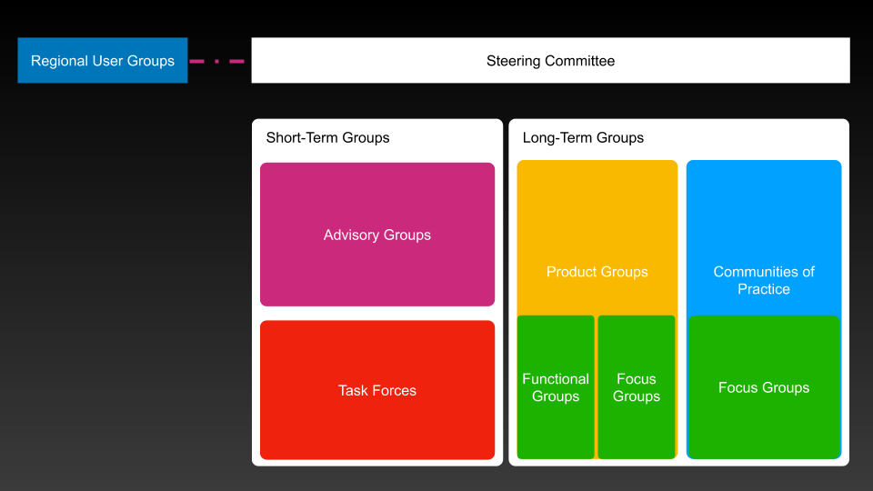
High level view of ELUNA group structure

Slide 16
Expected values of ELUNA leadership
Due diligence - having current and exhaustive knowledge of their charge and a current understanding of what is happening within the user organization.
Loyalty - putting the broader user community interest over your own or home institution’s interests,
Care - participating and actively engaging in ELUNA/IGeLU activities to the best of their ability
Professionalism - demonstrating honesty, integrity, and self-regulation, even under times of personal stress or ethical conflict
Collegiality/Cooperation - working cooperatively with working groups, the steering committee and communities of practice, not going it alone
Inclusiveness - pursuing a diversity of opinions and perspectives, and actively recruiting under-represented perspectives within the organization
Confidentiality - keeping discussions regarding Ex Libris products or initiatives private to facilitate a trustworthy relationship with the user organizations, even after leaving their position.
Transparency - disclosing accurate and actionable information to other working groups and the community in a timely fashion.

Slide 17
ELUNA Strategic Issues
  Relationships with Ex Libris, IGeLU, and Innovative User Group
  Monitoring and improving content issues in CDI, Linked Open Data, Authorities Focus Group, etc.
  New advisory groups
    Support
    AI
    Metadata Services
    NA Consortium
    IUG
  Diversity, Equity and Inclusion
  Enhancement Requests
    New System (Aha)
    Education

Slide 18
ELUNA – Ex Libris Issues
  Accessibility
  Linked Open Data
  CDI Enhancement Points
  New products in shared software agreement
    Rialto
    RapidLL/Rapido
    Alma-D
  Reboot developer community
  Metadata direction

Slide 19
Resources
  ELUNA Website - https://el-una.org/
  ELUNA Document Repository - https://el-una.org/document-repository/

Slide 20
Questions? Contact Us
  Jason.Griffith@uky.edu
  ELUNA-SC@exlibrisusers.org

