Slide 1
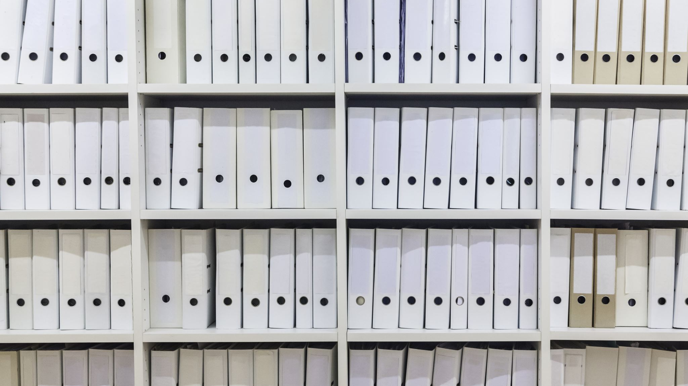
Untangling library data Spaghetti
eBug 2023
University of Tennessee Conference center, Knoxville, TN
By Craig Rosenbeck, systems librarian
Roberts Wesleyan University
Friday, June 17, 2023

Slide 2

AGENDA
Introduction
Primary goals
Timeline
Summary
Thank you and Questions
Outcomes

Slide 3


INTRODUCTION
There was data in numerous tabs on spreadsheets. There were no monthly reports for systems such as Primo, Website, LibGuides, Alma. The Social Media was not updated for two years. Fiscal Year End was basic information. There was no data visualization or a database containing this information.

Slide 4

PRIMARY GOALS
Centralize area for reports containing fiscal year end and monthly reports
A database that has schemas, tables, and views containing monthly data for Libguides, log and audit data for EZproxy
Data Visualization for reports
Built reports for fiscal year end of systems missing data
Making flat files readable in a database table
Taught data wrangling skills to assistant

Slide 5
TIMELINE 2021- 22
Q1
Design of Fiscal Year End and Annual Reports
Design of Reporting LibGuide
Training to Assist design of reports
Q2
Requested virtual servers to run PostgreSQL and OpenRefine
Participated on Leganto Analytics Focus Group
Q3
Data Visualization through Oracle Analytics Server
Created a dashboard of reports most requested
Design of the databases in PostgreSQL
Q4
Deploy of monthly circulation reports
Manage virtual servers

Slide 6
Outcomes
Reports more accessible and visualized
Databases and Virtual Servers Implemented
Personnel are able to efficiently access reports for various systems
​Limitation of multiple tabs in spreadsheets
​Visualization of Library Platform System data, website, and LibGuides​
PostgreSql running multiple databases
​Test Server for EZproxy
Decreased time for Information Technology Services

Slide 7
SUMMARY
We now have a LibGuide where personnel update Accreditation portals and annual reports. There are virtual servers with PostgreSQL and OpenRefine. There are reports for Alma, Primo, Leganto, Social Media, LibGuides. There are schemas and tables for EZproxy audit files and log files. In Analytics of library system platform, there are folders containing fiscal year end reports and the user can change the date range for the report.

Slide 8

Technologies Used in Untangle Library
Data spaghetti Project
Windows Servers
OpenRefine
PostgreSQL
Notepad++
Oracle Analytical Server through ExLibris Suite
Microsoft OneDrive
Google Analytics
Google Meet

Slide 9
Future Technologies Used in Untangle Library Data spaghetti Project
Microsoft Flow
Oracle Analytical Server through ExLibris Suite (OAS)
Microsoft OneDrive
Julia Programming
Python Programming
R Programming
Microsoft Visual Code
Orange Data Mining
Postman

Slide 10

THANK YOU and Questions
Craig Rosenbeck
csrose01@gmail.com

Slide 11

References
Juliadata: Data manipulation, storage, and I/O Github (n.d.). Juliadata: Data manipulation, storage, and I/O RETRIVED on June 7, 2023, from https://github.com/JuliaData
Grus J. (2015). Data science from scratch : first principles with python (First). O'Reilly.
Books (n.d). Julia Books. Retrieved on June 7, 2023, From https://julialang.org/learning/books
Lauwens B. & Downey A. (2019). Think julia : how to think like a computer scientist (First). O'Reilly Media.
Books (N.d.). Rstudio Books. Retrieved on June 7, 2023, From https://www.rstudio.com/resources/books/
Vanderplas J. T. (2017). Python data science handbook : essential tools for working with data. O'Reilly.
Wickham H. & Grolemund G. (2016). R for data science : import tidy transform visualize and model data (First). O'Reilly.

