Slide 1
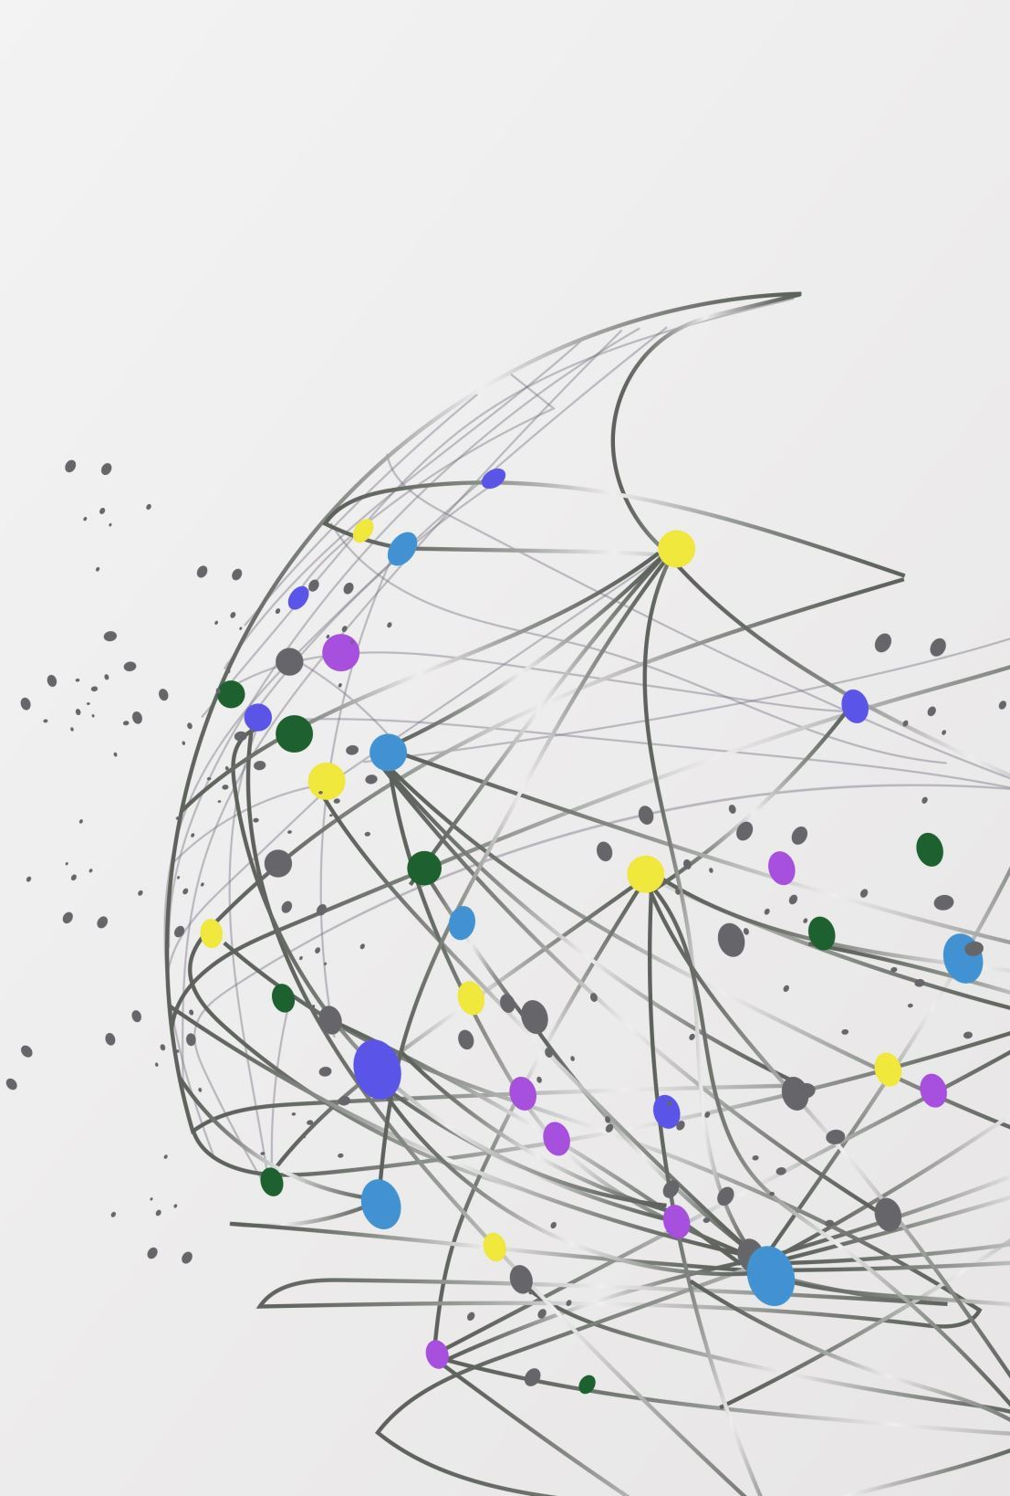
Transitioning from ILLiad to Rapido in 7 weeks: What we learned
Brooke Garland, Jennifer Young, and Travis Clamon
East Tennessee State University

Slide 2
Why We Switched
Cost savings
Cloud-based platform
Positive experience with RapidILL
Integration with Primo
User experience
Future potential for e-book lending & CDL

Slide 3
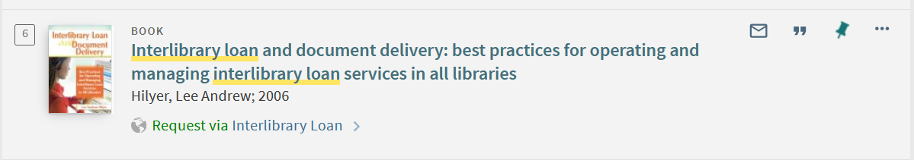
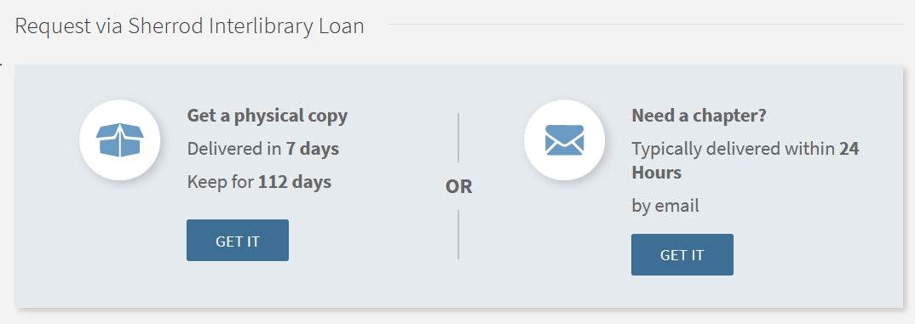
User Interface

Slide 4
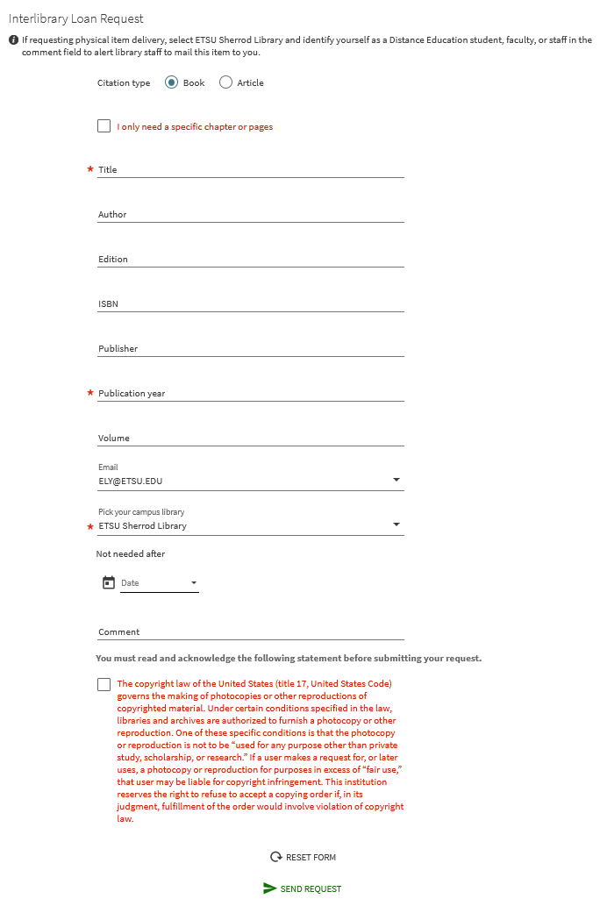
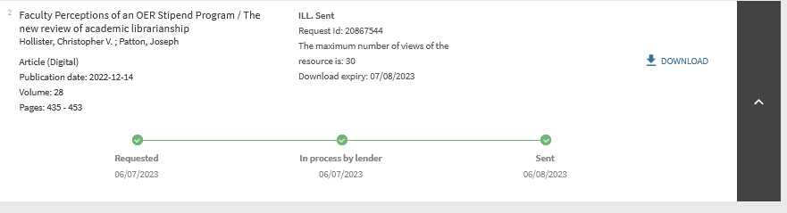

Slide 5
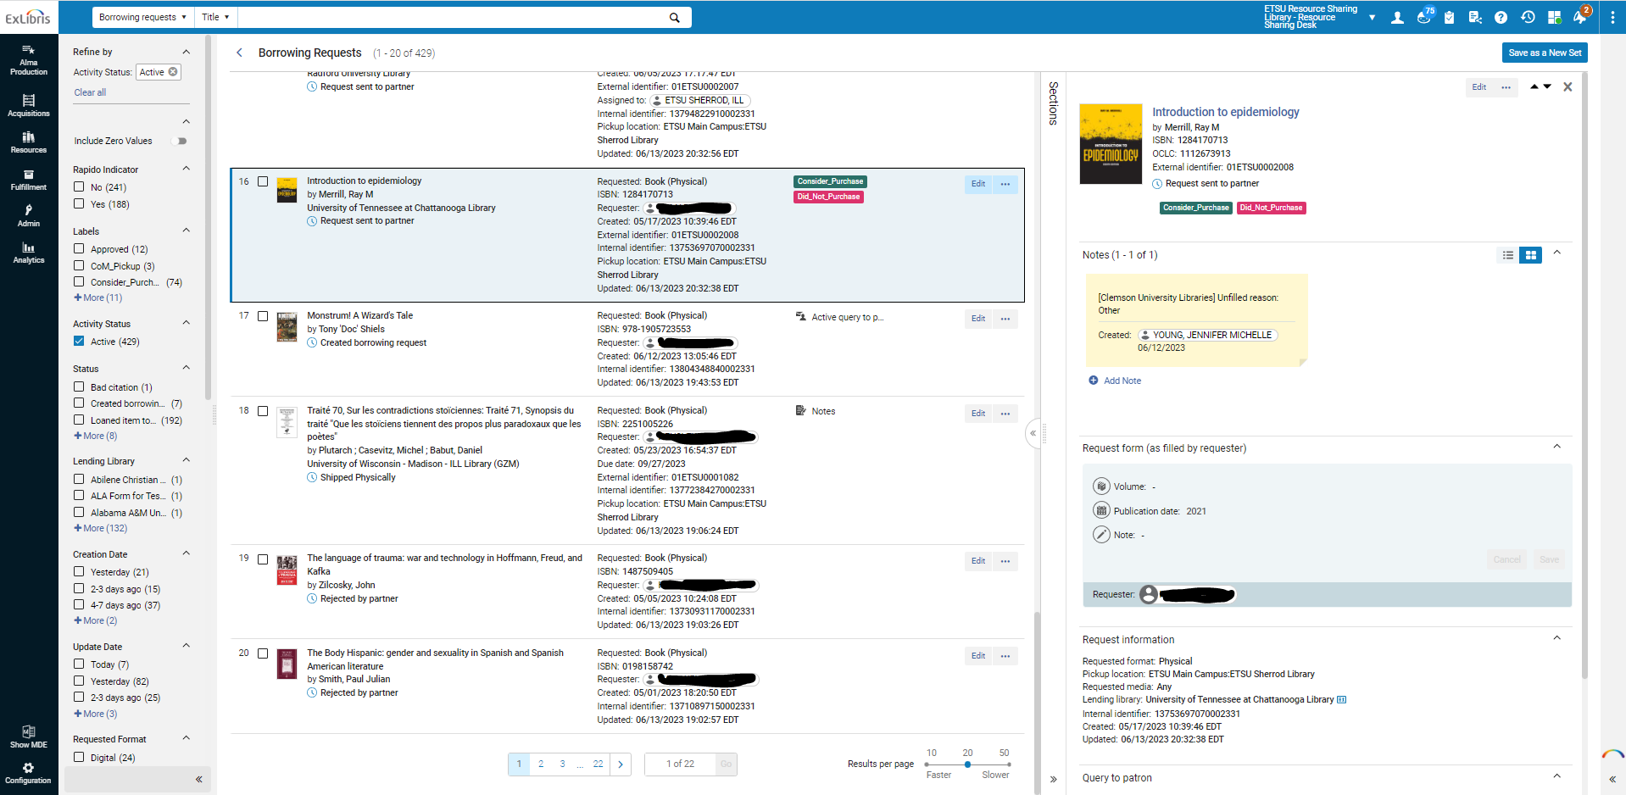
Staff Interface

Slide 6

Timeline
Started Implementation: March 13
Last Date- ILLiad: April 30
Projected Go-Live from Rapido: May 22
Actual Go-Live: May 1
Last Date- WorldShare ILL : June 30

Slide 7

Preparing for the transition
Stopped physical OCLC lending in January
Continued borrowing until April 28th
Provided users with their ILLiad history if requested
Processed copyright fees
Exported all outstanding requests, items checked out to patrons, articles delivered to web, and backed up articles still currently on server
Updated ILL website and released blog post about the transition
Presented short demo to other library faculty and staff of new ILL Request process so they could assist patrons if needed.
Recalled all OCLC loans from ETSU patrons

Slide 8
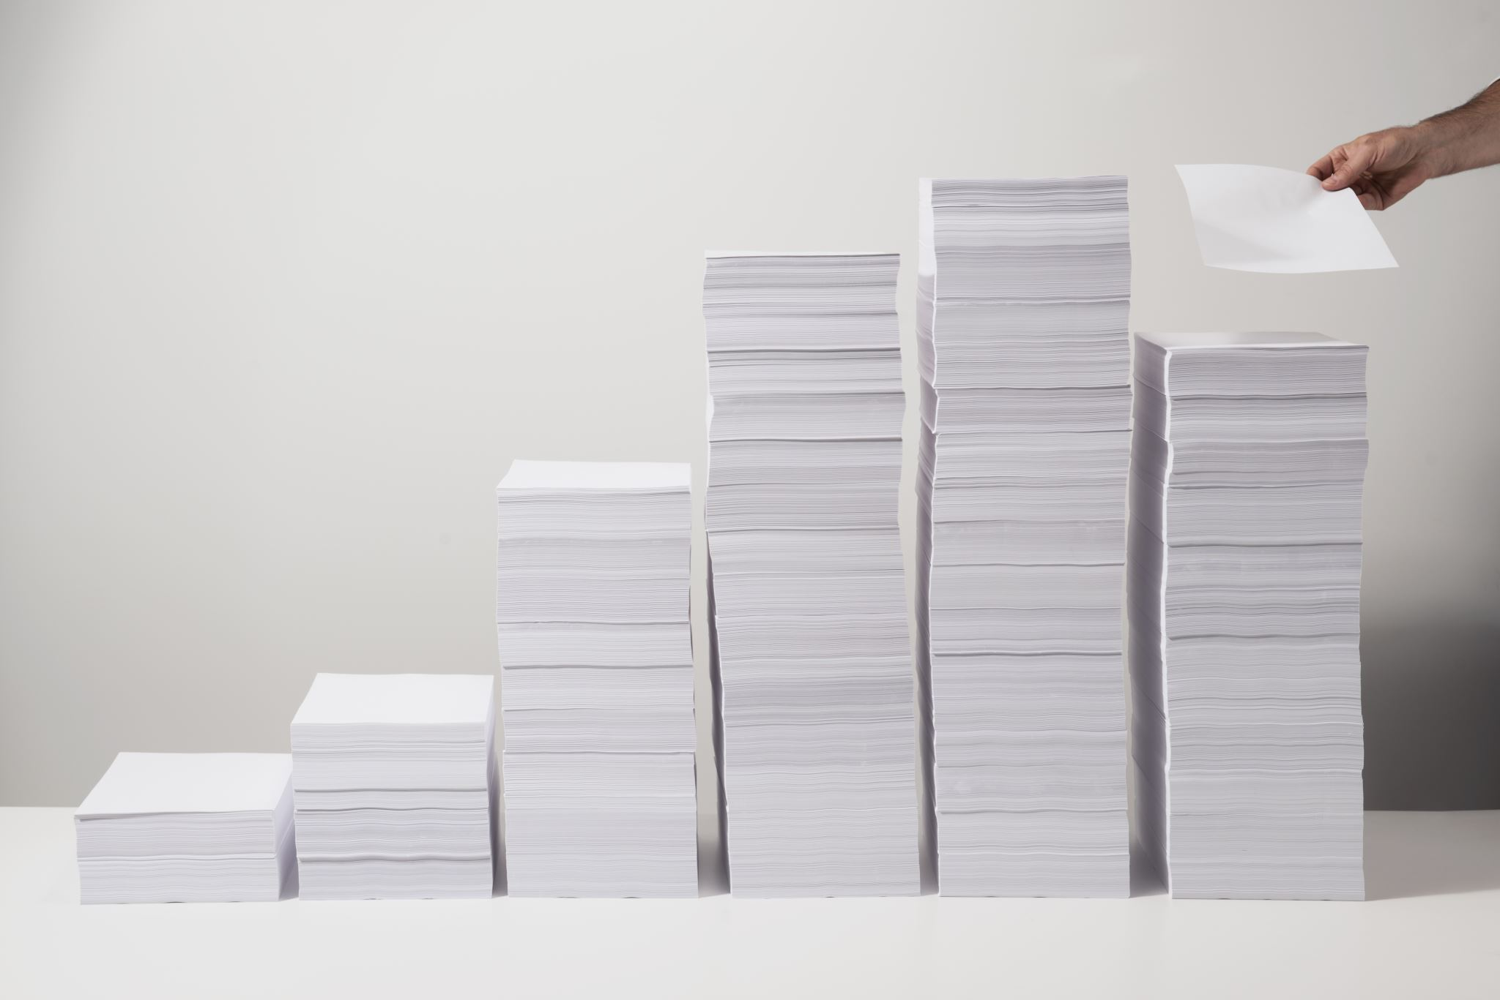
Implementation Advice
Read ALL Ex Libris documentation regarding Rapido. Then READ IT AGAIN.
Testing is difficult if you do not have a premium sandbox
Be sure your implementation team includes someone with in-depth Alma knowledge!
Dedicate a significant portion of implementation time to improve letters (many slips did not meet our needs)
To-do items from Ex Libris are not in order of when they need to be done and some steps cannot be performed until you're ready to go-live

Slide 9

Helpful set up tips
Create a set for resend requests (not mentioned in configuration documentation)
Take advantage of mediation rules to stop requests you want to take a second look at
Set up patron query types to reduce repetitive emails
If you keep Worldshare ILL, set it up as the last resort partner in your rota
Beware! When you ask for RapidILL to be disconnected from ILLiad it includes both the borrowing/lending aspects of RapidILL

Slide 10
Managing Electronic Resources
License agreements
Schedule publishing profiles

Slide 11

Letters
Over 30 possible letters to customize
Must use XSL and shared templates from other libraries did not match up with our fields/code
Some letters are not specific to Rapido and are shared by the institution/Alma, meaning changing format or turning it off completely affected circulation notices.
Barcodes will not print when trying to reprint a letter from the quick print queue

Slide 12
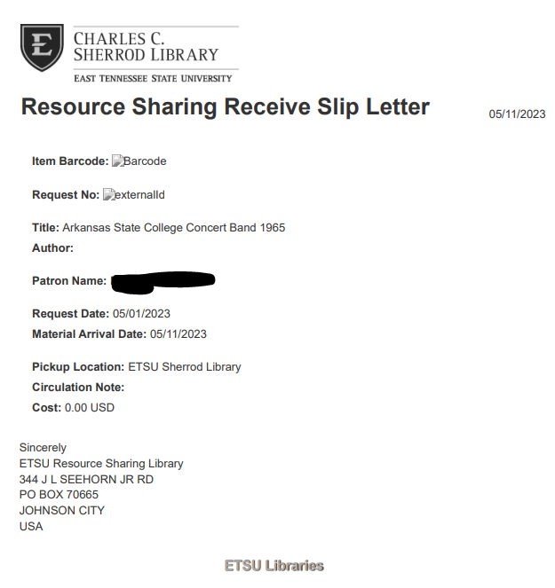

Slide 13
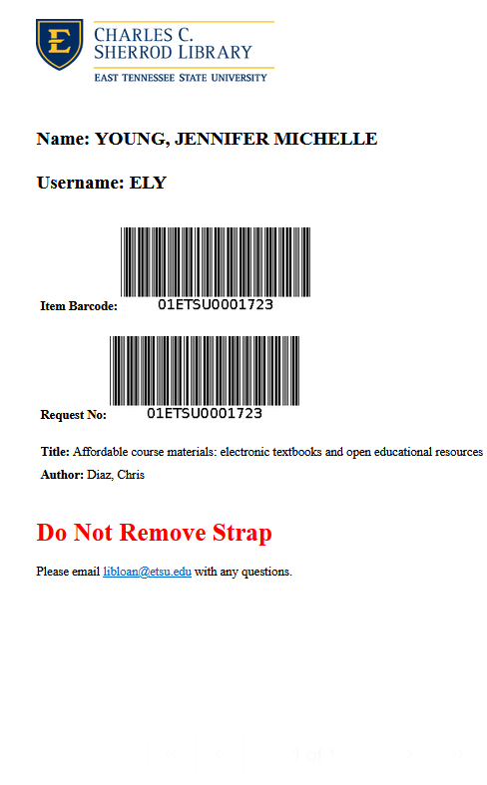

Slide 14
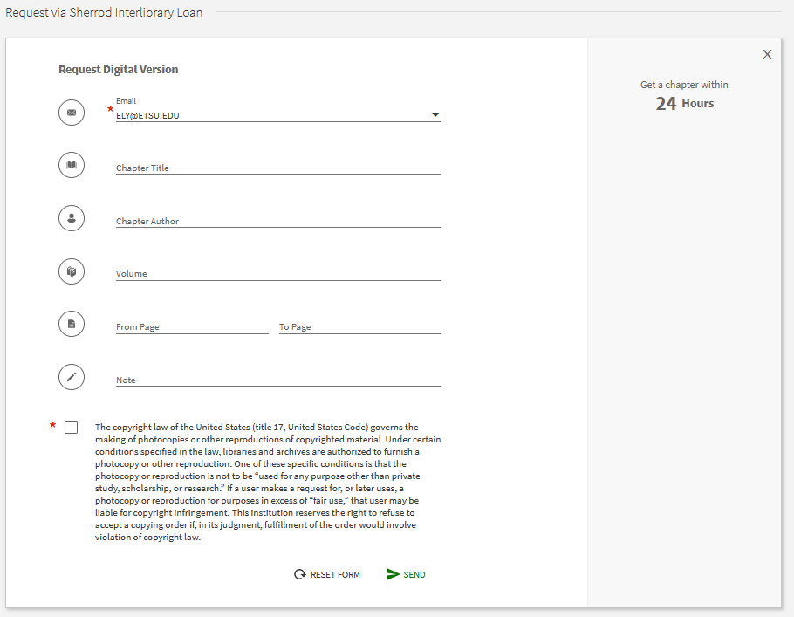
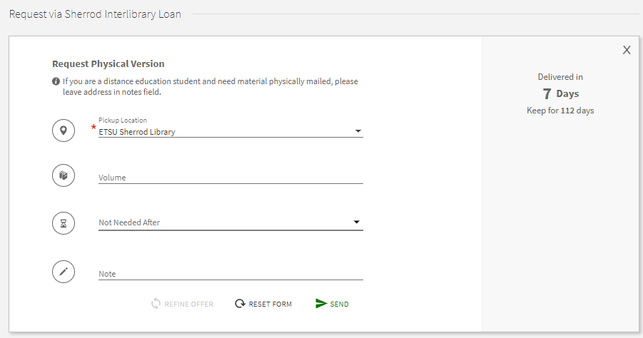
Request Forms
The forms are not super customizable / Digital & Physical forms share fields
Blank form imports "chapter title" into wrong field -"chapter note" resulting in staff mediation for each request

Slide 15

Workflow tips
"Not wanted after" date field
Bulk add labels
Enrich from Global Index
Don't use the Send button
Customize your sets
Use the "assign to" function to "route" requests
Use the "change status" option

Slide 16

Self-owned mediation rule
Self-ownership check is NOT on the configuration "to-do" list
Rapido recommends instead hiding Rapido offers for "owned" materials
Leaves patron with no option if resource link is broken, except to use blank ILL form to manually create request
If you do allow Rapido offers for all items, Rapido recommends turning on "Self-Owned" mediation rule to check for local availability
"Self-Owned" mediation rule CANNOT currently determine coverage beyond title, resulting in LOTS of staff mediation.
Rely on "local holding" built-in function instead

Slide 17


How things are going
Borrowing requests since go-live are up 71%
Lending requests are roughly the same
Still learning workflow improvements, features, as well as issues
Connected our first ISO partner!
Built up our ALA partner email list
Getting more comfortable customizing sets and interface settings
Trained lending staff members (both report easy to use)
Positive patron feedback about ease of use
Overall, happy with our transition to Rapido

Slide 18
May Statistics
Borrowing | May ILLiad | May Rapido
Digital | 598 | 932 | +44%
Physical | 78 | 344 | +126%
Doc Del | 30 | 210 | +150%
Unfilled | 20 | 34
Total | 706 | 1,486 | +71%
Lending | May ILLiad | May Rapido
Digital | 393 | 440
Physical | 71 | 21
Unfilled | 204 | 164
Total | 668 | 625 | -6%

Slide 19
Borrowing outside of Rapido
 | Rapido | Non-Rapido
Digital | 890 | 17
Physical | 181 | 129
Total | 1,070 | 146
12% of requests borrowed in May were from non-Rapido partners (2% of articles, 41% of loans)

Slide 20

Types of Partners
Rapido Pods
Peer-to-Peer
ILLiad Lending Accounts
ALA Email
Reprints Desk/CCC

Slide 21

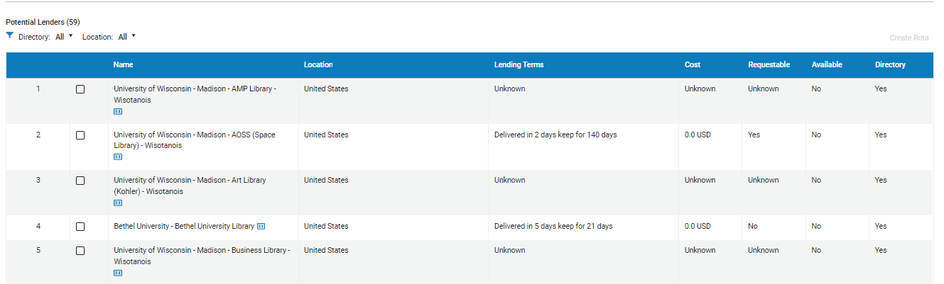
Finding Lenders
Alma Resource Sharing Directory
WorldCat
Checking library catalogs

Slide 22

ALA Form/ Email Workflow
Not all libraries respond :-(
Requires manually updating request statuses
If book doesn't arrive within 2 weeks, move to the next lender
Add "will not lend" to library name in partners list for libraries that will not accept ALA forms or for other reasons will not lend

Slide 23



TET, please submit this request via OCLC
In the beginning, expect to do a lot of explaining about why you are making a request outside of OCLC
Expect emails from other libraries telling you your own OCLC symbol

Slide 24

Things we love
Improved user experience
Long loan periods/fast shipping
Automation
Ability to easily create sets and customize set views for each staff member
Global Index for enriching request metadata
Copyright Management
Rapido monthly webinar updates / improvements

Slide 25

Things we don't love
Ex Libris Training videos /documentation
Letters/forms that are used for multiple purposes
Manually tracking ALA Forms
Users can't see full request history
Not all outgoing emails are attached to the request
Document Delivery workflow
Issue with EBSCO databases not importing chapter title in correct field

Slide 26

Partner with us!
Alma Resource Sharing
ISO connection with ILLiad
ALA Interlibrary Loan Forms
Reach out to libloan@etsu.edu if you're interested in partnering with us!

