Slide 1
The good, the bad, and the fun: using alma advanced search and analytics for data cleanup projects
Yoko Ferguson & Kimberley Edwards
2023 DC Ex Libris Regional User Group Meeting
November 3, 2023

Slide 2


Hello!
Yoko Ferguson
Cataloging & Metadata Librarian
University of the District of Columbia
Kimberley Edwards
Head, Database Integrity & Analysis
George Mason University

Slide 3
Characteristics
(the good & the bad)

Slide 4
Advanced search
Pros
Cons
Works well with a smaller set of records
Lists current records only
Multiple people can work on the same set simultaneously
Indexes some fields that Analytics doesn’t
Through indication rules, you can perform even more robust searches on bibliographic records
Harder to keep stats
Lists current records only
Not everything is indexed
If you want to export your list, limited in both fields and list size

Slide 5
Analytics
Pros
Cons
Easier to keep stats
Much more in depth searches possible (e.g., using SQL or regular expressions)
Lists all records (including deleted data)
Can create reports & dashboards and share with users
Limited number of fields indexed
Data is at least 24 hours out of date
Steeper learning curve
Lists all records (including deleted data)

Slide 6
Practical applications
(the fun)

Slide 7
Sample searches for Data cleanup projects
Advanced search
Analytics
Bibliographic rank*
Bibs missing subjects
Detailed field searching*
Titles in ALL CAPS*
Holdings/call number cleanup
SQL examples*
Regular expression examples

Slide 8
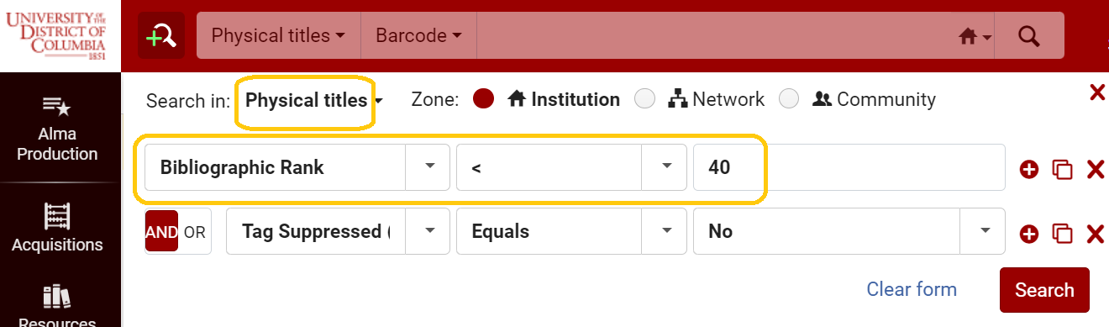
Advanced search – BIbliographic rank
Excludes suppressed bibs

Slide 9
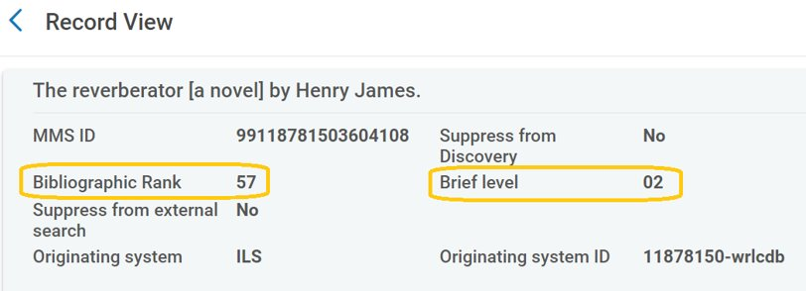
Advanced search – BIbliographic rank
Determined by the Bibliographic Rank algorithm; same across every institution and the zones;
ranges between 1-120; higher than 75 considered good records
Customizable by each institution; ranges between 01-10

Slide 10
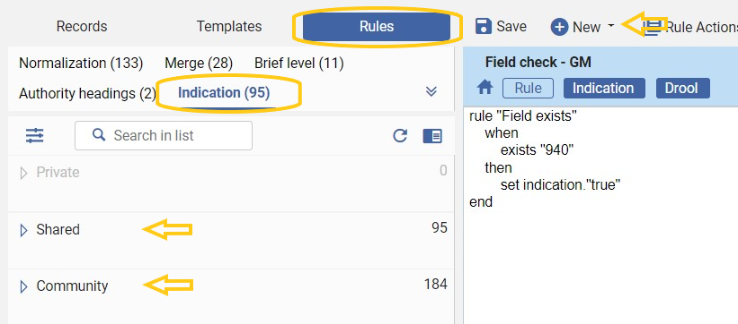
Advanced search – detailed field searching
*Important for rules to be saved as "Shared"

Slide 11
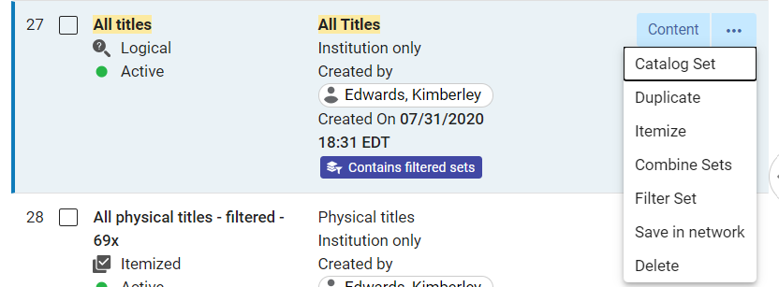
Advanced search – detailed field searching
New set created using indication rule filter

Slide 12
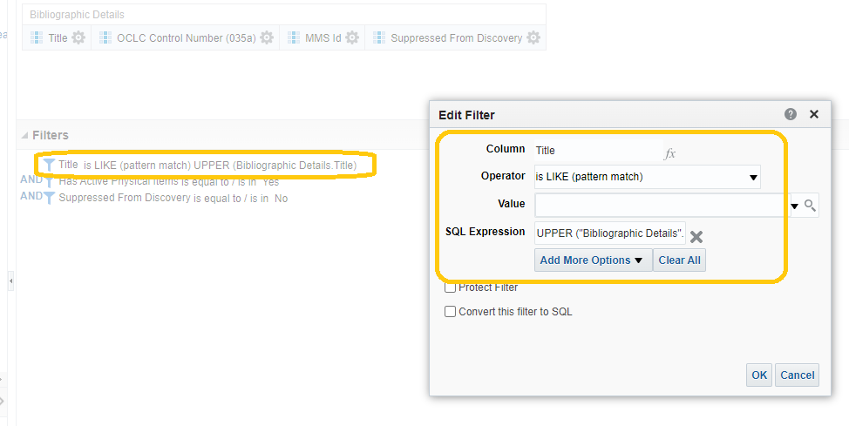
Analytics – Titles in ALL CAPS
SQL Expression: UPPER ("Bibliographic Details"."Title")

Slide 13
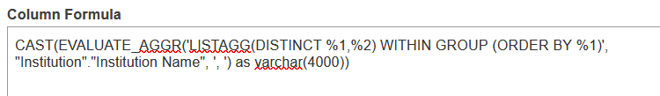
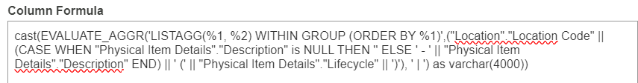
Analytics – SQL examples

Slide 14
Additional resources
Alma & Analytics listservs
Existing reports in the Alma and Community folders in Analytics
Ex Libris Alma Analytics: Become an Expert:
  https://knowledge.exlibrisgroup.com/Alma/Training/Webinars/Alma_Analytics%3A_Become_an_Expert
Analytics example sites:
  SQL: https://developers.exlibrisgroup.com/blog/alma-analytics-sql-filter-examples/
  Regular expressions: https://developers.exlibrisgroup.com/blog/alma-analytics-regular-expression-examples/

Slide 15
Questions?
Yoko Ferguson Kimberley Edwards
yoko.ferguson@udc.edu kedwar13@gmu.edu

Slide 16
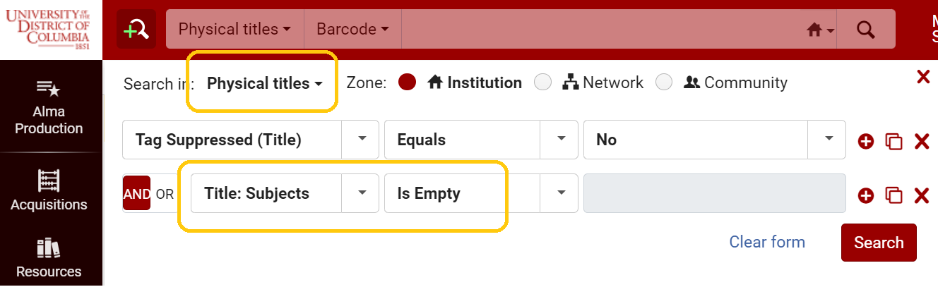
Advanced search - BIbs missing subjects
Similar searches:
Title:OCLC Controll Number -- Is Empty
Holdings:Has items -- Equals -- No
Physical item:Process type -- Equals -- In Process ...etc.
Excludes suppressed bibs

Slide 17
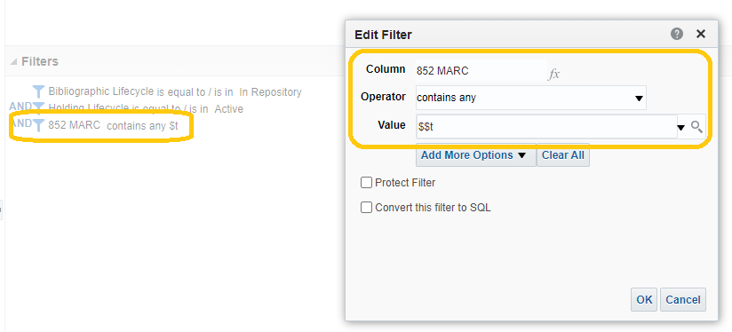
Analytics – Holdings/call number cleanup
Call numbers with a subfield "t" (simple)

Slide 18
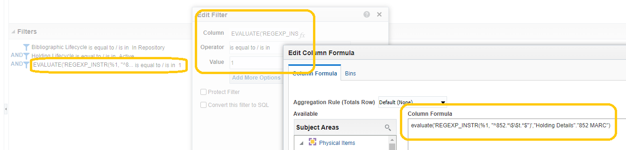
Analytics – Holdings/call number cleanup
Call numbers with a subfield "t" (more advanced)
Column Formula: evaluate('REGEXP_INSTR(%1, ''^852.*\$\$t.*$'')',"Holding Details"."852 MARC")

Slide 19
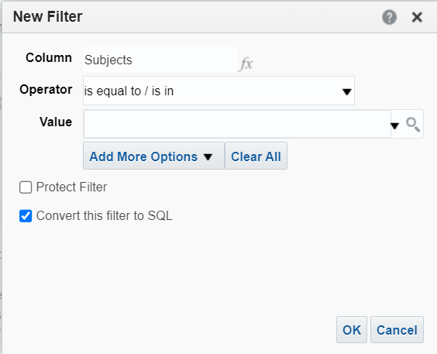
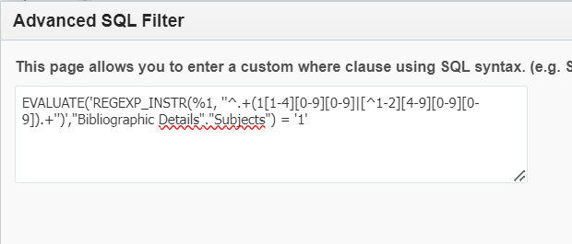
Analytics – Regular expression filters
Including only subject headings with specific numbers in the subject headings

