Slide 1

DCRUG Annual Meeting
October 25, 2024
Jason Griffith
ELUNA Chair, 2024-2027

Slide 2
About ELUNA?
Ex Libris Users of North America
Who we are:
  A not-for-profit, volunteer-based advocacy and educational membership organization for libraries using Ex Libris products
  Independent organization from Ex Libris
  Over 1,400 institutions across the US, Canada, Central America, and beyond
  Members include academic, public, government, corporate libraries and consortia
What we do:
  Connect member institutions
  Works toward improvement of Ex Libris Products
  Provides space for networking and dialog among membership
Mission, goals, and values:
  Education
  Networking
  Advocacy

Slide 3
ELUNA Membership Types
Membership Type | Annual Fee
Individual Institution | $380.00
Consortia (2-5 Members) | $600.00
Consortia (6-25 Members) | $705.00
Consortia (26-50 Members) | $815.00
Consortia (51+ Members) | $1,000.00
  Membership dues will not increase in 2025!

Slide 4
ELUNA Membership Benefits
  Institutional level membership
  Voting in enhancement process, SC elections
  Reduced registration fee at ELUNA Annual or ELUNA Developers Day+
  Complimentary access to ELUNA Learns Series (dues increase 2023)
  Access to ELUNA Document Repository
  Participation in Leadership Groups

Slide 5
ELUNA Initiatives
  Changes to product enhancement voting software and rebranding
    Enhancements Portal (Aha!) and Voting Portal (ElectionBuddy) launched in Summer 2024
    NERS retired
    CERV
  New Leadership Groups
    Alma-D Product Working Group
    Support Advisory Group
    Documentation Advisory Group
    Accessibility Community of Practice
  ELUNA Website redesign
    Improve accessibility and mobile view
    Clean up
    Currently working on mock-up
  Communication and Outreach
    Steering Committee/Product Working Groups
    Community at large

Slide 6
ELUNA Initiatives
  AI in Ex Libris Products
    Primo Research Assistant
    Cataloging Assistant
    Collecto
  Support for product enhancement cycle for first time products
    Alma-D
    Rapido/RapidILL
    Esploro
    Rosetta
  New policies for organization
    Conflict of Interest Policy
    Whistleblower Protection Policy
    Document Retention Policy
  Organizational changes
    501c3 vs 501c6
    Membership levels

Slide 7
Product Enhancement Cycle Rebranding (2024)
No more “NERS”, get ahead of the CERV!
CERV = Community Enhancement Requests and Voting
Platforms
  Enhancements Portal (Aha!)
  Voting Portal (ElectionBuddy)
Enhancements Portal User Guide
Instructions to update Institutional Profile in WildApricot

Slide 8
More CERV Details
Shared Software Agreement
Voting Rights
  Each member institution has 100 votes for the products it licenses
Voting Process
  Ballots made by exporting from Enhancements Portal to Voting Portal
  Voting links are generated and sent to institutional contact
  Three reminders are sent while voting is open
Important tips
  Make sure your software profile is up to date in Wild Apricot!
  Make your votes count!
Typical life of an enhancement cycle
    Call for enhancement requests with deadline made by WG
    WGs review enhancement requests
    Ballots are generated and sent
    Members vote
    WGs review enhancements voted on, grabs top 20, and send to ExL Product Manager for “pointing”
    Ex Libris “points” enhancement (“points” = development time needed to complete enhancement; 150 total)
    Second round of voting (if necessary)

Slide 9
Product Enhancement Cycle 2024-2025

Slide 10
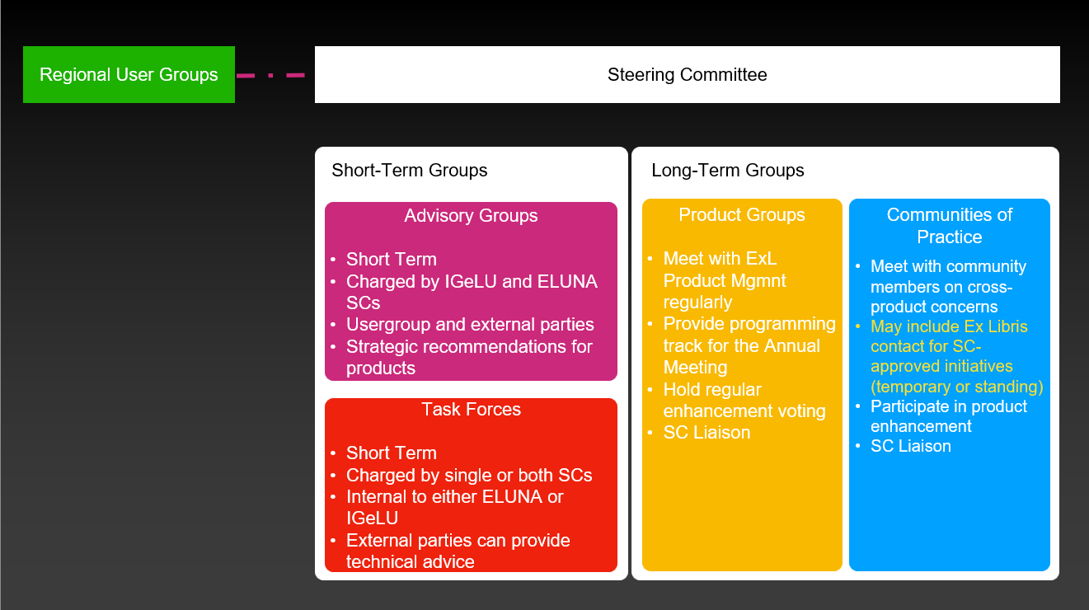
ELUNA Leadership Groups

Slide 11
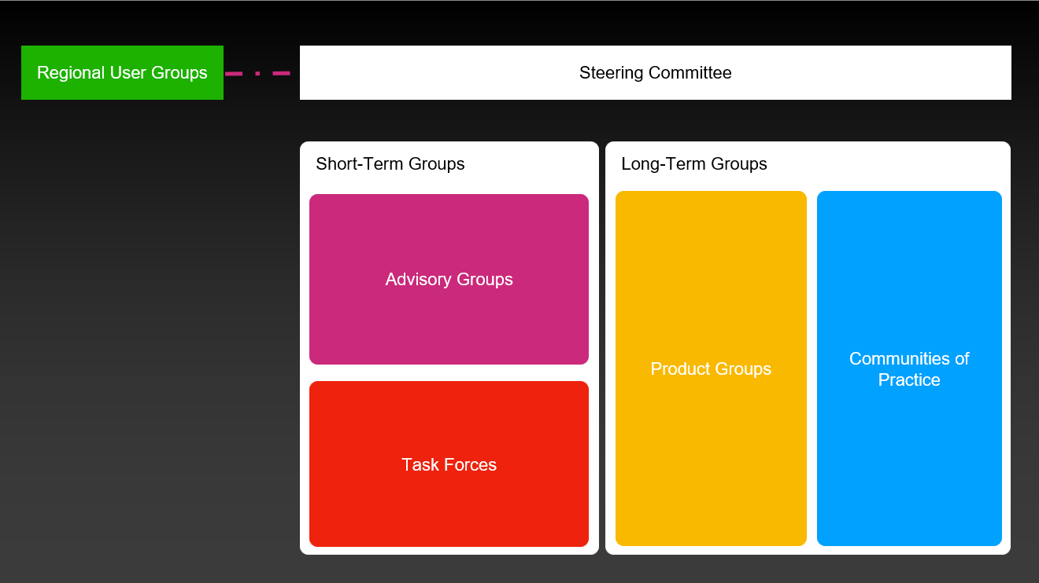
ELUNA Steering Committee
  9 members elected at large (voting members)
    Jason Griffith (Chair)
    Allen Jones (Liaison to Alma, SFX)
    Ryan Edwards (Secretary; Liaison to Rialto)
    Kirsten Clark (Liaison to Leganto, Communities of Practice)
    Karen Glover (Liaison to RUGs; Support Advisory Group)
    Lori Hilterbrand (Liaison to Rapido, RapidILL)
    Holli Kubly (Liaison to Content; Accessibility Community of Practice)
    Tabitha Ochtera (Liaison to Primo, Summon/360)
    David Schuster (Liaison to Esploro, Alma Digital, Rosetta)
  3 Ex-Officio Members
    John Greer (Technology)
    Laura Morse (Education/Conference)
    Ellen Jones (Treasurer)
  Officers
    Chair (elected by Steering Committee)
    Vice-Chair/Chair Elect (elected by Steering Committee; only present in final year of chair’s term)
    Past Chair (only present for one year after Chair’s term ends)
    Secretary (appointed role)

Slide 12
Working Groups (WGs)
Current WGs
  Aleph
  Alma (Joint)
  Alma Digital (Joint)
  Content (Joint)
  Esploro (Joint)
  Leganto
  Primo
  RapidILL
  Rapido
  Rialto (Joint)
  Rosetta (Joint)
  SFX (Joint)
  Summon/360
  Voyager
Officers
  Chair
  Secretary
  Enhancement Coordinator
  Education Coordinator
Sub-groups
  Focus Groups
  Functional Groups

Slide 13
Communities of Practice (CoPs)
Active CoPs
  Analytics (Joint)
  Consortia
  Linked Open Data
  National/State/Corporate (Joint)
  Special Collections
  Accessibility (new)
Inactive CoPs
  Interoperability (Joint)
Officers
  Chair
  Secretary
  Education Coordinator
Sub-groups
  Focus Groups

Slide 14
Advisory Groups (AGs)
Current AGs
  Diversity, Equity and Inclusion (DEI)
  Central Discovery Index (CDI)
  Support Advisory Group (SAG) – new in 2023
  Documentation Advisory Group (DAG) – new in 2024
Inactive CoPs
  Controlled Digital Lending (CDL)
  Authentication
  Bias in Search Applications
  Enhancement Voting Process

Slide 15
Task Forces
  Current Task Forces
    Conference Planning
    Governance
    Equity, Inclusion, and Diversity
    Shared Technology Infrastructure
    Code of Conduct
    Website

Slide 16
Regional User Groups (RUGs)
  Canada
    Eastern Canada User Group (ECUG)
    Western Canada User Group
  United States
    California User Group (eCAUG)
    Bluegrass Users Group (eBUG) (formerly KVUG)
    DC Regional User Group (DC RUG)
    Georgia (GIL) Users Group (GUGM)
    Great Lakes User Group (GLUG)
    Hawaii User Group (HUG) (formerly HVUG)
    Northeast User Group (ENUG)
    Northwest User Group (NWEG)
    Pacific Northwest User Group (PNWUG)
    Southcentral Users Group (ELSUG)
    Southeast User Group (ELUNA-SE)
    Southwest User Group (eSWUG)
    Upper Midwest Users Group (UMWUG)

Slide 17
ELUNA’s Relationship with IGeLU and Ex Libris
International Group of Ex Libris Users (IGeLU)
  Quarterly meetings between Steering Committees
  Bi-Weekly meetings between Chairs
  Joint PWGs, CoPs, AGs, Task Forces
  All member institutions of both organizations vote in product enhancement process
Ex Libris/Clarivate
  Product Managers work directly with WGs
  Quarterly Senior Management meetings with SC Chairs
  Sponsorship of ELUNA Annual Conference
  Ex Libris Knowledge Days

Slide 18

ELUNA Events - 2024
Developers Day+: May 13-14, 2024
Ex Libris Knowledge Days: May 13-14, 2024
Analytics Afternoon: May 14, 2024
Bridging the Gap: Annual Meeting in Review (June 3-5, 11-12, 2024)

Slide 19

ELUNA Events - 2024
ELUNA learns – E-resource Management – 10/2/2024
ELUNA learns – Alma Analytics – 10/9/2024
ELUNA learns – Acquisitions – 10/16/2024
ELUNA learns – Workflows- 10/23/2024
ELUNA learns – Alma Admin Configurations – 10/30/2024
ELUNA learns – Discovery – 11/6/2024
ELUNA learns – Emerging Technologies – 11/13/2024
ELUNA learns – Fulfillment – 11/20/2024
ELUNA learns – Resource Management – 12/4/2024
ELUNA learns – Resource Sharing – 12/11/2024
For details and registration visit https://el-una.org/2024/10/registration-now-open-eluna-learns-2024/
All sessions are held from 1:00pm-4:00pm EST
Join live or watch on demand
Individuals from ELUNA member institutions do not pay a registration fee
$25 registration fee for individuals from non-member institutions

Slide 20

ELUNA Events - 2025
Developers Day+: June 16-17, 2025
Ex Libris Knowledge Days: June 16-17, 2024
Analytics Afternoon: June 17, 2024

Slide 21
Get Involved!
Communicate
    Join Listservs – specific to products, organization types, RUGs, etc
Present
Network
Volunteer for Leadership Groups
    Anyone from an institution licensing products can volunteer
    One member per institution
    Keep an eye on product lists for volunteer calls for PWGs; ELUNA list for SC
Vote in product enhancement process and elections

Slide 22
Resources
ELUNA – more information about ELUNA, news stories, job postings
ELUNA Document Repository – view presentations, newsletters, etc.
ELUNA LibAnswers – ask a question to the ELUNA SC
Wild Apricot – search for ELUNA member institutions, update institution profile
Ex Libris – more information about Ex Libris
Ex Libris Knowledge Center – support articles, training documents for Ex Libris products
Ex Libris Developer’s Network – information about APIs, Cloud Apps, Tech Blog
Ideas Exchange – submit and vote on ideas for Ex Libris products
IGeLU – more information about IGeLU

Slide 23
Questions? Contact Us
  Jason.Griffith@uky.edu
  ELUNA-SC@exlibrisusers.org
Thank you!

