Slide 1

Migration to Primo VE : Communicating Change and Responding to Feedback
Ben Bradley, Discovery Strategies and Systems Librarian
Matthew Cain, Life Sciences/Open Science Librarian
Andrea Schuba, Monographs Cataloging Librarian

Slide 2


Migration Background
Member Library of the University System of Maryland and Affiliated Institutions Library Consortium (USMAI)
  17 Member Consortium
  Shared Aleph Instance
UMD’s original systems:
  ILS: Aleph (and WMS Collection Manager)
  Discovery system: WorldCat Discovery (Premium)
  Link Resolver: OCLC Link Resolver
Timeline:
  Contract awarded, January 2023
  Kickoff, August 2023
  Test environments received, November 2023
  Cutover April 1 - May 22, 2024
  Go-Live, May 23, 2024
  Fall semester first day of classes, August 26, 2024
Notes:
Recently, the University of Maryland migrated to Alma and Primo VE as part of the University System of Maryland and Affiliated Institutions’ (or USMAI) migration. USMAI has 17 members and managed a shared Aleph instance for an ILS, and UMD used WorldCat Discovery Premium.
USMAI awarded the contract to Ex Libris in January 2023, with the project kicked off in August 2023. The test environments were delivered in November 2023. Cutover started on April 1st and we went live on May 23rd. While we do have summer courses, the real test of the migration wasn’t until the Fall semester which started on August 26th.

Slide 3
Primo Discovery Implementation Working Group
Formed in November 2023
Charge : Working as a subgroup of the ILS Migration Task Force and collaborating with USMAI groups as necessary, the Primo Discovery Implementation (PDI) Working Group is charged with collaboratively planning for the configuration and implementation of the Primo discovery platform and integration into research and teaching content, tools, and guides for users.
UMD Libraries Faculty and Staff PDIWG members are 4 subject specialists, 1 teaching and learning librarian, 2 access services staff, 1 cataloger, 1 collection development librarian, 1 systems librarian, and 1 UX/UI designer.
Notes:
The Primo Discovery Implementation Working Group was formed in November 2023.
Our Charge is Working as a subgroup of the ILS Migration Task Force and collaborating with USMAI groups as necessary, the Primo Discovery Implementation (PDI) Working Group is charged with collaboratively planning for the configuration and implementation of the Primo discovery platform and integration into research and teaching content, tools, and guides for users.
PDIWG members are all from UMD Libraries and the current members are 4 subject specialists, 1 teaching and learning librarian, 2 access services staff, 1 cataloger, 1 collection development librarian, 1 systems librarian, and 1 UX/UI designer.

Slide 4
Subject Specialist Outreach for UMD Discover Rollout
Communication began early and focused on notifying departments of key dates and changes.
Some of the important outreach included:
New libraries’ webpage outlining key dates & changes;
Detailed announcements sent to department librarian liaisons;
Allowing faculty to preview the new search platform;
Instructions to preserve/migrate saved searches from WorldCat to Primo.
Notes:
Communication began early and focused on notifying departments of key dates and changes. Some of the important outreach efforts between the Libraries, subject specialists and faculty included:
We added a new webpage to our Libraries’ homepage called “UMD Discover: New Library System and Search Experience Coming Soon” that went over key dates and the changes made on those dates. The Libraries wanted to outline the dates that the changes would be made and how exactly users would be impacted. We frequently included links to our Ask Us and contact your subject librarian services to support inquiries about the process and outlined the benefits of making the switch to UMD Discover.
Announcements were sent to department librarian liaisons to distribute to their faculty. These announcements included how the migration would possibly disrupt important instruction and acquisition services while also detailing how the Libraries sought to minimize these disruptions.
Faculty could preview the new search platform and share their experiences and feedback via a feedback form and emailing the working group directly.
We sent instructions to help faculty preserve and migrate lists and saved searches from WorldCat to UMD Discover. We also troubleshooted this migration process with subject specialists as new issues arose that we did not foresee such as migration from our classic catalog rather than from worldCat.

Slide 5
Resources Created to Support Faculty With the Migration
Created a special LibGuide on UMD Discover:
Focused on important tips and tricks for accessing and searching UMD Discover.
Emphasized how the new features improved on WorldCat.
Created four UMD Discover help videos that covered:
What's in UMD Discover?
Using Your Account
Searching for Articles in UMD Discover
Searching for Books in UMD Discover
Notes:
The working group created a special LibGuide on UMD Discover that goes over the basics of using UMD Discover.
The guide focused on important tips and tricks for accessing and searching UMD Discover, including the importance of signing into your account, labeling favorite items and saving searches, and advancing searching using boolean operators and wildcards. We wanted to also emphasize how the new features in UMD Discover improved on WorldCat. These included the new Call Number Browse where patrons can choose between four call number types, Voice to Text Searching, and searching our top textbooks.
The Libraries’ Teaching and Learning Services Division created four UMD Discover help videos that covered:
What's in UMD Discover, covering how to access UMD Discover and what tools are available to help search UMD Discover.
Using Your Account, covering the "My Account" tabs and functions, how to manage saved and favorite searches, view borrowed materials, and manage library fines.
Searching for Articles in UMD Discover, covering how to filter and refine your search results, how to access academic articles, and how to save searches to your account.
Searching for Books in UMD Discover, covering how to search for and request books in UMD Discover.
All these resources are available for subject specialist use in instruction and teaching sessions, and were promoted as such.

Slide 6
Issues Reported to Subject Specialists from Faculty
Issues arose following the UMD Discover rollout that faculty report to their subject specialist.
Some common problems involved service connection issues, issues with deduplication, and inconsistent results.
The result from these issues is that researchers are going to WorldCat Discovery and reverting to the Libraries’ general, but non-local version.
Notes:
Since the rollout of UMD Discover, common issues have been reported to subject specialists, and then directed to the working group.
Some common reported problems involved service connection issues to items and databases, issues with deduplication of item records, and inconsistent results when searching. The deduplication issue in particular was frequently reported on as faculty had trouble finding a specific edition for a book as the system was combining/mismatching modern editions with older ones thereby mislabelling access.
The result of these issues is that our faculty are reverting back to WorldCat and using our now general, non-local version and at times finding better results.

Slide 7
Conversation with UIUC: Experiences & Lessons Learned
Met with Michael Norman, Discovery Services Librarian at UIUC.
Led massive implementation of the entire Illinois consortium.
Topics covered included how the public dealt with the migration, how guides were updated with the new primo information, user studies, primo configuration settings.
The information gained helped our group prioritize what to focus on and also possible best strategies with rolling out Primo.
Notes:
The working group met with Michael Norman, Discovery Services Librarian at the University of Illinois at Champaign-Urbana, my alma mater. Michael was and is in charge of their primo implementation, which was a massive effort that involved the entire Illinois consortium, called I-Share, of 84 libraries. The migration included 11 million bib records and about 46 million item records.
Our meeting covered several topics including how the public at Illinois dealt with the migration to Primo, how the library guides were updated with the new primo information (whether it was automated or done manually), user studies conducted and whether the results were integrated into Primo, and primo configuration settings and especially prioritization of those settings.
The information from Michael helped our group understand how another university migrated a huge catalog to Primo, and allowed us to prioritize what to focus on and also possible best strategies with rolling out Primo, some of which we did do such as the heavy promotion and instruction components to both subject specialists and faculty.

Slide 8
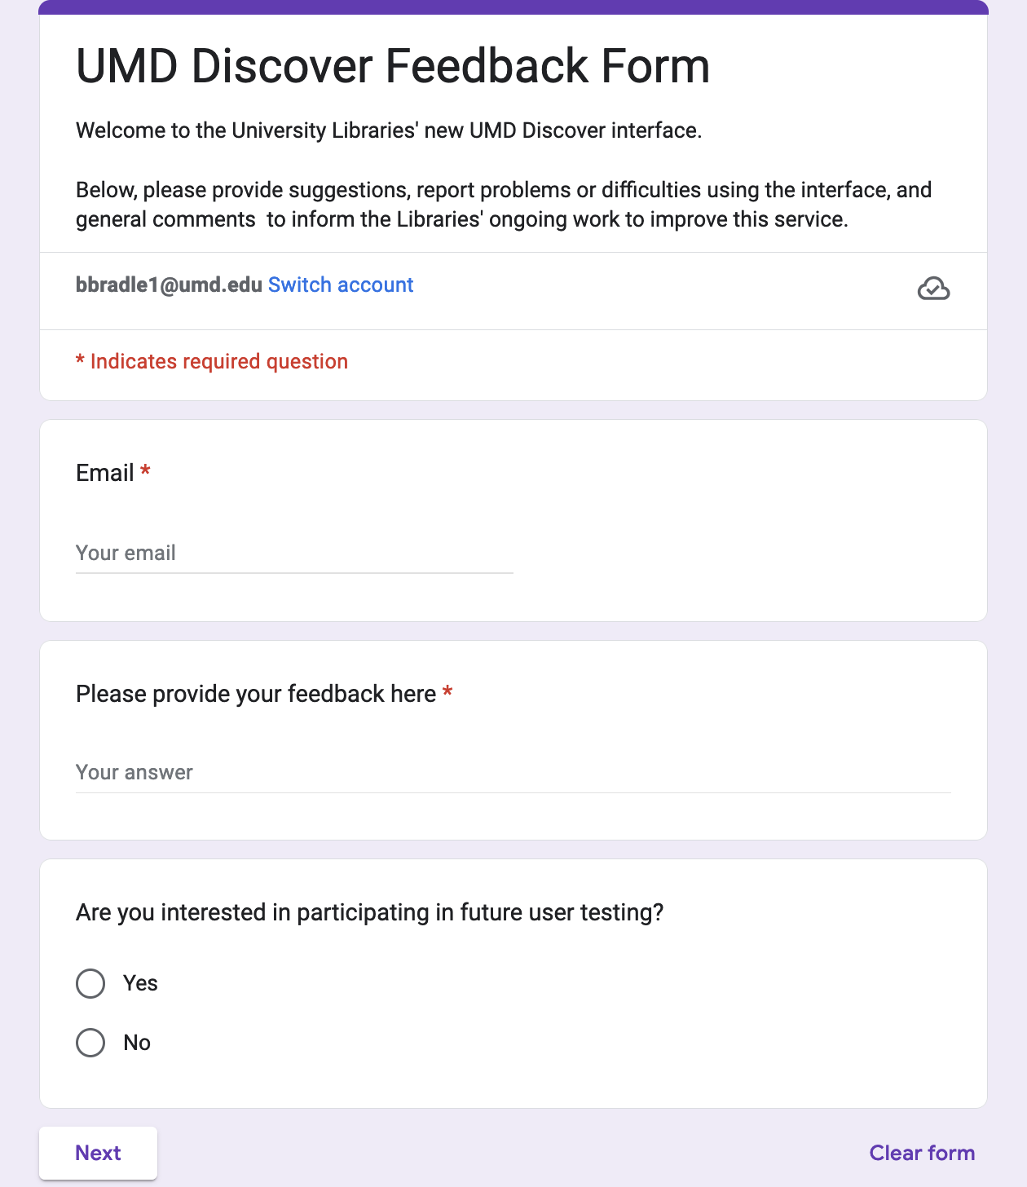
Primo VE homepage feedback form
Placed on Primo VE homepage
Only includes fields for email, general feedback, and an opt-in option for user testing
Followed up with folks who provided feedback
Notes:
One method for collecting feedback was a form linked to from the Primo homepage. It featured a free-text field for providing general feedback and asked for an email address and if the respondent wanted to opt into possible future user testing. The form was first put up during the test-load phase of the project when we were first configuring Primo. The feedback provided an opportunity to find any major pain points that we would need to address.
With the opt in feature, we have been able to collect a list of folks who are willing to work with us for user testing which will be helpful in the near future. Moreover, by collecting emails, the group was able to follow up with respondents to check-in about their feedback and provide any updates.

Slide 9
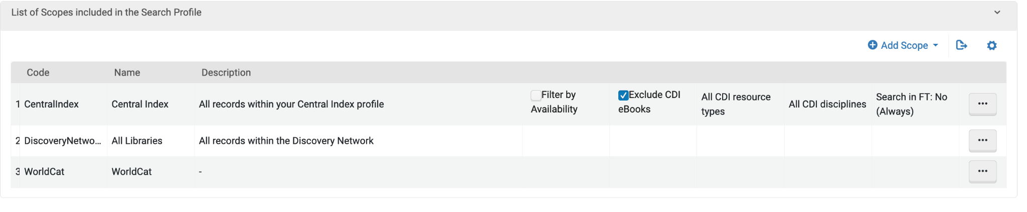
Adding the WorldCat API Index as a Scope
Feedback:
  “Not easy to figure out how to search WorldCat”
  “It was only WorldCat that had the item, and it came up instantly”
Implemented WorldCat Search API index in default search slot
No noticeable performance issues
  Using “&show_performance=true” to compare performance of searches using and not using WorldCat Index
  People possibly thinking of WorldCat webhook rather than API
Notes:
One of the major issues surfaced first in the feedback form was that using Primo rather than WorldCat was a challenge for our users. And this isn’t just in a sense that people simply didn’t like the new interface or were resistant to change. Rather, WorldCat provided better discovery of, in particular, books. In Primo, generally our users can only find a book if USMAI owns, but in WorldCat our users were able to see and request books from a broader set of holdings. As a library that is very ILL forward, especially with our Big Ten colleagues, this kind of discovery is something our users are after.
With this information in hand, however, it was difficult to decide on whether or not to implement the WorldCat API as an index searched by our default search slot. We heard from Ex Libris project team that WorldCat may cause performance issues and it is best to include it as a separate search slot. We started working on making links to WorldCat more visible within Primo, while testing the WorldCat API. Adding WorldCat to the default search slot in a test Primo view didn’t seem to show any performance issues, but with the warnings that it could still cause problems we were hesitant to implement it. When we continued to receive feedback, our group agreed that it was worth the risk to add the scope, so our default search slot included the index. I have been monitoring the performance of Primo by appending “ampersand show underscore performance equals true” to urls and comparing the performance to a search with and without the WorldCat index. While I am planning to monitor Primo for the whole semester, I still haven’t seen any indication that it causes serious performance issues. I believe that folks may have the API integration confused with the webhook integration.

Slide 10
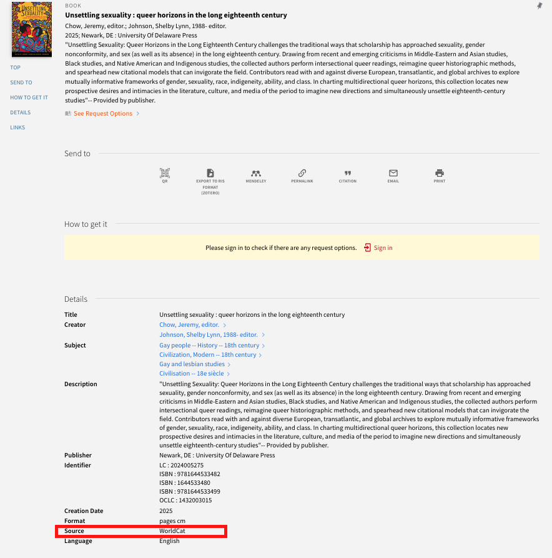
Notes:
Here is just a screenshot of a record displaying from WorldCat. This title was published this month by the University of Delaware Press and would not be discoverable in our Primo VE interface without the WorldCat integration.

Slide 11
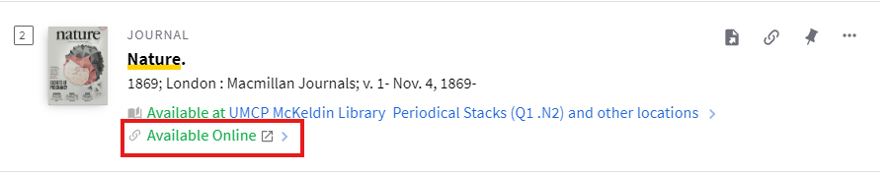
Available Online Links in the Search Results Pages
Previously, the “Available Online” links in the search results pages navigated directly to a database, even when an online resource was available through multiple databases.
We reconfigured this feature so that the link in the search results page navigates to the full catalog record when there are two or more online links to a resource.
Notes:
Another change that we made was related to links to online resources. When a user searches the catalog and views the search results pages, they will see availability information in each brief record view and this information is also a link. Previously, the “Available Online” links in the search result pages navigated directly to a database, even when an online resource was available through multiple databases. We reconfigured this feature so that the link in the search results page navigates to the full catalog record when there are two or more online links to a resource. This way, users can choose which database or website that they navigate to.
The example on this slide shows the record for Nature in the search results page. Previously, the available online link navigated to the EBSCO Academic Search Ultimate database and this only holds volumes and issues from 1997 to 2015. However, UMD also has access to the full run of Nature starting with the first volume published in 1869 through Nature’s website. Because the Search Results page link only navigated to a portion of volumes from Nature, users clicking on this link would miss the vast majority of Nature articles even though UMD affiliates can access all of them.

Slide 12
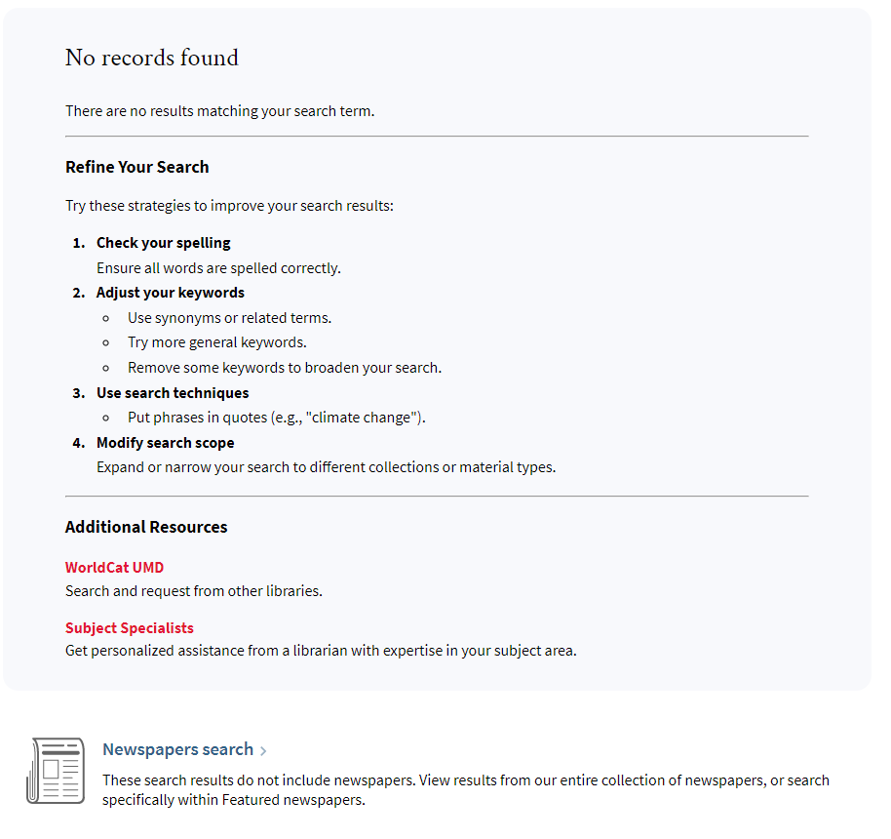
Notification when a search yields no results
Notes:
We also received feedback from users that hitting the no records found page was frustrating. While suggestions to refine a search can be helpful, sometimes there are just occasions where simply the book isn’t showing up. Before we included the WorldCat API, a link to WorldCat enabled our users to find books not held by USMAI. But another option might be google scholar or the library’s databases. Referring our users to our subject specialists can help them get help if perhaps they are a new researcher or have a very specific topic which the system might not handle well (maybe something with scores). This is a way to add a door to a dead end.
The code for this change was largely borrowed from SUNY.

Slide 13
Displaying and Indexing MARC Fields
The Cataloging and Metadata Department investigated MARC fields that were not displaying in catalog records and/or were not indexed.
This investigation resulted from a patron inquiry about the language of subtitles in a film and a PDIWG member’s discovery that some fields for music resources were not displaying.
The Discovery Strategies and Systems Librarian used normalization rules in Alma to allow MARC fields to display when they provide important and sometimes necessary information to patrons.
Notes:
The Cataloging and Metadata Department investigated MARC fields that were not displaying in catalog records and/or were not indexed. This investigation resulted from a patron question about the language of subtitles in a film. They wanted to know if a non-English movie had English subtitles. This question came to me via a subject specialist and I found out that the 546 field for language was not displaying. Additionally, a PDIWG member who is also a music librarian found out that some fields for music resources were not displaying.
I contacted other employees in the Cataloging and Metadata Services department so that we could create a list of MARC fields that need to be displayed or indexed. The Discovery Strategies and Systems Librarian used normalization rules in Alma to allow MARC fields to display when they provide important and sometimes necessary information to patrons. When it comes to indexing, UMD needs to contact Alma in order for fields to be indexed. This is ongoing and we notify the Discovery Strategies and Systems Librarian when we encounter more MARC fields that should display.

Slide 14
Displaying MARC Fields
Fields that originally did not display in catalog records
245 $c (statement of responsibility)
500 (general note)
504 (bibliography, etc. note)
511 (participant or performer note)
518 (date/time and place of an event note)
546 (language note)
590 (local note)
Notes:
Here are some of the MARC fields that currently display in Primo records although they did not originally display. The 245 $c records creators and contributors, such as authors or editors, as they appear on the cataloged work. This currently displays as an attribution and this attribution may display information such as “edited by” or “translated by”. Before this displayed, users only saw creator and contributor information based on how they were recorded in 1xx MARC fields and 7xx MARC fields. So, in general, users saw creator and contributor access points that generally come from their name authority records. These access points are necessary to display. However, the access points can leave out a creator or contributor’s specific role in creating a work. Some names are listed with terms like “author” or “editor” and some aren’t. Additionally, the way that a creator or contributor’s name is recorded on a work can be different than their access point. For example, a middle name or middle initial may be recorded in one place but not the other. So, this subfield gives users more information about creators and contributors and it’s important to display access points and the statement of responsibility.
The 500 field is great for recording general notes about a work when there isn’t a more specific note field. So, this can give a user important information about a work. The 504 field lets users know when there are references in the cataloged work, such as a bibliography, filmography, or discography. The 511 note is used a lot for sound recordings and lets users know who narrated, performed, presented, or otherwise participated in creating the sound in a sound recording. The 518 note displays the date and time of a sound recording, which allows a user to know the history of that sound recording. The 546 note includes language information. For example, it can indicate if a resource has text or sound in multiple languages or if the resource is a translation. It also records the languages of subtitles in a film. The 590 note is a local note that records information relevant to a specific item. For example, it could include binding information for a hand-press era book, marginalia, or an autograph. One way that users could find use in the 590 note is if they are researching print history and they are looking for works that are constructed in a specific way or marked in a certain way.

Slide 15
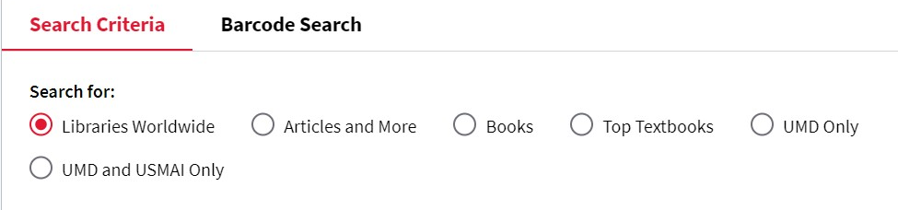
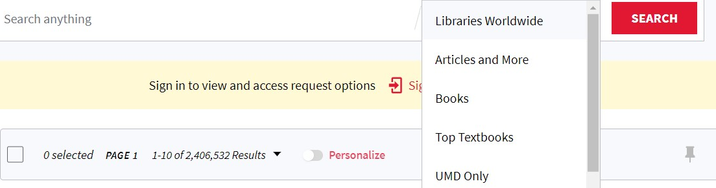
Changing “Everything” to “Libraries Worldwide” as search criteria
Advanced Search
Basic Search
Notes:
Another PDIWG activity was to work with wording in UMD Discover. These screenshots show “Libraries Worldwide” as a current search criteria in basic and advanced search. It replaced the word “everything”. We struggled to determine how to explain what the search filter for “everything” meant since it included results from the Central Discovery Index, but it was not as comprehensive as WorldCat. We also didn’t know to describe how it was different from UMD or USMAI results because we would need to describe what the Central Discovery Index is to users. We discussed the Arizona State University LibGuide that visualizes what each search filter searches for. They even say that the “Expand my Results” option searches Primo Central Index content that their library doesn’t own. Finding a solution to the “everything” search filter became easier after we turned on the option to search WorldCat through UMD Discover. We changed “everything” to “libraries worldwide” because WorldCat is known for providing catalog records from libraries worldwide.

Slide 16
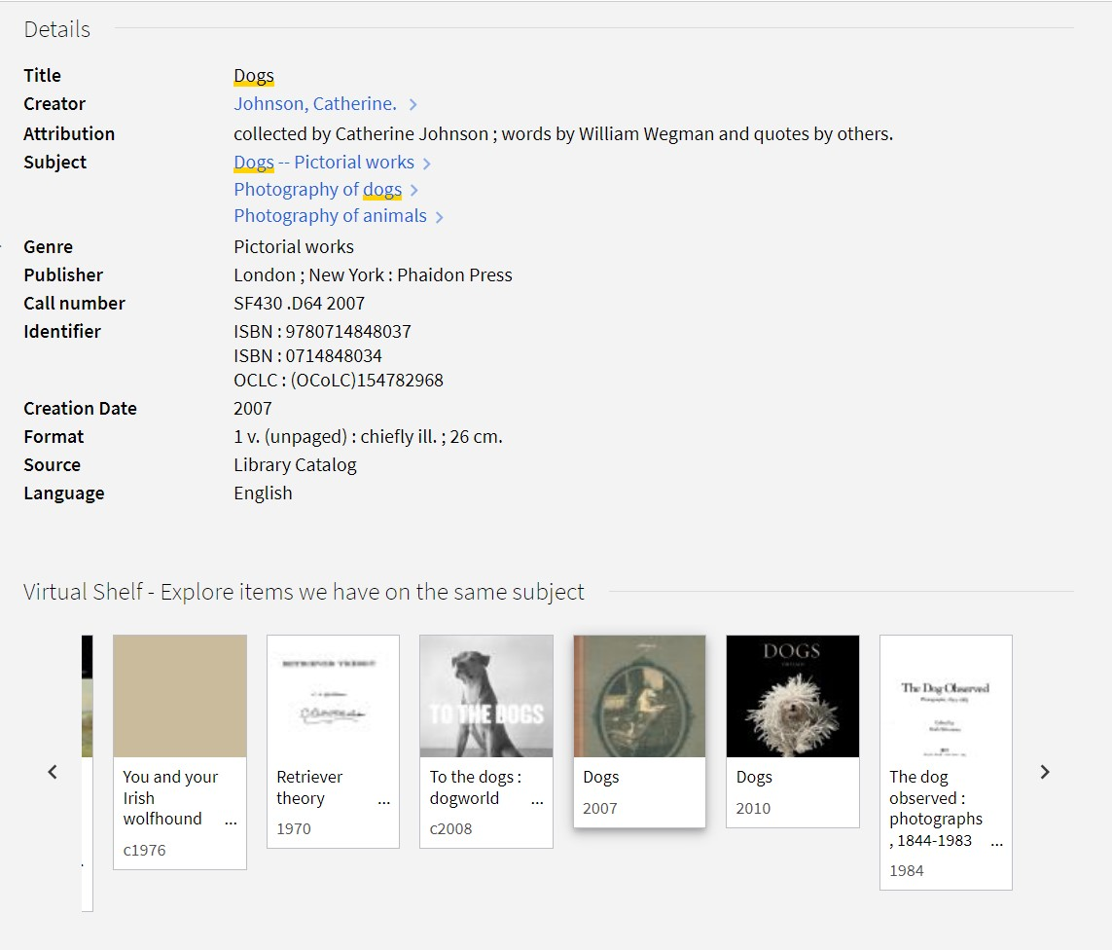
Changing “Virtual Browse” in Catalog Records
Notes:
Many catalog records have a browse option for resources that have call numbers. At the bottom of the record, users may see similar resources that have been assigned directly adjacent call numbers. This list of similar resources was called “virtual browse”, but that wasn’t very descriptive as to why these resources were connected with each other. We considered the term “browse by call number”, but this would be confusing because of our other call number browse search option. Other options were browse the items on the same shelf, browse, What’s nearby?, and nearby items. We decided on “Virtual shelf - explore items we have on the same subject”.

Slide 17
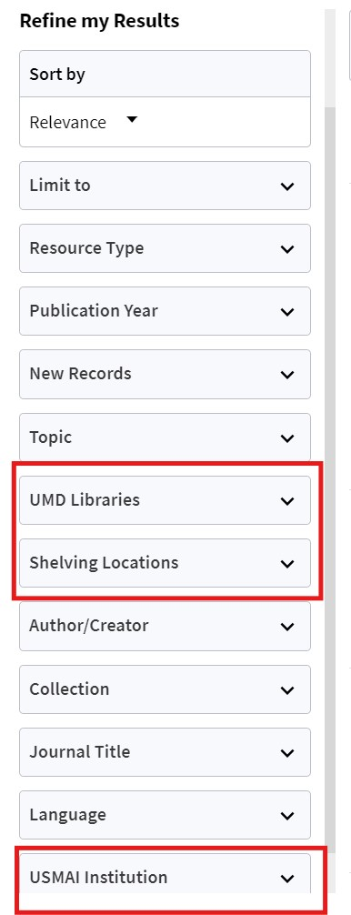
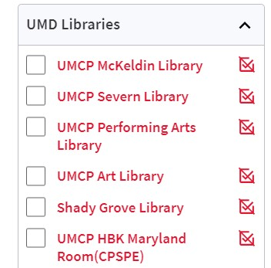
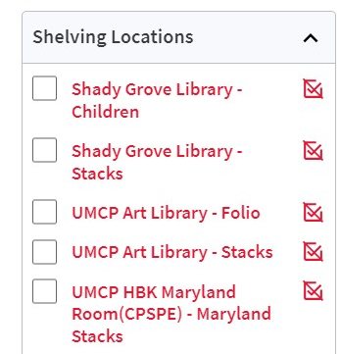
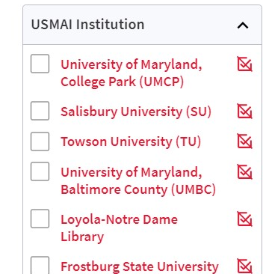
Filters for UMD Libraries, Locations, and USMAI Institutions
Notes:
On the search results page, we have three filters specific to location. These had more prominence in the past, but we decided to prioritize bibliographic information more, such as publication year. Right now, we have the labels, UMD Libraries, Shelving Locations, and USMAI Institution. In the past “Shelving locations” was just “location”, UMD Libraries was library, and USMAI Institution was Institution. We wanted to specify further what institution, library, and location meant and decided on these three terms, especially because the former “location” filter could have meant several different things.

Slide 18

Next Steps: Operationalizing Primo VE
Customization: from reactive to proactive
Usability testing
  Revisit test-load study recommendations
  Post go-live test
    Evaluates Primo implementation in wider context
Future plans
  USMAI research groups
  The Next Discovery Experience (NDE)!
Notes:
As we are coming to the end of our first semester with Primo VE, we are looking at moving from the project phase and mentality towards an operational, maintenance mentality. Over the migration period, configuration and customization of the Primo interface was largely reactionary, responding to immediate needs and feedback. Now we can focus on both the near and long term, enabling us to plan changes to the interface and share those plans across the library community, especially when it comes to development from Ex Libris
As part of this longer-term focus, we will be better positioned to implement recommendations from usability testing and continue testing in the future. We have worked with the Libraries’ website committee, the Online User Interfaces committee, to test Primo with users. In particular, I worked with a GA and the Libraries’ UX designer to test the out-of-the box Primo configurations during the test-load phase. Currently the the OUI group is working on redesigning the homepage search box and has been able to expand that work into more user testing using our current Primo interface. The results of this testing can help develop a plan for future work that can be planned alongside tracking Ex Libris’ developments with the interface.
In addition to our own usability testing, USMAI is developing two research groups, one focused on accessibility and the other on Primo configurations, which will provide recommendations we can use to inform our own decision making. And finally, of course, the Primo Next Discovery Experience will be released next year and will be a project all itself where we can hopefully build on the tools and strategies we developed over the course of this project.

