Slide 1
Fulfillment Configuration
From Beginning to End
DC ExLibris Regional User Group Virtual Meeting
October 25, 2024
Notes:
Amy -

Slide 2


About us
Patrick Cassidy
Systems & Discovery Librarian
cassidyp@union.edu
linkedin.com/in/patrick-cassidy-629b65186
Amy Hathaway
Head of Access Services
hathawaa@union.edu
linkedin.com/in/amyhathaway/
Notes:
Amy - Two minutes (one minute each)

Slide 3
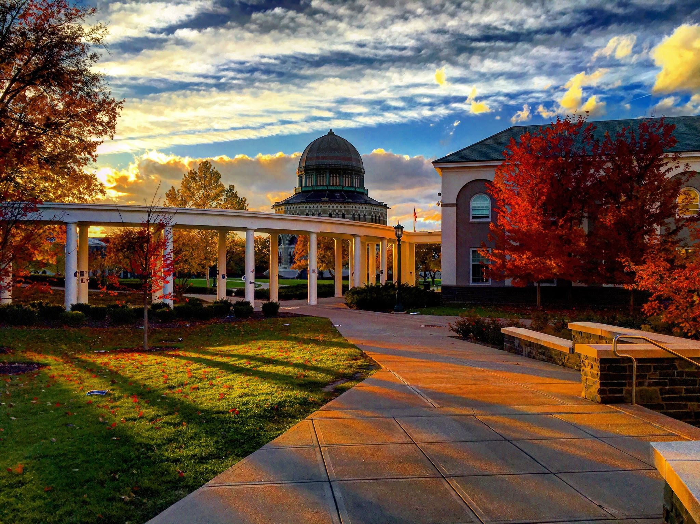
About Union College
Small liberal arts college in Schenectady, NY
Founded in 1795
Over 60 undergraduate majors and minors
Current enrollment: 2,050 students
Notes:
Amy

Slide 4
About Schaffer Library
Four distinct locations: central library, special research library,
special collections and archives, and offsite warehouse
Physical inventory: ~500,000 items
Migrated to Ex Libris Alma/Primo VE in 2019
Fourteen librarians, ten staff
We use: Checkout/Checkin, Resource Requests, Course Reserves; we do not use: Resource Sharing
Fine free!
Notes:
Amy

Slide 5
What are we talking about today?
Value of this Knowledge
Today's Agenda
Overview of Alma Fulfillment configuration
Reasons for redesigning Fulfillment configuration
What we did
Tips and takeaways
Flexibility in future developments
Knowledge of where issues may be occurring
Understanding of Alma’s connected systems
Notes:
Amy

Slide 6
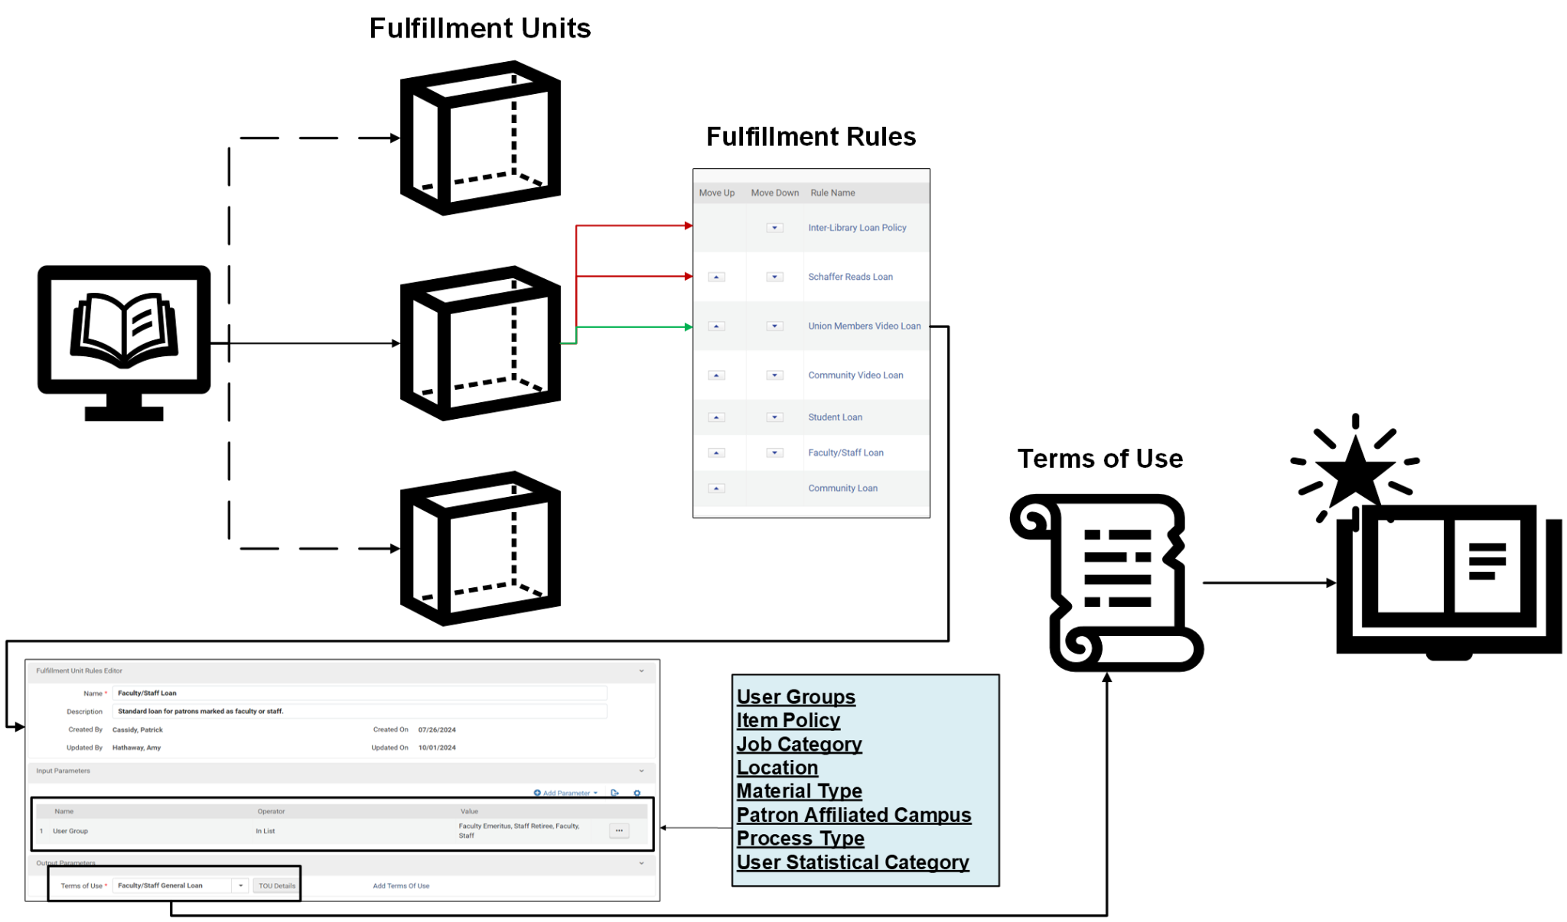
General Fulfillment Process
Notes:
Patrick - Before we dive into the weeds, I wanted to provide a brief overview of how Alma’s Fulfillment Configurations works in general, but we’ll go over some of these elements in more detail later. To start, when a user checks out a material, Alma will look at the location the item is currently assigned to, either temporary or permanent. It takes this location and gets routed to what are referred to as Fulfillment Units. Every location at your library or libraries should be assigned to various Fulfillment Units. Now a Fulfillment Unit is really just a bundle of rules, so when Alma finds the correct Fulfillment Unit associated with the location of the item, it’ll begin to go through the list of rules, starting from the top, to see if the parameters of the rules match with the checkout process. These rules can be defined by all sorts of values, and you can have multiple parameters within a single rule. Now, when Alma finds a rule that matches the parameters, the output will be a Terms of Use that is attached to the item and users account. This Terms of Use, or TOU, is the definitive list of values for the checkout process, so how long the item is checked out for, fees, renewal information, etc. So just to go backwards, every transaction has a TOU attached to it. The TOU is determined by a set of Fulfillment rules. Fulfillment Rules are listed within Fulfillment Units, which all have locations attached to them, which is how Alma will located it.
Hopefully this brief rundown will help provide a clear picture of what we were reviewing in our project.

Slide 7
Why redesign?
Challenging migration
Tried to map to previous ILS (Sierra)
Didn’t have the expertise/support to make an idealized configuration
Created too complex of a system for the size of our organization
Wasn’t successful: didn’t make sense and didn’t fully optimize Alma
Effects
Poor user experience
Constant collection management
Extraneous work for Access Services staff
Notes:
Amy

Slide 8
Why redesign?
“Short-term” solutions
Workarounds
Lots of follow-up tickets
Manual manipulation of transactions
Close account management
It was time!
Six years since migration started
Staff turnover
Changes to philosophy and service approach
Notes:
Amy

Slide 9
Project plan
October 2023 - September 2024:
50 hours of weekly meetings + 50 hours of project time
Review & Cleanup
2. Crafting Outcomes
3. Building Configuration
4. Testing & Implementation
Notes:
Patrick 1 & 3 - Patrick; 2 & 4 - Amy.
So with all of those reasons in mind, we decided to set up regular standing meetings to define the project and our goals. The bulk of the work took close to a year of figuring out how the fulfillment configuration worked, along with defining what we would like to have happen. Overall it took around 50 hours of consistent meetings, along with another 50 hours of project and design work, split between Amy and her team, and me configuration the work within Alma itself.
When we began these meetings, we defined some clear objectives listed here, starting with trying to understand our current fulfillment system and cleaning up existing data. Since we had a lot of carryover from Sierra, and all of this hasn’t been touched in around 6 years, we wanted to start fresh, and cleaning up old data was important to helping ensure we didn’t get wires crossed. After that, we defined our primary goals of how we believed the system should work, then built out the primary configuration. Finally we went through extensive testing using our sandbox and additional staff, before finally flipping the switch to turn it on.

Slide 10
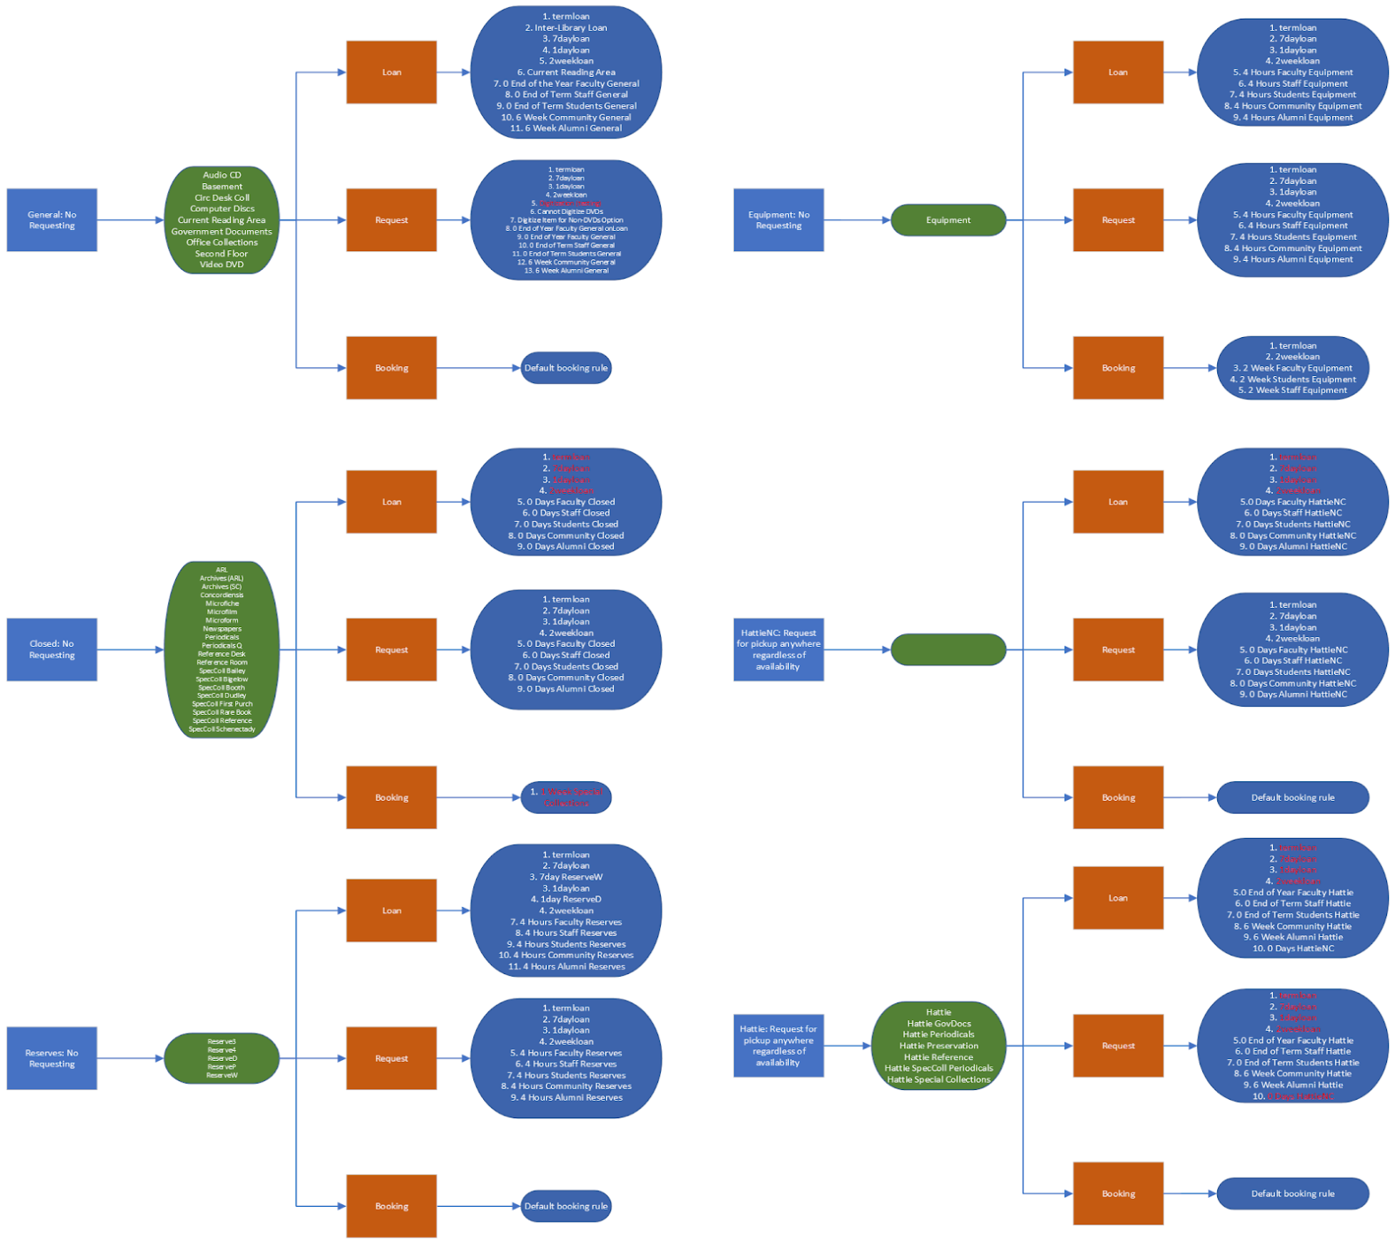
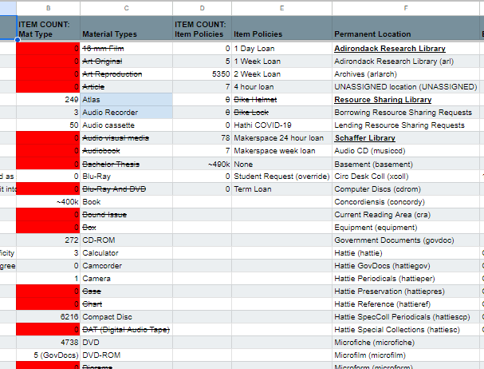

Review & Cleanup
Review what you have already to understand what you need.
General Data
Locations
Material Types
Item Policies
Terms of Use
User Groups
Identifying Pain Points
What are the current issues you’re struggling with?
Books not being returned.
Fees and blocks not triggering correctly.
Notes:
Patrick
As mentioned, to start we really wanted to understand how our current system as working, along with cleaning up old data that was potentially clogging the works, so to speak. This was largely of gathering a lot of existing data and having open conversations about what we were doing with these values and how they played into the final outcome. We wanted to highlight pain points our staff were currently dealing with especially as objectives to keep in mind throughout this project. In addition, I went through our existing Fulfillment Configuration and mapped out how it was structured in Microsoft Visio. Redundancy, inactivated fulfillment rules, no locations attached to fulfillment units, duplicate rules, etc.
We also gathered materials based on different parameters and worked with our cataloger to review if some of these content was even needed anymore. If it wasn’t, we started to delete it. Clearing up locations, outdated material types, old users groups.

Slide 11
Crafting Outcomes
1. Keep it simple
2. Find the exceptions
3. Work from both sides
4. Review the policies
If [User] wants [Material], what [Terms of Use] should occur?
Do these [Material]/[User] need different permissions?
How will these TOUs affect the Fulfillment Units?
Is this a standard we want to maintain?
Review the TOU List!
Notes:
Amy

Slide 12
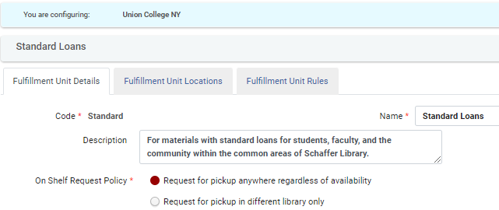




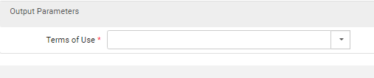
Building Configurations
Configuration > Fulfillment Units
On Shelf Request Policy
Request for pickup anywhere regardless of availability*
Request for pickup in different library only
Request for pickup in different campus only
No requesting from available holdings*
No requesting
*Fulfillments don’t go live until a location is attached
Notes:
Patrick -
Existing fulfillment units are a page consisting of three tabs
Creating a new fulfillment unit creates a cascading effect, where you’ll need your rules, which your rules will need their input parameters, which lead to their output Terms of Use
Fulfillment units won’t affect the system until your move locations to them.
Big stumbling block was the On Shelf Request Policy, for items being placed on hold. This is for specific situations for placing requests. For smaller insitutions, you’ll likely be safe picking the Request for pickup anywhere, or No requesting from options.
Other options are largely for offsite storage, or things that maybe just shouldn’t circulate. The “No requesting” will cover all similar items, even from different holding records according to Ex Libris.
Different library or different campus may be helpful if you bundle locations where you don’t want an item to be placed on hold together in a fulfillment unit, and only want those items available to be held at another location, such as your primary location.
The No requesting is a bit more complex, as according to Ex Libris, this will prevent any similar item, even if they’re under different holding records, to not be requestable, so it’s typically safer to go with No requesting from available holdings.

Slide 13
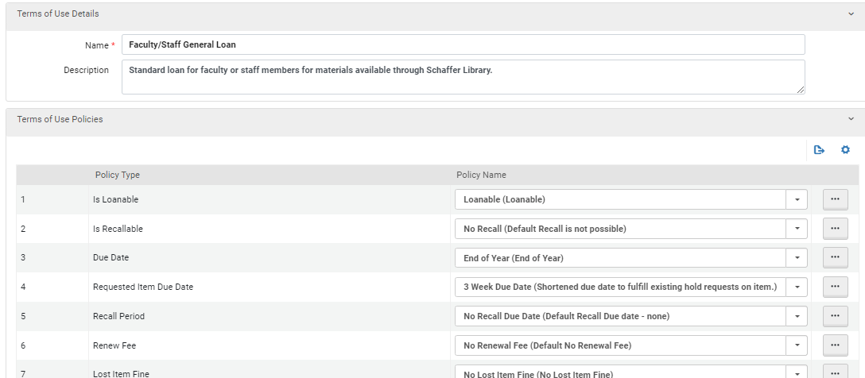
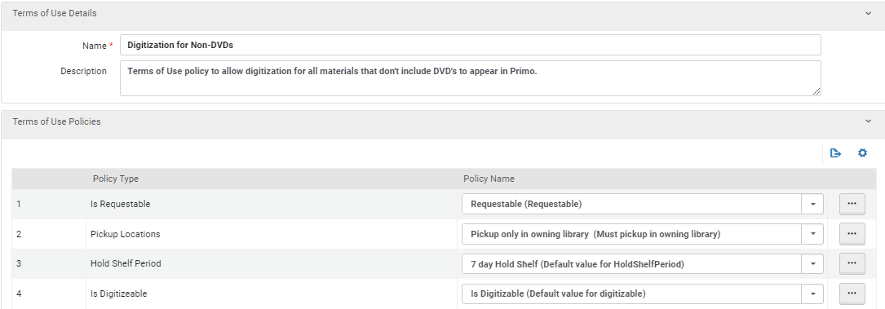
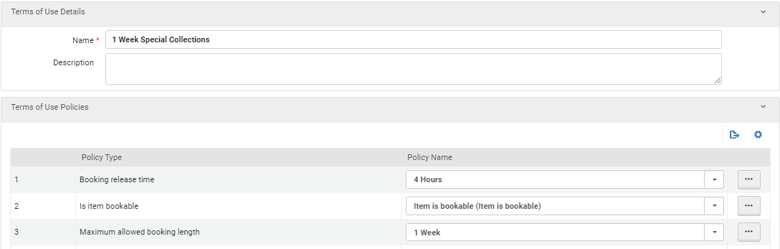
Types of TOUs
Booking* - 10 fields
Borrowing Resource Sharing
Lending Resource Sharing
Loan* - 26 fields
Request* - 13 fields
User Registration
Notes:
Patrick
Speaking of TOUs
3 types of TOUs are involved in Physical Item Fulfillment configurations.
Loans
Requesting, or placing something on Hold
Booking, or you may call it reserving an item
These lists consist of fields with dropdowns, you can also create new options for the dropdowns at any time through the three dots menu

Slide 14
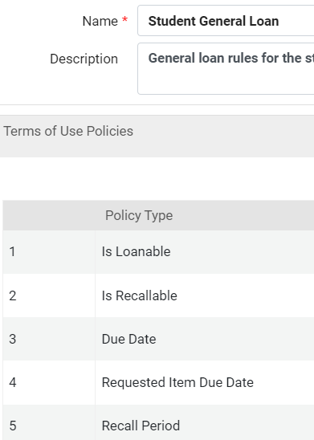
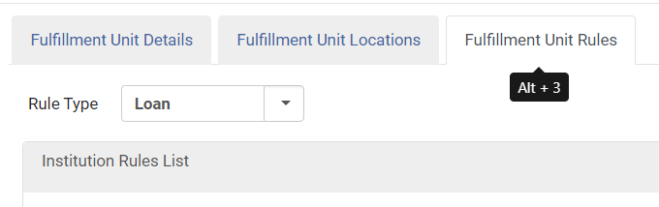
Terms of Use Building
Use descriptions and details
Notes:
Patrick - Give a clear name and description to help in the future. Really go through to ensure that the information is correct across the board to help with future Fulfillment Unit bundling. When creating Rules, in order to select the different types of rules and TOUs, you’ll need to use the dropdown to sort through the Rule Types. Loan TOUs will only populate under a Loan Type Rule

Slide 15
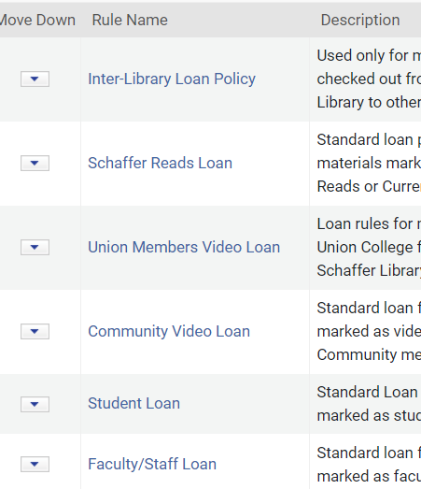
Rules Logic
User = ILL
Location = Schaffer Reads
Location = DVD
User Group “InList” Student, Faculty
Location = DVD
User Group = Community
User = Student
Build from the exceptions to the general
User “InList” Faculty, Staff
Notes:
Patrick - Building rule logic can be a tricky part. Hopefully if you’ve been communicating well, you should have a clear understanding of what the access side is looking for.
Start with the smallest exceptions when crafting rules as Alma reads the rules from the top down. This will help ensure that the logic captures those first. Build from the top down like a pyramid so you capture everything else at the bottom as needed. Typically User type differences or location difference won’t matter as much since those are more specific, but anything more complicated then that might be tougher
In this example, our DVD collection is in the same location as our regular stacks, and we have different rules between Union members and the public, so I broke those out specifically to help make sure they were caught. Rules can have multiple input parameters
ILL is specific since we don’t have Rapido, so it’s just for a user group ILL
Schaffer Reads Loan uses a Location
Video Loans use both a Location and User Group Rule
Standard loans just use a User Group parameter since the additional locations are caught by the fulfillment unit itself

Slide 16
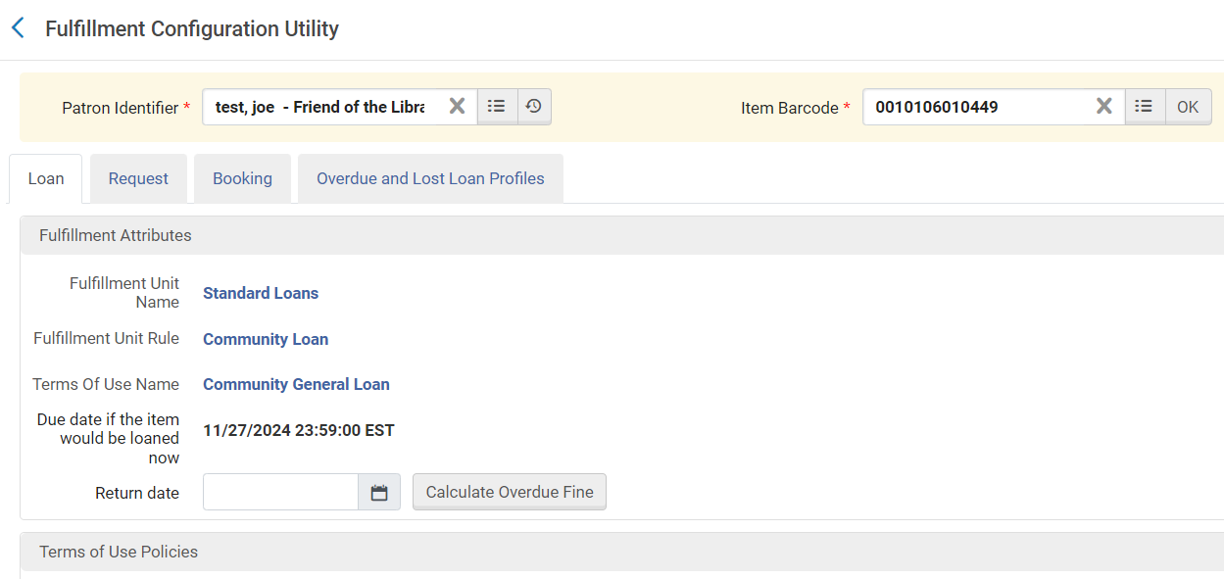
Testing & Implementation
Build out in the Sandbox
Fulfillment > Advanced Tools – Loan > Fulfillment Configuration Utility
Notes:
Amy

Slide 17
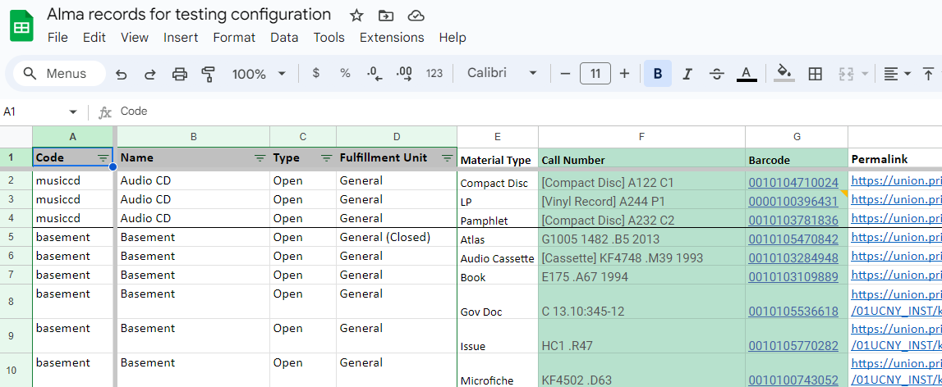
Testing sample records
Notes:
Amy

Slide 18
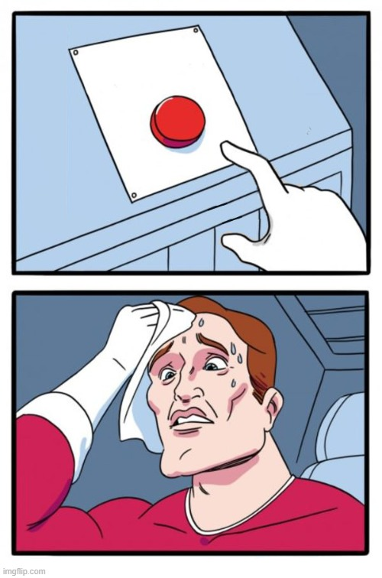
Notes:
Amy

Slide 19
Outcome Comparisons
Past
6 Fulfillment Units
90+ Terms of Use
15 User Groups
124 Rule Sets
104 Active Material Types
5,300+ Item Policy Fields
Current
3 Fulfillment Units
16 Terms of Use
12 User Groups
17 Rule Sets
50 Active Material Types
~30 Item Policy Fields
Notes:
Patrick

Slide 20
Tips for your own redesign
Use the sandbox if you have it
Talk to the people on the front lines
Do what works for you (creating/deleting things, user roles)
Review things regularly
Break things down into smaller categories
Notes:
Amy

Slide 21

Questions?
Notes:
Both, ask for questions

