Slide 1
Alma Licensing
Special Interest Group
ELUNA 2024
Minneapolis
Notes:
Slide theme by Slidesgo called “Employment Contracts Negotiation Meeting”

Slide 2
Welcome & Introductions
Sunshine Carter
  Director, Collection Strategy & eResource Management
  University of Minnesota
  scarter@umn.edu
Danielle Ostendorf
  Head of Collection Management & E-resources Librarian
  Colorado School of Mines
  danielleostendorf@mines.edu

Slide 3
Alma Licensing Special Interest Group
Who are we?
  The Alma Licensing SIG shares information regarding best practices and enhancement options relating to the licensing functionality in Alma. The group will meet at ELUNA and will communicate via the listserv between meetings to discuss advancements in the product as well as licensing issues of general interest. The group can act as a sounding board to organize enhancement ideas of interest to the entire group as well as to share workflows and, when the functionality is available, tips on set creation, record updating and analytics reports.
We utilize the Alma-L
Haven’t met since 2019

Slide 4
NERS Enhancements
Idea Exchange
Alma Voting (Round 1)…
8845 – Update license terms in bulk
8926 – Improve license module: section, delete and print
9023 – Subscription inflators
  Semi-related
Primo Voting (Round 1)…
8840 – Reference to public licenses of other institutions within the consortium in Primo VE
8922 – Add sections in the visualization of licenses in View It
~50 ideas are open for voting…
Ability to store & track VPAT® documents
Ability to suppress licenses from discovery
Improve the management of license terms in config
Colour/shade gradients to tell the different between license statuses (Active, Retired, Deleted)
Manage Multiyear Licenses for Electronic Resources in a POL
Common link between a POL and a License (for updating collections)
Notes:
65 ideas in the idea exchange — I copy and pasted the title, any grammar or spelling mistakes

Slide 5
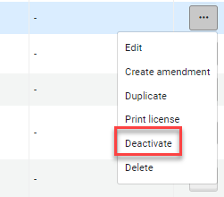
Starting in May 2024…
Ability to delete licenses & set to “Deactivated” with the option to reactivate
Ex Libris Documentation
Release Notes
Notes:
Any license currently in the “Deleted” status will be moved to “Deactivated”

Slide 6
Ex Libris Requesting Input
Tamar Fuches | Manager, Product Management | tamar.fuches@clarivate.com
Elements in Alma will be enhanced to capture and record Open Access activities, including Transformative agreements, Article Processing Charges and more.
We are now in the process of analyzing and better understanding the workflows and the pain points in them. One of the areas are Transformative agreements, which we think to represent as licenses in Alma.
Do you think that the Alma Licensing Special Interest Group will be able to help us in identifying the information that should be kept for such license?
Fill out their survey: https://www.surveymonkey.com/r/K65ML5D

Slide 7
Fall regression: unlinked licenses
Cyryl Borgfjord (University of Manitoba) emailed Alma-L on December 22, 2023, identifying an Alma regression (subject: License field on the Unified PO Line Task List)
Alma regression that started in Fall 2023, most likely related to the new Unified PO Line Task List
Issue: When POLs were linked to e-inventories that are linked to licenses/amendments, saving the POLs (i.e., clicking “Save”) removed the linkage between the e-inventories & the licenses/amendments.
Regression fixed in the Feb. 2024 Alma release (Feb. 4, 2024 to be exact)
Cleanup necessary if e-inventory/license linking is important to you, a cleanup project is necessary.
  Run an analytics report to find the e-inventories unlinked from the licenses/amendments to get them relinked.

Slide 8
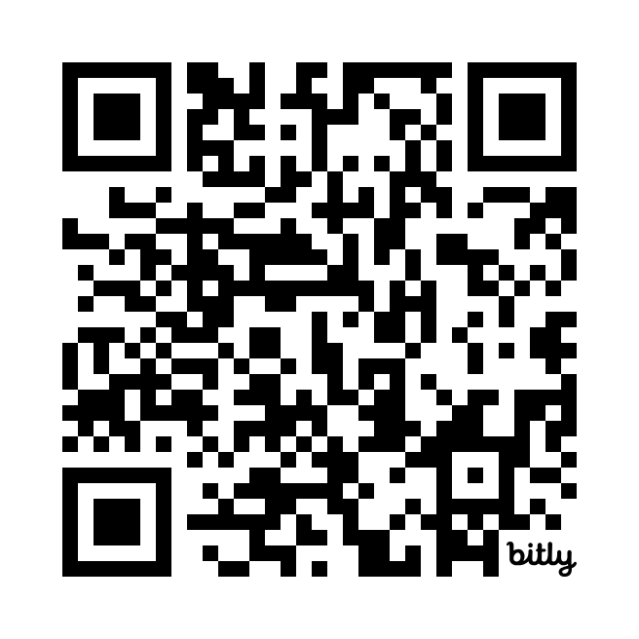
Let’s work together to record
Best Practices
https://bit.ly/AlmaLicensing
Notes:
https://tinyurl.com/LicensingSIG

Slide 9
Questions?
Thank you for joining!
Reach out if you’re interested in being a co-chair
scarter@umn.edu | danielleostendorf@mines.edu

