Slide 1
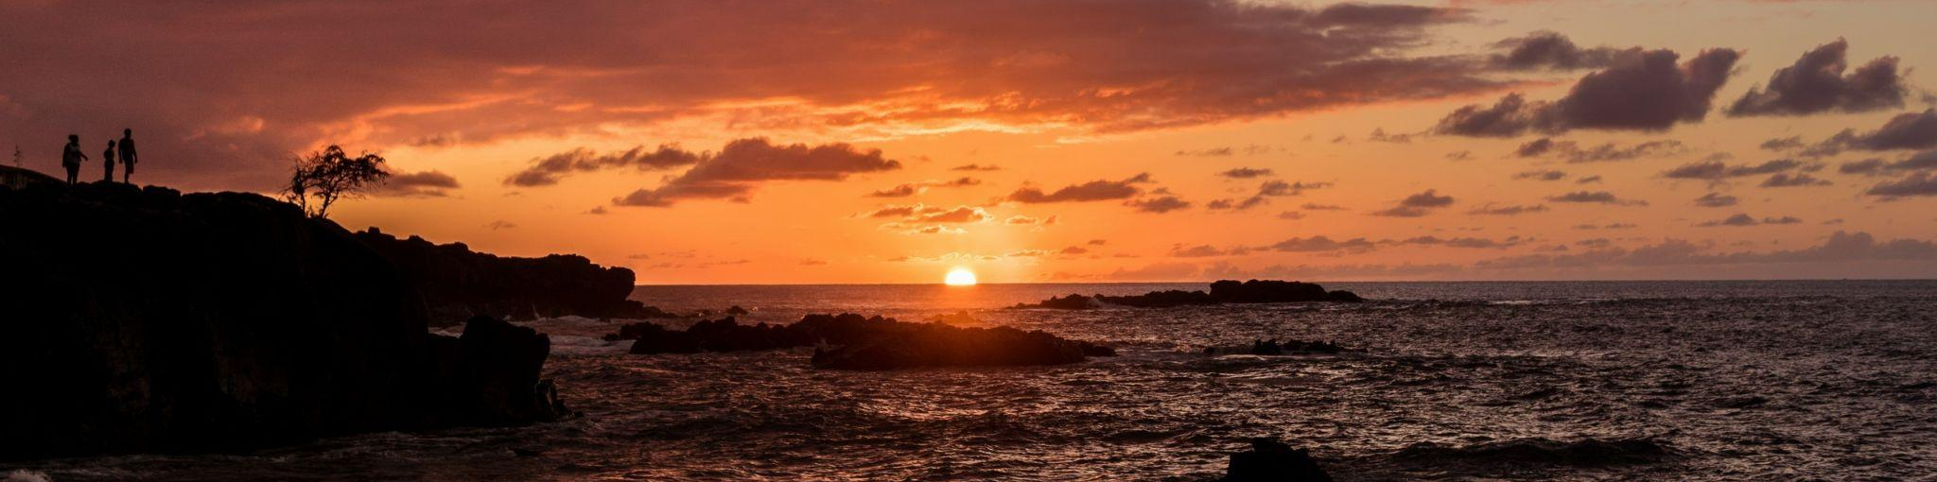
Alma Licensing
Special Interest Group
ELUNA 2025 || Atlanta
Notes:
Slide theme by SlideGo “Solar Power Company Profile” : https://slidesgo.com/theme/solar-power-company-profile#search-sun&position-40&results-146&rs=search&rs=search

Slide 2
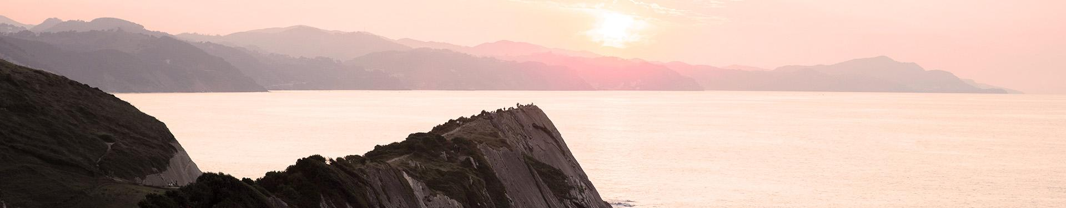
Table of contents
01
02
03
04
Brief
History
Our
Impact
Best Practices
Sunsetting the SIG

Slide 3

01
Brief History
of SIG
Notes:
Image credit: Inspiring view of morning light (freepik): https://www.freepik.com/free-photo/inspiring-view-morning-light_12413384.htm

Slide 4
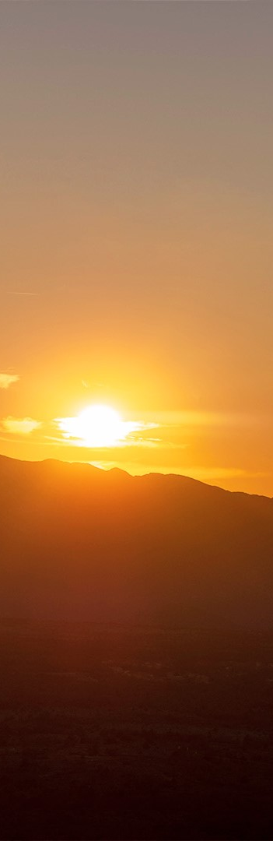

Co-Chairs & Committee Names
Janet Morrow
2016-2019
Sunshine Carter
2016-2025
Danielle Ostendorf
2019-2025
Alma Licensing Task Force
Alma Licensing Advocacy Group
Alma Licensing Special Interest Group
Notes:
Arrow image credit: https://www.flaticon.com/free-icon/jump_5376804

Slide 5
Our SIG history
2016-2019
2020-2023
2024-2025
Sunrise
Cloudy Days
Sunset
Creation of the group
Temporary new names
Progress in Idea Exchanges & Enhancements
No meetings at ELUNA
No progress as a SIG
Focus on best practices
Lack of investment from Ex Libris
Mixed priority for institutions

Slide 6
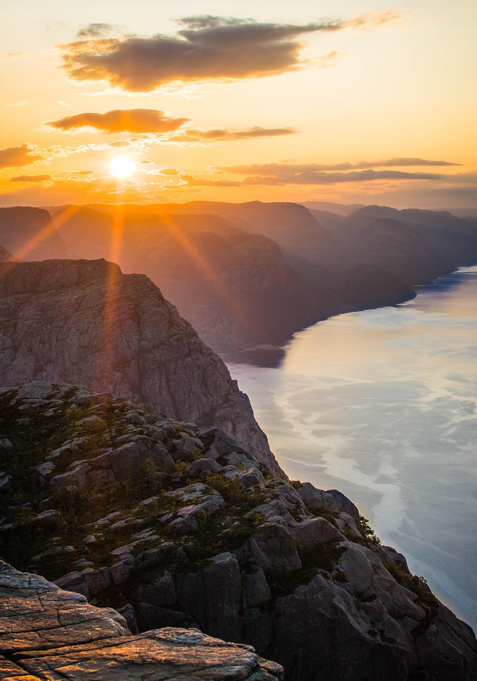
02
SIG Impact
Notes:
Image credit: Image by Jan Lüddemann from Pixabay https://pixabay.com/photos/cliff-mountain-sunset-sea-ocean-4420635/

Slide 7
~10 years of Alma Licensing Changes
Select changes that have occurred in the nearly 10 years of the SIG:
Template licenses
Advanced search on license terms
Ability to post a shared license to the network zone
License subject area in Alma Analytics
License Viewer user role
Adding a Negotiation License or a Centrally Managed License
Ability to delete licenses
Community created best practices
What we’re leaving on the table:
72 ideas in the idea exchange
1 unsuccessful enhancement (AENH-I-36240)

Slide 8

03
Best
Practices
Notes:
Image as part of SlideGo template

Slide 9

Link to Best Practices
This is currently in a shared Google Drive but will be moving to the ELUNA Documentation Repository soon
Notes:
During ELUNA 2024 we announced the community will be writing best practices. Between 2024-2025

Slide 10
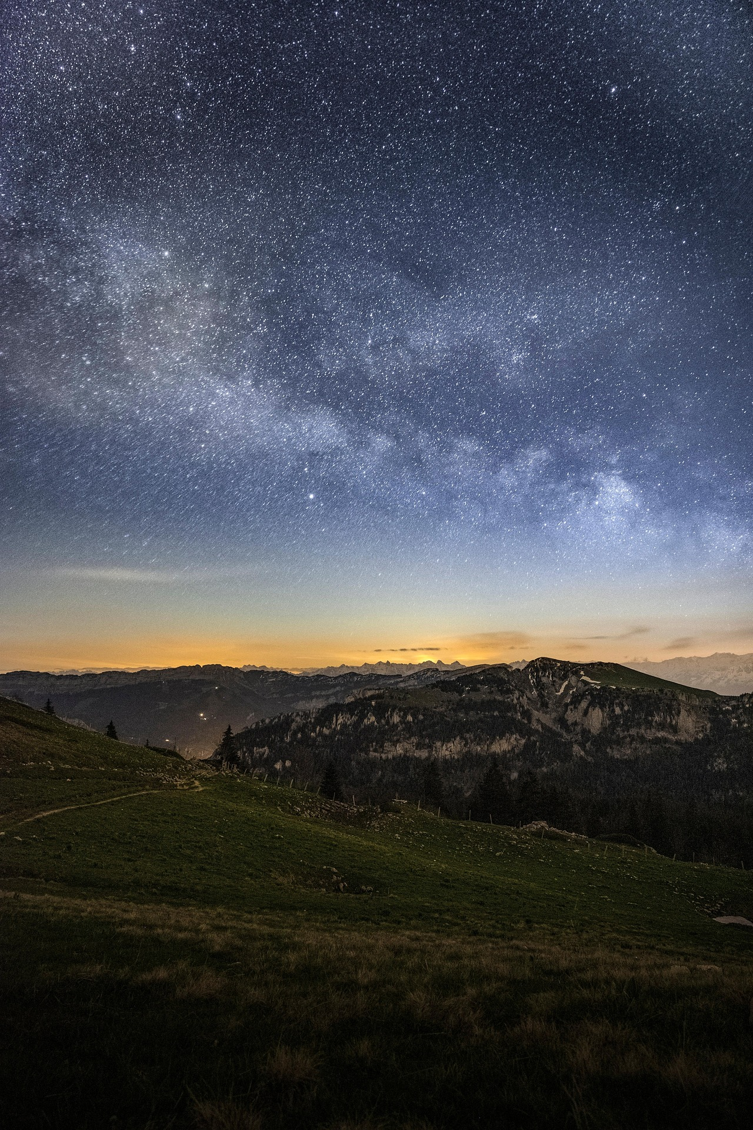
04
Time to say
goodbye
Notes:
Image credit: Image by Baptiste Lheurette from Pixabay https://pixabay.com/photos/stars-night-astrophotography-nature-6324434/

Slide 11
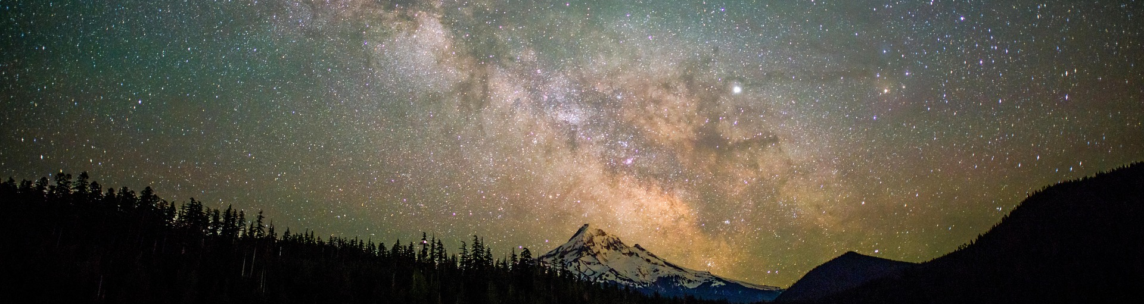
—Paulo Coelho
"If you're brave enough to say goodbye, life will reward you with a new hello."
Notes:
We recognize at this time that we have run the course of a special interest group and don’t see a productive way forward. So, we’ve decided to make the decision to sunset the Alma Licensing Special Interest Group.
Image credit: Image by mubasharnz5599 from Pixabay https://pixabay.com/photos/stars-sky-lake-milky-way-galaxy-6208559/

Slide 12

Shout out to yesterday’s session!
E-resources licensing and accessibility: using Alma license terms for resource sharing and Title II compliance
University of Kentucky
Courtney Taulbee & Jen Montavon-Green

Slide 13
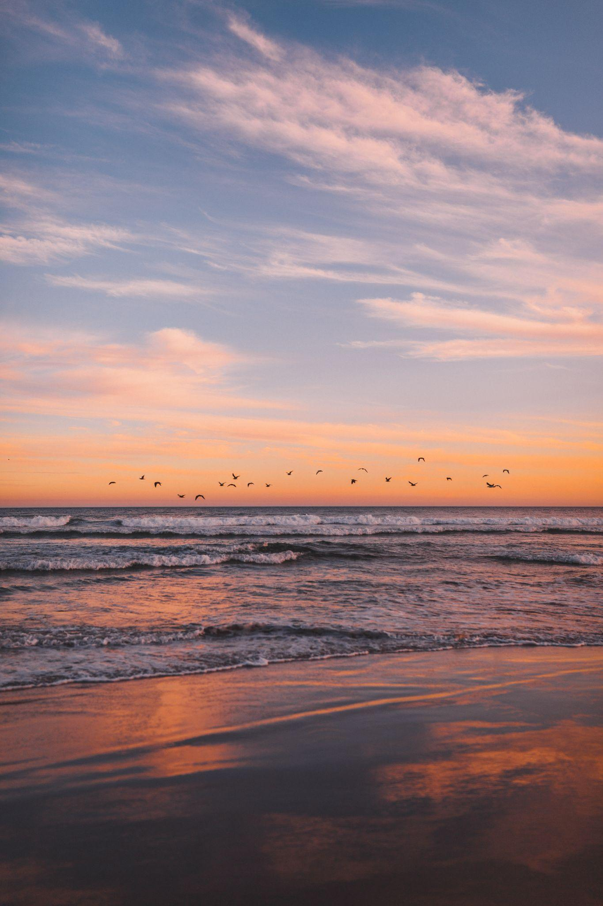
Thank you! Questions?
danielleostendorf@mines.edu
scarter@umn.edu
Notes:
Image credit: Vertical shot of a flock of sea birds flying over the sea during sunset (wirestock): https://www.freepik.com/free-photo/vertical-shot-flock-sea-birds-flying-sea-sunset_11062995.htm

