Slide 1
The Consortium as a Cloud
The Consortium as a Cloud
Parallels between consortium membership and cloud based library services
Parallels between consortium membership and cloud based library services

Slide 2
Carlos Melian Northeastern Illinois University
CARLI/
I-SHARE
Ted Schwitzner Illinois State University
Tom Goetz
Harper College

Slide 3
Overview
Introduction and premise
Brief description of our consortium (our context)
Similarities between the “cloud” and a consortium
Connections
Q&A

Slide 4
Introduction and Premise
Consortial environments exhibit similar features to cloud-based library systems
    Autonomy and cooperation
    Opportunities and challenges
    System(s) – What you give up, what you gain
    Governance
    Still some unknowns
Notes:
First off, our premise today is NOT to advocate for libraries to join a consortium. Rather it is to draw parallels between the consortial environment and the cloud environment. These parallels will help libraries considering a move to a hosted or cloud solution understand the tradeoffs and obligations of those moves.
What we will do is to provide insights into the areas where the activities and governance of a consortium may inform community activities surrounding a cloud or hosted system. We will also advocate for the idea that communication, cooperation, and collaboration should be a part of any library's participation in the cloud.
Our libraries (ISU, Harper, NEIU) are not yet part of any cloud but we have been members of CARLI/I-Share for some time.

Slide 5
Introduction and Premise (cont.)
Our context:
  Members of CARLI (Consortium of Academic and Research Libraries in Illinois)
  Members of I-Share
  Individually we are also members of the
  I-Share Users’ Group (IUG)

Slide 6
The Cloud
Data hosted off site
Maintenance
Members/customers connected by common software.
  Changes from current/past systems – Discovery layers, “open box”, local customization
  Branding
Notes:
Cm Full bullet points:
Members/customers connected by common software.
Changing somewhat with the new discovery layers and the more “open” box and level of customization.
Branding also gives a specific/unique look to your local instance.

Slide 7
The Cloud (cont.)
User groups contribute to “life” of the system (best practices, enhancements, user group meetings)
Users can share data, metadata, catalogs, etc.
Community

Slide 8
CARLI (Consortium of Academic and Research Libraries in Illinois: an Introduction
154 academic and research institutions of all sizes and constituencies representing 94% of Illinois higher education institutions
E-Resource brokering and document/resource delivery
CARLI Digital Collections
I-Share
More on CARLI/I-Share at http://www.carli.illinois.edu/
Notes:
Tom will edit slide six from reference desk
cm May want to remove document delivery and just keep resource delivery. I had to put it on one line to shorten the content area

Slide 9
I-Share
76 (soon to be 80) member libraries (all I-Share members are CARLI members)
11.9 million bib records, 35 million items, 390,000 UB request
Members share the Voyager ILS
  76 local catalogs (databases)
  1 shared union catalog (database)
Universal borrowing across I-Share
Notes:
Union catalog established as a common OPAC interface for all member libraries’ patrons. Individual libraries may choose interface or discovery system that suits them best.
Resource sharing: we have established common policies for reciprocal borrowing, so that patrons of each member institution will have clear understanding of their privileges and responsibilities. Libraries are encouraged to make collections as open and accessible as possible to borrowers of other institutions, but there is not a mandate to make 100% sharable.

Slide 10
I-Share (cont.)
Members may choose different front ends-- WebVoyage, VuFind, discovery tools, and coming soon eXtensible Catalog
Patron driven acquisition, CONTENTdm, SFX, HathiTrust, and more...
Notes:
cm Just a comment – Need to have a couple of examples of “more” in bullet #2

Slide 11
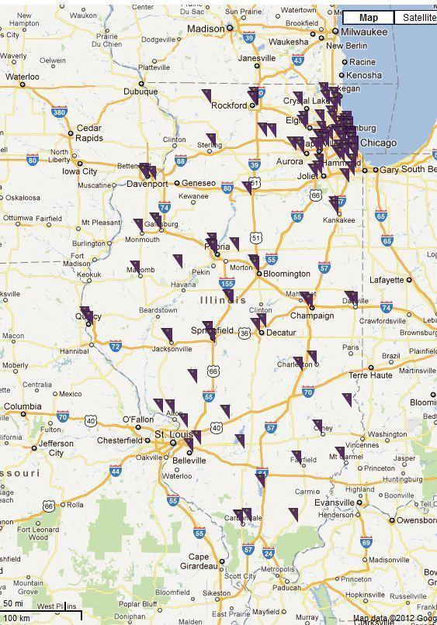
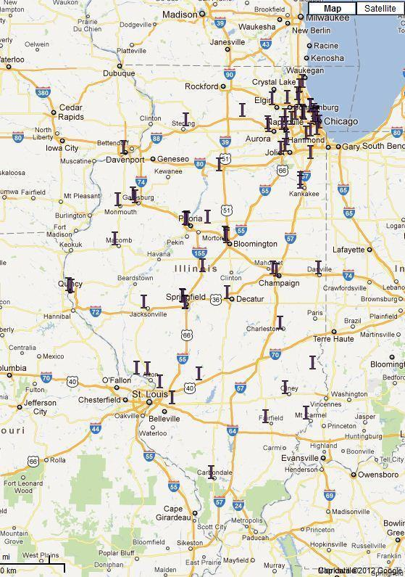
CARLI & I-Share Members
CARLI Libraries
I-Share Libraries
Notes:
Tom

Slide 12
Governance:
I-Share Users’ Group (IUG)
Facilitate communication among users, CARLI Board, and CARLI staff
Focus on the users--both front-line staff AND patrons
Governance structure supports numerous initiatives and system functions (Voyager)
  IUG, Acq/Ser, Cat, Instruction, OPAC, Resource Sharing)
Notes:
Focus on the users: Are there policies that represent hurdles to providing good customer service? How can we lower those barriers? Are there other solutions? How do we implement those solutions, and when?
Governance structure includes an imperative towards outreach to all members of the consortium. In practice, we hear much more from the libraries that stay involved in governance.

Slide 13
Governance (cont.)
Best practices
Initiate and promote consortial policies
Cooperate, cooperate, cooperate

Slide 14
IUG - What We Don’t Do
Initiate or determine local library policies
Impose any one library’s practices on others
Replace the responsibility of each library to plan for its own training needs
Replace the responsibility of each library to provide collections according to curriculum
Notes:
As far as collections go, this is an area of increasing ambiguity. Each library in Illinois that participates in resource sharing agrees to follow an interlibrary loan code that stipulates each library is responsible for developing collections for its own patrons. Resource sharing is agreed to supplement, not replace that development. That said, CARLI has long supported—through other governance groups—the ideals of cooperative collection development and consortial brokering for print and electronic resources. The economy of higher education being what it is, CARLI has become proactive in encouraging libraries to think of I-Share as a statewide collection, since each member can no longer afford to create duplicate “core collections.” The lack of clear opportunities for sharing ebooks has complicated this issue further. These areas of collection development and collection discovery intersect back in the domain of the union catalog and resource sharing, meaning that IUG is included in discussions on how to find solutions.

Slide 15
 | I-Share | Cloud
Remote hosting | X | X
Shared data | X | X
System maintenance | X | X
Centralized tech support | X | X
Common software | X | X
User groups (communities) | X | X
Upgrade efficiencies |  | X
Governance model | X
Cooperative acquisitions | ? | ?
Notes:
cm How about something like this for similarities slide? Even though it repeats the previous content it could serve as a "summary" Add more similarities?

Slide 16
Consortium, Cloud, Connection
What connections can an individual library take away from the consortial experience when considering moving to the cloud?
Notes:
cm Processes (yes and no). Local workflows may need to be tailored to system functions, as with any system. Local policies are still possible. Economies of scale, focus tech staff on different user-oriented solutions.
Cm
cm Should these next slides read “Connections” instead of “Connection”?

Slide 17
Consortium, Cloud, Connection
(cont.)
Control is not critical. Libraries can still maintain “control” in many ways
    Discovery layer
    Branding
    Local policies
    Collection management
    Processes (yes and no)
Notes:
cm Processes (yes and no). Local workflows may need to be tailored to system functions, as with any system. Local policies are still possible. Economies of scale, focus tech staff on different user-oriented solutions.

Slide 18
Consortium, Cloud, Connection
(cont.)
Sharing
    Data
    Resources
    Best practices
Community

Slide 19
What Doesn't Transfer
Consortium isn't always the cloud
  Timing of upgrades
    Consortium requires timing with all institutions' calendars
    Cloud upgrades roll out when ready, little/no downtime

Slide 20
What Doesn't Transfer (cont.)
Vendor's road map is still the vendor's
    Governance plays strong part in consortial upgrade priorities
Standards and expectations are moving targets
Voyager still client based system

Slide 21
Challenges & Opportunities
Challenges for both environments
  Collaborative collection development
  Patron driven acquisitions
  Delivery of electronic resources across membership
  Implementation of standards at different rates
  Development timelines for different libraries
  Mapping of old workflows vs. adoption of system flows

Slide 22
Challenges & Opportunities (cont.)
Opportunities for both environments
  Sharing of expertise
  True best practices development
Unknown
  Consortium in the Cloud

Slide 23
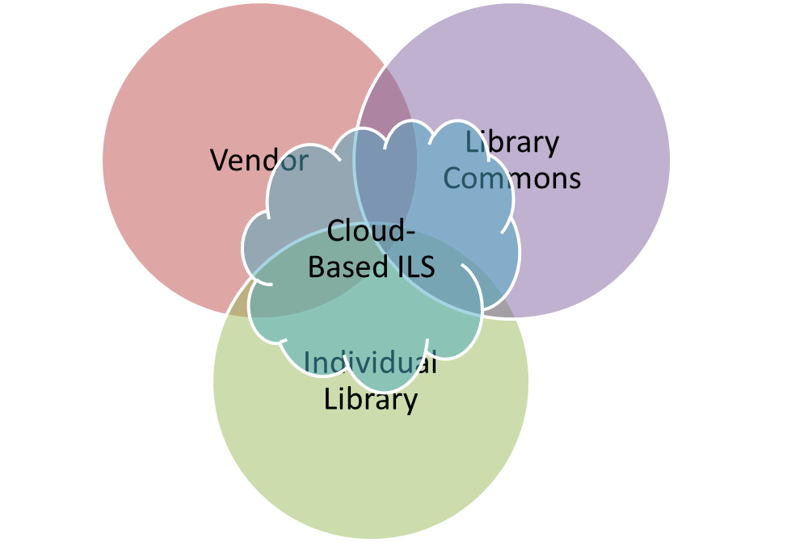
The Cloud Today and Tomorrow
Library
Community
Vendor

Slide 24

Thank You!
Questions?
More on CARLI/I-Share at http://www.carli.illinois.edu/

