Slide 1
ELUNA 2012
Primo Product Working Group Meeting
WELCOME

Slide 2
Current Primo PWG Leaders
Michael North – Chair
Northwestern University
Dale Poulter – Past-Chair
Vanderbilt University
Alison Hitchens – Program Coordinator
University of Waterloo
Dale Wann – Enhancement Coordinator
CCLA
Leaders at Large:
Sacha Jerabek
Université du Québec à Montréal
Bennett Ponsford
Texas A&M
Ex Officio
Gary Johnson – ELUNA Steering Comm Liaison
CCLA

Slide 3
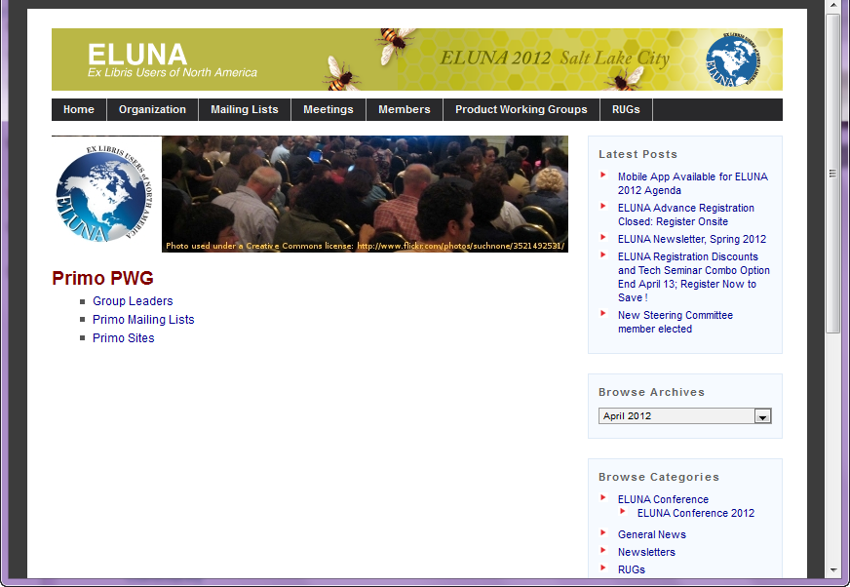

Slide 4
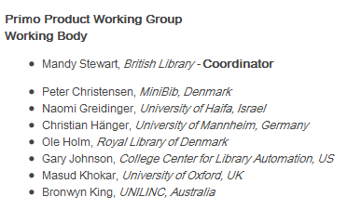
IGeLU Guests
Our international friends

Slide 5
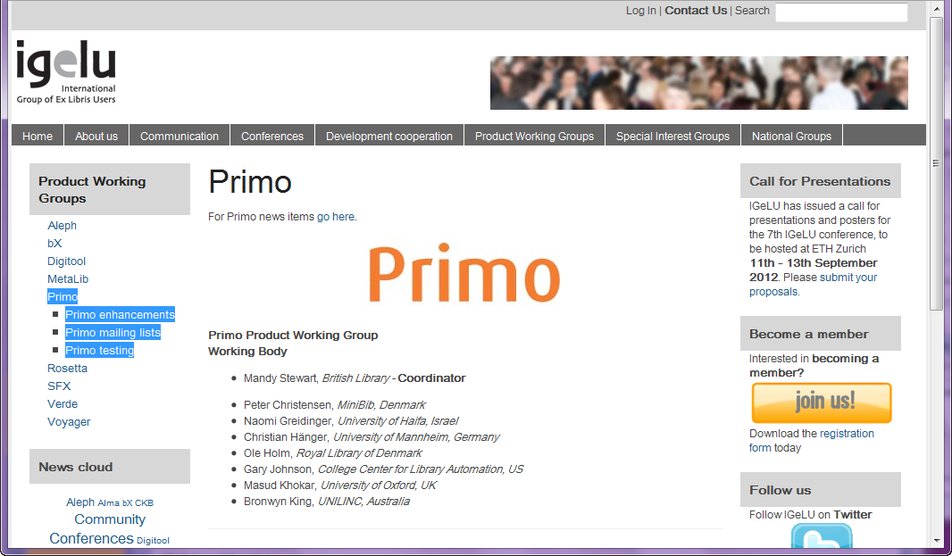

Slide 6
ExLibris Guests
Ido Peled - Primo Product Manager
Anyone else from ExLibris in attendance ?
Please introduce your self.
A word from Ido.

Slide 7
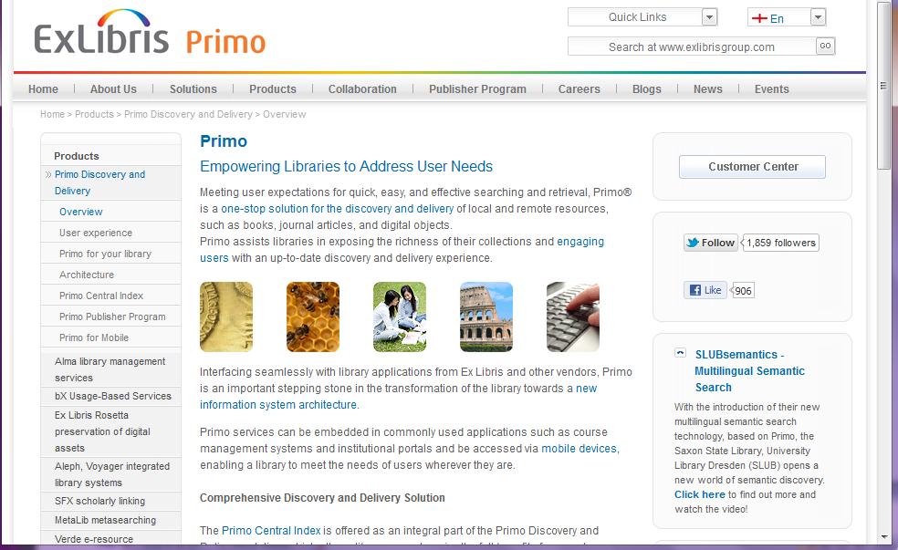

Slide 8
AGENDA
(1) Last years activity Report
(2) NERS Voting schedule report
(3) PPWG elections
Candidates:
Chair Elect : Curtis Thacker (BYU); Alison Hitchens (U of Waterloo)
Leader at Large: Dale Poulter (Vanderbilt), Sacha Jerabek (Université du Québec à Montréal)
(4) Future concerns
Metalib and Primo groups merging (maybe? - they did for IGeLU)
Deep Link position paper.
(5) Comments from floor.
Adjourn.

Slide 9
Last Year’s Activity Report following ELUNA 2011
The year started with the summer release of v3.1.
Recently we saw the release of v3.1.3
Primo v4 (Staging) is currently installed on selected sites for testing and comment. Things look good for a mid June general release of v4.

Slide 10
ELCommons continues to grow with developers adding their custom work into CODESHARE for other Primo sites to use. This enhances the overall Primo functionality as institutions continue to develop a Primo UI interface with added functionality.

Slide 11
The Primo PWG has enhanced the ELUNA Primo PWG website with more useful information. We created a SITES List where by institutions can share their Primo sites with others. This is a great tool for new users to look and see how others have set up their sites, and to see what development work they have done.

Slide 12
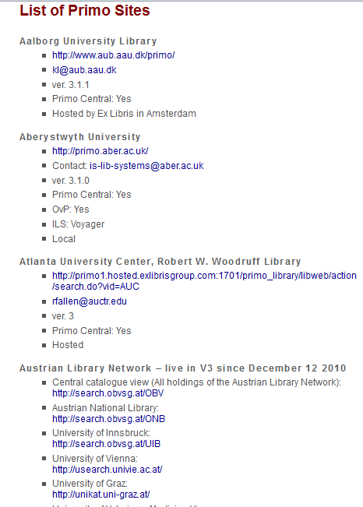

Slide 13
NERS Reporting System is under constant review as we seek better ways to collect enhancement requests, evaluate them with ExLibris input, Vote on them, and submit the top vote getters to ExLibris for development consideration in their next Primo development cycle.
NOTE: the eService Enhancement request is a separate system and any enhancement you want to be part of the NERS Enhancement Request process, needs to be added to NERS manually. There is not an automatic transfer process to add enhancements that were submitted directly to ExLibris, into NERS.

Slide 14
The IGeLU Primo and Metalib working groups have merged. The ELUNA PWG's are evaluating the impact of such a merger for us but we do not see that happening in the near future.

Slide 15
The Primo PWG strives to assist communications between the Primo user community and ExLibris. To that end, and at the request of several institutions, the Primo PWG has engaged ExLibris in discussions concerning the "deep link" issues that has been much discussed on the Primo listserv. We conducted a survey and created a summary document (thank you Jerabek) that we believe captures all of the nuances of this problem. This allows us to have a common starting point in our future discussions with ExLibris. This report has been submitted to ExLibris and future discussions will be occurring.

Slide 16
This past year has seen much advancement with Primo and the next year promises even more development.

Slide 17
NERS Voting schedule
- Dale Wann Report -

Slide 18
PPWG elections
Two Positions Need to be filled:
Chair-elect
Leader at Large
It is the desire of the Primo PWG that the members of this working group be people that "get their hands dirty" with Primo. The requirement is that they have a "detailed" knowledge of Primo. The problems we need to address require technical expertise (front end, backend, backoffice, normalization, indexing, etc.) with Primo.

Slide 19
Leader at Large Requirements
The "Leader-At-Large" is a two year position and contributes to the overall work of the Primo PWG and takes the lead on selected Primo related projects as they come up.

Slide 20
Leader at Large Candidates
Dale Poulter (Vanderbilt)
Sacha Jerabek (Université du Québec à Montréal)

Slide 21
The Chair-Elect Requirements
The "Chair-Elect" position requires a 4 year commitment. One year as "chair-elect" followed by two years acting as the "chair" and finally one year as the "past-chair."

Slide 22
Chair-elect Candidates
Alison Hitchens (U of Waterloo)
Curtis Thacker (BYU);

Slide 23
VOTE and RESULTS
Write down two names, one from each list.
Good Luck Candidates !
Leader at Large
Dale Poulter
Sacha Jerabek
Chair Elect
Alison Hitchens
Curtis Thacker

Slide 24
Future concerns
Continue to review the benefits of a Metalib and Primo group merge.
Deep Link discussions with ExLibris.
search.do vs. dlsearch.do.
Site List – continue to advertise and build this list for the Primo users to use.
NERS – continue to work with our IGeLU partners to improve the NERS Enhancement voting process
(5) Impact of ALMA ?

Slide 25
Floor Comments or Questions
?

Slide 26
Thank you until next year !

