Slide 1
Bringing it all together in Primo
Discovery Across Disparate Types of Digital Content

Slide 2
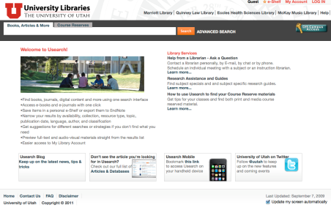
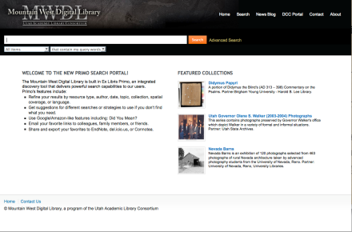
Our Implementation of Primo:
One installation, 2 institutions
University of Utah
Libraries
Mountain West Digital
Library Consortium

Slide 3
University of Utah Libraries
Usearch
J. Willard Marriott LIbrary
Eccles Health Sciences Library
Quinney Law Library
McKay Music Library
J. Willard Marriott Library
Eccles Health Sciences Library
Quinney Law Library
McKay Music Library
22,030 full-time undergrads
5,606 graduate students
1,354 teaching faculty
2,324,407 annual searches
3,375,576 volumes (Aleph)
224,229 digital collection items (CONTENTdm)
213,890 items (SFX)

Slide 4
Mountain West Digital Library
http://mwdl.org
Central search portal for 361 digital collections about the Mountain West from 60 partnering organizations
Metadata from 650,000 resources in 20 repositories
MWDL
Univ. of Utah
USU
BYU 1
UVU
WSU
UNLV
UN-Reno
SUU
Utah Educ. Network
Utah Dvsn. of Arts & Museums
Utah State Archives 2
Utah State Library
NWDA’s Utah Finding Aids
BYU 2
USU’s IR
Utah State Archives 1
Health Educ. Assets Lib.

Slide 5
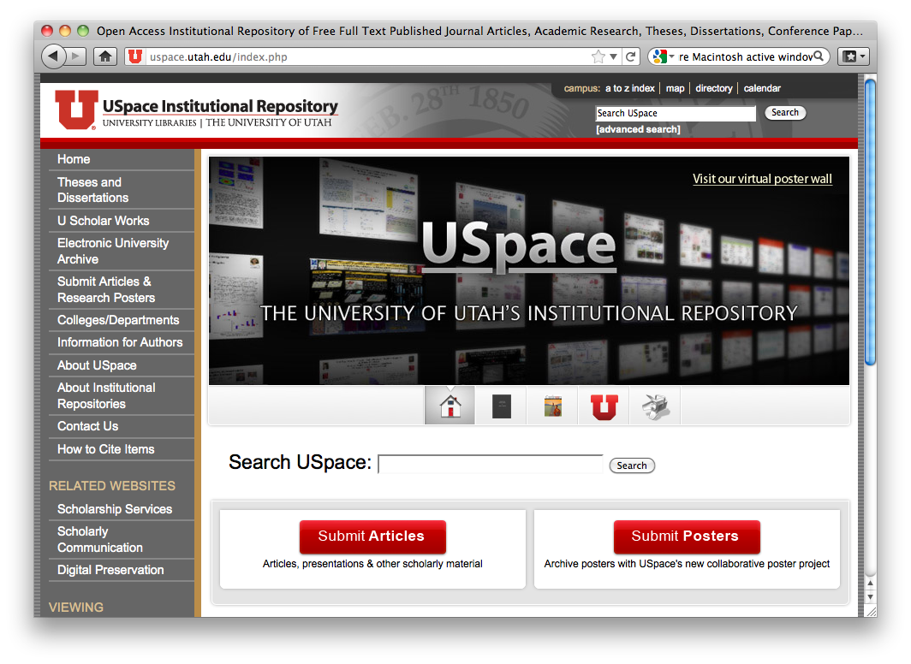
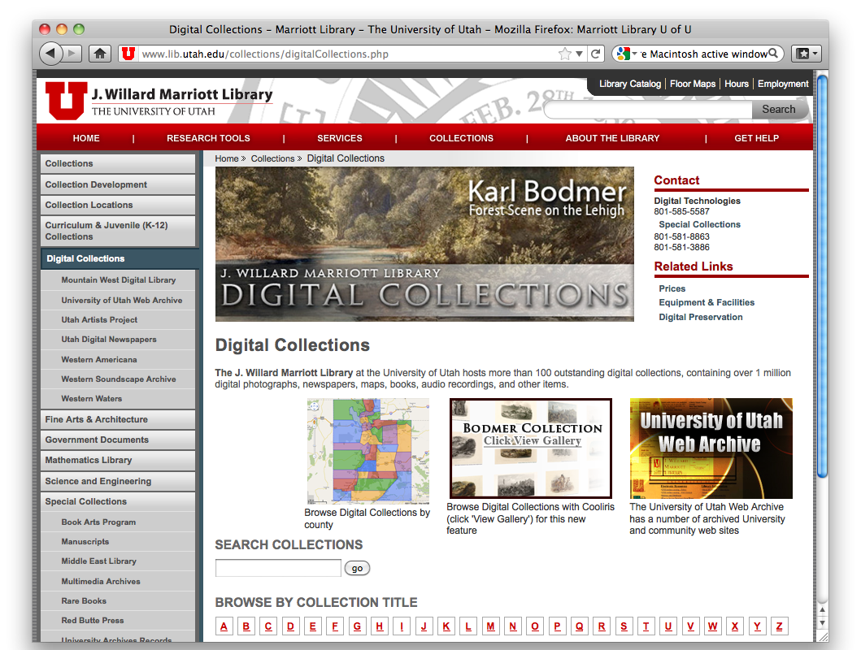
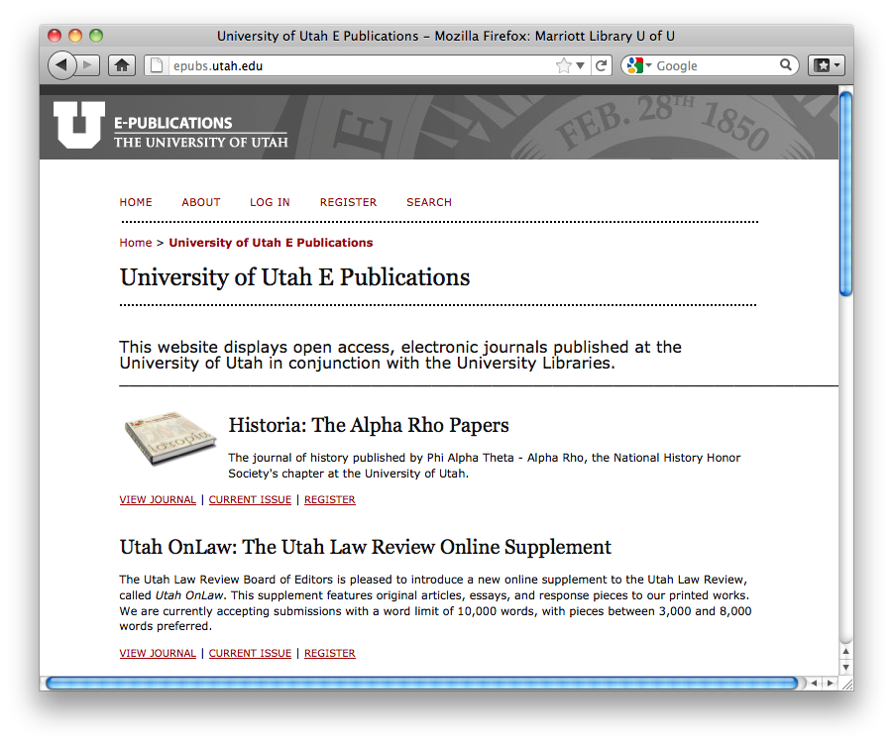
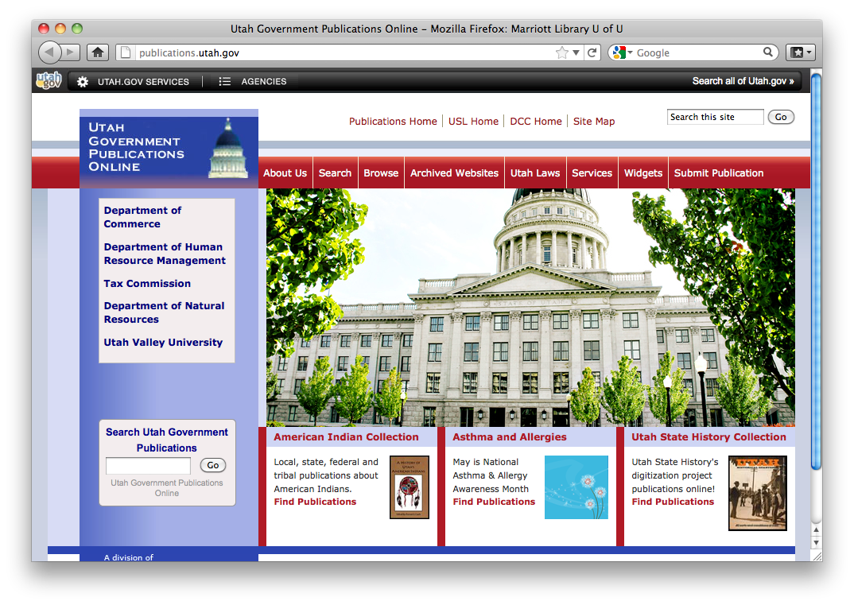
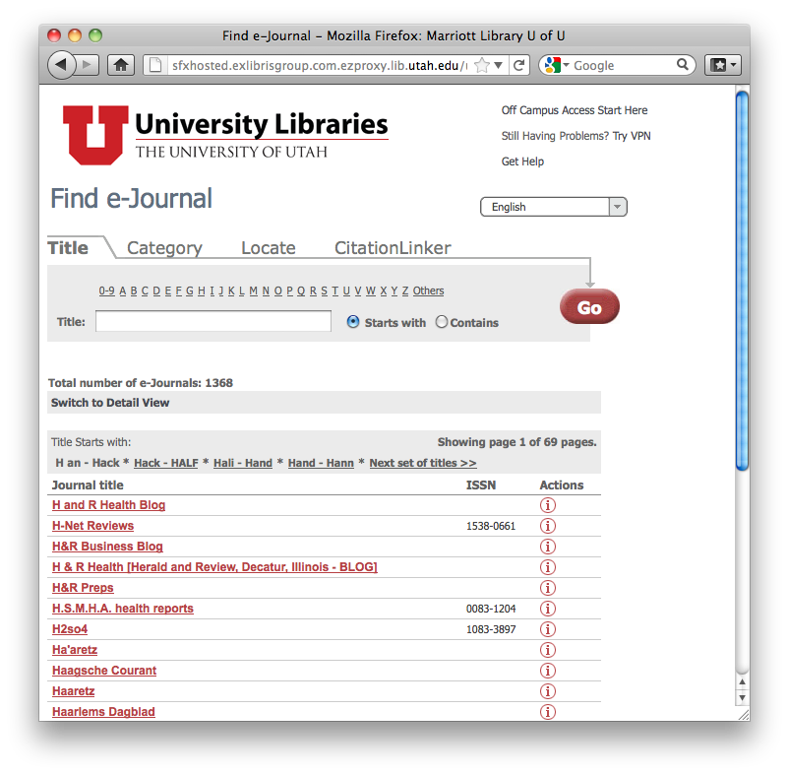
Source Portals

Slide 6




Source Systems
Bibliographic records (Aleph)
Course Reserves (Aleph)
Articles and e-resources (SFX)
Primo Central / bX

Slide 7


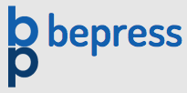


Source Systems
Digital Collections
Institutional Repositories
Encoded Archival Description (EAD) Finding Aids
Health Education Assets Library
BYU Finding Aids Repository

Slide 8

Goal: Central portal

Slide 9
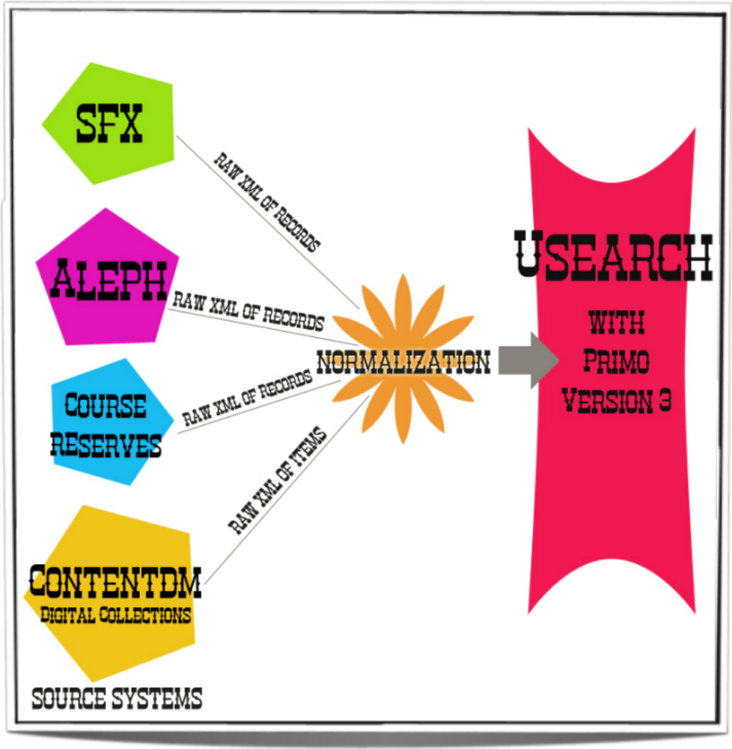

Slide 10
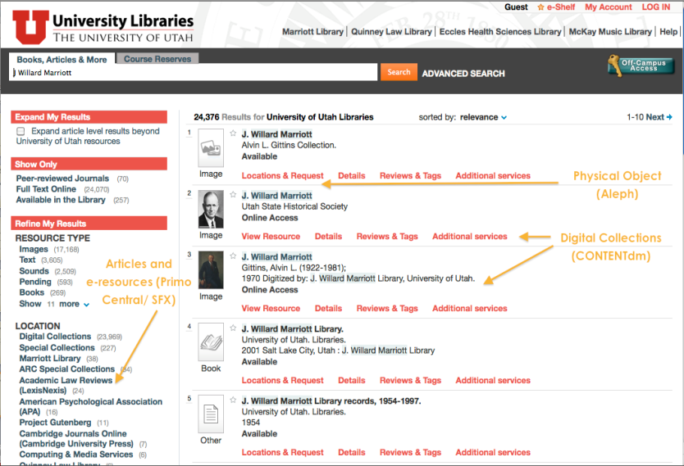
Seeing it all in action

Slide 11
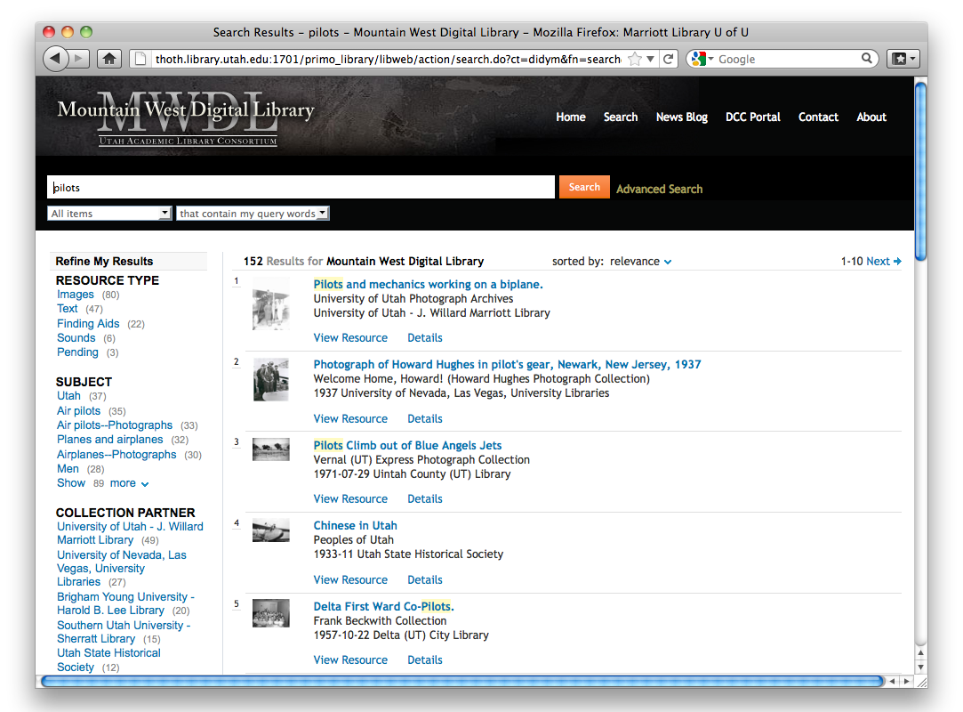
Seeing it all in action
http://mwdl.org
Different types
From different partners

Slide 12
Barriers to integration
Several dozen types
Bib records have different vocabulary from digital collections, with overlapping terms
Primo defaulted to a non-standard third set of terms
Confusion between resource type vs. genre
Confusion between resource type vs. medium
Audio vs. Sound
Video vs. Moving Image
Text resources
Image vs. Map
Image vs. Photograph
Sound vs. CD

Slide 13
PHASE 1
How hard can it be?

Slide 14
The “easy” stuff
Created separate mappings and normalization rules for each type of data source (ignoring the odd overlaps)
Put Course Reserves into a separate search tab
Added ranking/boosting of local resources
Created unique Primo tables to reflect MWDL consortium structure
  Hosting Center
  Repository
  Collection Partner
  Digital Collection name, ID, scope

Slide 15
The “queasy” stuff
Tested having drop-down, pre-search filtering options in Basic Search; mapped everything to only a few types; removed with the upgrade to version 3
Integrated Primo Central results in a blended search with all other resources
Accommodated oddball types (e.g., Photo) with extra normalization (→ Image)
Allowed for Other as a frequent assignment

Slide 16
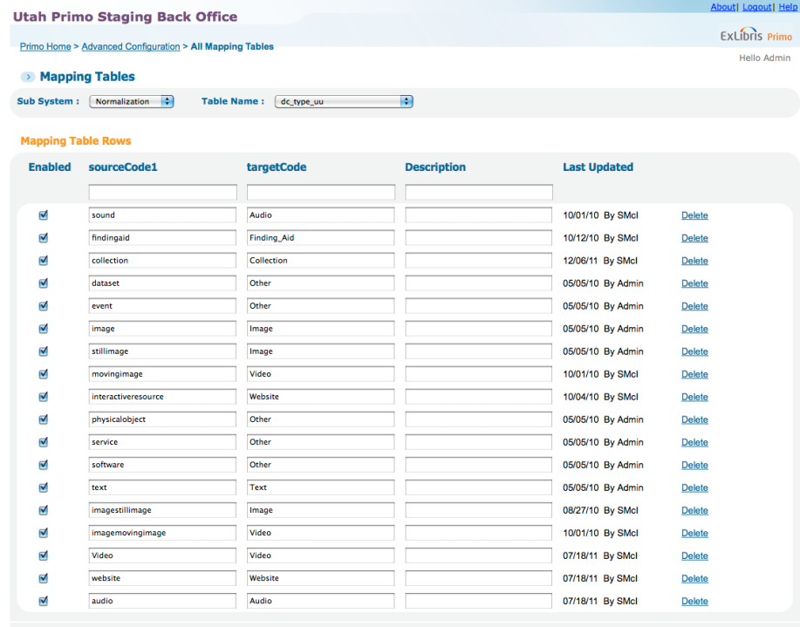
Making it work

Slide 17
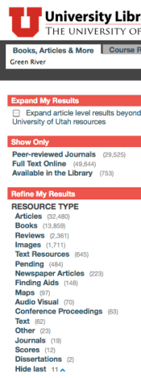
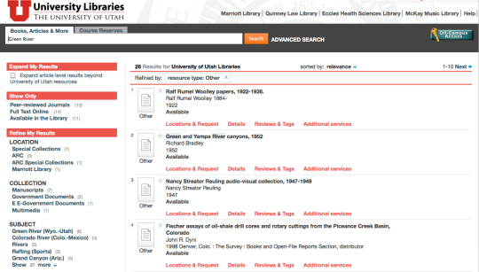
“Other” from another mother

Slide 18
The “sleazy” stuff
Integrating the 4 libraries at the U of U
  Different circulation procedures
  Different policies
  Different users
Integrating digital collections across the U of U and MWDL partners
  Implementing Qualified Dublin Core (QDC) in Primo fully
  Metadata standardization across MWDL collection partners
  Ensuring conformant Open Archives Initiative (OAI) provision

Slide 19
Internal Debates
Legacy expectations for pre-filter vs. post-filter searching from library staff
    “Old school” search methods were unnecessarily limiting search results
Unclear decision making process during implementation
    No clearly defined roles for “who does what”
    Too many/not enough cooks in the kitchen
    No individual Back Office logins for accountability

Slide 20
Phase 2
Let’s get serious now

Slide 21
Getting it together
Role clarification
  Primo and Aleph administrators were appointed
  Primo Advisory Group and Aleph Advisory Group created to drive decision making
Created specific user accounts for Back Office access with specific tiered permissions
Upgraded from Primo 2 to Primo 3
Developed workflow for adding new source systems

Slide 22
Setting our course
Standardizing “Online Resource” (856) delivery
Creating custom CSS to accommodate the unique needs of each view
Harmonizing resource types (as much as possible) for use in pre-search filters and post-search facets – customizing multiple mapping tables and code tables
Exposing non-conformant metadata with “Pending” or “Other” – no more extra normalizations
Addressing deduping inconsistencies across source systems
Pioneering Course Reserves
Harmonizing library policies
Instituting a consistent solution for accessing materials from off campus

Slide 23
Yay! (Aaghh!)
Revelation: Primo exposes every inconsistency or oddity we had in cataloging/metadata
Be careful what you ask for! Exposing it fully:
  Allows us to fix the normalization issues
  Gives catalogers incentive to edit and add metadata
  Allows user to filter much more (assuming good data)
  Gives us insight as to usage

Slide 24
Benefitting from the contrast
Differences in how the normalization rules came together: Aleph/SFX vs. Digital Collections
  Aleph/SFX/Primo Central/Course Reserves:
  Take risks with normalization implementation and allow users to influence fine-tuning rather than myopic focus (2,324,407 annual sessions)
  Digital Collections:
  Form a Task Force to create exact a priori rules in organized fashion.
Did we luck out having a mix of styles?
Would we do it differently now?

Slide 25
Lessons learned
Bringing it all together requires a lot of collaboration from people coming from different source system backgrounds
  Get them into the same room
  Take the time to work out roles and processes
  Take the time to integrate perspectives on library resources from ALL sources and ALL users
  Take risks
Providing the integrated search environment
  Is a great incentive for us all to collaborate
  Positive impact on student and faculty patrons
  Better understanding of perspectives across groups and organizations

Slide 26
“It looks much nicer.”
“I was the only one in my study group
able to find enough articles for
the paper we were working on.”
“I like not having to click so much to get to what I want.”
“I've truly enjoyed exploring the many collections of the partner institutions to which the portal provides access.”
“I've spread the word about the portal to numerous appreciative friends and relatives.”
“My Account is so much easier to look at.”

Slide 27
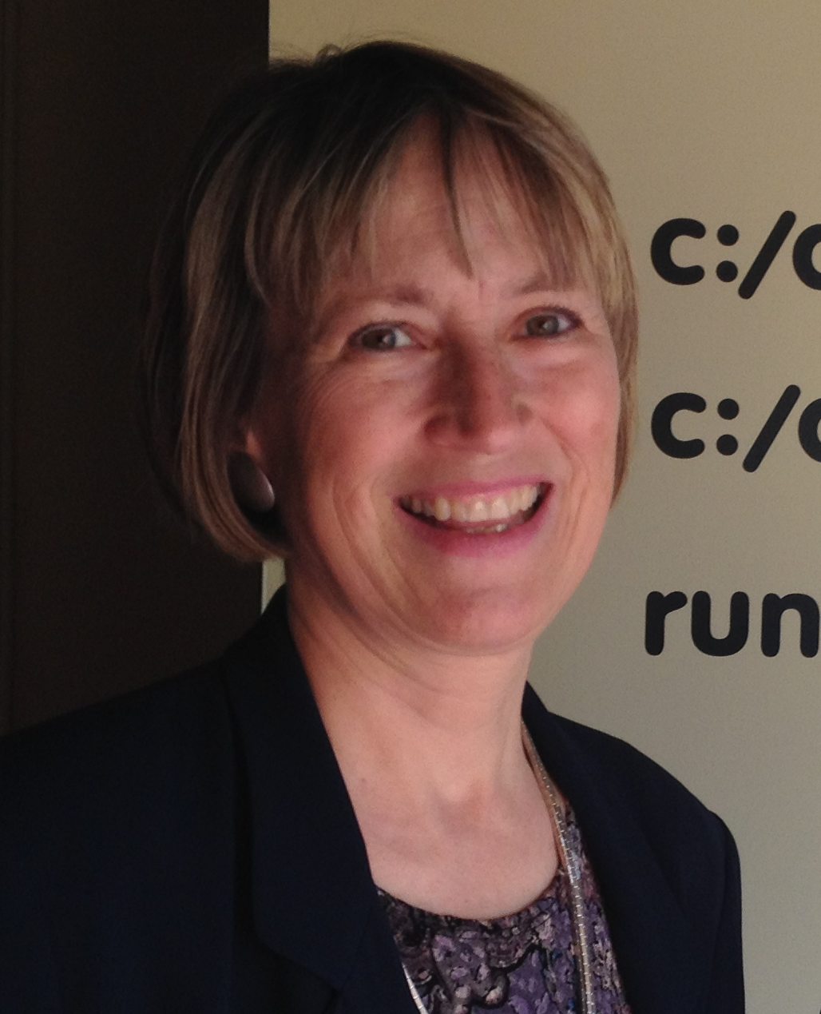


Questions?
Tracy Medley – Head of Discovery & Web Development
tracy.medley@utah.edu
Sandra McIntyre – Program Director, Mountain West Digital Library
sandra.mcintyre@utah.edu
Ian Godfrey – Head of Facilities, Collections and ILS Management
ian.godfrey@utah.edu

