Slide 1
Primo at TUG: Using Primo in a Consortial Environment
Presented by Alison Hitchens, University of Waterloo Library
ALA Midwinter, Seattle, 2013

Slide 2
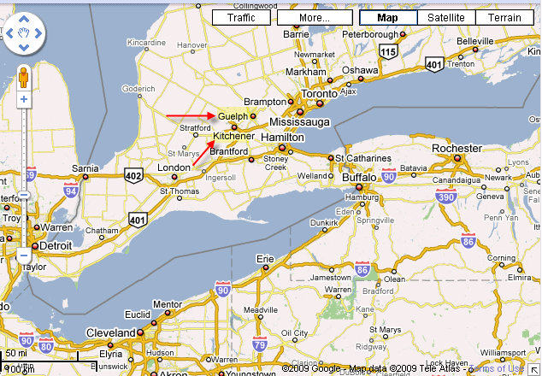









TriUniversity Group (TUG)
Notes:
I'm from the University of Waterloo which is a member of the TriUnviersity Group of Libraries, commonly known as TUG. TUG also includes University of Guelph and Wilfrid Laurier University. For those of you not familiar with southwestern Ontario, we are about 60 miles from Toronto and not far from Buffalo and Detroit. Unfortunately at this scale Google only shows Kitchener not Waterloo but we are right next door. TUG was formed in 1995 for shared resources and collaboration, including a shared ILS, reciprocal borrowing, document delivery, statistics portal and collaborative functional committees.

Slide 3
Quick Statistics
 | Waterloo (2011) | Guelph (2011) | Laurier (2012)
# of Undergrad Students | 28,200 | 18,296 | 15,132
Library employee FTE | 122 | 95.4 | 56
ACQ Budget | 7.5 Million (2012) | 6.8 Million | 3.4 Million
Notes:
Here are a few statistics to give you an idea of size

Slide 4
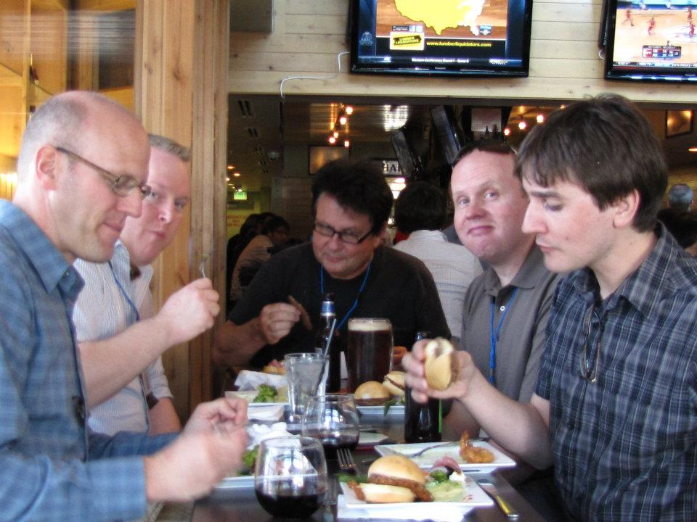
Sharing Expertise (and workload!)
Photo credit: Alison Hitchens, ELUNA 2012
Notes:
There are many things that I could tell you about Primo because I've been on the Primo team since the beginning in January 2008. However, I'd like to focus on the collaborative nature of TUG and how Primo allows us to be collaborative but still independent when necessary. By implementing Primo in a consortial environment we have been able to take advantage of the expertise at the 3 institutions and share the workload. Other than Charles, our Systems Administrator, we all have other jobs to do; Primo isn't in our job description! So being able to give people permissions and let them do work for your institution even when they aren't a member has been an essential part of our Primo work. We have a small Primo team with a little bit of redundancy to help during vacations. Charles, from Waterloo, is also the Voyager sys admin for TUG; Matt (from Laurier) and I are both metadata librarians so we worry about normalization, mapping tables, data quality but we also do a lot of the general testing. The user interface is taken care of by Randy at Guelph and Dillon at Laurier. This has been essential for Waterloo since we don't have a dedicated web person. We also have an administrative contact when we need some higher authority, which is Pascal at Waterloo.

Slide 5
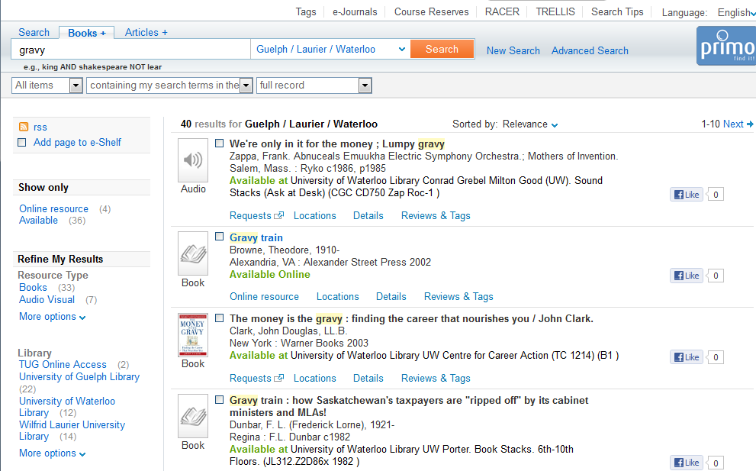
Common User Experience…
Notes:
So, what about our TUG users? Really we could have done anything we wanted and had totally different views at all 3 institutions. However, our students do go between campuses and some are even cross-registered for some programs therefore we prefer a common look and feel with a bit of individual branding and services. This is a view of the search results which will be essentially the same for all users. However, we can still choose to make certain services only apply to a particular view. For example, Guelph and Waterloo are working on bringing a "Where is it?" app that shows the location of the book in stacks; Laurier doesn't have the data for this app at the moment so we won't place it on the Laurier view.

Slide 6
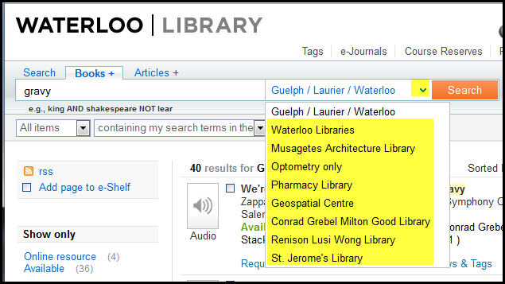
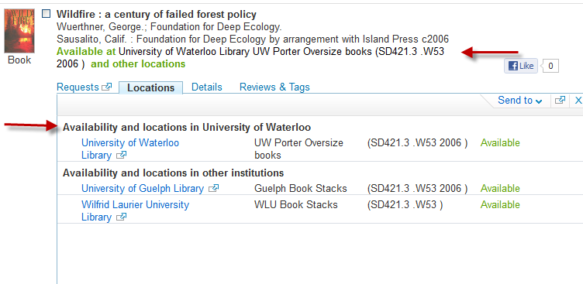
…With Some Differences
Search scopes
Calculated availability
Notes:
Here are some of the differences that you can configure in Primo even within that common result set. In the Waterloo search box we have the default TUG search scope but beyond that we have only included search scopes that are relevant to local Waterloo libraries such as Optometry or Conrad Grebel.
Primo also has a built in calculated availability function so that it will show the availability most relevant to the user, in this case showing the University of Waterloo library copy in the available statement. Also on the locations tab in the Waterloo view we have chosen to show the Waterloo locations first.

Slide 7
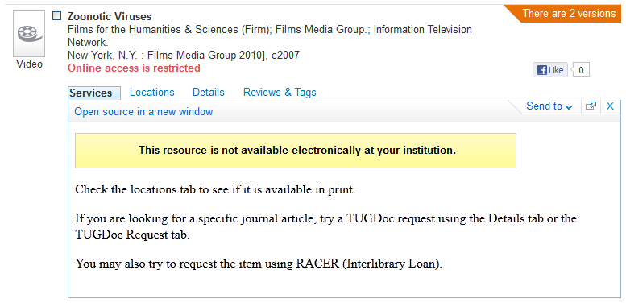
Restrictions
Notes:
We don't have any restricted search scopes, we allow all users to search everything in our catalogue. However, we were able to set up a restricted delivery so that Primo knows when an online resource isn't available at your institution. We modified the services tab to give users further instructions.

Slide 8
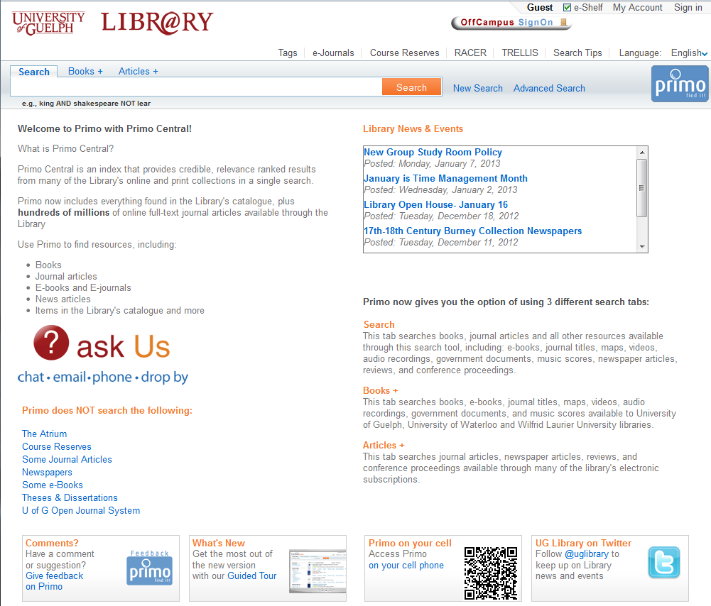
Primo home page - Guelph
Notes:
Here is the Primo home page or landing page for Guelph. I will point out the differences between the 3 institutions in the next 3 slides. At the top of the page you will see the institutional banner and the local offcampus sign on link. I don't have time to get into why our links aren't proxied in our catalogue records! Under the search box are some customizable tiles. The "welcome to Primo with Primo Central" and the description of the 3 tabs in common to all 3 institutions but you can see that Guelph has added their "ask us" link, library news and events, link to UG twitter and more

Slide 9
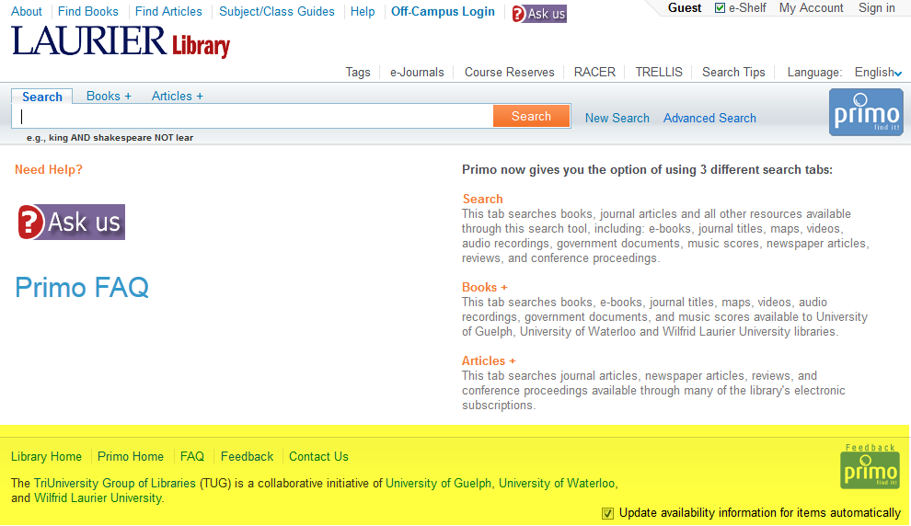
Primo home page - Laurier
Note: highlighted area common to all 3 institutions
Notes:
Laurier has a more minimal home page. You can see they have included their header from their main library web pages at the top. The highlighted portion at the bottom is common to all 3 views. I see that Laurier decided not to use the “Welcome to Primo” section.

Slide 10
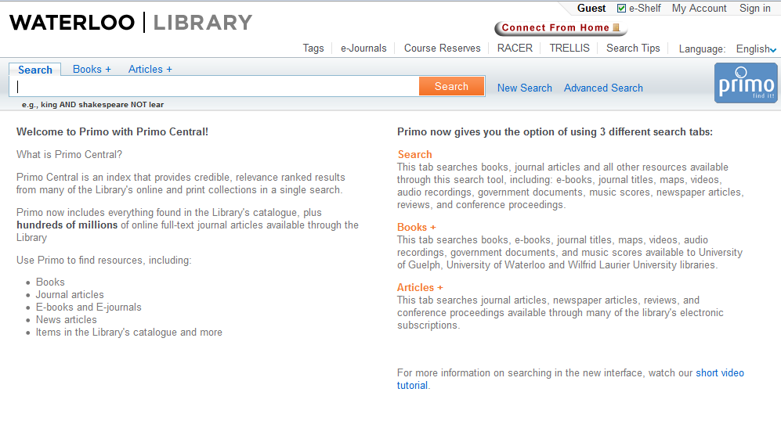
Primo home page - Waterloo
Notes:
The Waterloo homepage has the welcome to Primo section and the description of the 3 search boxes with an additional link to a video tutorial

Slide 11
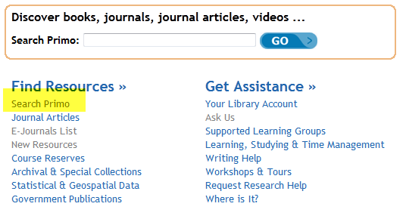
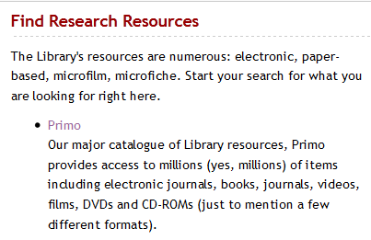
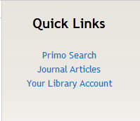
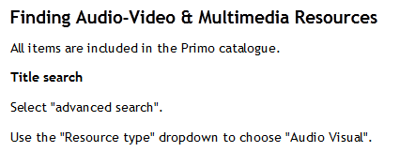
Accessing Primo - Guelph
Notes:
On the next 3 slides I'll show some examples on how the 3 institutions have added access point to Primo on their web pages.
Top left - This is Guelph's search box on their home page and you can also see a link to Primo in the "find resources section below"
Top right - Guelph has a page describing the library's research resources which includes a link and description of Primo
Bottom left - On many Guelph web pages Primo appears on the right hand navigation as a quick link
Bottom right - Here is an example of a link and instructions for Primo under finding A/V resources

Slide 12
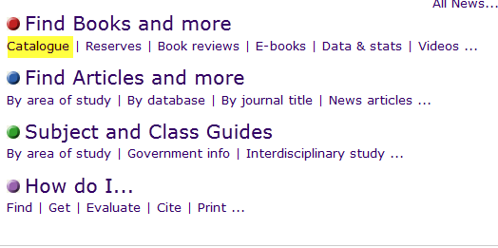
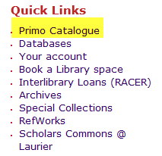
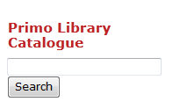
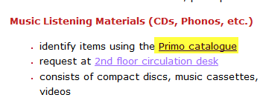

Accessing Primo - Laurier
Notes:
Laurier doesn't have a search box on their home page but in the top left and right are links to Primo found on the home page.
Bottom left - an example of a link to Primo under music materials
Bottom centre - a news item about the addition of journal articles into Primo
Bottom right - a simple search box that appears on some Laurier library pages

Slide 13
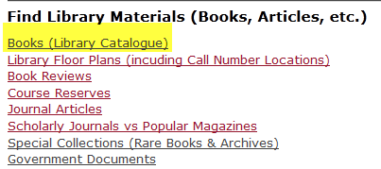
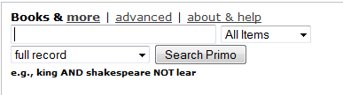
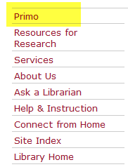
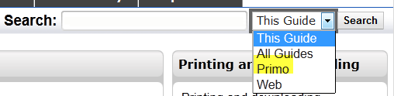
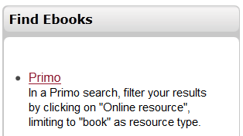
Accessing Primo - Waterloo
Notes:
At Waterloo we modeled our search box on our home page to resemble the one we had into Voyager. This is on the top left.
Top right - a link to Primo under finding library materials
Bottom left - Primo always appears on the left-hand navigation
Centre right and bottom right - We use the Lib Guides software at Waterloo and here are examples of how Primo can be used from Lib Guides

Slide 14
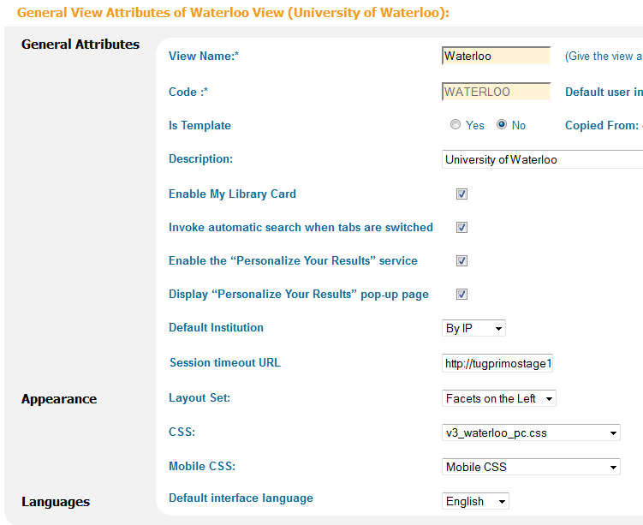
Configuring individual views
Notes:
Many of the things we do to make our views meet the needs of the individual institutions can be done right in the Primo back office. Here is an image from the view configuration wizard showing some of the initial choices for the Waterloo view including whether to include the library account, whether to enable the personalize your results feature, and where we want to position the facets. You can see that we also specify the CSS file here which allows us to use different CSS files for each view.

Slide 15
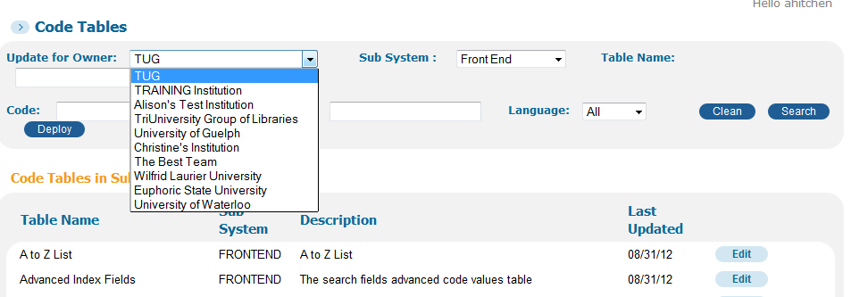
Configuring tables by institution
Notes:
Tables can also be owned by an individual institution and within a code table you can specify a view. For example, if Guelph wanted to call the "Resource Type" something else in the advanced search we would just specify the code for that view. If we change it for the default view then it will change for all institutions.

Slide 16
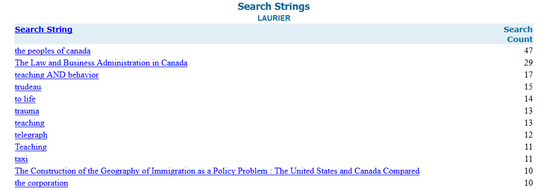
Viewing individual reports
Notes:
The Primo back office also has a report section. When running a report you can specify the institution you are interested in. For example he is a portion of a search strings report for Laurier. I am a super admin in Primo so I can view the Laurier reports but you can control roles in the back office and also restrict people by institution.

Slide 17

Involving TUG Staff
Notes:
All of things I’ve shown you so far have been done by the TUG Primo team. It is really important to the success of Primo, especially if your team is small, to involve consortium staff. Some examples of how we involve TUG Staff are:
1. we consult public services staff at all 3 institutions when we need feedback on the interface or on new services or features, for example we sent out a survey during the Primo Central Index trial to get their thoughts on web scale indexes, we sent a survey to ask about labeling the new interface when we added in Primo Central, and we also scheduled brainstorming sessions at all 3 institutions to ask staff what they like in Primo, what they don't like, what they would like to see in the future and so on.
2. we involve TUG staff in testing major releases, for example in advance of Primo 3 and Primo 4. We use the Voyager prototyping group which is already established and also ask for volunteers from public services. We created test scripts for consistent testing but also encourage them to do their own additional tests. Because people work in different environments and approach the interface in different ways this collaborative testing is key to spotting issues before we release an upgrade, even if it is just a labeling issue or an indication of where some training/FAQ might be needed
3. Usability studies - we have done usability studies at different times at all 3 institutions, especially around the Primo Central trial, but we've also been able to take advantage of Guelph's User Experience team to carry out tests on our behalf
4. We worked with the TUG Stats and Reports committee to set Primo up with Cognos, a third party reporting software used by TUG
5. We encourage feedback whenever we can

Slide 18
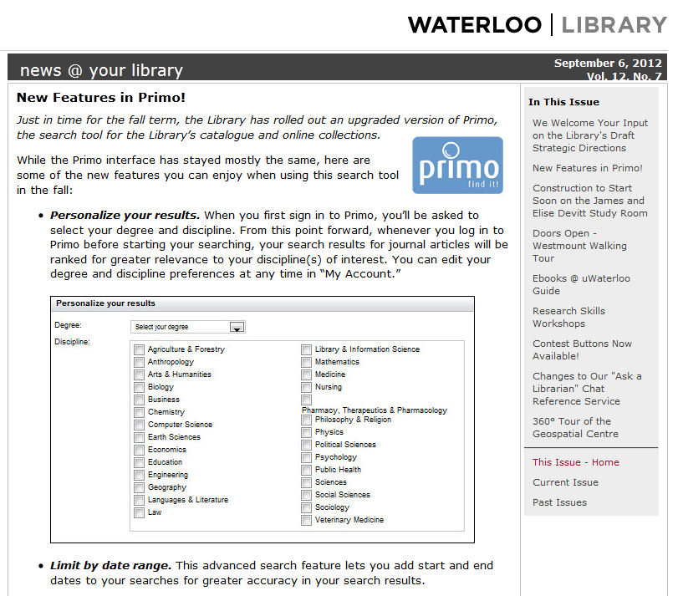
Shared Communications
http://www.lib.uwaterloo.ca/newsatlib/120906/primo.html
Notes:
Another advantage of working in a consortium is sharing communication text about Primo. Here is an example of a news @ your library issue from Waterloo that lists the new features in Primo. This text was partially adapted from Primo FAQs about these features. It was also shared with Laurier and Guelph in case they wanted to do a news story about Primo 4. Write once and then modify for local is my motto. During implementation we had a communications person on the team itself but now most e-mails to TUG staff are done by me and we just coordinate with local communications people for public messages.

Slide 19
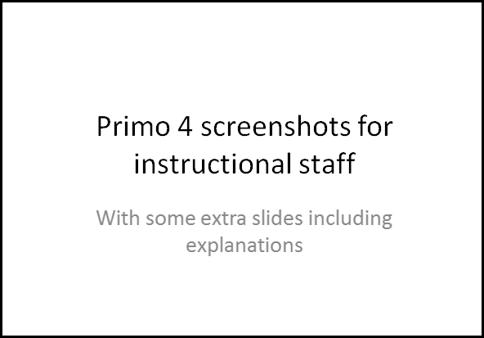
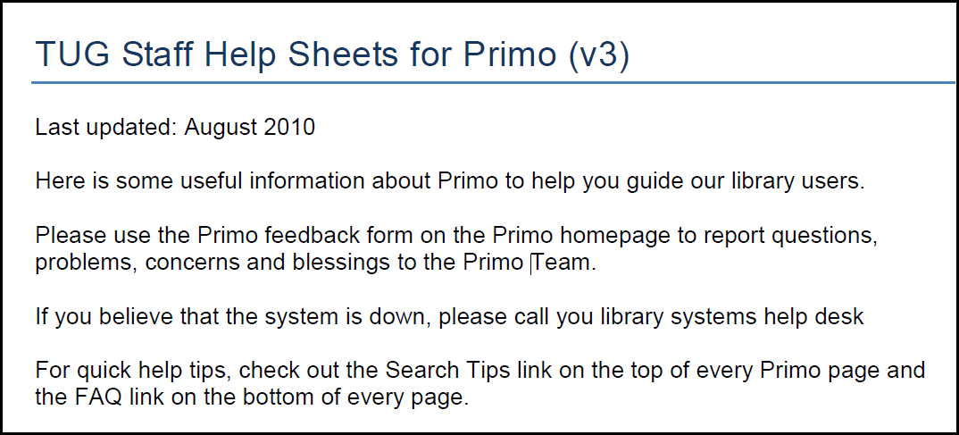
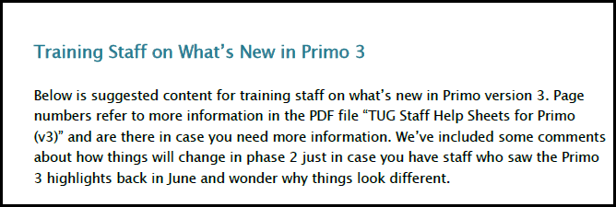
Collaborative Training
Notes:
Fairly early on we realized that you need to do some training or information sessions for staff when Primo is introduced or when major changes occur. We try to coordinate this training at TUG to reduce the effort. For example, we have a staff manual that we distributed in PDF to all TUG staff, we created a training outline and power point for Primo 3 so that multiple staff persons could deliver the same training with little preparation, and we created a selection of slides for each feature, duplicated for each institution when branding is visible, so that instructional librarians who are preparing for a new term can simply grab and modify slides that are already created. This is particularly helpful when a new version is being implemented in summer while staff are on vacation. We also try to record a session and send it out to TUG staff.

Slide 20

Case Study: Primo Central Index Trial
http://www.lib.uwaterloo.ca/newsatlib/110512/primocentraltrial.html
Notes:
I want to end by giving you a brief case study on how we handled the Primo Central Index trial at TUG. I'm not going to go into all the reasons why we did a trial, just tell you the different decisions we were able to do during the trial because of the flexibility in configuring Primo.
Home page access:
Guelph routed all users to Primo with Primo Central during the trial
Waterloo and Laurier had a separate trial view that users could opt to try out
Resource activation:
Waterloo activated anything that was free for search even if restricted for delivery
Guelph and Laurier activations more closely corresponded with their acquisitions
Look and feel
Guelph tried out a simply search box with no tab options and no drop-down options; it was a blended search with all filtering done post-search
Waterloo and Laurier tried the 3 tab approach: blended, local, PCI
Beginning the trial
Waterloo and Guelph began their trial in the Spring term
Laurier began their trial in the fall
Usability
Laurier, Waterloo and Guelph all ran different types of usability studies and focus groups

Slide 21
Questions?
Alison Hitchens
  Cataloguing & Metadata Librarian
  University of Waterloo Library
  Primo Team Lead
  TriUniversity Group of Libraries (TUG)
ahitchen@uwaterloo.ca

